Slide 1

Randomized Block Design (RBD)
Santosh chhatkuli

Slide 2
Introduction
Randomized block design is a type of experimental design which is used when experimenter has to study one primary factor and additionally he/she has to control one known source of extraneous variable.

Slide 3
Principle used in RBD
RBD uses all principles of experimental design.
Randomization
Replication
Blocking
Conditions required for blocking
1. Blocks must be selected carefully. The ability to form homogeneous blocks depends on the researcher’s knowledge of the experimental material or unit.
2. There are same no. of blocks as there are replicate per treatment
No. of blocks = no. of replication
3. Each treatment must be represented in each block.
4. Treatment allocation within each block must be random.

Slide 4
Common blocking criteria
Gender
IQ Level
Batches
Shift of operations or Operators
Fertility of soil
Humidity of the day etc.
Time or Season
Location or Site

Slide 5
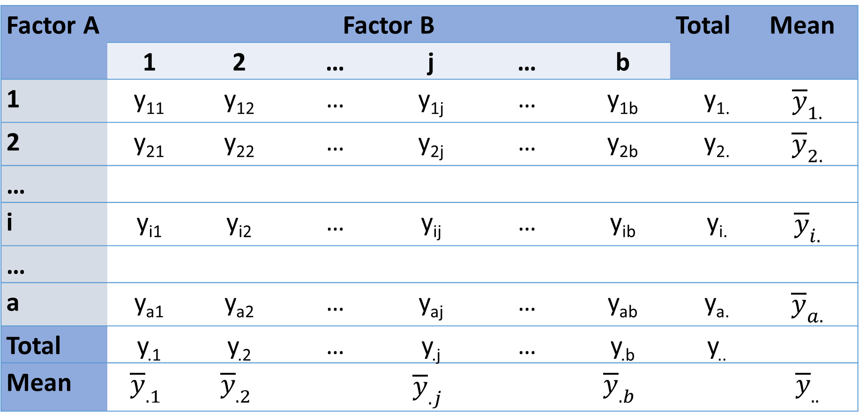
Two-way layout
Factor A | Factor B |  |  |  |  |  | Total | Mean
 | 1 | 2 | … | j | … | b
1 | y₁₁ | y₁₂ | … | y_{1j} | … | y_{1b} | y_{1.} | $${\overline{y}}_{1.}$$
2 | y₂₁ | y₂₂ | … | y_{2j} | … | y_{2b} | y_{2.} | $${\overline{y}}_{2.}$$
…
i | y_{i1} | y_{i2} | … | y_{ij} | … | y_{ib} | y_{i.} | $${\overline{y}}_{i.}$$
…
a | y_{a1} | y_{a2} | … | y_{aj} | … | y_{ab} | y_{a.} | $${\overline{y}}_{a.}$$
Total | y_{.1} | y_{.2} | … | y_{.j} | … | y_{.b} | y..
Mean | $${\overline{y}}_{.1}$$ | $${\overline{y}}_{.2}$$ |  | $${\overline{y}}_{.j}$$ |  | $${\overline{y}}_{.b}$$ |  | $${\overline{y}}_{..}$$

Slide 6
Assumptions of RBD
Randomization: The treatments are randomly assigned to the experimental units within each block.
Homogeneity of variance: The variances of the dependent variable are approximately equal within each block.
Independence: Observations within each block are independent of each other. This assumption means that the responses in one block are not influenced by the responses in other blocks.

Slide 7
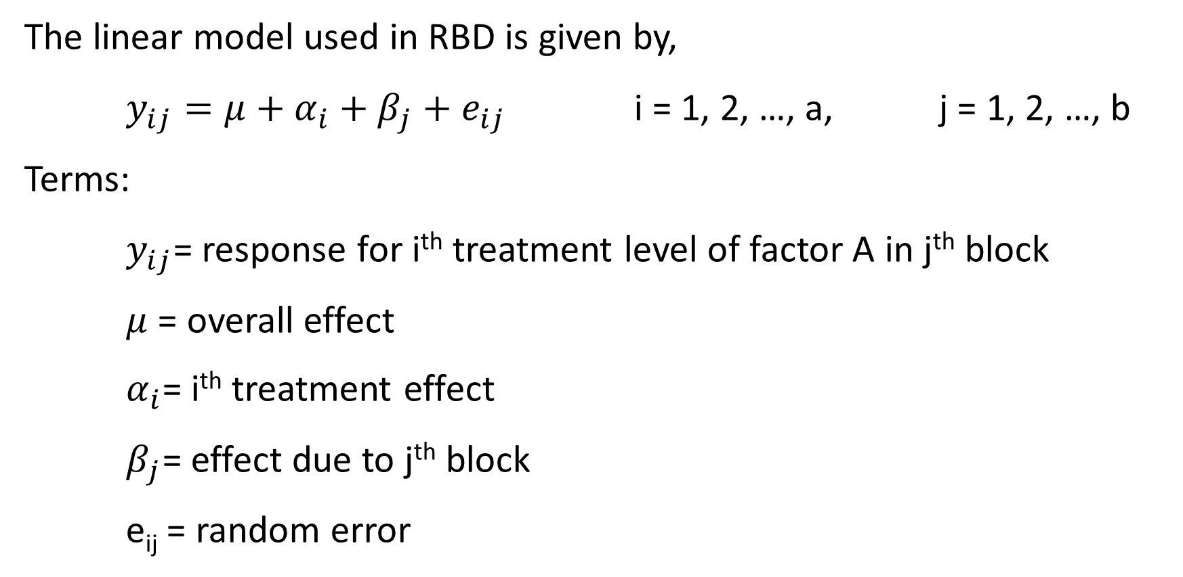
Statistical model of RBD
The linear model used in RBD is given by,
$y_{ij}=μ+α_{i}+β_{j}+e_{ij}$ i = 1, 2, …, a, j = 1, 2, …, b
Terms:
$y_{ij}$= response for i^{th} treatment level of factor A in j^{th} block
$μ$ = overall effect
$α_{i}$= i^{th} treatment effect
$β_{j}$= effect due to j^{th} block
e_{ij} = random error

Slide 8
Statistical analysis of RBD
The main idea of a randomized block design (RBD) is to reduce variability in an experiment by grouping experimental units (subjects or items) into blocks based on some known source of variability that may affect the outcome. This known source of variability is often called a blocking variable.
There are three sources of variation in the data.
Treatment levels of primary factor A (Treatment variation)
Levels of blocking of factor B (Blocking variation)
Random variation

Slide 9
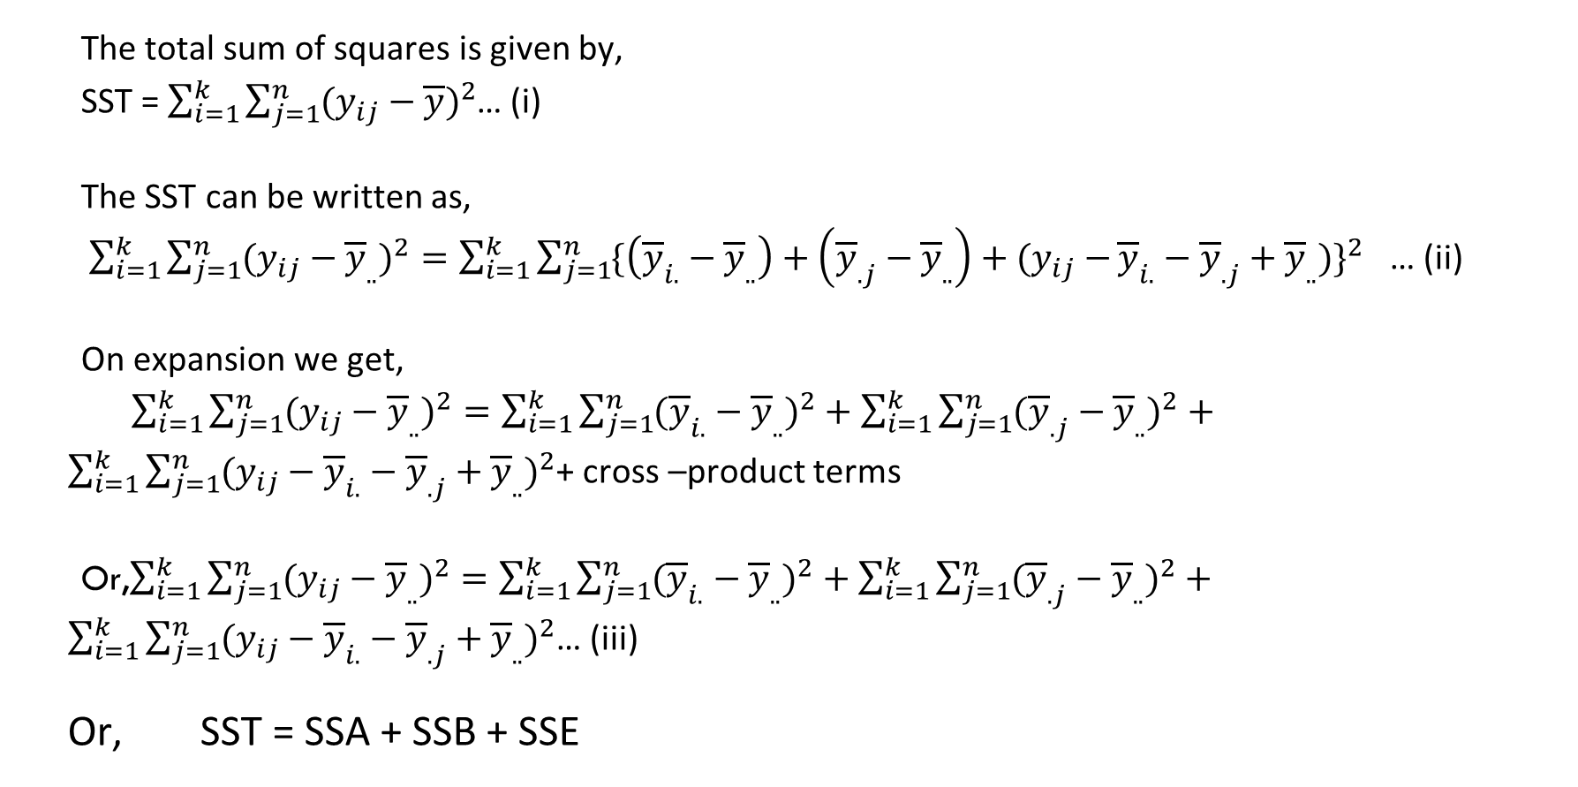
Splitting of total sum of squares
The total sum of squares is given by,
SST = $\sum_{i=1}^{k}{\sum_{j=1}^{n}{(y_{ij}−\overline{y}})^{2}}$… (i)
The SST can be written as,
$\sum_{i=1}^{k}{\sum_{j=1}^{n}{(y_{ij}−{\overline{y}}_{..})^{2}=\sum_{i=1}^{k}{\sum_{j=1}^{n}{\{\left({\overline{y}}_{i.}−{\overline{y}}_{..}\right)+\left({\overline{y}}_{.j}−{\overline{y}}_{..}\right)+(y_{ij}−}}}}{\overline{y}}_{i.}−{\overline{y}}_{.j}+{\overline{y}}_{..})\}^{2}$ … (ii)
On expansion we get,
$\sum_{i=1}^{k}{\sum_{j=1}^{n}{(y_{ij}−{\overline{y}}_{..})^{2}=\sum_{i=1}^{k}{\sum_{j=1}^{n}{({\overline{y}}_{i.}−{\overline{y}}_{..})^{2}+\sum_{i=1}^{k}{\sum_{j=1}^{n}{({\overline{y}}_{.j}−{\overline{y}}_{..})^{2}}}+}}}}$ $\sum_{i=1}^{k}{\sum_{j=1}^{n}{{(y_{ij}−{\overline{y}}_{i.}−{\overline{y}}_{.j}+{\overline{y}}_{..})}^{2}}}$+ cross –product terms
Or,$\sum_{i=1}^{k}{\sum_{j=1}^{n}{(y_{ij}−{\overline{y}}_{..})^{2}=\sum_{i=1}^{k}{\sum_{j=1}^{n}{({\overline{y}}_{i.}−{\overline{y}}_{..})^{2}+\sum_{i=1}^{k}{\sum_{j=1}^{n}{({\overline{y}}_{.j}−{\overline{y}}_{..})^{2}}}+}}}}$ $\sum_{i=1}^{k}{\sum_{j=1}^{n}{{(y_{ij}−{\overline{y}}_{i.}−{\overline{y}}_{.j}+{\overline{y}}_{..})}^{2}}}$… (iii)
Or, SST = SSA + SSB + SSE

Slide 10
Hypothesis to test
Primary Factor A
H_{0T}: the mean response is same for all levels of treatments (Treatment effect is insignificant)
Blocking factor B
H_{0B}: the mean response is same for all blocks (blocking effect is insignificant)

Slide 11
Test Statistic
Primary factor A
The test statistic for evaluating first test hypothesis H_{0T} is given by,
F_{A} = MSA/MSE
F_{A} is distributed as F with (a – 1) degrees of freedom in numerator and (a – 1) (b – 1) degrees of freedom in denominator
Block B
The test statistic for evaluating second test hypothesis is given by,
F_{B} = MSB/MSE
FB is distributed as F with (b – 1) degrees of freedom in numerator and (a – 1) (b – 1) degrees of freedom in denominator.

Slide 12
ANOVA table for RBD
Sources of variation | Degrees of freedom | Sums of square | Mean sums of square | Calculated F
Treatment levels | a – 1 | SSA | MSA = SSA / a - 1 | FA = MSA/MSE FB = MSB/MSE
Blocks | b – 1 | SSB | MSB = SSB / b-1
Error | (a -1) (b -1) | SSE | MSE = SSE / (a -1)(b – 1)
Total | N – 1 = ab – 1 | SST

Slide 13
Decision Rule
All ANOVA are right sided tests. So, we will reject null hypothesis if calculated F is greater than critical F or tabulated F.
Factor A: Reject H_{0T} if Cal F_{A} ≥ Fα {(a-1),(a-1)(b-1)}
Blocking factor B: Reject H_{0B} if Cal F_{B} ≥ Fα {(b-1),(a-1)(b-1)}

Slide 14

Computational formula for sum of squares
We can compute SS by using following short-cut formula derived form the definitional formula.
$$SST=\sum_{i=1}^{a}{\sum_{j=1}^{b}{y_{ij}^{2}}}−\frac{y_{..}^{2}}{N}$$
$$SSA=\frac{1}{b}\sum_{i=1}^{a}{y_{i.}^{2}}−\frac{y_{..}^{2}}{N}$$
$$SSB=\frac{1}{a}\sum_{j=1}^{b}{y_{.j}^{2}}−\frac{y_{..}^{2}}{N}$$
And,
SSE = SST - SSA - SSB

Slide 15
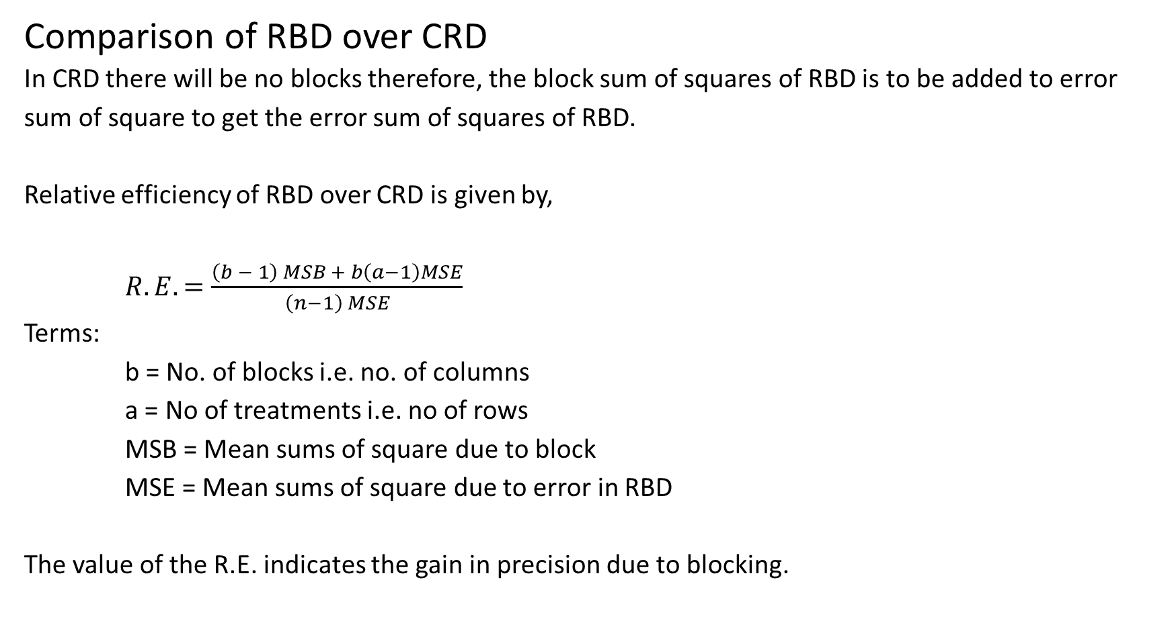
Comparison of RBD over CRD
In CRD there will be no blocks therefore, the block sum of squares of RBD is to be added to error sum of square to get the error sum of squares of RBD.
Relative efficiency of RBD over CRD is given by,
$R.E.=\frac{\left(b − 1\right) MSB + b\left(a−1\right)MSE}{\left(n−1\right) MSE}$
Terms:
b = No. of blocks i.e. no. of columns
a = No of treatments i.e. no of rows
MSB = Mean sums of square due to block
MSE = Mean sums of square due to error in RBD
The value of the R.E. indicates the gain in precision due to blocking.

Slide 16
Example
A chemist wishes to test the effect of four chemical agents on the strength of a particular type of cloth. There might be variability from one bolt to another, hence, the chemist decides to use a randomized block design, with the bolts of cloth considered as blocks. He selects five bolts and applies all four chemicals in random order to each bolt. The resulting tensile strength follow.
Carryout the ANOVA to compare RBD vs CRD
Chemical agents | Bolt
 | 1 | 2 | 3 | 4 | 5
1 | 73 | 68 | 74 | 71 | 67
2 | 73 | 67 | 75 | 72 | 70
3 | 75 | 68 | 78 | 73 | 68
4 | 73 | 71 | 75 | 75 | 69

Slide 17
One-way ANOVA for CRD
Two-way ANOVA for RBD
Source of Variation | SS | df | MS | F | P-value | F crit
Between Chemical Agents | 12.95 | 3 | 4.316667 | 0.386279 | 0.764377 | 3.238872
Within Groups (Error) | 178.8 | 16 | 11.175
Total | 191.75 | 19
Source of Variation | SS | df | MS | F | P-value | F crit
Chemical agents | 12.95 | 3 | 4.316667 | 2.376147 | 0.121144 | 3.490295
Bolts | 157 | 4 | 39.25 | 21.6055 | 2.06E-05 | 3.259167
Error | 21.8 | 12 | 1.816667
Total | 191.75 | 19

Slide 18
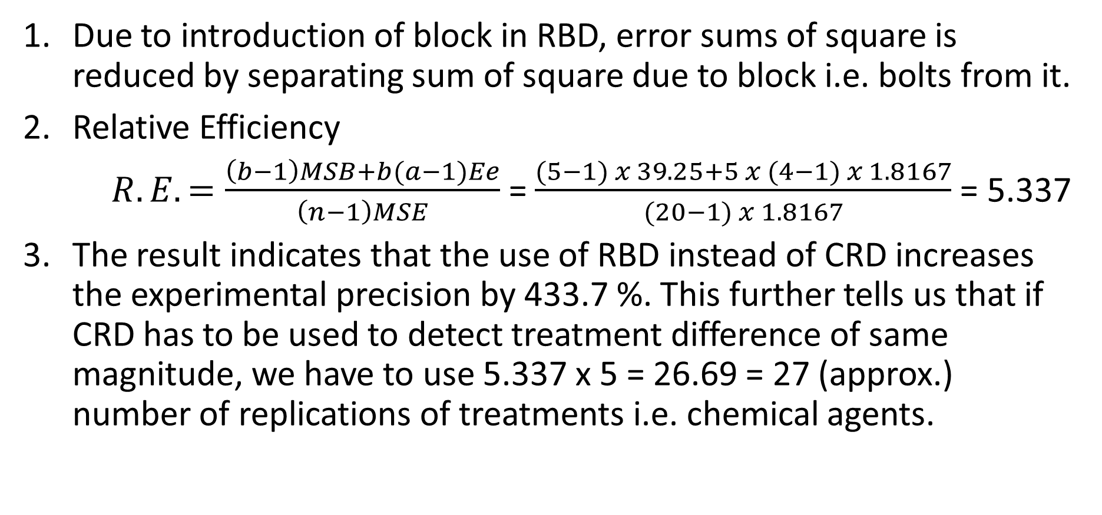
Conclusions
Due to introduction of block in RBD, error sums of square is reduced by separating sum of square due to block i.e. bolts from it.
Relative Efficiency
$R.E.=\frac{\left(b−1\right)MSB+b(a−1)Ee}{\left(n−1\right)MSE}$ = $\frac{(5−1) x 39.25+5 x (4−1) x 1.8167}{(20−1) x 1.8167}$ = 5.337
3. The result indicates that the use of RBD instead of CRD increases the experimental precision by 433.7 %. This further tells us that if CRD has to be used to detect treatment difference of same magnitude, we have to use 5.337 x 5 = 26.69 = 27 (approx.) number of replications of treatments i.e. chemical agents.

Slide 19
Advantages of RBD
Control of Confounding Variable: Randomized block design allows researchers to control for one known source of variation or nuisance variable by grouping similar experimental units into blocks. This helps to reduce variability within the block and increases the precision of treatment effect estimates.
Increased Sensitivity: By reducing variability within blocks, randomized block design increases the sensitivity of the experiment to detect treatment effects. This can lead to more accurate and reliable results compared to completely randomized design.
Efficiency: Generally, randomized block design can be more efficient than completely randomized designs when there are significant sources of variability that can be accounted for through blocking. Treatment effects can be estimated even with fewer experimental units.
Reduction of Experimental Error: Since the variability due to extraneous variable is separated from the treatment variability, we reduce the experimental error (variation due to error) and increase the validity of the results.
Simpler Analysis: Statistical analysis is relatively easier.
Missing Data Handling: Even with missing data points, analysis of RBD can be salvageable using missing plot techniques.

Slide 20
Disadvantages of RBD
Replication within the block: Replication of treatments within the block is not possible.
Block size constraint: As the number of treatments increases, so does the block size, making it difficult to ensure block homogeneity (consistency) and maintaining them
Potential for Biased Blocking: If blocks are not properly constructed or if the blocking factor is correlated with the treatment variable, randomized block design can introduce bias into the experiment, leading to invalid conclusions about treatment effects.
Loss of Degrees of Freedom: Blocking reduces the degrees of freedom available for testing treatment effects, which can decrease the power of statistical tests to detect significant differences between treatment groups.

Slide 21
Numerical example
A chemist wishes to test the effect of four chemical agents on the strength of a particular type of cloth. There might be variability from one bolt to another, hence, the chemist decides to use a randomized block design, with the bolts of cloth considered as blocks. He selects five bolts and applies all four chemicals in random order to each bolt. The resulting tensile strength follow.
(a) Carryout two-way analysis of variance to see effect of four chemicals agents as well as type of bolt on the strength of a particular type of cloth.
(b) Determine whether blocking is effective or not. Use α = 0.05
Chemical agents | Bolt
 | 1 | 2 | 3 | 4 | 5
1 | 73 | 68 | 74 | 71 | 67
2 | 73 | 67 | 75 | 72 | 70
3 | 75 | 68 | 78 | 73 | 68
4 | 73 | 71 | 75 | 75 | 69

