Slide 1

Latin Square Design
Santosh Chhatkuli

Slide 2
Introduction
The Latin-square design (LSD) is an experimental design which has capacity to handle two known nuisance sources of variability simultaneously. Hence, it treats the two known sources as two-independent blocking criteria, instead of only one as in the case of RBD.
In a LSD, treatments are arranged in a grid so that each treatment occurs once in each row and once in each column. The key feature of a Latin square design is that each treatment appears exactly once in each row and each column, ensuring that any effects due to the row or column are balanced across treatments.
Conditions required in LSD
Every treatment occurs one and only once in each row and in each column.
No. of treatments = No. of replications

Slide 3
Randomization in lsd
Collect few already prepared pxp LSD square layout from Fisher’s and Yate’s table beforehand, where each treatment appears in every row and column exactly once.
Randomly select one of these squares to use for your experiment.
A sample 5 x 5 layout is given below:
A | D | B | E | C
D | A | C | B | E
C | B | E | D | A
B | E | A | C | D
E | C | D | A | B

Slide 4
Data layout in lsd
A typical 5 x 5 layout is given below:
y_{ijk} = Response for experimental unit receiving kth treatment in i^{th} row block and j^{th} column block.
i = 1, 2, 3, 4,5 j = 1, 2, 3, 4, 5 k = 1, 2, 3, 4, 5
 | Block 1 | Block 2 | Block 3 | Block 4 | Block 5
Block 1 | Treatment A (y₁₁₁) | Treatment D (y₁₂₄) | Treatment B (y₁₃₂) | Treatment E (y₁₄₅) | Treatment C (y₁₅₃)
Block 2 | Treatment D (y₂₁₄) | Treatment A (y₂₂₁) | Treatment C (y₂₃₃) | Treatment B (y₂₄₂) | Treatment E (y₂₅₅)
Block 3 | Treatment D (y₃₁₄) | Treatment B (y₃₂₂) | Treatment E (y₃₃₅) | Treatment D (y₃₄₄) | Treatment A (y₃₅₁)
Block 4 | Treatment B (y₄₁₂) | Treatment E (y₄₂₅) | Treatment A (y₄₃₁) | Treatment C (y₄₄₃) | Treatment D (y₄₅₄)
Block 5 | Treatment E (y₅₁₅) | Treatment C (y₅₂₃) | Treatment D (y₅₃₄) | Treatment A (y₅₄₁) | Treatment B (y₅₅₂)

Slide 5
Assumptions of lsd
1. Interaction:
This is the most critical assumption. It states that there are no interactions between the:
Treatments: The different factors or conditions you're testing.
Blocking Factors: The factors (like rows or columns) used to control for extraneous variables.
If interactions exist, the effects of treatments can be masked or inflated, leading to misleading results.
2. Equal Levels:
The number of levels (categories) for each treatment and blocking factor must be equal.
For example, if you have 4 treatments (A, B, C, D), you also need 4 blocks (rows or columns) in your Latin square.
3. Normality:
Ideally, the errors in your experiment should be normally distributed. This allows for accurate statistical analysis using techniques like ANOVA (analysis of variance).
4. Homogeneity of Variance:
The variance (spread) of the errors should be consistent across all treatment groups and blocks. This ensures the validity of the statistical tests used in the analysis.
5. Independence of Errors:
The errors in your measurements should be independent. This means the error in one measurement shouldn't influence the error in another.

Slide 6
Statistical model of lsd
The linear model used in LSD is given by,
yijk = μ + αi + βj + γk + eijk
Where,
yijk = observation in the ith row and jth column and for the kth treatment
i = 1, 2, …., p and j = 1, 2, …., p
μ = general effect or overall effect
αi = Effect due to ith row or effect due to ith level of row blocking factor
βj = effect due to jth column or effect due to jth level of column blocking factor
γk = effect due to kth level of primary factor.
ejk = Random error which is distributed as normal with mean 0 and variance

Slide 7
Statistical Analysis of lsd
The statistical analysis of LSD is done by 3-way ANOVA. There are four sources of variation among
N = p² observations from a LSD. They are:
Primary factor
Row Blocking
Colum blocking
Error
We separate variation due to row block and variation due to column block from error variation.

Slide 8
Partitioning of total sum of squares (SST)

Slide 9
Hypothesis to test
In LSD we make inferences on three factors, they are primary factor A, row blocking factor R and column blocking factor C. So, LSD provides three pieces of information.
H_{0R} = There is no row blocking effect (mean response is same for all levels of row blocking factors)
H_{0C} = There is no column blocking effect (mean response is same for all levels of column blocking factors)
H_{0A} = There is no treatment effect (mean response is same for all treatment levels)

Slide 10
Anova table for lsd
Source of variation | Degrees of freedom | Sum of squares | Mean sum of squares | Calculated F
Rows | p – 1 | SSR | MSR = SSR/p –1 | FR = MSR/MSE
Columns | p – 1 | SSC | MSC = SSC/p –1 | FC = MSC/MSE
Treatment | p – 1 | SSA | MSA = SSA/p –1 | FA = MSA/MSE
Random Error | (p – 1) (p – 2) | SSE | MSE = SSE/(p – 1)(p – 2)
Total | N -1 = p2 - 1 | SST

Slide 11
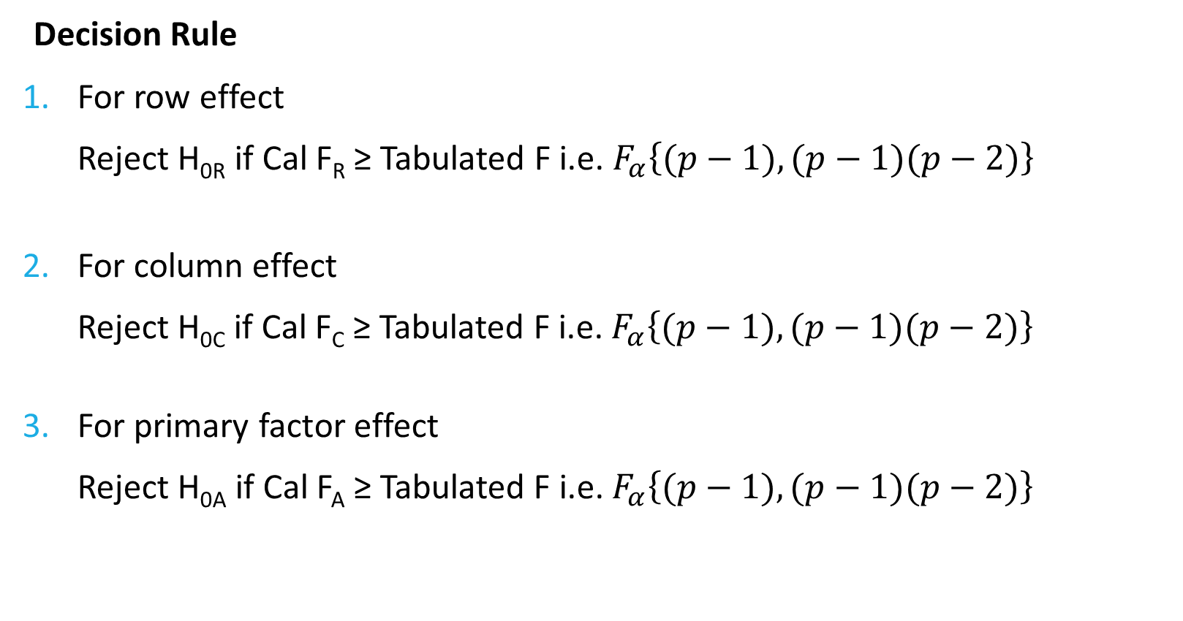
Decision Rule
Decision Rule
For row effect
Reject H_{0R} if Cal F_{R} ≥ Tabulated F i.e. $F_{α}\left\{(p−1),(p−1)(p−2)\right\}$
For column effect
Reject H_{0C} if Cal F_{C} ≥ Tabulated F i.e. $F_{α}\left\{(p−1),(p−1)(p−2)\right\}$
For primary factor effect
Reject H_{0A} if Cal F_{A} ≥ Tabulated F i.e. $F_{α}\left\{(p−1),(p−1)(p−2)\right\}$

Slide 12
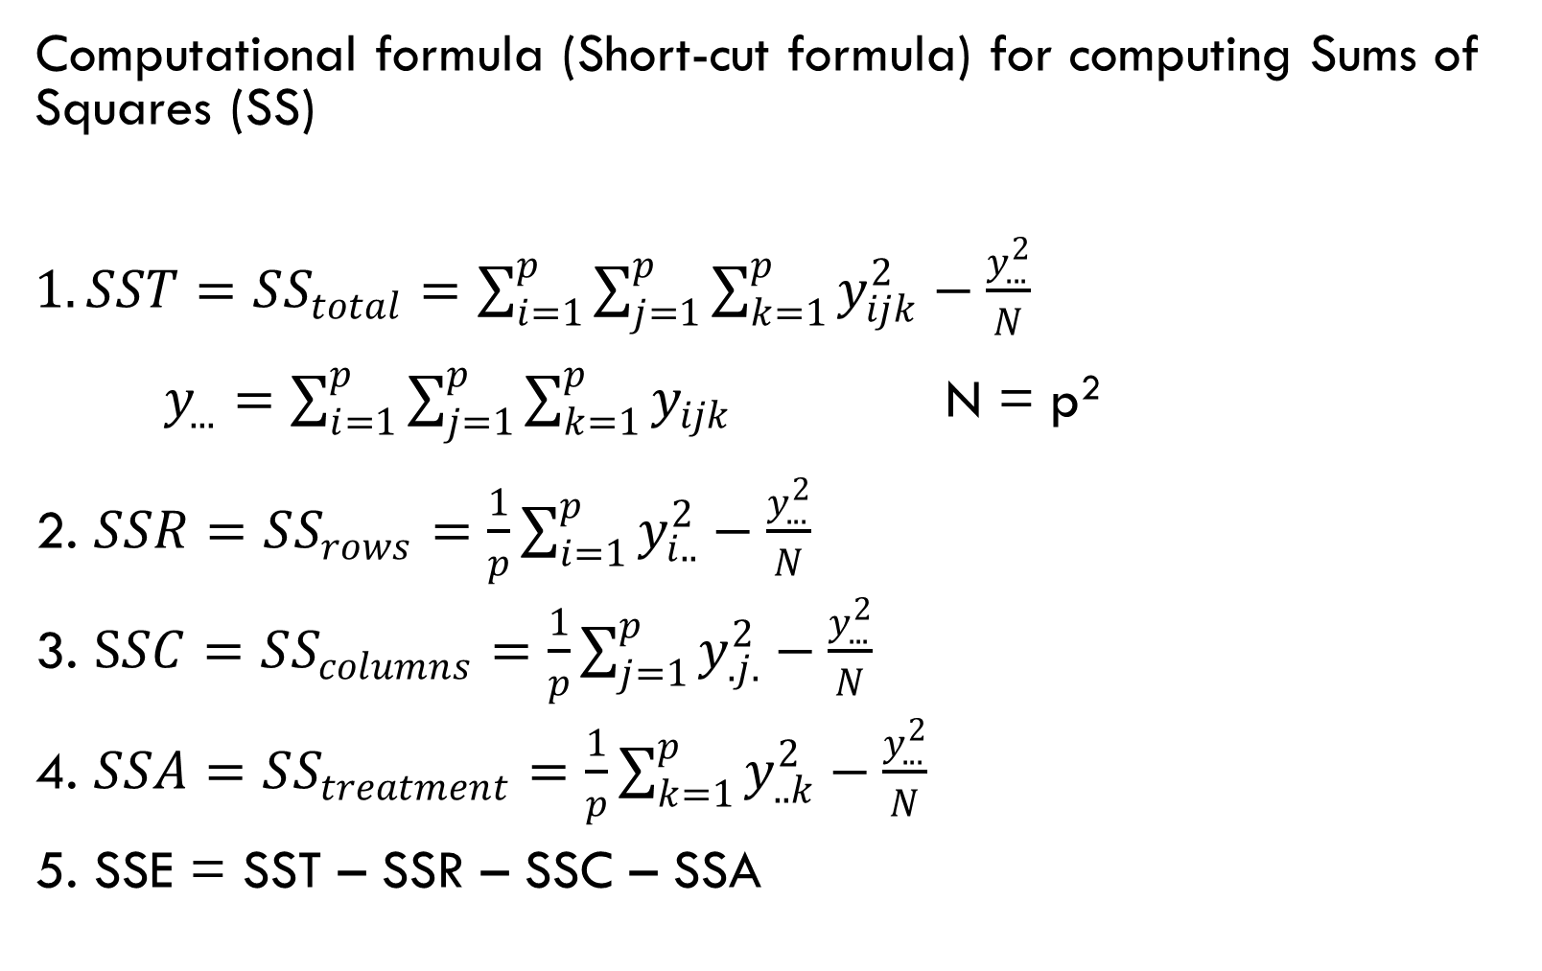
Computational formula (Short-cut formula) for computing Sums of Squares (SS)
$1. SST=SS_{total}=\sum_{i=1}^{p}{\sum_{j=1}^{p}{\sum_{k=1}^{p}{y_{ijk}^{2}}}}−\frac{y_{...}^{2}}{N}$
$y_{...}=\sum_{i=1}^{p}{\sum_{j=1}^{p}{\sum_{k=1}^{p}{y_{ijk}}}}$ N = p²
2. $SSR=SS_{rows}=\frac{1}{p}\sum_{i=1}^{p}{y_{i..}^{2}}−\frac{y_{...}^{2}}{N}$
3. $SSC=SS_{columns}=\frac{1}{p}\sum_{j=1}^{p}{y_{.j.}^{2}}−\frac{y_{...}^{2}}{N}$
4. $SSA=SS_{treatment}=\frac{1}{p}\sum_{k=1}^{p}{y_{..k}^{2}}−\frac{y_{...}^{2}}{N}$
5. SSE = SST – SSR – SSC – SSA

Slide 13
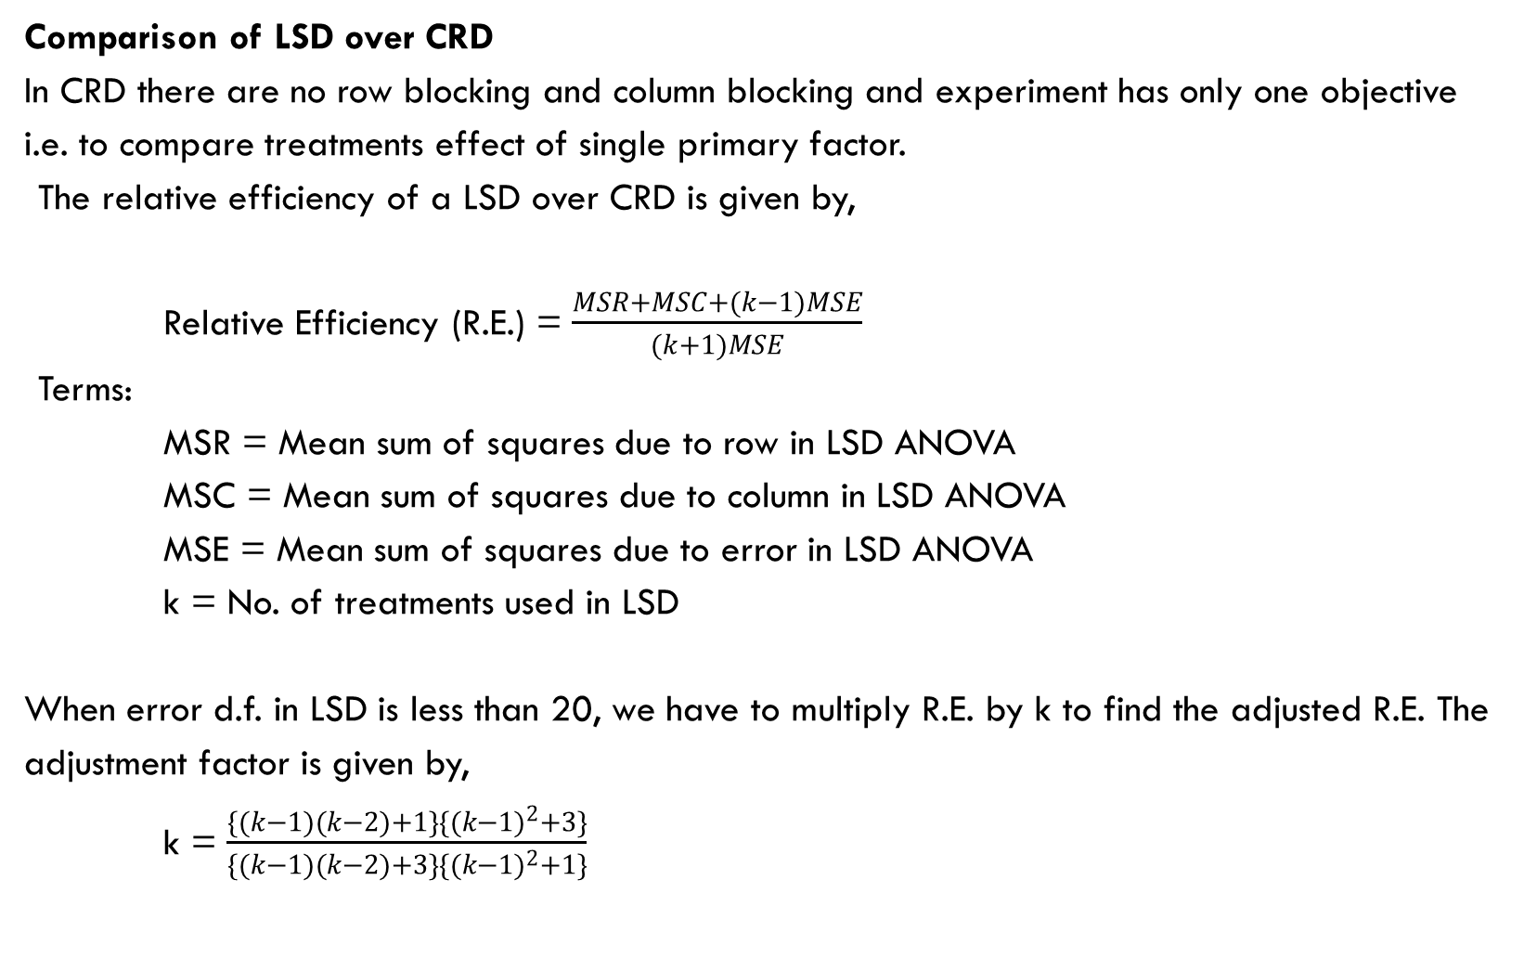
Comparison of LSD over CRD
In CRD there are no row blocking and column blocking and experiment has only one objective i.e. to compare treatments effect of single primary factor.
The relative efficiency of a LSD over CRD is given by,
Relative Efficiency (R.E.) = $\frac{MSR+MSC+(k−1)MSE}{(k+1)MSE}$
Terms:
MSR = Mean sum of squares due to row in LSD ANOVA
MSC = Mean sum of squares due to column in LSD ANOVA
MSE = Mean sum of squares due to error in LSD ANOVA
k = No. of treatments used in LSD
When error d.f. in LSD is less than 20, we have to multiply R.E. by k to find the adjusted R.E. The adjustment factor is given by,
k = $\frac{\{(k−1)(k−2)+1\}\{(k−1)^{2}+3\}}{\{(k−1)(k−2)+3\}\{(k−1)^{2}+1\}}$

Slide 14
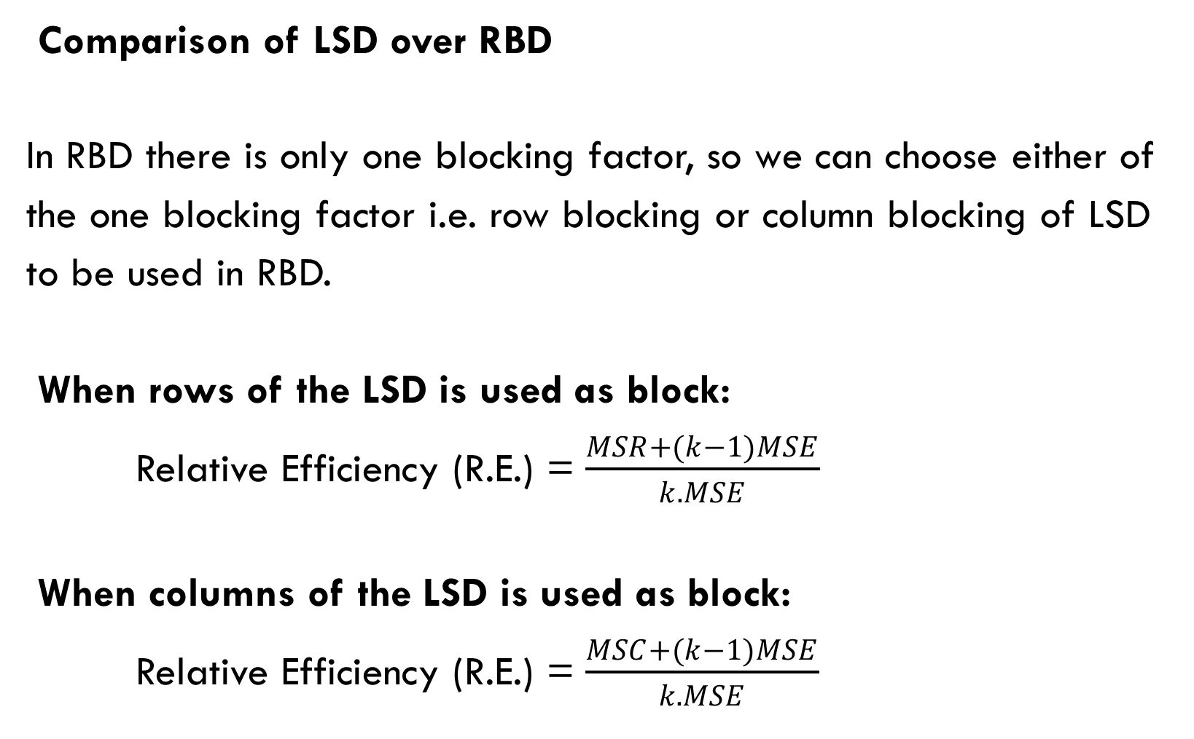
Comparison of LSD over RBD
In RBD there is only one blocking factor, so we can choose either of the one blocking factor i.e. row blocking or column blocking of LSD to be used in RBD.
When rows of the LSD is used as block:
Relative Efficiency (R.E.) = $\frac{MSR+(k−1)MSE}{k.MSE}$
When columns of the LSD is used as block:
Relative Efficiency (R.E.) = $\frac{MSC+(k−1)MSE}{k.MSE}$

Slide 15
Advantages of LSD
Stronger Control: LSD controls for two distinct sources of variation (rows and columns) compared to CRD (one) and RBD (two, but not as effectively) reducing the experimental error further and improving precision. This leads to sharper, more precise comparisons between treatment levels.
Efficient use of resources: LSD requires fewer experimental units compared to CRD or RBD, making it cost-effective.
Balanced and Unbiased Comparison: Each treatment appears exactly once in each row and each column, ensuring balanced allocation of treatment across the two blocking factors. This balance improves the reliability of comparisons between treatments. representation and minimizing bias.
Improved Precision: By eliminating two nuisance factors (row and column effects), LSD improves the precision of treatment comparisons.
Simple Analysis: The statistical analysis for a Latin Square Design is relatively straightforward.

Slide 16
Disadvantages of lsd
Limited Treatment Flexibility: The number of treatments is restricted by the design, i.e. the no. of treatments must equal the no. of rows and columns (quite restrictive). This restriction can make the design impractical for experiments with large number of treatments to be compared.
Complexity in Implementation: LSD requires careful randomization and arrangement, making it difficult to apply in practical scenarios.
Sensitive to Missing Data: If data re missing for one or more units, the balance of the design is disrupted, and analysis become more complicated and challenging
Assumption of No Interaction: Assumes no interaction between row, column, and treatment effects, which may not always hold in real-world experiments.
Limited d.f. for error: Small Latin Squares can have low degrees of freedom for error, which can make it harder to achieve statistically significant results. Hence, LSD is less effective with very few treatments (less than 5) since the benefits of double control diminish

Slide 17
The effects of five different ingredients (A, B, C, D, E) on the reaction time of a chemical process is being studied. Each batch of new material is only large enough to permit five runs to be made. Furthermore, each run requires approximately 1.5 hours, so only five run can be made in one day. The experimenter decides to run the experiment as 5X5 LSD so that day and batch effects may be systematically controlled. Data follow.
Batch Day
1 2 3 4 5
1 A = 8 B = 7 D = 1 C = 7 E = 3
2 C = 11 E = 2 A = 7 D = 3 B = 8
3 B = 4 A = 9 C = 10 E = 1 D = 5
4 D = 6 C = 8 E = 6 B = 6 A = 10
5 E = 4 D = 2 B = 3 A = 8 C = 8
Analyze the data from this experiment and draw conclusions.

