Slide 1
Recursion

Slide 2
Introduction
Recursion is the process of defining something in terms of itself
Alternative way to iteration in making a function execute repeatedly
Recursion is a process by which a function calls itself repeatedly until some specified
condition has been satisfied.
The process is used for repetitive computations in which each action is stated in terms of a
previous result.
To solve a problem recursively, two conditions must be satisfied.
First, the problem must be written in a recursive form, and
Second, the problem statement must include a stopping condition.

Slide 3
It can be formally defined as:
Recursion is a computer programming technique involving the use of a procedure, subroutine, function, or algorithm that calls itself in a step having a termination condition so that successive repetitions are processed up to the critical step where the condition is met at which time the rest of each repetition is processed from the last one called to the first

Slide 4
Advantages of Recursion:
Recursion adds clarity and reduces the time needed to write and debug code. If you know your input into a function will be small, then recursion is certainly a good choice if you want to de-clutter your code.
Recursion can reduce time complexity.if we save the value of each calculation for further use in the recursive call, we can reduce the time complexity
For a recursive function, you only need to define the base and recursive cases, so the code is simpler and shorter than an iterative code.
Some problems are inherently recursive, such as Graph and Tree Traversal.

Slide 5
Disadvantages of Recursion:
It is hard to think the logic of a recursive function.
It may require large amounts of memory.
For each call to the function more memory is allocated for local variables
Recursion can be slow. If not implemented correctly it can be much slower than iteration

Slide 6
Recursive Function
A recursive function is a function that calls itself during its execution
This enables the function to repeat itself several times, outputting the result and the
end of each iteration
That is, a function is called “recursive” if a statement within body of that function calls the same function

Slide 7
Recursion vs Iteration
Iteration: A function repeats a defined process until a condition fails. This is usually done through a loop, such as a for or while loop with a counter and comparative statement making up the condition that will fail.
Recursion: Instead of executing a specific process within the function, the function calls
itself repeatedly until a certain condition is met (this condition being the base case).

Slide 8
Recursion vs Iteration
Criteria | Recursion | Iteration
Basic | Recursion is the process of calling a function itself within its own code | In iteration, there is repeated execution of the set of instructions. In iteration, loops are used to execute the set of instructions repeatedly until the condition is false.
Syntax | There is a termination condition is specified | The format of iteration includes initialization, condition and increment/decrement of a variable
Termination | Termination condition is defined within the recursive function | Termination condition is defined in the definition of the loop
Infinite | If the recursive function does not meet to a termination condition, it leads to an infinite recursion . There is a chance of system crash in infinite recursion. | Iteration will be infinite if the control condition of the iteration statement never becomes false. On infinite loop, it repeatedly used CPU cycles.
Applied | It is always applied to functions. | It is applied to loops.
Speed | It is slower than iteration | It is faster than recursion
Memory | It uses more memory as compared to iteration | It uses less memory as compared to recursion
Stack | It has to update and maintain the stack | There is no utilization of stack
Code Size | The code size in recursion is smaller than the code size in iteration | The code size in iteration is larger than the code size of recursion

Slide 9
Example of recursive algorithms
# Iterative implementation
int fact(int n){
int fact=1;
for(int i =0;i<n;i++){ fact*=i;
return fact;
}
#Recursive implementation
int fact(int n){
if(n==0){
return 1;
}else
return n*fact(n-1);
}

Slide 10
Application of Recursion
This is the backbone of AI.
The most important data structure ‘Tree’ doesn’t exist without recursion we can iteratively solve that also but that will be a very tough task.
Many of the well-known sorting algo(Quick sort, Merge sort, etc) uses recursion.
All the puzzle games(Chess,Candy crush,etc) broadly uses recursion.
The use of recursion is uncountable, nowadays because it is the backbone of searching, which is the most important thing.

Slide 11
Recursive Definitions
Recursive definitions are used to define an object in terms
of itself.
int public sum (int n)
{
Base case
if (n <= 1)
Consists of two parts:
To do recursion we should know the followings
Base Case:
return n; else
return(n + sum(n-1));
}// end sum()
The case for which the solution can be stated non-recursively
The case for which the answer is explicitly known.
Recursive Case
General Case:
The case for which the solution is expressed in smaller version of itself. Also known as recursive case

Slide 12
Fibonacci Series
To add two numbers and generate a subsequent number is known as Fibonacci series.
Fibonacci series starts from two numbers -F₀ and F₁.
The initial values of F₀ and F₁ can be taken 0, 1 or 1, 1 respectively.
^{F}n ^{= F}n-1 ^{+ F}n-2
F(n) = 1 when n <= 1
= F(n-1) + F(n-2)
when n > 1

Slide 13
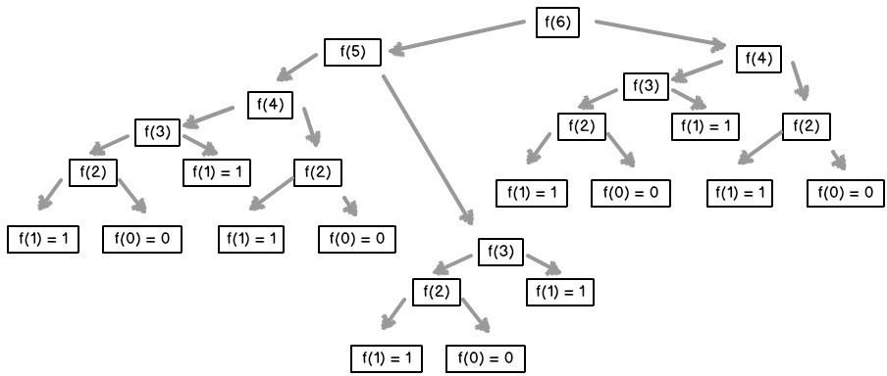
i.e.
F(0) = 0
F(1) = 1
F(2) = F(2-1) + F(2-2
= F(1) + F(0)
= 1 + 0
= 1
)

Slide 14
Using Recursion
Using Iteration
Procedure Fibonacci(n) declare f0, f1, fib, loop set f0 to 0
set f1 to 1 display f0, f1
for loop ← 1 to n
fib ← f0 + f1 f0 ← f1
f1 ← fib display fib
end for end
Fibo(n)
Begin
if n <= 1 then Return n;
else
Return Call Fibo(n-1) + Call Fibo(n-2); end if
End

Slide 15
Source Code:
#include <stdio.h> int fibonacci(int n) { if(n <=1)
return n; else {
return (fibonacci(n-1) + fibonacci(n-2));
}
}
int main() {
int i, n, fib;
printf("Enter the number of elements in fibonacci series:");
scanf("%d",&n); for(i = 0;i<n;i++) { fib = fibonacci(i); printf("%d ",fib);
}
}

Slide 16
Greatest Common Divisor (GCD):
Euclidean Algorithm for Greatest Common Divisor (GCD) , The Euclidean Algorithm finds the GCD of 2 numbers.
Assuming you want to calculate the GCD of 1220 and 516, lets apply the Euclidean
Algorithm-
Pseudo Code:
Step 1: Let a, b be the two numbers
Step 2: a mod b = R
Step 3: Let a = b and b = R
Step 4: Repeat Steps 2 and 3 until a mod b is greater than 0 Step 5: GCD = b
Step 6: Finish

Slide 17
Example:
Find the GCD of 270 and 192
A=270, B=192
A ≠0
B ≠0
Use long division to find that 270/192 = 1 with a remainder of 78. We can write this as: 270 = 192 * 1
+78
Find GCD(192,78), since GCD(270,192)=GCD(192,78)
A=192, B=78
A ≠0
B ≠0
Use long division to find that 192/78 = 2 with a remainder of 36. We can write this as:
192 = 78 * 2 + 36
Find GCD(78,36), since GCD(192,78)=GCD(78,36)

Slide 18
A=78, B=36
A ≠0
B ≠0
Use long division to find that 78/36 = 2 with a remainder of 6. We can write this as:
78 = 36 * 2 + 6
Find GCD(36,6), since GCD(78,36)=GCD(36,6)
A=36, B=6
A ≠0
B ≠0
Use long division to find that 36/6 = 6 with a remainder of 0. We can write this as:
36 = 6 * 6 + 0
Find GCD(6,0), since GCD(36,6)=GCD(6,0)

Slide 19
A=6, B=0
A ≠0
B =0, GCD(6,0)=6
So we have shown:
GCD(270,192) = GCD(192,78) = GCD(78,36) = GCD(36,6) = GCD(6,0) = 6
GCD(270,192) = 6

Slide 20
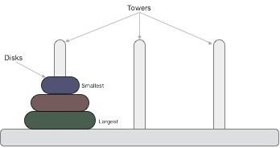
Tower of Hanoi
A mathematical puzzle consisting of three towers(rods) and more than one disk is known as Tower of Hanoi.
There are three poles(peg) named as origin(source), intermediate(aux) and destination.
Objective: Transfer all disks from origin pole(tower) to destination pole using intermediate pole for temporary storage.
Conditions:
Only one disk may be moved at a time.
Each move consists of taking the upper disk from one of the rods and sliding it onto another
rod, on top of the other disks that may already be present on that rod.
No disk may be placed on top of a smaller disk.

Slide 21
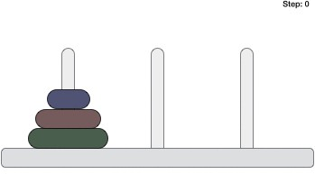
Tower of Hanoi puzzle with n disks can be solved in minimum 2^{n}−1 steps. This presentation shows that a puzzle with 3 disks has taken 2³ - 1 = 7 steps.
If there are 2 disks –
First, move the smaller (top) disk to intermediate peg.
Then, move the larger (bottom) disk to destination peg.
And finally, move the smaller disk from intermediate to destination peg.
Animated representation of solving a Tower
of Hanoi puzzle with three disks.

Slide 22
Algorithm: Recursive algorithm of tower of Hanoi
Step 1: Start
Step 2: Create a function Hanoi(n, source, inter, dest)
Step 3: if disk == 1, THEN
move disk from source to dest
else,
Hanoi(n - 1, source, dest, inter)
move disk from source to dest Hanoi(n - 1, inter, source, dest)
end if
Step 4: Stop

Slide 23
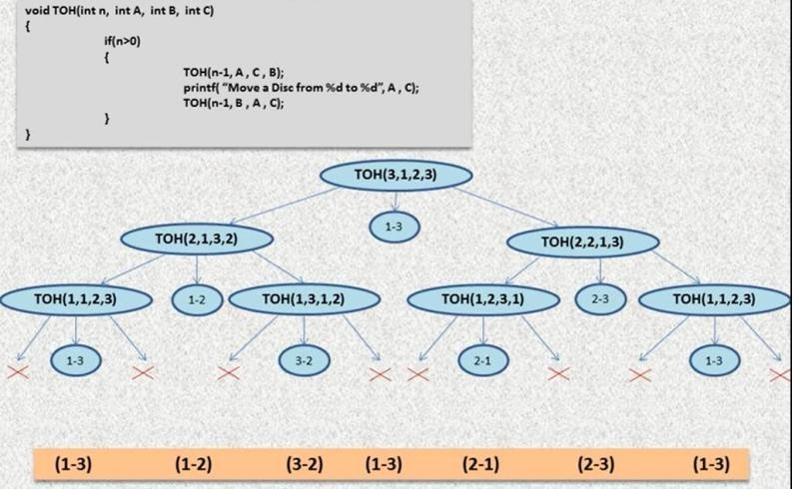

Slide 24
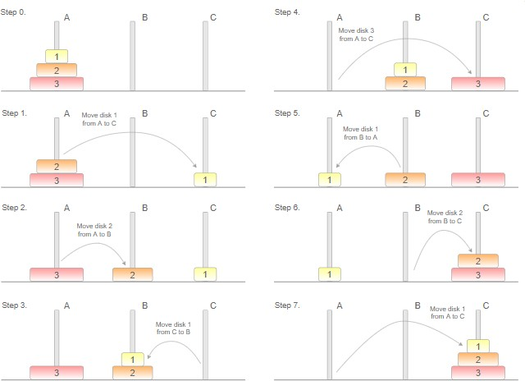
Below is the example of solving the Tower of Hanoi puzzle with 3 disks.

Slide 25
#include <stdio.h>
Source Code
int main()
{
int n;
printf("Enter the number of disks\n");
scanf("%d", &n);
move(n, 'A', ‘B', ‘C’);
printf("Total number of iterations required are: %d\n", counter);
return 0;
}
int counter = 0;
void move(int n, char src, char helper, char dest)
{ //base case
if(n == 0)
return;
//incrementing the counter counter++;
//recursive case, move N - 1 disks to the helper
move(n - 1, src, dest, helper);
printf("Shift disk %d from %c to %c\n", n, src, dest);
move(n - 1, helper, src, dest); }

Slide 26
Types of Recursion in C
1.Direct Recursion 2.Indirect Recursion 3.Tail Recursion
No Tail/ Head Recursion
Linear recursion 6.Tree Recursion

Slide 27
Direct Recursion
The function or method that invokes itself is called direct recursion
Direct recursion involves only one function
If X makes a recursive call to X itself, it is called direct recursion. (The factorial function which calls itself can be taken as an example of direct recursion)
fun()
{
// write some code fun();
// some code
}

Slide 28
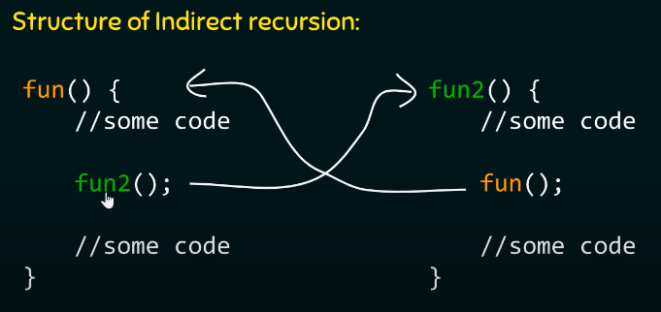
Indirect Recursion
When a function is mutually called by another function in a circular manner, the function is called an indirect recursion function.
fun1()
{
1.// write some code fun2()
}
fun2()
{
// write some code fun3()
// write some code
}
fun3()
{
// write some code fun1()
}

Slide 29
Tail Recursion
A recursive function is called the tail-recursive if the function makes recursive calling itself, and that
recursive call is the last statement executes by the function. After that, there is no function or statement is
left to call the recursive function.
#include <stdio.h>
// function definition
void fun1( int num)
{
// if block check the condition
if (num == 0)
return; else
printf ("\n Number is: %d", num); // print the numbe return fun1(num-1);
// recursive call at the end in the fun() function
}
int main ()
{
fun1(7); // pass 7 as integer argument
return 0; }
Output: Number is: 7
Number is: 6
Number is: 5
Number is: 4
Number is: 3
Number is: 2
Number is: 1

Slide 30
#include <stdio.h>
void head_fun (int num){
if ( num > 0 ) {
// Here the head_fun() is the first statement to be called head_fun (num -1);
printf (" %d", num);
}}
Output
int main () {
Use of Non-Tail/Head Recursive function 1 2 3 4 5
int a = 5;
printf (" Use of Non-Tail/Head Recursive function \n"); head_fun (a); // function calling
return 0; }

Slide 31
Non-Tail Recursion
A function is called the non-tail or head recursive if a function makes a recursive call itself, the recursive call will be the first statement in the function.
It means there should be no statement or operation is called before the recursive calls. Furthermore, the head recursive does not perform any operation at the time of recursive calling. Instead, all operations are done at the return time.

Slide 32
Linear Recursion
A function is called the linear recursive if the function makes a single call to itself at each time the function runs and grows linearly in proportion to the size of the problem. Linear recursion generally refers to a type of recursion where a function calls itself only once within its body. In other words, the recursive call forms a straight line, and there is no branching or multiple recursive calls.

Slide 33
#include <stdio.h> #define NUM 7
int rec_num( int *arr, int n) {
if (n == 1) {
return arr[0]; }
return Max_num (rec_num (arr, n-1), arr[n-1]); }
// get the maximum number
int Max_num (int n, int m) {
if (n > m)
return n;
return m; }
int main () {
// declare and initialize an array
int arr[NUM] = { 4, 8, 23, 19, 5, 35, 2};
int max = rec_num(arr, NUM); // call function
Output
The maximum number is: 35
printf (" The maximum number is: %d\n", max); // print the largest number
}

Slide 34
Tree Recursion
#include <stdio.h>
// It is called multiple times inside the fibo_num function
int fibo_num (int num)
{
if (num <= 1)
return num;
return fibo_num (num - 1 ) + fibo_num(num - 2);
}
void main()
{
int num = 7;
printf (" Use of Tree Recursion: \n");
// print the number
printf (" The Fibonacci number is: %d", fibo_num(7));
}
A function is called the tree recursion, in which the function makes more than one call to itself within the recursive function.
Output
Use of Tree Recursion: The Fibonacci number is: 13

Slide 35
Recurrence relation of recursive algorithms
Fibonacci Number
T(N) = T(N-1) + T(N-2)
Base Conditions: T(0) = 0 and T(1) = 1
Binary Search
T(N) = T(N/2) + C
Base Condition: T(1) = 1
Merge Sort
T(N) = 2 T(N/2) + CN
Base Condition: T(1) = 1

Slide 36
Analysis of merge sort using Recursion Tree Method
A recurrence tree is a tree where each node represents the cost of a certain recursive
subproblem.
Steps for solving a recurrence relation
Draw a recursion tree based on the given recurrence relation.
Determine the number of levels, cost at each level and cost of the last level.
Add the cost of all levels and simplify the expression.
Let us solve the given recurrence relation by Recurrence Tree Method T(N) = 2*T(N/2) + CN

Slide 37
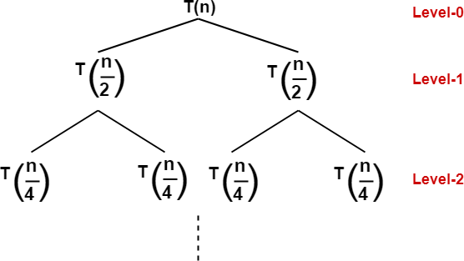
From the above recurrence relation, we can find that
The problem of size N is divided into two sub-problems of size N/2.
The cost of dividing a sub-problem and then combining its solution of size N is CN.
Each time, the problem will be divided into half, until the size of the problem becomes 1.
The recursion tree for the above relation will be

Slide 38
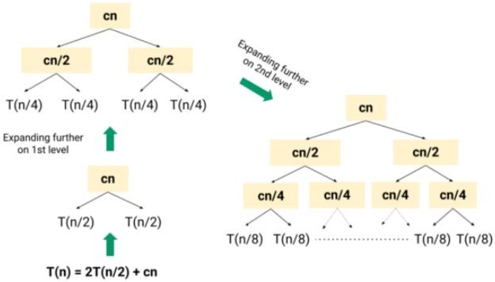

Slide 39
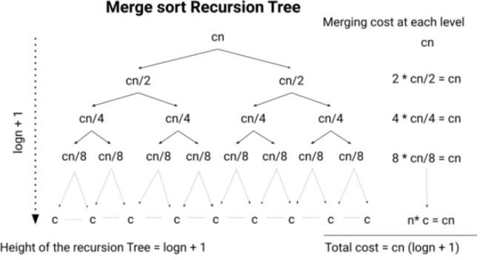

Slide 40
Cost of the last level
The cost at the last level where the size of the problem is 1 and the number of subproblems is N.
cost at last level = N*T(1) = O(N)
Now, let’s add up the cost at each level
= { N + N + N + ..logN times } + O(N)
= O(NlogN) + O(N)
= O(NlogN)
The time complexity of the above recurrence relation is O(N logN).

Slide 41
WAP to print number from 1 to 10 in such a way that when number is odd , add 1 and when number is even, subtract 1.

