Slide 1

Motion Capture Technology
Presenter : Ayush Tuladhar
Bsc. CSIT 1st Semester

Slide 2

Introduction
Technology that records motions of objects or people digitally
Provides realistic movement in animation, video games, and motion pictures
Evolved over centuries through advancements in spatial measuring, photography, and computing

Slide 3
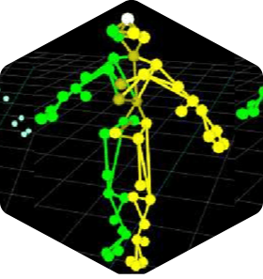
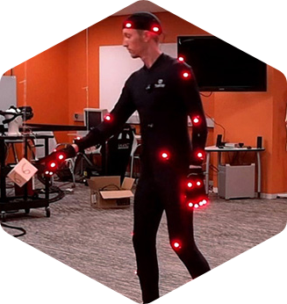
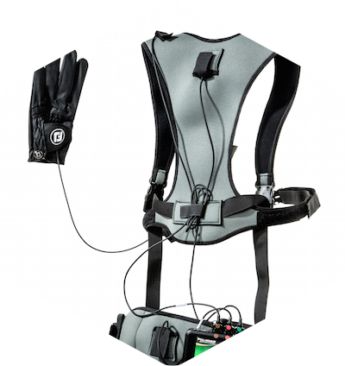
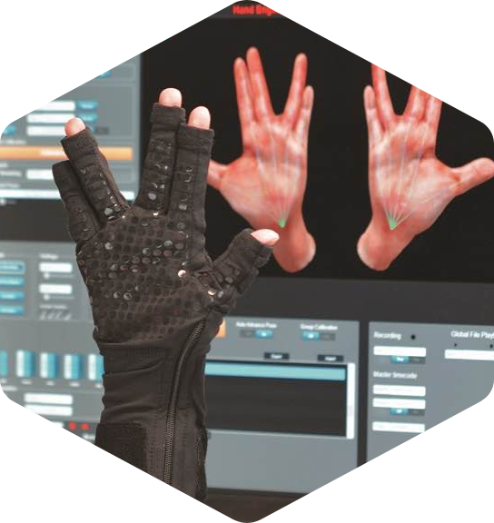
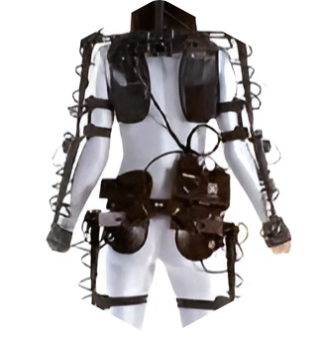
Types of Motion Capture Systems
1. Optical Systems
Passive Marker Systems
Active Marker Systems
Markerless Systems
2. Non-Optical Systems
Inertial Systems
Mechanical Systems
Stretch Sensors
Magnetic Systems

Slide 4
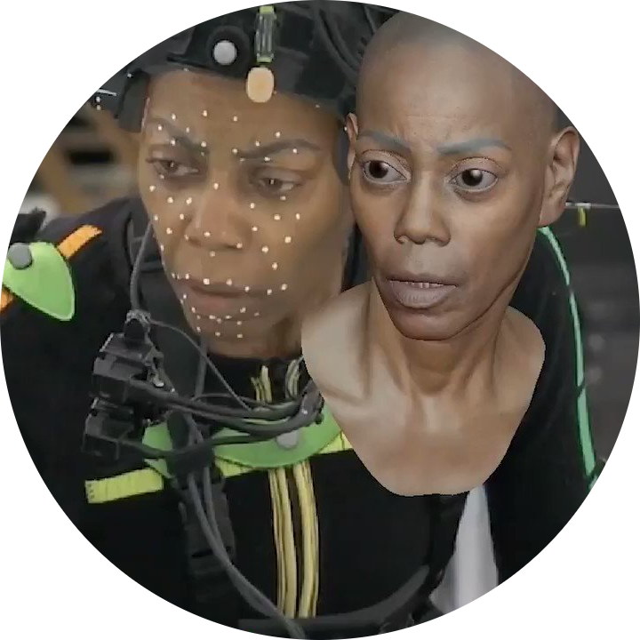
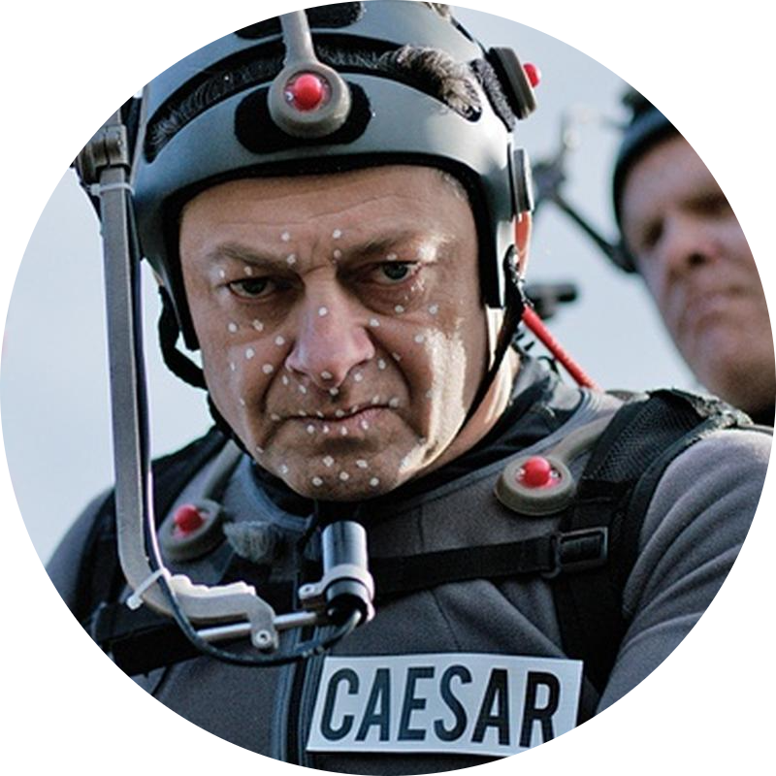
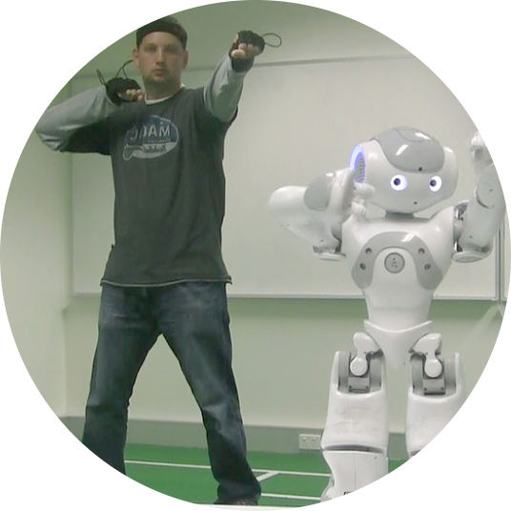
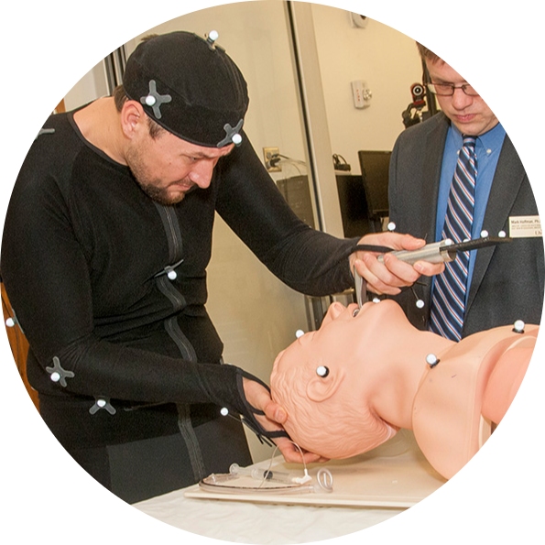
Applications
Video games
Movies
Robotics
Medicine

Slide 5
Advantages
Low latency and near-real-time performance
Ability to replicate complex movements and interactions
Cost-effectiveness in producing large amounts of animation data
Availability of free software and third-party solutions

Slide 6
Disadvantages
Needs specialized software/hardware
Small productions face affordability issues
Space requirements for capture system
Physics-violating movements are uncapturable

Slide 7
Conclusion
Capture, analyze, and animate human movement with unprecedented realism and precision
Technology that blends the physical and digital worlds
Future trends in AI, ML, VR and digital content creation

Slide 8
Thank You!
Any questions?

