Slide 1

Calorie tracker
Presented by:
Abhilekh Subedi
Ayush Tuladhar

Slide 2
Introduction
Based on C++ programming language
Automates calorie and protein tracking
Enhances dietary management efficiency and accuracy
Personalized Goal Setting
Automated Calculations
Data Storage and Retrieval
Progress Tracking

Slide 3
Features
Encapsulation: Data and methods for meals and user profiles are encapsulated in classes like Meal, UserProfile, and CalorieTracker.
Inheritance: Specialized meal types (Breakfast, Lunch, Dinner, Snacks) inherit from a base class Meal.
Polymorphism: Abstract methods (e.g., displayMeal) allow meal objects to display details specific to their type.
Dynamic Memory Management: Uses dynamic memory allocation (new and delete) for managing meal objects at runtime.

Slide 4
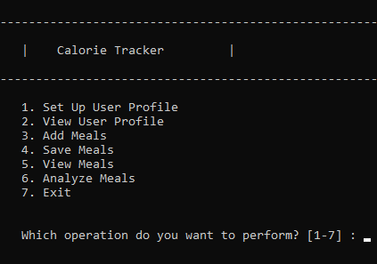
Functions
1. Set Goals: Calculates daily calorie and protein targets based on user profile.
2. Add Meals: Log meals with details like name, calories, and protein.
3. View Meals: Display logged meals for the day.
4. Analyze Total Intake: Calculate total calories and protein consumed.
5. Save Data: Store meal records for future reference.

Slide 5
Advantages
Removes manual errors
Increases precision and accuracy
Easy to use
Quick access to data
Provides warnings to prevent overeating or nutrient deficiencies
Reduces the time and effort required for manual tracking

Slide 6
Conclusion
Automates dietary tracking, significantly improving efficiency and accuracy.
Demonstrates the innovative potential of technology in health management.
Helps users effectively achieve dietary goals.

