Slide 1
SAMPLING DISTRIBUTION
INSTRUCTOR: SANTOSH CHHATKULI
Copyright: Santosh Chhatkuli

Slide 2
Two main divisions in Statistics:
Descriptive Statistics
Inferential Statistics
Descriptive Statistics can be defined as those methods involving the collection, presentation and characterization of a set of data in order to describe the various features of that set of data properly.
Some of the descriptive measures are:
Measures of central tendency: Mean, mode, median etc.
Measures of variation: Standard deviation, variance, range etc.
Measures of position: Percentiles, deciles, quartiles etc.
Measures of association: Karl Pearson’s correlation coefficient, Spearman’s correlation coefficient etc.
Copyright: Santosh Chhatkuli

Slide 3
Inferential statistics is the branch of statistics that focuses on drawing conclusions, making predictions, or testing hypotheses about a larger population based on data collected from a sample. It uses probability theory to estimate population parameters and determine the likelihood that observed patterns in the sample data apply to the entire population.
Common techniques of inferential statistics are:
Estimation of parameters: Used to estimate population parameters using sample statistics
Hypothesis testing: Used to determine whether a claim or hypothesis about a population parameter is supported by the sample data.
Modeling (Regression Analysis): Used to model the relationship between a dependent variable and one or more independent variables.
Copyright: Santosh Chhatkuli

Slide 4
Key concepts in Inferential Statistics
Population: The entire group of individuals or objects that you are interested in studying.
Sample: A subset of the population that is selected for analysis.
Parameter: A numerical characteristic of a population (e.g., population mean, population standard deviation).
Statistic: A numerical characteristic of a sample (e.g., sample mean, sample standard deviation).
Sampling: The process of selecting a subset of individuals or observations (a sample) from a larger group (the population) to study and make inferences about the population.
Sampling distribution: The probability distribution of a statistic (e.g., sample mean) calculated from all possible samples of the same size drawn from a population. It shows how the statistic varies between samples.
Probability distribution: A mathematical function that describes the likelihood of different outcomes for a random variable.
Copyright: Santosh Chhatkuli

Slide 5
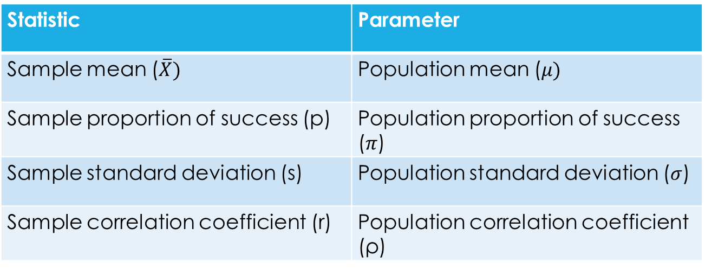
Statistics/Parameters
Copy Right: Santosh Chhatkuli

Slide 6
Sampling Distribution: Definition
The distribution of all possible values of a sample statistic, such as the mean or proportion, calculated from all possible samples of a given size, randomly drawn from a population.
Importance
Understanding Sample Variability: It helps us understand how much sample statistics can vary from sample to sample.
Foundation for making inferences: It enables inferential statistics, allowing us to generalize from a sample to the population.
Hypothesis Testing: It plays a crucial role in hypothesis testing by providing the framework to determine whether observed sample statistics are consistent with a null hypothesis or suggest evidence against it.
Confidence Intervals: It helps us construct confidence intervals, which provide a range of values likely to contain the true population parameter. (Helps to estimate population parameter)
Copyright: Santosh Chhatkuli

Slide 7
Concept of Sampling Distribution
The concept of Sampling distribution is very important since almost all inferential statistics are based on sampling distribution.
Sample distribution: A distribution resulting from the collection of actual data is called sample distribution.
Sampling distribution:
The probability distribution of all possible values that a statistic can assume (e.g. sample mean, sample proportion etc.), computed from samples of the same size, drawn randomly and repeatedly from the same population is called the sampling distribution of that statistic.
Copy Right: Santosh Chhatkuli

Slide 8
Three Measures describing a sampling distribution
The key measures used to describe a sampling distribution are:
Shape: The shape of the sampling distribution depends on the population distribution and the sample size.
(A common way to visualize a sampling distribution is through a histogram. The x-axis represents the range of possible values of statistic, and the y-axis represents the frequency or probability. The shape may take different forms, for example, Normal Distribution, t distribution, chi-square distribution, F distribution etc.)
Expected Value: The average value for the statistic
Standard Error: The standard deviation of the statistic.
Copyright: Santosh Chhatkuli

Slide 9
Sampling distribution of common statistic
The commonly studied sampling distribution are:
Sampling distribution of sample mean
Sampling distribution of sample proportion
Sampling distribution of sample standard deviation (not covered in the course)
Copyright: Santosh Chhatkuli

