Slide 1
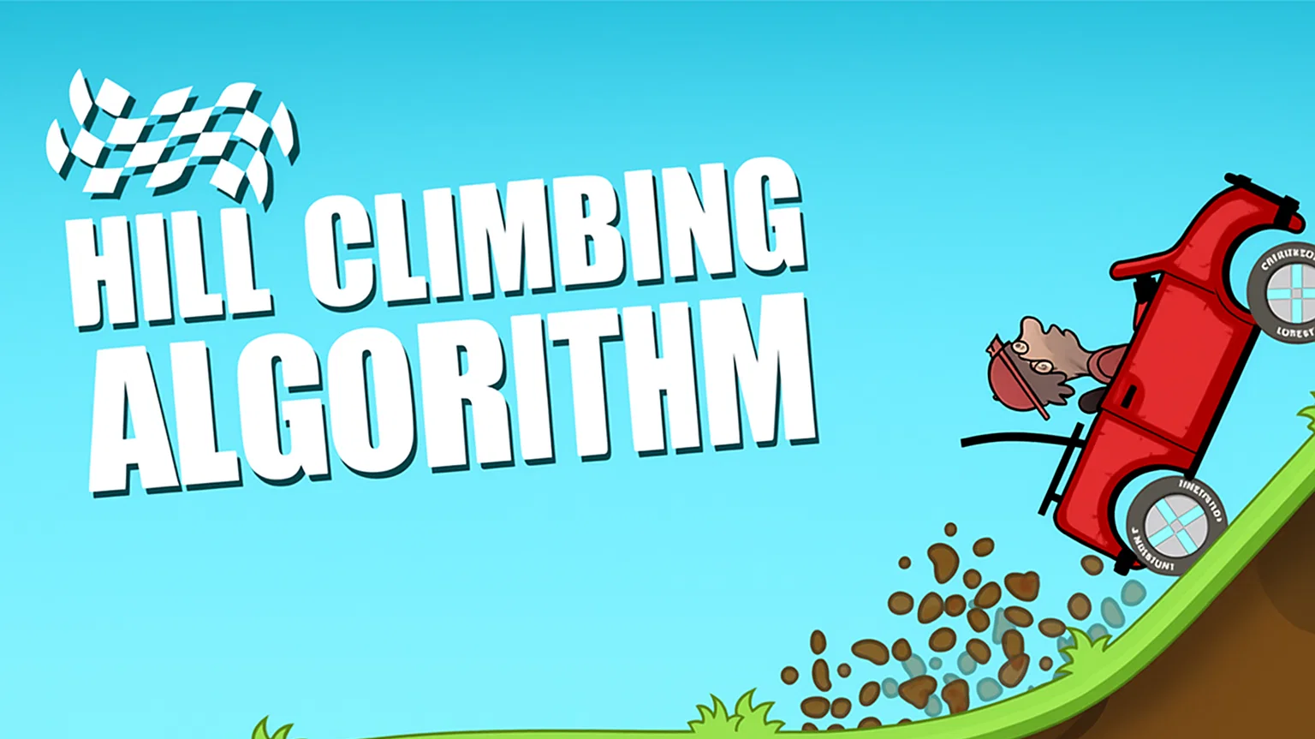
Presenter: Ayush Tuladhar
BSc. CSIT IV
Subject: Artificial Intelligence

Slide 2
Introduction
Hill Climbing is a heuristic search algorithm used for solving optimization problems
Works by iteratively improving the current solution until no better neighbours exist
Inspired by the idea of climbing uphill to reach the highest peak

Slide 3
Key Features
Variant of Generate-and-Test : Uses feedback from evaluation to guide search
Greedy Approach : Always moves to the best immediate neighbour
No Backtracking : Only considers the current and future states
Feedback Mechanism : Evaluation of neighbours directs the next step

Slide 4
State Space Landscape
Local Maximum – Better than neighbours, but not global best
Global Maximum – Highest value overall
Plateau – Flat region with equal neighbour values
Shoulder – Edge that leads upward

Slide 5
Types of Hill Climbing
Simple Hill Climbing:
Chooses the first better neighbour.
Fast, but often suboptimal.
Steepest-Ascent Hill Climbing :
Evaluates all neighbours, chooses the best.
More time-consuming, but better results.
Stochastic Hill Climbing : Randomly selects neighbours.
Useful for escaping local maxima

Slide 6
Problems in Hill Climbing
Local Maximum (Foothill Problem) – Algorithm gets stuck before the global peak.
Plateau Problem – Flat region, no clear direction.
Ridge Problem – Narrow peak requiring complex moves

Slide 7
Solutions to Problems
Random restarts - escape local maxima.
Sideways moves - handle plateaus.
Bidirectional or multi-directional search - deal with ridges.

Slide 8
Example: N-Queens Problem
Place n queens on an nan board without attacking each other.
Heuristic: h = number of pairs of queens attacking each other.
Hill climbing iteratively reduces h until no attacks remain

Slide 9
Applications
Function optimization
Game playing (local search)
Robotics pathfinding
Scheduling problems

Slide 10
Conclusion
Strengths: Simple, memory efficient, works well with good heuristics.
Weaknesses: Prone to local maxima, plateaus, and ridges.
Often combined with randomization or simulated annealing for robustness.

