Slide 1

Multimedia & Future Networking
Presenter : Abhilekh Subedi, Ayush Tuladhar
Subject : Computer Network
CSIT IV

Slide 2
Introduction to Multimedia Streaming
Multimedia streaming requires reliable, efficient, and flexible transport and network protocols
SCTP (Stream Control Transmission Protocol)
SDN (Software Defined Networking)
Notes:
Multimedia is combination of different of data
Streaming means delivering continuous media over the internet in real time
Instead of downloading the whole file, users can play content as it arrives.
This is widely used in platforms like YouTube, Netflix, or live streaming services.”
Sctp transport layer protocol
Sdn network arihtecture model

Slide 3
SCTP Overview
Transport layer protocol (like TCP & UDP)
Designed for multimedia, telecommunication, and real-time applications
Combines features of TCP (reliability, in-sequence message transportation) and UDP (multi-streaming, message-oriented)
Notes:
Provides full duplex association
Easy to establish connection over wireless network

Slide 4
Features
Unicast : point-to-point protocol but can uses different paths to each end host
Multi-streaming : avoids head-of-line blocking
Multi-homing : supports multiple IP addresses per endpoint
Reliable transmission with congestion & flow control
Message-oriented instead of byte stream
Built-in security (cookie mechanism against DoS attacks)
Notes:
Multi streaming: if video packet is lost in TCP, everything waits whereas in sctp audio continues smoothly while the lost video packet is recovered separately
Nulti- homing for fault tolerance
Reliable: uses SACK and checksum to detect correupted data, more efficient thatn TCP for reording of data

Slide 5
SDN Overview
Software Defined Networking (SDN): separates control plane from data plane
Controller-based model for network programmability
Ideal for managing multimedia streaming traffic dynamically
Notes:
modern approach where the control of the network is separated from the hardware
Separates control plane from switch and assigns to SDN controller
Network administrator can shape traffic via centralized console without having to touch individual switches

Slide 6
Data plane
All activities involving data packets sent by end user
Handles multimedia data transfer (voice, video, real-time messages)
Supports parallel streams for smooth delivery
Notes:
Responsilbe for Forwarding of packets
Segmentation and reassembly of data
Replication of packets ofr multicasting

Slide 7
Control plane
All activities required to perform data plane activites but don’t involve end user data packets
Connection setup (association establishment)
Error detection & retransmission
Path management (multi-homing)
Notes:
Brain of the network
The control plane makes decisions about where traffic should go. It installs rules into the data plane and manages routing, policies, and overall logic.Includes:
Making routing tables
Setting packet handling policies

Slide 8
Control Plane vs Data Plane
Aspect | Control Plane | Data Plane
Definition | Responsible for decision-making (how data should flow). | Responsible for forwarding data packets based on control plane decisions.
Function | Routing, signaling, connection setup, path selection, error control. | Transfers user data (voice, video, files) across the network.
Type of Traffic | Control messages (ACK, SACK, routing updates, policies). | Actual multimedia payload (audio, video, messages).
Protocols | Routing protocols (OSPF, BGP), SCTP control chunks, SDN controller logic. | Transport protocols (TCP, UDP, SCTP data chunks), forwarding in switches/routers.
Location | Typically in network controllers / protocol logic. | Typically in switches/routers hardware.
Analogy | Like the brain → makes decisions and sends instructions. | Like the muscles → executes instructions and carries the load.

Slide 9
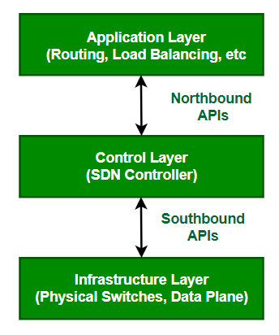
SDN Architecture
Notes:
AL: network apps for intrusion detection firewall and load balancing
CL: SDN controller brain of network and allows hardware abstraction to apps on top of it
IL: physical switches that for mdata plane and carry out actual movement of data packets
Layers communicate through set of interfaces called APIs

Slide 10
Features
Centralized control via SDN controller
Programmable networks (open APIs like OpenFlow)
Dynamic resource allocation for multimedia
Traffic engineering : ensures QoS (Quality of Service)
Scalability and flexibility for growing streaming demands

Slide 11
SCTP vs SDN in Multimedia Streaming
Aspect | SCTP | SDN
Layer | Transport | Network Architecture
Focus | Reliable delivery & multi-streaming | Network management & optimization
Data Plane | Media packet delivery | Packet forwarding
Control Plane | Connection, error, path control | Routing, policies, QoS
Notes:
“SCTP improves the transport of multimedia by avoiding delays, while SDN provides smarter traffic management. Together, they enhance streaming quality, reduce buffering, and improve scalability.”

Slide 12
NFV Overview
Virtualization of network functions (firewall, router, load balancer, etc.)
Runs on standard servers instead of proprietary hardware
Key goal: reduce cost, improve agility, and enable rapid innovation
Notes:
“Network Functions Virtualization, or NFV, replaces dedicated hardware appliances with software-based solutions running on general-purpose servers. Examples include virtual firewalls and virtual load balancers.”

Slide 13
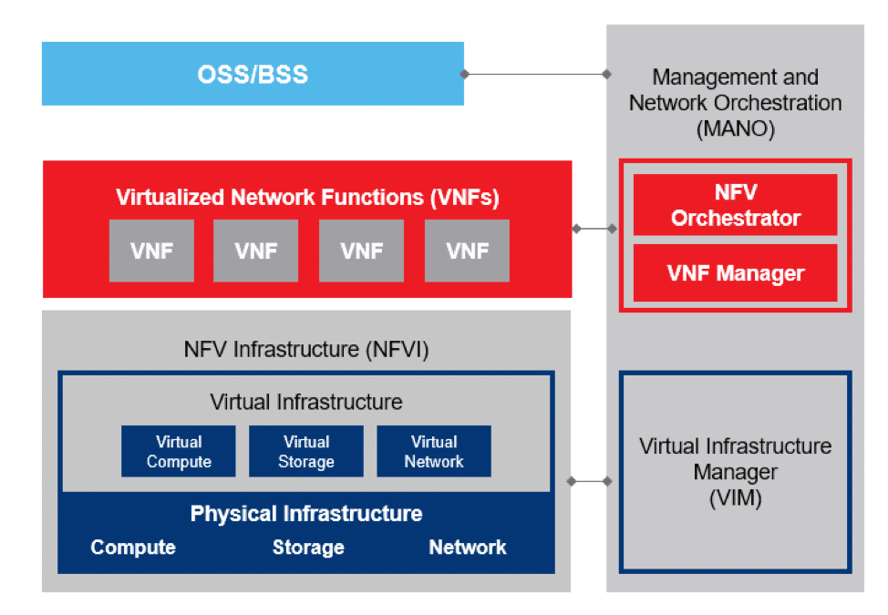
NFV Architecture
NFV Infrastructure (NFVI) – hardware + virtualization layer
Virtual Network Functions (VNFs) – software versions of network functions
Management & Orchestration (MANO) – control, automation, lifecycle management.
Notes:
“NFV consists of three main parts: NFVI, which is the hardware and virtualization layer; VNFs, which are the software-based network functions; and MANO, which manages and automates the lifecycle of those functions.”

Slide 14
advantages
Reduced CAPEX & OPEX
Faster service deployment
Scalability and flexibility
Notes:
“Advantages include reduced hardware costs, scalability, and faster deployment.

Slide 15
disadvantages
Performance overhead
Security risks
Interoperability issues
Notes:
Disadvantages include higher reliance on virtualization, possible performance issues, and complexity in management.”

Slide 16
NGN overview
Packet-based, IP-based converged network
Supports voice, data, video, mobility on same platform
Separation of service layer and transport layer
Notes:
“Next Generation Networks, or NGN, integrate multiple services like voice, data, and video over a single IP-based backbone. This supports convergence of telecommunications and internet services.”

Slide 17
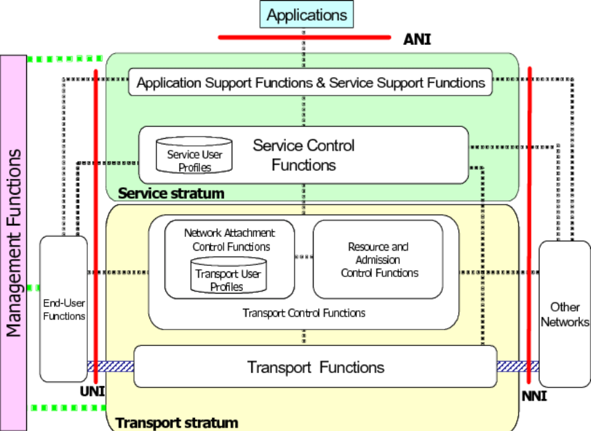
NGN Architecture
Applications: User services (VoIP, IPTV, IoT, etc.) connect via ANI.
Service Stratum: Handles service logic, control, user profiles, and authentication.
Transport Stratum: Provides actual data transfer, QoS, and user network access.
Interfaces:
UNI (User ↔ Network),
NNI (Network ↔ Network),
ANI (Apps ↔ Network).
Management Functions: Oversee operation, administration, and maintenance across all layers.
Notes:
“NGN has multiple layers: Applications provide services like VoIP or IPTV. The service stratum handles logic and authentication. The transport stratum ensures quality of service and connectivity. Interfaces like UNI, NNI, and ANI define how users, networks, and apps interact.”

Slide 18
advantages
Convergence of multiple services
Better QoS & mobility support
Scalability for future services
Notes:
“Advantages are service convergence, reduced costs, and support for multiple applications.

Slide 19
Disadvantages
Migration from legacy systems
Security threats
Standardization & regulation
Notes:
Disadvantages include security concerns, implementation cost, and dependency on IP networks.”

Slide 20
Applications
NFV
Virtual firewalls, routers, EPC
SD-WAN
5G Core & Cloud-native telecom
NGN
VoIP replacing PSTN
IPTV over broadband
Mobile broadband (4G/5G)
IoT device connectivity
Notes:
“Applications of NGN include VoIP calls, IPTV, IoT services, and integrated internet-based communication.”

Slide 21
NFV & NGN Combined
NFV enables NGN by providing flexible virtualized infrastructure
NGN needs NFV for cost efficiency and scalability
support 5G, IoT, edge computing, smart cities
Future Trends
Notes:
“When NFV and NGN are combined, they create a flexible, service-rich environment that reduces costs while improving efficiency and innovation in multimedia delivery.”
Future trends:
NFV + SDN = fully automated, programmable networks
5G and upcoming 6G powered by NFV/NGN
Edge computing integration
AI-driven network management

Slide 22
Conclusion
SCTP : Reliable, multi-streaming transport protocol for multimedia delivery
SDN : Flexible, programmable architecture for optimizing multimedia traffic
Together, they enhance efficiency, QoS, and scalability in multimedia streaming
NFV : Virtualizes network functions
NGN : Converged, IP-based, service-rich network
Together, they drive modern telecom evolution for 5G, IoT, and beyond
Notes:
“In conclusion, multimedia streaming relies on strong networking technologies. SCTP, SDN, NFV, and NGN together shape the future of multimedia delivery, making it faster, more reliable, and scalable.”

Slide 23
Thank you

Slide 24
Old questions
Why do you think Network Functions Virtualization architecture is required? Explain. (2081)
Explain architecture of SDN (2080-new)
Write short notes on NGN (model)
Explain the architecture of NGN. (2080)
Explain in brief about software defined network? What are its features? (2079)
What are the different approaches for multimedia streaming? Explain. (2078)

