Slide 1
Unit 2
Physical Layer

Slide 2
Physical Layer
Bit Transmission - Converts digital data from the data link layer into electrical, optical, or radio signals. Transmits bits sequentially over the physical medium.
Physical Topology - Defines the physical layout of devices and cables in a network (e.g., bus, star, ring, mesh).
Transmission Medium - Determines how signals are carried over the medium (e.g., copper wire, fiber optics, wireless).
Data Rate (Bit Rate) Control - Controls the speed of data transmission (measured in bps – bits per second).
Line Configuration - Determines the way devices are connected (e.g., point-to-point or multipoint).
Transmission Mode - Determines the direction of signal flow:
Simplex – one-way
Half-duplex – both ways, one at a time
Full-duplex – both ways, simultaneously

Slide 3
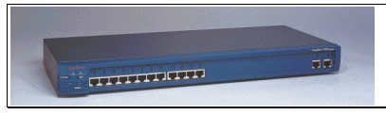
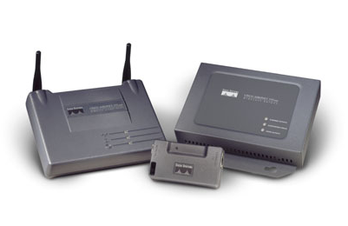
Networking Devices
HUB, Switches, Routers, ,Modems etc.

Slide 4
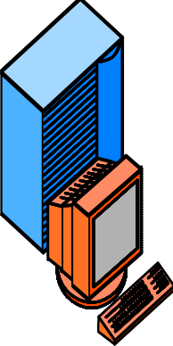
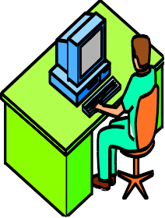

Networking Devices
Repeater:
A repeater operates at the physical layer. Its job is to regenerate the signal over the same network before the signal becomes too weak or corrupted so as to extend the length to which the signal can be transmitted over the same network. An important point to be noted about repeaters is that they do not amplify the signal. When the signal becomes weak, they copy the signal bit by bit and regenerate it at the original strength. It is a 2-port device.
200 m
100 m
100 m
Repeater

Slide 5

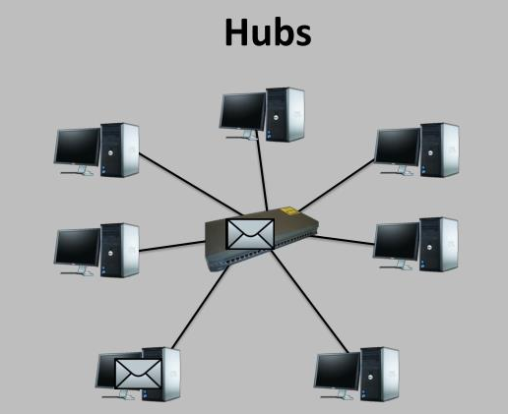



Hub:
A hub is basically a multiport repeater. A hub connects multiple wires coming from different branches, for example, the connector in star topology which connects different stations. Hubs cannot filter data, so data packets are sent to all connected devices. When multiple devices (like computers) are connected to a hub, only one device can successfully send data at a time. If two devices try to send data at the same time, a collision occurs. They then need to retransmit, leading to delays and reduced efficiency. Also, they do not have the intelligence to find out the best path for data packets which leads to inefficiencies and wastage.
HUB
•
•
•
•

Slide 6
.
Hub:
Types of Hub
Active Hub:-Not only connects devices but also amplifies (boosts) the signal before forwarding it.
Helps in extending the distance the signal can travel without degradation.
Acts like a repeater + hub — improves signal strength.
Passive Hub :-Simply connects multiple devices in a network. Does not amplify or regenerate the signal — just passes it along.
Acts like a physical junction box.
Often used in older or very simple networks.
No signal boosting — just basic connection
Intelligent Hub :- Performs the roles of an active hub plus network management features.
Can monitor traffic, detect errors, and support remote management.
More expensive and sophisticated.
Rarely used today — switches and routers do this better.
Adds basic intelligence and diagnostics to a hub.
•
•
•
•

Slide 7
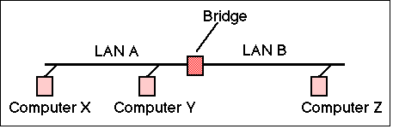
Bridge:
A bridge is a device used in a computer network that helps connect two smaller networks (LANs) and make them work as one. It works at the Data Link Layer (Layer 2) of the OSI model.
What does a bridge do?
It reads MAC addresses (hardware addresses) to decide whether to forward or block data.
It acts like a smart repeater: it receives a signal, cleans it up (if needed), and forwards it only when necessary.
It can filter traffic: only lets data through if it’s meant for the other side.
It has 2 ports: one input and one output — like a two-way door between two LANs.
Types of Bridges
Transparent Bridges:- These are the bridge in which the stations are completely unaware of the bridge’s existence i.e. whether or not a bridge is added or deleted from the network, reconfiguration of the stations is unnecessary. These bridges make use of two processes i.e. bridge forwarding and bridge learning.
Source Routing Bridges:- In these bridges, routing operation is performed by the source station and the frame specifies which route to follow. The host can discover the frame by sending a special frame called the discovery frame, which spreads through the entire network using all possible paths to the destination.
5
MAC Address | Port No.
2A-3B-AB-45-3B-5F | 1
1b-3B-43-45-3B-4F | 2
3F-35-6B-46-30-5F | 1

Slide 8
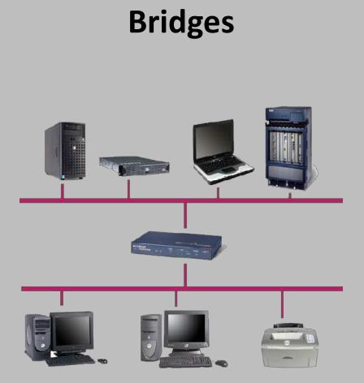

Slide 9
Switch:
A switch is a multiport bridge with a buffer and a design that can boost its efficiency(a large number of ports imply less traffic) and performance. A switch is a data link layer device. The switch can perform error checking before forwarding data, which makes it very efficient as it does not forward packets that have errors and forward good packets selectively to the correct port only. In other words, the switch divides the collision domain of hosts, but broadcast domain remains the same.
A switch is essentially a fast, multi-port bridge that can contain dozens of ports.
A switch dynamically builds and maintains a MAC table, which holds all of the necessary MAC information for each port.
The switch then forwards or discards frames based on the table entries.
Table entries are called Content Addressable Memory.
Switch works at Data link Layer of OSI Reference model

Slide 10






Networking Devices
Switch
Data Link Layer
MAC Address | Port No.
2A-3B-AB-45-3B-5F | 1
1b-3B-43-45-3B-4F | 2
3F-35-6B-46-30-5F | 3
Physical
Layer
Physical
Layer

Slide 11
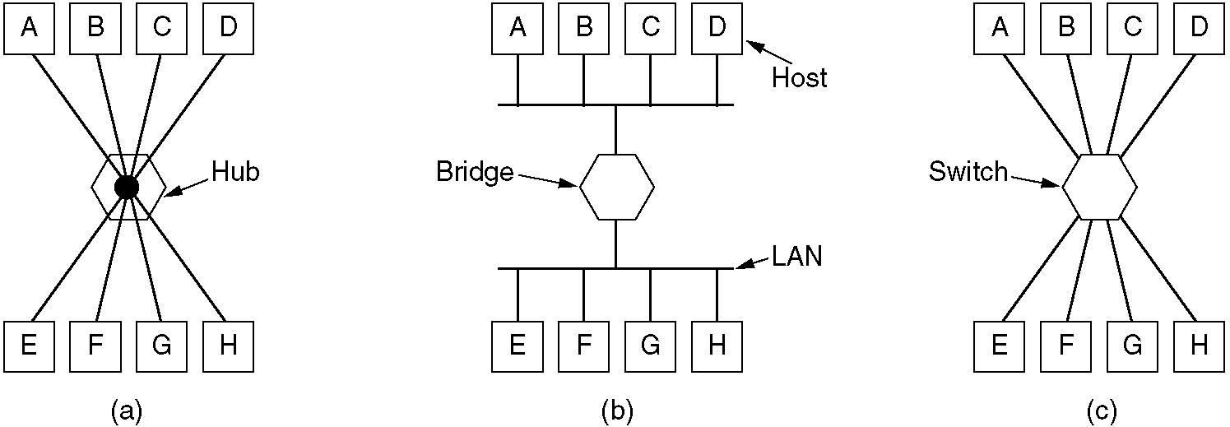
Networking Devices
(a) A hub.
(b) A bridge.
(c) a switch.

Slide 12
Router:
A router is a device like a switch that routes data packets based on their IP addresses. The router is mainly a Network Layer device. Routers normally connect LANs and WANs together and have a dynamically updating routing table based on which they make decisions on routing the data packets. Router divide broadcast domains of hosts connected through it.
It has the same basic components as a standard desktop PC. It has a CPU, memory, a system bus, and various input/output interfaces. However, routers are designed to perform some very specific functions that are not typically performed by desktop computers.
For example, routers connect and allow communication between two networks and determine the best path for data to travel through the connected networks.
Router works at Network Layer of OSI Reference model.
•
•

Slide 13
Gateway
As the name implies, a gateway is a network entity, also known as a protocol converter. It connects the computers of one network to another and defines the boundaries of the network. If two networks with different protocols want to be connected to each other, both networks need to have gateways that provide a point of presence and entry for computers from both networks to communicate. In other words, gateways can join different systems.
Gateways exist in routers, switches, or PCs. When communication is carried out within the same network segment, there is no need to involve the gateway. Only when the host communicates with devices outside this network segment, all packets need to be sent to the gateway device and then forwarded through the processing protocol of the gateway device.
•
•

Slide 14
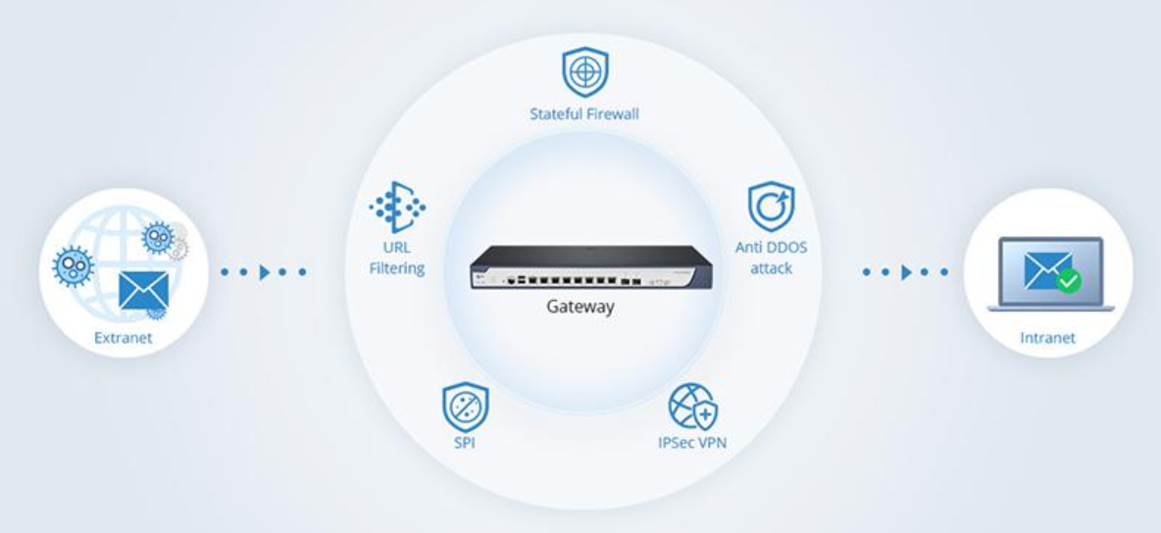
Gateway
•
•

Slide 15
What is the difference between?
Bridge: device to interconnect two LANs
Router: device to interconnect SIMILAR networks, e.g. similar protocols and workstations and servers
Gateway: device to interconnect DISSIMILAR protocols and servers, and Macintosh and IBM LANs and equipment

Slide 16
Data Transmission Media:
Transmission media are the physical pathways that connect computers, other devices, and people on a network- the highways and byways that comprise the information superhighway.
Each transmission medium requires specialized network hardware that has to be compatible with that medium.
The transmission medium is the physical path by which a message travels from sender to receiver.
Computers and telecommunication devices use signals to represent data.

Slide 17
Data Transmission Media:
The transmission media can be grouped into.
Conducted/wired or guided media: use a conductor such as a wire or a fiber optic cable to move the signal from sender to receiver. Examples are twisted pair wires, coaxial cables and optical fiber.
Wireless or unguided media: use radio waves of different frequencies and do not need a wire or cable conductor to transmit signals. Examples are terrestrial microwave, satellite microwave, broadcast radio and infrared.

Slide 18
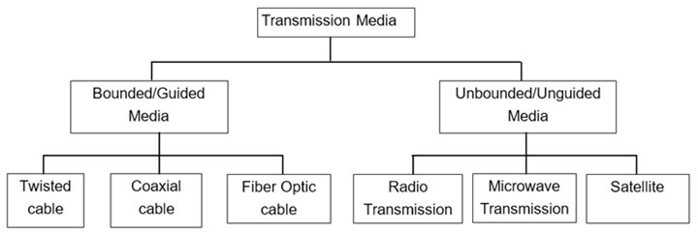
Data Transmission Media:
The transmission media can be grouped into.

Slide 19
Twisted Pair (TP):
One of the earliest guided transmission media is twisted pair cables. A twisted pair cable comprises of two separate insulated copper wires, which are twisted together and run in parallel. The copper wires are typically 1mm in diameter. One of the wires is used to transmit data and the other is the ground reference.
A twisted pair cable consists of four pairs of copper wires coated with an insulating material like plastic or Teflon, twisted together. Twisting reduces electromagnetic interference (or noise) .
Twisted pair cabling is often used in data networks for short and medium length connections because of its relatively lower costs compared to optical fiber and coaxial cable

Slide 20
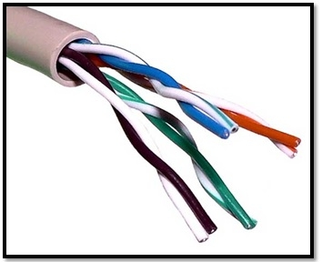
Twisted Pair (TP):
Applications of Twisted-Pair Cables
In telephone lines
In LANs
TP is of two kinds
Shielded Twisted Pair (STP),
Unshielded Twisted Pair (UTP).

Slide 21
Twisted Pair (TP):
Unshielded Twisted Pair (UTP):
This type of cable has the ability to block interference and does not depend on a physical shield for this purpose. I UTP is the most commonly used medium for transmission over short distances up to 100m. Out of the four pairs of wires in a UTP cable, only two pairs are used for communication.
Advantages:
Least expensive
Easy to install
High-speed capacity
Lower capacity and performance in comparison to STP
Short distance transmission

Slide 22
Twisted Pair (TP):
Shielded Twisted Pair (STP):
This type of cable consists of a special jacket to block external interference. It is used in fast-data-rate Ethernet and in voice and data channels of telephone lines.
STP cable has an extra layer of metal foil between the twisted pair of copper wires and the outer covering. The metal foil covering provides additional protection from external disturbances. STP is costly and is generally used in networks where cables pass closer to devices that cause external disturbances.
Advantages:
Better performance at a higher data rate in comparison to UTP
Comparatively faster
Comparatively difficult to install and manufacture
More expensive
Bulky

Slide 23
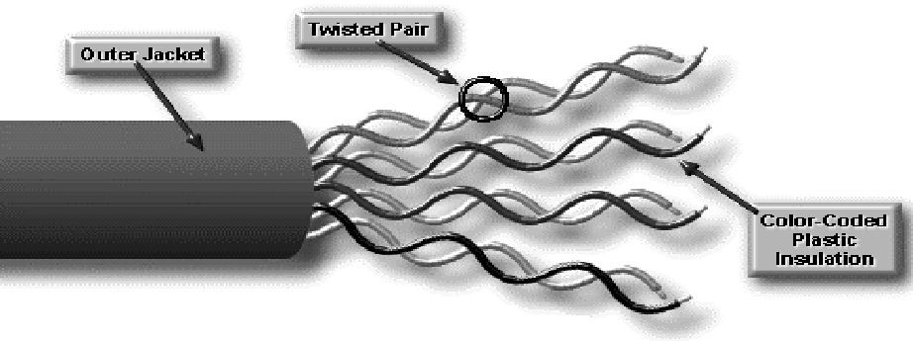
UTP
Types of UTP
▫ CAT 3: data rate up to 10 Mbps(Ethernet)
▫ CAT 4: data rate up to 20 Mbps(Token Ring)
▫ CAT 5: data rate up to 100 Mbps(Fast Ethernet)
▫ CAT 5e: data rate up to 1000 Mbps(Gigabit Ethernet)
▫ CAT 6: data rate up to 10 Gbps(Gigabit Ethernet)
Maximum cable length with out repeater 100m

Slide 24
Cable Color Coding
Cabling Standards :
EIA/TIA 568 A color coding :
EIA/TIA 568 B color coding :
g G o B b O br Br o O g B b G br Br
Where
▫ g - light green or Stripped green (wire)
▫ G - Solid Green (wire)
Similar For other wire as well.

Slide 25
UTP Cable Types
Straight through Cable: A-A or B-B setting, used to connect different layer device, e.g. hub to computer.
Cross-over Cable: A-B or B-A setting, used to connect same
layer device, e.g. computer to computer, router to computer.

Slide 26
Coaxial Cable:
Coaxial cables are the guided media that transmit the signal of higher frequency range compared to twisted pair cable. Coaxial cables are also called coax. (short form).
Two types of coaxial cables are widely used: 50 ohm cable and 75 ohm cable. 50 ohm cable is used for digital transmission and 75 ohm cable is used for analog transmission.
It has a large bandwidth and low losses. Co-axial cables are easy to install.
A coaxial cable consists of many small cables in a protective cover. The cover shields the cable from physical dangers as well as from electromagnetic interference.

Slide 27
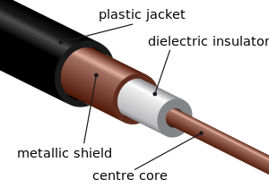

Slide 28
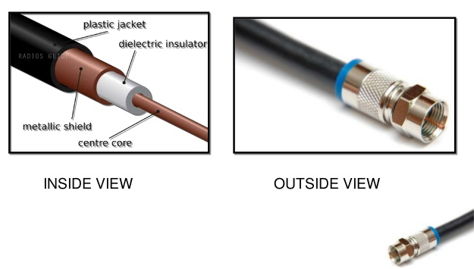
Coaxial Cable:

Slide 29
Coaxial Cable:
Advantages of Coaxial Cables
1. It can be used for both analog and digital transmission. 2. It offers higher bandwidth as compared to twisted pair cable. 3. Because of better shielding in coaxial cable, loss of signal is less. 4. Better shielding also offers good noise immunity. 5. It is relatively inexpensive as compared to optical fibers. 6. It has lower error rates as compared to twisted pair.

Slide 30
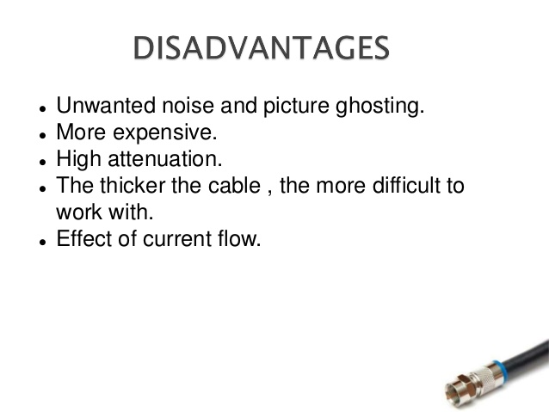
Coaxial Cable:

Slide 31
Coaxial Cable:
Applications of Co-axial Cables: (1) Cable TV (2) Digital transmission

Slide 32
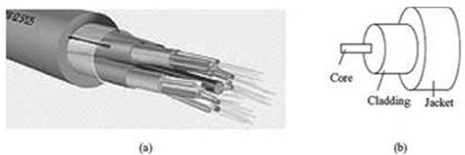
Optical Fiber:
Optical fibers are being used for transmission of information over large distances more cost effectively than the copper wire connection. Communication systems are now unthinkable without fiber optics.
Optical fiber transmits data as light signals instead of electric signals.
An optical fiber cable consists of
Core - optical fiber conductor (glass) that transmits light,
Cladding - an optical material that surrounds the core to prevent any light from escaping the core, and
Jacket - outer covering made of plastic to protect the fiber from damage.

Slide 33
Fiber Optic Layers
consists of three concentric sections
plastic jacket
glass or plastic
cladding
fiber core

Slide 34
The Advantages of Optical Fibers over wires are:
Bandwidth - Fiber optic cables have a much greater bandwidth than metal cables.
Low Power Loss - An optical fiber offers low power loss, which allows for longer transmission distances
Interference - Fiber optic cables are immune to electromagnetic interference. It can also be run in electrically noisy environments without concern as electrical noise will not affect fiber.
Weight- Fiber optic cables are much thinner and lighter than metal wires.

Slide 35
The Disadvantages of Optical Fiber are:
Expensive to Install - The optical fibers are more expensive to install, and they have to be installed by the specialists..
Highly Susceptible - The fiber optic cable is a small and compact cable, and it is highly susceptible to becoming cut or damaged during installation or construction activities.
Can’t Be Curved -. The fibers can be broken or have transmission losses when wrapped around curves of only a few centimeters radius.

Slide 36
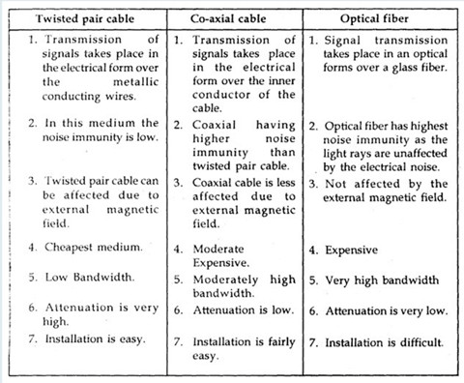

Slide 37
Radio Waves
Waves ranging in frequencies between 3 kHz and 1 GHz are called radio waves. Radio waves, for the most part, are omnidirectional. When an antenna transmits radio waves, they are propagated in all directions. This means that the sending and receiving antennas do not have to be aligned.
These waves are easy to generate and these can travel along long distances. These waves are omni directional in nature which means that they can travel in all the directions. They are widely used for the communication between both indoor and outdoor because they have the property that they can penetrate through the walls very easily. These waves are usually used for AM and FM radio, television, cellular phones and wireless LAN. It is a technique where data is transmitted using radio waves and therefore energy travels through the air rather than copper or glass.

Slide 38
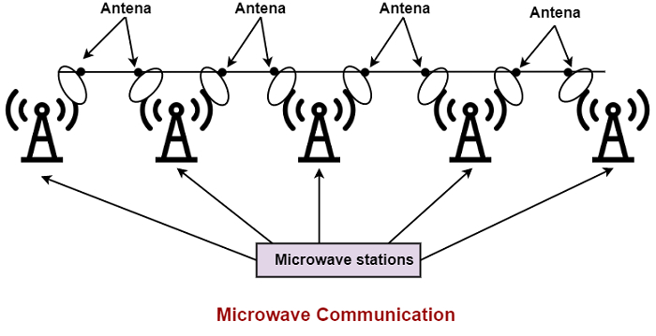
Microwave Transmission:
The transmission of data through microwave in telecommunication involves the sending and receiving of microwave signals over a microwave link.
Microwave links are used for point-to-point communications. It is a point-to-point, rather than a broadcast, transmission system. Additionally, each antenna must be within line of sight of the next antenna. If the frequencies are higher within the microwave band given in this impact is more than lower frequencies in the same band.

Slide 39
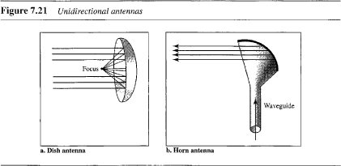
Micro Waves
Electromagnetic waves having frequencies between 1 and 300 GHz are called microwaves. Microwaves are unidirectional. When an antenna transmits microwave waves, they can be narrowly focused. This means that the sending and receiving antennas need to be aligned. The unidirectional property has an obvious advantage. A pair of antennas can be aligned without interfering with another pair of aligned antennas.

Slide 40
Micro Waves
Microwaves need unidirectional antennas that send out signals in one direction. Two types of antennas are used for microwave communications: the parabolic dish and the horn (see Figure). A parabolic dish antenna is based on the geometry of a parabola: Every line parallel to the line of symmetry (line of sight) reflects off the curve at angles such that all the lines intersect in a common point called the focus. Outgoing transmissions are broadcast through a horn aimed at the dish. The microwaves hit the dish and are deflected outward in a reversal of the receipt path.

Slide 41
Infrared
Infrared waves, with frequencies from 300 GHz to 400 THz (wavelengths from 1 mm to 770 nm), can be used for short-range communication. Infrared waves, having high frequencies, cannot penetrate walls. This advantageous characteristic prevents interference between one system and another; a short-range communication system in one room cannot be affected by another system in the next room. When we use our infrared remote control, we do not interfere with the use of the remote by our neighbors. However, this same characteristic makes infrared signals useless for long-range communication. In addition, we cannot use infrared waves outside a building because the sun's rays contain infrared waves that can interfere with the communication.
The infrared band, almost 400 THz, has an excellent potential for data transmission. Such a wide bandwidth can be used to transmit digital data with a very high data rate.

Slide 42
Satellite Transmission:
If the communication takes place between any two earth stations through a satellite, then it is called as satellite communication. In this communication, electromagnetic waves are used as carrier signals.
These signals carry the information such as voice, audio, video or any other data between ground and space and vice-versa.
Telephone, radio, television, internet, and military applications use satellite communications. Believe it or not, more than 2000 artificial satellites are hurtling around in space right above your heads.

Slide 43
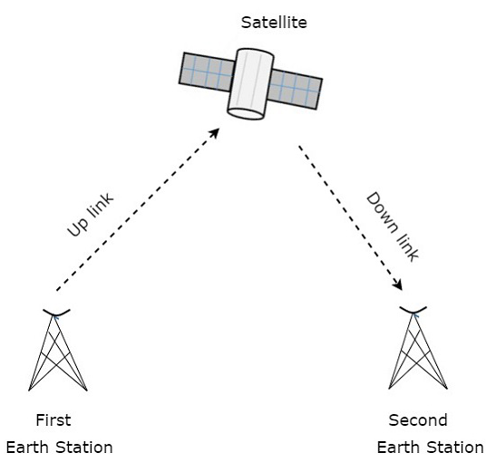
Satellite Transmission:

Slide 44
Satellite Transmission:
A satellite is a body that moves around another body in a particular path. A communication satellite is nothing but a microwave repeater station in space. It is helpful in telecommunications, radio and television along with internet applications.
A repeater is a circuit, which increases the strength of the received signal and then transmits it. But, this repeater works as a transponder. That means, it changes the frequency band of the transmitted signal from the received one.
The frequency with which, the signal is sent into the space is called as Uplink frequency. Similarly, the frequency with which, the signal is sent by the transponder is called as Downlink frequency.

Slide 45
Switching Techniques
Whenever we are dealing with a large network or say a very long-distance data transmission has to take place, this can't be done directly without any external hardware support. Hence, we must have a dedicated path for our data packets to traverse. Since there are so many choices for which path to take, so we have to select a particular path. This selecting of the path on which our data packets will be transmitted is known as Switching.
In large networks there might be multiple paths linking sender and receiver. Information may be switched as it travels through various communication channels.
There are three typical switching techniques available for digital traffic.
Circuit Switching
Message Switching
Packet Switching

Slide 46
Circuit Switching
Circuit switching is a switching technique that establishes a dedicated path between sender and receiver.
In the Circuit Switching Technique, once the connection is established then the dedicated path will remain to exist until the connection is terminated.
Circuit switching in a network operates in a similar way as the telephone works.
A complete end-to-end path must exist before the communication takes place.
In case of circuit switching technique, when any user wants to send the data, voice, video, a request signal is sent to the receiver then the receiver sends back the acknowledgment to ensure the availability of the dedicated path. After receiving the acknowledgment, dedicated path transfers the data.
Circuit switching is used in public telephone network. It is used for voice transmission.
Fixed data can be transferred at a time in circuit switching technology.

Slide 47
Advantages Of Circuit Switching:
In the case of Circuit Switching technique, the communication channel is dedicated.
Because the circuit is fixed, the data transfer rate remains constant throughout the session.
Suitable for real-time applications like voice calls, as data is delivered in the correct order without delay.
After a connection is established, there is no network congestion for that session since resources are reserved.
Disadvantages Of Circuit Switching:
Once the dedicated path is established, the only delay occurs in the speed of data transmission.
It takes a long time to establish a connection approx 10 seconds during which no data can be transmitted.
It is more expensive than other switching techniques as a dedicated path is required for each connection.
It is inefficient to use because once the path is established and no data is transferred, then the capacity of the path is wasted.
In this case, the connection is dedicated therefore no other data can be transferred even if the channel is free.

Slide 48
Message Switching
• Message Switching is a switching technique in which a message is transferred as a complete unit and routed through intermediate nodes at which it is stored and forwarded.
In Message Switching technique, there is no establishment of a dedicated path between the sender and receiver.
The destination address is appended to the message. Message Switching provides a dynamic routing as the message is routed through the intermediate nodes based on the information available in the message.
Message switches are programmed in such a way so that they can provide the most efficient routes.
Each and every node stores the entire message and then forward it to the next node. This type of network is known as store and forward network.
Message switching treats each message as an independent entity.

Slide 49
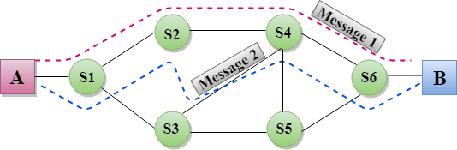
Message Switching

Slide 50
Advantages Of Message Switching
Data channels are shared among the communicating devices that improve the efficiency of using available bandwidth.
Messages are stored at intermediate nodes and forwarded when the path is available, reducing the chance of data loss.
Traffic congestion can be reduced because the message is temporarily stored in the nodes.
Message priority can be used to manage the network.
Entire messages (not just small packets) can be transmitted, making it suitable for text documents and files.
Disadvantages Of Message Switching
Because the entire message is stored at each node before forwarding, it can take a long time to reach the destination.
Intermediate devices need enough memory to store whole messages, which can be a problem for big messages.
Not suitable for voice or video calls, where data must arrive instantly — message switching is too slow for that.

Slide 51
Packet Switching
The packet switching is a switching technique in which the message is sent in one go, but it is divided into smaller pieces, and they are sent individually.
The message splits into smaller pieces known as packets and packets are given a unique number to identify their order at the receiving end.
Every packet contains some information in its headers such as source address, destination address and sequence number.
Packets will travel across the network, taking the shortest path as possible.
All the packets are reassembled at the receiving end in correct order.
If any packet is missing or corrupted, then the message will be sent to resend the message.
If the correct order of the packets is reached, then the acknowledgment message will be sent.

Slide 52
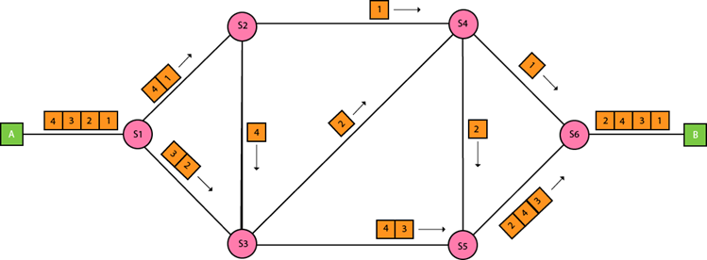
Packet Switching

Slide 53
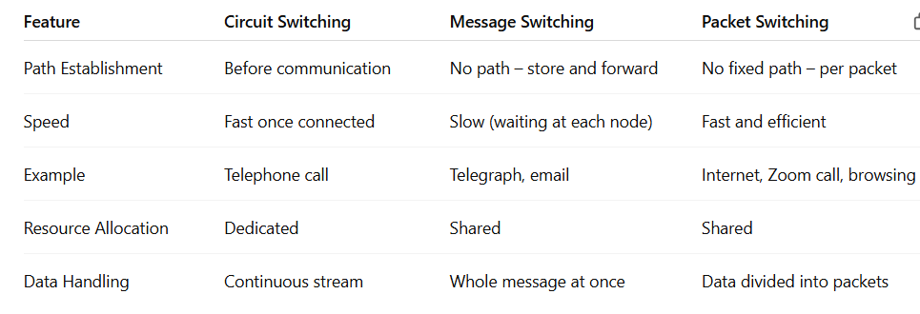

Slide 54
Approaches Of Packet Switching:
There are two approaches to Packet Switching:
Datagram Packet switching:
It is a packet switching technology in which packet is known as a datagram, is considered as an independent entity. Each packet contains the information about the destination and switch uses this information to forward the packet to the correct destination.
The packets are reassembled at the receiving end in correct order.
In Datagram Packet Switching technique, the path is not fixed.
Intermediate nodes take the routing decisions to forward the packets.
Datagram Packet Switching is also known as connectionless switching.

Slide 55
Approaches Of Packet Switching:
Virtual Circuit Switching
Virtual Circuit Switching is also known as connection-oriented switching.
In the case of Virtual circuit switching, a preplanned route is established before the messages are sent.
Call request and call accept packets are used to establish the connection between sender and receiver.
In this case, the path is fixed for the duration of a logical connection.

Slide 56
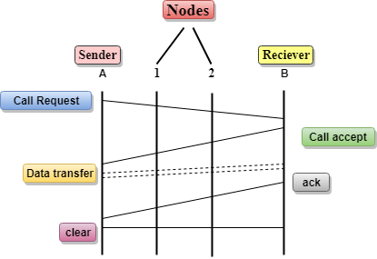
Approaches Of Packet Switching:

Slide 57
Approaches Of Packet Switching:
In the above diagram, A and B are the sender and receiver respectively. 1 and 2 are the nodes.
Call request and call accept packets are used to establish a connection between the sender and receiver.
When a route is established, data will be transferred.
After transmission of data, an acknowledgment signal is sent by the receiver that the message has been received.
If the user wants to terminate the connection, a clear signal is sent for the termination.

Slide 58
Advantages Of Packet Switching:
Cost-effective: In packet switching technique, switching devices do not require massive secondary storage to store the packets, so cost is minimized to some extent. Therefore, we can say that the packet switching technique is a cost-effective technique.
Reliable: If any node is busy, then the packets can be rerouted. This ensures that the Packet Switching technique provides reliable communication.
Efficient: Packet Switching is an efficient technique. It does not require any established path prior to the transmission, and many users can use the same communication channel simultaneously, hence makes use of available bandwidth very efficiently.

Slide 59
Disadvantages Of Packet Switching:
Packets can take different routes to the destination, causing delay and variation in arrival time (jitter), which is bad for voice or video calls.
In case of network congestion or failure, some packets may be lost, leading to incomplete data unless retransmitted.
Every packet contains a header (address and control info), which adds overhead and reduces efficiency for small data.
Needs advanced protocols (like TCP/IP) to manage packet ordering, delivery, error checking, and retransmission.

Slide 60
Integrated Service Digital Network (ISDN)
Earlier, the transmission of data and voice both were possible through normal POTS, Plain Old Telephone Systems. With the introduction of Internet came the advancement in telecommunication too. Yet, the sending and receiving of data along with voice was not an easy task. One could use either the Internet or the Telephone. The invention of ISDN helped mitigate this problem.
The process of connecting a home computer to the Internet Service Provider used to take a lot of effort. The usage of the modulator-demodulator unit, simply called the MODEM was the essential thing to establish a connection. The following figure shows how the model worked in the past.

Slide 61
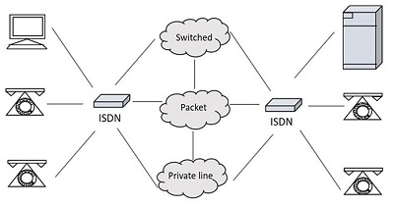
Integrated Service Digital Network (ISDN)
SDN was first defined in the CCITT red book in 1988.The Integrated Services of Digital Networking, in short ISDN is a telephone network-based infrastructure that allows the transmission of voice and data simultaneously at a high speed with greater efficiency. This is a circuit switched telephone network system, which also provides access to Packet switched networks.
The model of a practical ISDN is as shown below.

Slide 62
Integrated Service Digital Network (ISDN)
ISDN supports a variety of services. A few of them are listed below −
Voice calls
Facsimile
Videotext
Teletext
Electronic Mail
Database access
Data transmission and voice
Connection to internet
Electronic Fund transfer
Image and graphics exchange
Document storage and transfer
Audio and Video Conferencing
Automatic alarm services to fire stations, police, medical etc.

Slide 63
Features of ISDN
Uses Digital Signal
Uses Existing telephone wiring
Charges are generally based on the duration of call (How long the WAN link was used)
Can transport many types of Network traffic (Voice, Data, Video, Text, Graphics etc)
Faster Data transfer rate than modems
Faster Call setup than Modems

Slide 64
Integrated Service Digital Network (ISDN)
Types of ISDN
Among the types of several interfaces present, some of them contains channels such as the B-Channels or Bearer Channels that are used to transmit voice and data simultaneously; the D- Channels or Delta Channels (carry control signal) that are used for signaling purpose to set up communication.
The ISDN has several kinds of access interfaces such as −
Basic Rate Interface (BRI)
Primary Rate Interface (PRI)
Narrowband ISDN
Broadband ISDN

Slide 65
Integrated Service Digital Network (ISDN)
Basic Rate Interface (BRI)
The Basic Rate Interface or Basic Rate Access, simply called the ISDN BRI Connection uses the existing telephone infrastructure. The BRI configuration provides two data or bearer channels at 64 Kbits/sec speed and one control or delta channel at 16 Kbits/sec. This is a standard rate.
The ISDN BRI interface is commonly used by smaller organizations or home users or within a local group, limiting a smaller area.

Slide 66
Integrated Service Digital Network (ISDN)
Primary Rate Interface (PRI)
The Primary Rate Interface or Primary Rate Access, simply called the ISDN PRI connection is used by enterprises and offices. The PRI configuration is based on T-carrier or T1 in the US, Canada and Japan countries consisting of 23 data or bearer channels and one control or delta channel, with 64kbps speed for a bandwidth of 1.544 M bits/sec. The PRI configuration is based on E-carrier or E1 in Europe, Australia and few Asian countries consisting of 30 data or bearer channels and two-control or delta channel with 64kbps speed for a bandwidth of 2.048 M bits/sec.
The ISDN PRI interface is used by larger organizations or enterprises and for Internet Service Providers.

Slide 67
Integrated Service Digital Network (ISDN)
Narrowband ISDN
The Narrowband Integrated Services Digital Network is called the N-ISDN. This can be understood as a telecommunication that carries voice information in a narrow band of frequencies. This is actually an attempt to digitize the analog voice information. This uses 64kbps circuit switching.
The narrowband ISDN is implemented to carry voice data, which uses lesser bandwidth, on a limited number of frequencies.

Slide 68
Integrated Service Digital Network (ISDN)
Broadband ISDN
The Broadband Integrated Services Digital Network is called the B-ISDN. This integrates the digital networking services and provides digital transmission over ordinary telephone wires, as well as over other media. The broadband ISDN speed is around 2 MBPS to 1 GBPS and the transmission is related to ATM, i.e., Asynchronous Transfer Mode. The broadband ISDN communication is usually made using the fiber optic cables.
As the speed is greater than 1.544 Mbps, the communications based on this are called Broadband Communications. The broadband services provide a continuous flow of information, which is distributed from a central source to an unlimited number of authorized receivers connected to the network. Though a user can access this flow of information, he cannot control it.

Slide 69
Integrated Service Digital Network (ISDN)
ISDN Standards:
The ISDN works based on the standards defined by ITU-T. The Telecommunication Standardization Sector (ITU-T) coordinates standards for telecommunications on behalf of the International Telecommunication Union (ITU) and is based in Geneva, Switzerland. The various principles of ISDN as per ITU-T recommendation are:
To support switched and non-switched applications
To support voice and non-voice applications
Reliance on 64-kbps connections
Intelligence in the network
Layered protocol architecture
Variety of configurations

Slide 70
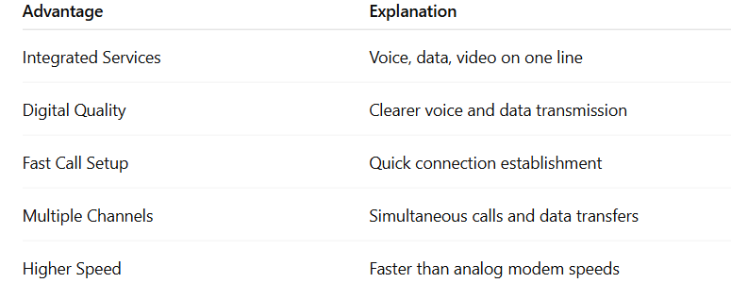
Integrated Service Digital Network (ISDN)
Advantages of ISDN

Slide 71
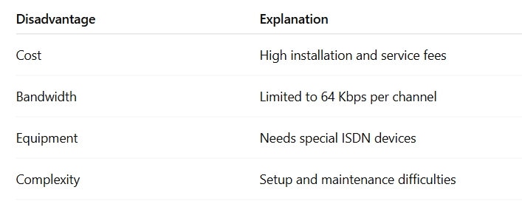
Integrated Service Digital Network (ISDN)
Disadvantages of ISDN

