Slide 1

Student Management System
Presented by:
Abhilekh Subedi
Ayush Tuladhar
Krish Ghale

Slide 2
Introduction
Based on C programming language
Automation of student details
Making the System effective

Slide 3
Features
Automated Record Management
Record Display
Record Update
Secure Deletion
Search Functionality

Slide 4
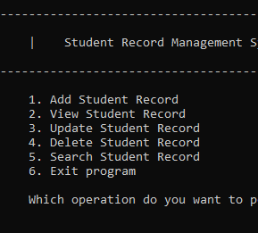
Functions
1. Add Student Record: store student details
2. View Student Record: display student details based on criteria
3. Update Student Record: modify student details
4. Delete Student Record: Remove student details
5. Search Student Record: retrieve individual student details

Slide 5
Advantages
Removes manual error
Increased precision and accuracy
Easy to use
Quick access to data

Slide 6
Conclusion
The project automates student management procedures, significantly increasing efficiency and accuracy in academic administration.
It showcases the innovative potential of technology in education, helping institutions reduce human workload, allocate resources effectively, and optimize administrative processes to improve teaching quality.

Slide 7
THANK YOU
Any Questions?

