Slide 1
Unit 2 Software processes
Software Engineering
CSIT 6th Semester

Slide 2
Syllabus
Software Process 5 hours
Software Process Models (Waterfall Model; Incremental Development; Integration and Configuration)
Software Process Activities (Software Specification, Software Design and Implementation; Software Validation; Software Evolution)
Coping with Change (Prototyping, Incremental Delivery)
Process Improvement

Slide 3
Software Processes
It is the set of related activities that leads to cost effective and timeliness production of software from scratch or modifying existing software in some programming language. This processes are included in different activities.
These activities are:
Software specifications: The functionality of the software and constraints on its operation must be defined.
Software development: The software to meet the requirement must be produced.
Software validation: The software must be validated to ensure that it does what the customer wants.
Software evolution: The software must evolve to meet changing client needs.

Slide 4
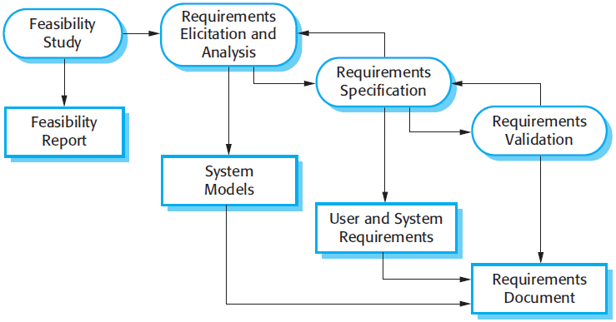
1.Software Specification

Slide 5
1.Software Specification
Key Activities in the Process:
Feasibility Study: An initial assessment to determine if the proposed system is cost-effective and technically achievable. This results in a Feasibility Report.
Requirements Elicitation and Analysis: The process of collaborating with stakeholders to discover what the system should do. This stage often involves creating System Models.
Requirements Specification: Translating the gathered information into a formal document. This defines both User Requirements (high-level) and System Requirements (detailed functional/non-functional specs).
Requirements Validation: Checking the requirements to ensure they define the system that the customer really wants. If errors are found, the process loops back to specification or elicitation.
Requirements Document: The final output (often called a Software Requirements Specification or SRS) that serves as the official agreement between developers and customers.

Slide 6
2. Software Development and Implementation
Software design is a creative activity in which you identify software components and their relationships based on customer’s relationships. Implementation is the process of realizing the design as a program.
It is description of the structure of the software to be implemented the data which is part of system, the interfaces between system component, sometimes algorithm used, logical structure of database etc.
The implementation of software development is the process of converting system specification and design into an executable system.

Slide 7
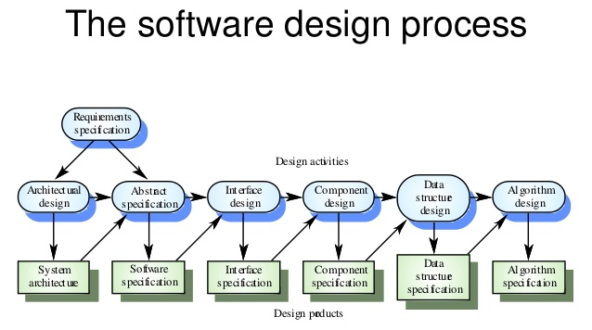
2. Software Development

Slide 8
2. Software Development
Breakdown of Stages
Activity Description of Product
Architectural design Defines the broad System architecture, identifying major components and their relationships.
Abstract specification Produces a Software specification that describes what each sub-system must do without detailing how.
Interface design Results in an Interface specification defining how different parts of the system interact with each other or external systems.
Component design Creates a Component specification detailing the functional requirements for individual software units.
Data structure design Leads to a Data structure specification, detailing how data will be organized and managed.
Algorithm design Produces the final Algorithm specification, providing the logic and step-by-step procedures for the software to execute.

Slide 9
3. Software validation
It is the process of evaluating software product, to ensure that the software meets the pre defined and specified business requirements as well as the end user demands and expectations.
It involves checking process such as inspection and reviews at each stage of software process from user requirement to software development.
It involves checking review processes and system testing. System testing involving executing the system with cases that are derived from the specification of the real data to be processed by the system.

Slide 10
3. Software validation
Component or unit testing
Individual components are tested independently to ensure that they operate correctly.
Components may be function or objects or coherent groupings of these entities.
System testing
Testing of the system as a whole . Testing of emergent properties is particularly important.
It is also concerned with validating that the system meets its functional and non functional requirement and testing the emergent system properties.
Acceptance Testing
Acceptance testing revel error in the system requirement definition because the real data exercise the system in different ways from the test data
Testing with customer data to check that the system meets the customer’s need.

Slide 11
4. Software evolution
Software evolution is referred to as the process of developing , maintaining and updating software for various reasons. Software changes are inevitable because there are many factors that change during the life cycle of a piece of software.
The evolution process includes fundamental activities of change analysis, release planning, system implementation and releasing a system to customers. These factors are:
Requirement changes
Environment changes
Errors or security breaches
New equipment added or removed
Improvements to the system

Slide 12
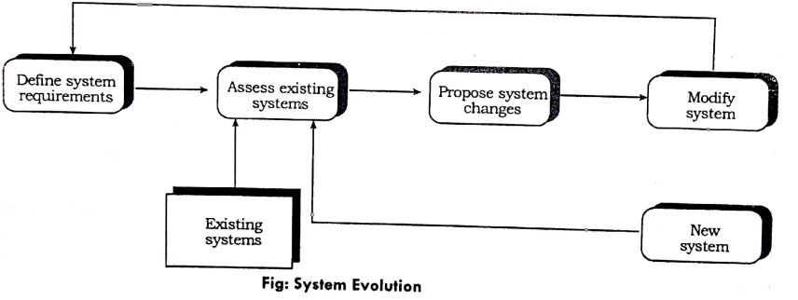
3. Software evolution

Slide 13
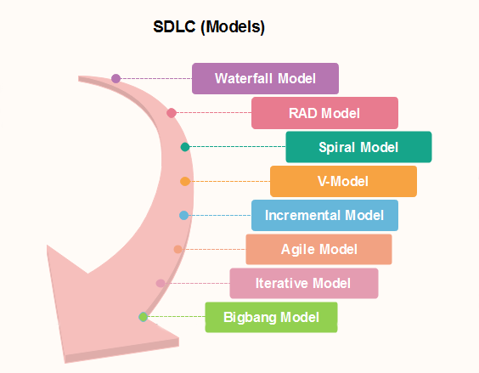
The Software Process Models

Slide 14
Waterfall model:
The waterfall model, documented in 1970 by Royce was the first public documented life cycle model.
The Waterfall Model was the first Process Model to be introduced. It is also referred to as a linear-sequential life cycle model. It is very simple to understand and use.
In a waterfall model, each phase must be completed before the next phase can begin and there is no overlapping in the phases.

Slide 15
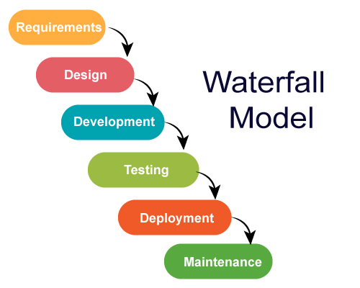

Slide 16
Waterfall Model - Application
Every software developed is different and requires a suitable SDLC approach to be followed based on the internal and external factors. Some situations where the use of Waterfall model is most appropriate are −
Requirements are very well documented, clear and fixed.
Product definition is stable.
Technology is understood and is not dynamic.
There are no ambiguous requirements(No confusion).
Enough resources with required expertise are available to support the product.
The project is short and low cost.

Slide 17
Waterfall Model - Advantages
Some of the major advantages of the Waterfall Model are as follows −
Simple and easy to understand and use
Easy to manage due to the rigidity of the model. Each phase has specific deliverables and a review process.
Phases are processed and completed one at a time.
Works well for smaller projects where requirements are very well understood.
Clearly defined stages.
Well understood requirement.
Easy to arrange tasks.
Process and results are well documented.

Slide 18
Waterfall Model - Disadvantages
The major disadvantages of the Waterfall Model are as follows −
No working software is produced until late during the life cycle.
High amounts of risk and uncertainty.
Not a good model for complex and object-oriented projects.
Poor model for long and ongoing projects.
Not suitable for the projects where requirements are at a moderate to high risk of changing. So, risk and uncertainty is high with this process model.
It is difficult to measure progress within stages.
Cannot accommodate changing requirements.
Adjusting scope during the life cycle can end a project.
Integration is done at the very end, which doesn't allow identifying any technological or challenges early.

Slide 19
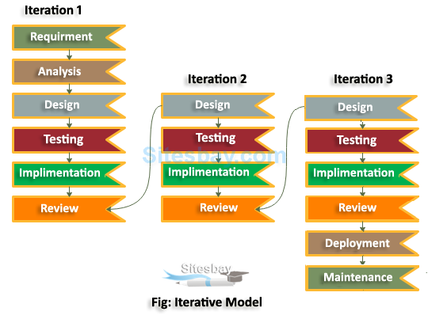
Iterative model

Slide 20
Iterative model
An iterative life cycle model does not attempt to start with a full specification of requirements. Instead, development begins by specifying and implementing just part of the software, which can then be reviewed in order to identify further requirements. This process is then repeated, producing a new version of the software for each cycle of the model.

Slide 21
Iterative model
When to use Iterative Model
When requirements are defined clearly and easy to understand.
When the software application is large.
When there is a requirement of changes in future.
Agile works really well when the product vision or features are not well defined. Agile allows product owners to adjust requirements and priorities along the way to take advantage of opportunities and ultimately deliver a better product to all of the project stakeholders.

Slide 22
Iterative model
Advantages of Iterative Model
Generates working software quickly and early during the software life cycle.
More flexible - less costly to change scope and requirements.
Easier to test and debug during a smaller iteration.
Easier to manage risk because risky pieces are identified and handled during its iteration.
Each iteration is an easily managed milestone.
Disadvantages of Iterative Model
Each phase of an iteration is rigid and do not overlap each other.
Problems may arise pertaining to system architecture because not all requirements are gathered up front for the entire software life cycle.

Slide 23
Incremental Development Model
Incremental Model is a process of software development where requirements are broken down into multiple standalone modules of software development cycle. Incremental development is done in steps from analysis design, implementation, testing/verification, maintenance.
Characteristics of an Incremental module includes
System development is broken down into many mini development projects
Partial systems are successively built to produce a final total system
Highest priority requirement is tackled first
Once the requirement is developed, requirement for that increment are frozen

Slide 24
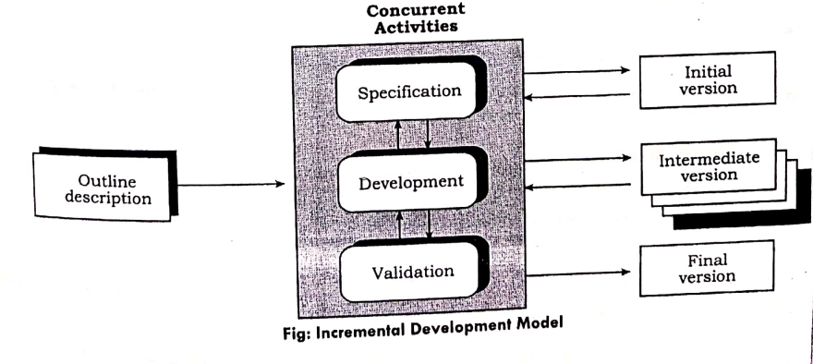
Incremental Development Model

Slide 25
Incremental Development model
Incremental Model is a process of software development where requirements are broken down into multiple standalone modules of software development cycle. Incremental development is done in steps from analysis design, implementation, testing/verification, maintenance.
Characteristics of an Incremental module includes
System development is broken down into many mini development projects
Partial systems are successively built to produce a final total system
Highest priority requirement is tackled first
Once the requirement is developed, requirement for that increment are frozen

Slide 26
Incremental Model
Advantages of Incremental Model
Below are some advantages of the Incremental Model.
The software will be generated quickly during the software life cycle
It is flexible and less expensive to change requirements and scope
Throughout the development stages changes can be done
This model is less costly compared to others
A customer can respond to each building
Errors are easy to be identified
Disadvantages of Incremental Model
Below are some main disadvantages of the Incremental model.
It requires a good planning designing
Problems might cause due to system architecture as such not all requirements collected up front for the entire software lifecycle
Each iteration phase is rigid and does not overlap each other
Rectifying a problem in one unit requires correction in all the units and consumes a lot of time

Slide 27
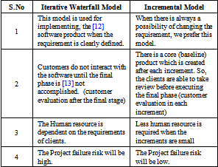
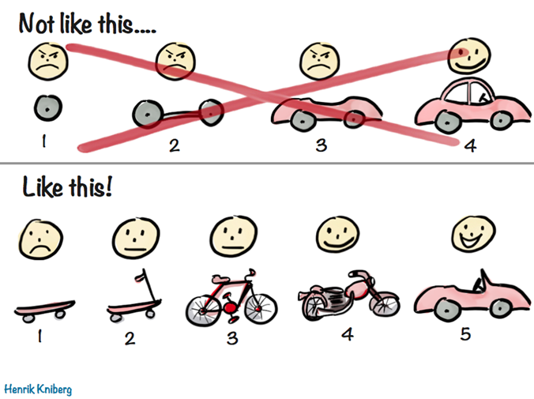
Difference between Iterative and Incremental model

Slide 28
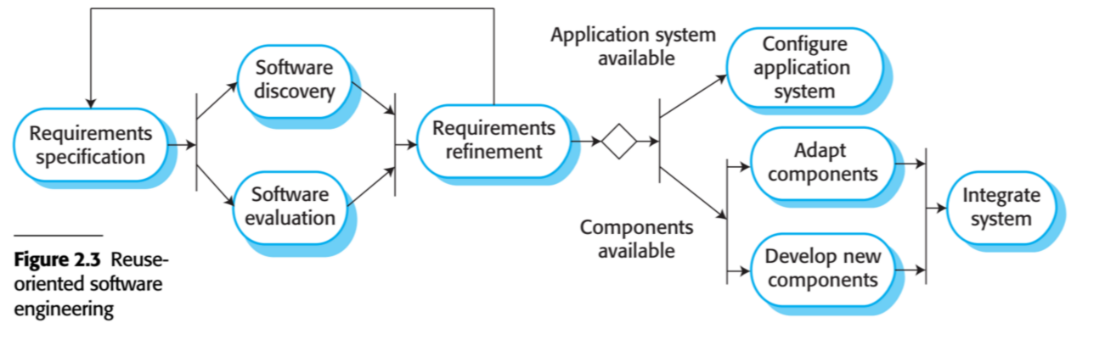
Integration and Configuration model

Slide 29
Incremental Development Model
When to use Incremental models?
Requirements of the system are clearly understood
When demand for an early release of a product arises
When software engineering team are not very well skilled or trained
When high-risk features and goals are involved
Such methodology is more in use for web application and product based companies

Slide 30
Integration and Configuration
Concept of this model is to reuse parts of existing system and integrate these parts and configure according to requirements.
Requirement specification: The expected features and functionality of system to be developed is explored.
Software discovery: Is there any available systems that nearly satisfies the requirement specified by the client.
Software evaluation: The discovered software are evaluated in detail.
Requirement refinement: Trying to adjust the requirement according to the available system . If trade off is failed then parts of system is reused.
Adopt components with new developed components and integrate system

Slide 31
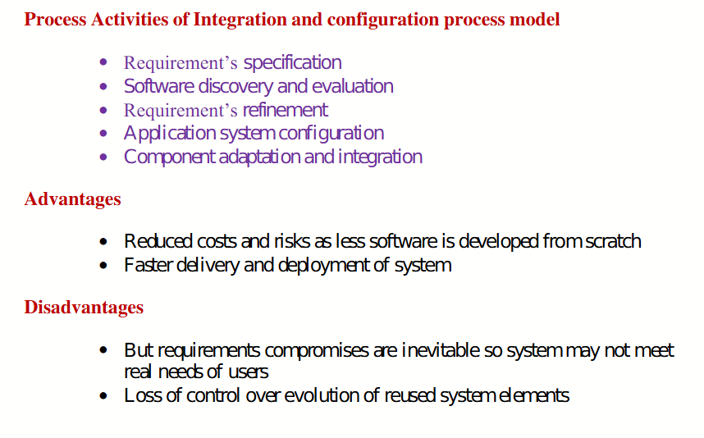
Integration and Configuration

Slide 32
Question 1:
If you have to build a small project, would you use waterfall model? Give reason for your answer. And also mention some challenges while using this model.

Slide 33
Coping with change
Change is sure to happen in all large software projects.
The system requirements change as business respond to external pressures, competition, and changed management priorities. Change adds to the costs of software development because it usually means that work that has been completed hast to be redone.
Following are the two ways of coping with change and changing system requirements:
Prototyping
Incremental Delivery

Slide 34
Prototyping Model
Prototyping is defined as the process of developing a working replication of a product or system that has to be engineered. It offers a small-scale facsimile of the end product and is used for obtaining customer feedback.
This model is used when the customers do not know the exact project requirements beforehand. In this model, a prototype of the end product is first developed, tested, and refined as per customer feedback repeatedly till a final acceptable prototype is achieved which forms the basis for developing the final product.

Slide 35
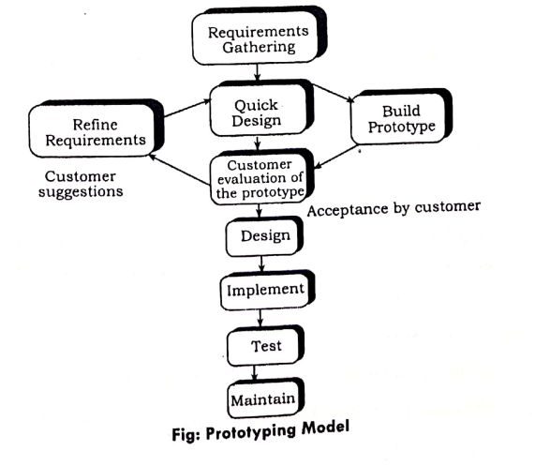
Prototyping Model

Slide 36
Assignment
What do you mean by throwaway prototyping and evolutionary prototyping?
Differentiate between incremental delivery and evolutionary model

Slide 37
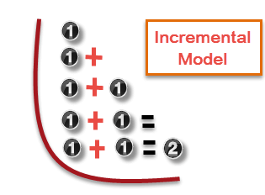
Incremental delivery:
Incremental Model is a process of software development where requirements are broken down into multiple standalone modules of software development cycle. Incremental development is done in steps from analysis design, implementation, testing/verification, maintenance.

Slide 38
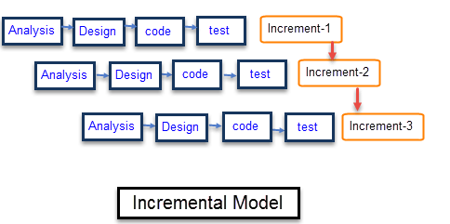
Each iteration passes through the requirements, design, coding and testing phases. And each subsequent release of the system adds function to the previous release until all designed functionality has been implemented.

Slide 39
Advantages of Incremental Model
Generates working software quickly and early during the software life cycle.
More flexible – less costly to change scope and requirements.
Easier to test and debug during a smaller iteration.
Easier to manage risk because risky pieces are identified and handled during its iteration.

Slide 40
Disadvantages of Incremental Model
Each phase of an iteration is rigid and do not overlap each other.
Rectifying a problem in one unit requires correction in all the units and consumes a lot of time.

Slide 41
Component Based Software Engineering (CBSE) / Reuse Oriented Software Engineering
Component Based Software Engineering (CBSE) is a process that focuses on the design and development of computer-based systems with the use of reusable software components.
The component-based software life cycle (CSLC) is the life cycle process for a software component with an emphasis on business rules, business process modelling, design, construction, continuous testing, deployment, evolution, and reuse and maintenance. In general, analysis and design phases for component-based process models take more time than traditional ones take.
Reusability within this life cycle is smoother and more effective than within the traditional models because it integrates at its core the concern for reuse and its mechanisms.

Slide 42
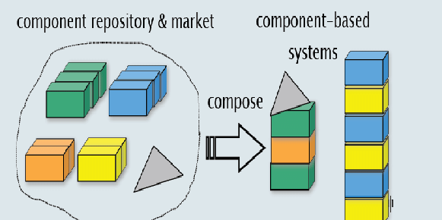
Example:

Slide 43
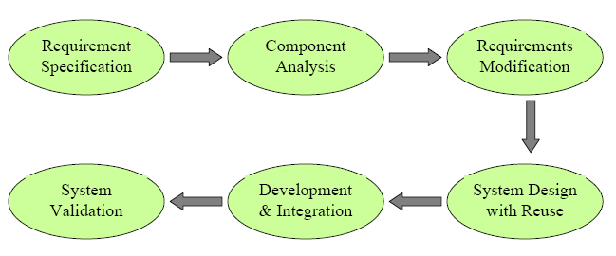
Stages of CBSE:

Slide 44
Objective of CBSE:
To have a useful replaceable property' i.e. easy to assemble and easy to disassemble.
Increase Reusability: Develop once and reuse several instances of the same over the period.
Enhancing Development Flexibility: Components are an independent software element that can be designed and developed independently enhancing the development flexibility.
Reduced System Development Time: Reusing pre developed existing components instead of new fresh development will reduce total development time.

Slide 45
Reduced System Development Cost: Reduced development time will result in significant reduction in total development cost.
Improve Software Quality: Ideally, a component is pre- tested for errors and quality parameters. Hence, using such pre-tested, high quality software components improves the quality of complete software systems.
Reducing Project Risk: From management perspective, if an asset's costs can be optimized through a large number of uses, it would then be possible for the management to expend more effort and allocate more budgets to improve the quality of software components. This in turn reduces the level of risk faced by the development effort and will undeniably improve the likelihood of success.

Slide 46
Process Improvement
Process improvement means understanding existing processes and changing these processes to increase product quality and/or reduce cost and development time. Two quite different approaches to process improvement and change are used
Process maturity approach: It has focused on improving process and project management and introducing good software engineering practice into an organization. The level of process maturity reflects the extent to which good technical and management practice has been adopted in organizational software development process.
Agile approach: It has focused on iterative development and the reduction of over heads in the software process. The primary characteristic of agile methods are rapid delivery of functionality and responsiveness to changing customer requirements.

Slide 47
Spiral model:
Spiral model is one of the most important Software Development Life Cycle models, which provides support for Risk Handling. In its diagrammatic representation, it looks like a spiral with many loops.
The spiral model is a systems development lifecycle (SDLC) method used for risk management that combines the iterative development process model with elements of the Waterfall model.
The spiral model is used by software engineers and is favored for large, expensive and complicated projects.

Slide 48
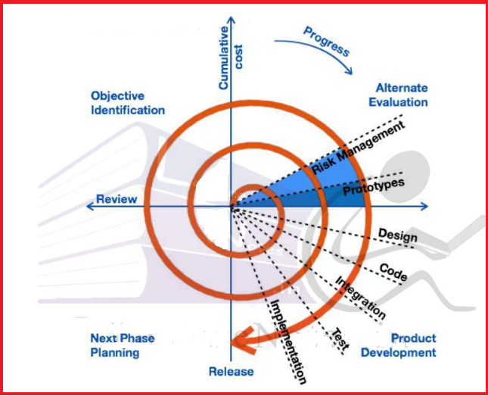

Slide 49
Advantages of Spiral Model:
Risk Handling: The projects with many unknown risks that occur as the development proceeds, in that case, Spiral Model is the best development model to follow due to the risk analysis and risk handling at every phase.
Good for large projects: It is recommended to use the Spiral Model in large and complex projects.
Flexibility in Requirements: Change requests in the Requirements at later phase can be incorporated accurately by using this model.
Customer Satisfaction: Customer can see the development of the product at the early phase of the software development and thus, they habituated with the system by using it before completion of the total product.

Slide 50
Disadvantages of Spiral Model:
Complex: The Spiral Model is much more complex than other SDLC models.
Expensive: Spiral Model is not suitable for small projects as it is expensive.
Too much dependability on Risk Analysis: The successful completion of the project is very much dependent on Risk Analysis. Without very highly experienced experts, it is going to be a failure to develop a project using this model.
Difficulty in time management: As the number of phases is unknown at the start of the project, so time estimation is very difficult.

Slide 51
V Model
The V-model is a type of SDLC model where the process executes in a sequential manner in a V-shape. It is also known as the Verification and Validation model. It is based on the association of a testing phase for each corresponding development stage.
The development of each step is directly associated with the testing phase. The next phase starts only after completion of the previous phase i.e., for each development activity, there is a testing activity corresponding to it.

Slide 52
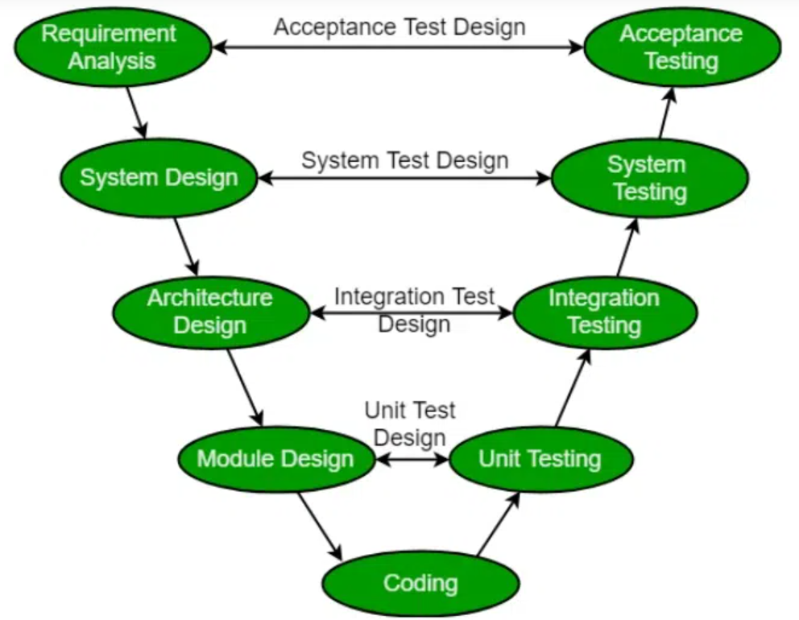
V Model

Slide 53
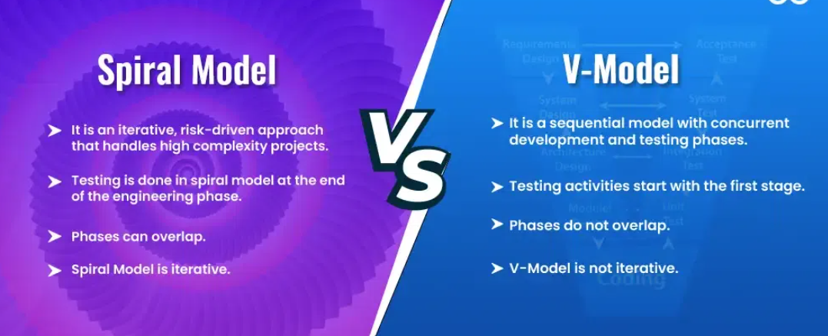

Slide 54
End of unit 2

