Slide 1
Unit 3 Agile software development
Software Engineering
CSIT 6th Semester

Slide 2
Syllabus
Agile Software Development (3 Hrs.)
Agile Development
Plan-Driven vs. Agile Development
Agile Methods
Agile Development Techniques
Introduction to Agile Project Management

Slide 3
Agile software Development
Agile software development is a software development method based on iterative and incremental development in which requirement and solutions evolve through collaboration between self organizing, cross functional teams."
It generally promotes a disciplined project management process that encourages frequent inspection and adaption, a leadership philosophy that encourages a team works self-organizing and accountability, a set of engineering best practices intended to allow for rapid delivery of high quality software.
Agile software development combines the philosophy and set of development guidelines that encourses the customer satisfaction and early development of software together with small, highly motivated software development team minimum software engineering work product and overall development simplicity.

Slide 4
Agile principles
There are five major agile development principles
Customer Involvement: In agile development, customers are closely involved in the development team throughout the development process. Their role in development team is to evaluate the newly developed increments, provide the feedback and priorities new system requirements for new increment of the system.
Incremental Delivery: In agile development, software is developed in increments with the customer specifying the requirements to be included in each increment.
People not Process: In this method, the skills of development team should be recognized and exploited then team members should be left to develop in their own ways of working without prescriptive processes.
Embrace Change: Agile development process expects the system requirement to change as much as possible so encourage the customer to change the requirement during early stage of development so that system can be designed to accommodate these changes.
Maintain Simplicity: In agile development we should focus of Simplicity in both the software being developed and the development process. Development team actively works to eliminate complexity from the system wherever possible.

Slide 5
Advantages/ Disadvantages
Advantages of Agile Method:
Customer satisfaction by rapid, continuous delivery of useful software.
Face-to-face conversation is the best form of communication.
Regular adaptation to changing circumstances.
Even late changes in requirements are welcomed.
Disadvantages of Agile Method:
Due to lack of formal documents, it creates different confusions.
Due to absence of proper documentation, maintenance of the -developed project can become a problem.
the project can easily get taken off track of the customer is not clear what final outcome they want,
Only senior programmers are capable of taking decisions required during agile development process,

Slide 6
When to use Agile Method?
When new changes are needed to be implemented. Agile method provides facility such that new changes can be implemented at very little cost because of the frequency of new increments that are produced.
To implement a new feature the developers need to lose only the work of a few days, or even only hours, to roll back and implement it.
Unlike the waterfall model in agile model very limited planning is required to get started with the project. Agile assumes that the end users' needs are ever changing in a dynamic business and IT world. Changes can be discussed and features can be newly affected or removed based on feedback. This effectively gives the customer the finished system they want or need.

Slide 7
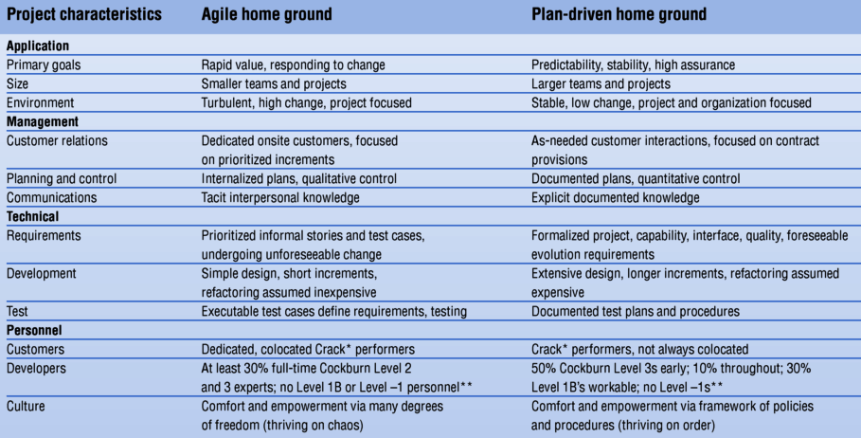
Agile vs plan driven development

Slide 8
Agile vs plan driven development
If you have a very detailed specification and design before moving to implementation then, software engineer needs to use a plan-driven approach.
If software engineer have to deliver the software to customers using an incremental delivery strategy and get rapid feedback from them, use agile method.
Agile methods are most effective when the system can be developed with a small co-located team who can communicate informally. This may not be possible for large systems that require larger development teams so a plan-driven approach may have to be used.
Plan-driven approaches may be required for systems that require a lot of analysis before implementation (e.g. real-time system with complex timing requirements).

Slide 9
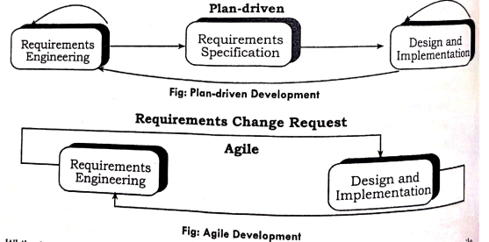
Agile vs plan driven development
Long-lifetime systems may require more design documentation to communicate the original intentions of the system developers to the support team. Use plan driven approach.
If the development team is distributed or if part of the development is being outsourced, then software engineer may need to develop design documents to communicate across the development teams. Then you need to use plan driven approach.

Slide 10
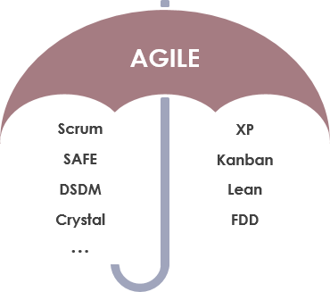
Agile Methodology Umbrella:

Slide 11
Extreme Programming (XP)
EXTREME PROGRAMMING Extreme Programming (XP) is a software development methodology which is intended to improve software quality and responsiveness to changing customer requirements.
As a type of agile software development, it advocates frequent releases in short development cycles, which is intended to improve productivity and introduce checkpoints at which new customer requirements can be adopted.
It is the discipline of software development based on values of simplicity, communication, feedback, respect and courage.
The methodology takes its name from the idea that the beneficial elements of traditional software engineering practices are taken to "extreme“ levels.

Slide 12
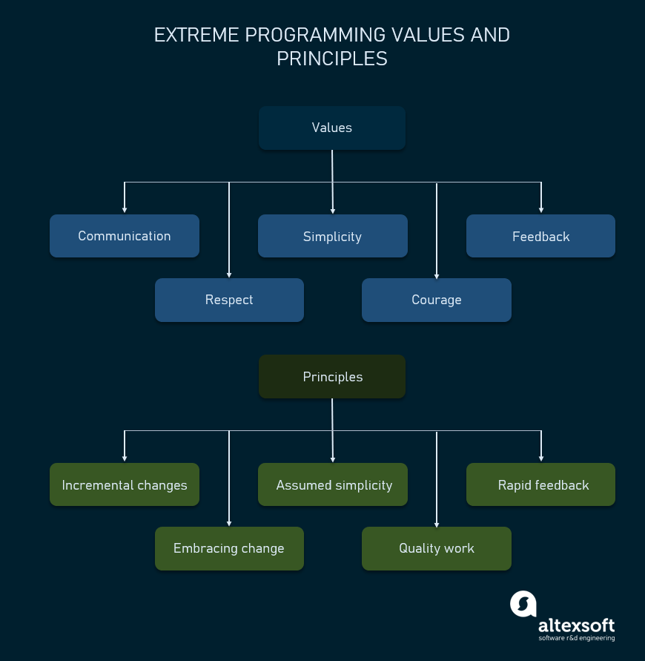
XP Values and principles

Slide 13
Core Practices of Extreme Programming
Continuous Planning: This involves planning and re-planning throughout the software development process. Planning is done on a short-term basis, usually on a weekly or bi-weekly basis, to adapt to changing requirements and priorities.
Small Releases: XP emphasizes frequent and small releases of working software, allowing stakeholders to provide feedback early in the development process.
Test-Driven Development (TDD): This practice involves writing tests before writing code. TDD ensures that the code is testable, and that it meets the requirements specified in the test.
Pair Programming: This is a practice where two programmers work together on the same codebase. One person writes the code, while the other reviews the code and provides feedback.
Continuous Integration: This involves continuously integrating changes made by different developers into a single codebase, ensuring that the code is always in a working state.
Refactoring: This is the process of improving the code without changing its behavior. Refactoring is done continuously to ensure that the code remains maintainable and easy to understand.

Slide 14
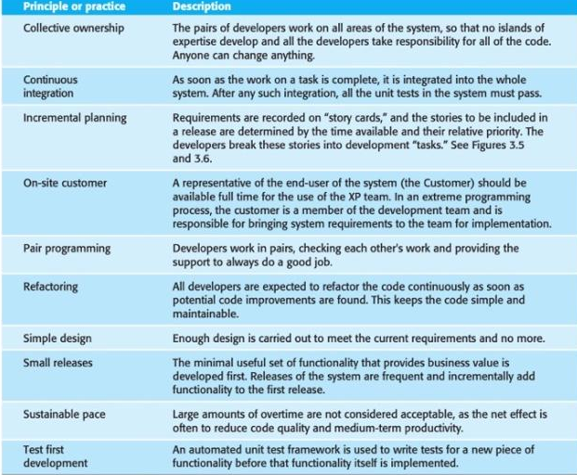

Slide 15
Agile Project Management
Software project manager have to manage the software project so that the software is delivered on time and with the estimated budget for the software. To accomplish this, manage have to follow the plan based approach and should have a stable view of everything that has to be developed and the development processes. But this does not work well with agile methods where requirement are developed incrementally, and delivered in short time interval.
Agile project management is an iterative approach to delivering a project throughout its life cycle. Iterative or agile life cycles are composed of several iterations or incremental steps towards the completion of a project. Iterative approaches are frequently used in software development projects to promote velocity and adaptability since the benefit of iteration is that you can adjust as you go along rather than following a linear path. At the core, agile projects should exhibit central values and behaviors of trust, flexibility, empowerment and collaboration. To manage agile project, different approach to project management is adapted that support incremental development and strength of agile method which is realized in scrum.

Slide 16
SCRUM
Scrum is an iterative and incremental agile software development framework for managing agile software projects and product or application development.
The concept is originated from the game named rugby football, in which scrum refers to the manner of restarting the game after a minor infraction.
It refers to the agile software development model based on multiple small teams working in an intensive and interdependent manner. It is a way for team to work together to develop a product.
Product development, using scrum, occurs in small pieces, with each piece building up on previously created pieces.
Building products one small piece ta time encourages creativity and enables teams to respond to feedback and change, to build exactly and only what is needed.
Scrum enables teams to self-organize by encouraging physical co-location of all team members and daily face to face communication among all team members and disciplines in the project.
A key principle of Scrum is its recognition that during a project the customers can change their minds about what they want and need, and that unpredicted challenges cannot be easily addressed in a traditional predictive or planned manner.
Scrum focuses on maximizing the team's ability to deliver quickly and respond to emerging requirements. The Scrum framework consists of Scrum Teams and their associated roles, events, artifacts, and rules. Each component within the framework serves a specific purpose and is essential to Scrum's success and usage.

Slide 17
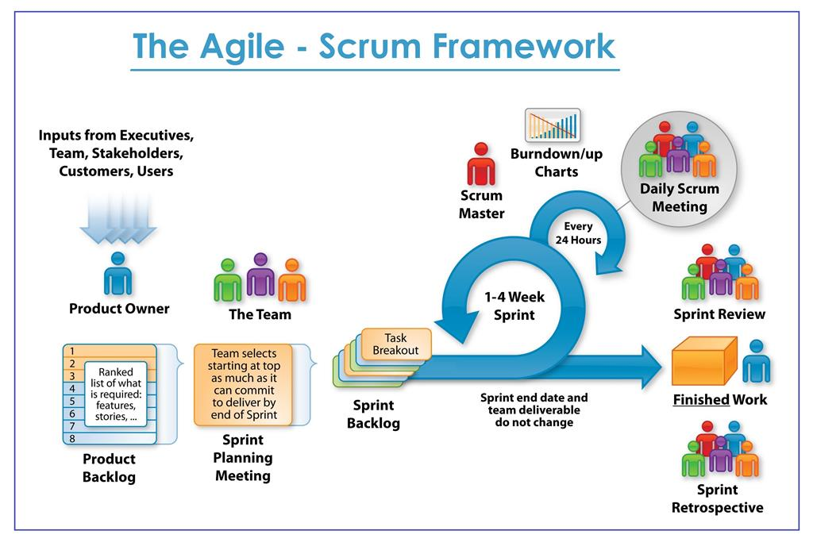
Scrum Framework:
Scrum is a lightweight framework that helps people, teams and organizations generate value through adaptive solutions for complex problems.

Slide 18
Scrum roles
In Scrum based agile project development, The Scrum Team consists of a Product Owner, the Development Team, and a Scrum Master.
Scrum Teams are self-organizing and cross-functional. Self-organizing teams choose how best to accomplish their work, rather than being directed by others outside the team. Cross functional teams have all competencies needed to accomplish the work without depending on others not part of the team.
Scrum Teams deliver products iteratively and incrementally, maximizing opportunities for feedback. Incremental deliveries of "Done" product ensure a potentially useful version of working product is always available.

Slide 19
Product owner
The Product Owner is responsible for maximizing the value of the product and the work of the Development Team and for managing the Product Backlog.
Product Backlog management includes:
ordering the items in the Product Backlog to best achieve goals and missions;
ensuring that the Product Backlog is visible, transparent, and clear to all;
ensuring the Development Team understands items in the Product Backlog to the level needed.
The Product Owner may represent the desires of a committee in the Product Backlog, but those wanting to change a backlog item's priority must convince the Product Owner. For the Product Owner to succeed, the entire organization must respect his or her decisions.

Slide 20
Development team
The Development Team consists of 3-9 professionals who do the work of delivering a potentially releasable Increment of "Done" product at the end of each Sprint. Only members of the Development Team create the Increment. Development Teams have the following main characteristics:
They are self-organizing. No one (not even the Scrum Master) tells the Development Team how to turn Product Backlog into Increments of potentially releasable functionality;
Development Teams are cross-functional, with all of the skills as a team necessary to create a product Increment;
Individual Development Team members may have specialized skills and areas focus, but accountability belongs to the Development Team as a whole.

Slide 21
Scrum master
The do this Scrum by Master ensuring is responsible for ensuring Scrum is understood and enacted. Scrum Masters do this by ensuring that the Scrum Team adheres to Scrum theory, practices, and rules. The Scrum Master is a servant-leader for the Scrum Team.
The Scrum Master helps those outside the Scrum Team understand which of their interactions are helpful and which aren't. The Scrum Master helps everyone change these interactions to maximize Scrum the value created by the Scrum Team.

Slide 22
Terminologies in Scrum
Scrum's artifacts represent work or value in various ways that are useful in providing transparency and opportunities for inspection and adaptation. Artifacts defined by Scrum are specifically designed to maximize transparency of key information needed to ensure Scrum Teams are successful in delivering a "Done" Increment.
The Product Backlog is an ordered list of everything that might be needed in the product and is the single source of requirements for any changes to be made to the product. The Product Owner is responsible for the Product Backlog, including its content, availability, and ordering.
A Product Backlog is never complete. The earliest development of it only lays out the initially known and best-understood requirements. The Product Backlog evolves as the product and the environment in which it will be used evolves.
The Product Backlog lists all features, functions, requirements, enhancements, and fixes that constitute the changes to be made to the product in future releases. Product Backlog items have the attributes of a description, order, and estimate.
As a product is used and gains value, and the marketplace provides feedback, the Product Backlog becomes a larger and more exhaustive list. Requirements never stop changing, so a Product Backlog is a living artifact. Changes in business requirements, market condition or technologies can cause change in requirements

Slide 23
Terminologies in Scrum
The Sprint is a time-box of one month or less during which a "Done", useable, and potentially releasable product Increment is created. The duration of Sprint is fixed in advance for each sprint and is normally between one week and one month, although two weeks is typical. Each Sprint has a definition of what is to be built, a design and flexible plan that will guide building it, the work, and the resultant product. Each sprint is started by a planning meeting, where the tasks for the sprint are identified and an estimated commitment for the sprint goal is made, and ended by a sprint review. Scrum software, emphasizes this means working product at the end of the Sprint that is really "done"; in the case of potentially shippable.

Slide 24
Terminologies in Scrum
Sprint Planning Meeting: The created work to be performed in the Sprint is planned at the Sprint Planning Meeting. This plan is by the collaborative work of the entire Scrum Team. In this part, the Development Team works to forecast the functionality that will be developed during the Sprint.
The Product Owner presents ordered Product Backlog items to the Development Team and the entire Scrum Team collaborates on understanding the work of the Sprint. The number of items selected from the Product Backlog for the Sprint is solely up to the Development Team. By the end of the Sprint Planning Meeting, the Development Team should be able to explain to the Product Owner and Scrum Master how it intends to work as a self organizing team to accomplish the Sprint Goal and create the anticipated Increment.

Slide 25
Terminologies in Scrum
The Daily Scrum is a 15-minute time-boxed event for the Development Team to synchronize activities and create a plan for the next 24 hours. The Daily Scrum is held at the same time and places each day to reduce complexity. During the meeting, each Development Team member explains:
What has been accomplished since the last meeting?
What will be done before the next meeting?
What obstacles are in the way?

Slide 26
Terminologies in Scrum
Sprint Review
This is an informal meeting, and the presentation of the Increment. A Sprint Review is held at the end of the Sprint to inspect the Increment and adapt the Product Backlog if needed.
During the Sprint Review, the Scrum Team and stakeholders collaborate about what was done in the Sprint. Based on that and any changes to the Product Backlog during the Sprint, attendees collaborate on the next things that could be done. The result of the Sprint Review is a revised Product Backlog that defines the probable Product Backlog items for the next Sprint. The Product Backlog may also be adjusted overall to meet new opportunities.

Slide 27
exercise
What do you mean by agile software development? Explain how the principles of agile method accelerate the development of software application.
Differentiate between plan driven development and agile development with diagram.
Define extreme programming. How does extreme programming support the principles of agile development?
How the concept of test first development helps the programmer to develop a better understanding of the system requirements? Explain.
Explain the concept of pair programming and constant refactoring with their advantages.
What is agile project development? Explain different perspective on scaling agile methods. What is scrum? Explain scrum roles and terminologies with block diagram.

Slide 28
End of unit 3

