Slide 1
Unit 4 Requirement engineering
Software Engineering
CSIT 6th Semester

Slide 2
Syllabus
Unit 4: Requirements Engineering (3 Hrs.)
Concept of User and System Requirements;
Functional and Non-Functional Requirements;
Requirements Engineering Process;
Requirements Elicitation;
Requirements Specification;
Requirements Validation;
Requirements Change

Slide 3
User requirement
User requirements are the statements in a natural, language plus diagram of what services that the system is expected to provide and the constrains under which it must operate.
User requirement comes from the user or other type of stakeholders to express what new system will bring about.
User requirements are generally documented in user requirement document using narrative text. User requirements are generally signed off by the user and used as primary input for creating system requirements.
An important and difficult step of designing a software product is determining what the user actually wants it to do. This is because the user is often not able to communicate the entirety of their needs and wants and the information they provide may also be incomplete, inaccurate and self-conflicting. This is why user requirements and generally considered separately from system requirements.
User requirement document is read by end user, client’s manager, system analyst and system architects.

Slide 4
system requirement
System requirements set out the systems function, services and operational constraints in detail.
System requirements are the building blocks that the developers use to build the system. These are the traditional "Shall" statement that describes what the system shall do.
System requirement document is the structured document setting out the detailed description of the system services written as a contractor(system analyst) between client and contractor.
System requirement are read by system analyst, system architects, system engineers and system testers

Slide 5
Functional Requirement
Functional requirements define the basic system behavior. Essentially, they are what the system does or must not do, and can be thought of in terms of how the system responds to inputs.
Functional requirements usually define if/then behaviors and include calculations, data input, and business processes. Functional requirements are the statement of the services that the system must provide or descriptions of how some computation are carried out.
Example of Functional Requirements
The software automatically validates customers against the Contact Management System
The Sales system should allow users to record customers sales

Slide 6
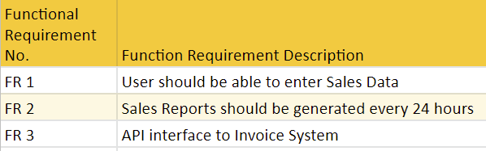
What should be included in the Functional Requirements Document?
Here is how to write functional requirements document:

Slide 7
Benefits of Functional Requirement
Here, are the pros/advantages of creating a typical functional requirement document-
Helps you to check whether the application is providing all the functionalities that were mentioned in the functional requirement of that application
A functional requirement document helps you to define the functionality of a system or one of its subsystems.
Functional requirements along with requirement analysis help identify missing requirements. They help clearly define the expected system service and behavior.
Errors caught in the Functional requirement gathering stage are the cheapest to fix.
Support user goals, tasks, or activities

Slide 8
Non-Functional Requirement
Non-Functional Requirement (NFR) specifies the quality attribute of a software system. They judge the software system based on Responsiveness, Usability, Security, Portability and other non-functional standards that are critical to the success of the software system.
Examples of Non-functional requirements
Users must change the initially assigned login password immediately after the first successful login.
Employees never allowed updating their salary information. Such attempt should be reported to the security administrator.
Every unsuccessful attempt by a user to access an item of data shall be recorded on an audit trail.
A website should be capable enough to handle 20 million users with affecting its performance The software should be portable.
So moving from one OS to other OS does not create any problem. Privacy of information, the export of restricted technologies, intellectual property rights, etc. should be audited.

Slide 9
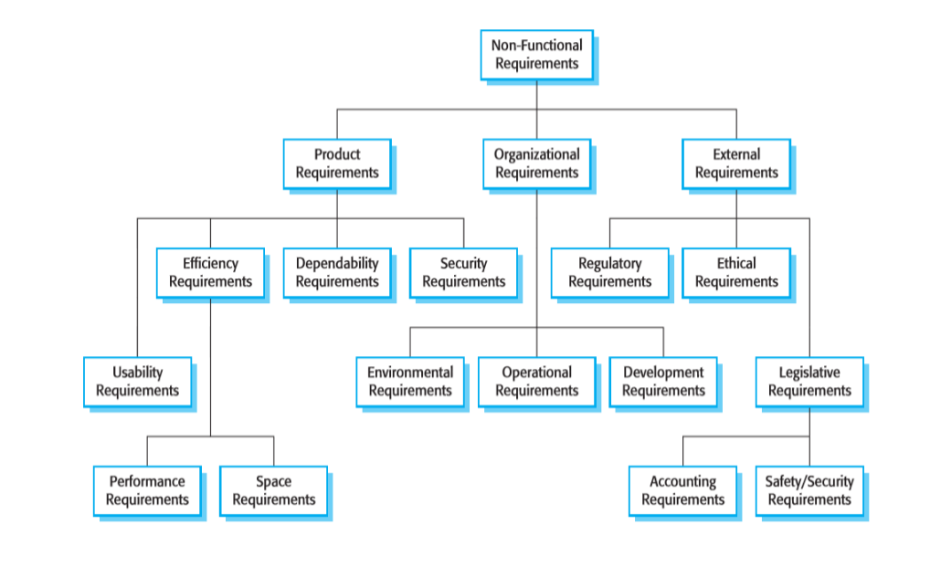
Types of Non-functional Requirement

Slide 10
Advantages of Non-Functional Requirement
The nonfunctional requirements ensure the software system follow legal and compliance rules.
They ensure the reliability, availability, and performance of the software system
They ensure good user experience and ease of operating the software.
They help in formulating security policy of the software system.

Slide 11
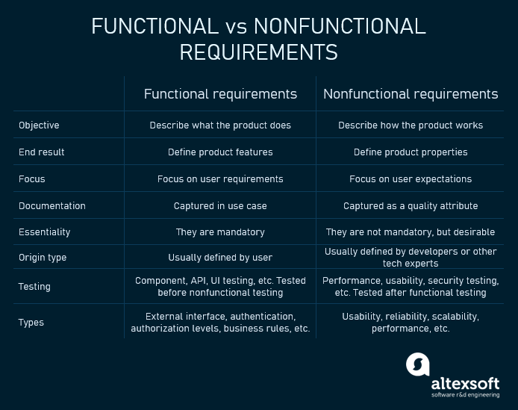

Slide 12
Domain Requirement
Domain:
Domain is simply the area where a software belongs to.
Example: E-commerce, Social Media, Health Insurance etc.
Domain requirements are the requirements that need to be fulfilled by the software to remain in that domain.
Example:
E-commerce domain : User should be able to buy/sell products, search for products.

Slide 13
Requirement Engineering
Requirements engineering (RE) refers to the process of defining, documenting, and maintaining requirements in the engineering design process.
Requirement engineering provides the appropriate mechanism to understand what the customer desires, analyzing the need, and assessing feasibility, negotiating a reasonable solution, specifying the solution clearly, validating the specifications and managing the requirements as they are transformed into a working system.

Slide 14
Requirement Engineering Process
Feasibility Study
Requirement Elicitation and Analysis
Software Requirement Specification
Software Requirement Validation

Slide 15
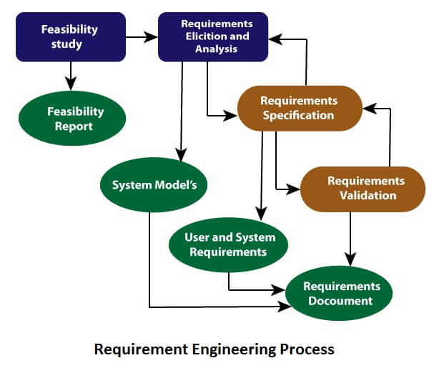

Slide 16
1. Feasibility Study:
Feasibility Study in Software Engineering is a study to evaluate feasibility of proposed project or system.
As name suggests feasibility study is the feasibility analysis or it is a measure of the software product in terms of how much beneficial product development will be for the organization in a practical point of view.
Information such as resource availability, cost estimation for software development, benefits of the software to the organization after it is developed and cost to be incurred on its maintenance are considered during the feasibility study.
The objective of the feasibility study is establish the reasons for developing the software that is acceptable to users, adaptable to change and conformable to established standards. A feasibility study takes into account various constraints equipment, manpower, within which system should be implement and operate such as computing cost etc.

Slide 17
Types of Feasibility Study :
Technical Feasibility
Operational Feasibility
Economic Feasibility
Legal Feasibility
Schedule Feasibility

Slide 18
Technical Feasibility
In Technical Feasibility current resources both hardware software along with required technology are analyzed/assessed to develop project.
This technical feasibility study gives report whether there exists correct required resources and technologies which will be used for project development.
Along with this, feasibility study also analyzes technical skills and capabilities of technical team, existing technology can be used or not, maintenance and up-gradation is easy or not for chosen technology etc.
Notes:
Backend Infrastructure:Servers for data processing (e.g., AWS, Azure).
API for accessing weather data (e.g., OpenWeatherMap API).
Push notification services (Firebase Cloud Messaging or Apple Push Notification Service).

Slide 19
Operational Feasibility
In Operational Feasibility degree of providing service to requirements is analyzed along with how much easy product will be to operate and maintenance after deployment.
Along with this other operational scopes are determining usability of product, Determining suggested solution by software development team is acceptable or not etc.
Notes:
Hospital scenario:
How will it reduce staff workload while maintaining high-quality service?
User Readiness:
Are patients (especially elderly or less tech-savvy) ready to adopt an online system?
How much time and effort are needed to train staff?
Does the system meet healthcare privacy laws, such as HIPAA or GDPR?

Slide 20
Economic Feasibility
In Economic Feasibility study cost and benefit of the project is analyzed.
Under this feasibility study a detail analysis is carried out what will be cost of the project for development which includes all required cost for final development like hardware and software resource required, design and development cost and operational cost and so on.
After that it is analyzed whether project will be beneficial in terms of finance for organization or not.
Notes:
Retail shop:
Upfront Costs:
Development: $50,000 for app design, development, and testing.
Marketing: $10,000 for app launch campaigns.
Infrastructure: $5,000 for hosting services and cloud storage.
Recurring Costs:
Maintenance: $5,000 annually for updates and troubleshooting.
Customer Support: $3,000 annually for support staff.
Use CRM SOFTWARE OR NOT?
Total First-Year Cost: $73,000 Subsequent Annual Costs: $8,000
ROI (Return on Investment):
Break-Even Point: Total Initial Cost ($73,000) ÷ Incremental Gain per Customer ($25) = 2,920 customers. The program becomes profitable after onboarding 2,920 loyal customers.

Slide 21
Legal Feasibility
In Legal Feasibility study project is analyzed in legality point of view. This includes analyzing barriers of legal implementation of project, data protection acts or social media laws, project certificate, license, copyright etc.
Overall it can be said that Legal Feasibility Study is study to know if proposed project conform legal and ethical requirements.
Notes:
Data Privacy Laws: and CARD NETWORK EXAMPLE
GDPR (General Data Protection Regulation): If operating in the EU, the platform must obtain explicit user consent for collecting and processing personal data.
CCPA (California Consumer Privacy Act): If operating in California, users must have the right to access, delete, or opt out of data collection.
Licensing and Permits:
Business Licenses: Obtain licenses to operate in target regions.
Health and Safety Compliance: Verify that partner restaurants comply with local health and safety regulations.
Intellectual Property:
Trademark the platform’s name and logo.
Ensure that the app design, code, and branding do not infringe on existing copyrights or patents.
Third-Party Contracts:
Draft agreements with partner restaurants and delivery personnel to clearly outline responsibilities, payment terms, and liability.
AML (Anti-Money Laundering): Laws and regulations to prevent money laundering and financial crimes.KYC (Know Your Customer): Processes to verify the identity of customers to prevent fraud and ensure compliance.

Slide 22
Schedule Feasibility
In Schedule Feasibility Study mainly timelines/deadlines is analyzed for proposed project which includes how many times teams will take to complete final project which has a great impact on the organization as purpose of project may fail if it can’t be completed on time.
Notes:
Gannt chart
Manpower:Development Team: 8 developers, 2 designers, 1 project manager.
Testing Team: 3 QA engineers.
Marketing Team: 2 specialists.
Tools:Project Management: Jira, Slack.
Design: Figma, Adobe XD.
Development: AWS, Node.js, React.
Potential Risks:
Delays in Requirements Gathering:
Misalignment with stakeholders could delay subsequent phases.
Technical Challenges:
Integration with third-party payment systems or inventory management might take longer than expected.
Testing Bottlenecks:
Bugs or critical failures might extend testing timelines.
Staffing Issues:
Loss of key team members could disrupt progress.

Slide 23
2. Requirement Elicitation and analysis
Aims of the requirements elicitation process are to understand the work that stakeholders do and how they might use a new system to help support that work
Software engineers work with stakeholders to find out about the application domain, work activities, the services and system features that stakeholders want, the required performance of the system, hardware constraints
Notes:
gathering and discovering the needs and expectations of stakeholders for a system,

Slide 24
Eliciting and understanding requirements from system stakeholders is a difficult process for several reasons:
Stakeholders often don’t know what they want from a computer system except in the most general terms; they may make unrealistic demands because they don’t know what is and isn’t feasible
Stakeholders in a system naturally express requirements in their own terms and with implicit knowledge of their own work. Requirements engineers, without experience in the customer’s domain, may not understand these requirements

Slide 25
Different stakeholders, with diverse requirements, may express their requirements in different ways. Requirements engineers have to discover all potential sources of requirements and discover commonalities and conflict
Government factors may not allow system to be built. Stakeholders may demand specific system requirements because these will allow them to increase their influence in the organization.
The economic and business environment in which the analysis takes place is dynamic. It inevitably changes during the analysis process. The importance of particular requirements may change. New requirements may emerge from new stakeholders who were not originally consulted.

Slide 26
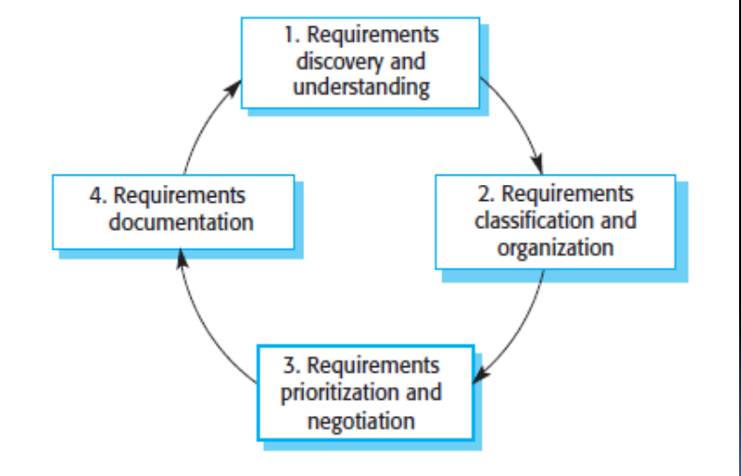
Requirement Elicitation process

Slide 27
Requirement Elicitation process
The process activities are:
1. Requirements discovery and understanding
This is the process of interacting with stakeholders of the system to discover their requirements. Domain requirements from stakeholders and documentation are also discovered during this activity.
2. Requirements classification and organization
This activity takes the unstructured collection of requirements, groups related requirements and organizes them into logical structure.
Notes:
Classification ma big data data science ko kura haleni hunxa … unstructured ma data lake haru ko example structured ma data warehouse data bricks haru ko kura lekhna sakinxa

Slide 28
Requirement Elicitation process
3. Requirements prioritization and negotiation
Inevitably, when multiple stakeholders are involved, requirements will conflict. This activity is concerned with prioritizing requirements and finding and resolving requirements conflicts through negotiation. Usually, stakeholders have to meet to resolve differences and agree on compromise requirements.
4. Requirements documentation
The requirements are documented and input into the next round of the spiral. An early draft of the software requirements documents may be produced at this stage, or the requirements may simply be maintained informally on whiteboards, wikis, or other shared spaces.

Slide 29
Requirements Elicitation Techniques
Interviewing
Formal or informal interviews with system stakeholders are part of most requirements engineering processes Interviews may be of two types:
Closed interviews Where the stakeholders answers a predefined set of questions
Open interviews In which there is no predefined agenda. The requirements engineering team explores a range of issues with system stakeholders and hence develops a better understanding of their needs

Slide 30
To be an effective interviewer, you should bear two things in mind:
1. You should be open-minded, take useful ideas about the requirements, and willing to listen to stakeholders. If the stakeholder comes up with surprising requirements, then you should be willing to change your mind about the system.
2. You should prompt the interviewee to get discussions going by using a springboard question or a requirements proposal, or by working together on a prototype system. Saying to people “tell me what you want” is unlikely to result in useful information. They find it much easier to talk in a defined context rather than in general terms.

Slide 31
Use cases
They are a scenario based technique for requirements elicitation
Identifies the type of interaction between the system and its users and the actors involved
In use case, actor in the process is represented as stick figure, each of interaction is represented as a normal ellipse and system boundary is represented by rectangle box

Slide 32
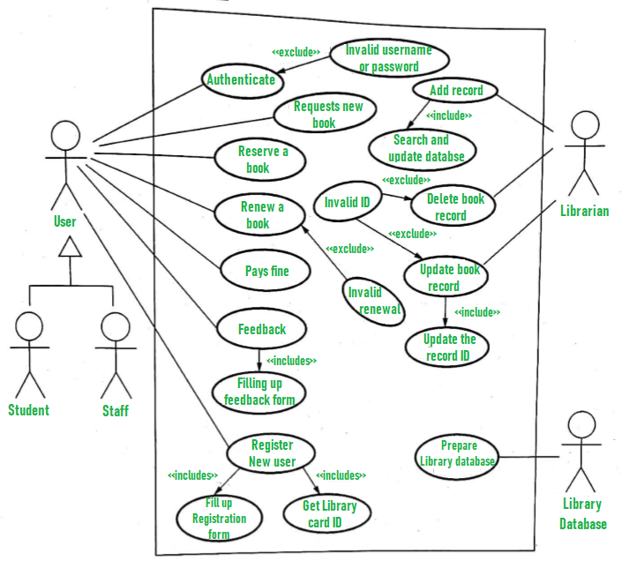
Example of Use case:

Slide 33
Question 2
Do feasibility study in your project work. And as we have learn about Requirement Elicitation Methods, one of the method is Use case diagram. So, draw Use case diagram of your project work’s system.

Slide 34
Ethnography
It is an observational technique that can be used to understand social and organizational requirements. In this, an analyst immerses him or herself in the working environment where the system will be used and observes the day to day work and notes made of the actual tasks in which participants are involved and building up a picture of how work is done.
In system development, ethnography is particularly effective at discovering two types of requirements: the functions requested from customers and the functions observed from the ethnographic analyst. This help to predicts implicit system requirements that not defined by the organization.

Slide 35
Stories and scenarios
People find it easier to relate to real-life examples than abstract descriptions. They are not good at telling you the system requirements. However, they may be able to describe how they handle particular situations or imagine things that they might do in a new way of working. Stories and scenarios are ways of capturing this kind of information.

Slide 36
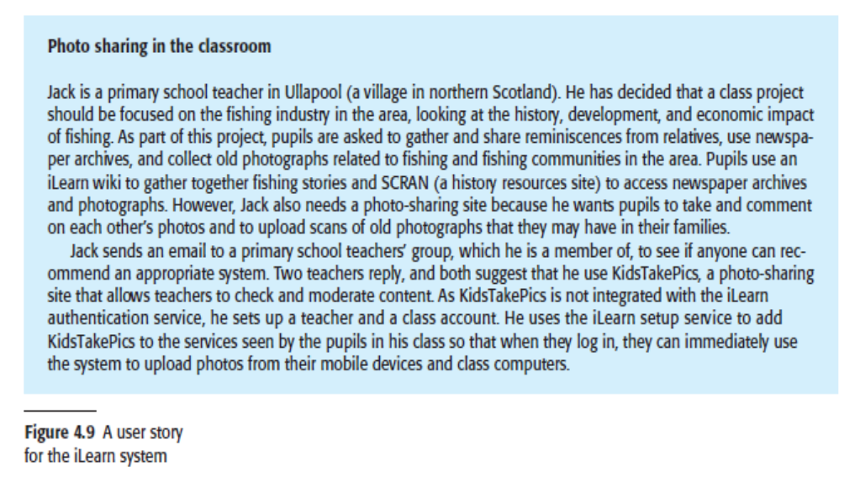
Example:

Slide 37
Example:
A scenario may include:
1. A description of what the system and users expect when the scenario starts.
2. A description of the normal flow of events in the scenario.
3. A description of what can go wrong and how resulting problems can be handled.
4. Information about other activities that might be going on at the same time.
5. A description of the system state when the scenario ends.

Slide 38
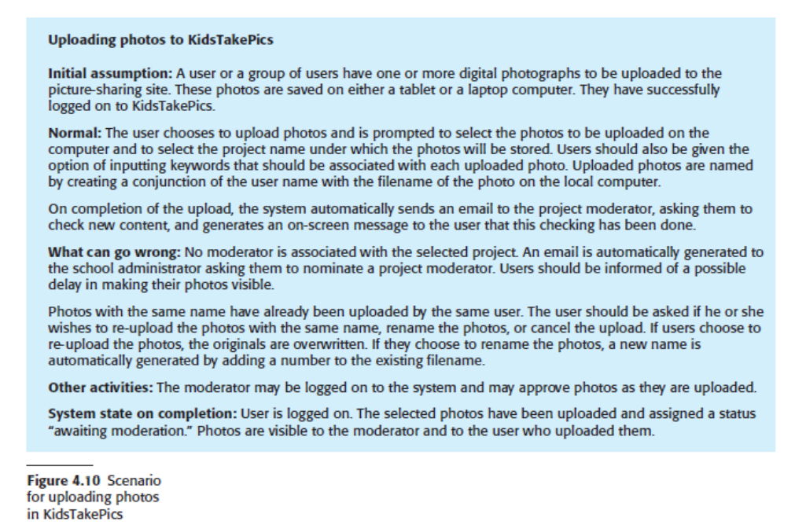
Example:

Slide 39
Viewpoints
It is a way of collecting and organizing a set of requirements from a group of stakeholders who have something in common. Each viewpoint therefore includes a set of system requirements. Viewpoints might come from end-users, managers or others.
There are two generic types of viewpoints: -
Interactor Viewpoints
It represents people of other systems that interact directly with the system. Example: In the bank ATM system, bank’s customer and bank’s account database act as this type.

Slide 40
Indirect Viewpoints
It represents stakeholders who do not use the system themselves but who influence the requirement in some way. Example: In ATM system, management of bank and bank security staff falls under this category.

Slide 41
Software Requirements Specification
It is the process of writing down the user and system requirements in a requirements document
Ideally, the user and system requirements should be clear, unambiguous, easy to understand, complete, and consistent but in practice this is hard to achieve.
Users of the SRS:
• Development Team
• Maintenance Team
• Clients
• Technical writers

Slide 42
Contents of the SRS
Category: What kind of your software is e.g.: Desktop application, Web application, Android app
Purpose: Describe what is the purpose of making this system (as nothing is without any reason)
Scope: What is the area it covering, what is its range, to what limits it will help you.
Introduction: Define the existing system and Proposed system. (In the perspective how the proposed one is better than existing. )

Slide 43
5. Advantages: Define the advantages of the system. (In every perspective).
6. Functional Requirements of the System
7. Non-Functional Requirements of the System
8. Software Tools: Mention the software tools which will involve in all this development process.
9. Deployment: What kind of Environment will be needed to deploy the Software.
E.g. OS, RAM, Processor and etc.
10. Hardware Specifications: The hardware required to develop this system.
11. Gantt Chart: Chart use to show the schedule of project.

Slide 44
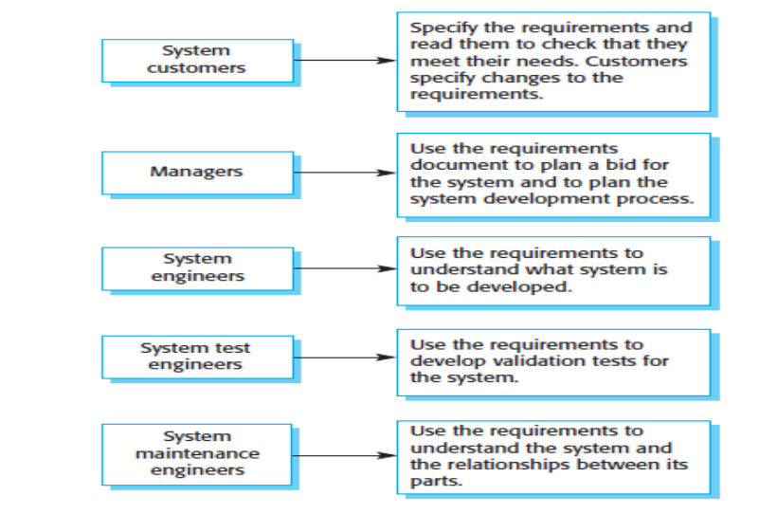
Users of requirements document

Slide 45
Requirements Validation
Process of checking that requirements define the system that the customer really wants
It overlaps with elicitation and analysis, as it is concerned with finding problems with the requirements
It is critically important because errors in a requirements document can lead to extensive rework costs
It checks requirement document for:
Completeness and Consistency
Requirement conflicts
Technical errors

Slide 46
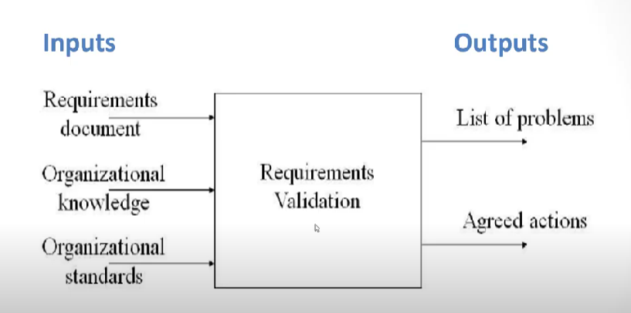

Slide 47
Requirement Validation techniques
1. Requirements reviews
Requirements are analyzed systematically by a team of reviewers from the system customer and the system developer and check for errors, anomalies, and inconsistencies
2. Prototyping
This involves developing an executable model of the system and using this with end-users and customers to see if it meets their needs expectation
3. Test-case generation
Requirement mentioned in SRS document should be testable, the conducted tests reveal the error present in the requirement. It is generally believed that if the test is difficult or impossible to design than, this usually means that requirement will be difficult to implement and it should be reconsidered.

Slide 48
Requirement Change
A requirement change refers to any modification, addition, or deletion of a requirement in a project or system development. Requirements are specifications that define what a system or product is expected to achieve and how it should function. Changes to these requirements can occur for various reasons throughout the project lifecycle. Some common reasons for requirement changes include:
Clarification: Stakeholders may gain a clearer understanding of their needs or the project scope over time, leading to the need for changes to existing requirements.
Emergent Requirements: New requirements may emerge as the project progresses, either due to technological advancements, changes in the business environment, or other unforeseen factors.

Slide 49
Requirement Change
Errors or Ambiguities: Mistakes, misunderstandings, or ambiguities in the original requirements may be identified during the development process, necessitating corrections.
External Influences: Changes in laws, regulations, or industry standards may require adjustments to the project's requirements to ensure compliance.
Market Conditions: Shifts in market conditions, customer preferences, or competitive landscapes may prompt adjustments to the project's goals and requirements.
Budget and Resource Constraints: Changes in available resources, budget constraints, or unexpected issues may lead to modifications in the project's requirements.

Slide 50
End of unit 4

