Slide 1
Brief Correspondence
Presenter: Abhilekh Subedi, Ayush Tuladhar, Krish Ghale
Subject: Technical Writing
BSc. CSIT VI

Slide 2
Introduction

Slide 3
Audience
Brief communication
Target specific reader / readers
Specific purpose
Standard format

Slide 4
Prewriting

Slide 5
Formatting

Slide 6
Composing the Message

Slide 7
Text Messages

Slide 8
E-mails

Slide 9
Memos
Printed documents that correspond inside organization
Types: inquiry, response, policy/directive, status, and various report memos
Audience : receiver inside writer’s organization (internal)

Slide 10
Prewriting for Memos
Brief without overriding substance
Cover one topic only
Proof of actions

Slide 11
Formatting for Memos
TO line : audience
FROM line : sender
DATE line : international / traditional
SUBJECT line : one main idea (predict, distinguish, focus)

Slide 12

Format of Memo

Slide 13
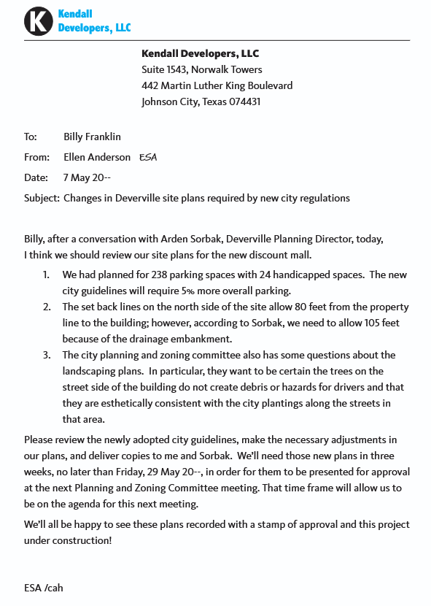
Example of Memo

Slide 14
Letters
Extension of organization in absence of writer
Styles: block style (all lines at the left margin), modified block style (date and closing centered)
Audience : readers outside organization

Slide 15
Prewriting for Letters
Formal
History and background of organization
Insider language, jargon
Purpose of correspondence
Avoid:
Contractions
Cliches
Personal/emotional commentary
Conversational speech
Abbreviations

Slide 16
Formatting for Letters
Heading : return address of sender
Dateline : when date was written
Inside address : address of receiver
Salutation : name of receiver
Body : 2-5 paragraphs
Complimentary closing : friendly but businesslike ending
Signature : name and title with space for handwritten signature
Reference initials : people who dictated and keyed the letter

Slide 17
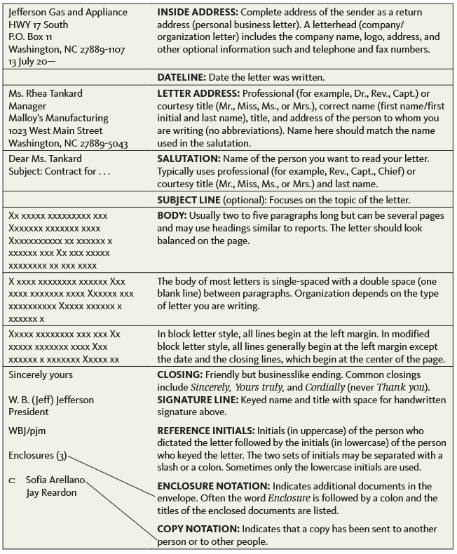
Format of Letter

Slide 18
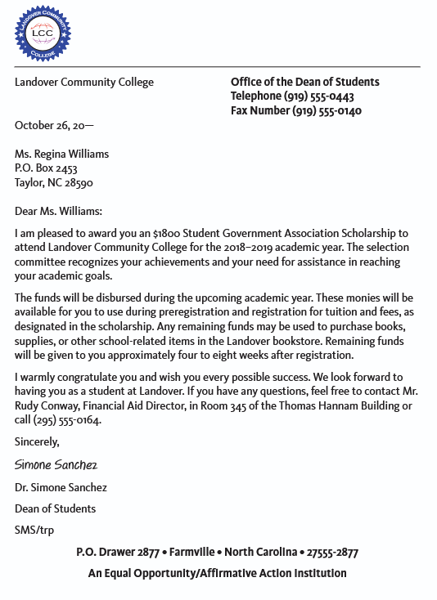
Example of Letter

Slide 19
Conclusion

