Slide 1
Unit 5 System Modeling
Software Engineering
CSIT 6th Semester

Slide 2
Syllabus
Introduction to System Modeling;
Context Models;
Interaction Models;
Structural Models;
Behavioral Models;
Model-Driven Architecture

Slide 3
System Modeling
System modeling in software engineering involves creating abstract representations of software systems to help software engineers and stakeholders understand the system's architecture, behavior, and relationships between different components.
It is a critical aspect of software development because it enables software engineers to communicate and collaborate effectively, identify potential issues early on in the development process, and make informed decisions about the system's design and implementation.

Slide 4
Types of Modeling
There are various types of system modeling techniques in software engineering, including:
Behavioral models
Context models
Interaction models
Structural models

Slide 5
Behavioral modeling
Behavioral modeling is a type of system modeling in software engineering that focuses on the behavior of a software system or its components. It involves creating models to depict how the system behaves in response to various inputs and events.
Behavioral modeling is an essential aspect of software development because it enables software engineers to identify potential issues early on in the development process and make informed decisions about the system's design and implementation.

Slide 6
Types of behavioral modeling
There are various types of behavioral modeling techniques used in software engineering, including:
Use case modeling: This type of modeling is used to describe the interactions between the users and the system. It involves creating diagrams to depict the system's functionality and the various ways in which the users interact with the system.
Activity modeling: This type of modeling is used to describe the behavior and flow of control of a system or process. It involves creating diagrams to depict the steps or operations carried out in the system or process.
State modeling: This type of modeling is used to describe the behavior of a system or component in response to various events or inputs. It involves creating diagrams to depict the different states that the system or component can be in and the transitions between them.

Slide 7
Activity Diagram
Activity diagrams are a type of behavioral modeling in software engineering. They depict the behavior and flow of control of a system or process. Activity diagrams are typically used to model business processes, software workflows, and use cases.
Activity diagrams use different types of symbols to represent the components of the system or process being modeled, including actions, decisions, and flows. Actions represent the steps or operations that are carried out in the system or process, decisions represent the branching points in the process, and flows represent the connections between different components.
In summary, activity diagrams are a type of behavioral modeling that are used to depict the behavior and flow of control of a system or process, and they use different types of symbols to represent the components of the system or process being modeled.

Slide 8
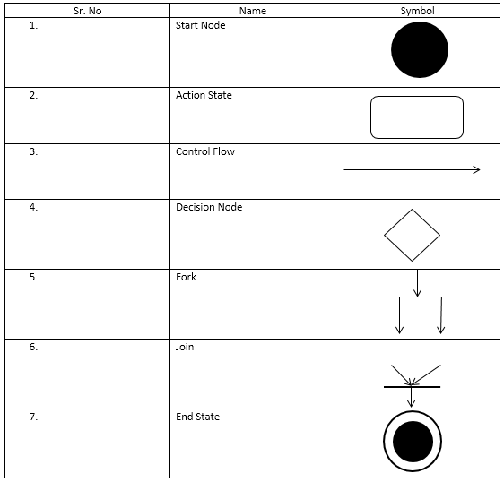
Activity Diagram

Slide 9
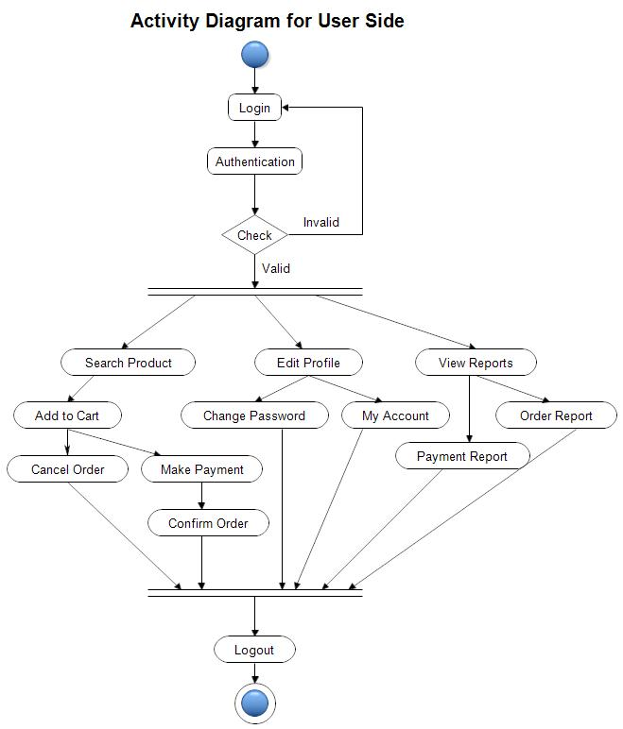
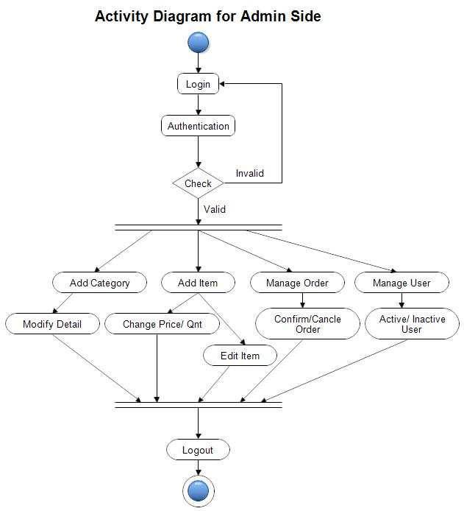
Example:

Slide 10
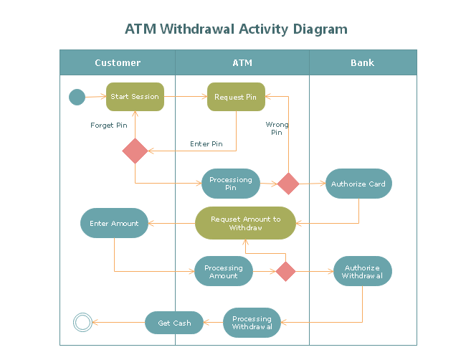
Example:

Slide 11
Question
Draw Activity diagram of your project work.

Slide 12
State Diagram
A state diagram is a visual representation of the states an object or system can be in, and the transitions between those states. It is often used in software engineering, control engineering, and other fields to model the behavior of systems.
A state diagram consists of a set of states, represented by rounded rectangle, circles or ovals, and transitions between those states, represented by arrows. Each state represents a possible condition or mode of operation of the system, while each transition represents a change of state that can occur in response to some input or event.
Notes:
Components:States: Represent the condition or situation of an object at a specific time.
Transitions: Show how the object moves from one state to another due to an event or condition.
Events: Trigger transitions.

Slide 13
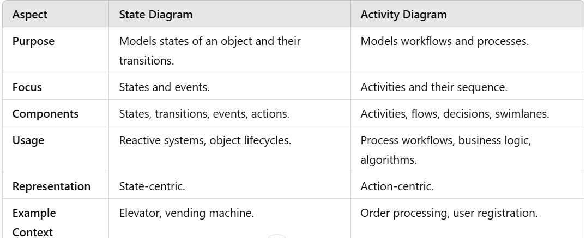
Difference between state and activity diagram
Notes:
Reactive Systems:
Example: UI components, where the behavior depends on the current state.
A button can be in states like enabled, disabled, or hovered.
State diagrams help define how the system reacts to events like mouse clicks or user input.
Embedded Systems:
Example: Systems like elevators, washing machines, or IoT devices.
These systems often have clear state transitions based on sensor inputs or user commands.
Object-Oriented Design:
State diagrams are used to model the behavior of individual classes in a system.
Example: A BankAccount class might have states like active, overdrawn, or closed.
Protocol and Communication Systems:
Example: Networking protocols like TCP/IP.
States such as LISTENING, SYN_SENT, ESTABLISHED, and CLOSED can be modeled using a state diagram.
Workflow Engines:
Software that manages tasks and approvals can use state diagrams to represent states like draft, submitted, approved, or rejected.
Game Development:
Example: Player character states like idle, running, jumping, attacking, or damaged.
State diagrams help manage transitions between these states based on game logic.
Finite State Machines (FSMs):
State diagrams are essential for designing FSMs, which are used in parsers, compilers, and algorithms.

Slide 14
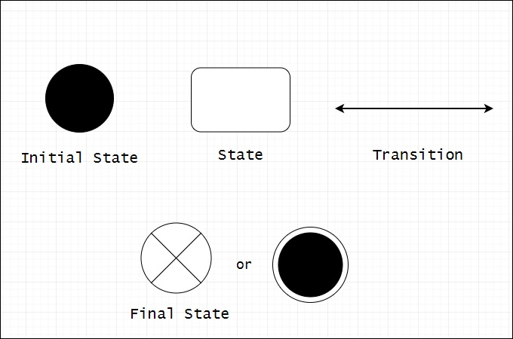
Symbols of State Diagram

Slide 15
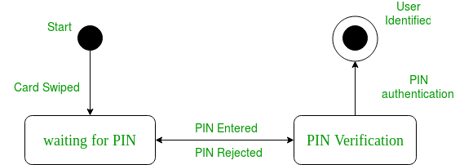
Example:

Slide 16
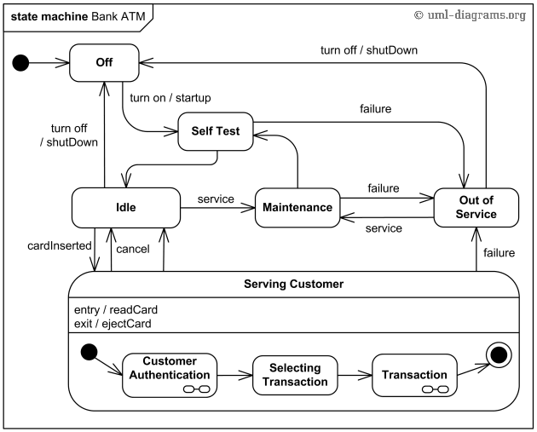
Example of Bank ATM
Notes:
Idle → Money Inserted:Trigger: User inserts money.
Money Inserted → Product Selected:Trigger: User selects a product.
Condition: The selection is valid (enough money, product available).
Product Selected → Dispense Product:Trigger: The selection is processed, and the product is ready to be dispensed.
Dispense Product → Idle:Trigger: The product is dispensed, and any change is returned.
Any State → Out of Service:Trigger: An error occurs (e.g., jam, no stock, or system malfunction).

Slide 17
Question:
Draw State diagram for vending machine.
Notes:
Verification Checklist:
Correctness:
Does the machine return to Idle after dispensing a product?
Does it reject invalid selections (e.g., insufficient funds)?
Completeness:
Are all inputs (e.g., coin insertion, product selection) handled in each state?
What happens if the user inserts more money than needed?
Safety:
Does the machine avoid dispensing a product if no money is inserted?
Does it handle errors like product jams or running out of stock?
Liveness:
Will the machine eventually dispense a product if all conditions are met?
Simulation:
Run the state machine with various sequences of inputs (e.g., money insertion, product selection, cancellation) and observe behavior.
Model Checking:
Use a tool like SPIN, UPPAAL, or NuSMV to verify that the machine's state transitions satisfy predefined properties.

Slide 18
Context Modeling
Context modeling is a technique used to define and represent the scope and boundaries of a system within its environment. It focuses on understanding how the system interacts with external entities, such as users, external systems, or other stakeholders, and how data flows in and out of the system.
Context modeling provides a high-level view that helps stakeholders understand the system's purpose, inputs, outputs, and relationships without delving into implementation details.

Slide 19
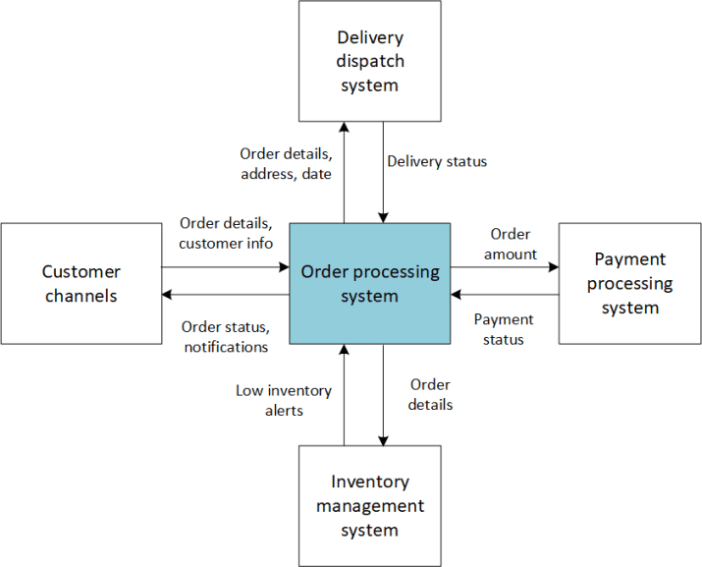
Example of Context diagram

Slide 20
Data Flow Diagram(DFD)
A data flow diagram (DFD) is a graphical representation of a system or process that shows the flow of data through it. It is a modeling technique that allows you to visualize how data moves between processes, data stores, and external entities.
A DFD typically consists of four components: processes, data flows, data stores, and external entities.
Processes: A process represents a function or activity that transforms input data into output data. Processes are depicted as rectangles with the process name inside.
Data Flows: A data flow represents the movement of data from one part of the system or process to another. Data flows are depicted as arrows that connect processes, data stores, and external entities.

Slide 21
Data Flow Diagram(DFD)
Data Stores: A data store represents a repository of data that is used by the system or process. Data stores are depicted as rectangles with the data store name inside.
External Entities: An external entity represents a source or destination of data outside of the system or process being modeled. External entities are depicted as squares or circles with the entity name inside.
DFDs can be used to model a wide range of systems or processes, from simple to complex. They can be used to identify and analyze data flows, improve system efficiency, and communicate system requirements to stakeholders.

Slide 22
Levels in DFD
Level of Detail: Varies by level:Level 0 (Context Diagram): Equivalent to the context diagram, showing the system as a single process.
Level 1 DFD: Breaks the system into major processes, data stores, and data flows.
Level 2 and Beyond: Further decomposes processes into sub-processes for greater detail.
Notes:
Hotel reservation system example:
Processes:
Search Available Rooms
Make Reservation
Process Payment
Manage Room Availability
level 2:
Sub-processes:
Validate Customer Details
Create Reservation Record
Generate Invoice
4. Payment
Level 3
Validate Payment Details
Send Payment Request to Gateway
Update Payment Status

Slide 23
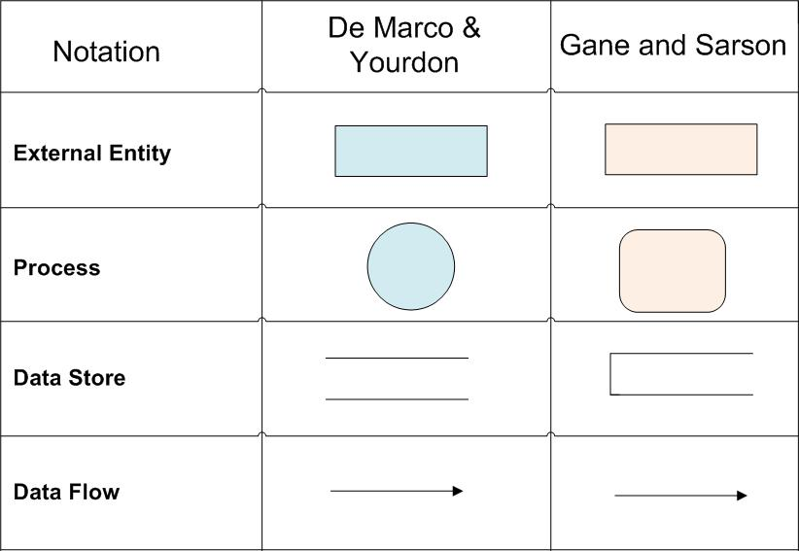
Symbols of DFD

Slide 24
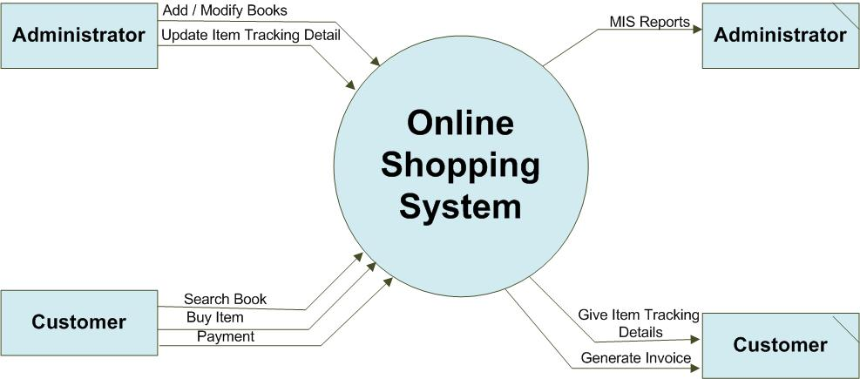
Example of DFD
For more detail:
https://www.visual-paradigm.com/guide/data-flow-diagram/what-is-data-flow-diagram/

Slide 25
Interaction Modeling
Interaction modeling is a crucial step in software engineering that involves creating a representation of how users interact with a system or product. It helps designers and developers to understand the needs and expectations of users and design an interface that is intuitive, efficient, and enjoyable to use.
Interaction modeling typically includes the following steps:
Identifying user personas: This involves creating a detailed profile of the typical users who will interact with the system or product, including their goals, tasks, preferences, and limitations.
Defining user scenarios: This involves identifying the different ways in which users will interact with the system or product, including the steps they will take and the outcomes they expect.
Creating interaction diagrams: This involves using different types of diagrams, such as wireframes, flowcharts, sequence diagrams, and state diagrams, to represent the various interactions between the user and the system or product.

Slide 26
Interaction Modeling
Prototyping and testing: This involves creating prototypes of the system or product, and testing them with real users to identify potential problems or areas for improvement.
Iterating and refining: This involves using the feedback from testing to refine the design, and repeating the testing process until the design is optimized for user needs.
Interaction modeling is a critical part of software engineering because it helps ensure that the system or product is designed to meet the needs and expectations of its users. By modeling the interactions between the user and the system or product, designers can identify potential problems and create a more user-friendly design.

Slide 27
Wireframes
Wireframes are a type of visual design artifact that represent the skeletal structure of a user interface, without including the full visual design or graphic elements. They are typically used in software engineering and user experience design to help visualize and communicate the layout and functionality of a digital product or system.
Wireframes can take many forms, including paper sketches, digital drawings, or interactive prototypes. They can be used to test and refine the layout, navigation, and functionality of the interface, and to ensure that the user experience meets the needs and expectations of the target audience.

Slide 28
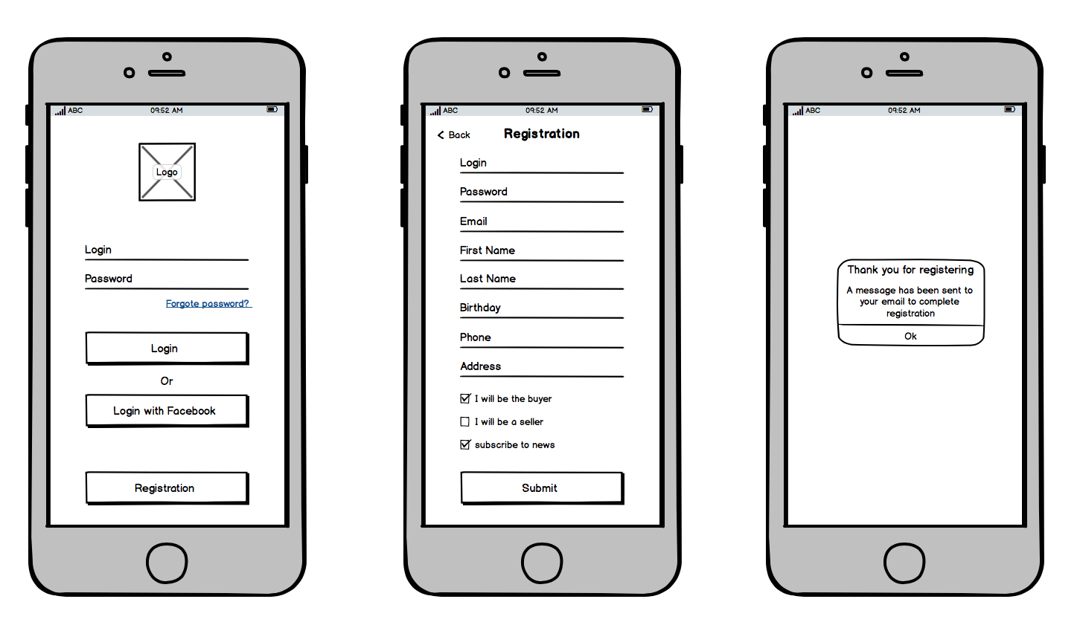
Example of Wireframe

Slide 29
Sequence Diagram
A sequence diagram is a type of UML (Unified Modeling Language) diagram that illustrates the interactions and behavior between objects or components in a system over time. It is used to model the behavior of a system or process and is particularly useful in modeling complex interactions between objects or components.
A sequence diagram consists of objects, messages, and lifelines. The objects represent the components or actors in the system, while the messages represent the interactions between them. The lifelines represent the lifespan of an object, and show how long an object is active in the system.
Notes:
Lifelines: Represent entities (objects, classes, or actors) that interact in the system. Each entity is depicted as a vertical dashed line.
Examples: User, System, Database, Driver, etc.
Messages: Represent the communication between lifelines, shown as arrows between the vertical lines. Messages can be:
Synchronous (e.g., function calls, represented with a solid arrow).
Asynchronous (e.g., signals or events, represented with a dashed arrow).
Activation Bars: Indicate the time an object is actively processing or executing a task. These are vertical rectangles on the lifeline.
Actors: External users or systems interacting with the system, typically shown as stick figures or labeled ovals.
Events or Actions: Describe the activities or operations invoked during the interaction.

Slide 30
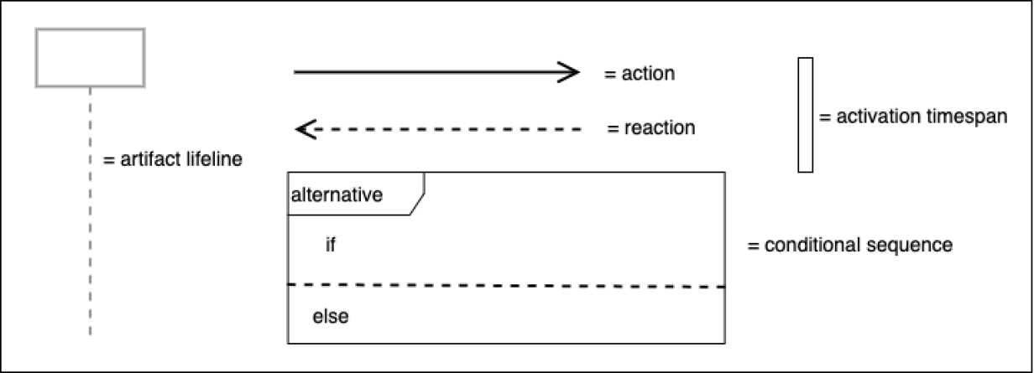
Symbols:

Slide 31
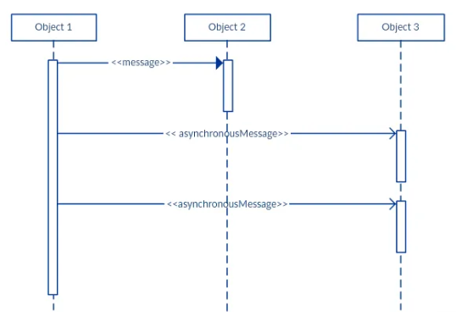
Example:

Slide 32
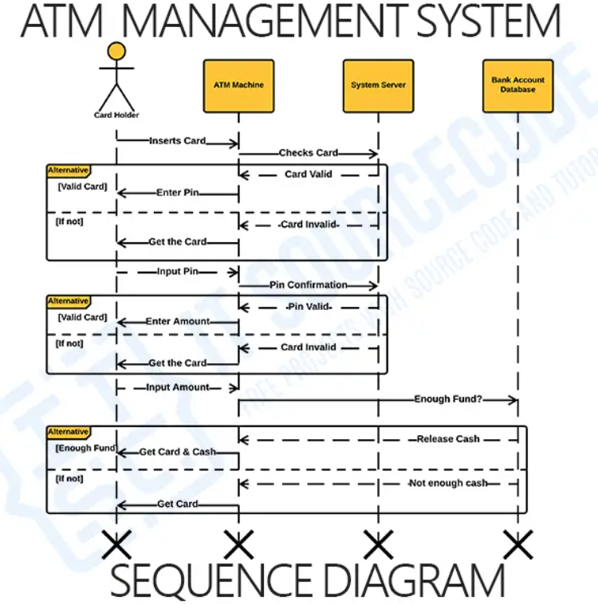

Slide 33
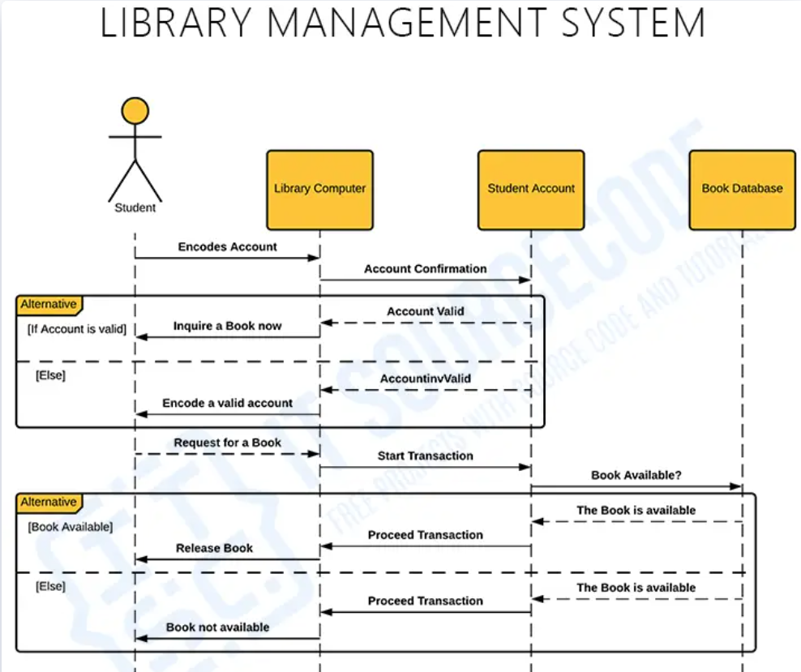

Slide 34
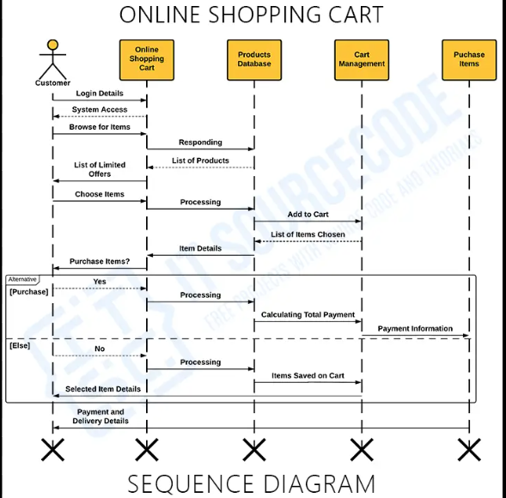

Slide 35
Question
Draw Sequence Diagram of your own project.
Notes:
Actors
These are external users or systems interacting with the app:
User: The rider who requests a ride.
Driver: The person offering the ride service.
Admin: A system administrator managing the platform (optional).
2. Frontend Objects
These represent the user interfaces and functionalities exposed to the actors:
User App: The application used by the rider.
Login/Registration Interface
Ride Request Form
Payment Confirmation Screen
Driver App: The application used by the driver.
Ride Acceptance Interface
Navigation Tool
Earnings Dashboard
3. Backend Objects
These are server-side components handling logic, data processing, and interactions:
Ride Service: Manages ride requests and matches riders with drivers.
Driver Management: Handles driver availability, status updates, and assignment.
User Management: Handles user profiles, authentication, and preferences.
Geolocation Service: Provides location tracking, distance calculation, and route optimization.
Trip Management: Tracks ongoing trips and their statuses (e.g., started, completed).
Notification Service: Sends updates to users and drivers (e.g., ride status, payment confirmations).
Payment Gateway Integration: Processes ride payments and manages transactions.
Database: Stores data for users, drivers, rides, and payments.
4. External Services
These are third-party systems integrated with the app:
Payment Gateway: Handles secure payment processing (e.g., Stripe, PayPal).
Maps API: Provides geolocation and navigation data (e.g., Google Maps, Mapbox).
SMS/Email Service: Sends notifications or OTPs to users and drivers (e.g., Twilio).
Cloud Infrastructure: Hosts the app’s backend and handles scalability (e.g., AWS, Azure).

Slide 36
Structural model
In software engineering, a structural model is a visual representation of the architecture of a software system, which shows the relationship between different components and how they interact with each other. It is used to depict the overall design of the system and provide a framework for software development.
Structural models can be created using various modeling techniques, such as UML (Unified Modeling Language) or ER (Entity-Relationship) diagrams. These models help developers to better understand the requirements of the system and create a blueprint for software development.

Slide 37
Some common types of structural models in software engineering include:
Class Diagrams: These diagrams represent the classes and relationships between them in an object-oriented programming language.
Component Diagrams: These diagrams represent the components of a system and how they interact with each other.
Package Diagrams: These diagrams show the organization of software components into packages and how they are related to each other.
Deployment Diagrams: These diagrams show how software components are deployed across different physical nodes.
Structural models are an important aspect of software engineering as they help in understanding the overall structure of the system, identifying potential design flaws, and providing a basis for further software development.

Slide 38
Class Diagram
A class diagram is a type of structural diagram in software engineering that describes the structure of a system by showing the classes and their relationships to each other. It is a fundamental tool for object-oriented modeling, design, and programming, and is commonly used in the Unified Modeling Language (UML).
In a class diagram, a class is represented as a rectangle, with the class name written inside. The class may have attributes, which are represented as lines that connect the rectangle to the attribute name, and methods, which are represented as lines that connect the rectangle to the method name.

Slide 39
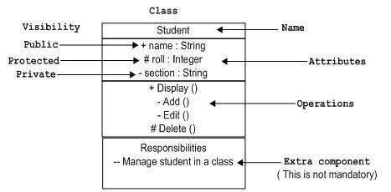
Class Diagram Symbol
Notes:
Access: Members marked as public are accessible from anywhere in the program. Other classes, subclasses, and external code can access these members.
Members marked as protected are accessible only within:The class itself.
Subclasses (derived classes).
Classes in the same package/module (in some languages like Java or Python).
:
Members marked as private are accessible only within the class where they are defined. They are not accessible to subclasses or external classes
.
Example:
Private :Attributes/Methods: id, password, hashPassword()
Protected: Attributes/Methods: email, sendEmail()
The email attribute might need to be accessed or modified by subclasses, such as AdminUser or PremiumUser.The sendEmail() method could be used internally by the class or its subclasses to notify users about updates or promotions.
Public: Attributes/Methods: name, address, getProfile()Why Public?name and address are general information that external components (like the checkout system) need to access.

Slide 40
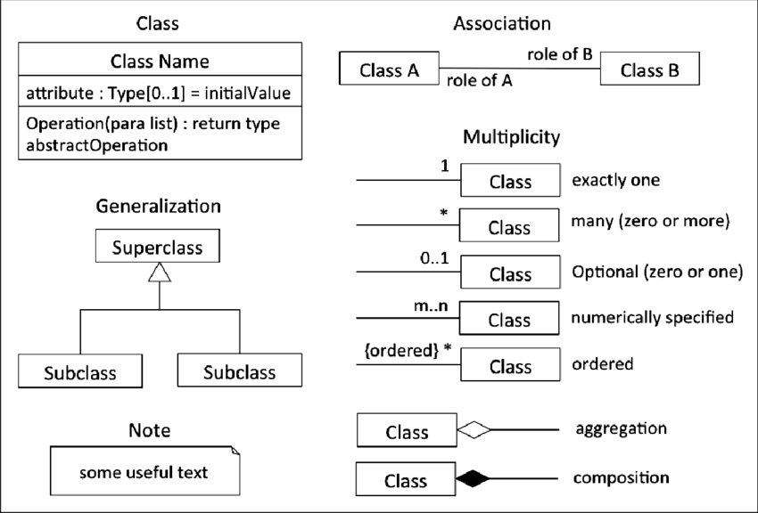
Class Diagram Symbol
Notes:
Aggregation
Definition: A weaker association where one class (the whole) can contain another class (the part), but the part can exist independently of the whole.
Key Characteristics:
Represents a "has-a" relationship.
The part object does not depend on the lifecycle of the whole.
Denoted with a hollow diamond at the whole side in UML diagrams.
Example:
A Teacher can belong to a Department, but the Teacher can exist independently of the Department.
Product Payment
Definition: A stronger association where one class (the whole) contains another class (the part), and the part's lifecycle depends on the whole.
Key Characteristics:
Represents a "part-of" relationship.
The part object cannot exist independently of the whole.
Denoted with a filled diamond at the whole side in UML diagrams.
Example:
A House contains Rooms, and a Room cannot exist without the House.
Order and orderllist

Slide 41
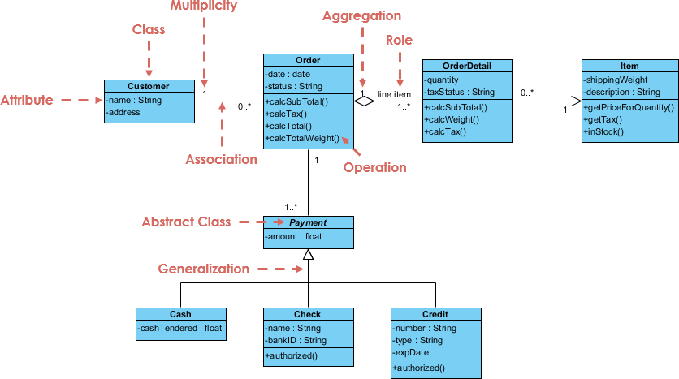
Example of Class Diagram

Slide 42
Component diagram
One kind of structural diagram in the Unified Modeling Language (UML) that shows how the components of a system are arranged and relate to one another is termed a component-based diagram, or simply a component diagram.
System components are modular units that offer a set of interfaces and encapsulate implementation.
These diagrams illustrate how components are wired together to form larger systems, detailing their dependencies and interactions.
Component-Based Diagrams are widely used in system design to promote modularity, enhance understanding of system architecture.

Slide 43
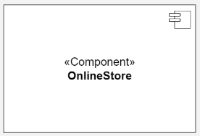
Components of Component-Based Diagram
Component
Represent modular parts of the system that encapsulate functionalities. Components can be software classes, collections of classes, or subsystems.
Symbol: Rectangles with the component stereotype («component»).
Function: Define and encapsulate functionality, ensuring modularity and reusability.

Slide 44
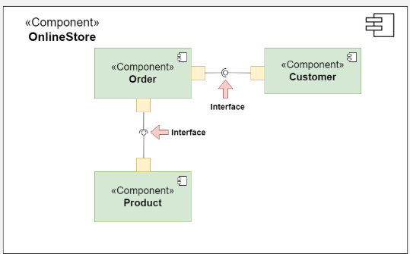
Components of Component-Based Diagram
Interfaces
Specify a set of operations that a component offers or requires, serving as a contract between the component and its environment.
Symbol: Circles (lollipops) for provided interfaces and half-circles (sockets) for required interfaces.
Function: Define how components communicate with each other, ensuring that components can be developed and maintained independently.

Slide 45
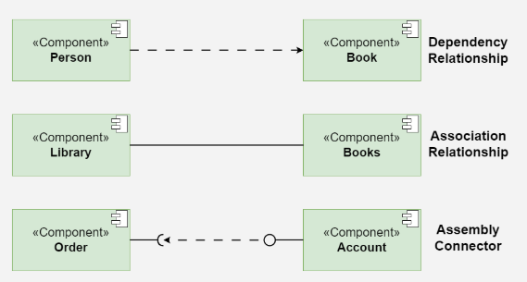
Components of Component-Based Diagram
Relationships
Depict the connections and dependencies between components and interfaces.
Symbol: Lines and arrows.
Dependency (dashed arrow): Indicates that one component relies on another.
Association (solid line): Shows a more permanent relationship between components.
Assembly connector: Connects a required interface of one component to a provided interface of another.
Function: Visualize how components interact and depend on each other, highlighting communication paths and potential points of failure.
Notes:
Dependency: A PaymentProcessor component depends on an external PaymentGateway component to process transactions.
Association: Example: A UserInterface component is associated with a DatabaseAccess component to fetch and display data.
Assembly connector: WebClient component requires the IService interface provided by a WebService component.
Summary of Notations
Dependency: Dashed arrow (→)
Association: Solid line (↔)
Realization: Dashed arrow with hollow triangle (▷)
Generalization: Solid arrow with hollow triangle (▷)
Assembly: "Lollipop" for provided interfaces; ball-and-socket connector.
Delegation: Dashed arrow with a filled circle.

Slide 46
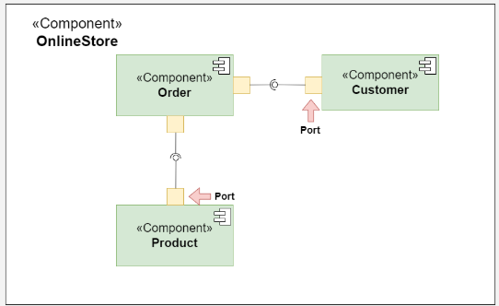
Components of Component-Based Diagram
Ports
Role: Represent specific interaction points on the boundary of a component where interfaces are provided or required.
Symbol: Small squares on the component boundary.
Function: Allow for more precise specification of interaction points, facilitating detailed design and implementation.
Notes:
### **Benefits of Using Ports**
1. **Clarity**: They clearly define the points of interaction for a component.
2. **Modularity**: Ports support better modular design by separating concerns.
3. **Flexibility**: Changes to a component’s internal structure don’t affect the external interactions as long as the ports remain unchanged.
4. **Scalability**: Ports can represent multiple communication protocols or channels.

Slide 47
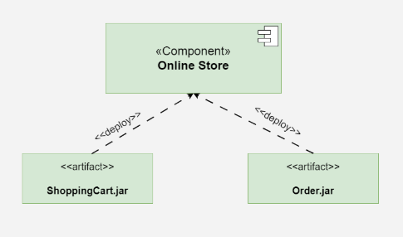
Components of Component-Based Diagram
Artifacts
Represent physical files or data that are deployed on nodes.
Symbol: Rectangles with the artifact stereotype («artifact»).
Function: Show how software artifacts, like executables or data files, relate to the components.
Notes:
A JAR (Java Archive) file is a file format used to bundle multiple Java class files, metadata, and resources (like images or configuration files) into a single archive for distribution and deployment. It is based on the ZIP file format and has a .jar extension.

Slide 48
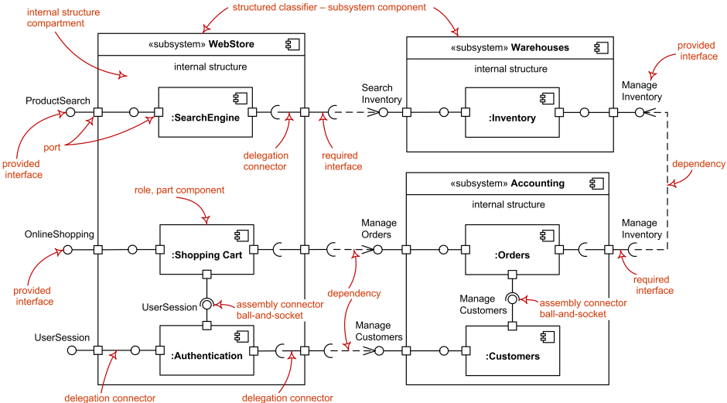
Example:

Slide 49
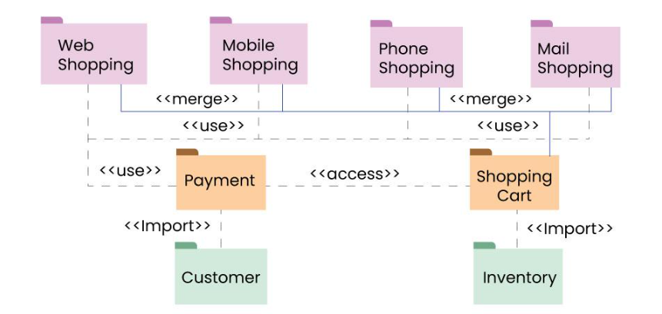
Package diagram
A package diagram is another type of UML diagram that focuses on the logical grouping of elements (such as classes, components, or use cases) into packages. It is primarily used to organize and manage the structure of a large system by showing the relationships between packages and their dependencies.
For Detail:
https://www.geeksforgeeks.org/package-diagram-introduction-elements-use-cases-and-benefits/

Slide 50
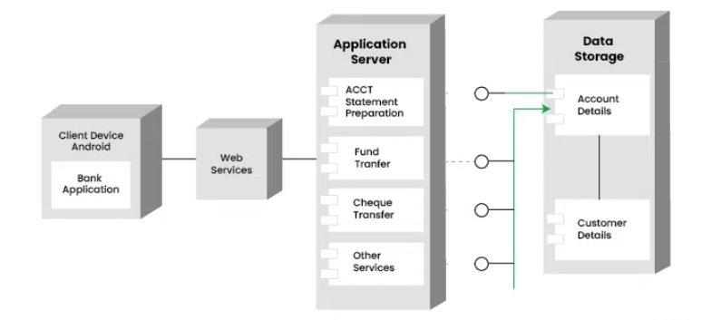
Deployment diagram
A deployment diagram is a type of UML diagram that represents the physical deployment of artifacts (e.g., software components, executables, or data) on hardware nodes. It focuses on the infrastructure of a system, showing how software and hardware work together to support the system's operation.
https://www.geeksforgeeks.org/deployment-diagram-unified-modeling-languageuml/

Slide 51
Model-driven engineering (MDE)
Model-driven engineering (MDE) is an approach to software development that emphasizes the use of models as a primary artifact for the design, analysis, and implementation of software systems.
In MDE, models are used to represent different aspects of a system, such as its behavior, structure, and interactions with other systems. These models can be used to automatically generate code, documentation, and other artifacts, reducing the need for manual coding and increasing the level of automation in software development.
The process of MDE typically involves the following steps:
Requirements modeling: In this step, the requirements of the system are captured and modeled using appropriate modeling languages and tools.
Design modeling: In this step, the requirements are translated into a design model, which includes details such as the system architecture, behavior, and interactions with other systems.
Domain Model: Next, you create a domain model that represents the core entities and relationships in the system, such as tasks, users, deadlines, etc. This model could be represented using a modeling language specific to the problem domain, such as Entity-Relationship Diagrams (ERDs) for a database-centric approach.
Code generation: Once the design model is complete, it can be automatically translated into code using code generation tools.

Slide 52
Testing and verification: The generated code is tested and verified to ensure that it meets the requirements and specifications of the system.
Maintenance and evolution: Once the system is deployed, it may need to be updated or modified over time. In MDE, changes to the system can be made at the model level, and the code can be automatically regenerated based on the updated model.
MDE offers several benefits, including improved productivity, increased consistency and quality, and reduced time-to-market. It also promotes better communication between stakeholders by providing a common language and understanding of the system being developed. However, MDE also requires specialized skills and expertise, and may involve significant up-front costs for modeling and tooling.

Slide 53
End of unit 5

