Slide 1
Unit 6 System Architecture & Design
Software Engineering
CSIT 6th Semester

Slide 2
Syllabus
Introduction to System Modeling;
Context Models;
Interaction Models;
Structural Models;
Behavioral Models;
Model-Driven Architecture

Slide 3
Architectural Design
Architecture design in software engineering refers to the process of creating a conceptual model or plan for the software system. The architecture design involves making crucial decisions about the structure, behavior, and functionality of the system, as well as the components and modules that will be used.
The goal of architecture design is to create a blueprint that guides the development process and ensures that the resulting software system meets the desired requirements and specifications. Effective architecture design helps to reduce complexity, improve maintainability, and enhance the overall quality of the software system.
Notes:
Architecture design refers to the conceptualization, planning, and development of structures or systems, ensuring functionality, aesthetics, and sustainability.
architecture design refers to the high-level structuring of a software system, focusing on how its components interact and align to meet the desired functionality, scalability, and maintainability.
Key Components
Architecture Patterns: Commonly used designs like client-server, microservices, or monolithic architectures.
Modules: Dividing the system into smaller, manageable units.
Components: Individual units or functionalities within the system.
Interfaces: How components interact with each other and external systems.
Data Flow: How data moves through the system

Slide 4
Who does it?
Although a software engineer can design both data and architecture, the job is often allocated to specialists when large, complex systems are to be built. A database or data warehouse designer creates the data architecture for a system. The “system architect” selects an appropriate architectural style from the requirements derived during software requirements analysis.
Why is it important? You wouldn’t attempt to build a house without a blueprint, would you? You also wouldn’t begin drawing blueprints by sketching the plumbing layout for the house. You’d need to look at the big picture—the house itself—before you worry about details. That’s what architectural design does—it provides you with the big picture and ensures that you’ve got it right.

Slide 5
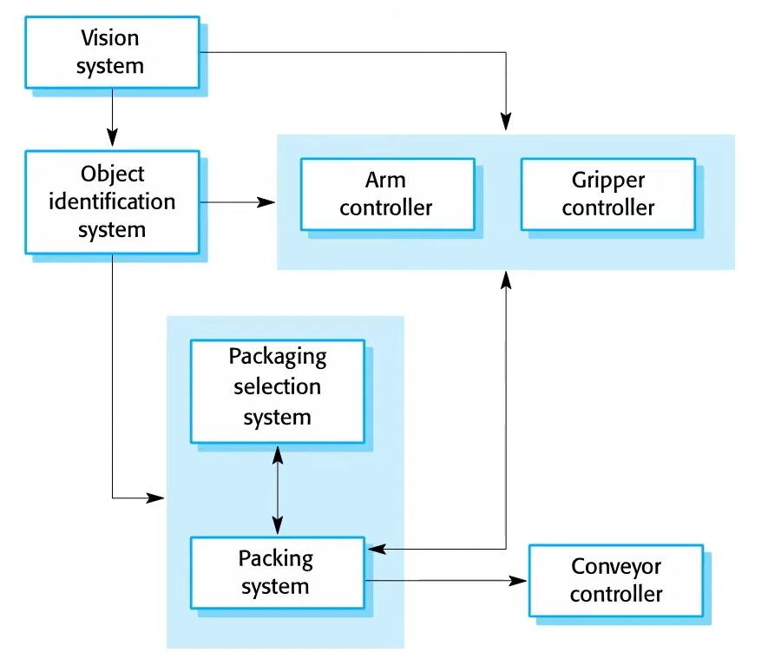
Example : Architecture of Packing Robot System

Slide 6
Description:
To help you understand what I mean by system architecture, look at Figure . This diagram shows an abstract model of the architecture for a packing robot system. This robotic system can pack different kinds of objects. It uses a vision component to pick out objects on a conveyor, identify the type of object, and select the right kind of packaging. The system then moves objects from the delivery conveyor to be packaged. It places packaged objects on another conveyor. The architectural model shows these components and the links between them

Slide 7
Description
System architectures are often modeled informally using simple block diagrams, as in Figure. Each box in the diagram represents a component. Boxes within boxes indicate that the component has been decomposed to subcomponents. Arrows mean that data and or control signals are passed from component to component in the direction of the arrows.
Block diagrams present a high-level picture of the system structure, which people from different disciplines, who are involved in the system development process, can readily understand.
Notes:
Example of architecture diagram

Slide 8
Advantages of Architectural Design
1. Stakeholder communication: The architecture is a high-level presentation of the system that may be used as a focus for discussion by a range of different stakeholders.
2. System analysis: Making the system architecture explicit at an early stage in the system development requires some analysis. Architectural design decisions have a profound effect on whether or not the system can meet critical requirements such as performance, reliability, and maintainability.
3. Large-scale reuse: An architectural model is a compact, manageable description of how a system is organized and how the components interoperate. The system architecture is often the same for systems with similar requirements and so can support large-scale software reuse

Slide 9
Architectural Design Decisions
Architectural design is a creative process in which you design a system organization that will satisfy the functional and non-functional requirements of a system.
There is no formulaic architectural design process. It depends on the type of system being developed, the background and experience of the system architect, and the specific requirements for the system.
These decisions involve a wide range of considerations, including functional and non-functional requirements, scalability, maintainability, performance, security, and usability.

Slide 10
Some common architecture design decisions include:
Choosing the appropriate architecture style: The architecture style defines the overall structure and organization of the software system, such as layered, client-server, micro services, or event-driven architecture.
Deciding on the software components: The software components are the building blocks of the software system, and architects and developers need to choose the appropriate components based on the design requirements and constraints. For eg. Buttons, forms, server can be components of web based application

Slide 11
Some common architecture design decisions include:
Selecting the appropriate programming language and frameworks: The programming language and frameworks affect the development process, performance, and maintainability of the software system.
Designing the database schema and data access layer: The database schema and data access layer define how the system stores and retrieves data. Architects and developers need to choose an appropriate database management system and design the schema and data access layer to ensure scalability, performance, and security.
Deciding on the software deployment architecture: The deployment architecture defines how the software system is deployed and managed, such as on premise or cloud-based.
Overall, architecture design decisions in software engineering involve a complex set of considerations and require careful planning and analysis to create a functional, efficient, and secure software system.

Slide 12
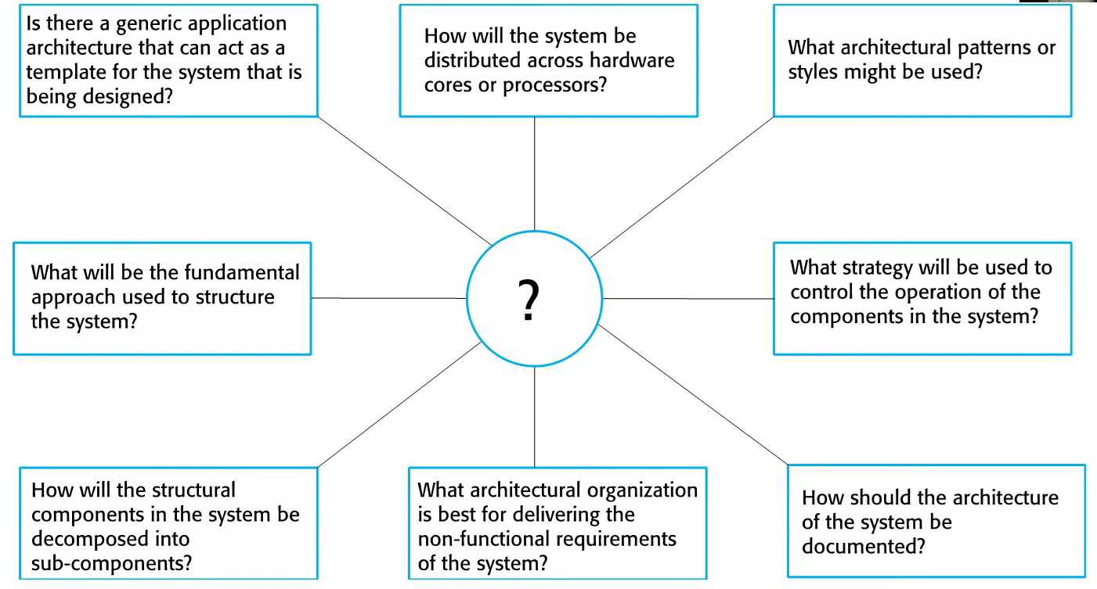
Questions which may arise during Architectural design
Notes:
Requirements and Objectives
What are the system's primary functional requirements?
What are the non-functional requirements (e.g., scalability, performance, security)?
What are the key business goals driving this design?
Are there any regulatory or compliance requirements to consider?
Technology and Tools
What technologies or frameworks best suit the project?
Are the chosen tools compatible with existing systems or infrastructure?
What are the trade-offs between open-source and proprietary solutions?
How do we ensure the system can adapt to future technological changes?
Scalability and Performance
Can the architecture handle expected growth in users or data?
What are the performance bottlenecks, and how can they be mitigated?
How will the system maintain performance under high load or stress?
Are caching or load-balancing mechanisms necessary?
What measures are in place to protect sensitive data?Are there vulnerabilities in the chosen technologies or design?How will authentication, authorization, and encryption be implemented?How does the architecture comply with privacy regulations (e.g., GDPR)?

Slide 13
Architectural Views
It is impossible to represent all relevant information about a system’s architecture in a single diagram, as a graphical model can only show one view or perspective of the system. It might show how a system is decomposed into modules, how the runtime processes interact, or the different ways in which system components are distributed across a network. Because all of these are useful at different times, for both design and documentation, you usually need to present multiple views of the software architecture

Slide 14
4+1 Architectural View Model
In software engineering, an architectural view refers to a high-level representation of a software system's structure and organization, from a specific perspective or stakeholder's point of view. The architectural view allows stakeholders to understand and communicate the system's architecture in a way that aligns with their concerns and priorities.
The views are used to describe the system from the viewpoint of different stakeholders, such as end-users, developers, system engineers, and project managers. The four views of the model are logical, development, process and physical view. In addition, selected use cases or scenarios are used to illustrate the architecture serving as the 'plus one' view. Hence, the model contains 4+1 views:

Slide 15
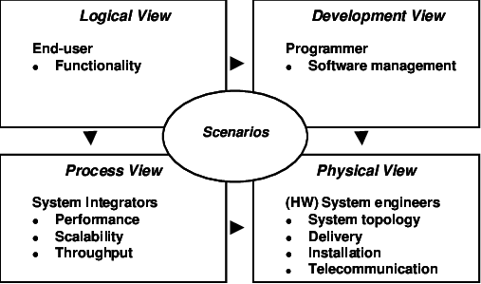
4+1 Architectural View Model
Notes:
Logical ViewFocus: Captures the functional requirements of the system by showing its key abstractions and entities.
Stakeholders: Developers, analysts.
Artifacts: Class diagrams, state diagrams, and other UML diagrams.
Example: How the system’s components (like users, services, and objects) interact to provide functionality.
Development (Implementation) ViewFocus: Shows the organization of the software code and its modular structure.
Stakeholders: Developers, maintainers.
Artifacts: Package diagrams, component diagrams.
Example: The hierarchy and dependencies among software modules.
Process ViewFocus: Addresses the system's runtime behavior, including concurrency, performance, and scalability.
Stakeholders: System integrators, performance engineers.
Artifacts: Activity diagrams, sequence diagrams, and state diagrams.
Example: How processes communicate, manage resources, or handle errors.
Physical (Deployment) View
Focus: Describes the system's physical deployment on hardware, including nodes, servers, and networks.
Stakeholders: System engineers, network engineers.
Artifacts: Deployment diagrams, network topologies.
Example: Mapping software components to physical servers.
Scenarios (Use Case) ViewFocus: Bridges all other views by describing specific use cases or scenarios that the system must handle.
Stakeholders: All stakeholders, including clients and end-users.
Artifacts: Use case diagrams, sequence diagrams.
Example: A specific workflow, such as "user login," highlighting how different views come together.

Slide 16
4+1 Architectural View Model
Logical view: The logical view is concerned with the functionality that the system provides to end-users. UML diagrams are used to represent the logical view, and include class diagrams, and state diagrams. A logical view, which shows the key abstractions in the system as objects or object classes. Static modeling view.
Process view: The process view deals with the dynamic aspects of the system, explains the system processes and how they communicate, and focuses on the run time behavior of the system. The process view addresses concurrency, distribution, integrator, performance, and scalability, etc. UML diagrams to represent process view include the sequence diagram, communication diagram, activity diagram.
Development view: The development view illustrates a system from a programmer's perspective and is concerned with software management. This view is also known as the implementation view. UML Diagrams used to represent the development view include the Package diagram and the Component diagram. A development view, which shows how the software is decomposed for development; that is, it shows the breakdown of the software into components that are implemented by a single developer or development team. This view is useful for software managers and programmers.

Slide 17
4+1 Architectural View Model
Physical view: The physical view (aka the deployment view) depicts the system from a system engineer's point of view. It is concerned with the topology of software components on the physical layer as well as the physical connections between these components. UML diagrams used to represent the physical view include the deployment diagram. physical view, which shows the system hardware and how software components are distributed across the processors in the system. This view is useful for systems engineers planning a system deployment.
Scenarios: The description of an architecture is illustrated using a small set of use cases, or scenarios, which become a fifth view. The scenarios describe sequences of interactions between objects and between processes. They are used to identify architectural elements and to illustrate and validate the architecture design. They also serve as a starting point for tests of an architecture prototype. This view is also known as the use case view.

Slide 18
Questions:
What is Architectural Design? Who does it? Why it is important? Give some appropriate example.
What is Architectural Design Decision? What Questions may arise during Architectural Design.
What is 4+1 Architectural View Model? Explain in brief.

Slide 19
Modular Decomposition:
To design system is to determine a set of components and inter component interface that satisfy a specified set of requirements. Basically there are many methods to create good designs, however very design method involves some kind of decomposition starting with a high level depiction of the system key elements and creating lower level looks at how the system feature and functions will fit together.
Notes:
dividing an application into smaller, reusable, and maintainable units called modules. This approach promotes separation of concerns, better organization, and easier testing.
Modules organize the app into logical sections. For example:UserModule: Handles user-related functionality (login, profile, settings).
ProductModule: Manages product catalog, details, and reviews.
AdminModule: Contains admin dashboards, reports, and settings.
A module contains all the components needed for a feature or section. For instance:ProductModule might include:
ProductListComponent
ProductDetailsComponent
ProductReviewComponent
Modules can be reused across multiple projects or parts of the application. For instance:A SharedModule contains common components (like a modal, button, or toast notification) used across different features.
Lazy Loading
Modules support lazy loading, which means loading specific parts of the app only when needed, improving performance for large apps.

Slide 20
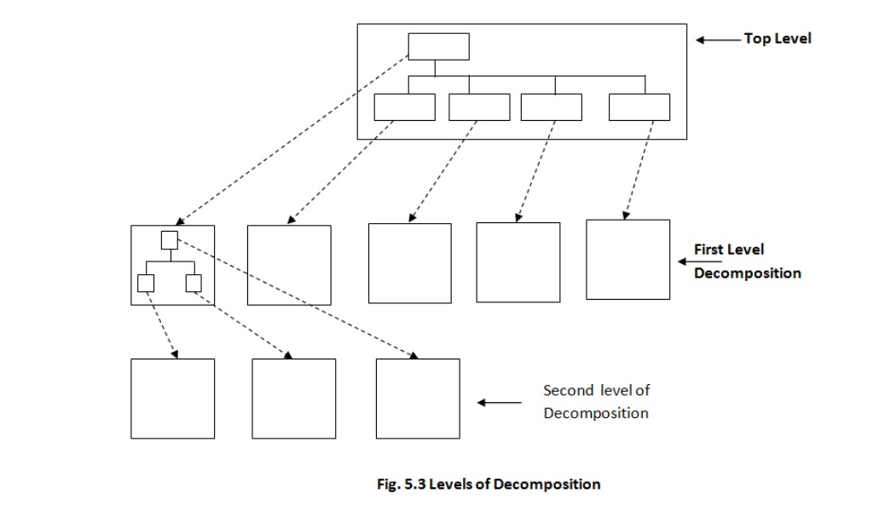
Level of Decomposition:
Notes:
Scope Organizes multiple components and features into a unit
COMPONENT Defines the UI and logic for a specific part of the app
Granularity Higher-level, broad grouping
COMPONENT Lower-level, fine-grained
PurposeEncapsulates related app functionality
COMPONENT Encapsulates a specific UI element or interaction
ReusabilityGroups reusable components and services
COMPONENT Creates reusable UI elements

Slide 21
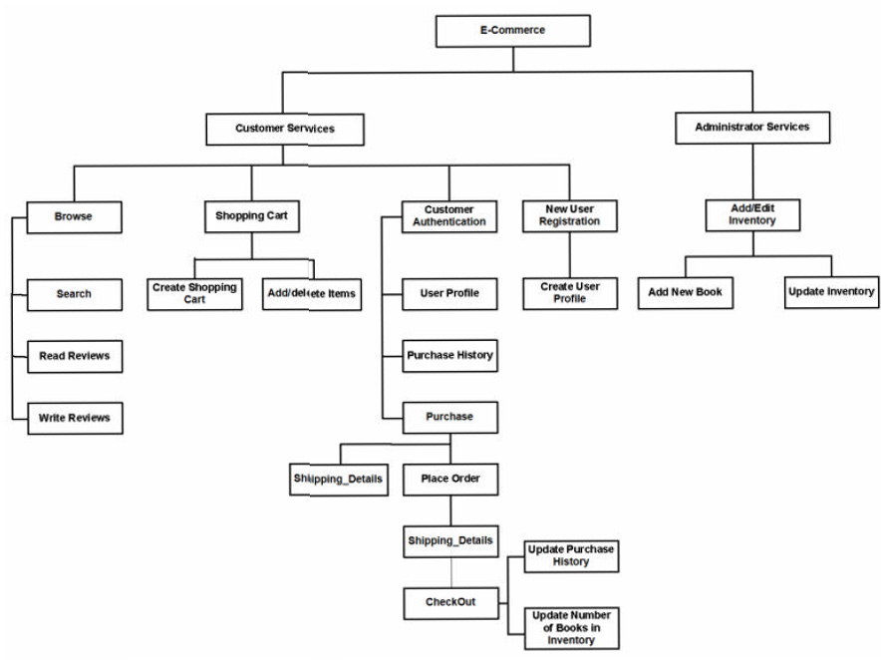
Example of Functional Decomposition:

Slide 22
Cohesion and Coupling
Cohesion and Coupling are two important terminologies in software engineering. Both of them relate to the interconnection between different parts of a system. Thus, there appears to be some similarity between the two.
Developers need to keep track of the coupling between the modules as in case of no records, there would be a lot of time spent on checking and rechecking the changes in the system. Also, they need to understand whether high or low cohesion/coupling is preferred to better design the system.
For more info. :
https://dare2compete.com/blog/react-project-ideas
Notes:
Cohesion refers to how closely related and focused the responsibilities of a module or component are. High cohesion means the module or component does one thing and does it well.
Coupling refers to the degree of dependency between modules or components. Low coupling is preferred because it makes the system more modular and flexible.

Slide 23
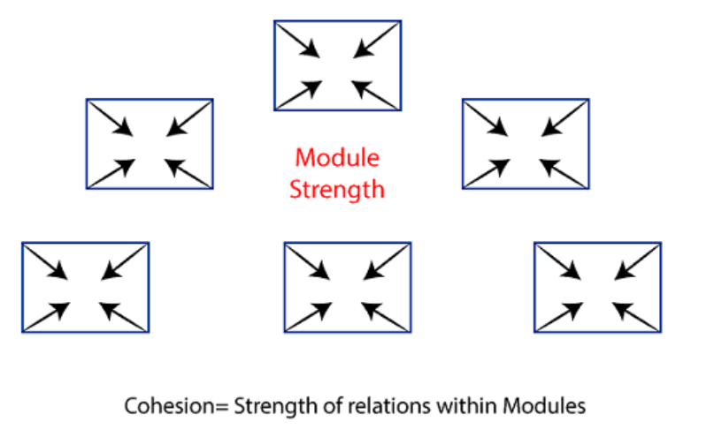
Cohesion
Cohesion is the indication of the relationship within module. It is concept of intra-module. Cohesion has many types but usually highly cohesion is good for software.
Notes:
Software Example: High Cohesion
A LoginService that:
Validates user credentials.
Communicates with the authentication API.
Why High Cohesion? The service focuses solely on login-related tasks and doesn’t handle unrelated logic like user profile management or order processing.
Low Cohesion
A service that:
Logs in users.
Manages user profiles.
Sends order confirmations.
Why Low Cohesion? Combining unrelated responsibilities makes the service harder to maintain, test, and reuse.

Slide 24
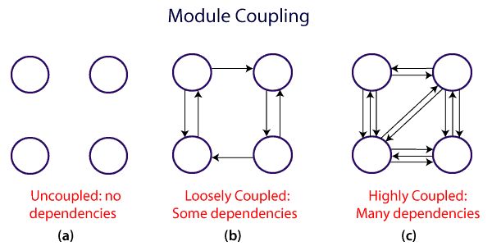
Coupling
Coupling is also the indication of the relationships between modules. It is concept of Inter-module. Coupling has also many types but usually low coupling is good for software.
Notes:
Software Example: Low Coupling
A PaymentService and OrderService communicate using well-defined interfaces.
OrderService calls PaymentService to process payments but doesn’t know the implementation details (e.g., which payment gateway is used).
Why Low Coupling? You can change the payment gateway logic without modifying the OrderService.
Software Example: High Coupling
The OrderService directly calls methods inside the PaymentService and relies on its internal implementation (e.g., accessing private methods or specific database schemas).
Why High Coupling? Changes in the PaymentService can break the OrderService, making the system less maintainable.

Slide 25
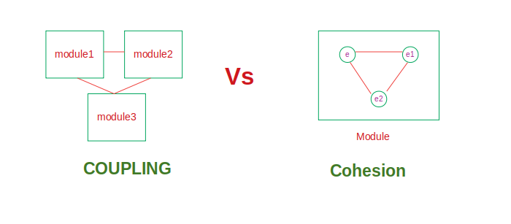
Example of Cohesion and Coupling:

Slide 26
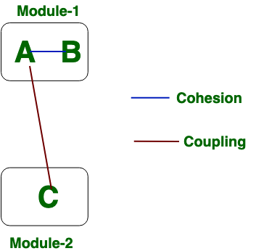
Example of cohesion and coupling

Slide 27
Question:
What is Modular Decomposition? Give some examples.
Differentiate between Cohesion and Coupling.

Slide 28
Architectural Pattern/Style:
In software engineering, an architectural style refers to a set of principles, conventions, and practices used to design and structure software systems.
Architectural styles provide a high-level blueprint for organizing system components, defining their interactions, and addressing common design concerns.
Architectural patterns help software architects and developers to design systems that are flexible, maintainable, and scalable. They provide a proven approach for addressing common problems, such as managing data persistence, handling user interfaces, and structuring the interaction between components.

Slide 29
Architectural Styles includes
Client server architecture
Layered architecture
Repository architecture
Pipe and filter architecture
MVC architecture

Slide 30
Client Server Architecture
The client-server architectural pattern is a widely used pattern in software engineering, particularly in networked applications. It is based on the idea of dividing the application into two parts: the client and the server.
In this pattern, the client is a user interface or application that runs on the user's device, such as a computer or a smartphone. The server is a centralized component that provides services or resources to multiple clients over a network.
The client sends requests to the server for specific tasks or data, and the server responds by providing the requested information or performing the requested action. This communication is typically done using a protocol such as HTTP, TCP/IP, or WebSocket.
Notes:
Client side ko components
User Interface (UI):
Displays data to the user and captures user input.
Example: Buttons, forms, and menus in a mobile app or website.
Application Logic:
Processes user input before sending a request to the server.
Example: Validating form data before sending it to the server.
Request Mechanism:
Sends requests to the server over a network using protocols (e.g., HTTP, HTTPS, or WebSocket).
Example: AJAX calls or API requests.
Client Device:
The physical or virtual device hosting the client software.
Examples: Browsers (Chrome, Firefox), mobile apps, or desktop applications.
Server side ko components
Application Logic:
Handles the processing of client requests and implements business rules.
Example: Authenticating a user or calculating pricing.
Database Management:
Stores and retrieves data needed by the server to fulfill client requests.
Example: A SQL database storing user profiles or product catalogs.
Request Handler:
Receives and processes client requests, then prepares a response.
Example: An API endpoint like GET /users.
Communication Protocol:
Defines how the server and client communicate.
Example: HTTP/HTTPS for web applications or TCP/IP for other applications.
Hardware Infrastructure:
The physical or virtual server hosting the application.
Examples: Cloud servers (AWS, Azure), on-premises servers.
Components of the Network:
Transport Protocols:
Facilitates communication between the client and server.
Example: TCP/IP for reliability, UDP for speed.
Security Protocols:
Ensures secure communication.
Example: SSL/TLS for encrypted HTTP requests (HTTPS).
Network Devices:
Physical devices like routers, switches, and firewalls that route data between clients and servers.

Slide 31
Benefits of client server architecture
Some of the benefits of using the client-server architectural pattern include:
Scalability: The server can handle a large number of clients, and additional servers can be added to handle increased demand.
Security: The server can control access to resources and enforce security policies to protect sensitive data.
Centralized management: The server can manage and maintain resources, such as databases and files, in a centralized location.
Flexibility: The client can be designed to work with different servers, and the server can be designed to provide different services to different clients.
Examples of applications that use the client-server architectural pattern include web applications, online games, and file sharing services.

Slide 32
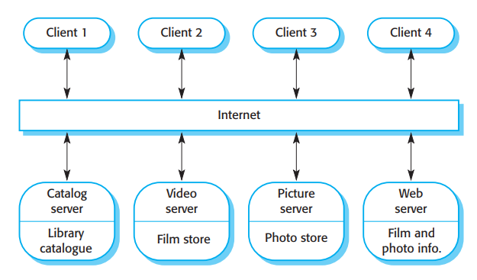
Client Server Architecture for a film library

Slide 33
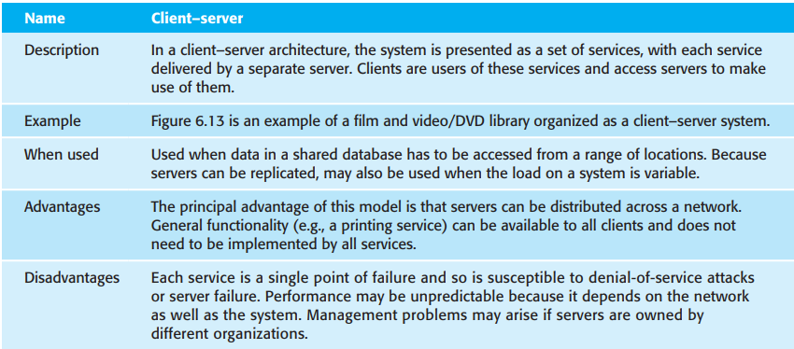
Client Server pattern

Slide 34
Layered Architecture
Layered architecture is a software design pattern that separates an application into a set of horizontal layers, each with a specific responsibility. Each layer is designed to perform a well-defined set of tasks, and communication between the layers follows a strict hierarchy.
Typically, a layered architecture consists of three or more layers. The most common layers are:
Presentation layer: This layer handles user interaction and typically includes the user interface components such as forms, dialogs, and web pages.
Business logic layer: This layer contains the application's core logic and rules that process and manipulate data. It is responsible for implementing the business logic of the application.
Data access layer: This layer provides an interface to access data from various sources, such as databases or web services. It is responsible for managing data storage and retrieval operations.

Slide 35
Benefits of Layered Architecture
The main benefits of using a layered architecture are:
Separation of concerns: Each layer has a specific responsibility, which makes it easier to maintain and update the application.
Modularity: The application is divided into a set of smaller, self-contained components that can be developed and tested independently.
Reusability: The components in each layer can be reused in other applications.
Scalability: The layers can be distributed across multiple servers, which makes it easier to scale the application as needed.
Testability: The layers can be tested independently, which makes it easier to identify and fix issues.
Notes:
Each layer has a distinct role and responsibility.
Layers only interact with the adjacent layers, reducing dependencies and complexity.
Internal details of each layer are hidden from other layers, exposing only necessary interfaces.
Changes in one layer have minimal impact on other layers.Easier to update, test, and maintain individual components.

Slide 36
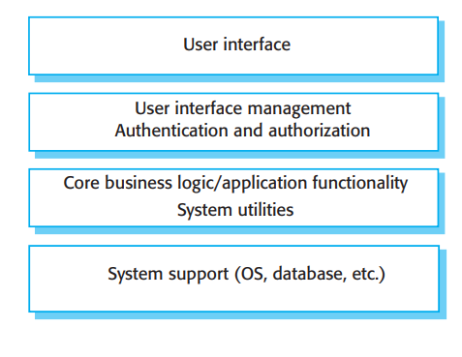
Layered Architecture
Notes:
Presentation Layer (UI/UX)
Role: Interacts with the end user.
Example:
A customer accesses the shopping platform using a web browser or mobile app.
Pages display product catalogs, shopping cart, and checkout forms. PASSWORD AND RE PASSWORD CHECK VAIRAKO HUNXA
Technologies: React, Angular, HTML, CSS, JavaScript, or mobile frameworks like Flutter.
2. Application Layer (Service Layer)
Role: Processes user requests and coordinates actions between layers.
Example:
Handles actions such as "Search for a product," "Add to cart," or "Place an order.“PASSWORD AND RE PASSWORD CHECK VAIRAKO HUNXA
Ensures that user inputs (e.g., selected items) are validated and processed correctly.
Implements APIs that the front-end (presentation layer) calls.
Technologies: REST APIs or GraphQL services implemented in Node.js, Java (Spring Boot), or Python (Django/Flask).
3. Domain Layer (Business Logic Layer)
Role: Contains the core logic and rules of the application.
Example:
Rules such as "Check stock availability before adding an item to the cart" or "Apply discounts based on promotion codes."
Business entities like Product, User, Order, and Payment are defined here with their behavior.
Technologies: Pure business logic implemented in programming languages like Java, Python, or C#.
4. Data Access Layer (Persistence Layer)
Role: Manages data storage and retrieval.
Example:
Fetches product details from the database when the user searches.
Saves the user's order details to the database when they check out.
Technologies: SQL or NoSQL databases like MySQL, PostgreSQL, MongoDB, or DynamoDB.
Tools: ORMs such as Hibernate, Entity Framework, or Sequelize.
5. Infrastructure Layer (Optional)
Role: Provides foundational services that support other layers.
Example:
Sending email notifications for order confirmations.
Logging errors or tracking user behavior.
Integrating with third-party systems like payment gateways (Stripe, PayPal).
Technologies: RabbitMQ for messaging, Elasticsearch for logging, AWS or Azure services for hosting.

Slide 37
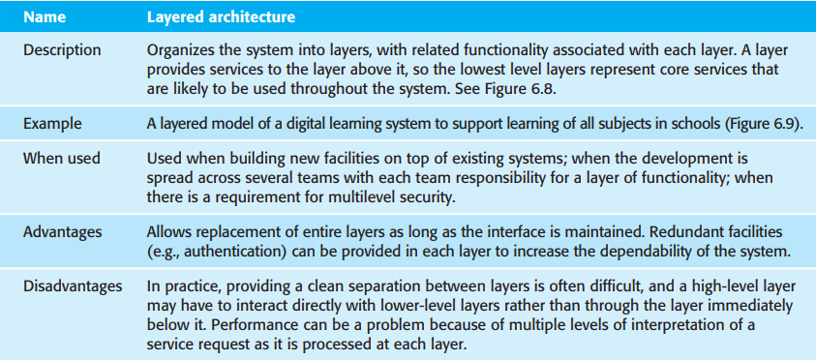
Layered Architectural Pattern
Notes:
When to Use
For applications needing clear separation of concerns (e.g., UI, business logic, and data).
When scalability, maintainability, and testability are priorities.
For large teams working on separate components.
In long-term projects expected to evolve over time.
Best suited for web and enterprise systems using standard frameworks.
Disadvantages
Introduces performance overhead due to inter-layer communication.
Can overcomplicate simple systems.
Cross-layer changes require significant effort.
Risks tight coupling if layers are not properly isolated.
Initial setup requires more time and planning.

Slide 38
Repository Architecture
• Data is stored in a central shared repository.
• Components interact through the repository only.
• Suited to applications whose data is generated by one component and used by another.
• Advantages: - Components are independent/separate.
- Changes to data are automatically available to other components.
• Communication between components may be inefficient.
Notes:
Enterprise Data Warehouses (e.g., Snowflake, Amazon Redshift)
Repository: Centralized data storage for business intelligence and analytics.
Usage: Multiple teams access the repository to generate reports, perform queries, and derive insights.
Content Management Systems (e.g., WordPress, Drupal)
Repository: Central database storing website content, user data, and metadata.
Usage: Editors, plugins, and users interact with the central repository to create, update, or retrieve content.

Slide 39
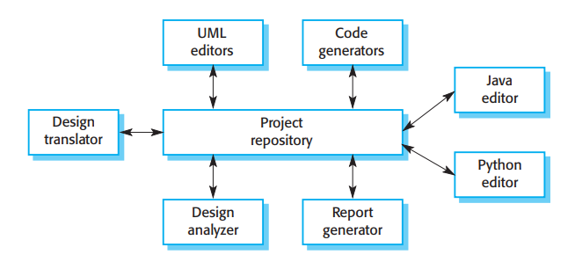
Repository Architecture
Notes:
Small or Rapid Development: Use Python, Ruby, or Node.js.
Enterprise Applications: Use Java, C#, or Kotlin.
Performance-Critical Systems: Use Go, Rust, or C++.
Web-Based Repositories: Use Node.js, Python, or Ruby.
Cross-Platform or Cloud-Native: Use Go or Rust.

Slide 40
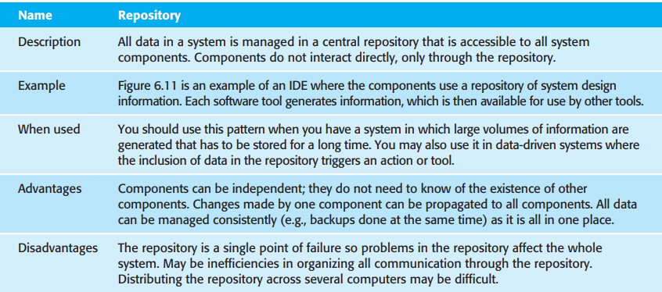
Repository Architecture
Notes:
Disadvantages
Single Point of Failure: The repository's unavailability impacts the entire system.
Potential for bottlenecks if the repository is not optimized.
Increases complexity when managing repository synchronization in distributed systems.

Slide 41
Pipe and Filter Architecture
A series of transformations on data
Composed of: - A set of “filters”, each one transforming some input stream into an output stream.
- Pipes connecting the filters.
Data is transformed as it moves through the system.
Transformations can be run concurrently.
Commonly used in batch processing systems and embedded control systems.
Difficult to use for interactive systems.
Notes:
Examples: for pani bata safa pani ma convert
Pre-Filter (Sediment Filter)
Purpose: Removes large particles like sand, dirt, silt, and rust.
Carbon Filter (Activated Carbon Filter)
Purpose: Removes chlorine, chemicals, and organic impurities that may affect taste, odor, or damage the RO membrane.
Post-Filter (Polishing Filter)
Purpose: Further polishes the filtered water, improving taste by removing any remaining odors or tastes.
UV Filter (Optional, in some systems)
Purpose: Kills or inactivates microorganisms such as bacteria and viruses using ultraviolet light.
Unix/Linux Command-Line Pipelines:
Command-line tools like grep, awk, and sed are classic examples of pipe and filter architecture.
Example: cat file.txt | grep "error" | sort | uniq – data flows through a sequence of commands, each filtering or transforming the data.
Data ETL (Extract, Transform, Load) Processes:
In ETL systems, data is extracted from a source, transformed through various filters (e.g., cleaning, aggregation), and loaded into a destination like a database.
Audio/Video Processing:
Audio or video editing tools often use a pipeline of filters (e.g., applying effects, filters, and transformations to the media).

Slide 42
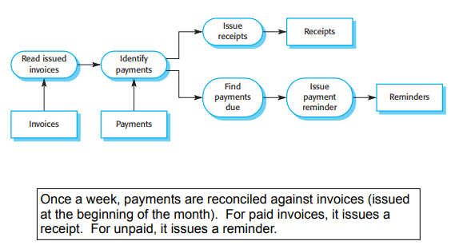
Pipe and Filter Architecture
Notes:
Scenario: An image processing system.
Filter 1: Load Image – Loads the image from a file into memory.
Filter 2: Resize – Resizes the image to a specified dimension.
Filter 3: Apply Filter – Applies a color filter or effect (e.g., grayscale).
Filter 4: Compress – Compresses the image to reduce file size.
Filter 5: Save – Saves the processed image to disk.

Slide 43
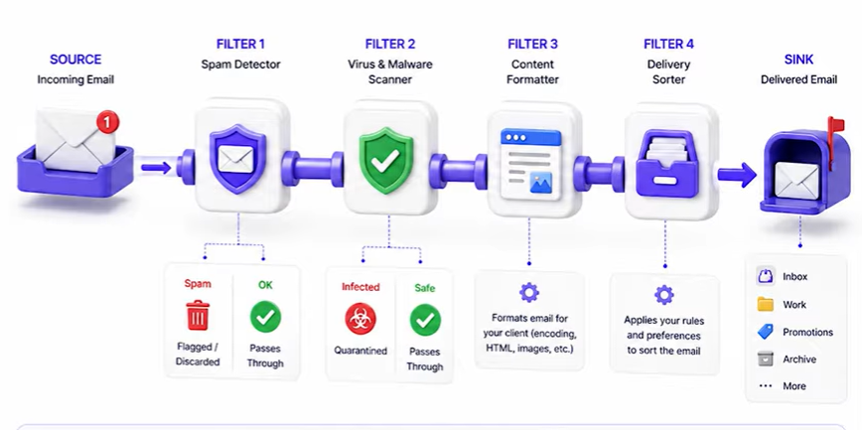
Pipe and Filter Architecture
Notes:
Scenario: An image processing system.
Filter 1: Load Image – Loads the image from a file into memory.
Filter 2: Resize – Resizes the image to a specified dimension.
Filter 3: Apply Filter – Applies a color filter or effect (e.g., grayscale).
Filter 4: Compress – Compresses the image to reduce file size.
Filter 5: Save – Saves the processed image to disk.

Slide 44
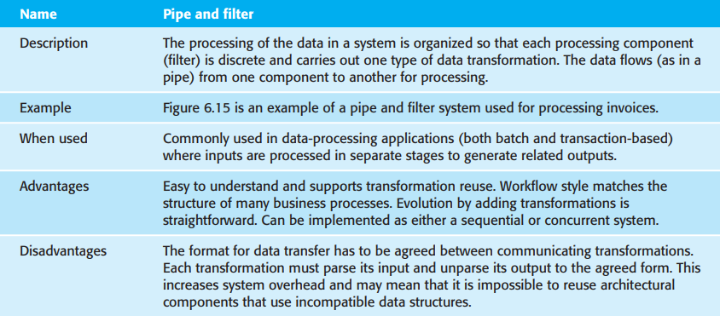
Pipe and Filter Architecture

Slide 45
Question
Write short notes on
Layered architecture
Repository architecture
Pipe and filter architecture

Slide 46
Model-View-Controller (MVC) Pattern
Commonly used in desktop, mobile phone, and web applications.
Used to separate the data (the model) from the way it is presented to the user (the views)
Model objects encapsulate the data.
View objects present data to and receive actions from the user.
Controller Responds to user actions (from View) by updating Model (and View).
Notes:
Model (Data and Business Logic)
What it does: Handles the data and the rules of the application. It doesn’t interact directly with the user.
Example in the system:
Data: Menu items, prices, user profiles, order history.
Logic: Calculating the total price, applying discounts, updating order status (e.g., “Preparing,” “Out for Delivery”).
Database interaction: Fetching and storing menu items, user information, and orders.
View (User Interface)
What it does: Displays the data and accepts input from the user.
Example in the system:
Mobile app or website interface where the user browses the menu, selects items, and checks out.
Visual elements like buttons, images, and text boxes.
Example view screens:
Menu page: Displays the list of available items.
Cart page: Shows selected items and total cost.
Controller (Input Logic and Coordination)
What it does: Acts as an intermediary between the model and the view. It takes user input, processes it, and updates the model or view accordingly.
Example in the system:
When a user selects a menu item, the controller processes the request, updates the cart in the model, and refreshes the cart view.
When the user confirms an order, the controller sends the order details to the model, updates the database, and navigates the user to the confirmation view.
Handles user authentication and redirects to the appropriate view based on login status.

Slide 47
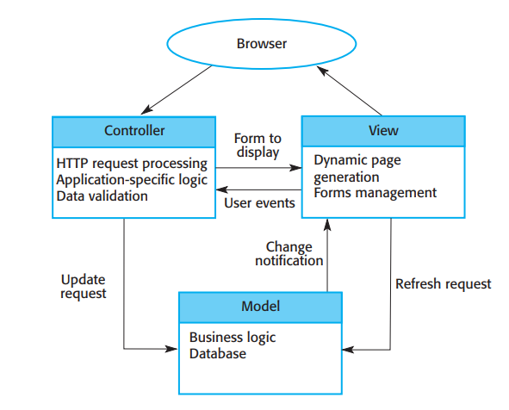
Model-View-Controller (MVC) Pattern

Slide 48
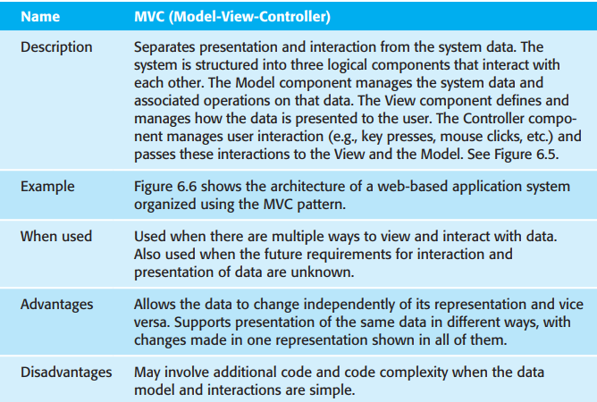
Model-View-Controller (MVC) Pattern
Notes:
When to use: (example share bazar)
Frequent UI Changes: When UI requirements evolve faster than business logic.
Multi-platform Development: When the same business logic (model) needs to support different interfaces (e.g., web and mobile).
Collaborative Development: Teams working on separate components (e.g., UI team focuses on the View, while backend developers focus on the Model).
Disadvantages :
3. Tight Coupling Between View and Controller
Controllers often have logic tied closely to specific Views, which can make switching Views harder than expected.
4. Overhead in Development
Implementing and maintaining three separate components can increase development time.
5. Difficult Debugging
Tracing a bug can be challenging because the flow of data spans multiple components.

Slide 49
Question:
Define Repository, Pipe and Filter and MVC pattern with proper figure.

Slide 50
Application architecture
Application architecture refers to the design and structure of an application, including its components, modules, and interactions. It is a crucial aspect of software development that determines the functionality, performance, scalability, and maintainability of an application.
There are several types of application architecture, including:
Monolithic architecture: In this architecture, the application is designed as a single unit, where all components are tightly coupled and interconnected. It is relatively simple to develop and deploy but lacks scalability and flexibility.
Service-oriented architecture (SOA): This architecture is based on the concept of dividing the application into smaller, independent services that can be developed and deployed separately. It provides better scalability, flexibility, and reusability of services.
Microservices architecture: This is an extension of SOA, where the application is broken down into even smaller services, each with a specific function. It provides high scalability, fault tolerance, and faster time-to-market.

Slide 51
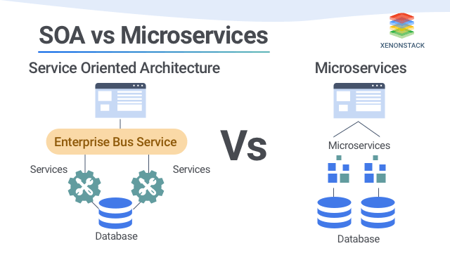
Application architecture
Notes:
SOA is a design paradigm that organizes software components (services) to provide reusable functionality through a common communication mechanism, typically using an Enterprise Service Bus (ESB).
An Enterprise Service Bus (ESB) is a middleware technology used in Service-Oriented Architecture (SOA) to enable communication and integration between various services, applications, and systems within an enterprise. It acts as a central hub that facilitates the routing, transformation, and orchestration of data across distributed systems.
Characteristics:
Centralized Communication: Often relies on an ESB for coordinating service interactions.
Reusable Services: Emphasizes reusability of services across different systems.
Disadvantages:
Complexity: The use of ESB and heavyweight protocols can make it complex to implement and maintain.
Tight Coupling: Often creates dependencies between services and the ESB.
Performance Overhead: Centralized communication and large payloads can lead to latency.
Microservices architecture structures an application as a collection of small, independent, and loosely coupled services, each focusing on a single business function.
Characteristics:
Decentralized Communication: Each service communicates directly with others, often via lightweight protocols like REST, gRPC, or messaging queues.
Single Responsibility: Each microservice focuses on a specific business capability.
Independence: Services are independently deployable and scalable.
Diverse Technology Stack: Services can use different technologies and languages.
Disadvantages:
Increased Complexity: Managing many small services, deployments, and communication paths can be challenging.
Operational Overhead: Requires robust DevOps practices and tools for CI/CD, monitoring, and logging.
Data Consistency: Ensuring data consistency across distributed services can be difficult.

Slide 52
Event-driven architecture (EDA)
Event-driven architecture (EDA) is a software design pattern that enables an organization to detect “events” or important business moments (such as a transaction, site visit, shopping cart abandonment, etc) and act on them in real time or near real time.
This pattern replaces the traditional “request/response” architecture where services would have to wait for a reply before they could move onto the next task. The flow of event-driven architecture is run by events and it is designed to respond to them or carry out some action in response to an event.

Slide 53
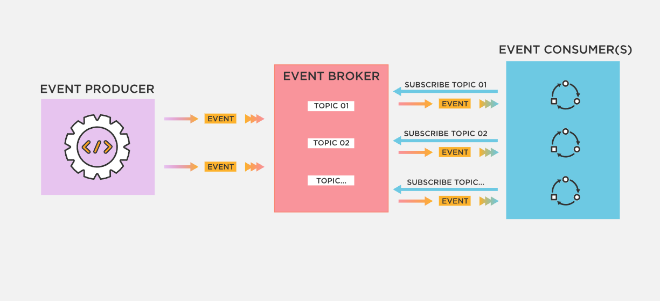
Event-driven architecture (EDA)

Slide 54
Information System
An information system (IS) is a set of interconnected components that collect, store, process, and distribute data or information to support decision-making, coordination, and control in an organization.
IS can be used in various areas of business such as accounting, finance, marketing, production, and human resources. It can also be used in different types of organizations such as businesses, non-profits, and governments.
IS are critical to the success of many organizations as they enable the efficient processing and sharing of information across departments, functions, and geographic locations. They can also help organizations to improve their decision-making, increase their productivity, and gain a competitive advantage.

Slide 55
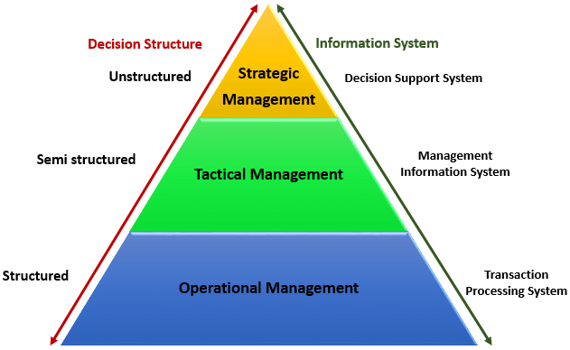
Types of Information System

Slide 56
Types of Information System
Transaction Processing System (TPS): These systems are used to capture and process data from daily transactions such as sales, orders, and payments. They are often used by businesses that deal with large volumes of transactions such as retail stores and banks.
Management Information System (MIS): These systems are used to generate reports that provide managers with information about the organization's performance, such as sales, inventory levels, and financials. They are often used by middle-level managers to make operational decisions.
Decision Support System (DSS): These systems are designed to help managers make strategic decisions by analyzing data and providing recommendations. They often use advanced analytical tools such as data mining and forecasting.

Slide 57
Question
Write short notes on:
Monolithic architecture
SOA architecture
Microservices architecture
Event Driven architecture

Slide 58
End of unit 6

