Slide 1
Unit 7 System Design Implementation
Software Engineering
CSIT 6th Semester

Slide 2
Syllabus
Introduction;
Object-Oriented Design using UML;
Design Patterns;
Implementation Issues;
Open-Source Development

Slide 3
Introduction
System design is the process of defining and planning the architecture, components, modules, interfaces, and data for a software system to satisfy specific business or technical requirements. It involves creating a detailed plan for how the software will be built, including its structure, functionality, and performance.
System implementation, on the other hand, involves actually building the software system based on the design specifications. This includes coding, testing, debugging, and deploying the software to production.

Slide 4
1. Software Design Concepts:
Concepts are defined as a principal idea or invention that comes into our mind or in thought to understand something.
The software design concept simply means the idea or principle behind the design. It describes how you plan to solve the problem of designing software, the logic, or thinking behind how you will design software.
It allows the software engineer to create the model of the system or software or product that is to be developed or built. The software design concept provides a supporting and essential structure or model for developing the right software. There are many concepts of software design and some of them are given below:

Slide 5
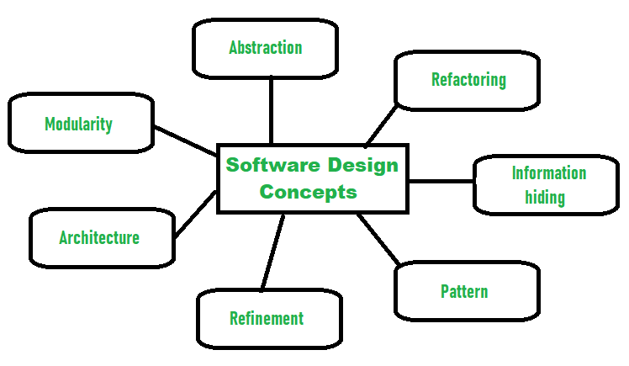
There are many concepts of software design and some of them are given below:

Slide 6
a. Abstraction- hide Irrelevant data
Abstraction simply means to hide the details to reduce complexity and increases efficiency or quality.
Different levels of Abstraction are necessary and must be applied at each stage of the design process so that any error that is present can be removed to increase the efficiency of the software solution and to refine the software solution.
The solution should be described in broad ways that cover a wide range of different things at a higher level of abstraction and a more detailed description of a solution of software should be given at the lower level of abstraction.
Notes:
In Databases:
Physical Abstraction: Disk blocks storing raw records.
Logical Abstraction: Tables and schemas that organize data logically.
View Abstraction: Application interfaces or custom views for specific user needs.
In Programming:
Low-Level (Physical): Bitwise data manipulation, memory pointers.
Intermediate Level: Abstract data types like arrays, lists, trees.
High-Level: APIs, frameworks, and objects representing the data.

Slide 7
Example:
An Example Of Abstraction
Consider a real-world analogy. Let’s say you want to ride a motor bike. All you need to start the motor bike is to put the key on, push the start button, and use the accelerator. While riding, you may need to use the brake as well.
You are not really concerned about how the engine, accelerator and brake are working during the ride. All that is abstract to you, and you are not concerned with it (unless you are mechanic).
Another Example
Take another example - printing a document from your computer. You just open the document, click on the “print” command, and in a short while, the printed document is ready. You are not really bothered about how the computer stores the document in 0s and 1s, nor about how it is transferred to the printer.

Slide 8
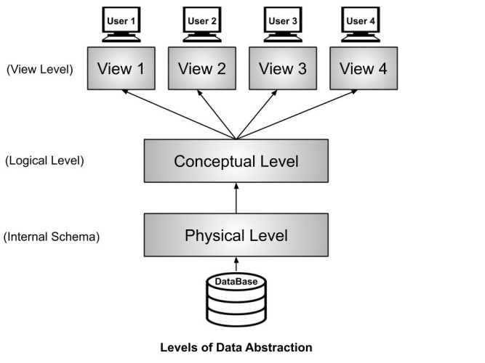

Slide 9
b. Architecture- design a structure of something
Architectural design is a process for identifying the sub-systems making up a system and the framework for sub-system control and communication. The output of this design process is a description of the software architecture.
Architectural design is an early stage of the system design process. It represents the link between specification and design processes and is often carried out in parallel with some specification activities. It involves identifying major system components and their communications.

Slide 10
c. Refinement- removes impurities
Refinement simply means to refine something to remove any impurities if present and increase the quality. The refinement concept of software design is actually a process of developing or presenting the software or system in a detailed manner that means to elaborate a system or software. Refinement is very necessary to find out any error if present and then to reduce it.
Notes:
The code was refined to use Python's built-in sum() function, which abstracts away the implementation details.
By normalizing, we eliminated redundancy and ensured better maintainability.
Missing values were filled (e.g., average income), and incomplete records were corrected.

Slide 11
d. Information Hiding- hide the information
Information hiding simply means to hide the information so that it cannot be accessed by an unwanted party. In software design, information hiding is achieved by designing the modules in a manner that the information gathered or contained in one module is hidden and can’t be accessed by any other modules.
Notes:
Encapsulation: Combining data and methods into a single unit (e.g., a class) while restricting direct access to internal components.Abstraction: Providing a simplified interface that hides implementation details.Controlled Access: Using access modifiers like private, protected, or public in object-oriented programming to limit access to data and methods.
FocusDescribes what data and operations are relevant.
Conceals how data and operations are implemented.
PurposeSimplifies complexity by providing a clean interface.Ensures security, prevents misuse, and reduces dependencies.
ScopeDeals with interfaces (e.g., abstract classes, ADTs).Deals with implementation details (e.g., private variables).
ImplementationAchieved through classes, abstract classes, interfaces, etc.Achieved through access modifiers (private, protected, etc.).
Example UseAbstract data types, APIs, or class interfaces.Restricting access to internal logic or variables in a class.

Slide 12
e. Refactoring- reconstruct something
Refactoring simply means reconstructing something in such a way that it does not affect the behavior of any other features. Refactoring in software design means reconstructing the design to reduce complexity and simplify it without affecting the behavior or its functions. Fowler has defined refactoring as “the process of changing a software system in a way that it won’t affect the behavior of the design and improves the internal structure”.
Notes:
Code Duplication: The percentage validation logic is repeated in both functions.Maintainability Issue: Any change to the percentage validation logic would require updating both functions.

Slide 13
f. Modularity- subdivide the system
Modularity simply means dividing the system or project into smaller parts to reduce the complexity of the system or project. In the same way, modularity in design means subdividing a system into smaller parts so that these parts can be created independently and then use these parts in different systems to perform different functions.
It is necessary to divide the software into components known as modules because there are different software available like Monolithic software that is hard to grasp for software engineers.
So, modularity in design has now become a trend and is also important. If the system contains fewer components then it would mean the system is complex which requires a lot of effort (cost) but if we are able to divide the system into components then the cost would be small.

Slide 14
g. Pattern- a repeated form
In software engineering, a design pattern is a general repeatable solution to a commonly occurring problem in software design. A design pattern isn't a finished design that can be transformed directly into code. It is a description or template for how to solve a problem that can be used in many different situations.
Design patterns can speed up the development process by providing tested, proven development paradigms. Effective software design requires considering issues that may not become visible until later in the implementation.
Reusing design patterns helps to prevent subtle issues that can cause major problems and improves code readability for coders and architects familiar with the patterns.
Notes:
Problem:
You want to create objects without specifying their exact class, allowing the code to remain flexible and scalable.
Solution:
Use the Factory Method Pattern, which provides an interface for creating objects in a superclass but allows subclasses to alter the type of objects that will be created.
Problem:
You need to ensure that only one instance of a class exists throughout the lifecycle of an application (e.g., a configuration manager or database connection).
Solution:
Use the Singleton Pattern, which restricts instantiation of a class to a single object.

Slide 15
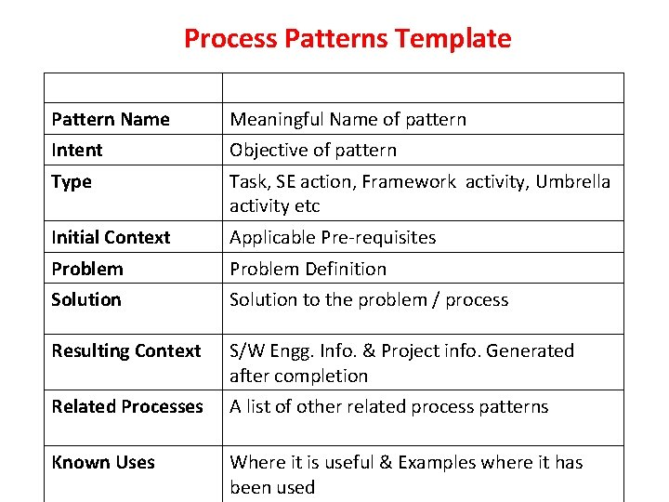
Pattern Template:

Slide 16
2. Object Oriented design using UML
Object-oriented design (OOD) is an approach to software design that involves modeling software systems as collections of objects that interact with one another to perform tasks.
UML (Unified Modeling Language) is a standardized language for modeling object-oriented software systems. UML provides a set of graphical notations for creating visual models of software systems.
UML diagrams are a powerful tool for communicating the design of a software system, and can be used by developers, architects, and stakeholders to better understand the system and ensure that it meets the requirements of the business. However, it is important to note that UML is just a tool, and that a deep understanding of object-oriented programming concepts and principles is still required to create effective software designs.

Slide 17
2. Object Oriented design using UML
Common activities in these processes include:
Define the context and models of use of the system;
Design the system architecture;
Identify the principal system objects;
Develop design models;
Specify object interfaces.

Slide 18
UML diagrams used in object oriented design
Here are some key UML diagrams used in object-oriented design:
Class diagram: A class diagram is a diagram that shows the relationships among classes in a software system. It includes information about the attributes and methods of each class, as well as the relationships between classes.
Sequence diagram: A sequence diagram shows the interactions between objects in a software system over time. It includes information about the messages sent between objects and the order in which they are sent.
Use case diagram: A use case diagram shows the interactions between actors (users or other systems) and a software system. It includes information about the tasks that the system can perform and the actors that can perform them.
Activity diagram: An activity diagram shows the flow of activities (tasks or actions) in a software system. It includes information about the inputs, outputs, and conditions for each activity.

Slide 19
2.1 System context and interactions
In this step, We define the system boundary and understand how the system interacts with its surrounding environment to deliver required functionality.
External entities (such as other automated systems) interact with the target system by either providing input data or consuming output data.
To avoid excessive detail early in design, an abstract approach is used to model these external interactions.
Use Case Diagrams are constructed to represent these high-level interactions between the system and its external actors without cluttering the design with implementation details.

Slide 20
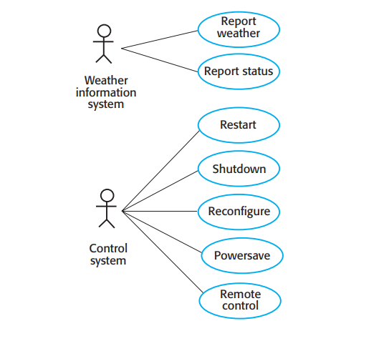
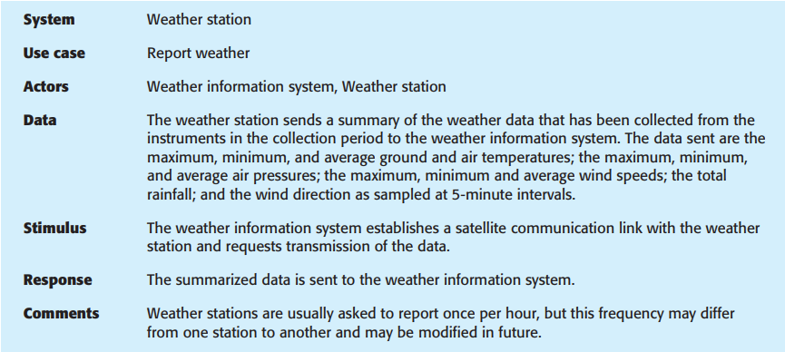
Example of Use case diagram
**use case notations, its features and advantages. Study yourself

Slide 21
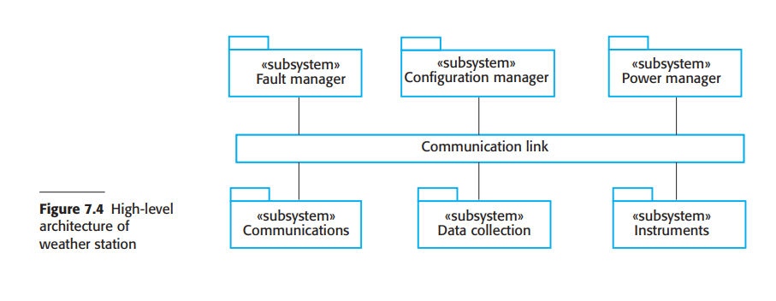
2.2 Architectural design
After identifying the interactions between the software system and its environment, that information is used for designing systems architecture.
Architectural design is the process of decomposing the system into subsystems and establishing the relationship between subsystems. For this any of the architectural pattern is chosen from repository architecture, client server architecture or layered architecture.

Slide 22
2.3 Object class identification
From architectural design you already have idea about the necessary objects in the system. Object identification is the important and critical issue in the object oriented design. There is no 'magic formula' for object identification. It relies on the skill, experience and domain knowledge of object-oriented system designers.
The functions of this stage are
Identifying and refining the classes in each subsystem or package
Defining the links and associations between classes
Designing the classes the hierarchical, associations among the classes, the generalization/specialization and inheritances
Designing aggregations
This can be modeled using object and class diagram of the system.

Slide 23
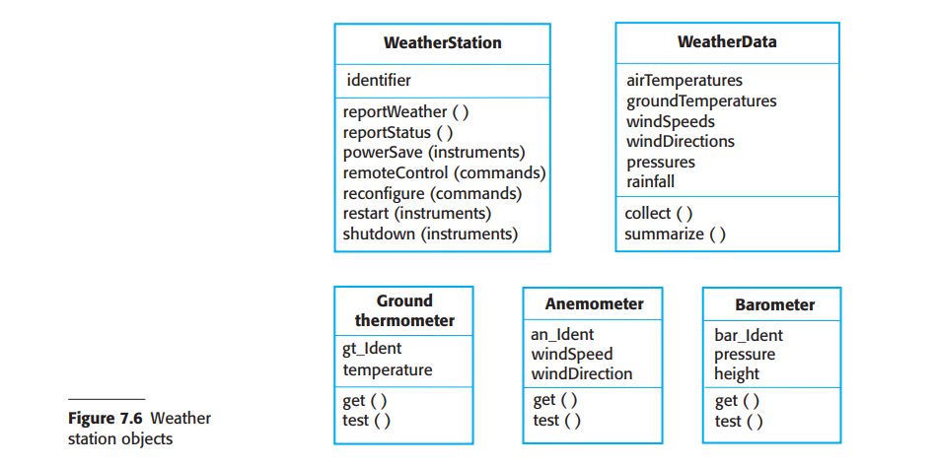
2.3 Object class identification
The use case description helps to identify objects and operations in the system. From the description of the Report weather use case, it is obvious that you will need to implement objects representing the instruments that collect weather data and an object representing the summary of the weather data.

Slide 24
2.4 develop Other Design models
Design or system models, as we discussed in Chapter 5, show the objects or object classes in a system. They also show the associations and relationships between these entities.
A design model in Software Engineering is an object-based picture or pictures that represent the system. It shows the object or object classes in a system.
Design models show the associations or relationship between system entities that act as bridge between requirement specification and implementation of system.
The design model that we choose to design a system depends on the type of system being developed. For example we design a sequential data processing system in a different way than real time systems.

Slide 25
2.4 develop Other Design models
1. Static/Structural Model:
Structural diagrams, as the name suggest show how the system is structured, including the classes, objects, packages, components, etc. in the system and the relationships between those elements. The structural diagrams represent the static aspect of the system. These static aspects represent those parts of a diagram, which forms the main structure and are therefore stable. This model describes the static structure of the system in terms of object classes and their relationships. Class diagram/Component diagram are the best example of static model
2. Dynamic/ Behavioral Model:
This model shows the dynamic structure of the system that shows the interactions between the system objects. Dynamic aspect can be described as the changing/moving parts of a system. Behavioral diagram assist in understanding and communicating how elements interact and collaborate to provide the functionality of a system. Use case diagram, activity diagram, sequence diagram etc. are examples of dynamic models.

Slide 26
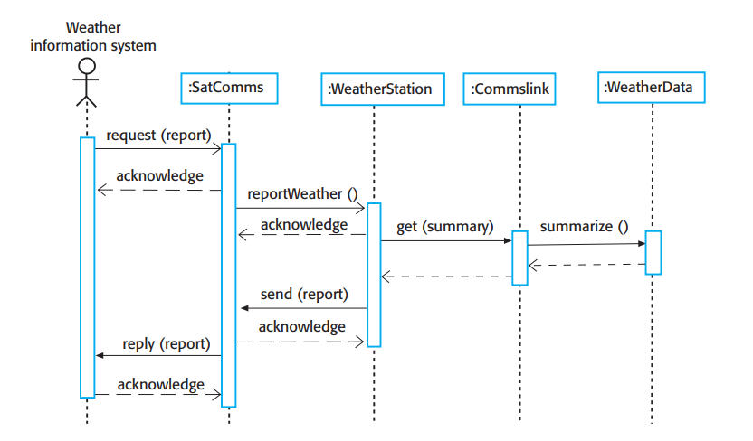
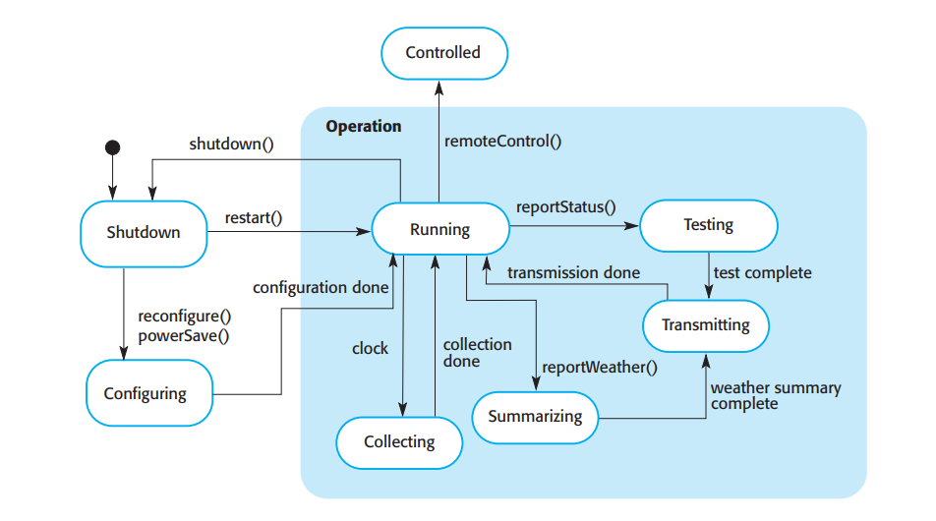
Example of Sequence diagram and State diagram

Slide 27
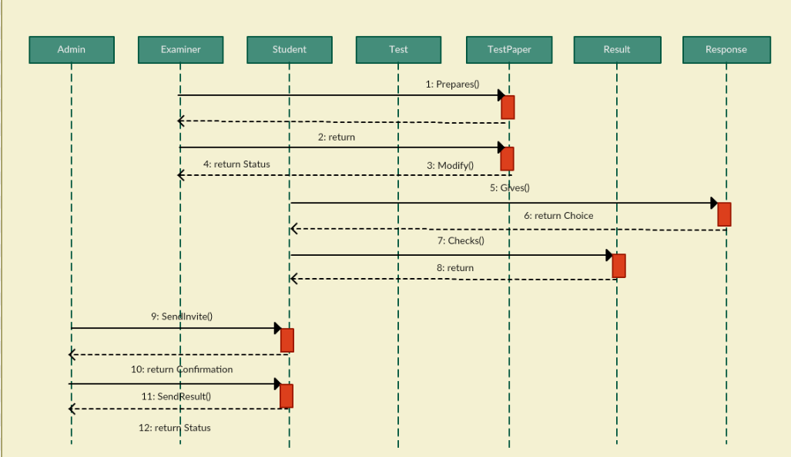
Example of Sequence diagram

Slide 28
2.4 Identify object Interface
Interface specifications provide the standardized mechanism in which subsystems can effectively communicate with each other and enable them to operate as independent modules.
In this interface between the components in the design is specified so that objects and sub systems can be designed in parallel and they can communicate with each other.
Interface design concerned with specifying the detail of the interface to an object or to a group of objects. It defines the signatures and semantics of the services that are provided by the object or by a group of objects. The UML uses class diagrams for interface specification but Java may also be used.

Slide 29
Question:
What is System Design? Explain the concept of system design.
What is Object oriented design using UML? What UML diagrams are there to design the system?

Slide 30
3. Design Patterns
In software engineering, a design pattern is a general, reusable solution to a commonly occurring problem within a given context in software design. It is not a finished piece of code that you can copy and paste. Instead, it serves as a conceptual template or blueprint explaining how to solve a problem efficiently.
Advantages
Object-oriented design patterns typically show relationships and interactions between classes or objects, without specifying the final application classes or objects that are involved.
Design patterns can speed up the development process by providing tested, proven development paradigms. Effective software design requires considering issues that may not become visible until later in the implementation.
Reusing design patterns helps to prevent subtle issues that can cause major problems and improves code readability for coders and architects familiar with the patterns.

Slide 31
3.1 Gang of four
The foundation of modern design patterns was codified in 1994 by Erich Gamma, Richard Helm, Ralph Johnson, and John Vlissides, collectively known as the "Gang of Four" (GoF). They documented 23 classic design patterns and divided them into three major categories.
The Three Core Categories
Creational Patterns: These patterns deal with object creation mechanisms, trying to create objects in a manner suitable to the situation. They reduce complexity by controlling how objects are instantiated.
Structural Patterns: These patterns explain how to assemble objects and classes into larger structures while keeping these structures flexible and efficient.
Behavioral Patterns: These patterns are specifically concerned with communication, interaction, and assignment of responsibilities between objects.

Slide 32
Creational Design Patterns:
Singleton Pattern
Factory Method Pattern
Abstract Factory Pattern
Builder Pattern
Prototype Pattern
Notes:
Singleton Pattern (Creational)
Purpose: Ensures a class has only one instance and provides a global access point to it.
Example: Database Connection A database connection should be one shared instance instead of creating multiple connections.
Factory pattern Purpose: Provides an interface for creating objects but lets subclasses decide which class to instantiate.
Example: Shape Factory: IN MS WORD SHAPE VANNE XA RE TESMA HAMLE AFNO MANPARNE SHAPE BANAUXAU Instead of manually creating objects, a factory method creates them dynamically.
Abstract factory
Purpose: Provides an interface for creating families of related objects without specifying their concrete classes.
Real-World Example: GUI Library (Windows, Mac, Linux) IF HAMLAI FLEXIBLE CHAINXA RA RIGIDLY WINDOWS KO LAGI MATRA CHALXA VANERA BASDAINAM
A UI toolkit should generate buttons and checkboxes that match the OS style (Windows, Mac, Linux).
Builder Pattern
Purpose: Separates the construction of a complex object from its representation, step by step.
Real-World Example: Burger Ordering System KUNAI PANI EUTA KAAM HUNALAI MULTIPLE STEPS COMPLETE HUNU PARXA
A restaurant offers customized burgers with different ingredients (bun, cheese, sauce, etc.).
Prototype Pattern
Purpose: Allows cloning objects instead of creating new ones from scratch, improving performance.
Real-World Example: Document Templates HAMLE SAVE AS GARXAM OR COPY GARXAM IN PHOTOSHOP OR WORD MA
A text editor allows users to create new documents from predefined templates (resume, invoice, etc.).

Slide 33
Creational Design Patterns:
1. Creational Patterns (5 Patterns)
These patterns control object creation mechanisms, isolating the generation logic from the system to reduce complexity and tight coupling.
Abstract Factory: Creates families of related or dependent objects without specifying their exact concrete classes.
Builder: Constructs complex objects step-by-step, allowing the same construction process to produce different representations.
Factory Method: Defines a creation interface but lets subclasses decide which specific class to instantiate.
Prototype: Creates new objects by cloning an existing configured instance (prototype) rather than creating them from scratch.
Singleton: Ensures that a class has exactly one global instance and provides a single, unified point of access to it.
Notes:
Singleton Pattern (Creational)
Purpose: Ensures a class has only one instance and provides a global access point to it.
Example: Database Connection A database connection should be one shared instance instead of creating multiple connections.
Factory pattern Purpose: Provides an interface for creating objects but lets subclasses decide which class to instantiate.
Example: Shape Factory: IN MS WORD SHAPE VANNE XA RE TESMA HAMLE AFNO MANPARNE SHAPE BANAUXAU Instead of manually creating objects, a factory method creates them dynamically.
Abstract factory
Purpose: Provides an interface for creating families of related objects without specifying their concrete classes.
Real-World Example: GUI Library (Windows, Mac, Linux) IF HAMLAI FLEXIBLE CHAINXA RA RIGIDLY WINDOWS KO LAGI MATRA CHALXA VANERA BASDAINAM
A UI toolkit should generate buttons and checkboxes that match the OS style (Windows, Mac, Linux).
Builder Pattern
Purpose: Separates the construction of a complex object from its representation, step by step.
Real-World Example: Burger Ordering System KUNAI PANI EUTA KAAM HUNALAI MULTIPLE STEPS COMPLETE HUNU PARXA
A restaurant offers customized burgers with different ingredients (bun, cheese, sauce, etc.).
Prototype Pattern
Purpose: Allows cloning objects instead of creating new ones from scratch, improving performance.
Real-World Example: Document Templates HAMLE SAVE AS GARXAM OR COPY GARXAM IN PHOTOSHOP OR WORD MA
A text editor allows users to create new documents from predefined templates (resume, invoice, etc.).

Slide 34
Structural Design Patterns:
Adapter Pattern
Bridge Pattern
Composite Pattern
Decorator Pattern
Facade Pattern
Flyweight Pattern
Proxy Pattern
Notes:
Adapter Pattern (Translator)
Purpose: Converts one interface into another that a client expects.
Think of it as a translator – If a person speaks English and another speaks French, a translator (adapter) helps them communicate. HAMRO HDMI CABLE TO USB CABLE DATA TRANSFER VAIRAKO XA RE
Bridge Pattern (Decoupler)2 OTA MACHINE INDEPENDENT HO BUT INTERACTION NI GARXA
Purpose: Decouples abstraction from implementation so they can change independently. 🔹 Think of it as a remote control – The same remote (interface) can control different TVs (implementations).
Composite Pattern (Tree Structure) GROUP OF OBJECTS LAI OVERALL EUTA KO HISAB MA KAAM GARXA
Purpose: Treats a group of objects the same way as a single object (Hierarchical structure). 🔹 Think of it as a file system – A folder contains files and other folders, and they are all treated the same way.
Decorator Pattern (Adding Features) HAMLE EUTA OBJECT LAI MULTIPLE TARIKA LE REPRESENT GARNA MILNE
Purpose: Dynamically adds new behavior to objects without modifying their structure. 🔹 Think of it as a pizza – You can add toppings (cheese, olives, pepperoni) without changing the base pizza.
Real-World Example:
Adding extra features to a car (like sunroof, GPS, leather seats).
Wrapping text with bold, italic, or underline in a text editor.
Facade Pattern (Simplified Interface)
Purpose: Provides a simple interface to a complex system. 🔹 Think of it as a car dashboard – You don’t need to understand the engine, just press the "Start" button.
Flyweight Pattern (Memory Optimization) GOOGLE MAP LE TRAFFIC JAM XA XAINA VANERA DEKHAUNE USING GPS TRACKER NOT BECAUSE SATTELITE BATA CAMERA KO THROUGH HERERAKO..
Purpose: Shares common objects instead of creating new ones, reducing memory usage. 🔹 Think of it as a chess game – Instead of creating a new object for every "pawn", we reuse existing ones.
Proxy Pattern (Controlled Access) KUNAI EUTA COMPONENT LE ACCESS GARNE ..
Purpose: Provides a placeholder for another object to control access to it. 🔹 Think of it as a security guard – Controls access to a VIP area.
Real-World Example:
Bank ATMs act as proxies to actual bank accounts.
Netflix proxies manage access to content based on user location.

Slide 35
Structural Design Patterns:
2. Structural Patterns (7 Patterns):
These patterns focus on class and object composition, using inheritance and interfaces to safely assemble smaller objects into larger, flexible structures.
Adapter: Translates the incompatible interface of an existing class into another interface that a client expects.
Bridge: Decouples an object's abstraction from its implementation details so the two can vary independently.
Composite: Composes objects into tree-like structures to represent part-whole hierarchies, treating individual objects and compositions uniformly.
Decorator: Dynamically adds new behaviors or responsibilities to an object at runtime without altering its structure.
Facade: Provides a simplified, high-level interface that hides the complex internal subsystems of a framework or library.
Flyweight: Shares large volumes of fine-grained object data to minimize memory consumption.
Proxy: Provides a placeholder or surrogate object to control or restrict access to the original object.
Notes:
Adapter Pattern (Translator)
Purpose: Converts one interface into another that a client expects.
Think of it as a translator – If a person speaks English and another speaks French, a translator (adapter) helps them communicate. HAMRO HDMI CABLE TO USB CABLE DATA TRANSFER VAIRAKO XA RE
Bridge Pattern (Decoupler)2 OTA MACHINE INDEPENDENT HO BUT INTERACTION NI GARXA
Purpose: Decouples abstraction from implementation so they can change independently. 🔹 Think of it as a remote control – The same remote (interface) can control different TVs (implementations).
Composite Pattern (Tree Structure) GROUP OF OBJECTS LAI OVERALL EUTA KO HISAB MA KAAM GARXA
Purpose: Treats a group of objects the same way as a single object (Hierarchical structure). 🔹 Think of it as a file system – A folder contains files and other folders, and they are all treated the same way.
Decorator Pattern (Adding Features) HAMLE EUTA OBJECT LAI MULTIPLE TARIKA LE REPRESENT GARNA MILNE
Purpose: Dynamically adds new behavior to objects without modifying their structure. 🔹 Think of it as a pizza – You can add toppings (cheese, olives, pepperoni) without changing the base pizza.
Real-World Example:
Adding extra features to a car (like sunroof, GPS, leather seats).
Wrapping text with bold, italic, or underline in a text editor.
Facade Pattern (Simplified Interface)
Purpose: Provides a simple interface to a complex system. 🔹 Think of it as a car dashboard – You don’t need to understand the engine, just press the "Start" button.
Flyweight Pattern (Memory Optimization) GOOGLE MAP LE TRAFFIC JAM XA XAINA VANERA DEKHAUNE USING GPS TRACKER NOT BECAUSE SATTELITE BATA CAMERA KO THROUGH HERERAKO..
Purpose: Shares common objects instead of creating new ones, reducing memory usage. 🔹 Think of it as a chess game – Instead of creating a new object for every "pawn", we reuse existing ones.
Proxy Pattern (Controlled Access) KUNAI EUTA COMPONENT LE ACCESS GARNE ..
Purpose: Provides a placeholder for another object to control access to it. 🔹 Think of it as a security guard – Controls access to a VIP area.
Real-World Example:
Bank ATMs act as proxies to actual bank accounts.
Netflix proxies manage access to content based on user location.

Slide 36
Behavioral Design Patterns:
Chain of Responsibility Pattern
Command Pattern
Interpreter Pattern
Iterator Pattern
Mediator Pattern
Memento Pattern
Observer Pattern
State Pattern
Strategy Pattern
Template Method Pattern
Visitor Pattern
Notes:
Chain of Responsibility Pattern (Passing the Request)
🔹 Purpose: Passes requests along a chain of handlers, where each handler decides whether to process or pass it to the next. 🔹 Real-World Example:
Technical support system (Level 1 → Level 2 → Level 3).
Bank loan approval (Clerk → Manager → Director).
Command Pattern (Encapsulating Actions)
🔹 Purpose: Encapsulates a request as an object to parameterize clients. 🔹 Real-World Example:
Undo/Redo operations in text editors.
Remote control buttons (each button is a command).
Interpreter Pattern (Language Interpreter)
🔹 Purpose: Interprets expressions based on a grammar. 🔹 Real-World Example:
Google Translate, SQL Query Parsers.
Regex (Regular Expressions) for string matching.
Iterator Pattern (Sequential Access)
🔹 Purpose: Provides a way to access elements sequentially without exposing their structure. 🔹 Real-World Example:
TV Channel Navigation (Next/Previous).
Playlist navigation in music players.
Mediator Pattern (Centralized Communication)
🔹 Purpose: A mediator object handles communication between different objects, preventing direct coupling. 🔹 Real-World Example:
Air Traffic Controller managing communication between pilots.
Chatroom where users communicate through a mediator (server).
Memento Pattern (Saving & Restoring State)
🔹 Purpose: Captures an object's state and restores it later. 🔹 Real-World Example:
Undo/Redo SAVE RESTORE AUTOMATICALLY in text editors.
Saving game progress in video games.
Observer Pattern (Event Subscription)
🔹 Purpose: Allows multiple objects to listen for changes in another object. 🔹 Real-World Example:
YouTube subscriptions (You get notified when a channel posts a new video).
Stock market updates (Investors get notified of price changes)
State Pattern (Behavior Changes Based on State)
🔹 Purpose: Allows an object to alter its behavior when its internal state changes. 🔹 Real-World Example:
Traffic lights (Red → Green → Yellow).
ATM Machine (Idle → Processing → Dispensing Cash).
Strategy Pattern (Multiple Algorithms)
🔹 Purpose: Allows selecting an algorithm dynamically. 🔹 Real-World Example:
Navigation apps (Choose between fastest, shortest, or scenic route).
Compression algorithms (ZIP, RAR, 7z).
Template Method Pattern (Skeleton Algorithm)
🔹 Purpose: Defines a template for an algorithm and allows subclasses to fill in details. 🔹 Real-World Example:
Coffee Making Process (Boil water → Brew Coffee → Pour in cup → Add sugar/milk).
Visitor Pattern (Adding New Operations)
🔹 Purpose: Adds new operations to objects without modifying them. 🔹 Real-World Example:
Tax calculation for different product types.
Insurance premium calculation based on user type.

Slide 37
3. Behavioral Patterns (11 Patterns)
These patterns manage object communication and responsibility assignment, outlining how objects interact and pass messages efficiently.
Chain of Responsibility: Passes a request along a sequential chain of potential handlers until one processes it.
Command: Encapsulates a request or action into a self-contained object, supporting undo/redo operations and request queuing.
Interpreter: Establishes a grammatical representation for a simple language along with an interpreter to evaluate sentences.
Iterator: Sequentially accesses elements of an aggregate collection without exposing its underlying internal structure.
Mediator: Restricts direct communication between objects and forces them to collaborate through a central mediator object.
Memento: Captures and externalizes an object's internal state so it can be restored later without violating encapsulation.
Observer: Sets up a one-to-many dependency where state changes in a subject automatically notify and update all linked dependents.
State: Changes an object's behavior dynamically when its internal state changes, mimicking a state machine.
Strategy: Defines a family of interchangeable algorithms and encapsulates each one, letting you switch them out at runtime.
Template Method: Defines the skeleton of an algorithm in a base class method, deferring specific steps to subclasses without overriding the structure.
Visitor: Separates an algorithm from the object structure it operates on, letting you add new operations to existing classes without modifying them
Notes:
Chain of Responsibility Pattern (Passing the Request)
🔹 Purpose: Passes requests along a chain of handlers, where each handler decides whether to process or pass it to the next. 🔹 Real-World Example:
Technical support system (Level 1 → Level 2 → Level 3).
Bank loan approval (Clerk → Manager → Director).
Command Pattern (Encapsulating Actions)
🔹 Purpose: Encapsulates a request as an object to parameterize clients. 🔹 Real-World Example:
Undo/Redo operations in text editors.
Remote control buttons (each button is a command).
Interpreter Pattern (Language Interpreter)
🔹 Purpose: Interprets expressions based on a grammar. 🔹 Real-World Example:
Google Translate, SQL Query Parsers.
Regex (Regular Expressions) for string matching.
Iterator Pattern (Sequential Access)
🔹 Purpose: Provides a way to access elements sequentially without exposing their structure. 🔹 Real-World Example:
TV Channel Navigation (Next/Previous).
Playlist navigation in music players.
Mediator Pattern (Centralized Communication)
🔹 Purpose: A mediator object handles communication between different objects, preventing direct coupling. 🔹 Real-World Example:
Air Traffic Controller managing communication between pilots.
Chatroom where users communicate through a mediator (server).
Memento Pattern (Saving & Restoring State)
🔹 Purpose: Captures an object's state and restores it later. 🔹 Real-World Example:
Undo/Redo SAVE RESTORE AUTOMATICALLY in text editors.
Saving game progress in video games.
Observer Pattern (Event Subscription)
🔹 Purpose: Allows multiple objects to listen for changes in another object. 🔹 Real-World Example:
YouTube subscriptions (You get notified when a channel posts a new video).
Stock market updates (Investors get notified of price changes)
State Pattern (Behavior Changes Based on State)
🔹 Purpose: Allows an object to alter its behavior when its internal state changes. 🔹 Real-World Example:
Traffic lights (Red → Green → Yellow).
ATM Machine (Idle → Processing → Dispensing Cash).
Strategy Pattern (Multiple Algorithms)
🔹 Purpose: Allows selecting an algorithm dynamically. 🔹 Real-World Example:
Navigation apps (Choose between fastest, shortest, or scenic route).
Compression algorithms (ZIP, RAR, 7z).
Template Method Pattern (Skeleton Algorithm)
🔹 Purpose: Defines a template for an algorithm and allows subclasses to fill in details. 🔹 Real-World Example:
Coffee Making Process (Boil water → Brew Coffee → Pour in cup → Add sugar/milk).
Visitor Pattern (Adding New Operations)
🔹 Purpose: Adds new operations to objects without modifying them. 🔹 Real-World Example:
Tax calculation for different product types.
Insurance premium calculation based on user type.

Slide 38
Question:
What is Design Pattern? List out 23 design patterns. Give proper example of Observer Pattern with proper figure.

Slide 39
4. Implementation Issues
Software engineering includes all of the activities involved in software development from the initial requirements of the system to maintenance and management of the deployed system. A critical stage of this process is, of course, system implementation, where you create an executable version of the software. Implementation may involve developing programs in high- or low-level programming languages or tailoring and adapting generic, off-the-shelf systems to meet the specific requirements of an organization.
Bugs and Errors: One of the biggest implementation issues in software engineering is bugs and errors. This can be caused by a variety of factors such as incorrect syntax, logic errors, or hardware malfunctions. These issues can lead to significant problems with the software, including crashes, data corruption, or data loss.
Compatibility Issues: Another common implementation issue is compatibility. As software evolves, changes to the underlying hardware, operating systems, and other software can cause compatibility issues. This can lead to errors, crashes, and other problems when trying to run the software on different systems.
Notes:
Bugs and errors:
Instead of reducing the price by 20%, the discount only subtracts 0.2, leading to incorrect billing.Customers may overpay, causing complaints and refund requests.The company could face legal issues for charging incorrect amounts
A graphics design software relies on an old version of DirectX, but the new operating system updates have removed support for that version.
Impact:
The application crashes on startup.
Users are forced to downgrade their OS or wait for an update.
The company needs to release a patch to fix compatibility.

Slide 40
4. Implementation Issues
Security Issues: Security is a critical concern in software engineering. Implementing software without proper security measures can leave it vulnerable to attacks such as hacking or data theft. Common security issues include insufficient authentication and authorization mechanisms, buffer overflows, and SQL injection.
Performance Issues: Performance is another important factor to consider in software engineering. Poorly designed or implemented software can lead to slow performance or even crashes. This can be caused by factors such as inefficient algorithms, memory leaks, or poor coding practices.
Maintenance and Scalability Issues: Finally, maintenance and scalability are critical issues to consider in software engineering. Poorly designed software can be difficult to maintain, leading to increased costs and downtime. Similarly, software that is not designed to scale well can become slow or unusable as it grows in size or complexity.
These are just a few of the many implementation issues that software engineers may encounter when developing software. Addressing these issues requires careful planning, attention to detail, and a thorough understanding of the software development lifecycle.
Notes:
Security issues :
A web application has a login form that does not properly sanitize user input, making it vulnerable to SQL Injection.
sql
CopyEdit
SELECT * FROM users WHERE username = '" + user_input + "' AND password = '" + password + "';"
Issue:
If an attacker enters the following in the username field:
sql
CopyEdit
' OR '1'='1
The SQL query becomes:
sql
CopyEdit
SELECT * FROM users WHERE username = '' OR '1'='1' AND password = 'password';
Since '1'='1' is always true, the attacker gains unauthorized access.
Impact:
Hackers can bypass authentication and access sensitive user data.
The database may be compromised, leading to data breaches.
Solution:
Use prepared statements or parameterized queries:
cursor.execute("SELECT * FROM users WHERE username = ? AND password = ?", (user_input, password))
2. Performance Issues Example
Example Scenario:
A social media platform loads all user posts at once when a user logs in.
python
CopyEdit
posts = db.get_all_posts(user_id) # Fetches all posts at once
Issue:
If a user has thousands of posts, this leads to slow loading times and high memory usage.
Impact:
The app becomes unresponsive.
High server load increases infrastructure costs.
Users may leave due to slow performance.
Solution:
Implement pagination to load only a few posts at a time:
python
CopyEdit
posts = db.get_posts(user_id, limit=10, offset=0) # Loads only 10 posts at a time
Maintainability issues:
If monolithic architecture then,
Hard to test individual components separately.Difficult to add new features (e.g., new discount rules or multiple payment options).Increased risk of bugs when modifying existing logic.

Slide 41
4.1 Reuse
Reuse Most modern software is constructed by reusing existing components or systems. When you are developing software, you should make as much use as possible of existing code.
Software reuse is possible at a number of different levels:
The abstraction level :
At this level, you don’t reuse software directly but rather use knowledge of successful abstractions in the design of your software. Design patterns and architectural patterns (covered in Chapter 6) are ways of representing abstract knowledge for reuse.
2. The object level :
At this level, you directly reuse objects from a library rather than writing the code yourself. To implement this type of reuse, you have to find appropriate libraries and discover if the objects and methods offer the functionality that you need. For example, if you need to process email messages in a Java program, you may use objects and methods from a JavaMail library.
Notes:
Abstraction Level (Conceptual Reuse)
Example: A sorting algorithm like Quicksort is reused across different programming languages and projects without re-implementing the logic from scratch.
Explanation: The idea (algorithm) remains the same, but it can be implemented in different ways (e.g., C++, Java, Python).
Object Level (Code Reuse through Objects/Classes)
Example: A "Car" class in an object-oriented program can be reused to create multiple car objects with different attributes (e.g., brand, color).
Explanation: The class defines properties and methods once, and multiple objects can be instantiated from it.

Slide 42
4.1 Reuse
3. The component level :Components are collections of objects and object classes that operate together to provide related functions and services. You often have to adapt and extend the component by adding some code of your own. An example of component-level reuse is where you build your user interface using a framework.
4. The system level :At this level, you reuse entire application systems. This function usually involves some kind of configuration of these systems. This may be done by adding and modifying code (if you are reusing a software product line) or by using the system’s own configuration interface. Most commercial systems are now built in this way where generic application systems are adapted and reused. Sometimes this approach may involve integrating several application systems to create a new system.
Notes:
Component Level (Reusable Modules or Libraries)
Example: A payment gateway module (e.g., PayPal SDK, Stripe API) can be integrated into different e-commerce platforms without modifying its internal code.
Explanation: The component provides a predefined interface, allowing multiple applications to reuse it.
System Level (Reuse of Entire Systems or Services)
Example: A CRM system (e.g., Salesforce) can be reused across multiple businesses with minor customizations.
Explanation: The entire system functions as a reusable unit for different organizations, reducing the need for developing similar functionality from scratch.

Slide 43
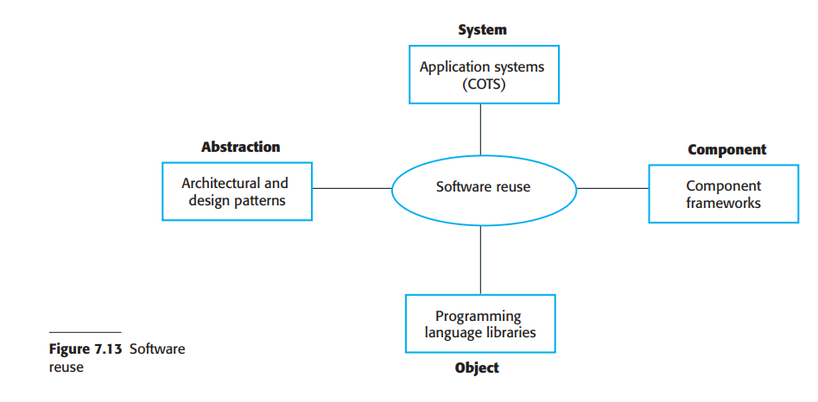
4.1 Reuse
Notes:
COTS stands for Commercial Off-The-Shelf.
It refers to ready-made software or hardware products that are available for purchase and use without modification, rather than being custom-built for a specific user or organization. Examples include Microsoft Office, Adobe Photoshop, and enterprise software like SAP.

Slide 44
4.2 Configuration Management
Configuration Management is a systematic process for establishing and maintaining consistency of a system's performance, functional, and physical attributes with its requirements, design, and operational information throughout its lifecycle.
Examples of Configuration Management Tools:
Software Development: Git, SVN, Jenkins
IT Infrastructure: Ansible, Puppet, Chef
Enterprise Systems: ServiceNow, IBM Rational ClearCase
Notes:
SVN (Apache Subversion)
SVN (Subversion) is a version control system (VCS) that helps track changes in files and code over time.
Jenkins is a Continuous Integration/Continuous Deployment (CI/CD) tool that automates software development processes like building, testing, and deploying applications.

Slide 45
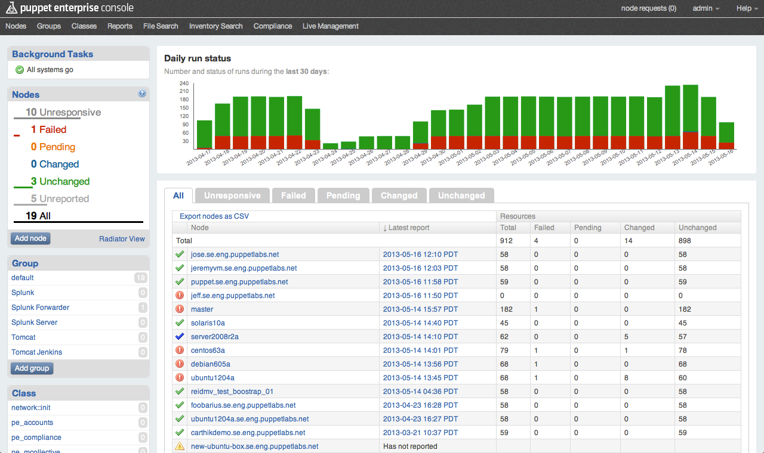
Example

Slide 46
4.3 Host-target development
Host-target development is a software development methodology that involves developing software on one machine (the host) for use on another machine (the target). The host machine is typically a development environment, while the target machine is the platform on which the software will be deployed.
Host System
The computer where software is written, compiled, and tested.
Usually a powerful machine (e.g., Windows/Linux PC).
Has development tools like IDEs, compilers, and debuggers.
Target System
The actual device where the software runs.
Often a different architecture (e.g., microcontrollers, IoT devices, mobile phones).
May have limited resources (memory, CPU, OS).
Eg: Mobile App Development:
Developing and testing Android apps using Android Studio on a PC but running them on an Android phone.
Notes:
✅ Mobile App Development:
Developing and testing Android apps using Android Studio on a PC but running them on an Android phone.
✅ Game Development:
Creating games using Unity or Unreal Engine on a PC and deploying them to a PlayStation, Xbox, or Nintendo Switch.
✅ Cloud & Server Development:
Writing code on a Windows or Mac machine but deploying it to a Linux-based cloud server.

Slide 47
5. Open-source licensing
Although a fundamental principle of open-source development is that source code should be freely available, this does not mean that anyone can do as they wish with that code. Legally, the developer of the code (either a company or an individual) owns the code. They can place restrictions on how it is used by including legally binding conditions in an open-source software license.
Some open-source developers believe that if an open-source component is used to develop a new system, then that system should also be open source. Others are willing to allow their code to be used without this restriction. The developed systems may be proprietary and sold as closed-source systems.

Slide 48
5. Open-source licensing
Most open-source licenses are variants of one of three general models:
1. The GNU General Public License (GPL). This is a so-called reciprocal license that simplistically means that if you use open-source software that is licensed under the GPL license, then you must make that software open source.
2. The GNU Lesser General Public License (LGPL). This is a variant of the GPL license where you can write components that link to open-source code without having to publish the source of these components. However, if you change the licensed component, then you must publish this as open source.
3. The Berkley Standard Distribution (BSD) License. This is a nonreciprocal license, which means you are not obliged to re-publish any changes or modifications made to open-source code. You can include the code in proprietary systems that are sold. If you use open-source components, you must acknowledge the original creator of the code. The MIT license is a variant of the BSD license with similar conditions.
https://opensource.fb.com/legal/privacy
https://github.com/facebook/react/blob/main/LICENSE
Notes:
4-Clause BSD (Original BSD License)
✅ Attribution Clause → Credit the original author in source and documentation. ✅ Redistribution Clause → You can redistribute, but must include the original license. ✅ No Endorsement Clause → You cannot use the author's name for promotion without permission. ❌ Advertising Clause → Any advertising mentioning the software must give credit. (Removed in later versions due to inconvenience.)
3-Clause BSD (Modified BSD License - Most Common)
✅ Attribution Clause ✅ Redistribution Clause ✅ No Endorsement Clause ❌ Advertising Clause (Removed for easier commercial use.)
2-Clause BSD (Simplified BSD License - FreeBSD License)
✅ Attribution Clause ✅ Redistribution Clause ❌ No Endorsement Clause (Removed for simplicity.) ❌ Advertising Clause (Removed for flexibility.)

Slide 49
Questions
In software engineering, what can be the implementation issues and what can be the good programming practices to resolve implementation issues?
What is open source licensing? What are the general models of licensing?

Slide 50
End of unit 7

