Slide 1
Unit 8 Software Testing
Software Engineering
CSIT 6th Semester

Slide 2
Syllabus
Introduction
Validation and Verification Testing
Software Inspection
Software Testing Process
Development Testing
Test-Driven Development
Release Testing
User Testing

Slide 3
1. System Testing
System testing is a type of software testing that evaluates the behavior and functionality of a complete and integrated software system. The goal of system testing is to verify that the software meets its specified requirements and that it performs as expected in the intended environment.
System testing is typically performed after unit testing, integration testing, and other forms of testing have been completed. It involves testing the software system as a whole, including all its components and interfaces, and evaluating how well it works in different scenarios and situations.
System testing can include functional testing, performance testing, security testing, usability testing, and other types of testing depending on the specific requirements of the software system being tested.

Slide 4
Verification:
Verification is the process of checking that a software achieves its goal without any bugs. It is the process to ensure whether the product that is developed is right or not. It verifies whether the developed product fulfills the requirements that we have. Verification is static testing. Verification means Are we building the product right?
Activities involved in verification:
Inspections
Reviews
Walkthroughs
Desk-checking
Notes:
Inspection : code quality check garnu, srs mileko xa xaina hernu
Review: manpower ko review garnu development start hunu vanda agade or requirement review
Walkthroughs : double checking garnu junior le kei lekheko xa vane senior le ni hernu
Desk checking: serially manuaaly sabai code haru check garnu
During verification, you would check if:The form has the required fields.
The button works.
The form submits the data correctly to the backend.
You might do a code review to check if the form was built according to the design specifications.

Slide 5
Validation
Validation is the process of checking whether the software product is up to the mark or in other words product has high level requirements. It is the process of checking the validation of product i.e. it checks what we are developing is the right product. It is validation of actual and expected product.
Validation is the dynamic testing. Validation means Are we building the right product?
Activities involved in validation:
Black box testing
White box testing
Notes:
During validation, you would:Test the login functionality with valid credentials to make sure users can log in successfully.
Test with invalid credentials to check if the system denies access appropriately.
Test if error messages are shown correctly.

Slide 6
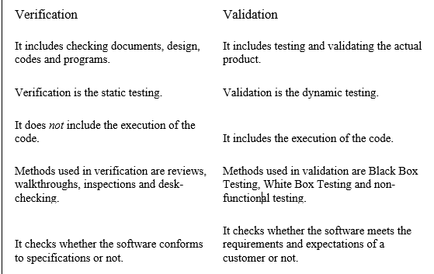
Difference between verification and validation

Slide 7
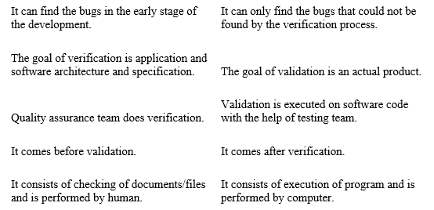
Contd.

Slide 8
2. Testing Technique:
Testing Techniques is the method applied to evaluate a system or a component with a purpose to find if it satisfies the given requirements.
Testing of a system helps to identify gaps, errors, or any kind of missing requirements differing from the actual requirements. Testing techniques are the best practices used by the testing team to assess the developed software in regards to given requirements.
These techniques ensure the overall quality of the product or software including performance, security, customer experience, and so on.

Slide 9
Software Inspection
Software inspection is a control technique for ensuring that the documentation produced during a given phase remains consistent with the documentation of the previous phases and respects reestablished rules and standards.
It is a technique to analyze and check system representation such as requirement document, design diagrams and program source code with executing it. It can be used as verification technique techniques before software is implemented.
Inspection have proved to be an effective techniques of error detection, error can be found more cheaply through inspection than by extensive program testing. The aim of inspection is to locate faults and process should be driven by fault check list.

Slide 10
Software Inspection
Inspection key Points
It is most formal review type
It is lead by trained moderator
Documents are prepared and checked thoroughly by the reviewer.
A separate preparation is carried out during which product is examined and defects are found
It helps the author to improve the quality of the documents under inspection
It removes the defects efficiently and as early as possible
It improves product quality
It creates common understanding by exchanging information
It learn from defects found and prevent the occurrence of similar defects.

Slide 11
Software Inspection
During an inspection, following roles are used
Author: An author is the person who created the work product being inspected. Author is responsible for producing the program or document, fixing defects discovered during the inspection process.
Moderator: Moderator is the leader of the inspection plans the inspection and coordinates it. Moderator reports process results to the chief moderator.
Chief Moderator: Responsible for inspection process improvement, checklist updating, standards developments etc.
Reader: Reader is the person reading through the documents one item at a time presents the code or documents at inspection meeting.
Recorder/Scribe: The person that documents the defects that are found during the inspection is recorder.
Inspector: Inspector is the person that examines the work product to identify possible defects, finds errors, omissions and inconsistencies in the code and documents.

Slide 12
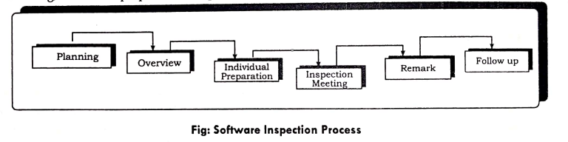
Inspection Process
Inspections are a formal process used to identify and correct errors in a completed deliverable, before the deliverable is used as input to a subsequent deliverable. For example, after inspection, the Requirements Definition is released for reference by the Functional Design Specification.

Slide 13
Inspection Process
Planning: The inspection is planned by the moderator which involves selecting an inspection team, organizing a meeting room and ensuring that the material to be inspected and its specifications are complete.
Overview: In this step, the software and documents to be inspected are presented to the inspection team where author of the code describes the background of the work product.
Individual Preparation: In this stage, each inspection team member studies the specification and the program and looks for the defects and identifies possible defects.
Inspection Meeting: During this meeting, the readers read through the work product part by part and inspectors point out defects for every part. Inspection meeting should be fairly short no more than two hours and should be focused on defect detection.
Rework: In this stage, the author makes changes to work product according to the action plan from the inspection meeting.
Follow up: In this step, the changes made by the author are checked to make sure that everything correct. The moderator should decide whether reinspection of the code and document is required. If not the software is then approved by moderator for release.

Slide 14
4. Development testing
Development testing is the process of testing software during the development phase, which helps to identify defects early in the development lifecycle. It involves a variety of testing techniques, such as unit testing, integration testing and system testing.
Development testing helps to ensure that software is of high quality and is reliable, efficient, and secure. It also helps to reduce the risk of defects and issues that may arise later in the software development process, which can be more costly and time-consuming to fix. By conducting thorough development testing, developers can identify and fix defects early in the development process, which helps to save time and resources in the long run.

Slide 15
4.1 Unit testing
Unit testing is a type of testing that is performed on individual units or components of a software application. The purpose of unit testing is to validate that each unit of code works as intended and meets the specified requirements. It is typically performed by developers themselves or by an automated testing tool.
During unit testing, developers write test cases to validate the behavior of individual functions or methods within a software component. The test cases are designed to exercise the code with different input values and verify that the output is correct. This helps to catch defects early in the development cycle and provides developers with fast feedback on the quality of their code.

Slide 16
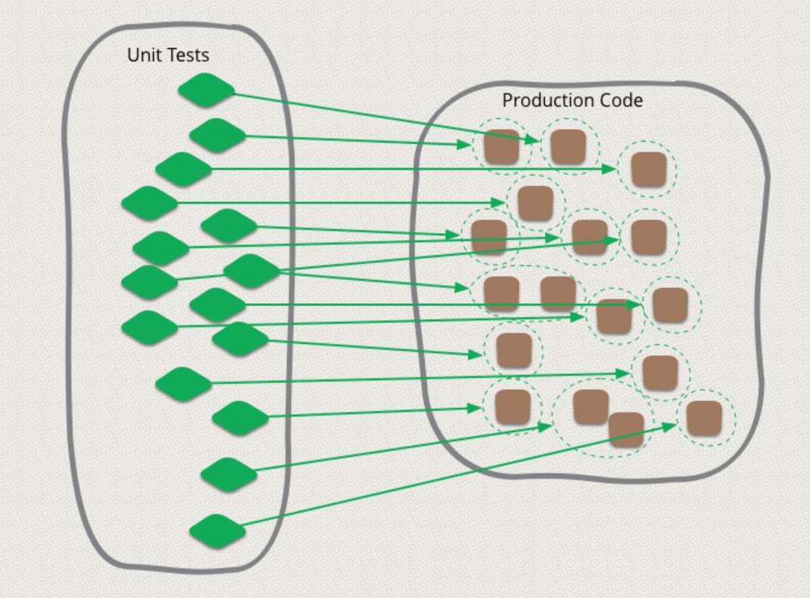
4.1 Unit Testing

Slide 17
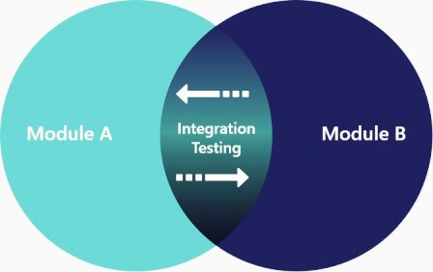
4.2 Integration testing
Integration testing is a type of testing that is performed to verify the interaction between different components or modules of a software system. The purpose of integration testing is to detect defects that may arise from the integration of different software components, such as interfaces, data flow, and communication.
Integration testing is typically performed after unit testing and before system testing. During integration testing, the individual software components are combined and tested as a group. This helps to identify defects that may arise from the integration of the individual components and to ensure that the system functions as intended.
Notes:
JUnit (for Java applications): JUnit is widely used in top-down testing for unit and integration testing, where higher-level components can be tested first using mocks and stubs.
Mockito (for Java): Mockito is used to create stubs for components that are not yet available. It allows you to mock lower-level services while testing high-level modules
.Postman (for API testing): If you're testing a high-level API, Postman can be used to simulate and test RESTful APIs.
WireMock: WireMock is useful when you need to simulate HTTP-based services (i.e., for stubbing APIs during top-down testing).

Slide 18
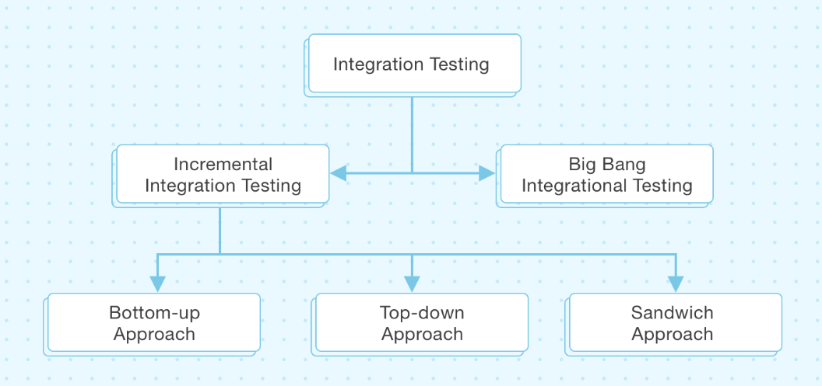
4.2 Different approaches of Integration testing

Slide 19
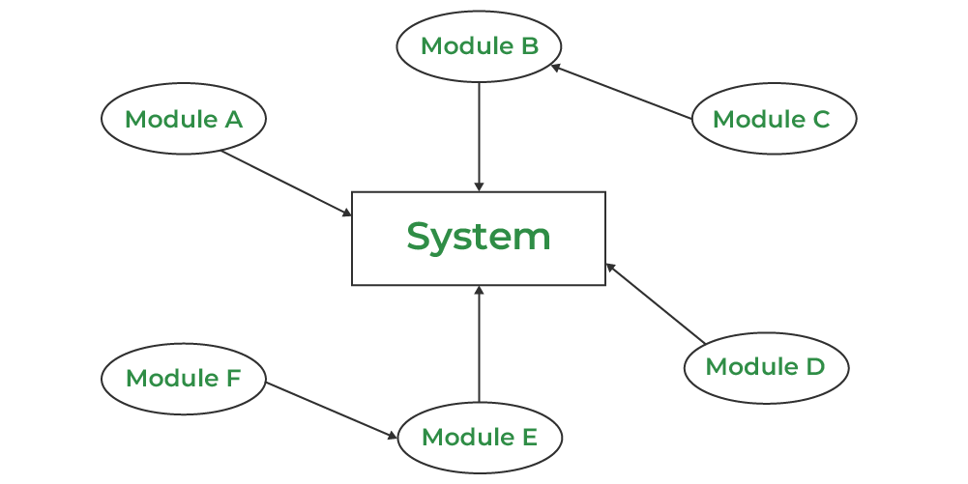
4.2.1 Big Bang Integration testing
Use this approach when all the components or modules of the application are readily available.
Once the module development is finished, they are integrated and tested together in one go. Due to the sheer volume of this type of testing, it is generally suitable for testing compact applications.
Notes:
Selenium (for web applications): Selenium can be used for automating tests of the entire integrated system once all components are combined. It helps simulate user interactions with the UI.
Jenkins (CI/CD tool): Jenkins can be used for running Big Bang integration tests in a continuous integration pipeline, triggering the integration testing process once all components are integrated.
JUnit/TestNG: These testing frameworks can be used to run tests across the entire system once all components are integrated.
JMeter (for performance testing): If Big Bang testing involves performance evaluation (e.g., load testing the entire system), JMeter is a popular tool for simulating high traffic loads on a complete integrated system.

Slide 20
4.2.2 Incremental Integration Testing
Incremental Integration Testing is a type of integration testing approach in which software components or modules are combined and tested in a gradual manner, from simple to complex. This approach allows for testing of smaller and more manageable units of code, which are combined and tested as a group to ensure that they work together as intended.
In incremental integration testing, the system is built and tested incrementally, with each iteration integrating more components until the entire system is tested. This approach can be performed in several ways, including top-down, bottom-up, and a Sandwich (combination of both) testing.

Slide 21
4.2.2 Incremental Integration Testing
In top-down incremental integration testing, the high-level components or modules are tested first, and then the lower-level components are integrated and tested. This approach allows for testing of the overall system structure and functionality early in the development cycle.
In bottom-up incremental integration testing, the low-level components are tested first, and then the higher-level components are integrated and tested. This approach allows for testing of individual components and their functionality before they are combined with other components.
Finally, the combination approach is a hybrid of both top-down and bottom-up testing. In this approach, the testing team selects a set of related components to integrate and test together.

Slide 22
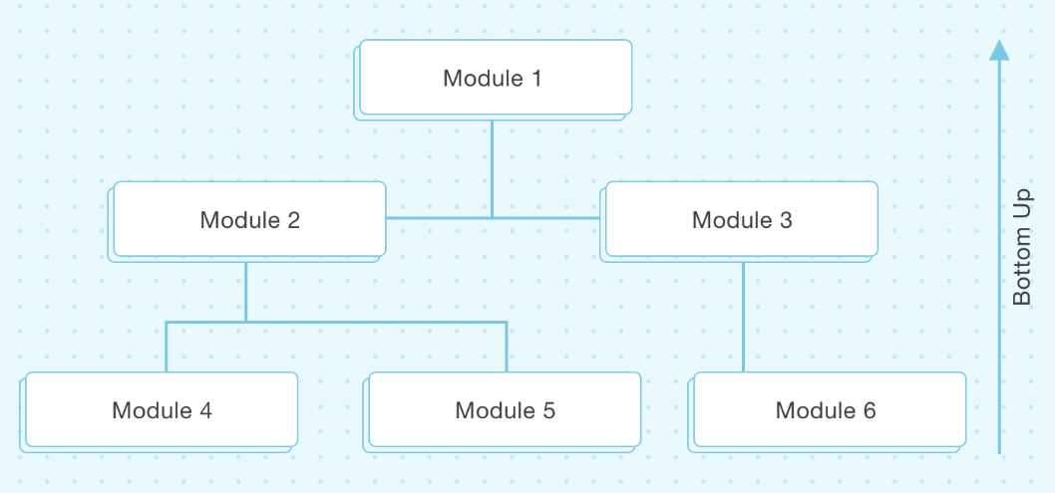
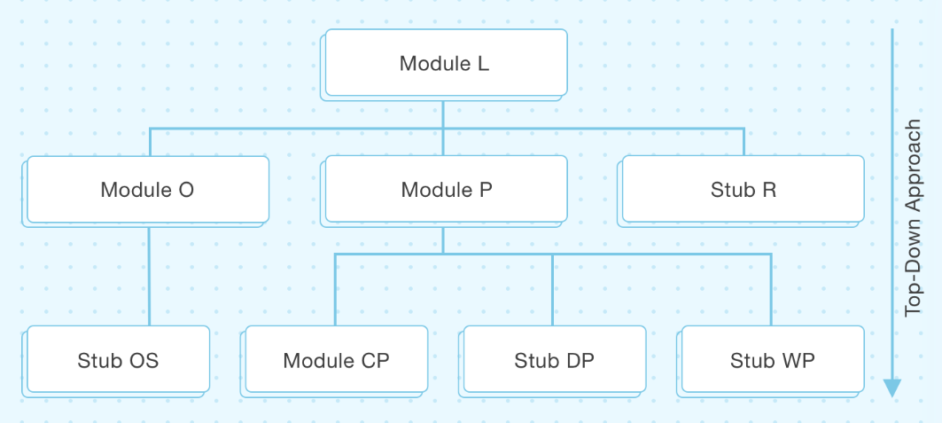
Example:

Slide 23
4.3 System testing
System testing is a type of software testing that evaluates the entire software system as a whole to verify that it meets the specified requirements and performs as expected. The objective of system testing is to identify defects, errors, and other issues that could impact the functionality, reliability, and usability of the software system.
System testing involves testing the entire system, including all hardware and software components, to ensure that they work together as intended. This testing can include functional testing, performance testing, security testing, usability testing, and other types of testing, depending on the requirements of the software system.

Slide 24
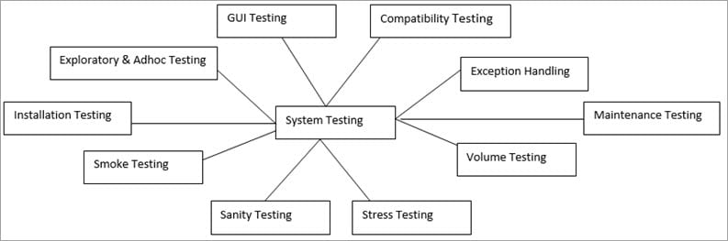
4.3 System testing
Notes:
Smoke testing is a preliminary test that checks whether the basic functionalities of a software application are working as expected. It’s often referred to as "Build Verification Testing" (BVT) because it verifies if a build is stable enough to proceed with further testing.
Sanity testing new change gareko xa vane is a type of software testing that verifies if a specific functionality or bug fix works correctly after changes have been made. It’s a more focused test compared to smoke testing, typically performed when a new build is received with minor changes, fixes, or enhancements to a specific module or feature.
Ad hoc testing is a type of informal, unstructured testing that is done without predefined test cases or planning. The main idea is to test the application randomly, based on the tester's intuition, experience, or knowledge of the system

Slide 25
Regression Testing
Regression testing is a software testing technique that involves retesting previously tested software features after modifications or changes have been made to the software. The main objective of regression testing is to ensure that the software still functions correctly after the changes have been made.
Regression testing is typically performed when changes are made to the software code, such as bug fixes, feature enhancements, or updates to external libraries or APIs. This testing is important because it ensures that the changes made to the software have not caused any unintended side effects or introduced new bugs that were not present before.

Slide 26
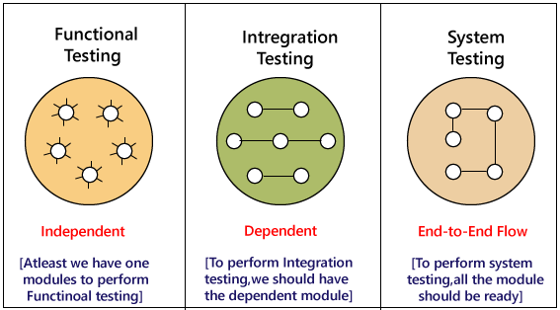
Example:

Slide 27
Question:
What is System testing? Differentiate between Verification and Validation.
Explain Black Box testing and White Box testing.
What is Development testing? What are the variety of testing techniques in development testing? Explain with proper example.

Slide 28
5. Release testing
Release testing is the process of testing a particular release of a system that is intended for use outside of the development team. Normally, the system release is for customers and users.
The primary goal of the release testing process is to convince the supplier of the system that it is good enough for use. If so, it can be released as a product or delivered to the customer. Release testing, therefore, has to show that the system delivers its specified functionality, performance, and dependability, and that it does not fail during normal use.
Release testing is usually a black-box testing process whereby tests are derived from the system specification. The system is treated as a black box whose behavior can only be determined by studying its inputs and the related outputs
Notes:
Before releasing the update, testers install the app on multiple devices (iOS, Android) with different OS versions.
They check for crashes, UI responsiveness, and integration with payment gateways.
The app is tested in real-world network conditions (Wi-Fi, mobile data, poor connectivity).
If issues are found, the release is delayed for fixes.

Slide 29
5.1 Requirements-based testing
A general principle of good requirements engineering practice is that requirements should be testable. That is, the requirement should be written so that a test can be designed for that requirement. A tester can then check that the requirement has been satisfied. Requirements-based testing, therefore, is a systematic approach to test-case design where you consider each requirement and derive a set of tests for it.
For example, consider the following Mentcare system requirements that are concerned with checking for drug allergies:
If a patient is known to be allergic to any particular medication, then prescription of that medication shall result in a warning message being issued to the system user. If a prescriber chooses to ignore an allergy warning, he or she shall provide a reason why this has been ignored.

Slide 30
5.1 Requirements-based testing
To check if these requirements have been satisfied, you may need to develop several related tests:
1. Set up a patient record with no known allergies. Prescribe medication for allergies that are known to exist. Check that a warning message is not issued by the system.
2. Set up a patient record with a known allergy. Prescribe the medication that the patient is allergic to and check that the warning is issued by the system.
3. Set up a patient record in which allergies to two or more drugs are recorded. Prescribe both of these drugs separately and check that the correct warning for each drug is issued.
4. Prescribe two drugs that the patient is allergic to. Check that two warnings are correctly issued.
5. Prescribe a drug that issues a warning and overrule that warning. Check that the system requires the user to provide information explaining why the warning was overruled.
You can see from this list that testing a requirement does not mean just writing a single test. You normally have to write several tests to ensure that you have coverage of the requirement. You should also keep traceability records of your requirements based testing, which link the tests to the specific requirements that you have tested.

Slide 31
5.2 Scenario testing
Scenario testing is an approach to release testing whereby you devise typical scenarios of use and use these scenarios to develop test cases for the system. A scenario is a story that describes one way in which the system might be used.
Scenarios should be realistic, and real system users should be able to relate to them. If you have used scenarios or user stories as part of the requirements engineering process (described in Chapter 4), then you may be able to reuse them as testing scenarios.
In a short paper on scenario testing, Kaner suggests that a scenario test should be a narrative story that is credible and fairly complex. It should motivate stakeholders; that is, they should relate to the scenario and believe that it is important that the system passes the test. He also suggests that it should be easy to evaluate. If there are problems with the system, then the release testing team should recognize them.

Slide 32
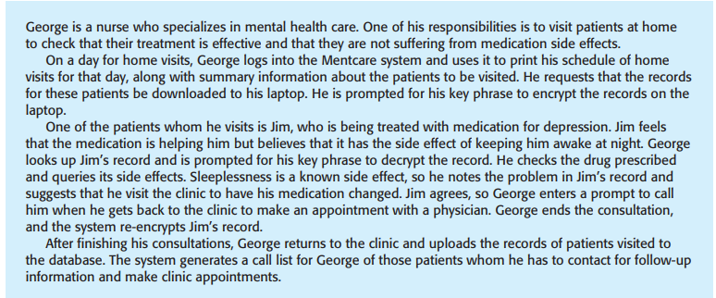
5.2 Scenario testing
Notes:
George vanne ekjana nurse xa jasko responsibility chai :
Home visit garne ra survey garne ki medicine effective xa ki xaina vanera
Tesko lagi MENTCARE vanne app use garxa ra ko patient ho usko document print garxa. Authentication and download hunu paryo
Jim vanne ekjana patient lai chai depression xa
Medicine kaam ta lairaxa BUT SIDEEFFECT XA uslai nindra laagdaina .
So medication change garnu parne hunxa clinic ma visit date ni dinu parne hunxa : DATA MANIPULATION SCHEDULE MILAUNE MEDICNE CHANGE GARNE
Jim lai appointment ni milaidinxa for physicians

Slide 33
5.2 Scenario testing
As an example of a possible scenario from the Mentcare system, Figure describes one way that the system may be used on a home visit. This scenario tests a number of features of the Mentcare system:
1. Authentication by logging on to the system.
2. Downloading and uploading of specified patient records to a laptop.
3. Home visit scheduling.
4. Encryption and decryption of patient records on a mobile device.
5. Record retrieval and modification.
6. Links with the drugs database that maintains side-effect information.
7. The system for call prompting.

Slide 34
5.3 Performance testing
Once a system has been completely integrated, it is possible to test for emergent properties, such as performance and reliability. Performance tests have to be designed to ensure that the system can process its intended load. This usually involves running a series of tests where you increase the load until the system performance becomes unacceptable.
This approach, of course, is not necessarily the best approach for defect testing. Experience has shown that an effective way to discover defects is to design tests around the limits of the system. In performance testing, this means stressing the system by making demands that are outside the design limits of the software. This is known as stress testing.
Notes:
Load Testing – Checks system performance under normal & peak loads.
Example:
Simulate 1,000 users visiting an online store and making purchases.
Monitor how the server handles traffic.
b) Stress Testing – Pushes the system beyond its capacity to see when it fails.
Example:
Simulate 500,000 users logging in at the same time to test server limits.
c) Spike Testing – Tests system behavior with sudden traffic spikes.
Example:
Simulate 10,000 users accessing a ticket booking site when a concert ticket sale goes live.
d) Endurance (Soak) Testing – Runs a system for an extended period to detect memory leaks.
Example:
Simulate continuous transactions on a banking app for 24 hours.
e) Scalability Testing – Measures how the system scales when resources are increased.
Example:
Add more servers to an app and check if performance improves.

Slide 35
5.3 Performance testing
Say you are testing a transaction processing system that is designed to process up to 300 transactions per second. You start by testing this system with fewer than 300 transactions per second. You then gradually increase the load on the system beyond 300 transactions per second until it is well beyond the maximum design load of the system and the system fails.

Slide 36
6. User Testing
User or customer testing is a stage in the testing process in which users or customers provide input and advice on system testing. This may involve formally testing a system that has been commissioned from an external supplier.
Alternatively, it may be an informal process where users experiment with a new software product to see if they like it and to check that it does what they need.
User testing is essential, even when comprehensive system and release testing have been carried out. Influences from the user’s working environment can have a major effect on the reliability, performance, usability, and robustness of a system.

Slide 37
6. User testing
There are three different types of user testing:
1. Alpha testing, where a selected group of software users work closely with the development team to test early releases of the software.
2. Beta testing, where a release of the software is made available to a larger group of users to allow them to experiment and to raise problems that they discover with the system developers.
3. Acceptance testing, where customers test a system to decide whether or not it is ready to be accepted from the system developers and deployed in the customer environment.
Notes:
Alpha Testing (Internal Testing)
Purpose:
Detect and fix bugs before releasing the software to external users.
Validate functionality, usability, and performance in a controlled environment.
Where It Happens:
Conducted in-house by developers and internal testers in a staging environment.
Beta Testing (Real-World Testing)
Purpose:
Gather real user feedback before the official launch.
Identify unexpected bugs in diverse environments.
Where It Happens:
Conducted externally by a select group of real users in their own environments.
Types of Beta Testing:
🔹 Open Beta – Anyone can test and provide feedback (e.g., public beta for apps). 🔹 Closed Beta – Only invited users test the software (e.g., limited beta for enterprise software).
Acceptance Testing (Final Validation)
Purpose:
Ensure the software meets business requirements and is ready for deployment.
Where It Happens:
Conducted by clients, end-users, or business stakeholders in a pre-production environment.

Slide 38
7. Test Driven Development
Test-driven development (TDD) is an approach to program development in which you interleave testing and code development You develop the code incrementally, along with a set of tests for that increment. You don’t start working on the next increment until the code that you have developed passes all of its tests.
Test-driven development was introduced as part of the XP agile development method. However, it has now gained mainstream acceptance and may be used in both agile and plan-based processes

Slide 39
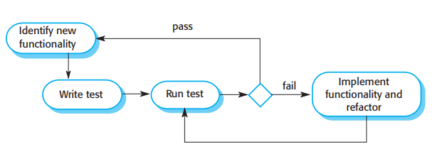
Test Driven Development

Slide 40
Test Driven Development
The fundamental TDD process is shown in Figure 8.9. The steps in the process are as follows:
1. You start by identifying the increment of functionality that is required. This should normally be small and implementable in a few lines of code.
2. You write a test for this functionality and implement it as an automated test. This means that the test can be executed and will report whether or not it has passed or failed.
3. You then run the test, along with all other tests that have been implemented. Initially, you have not implemented the functionality so the new test will fail. This is deliberate as it shows that the test adds something to the test set.
4. You then implement the functionality and re-run the test. This may involve refactoring existing code to improve it and add new code to what’s already there.
5. Once all tests run successfully, you move on to implementing the next chunk of functionality.

Slide 41
8. Test Cases:
The test case is defined as a group of conditions under which a tester determines whether a software application is working as per the customer's requirements or not. Test case designing includes preconditions, case name, input conditions, and expected result. A test case is a first level action and derived from test scenarios.
It is an in-details document that contains all possible inputs (positive as well as negative) and the navigation steps, which are used for the test execution process. Writing of test cases is a one-time attempt that can be used in the future at the time of regression testing.

Slide 42
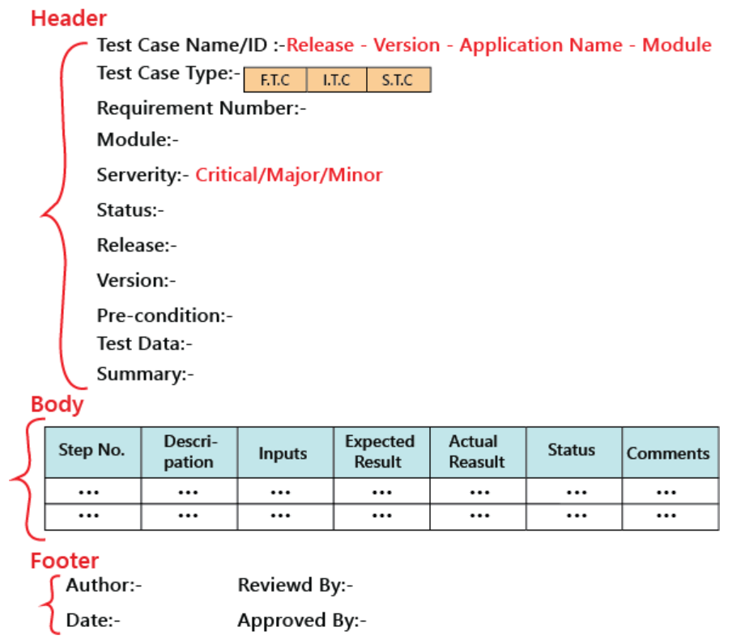
Test case template
The primary purpose of writing a test case is to achieve the efficiency of the application.

Slide 43
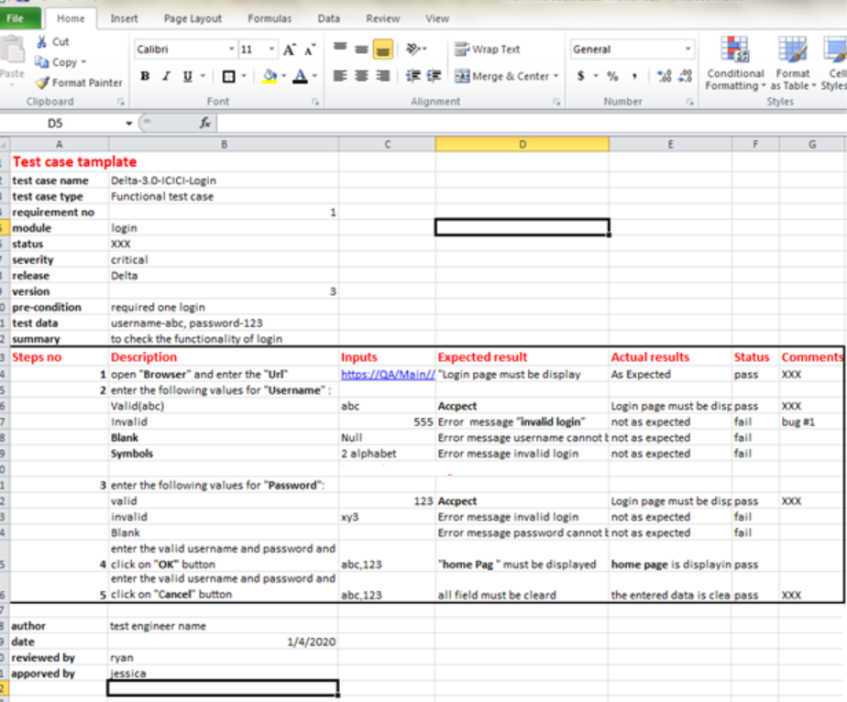
Example of a test case template

Slide 44
Question:
What is Release testing? Also explain requirement based testing, scenario based testing and performance based testing.
What is User testing? Also explain Alpha testing, Beta testing and Acceptance testing.
What is Test Driven Development? Explain its steps.
Write test case of any module of your project work with proper details as shown in the sample.

Slide 45
End of unit 7

