Slide 1
How do Programs Run Fast
Cs 439

Slide 2

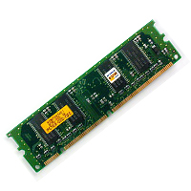
Improving Program Performance
Programming Language
Hardware – Physical Memory, Caches, Clock Cycle
Efficiency – evaluate Big O of time and space complexity

Slide 3
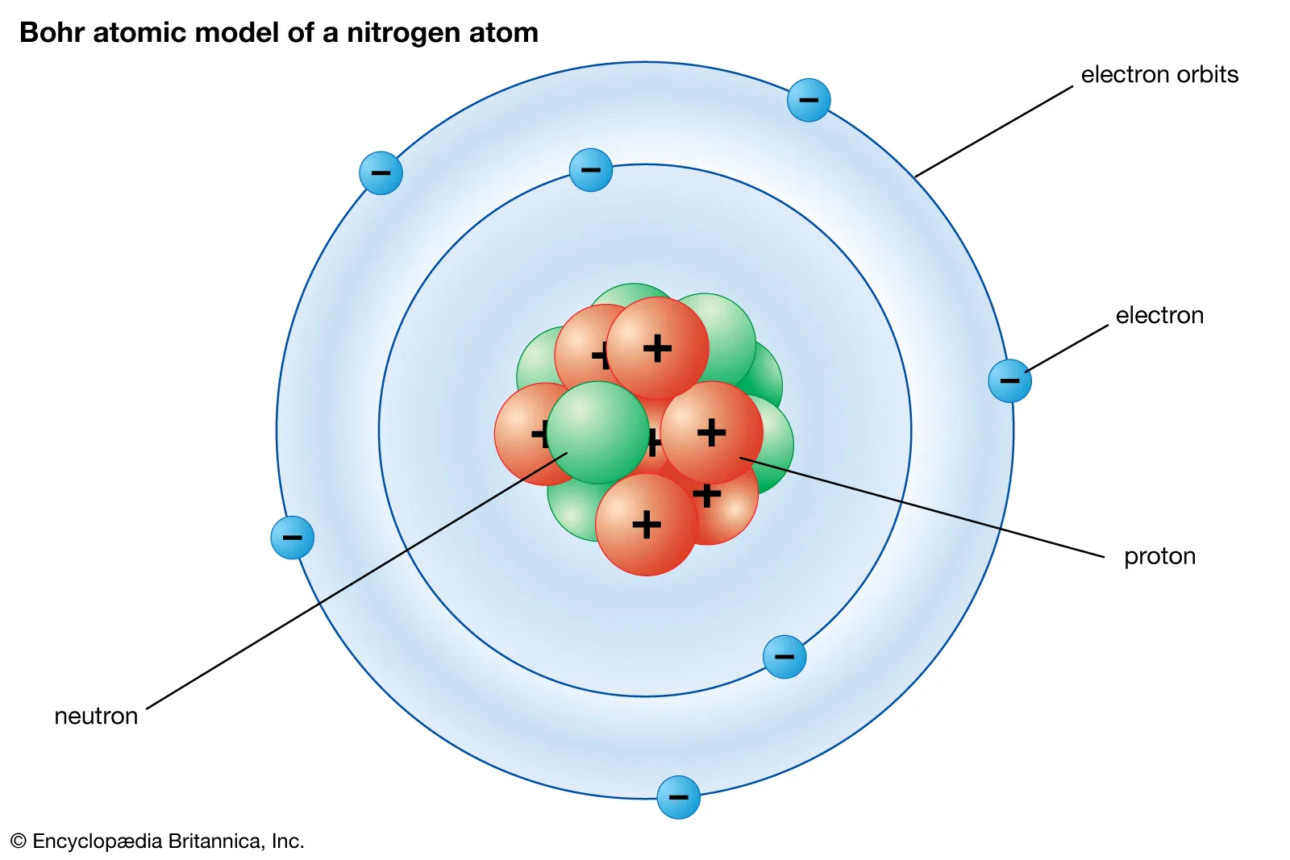
Models of the Atom
First was atom thought of as a single ball
Plum Pudding Model – Nucleus and negative electrons randomly inside
Bohr Model – nucleus in center and electrons orbit
Quantum mechanical model – different shapes for different atoms

