Slide 1
Statistical Thinking for the 21st Century
Advanced Telecommunications Research Institute International (ATR)
Department of Cognitive Neuroscience (DCN)
RIKEN Center for Biosystems Dynamics Research (BDR)
Ayumu Yamashita

Slide 2
Summarizing data
Chapter 4

Slide 3

OUTLINE
Why and how to summarize data
4.1
Why summarize data?
4.2
Summarizing data using tables
4.3
Idealized representations of distributions
4.4
Suggested readings

Slide 4
OUTLINE
4.1
Why summarize data?
4.2
Summarizing data using tables
4.3
Idealized representations of distributions
4.4
Suggested readings

Slide 5

Why summarize data?
Summarize data = generalization
Generalization lets us make predictions about these individuals
One example is categorization
Through away information

Slide 6
OUTLINE
4.1
Why summarize data?
4.2
Summarizing data using tables
4.3
Idealized representations of distributions
4.4
Suggested readings

Slide 7
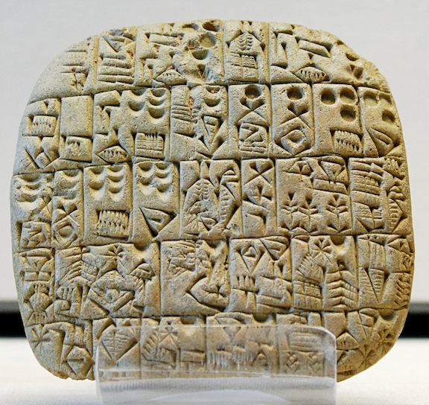
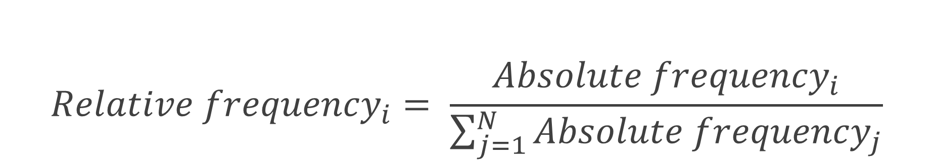
Summarizing data using tables
4.2.1 Frequency distributions
$${Relative frequency}_{i}= \frac{{Absolute frequency}_{i}}{\sum_{j=1}^{N}{{Absolute frequency}_{j}}}$$
tibble: Rにおけるデータ形式
PhysActive | AbsoluteFrequency | RelativeFrequency | Percentage
No | 2473 | 0.454 | 45.418
Yes | 2972 | 0.546 | 54.582

Slide 8
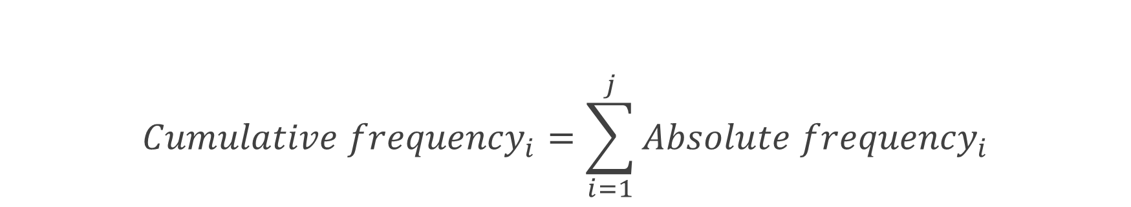
Summarizing data using tables
$${Cumulative frequency}_{i}=\sum_{i=1}^{j}{{Absolute frequency}_{i}}$$
4.2.2 Cumulative distributions
SleepHrsNight | AbsoluteFrequency | RelativeFrequency | Percentage
2 | 9 | 0.002 | 0.179
3 | 49 | 0.01 | 0.973
4 | 200 | 0.04 | 3.972
5 | 406 | 0.081 | 8.064
6 | 1172 | 0.233 | 23.277
7 | 1394 | 0.277 | 27.686
8 | 1405 | 0.279 | 27.905
9 | 271 | 0.054 | 5.382
10 | 97 | 0.019 | 1.927
11 | 15 | 0.003 | 0.298
12 | 17 | 0.003 | 0.338

Slide 9
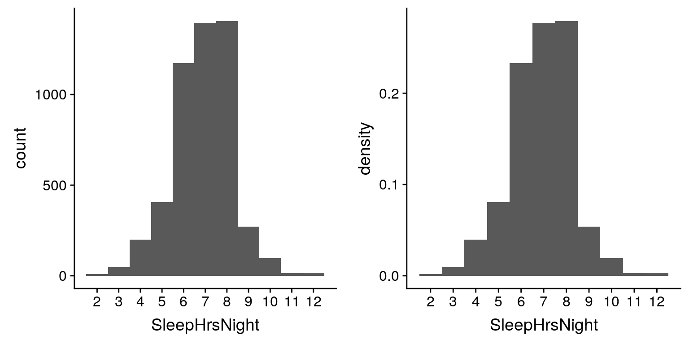
Summarizing data using tables
4.2.3 Plotting histograms

Slide 10
Summarizing data using tables
4.2.4 Histogram bins
SleepHrsNight | AbsoluteFrequency | CumulativeFrequency
2 | 9 | 9
3 | 49 | 58
4 | 200 | 258
5 | 406 | 664
6 | 1172 | 1836
7 | 1394 | 3230
8 | 1405 | 4635
9 | 271 | 4906
10 | 97 | 5003
11 | 15 | 5018
12 | 17 | 5035

Slide 11
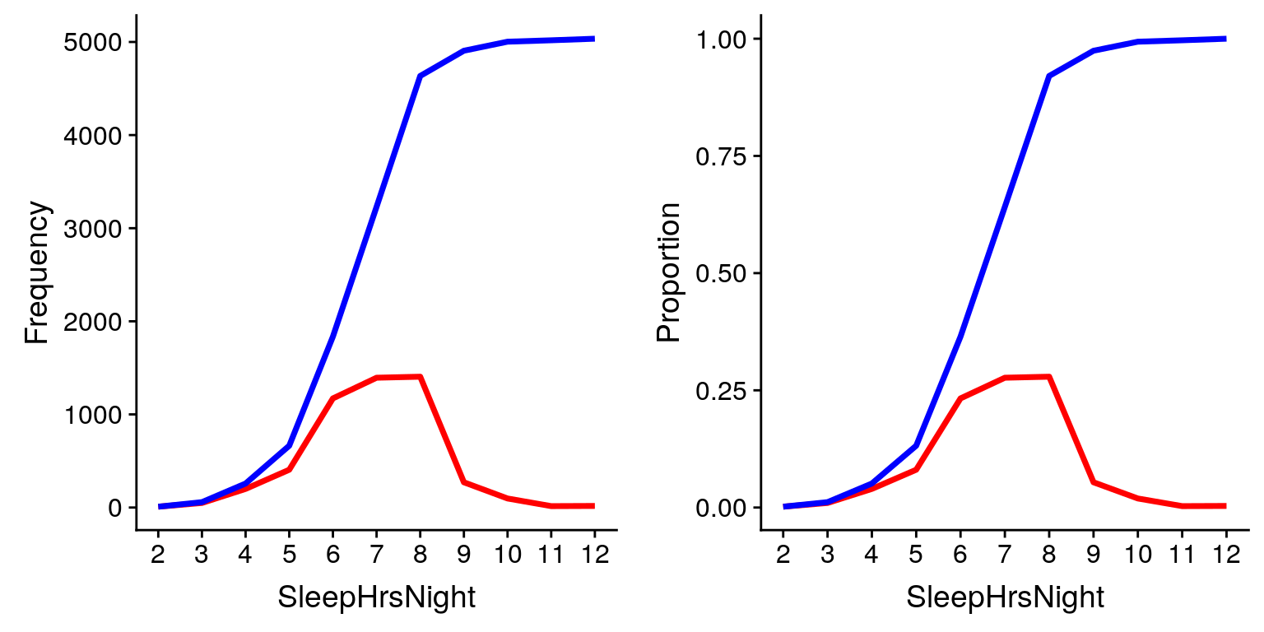
Summarizing data using tables
4.2.4 Histogram bins

Slide 12
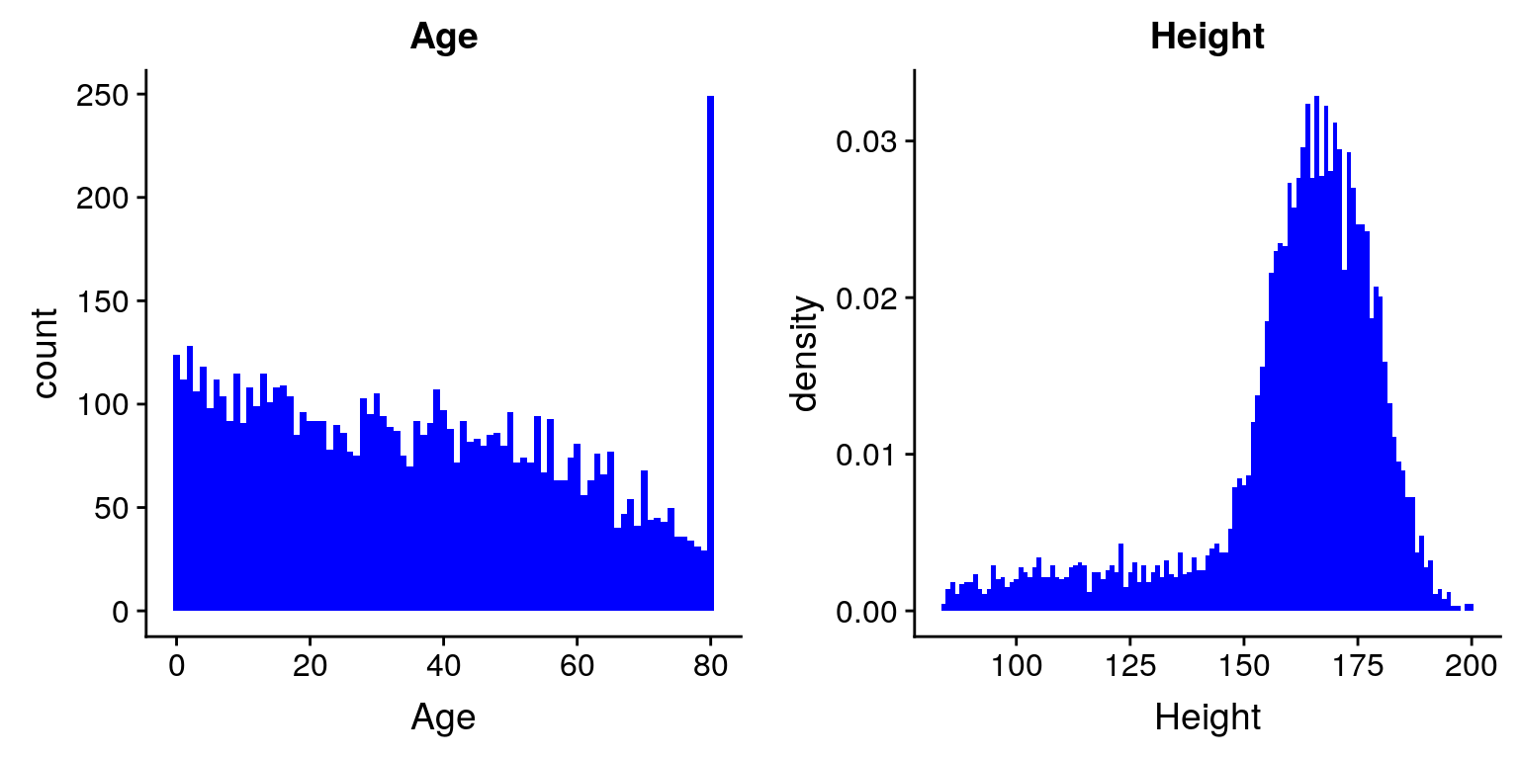
Summarizing data using tables

Slide 13
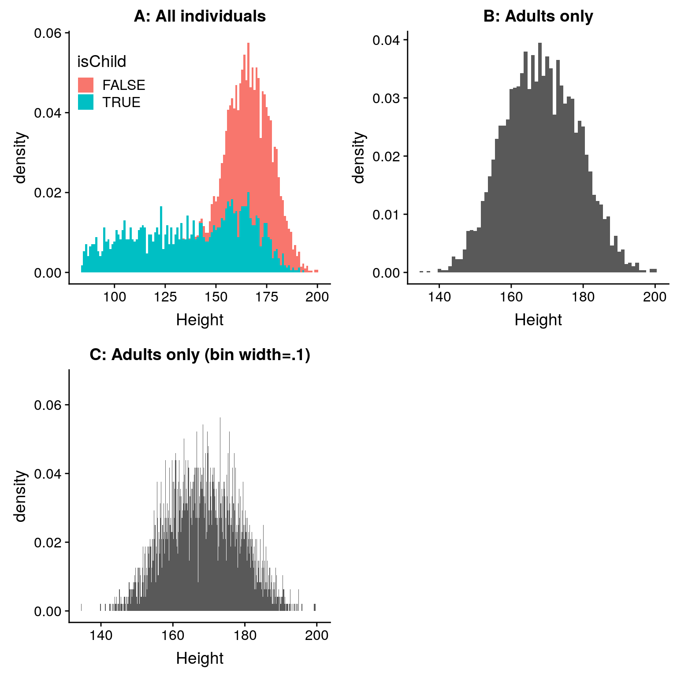
Summarizing data using tables

Slide 14
OUTLINE
4.1
Why summarize data?
4.2
Summarizing data using tables
4.3
Idealized representations of distributions
4.4
Suggested readings

Slide 15
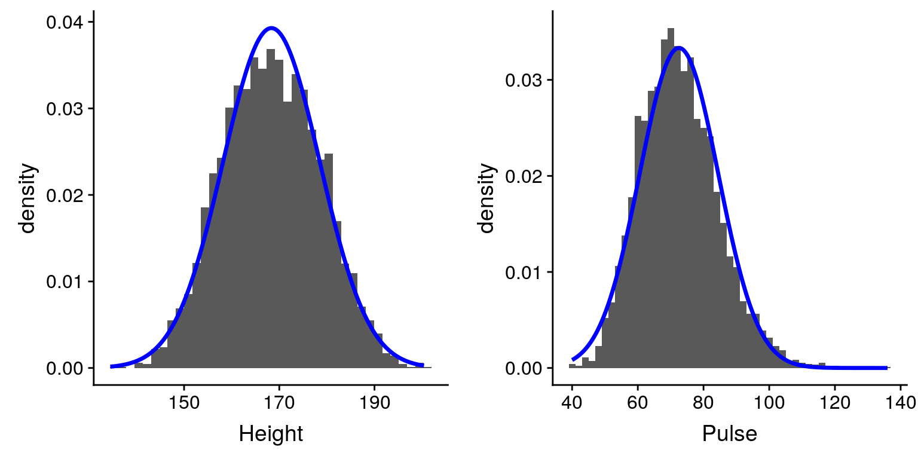
Idealized representations of distributions
4.3.1 Skewness

Slide 16
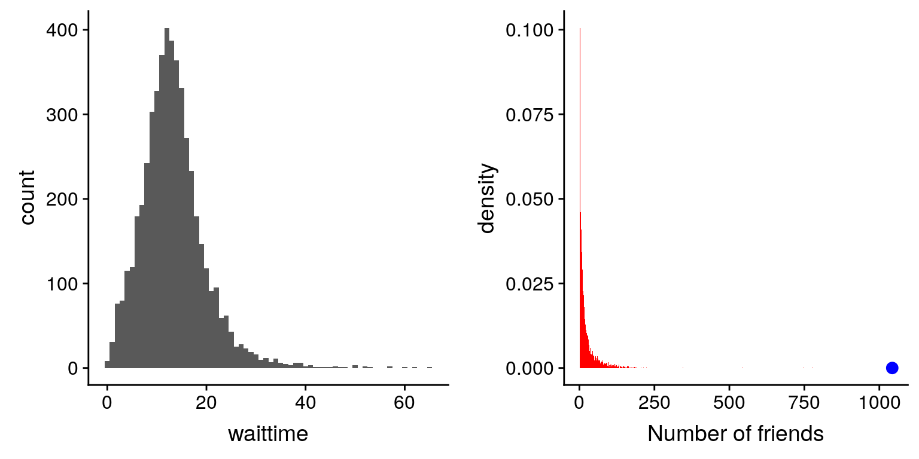
Idealized representations of distributions
4.3.2 Long-tailed distributions
Waiting time in airport
The number of friends in Facebook

Slide 17
OUTLINE
4.1
Why summarize data?
4.2
Summarizing data using tables
4.3
Idealized representations of distributions
4.4
Suggested readings

Slide 18



Suggested readings

Slide 19
Supplementary Information

