Slide 1

Machine Learning-Based Network Intrusion Detection
Group members :
Ayuob Al-Mubedein
Bashar Rsheed
Mohammad Ashqar
Yaman Nayfeh

Slide 2
Project Overview
This project presents a comprehensive three-stage machine learning pipeline for network intrusion detection and attack classification, designed to enhance accuracy, efficiency, and interpretability in cybersecurity applications.
Pipeline Stages :
1- Traffic Type Classification
The initial model systematically categorizes network traffic by protocol (e.g., DNS, HTTP, FTP). This multi-class classification facilitates targeted analysis and reduces irrelevant data noise in subsequent stages, improving downstream model focus and performance.
2- Suspicious Traffic Detection
Leveraging binary classification, the second model discriminates between benign and potentially malicious traffic. This gatekeeping step optimizes resource allocation by focusing attention and computational effort on suspicious flows, while minimizing false alarms from benign traffic.
3- Attack Type Classification
The final model conducts fine-grained multi-class classification to identify specific attack categories such as DDoS, Brute Force, and Heartbleed. This enables precise threat characterization and targeted security responses, critical for effective mitigation.

Slide 3
Motivation foR a Multi-Stage Pipeline
Network traffic data is inherently complex and noisy, often dominated by benign activity with a wide variety of protocols and attack types. A single monolithic model struggles to effectively process this heterogeneity and volume.
By decomposing intrusion detection into three specialized stages, this project addresses challenges of:
Data volume and noise reduction through early traffic type filtering.
Class imbalance by isolating suspicious flows before detailed attack classification.
Computational efficiency by narrowing the scope at each stage.
Enhanced interpretability by providing modular insights at multiple levels of analysis.

Slide 4
Why This Project Matters
Real-world Applicability: Reflects practical IDS workflows and network traffic complexity.
Layered, Modular Architecture: Enhances accuracy and interpretability at each detection phase.
Clear Evaluation: Standard metrics allow objective performance assessment and continuous improvement.
Scalability: Easily extendable to larger networks, new traffic types, and emerging attack vectors.

Slide 5
Dataset Overview
CIC-IDS-2017
Source : Developed by the Canadian Institute for Cybersecurity at the University of New Brunswick.
Purpose : Designed to evaluate and benchmark Intrusion Detection Systems (IDS) using realistic network traffic data.
Data Collection Period: July 3–7, 2017.
Traffic Types:
Benign Traffic: Simulated normal user activities.
Attack Traffic: Simulated attacks including DoS, DDoS, Brute Force, Heartbleed, Web Attacks, Infiltration, and Botnet.
Data Format : PCAP files converted to CSV using CICFlowMeter
Total Instances: Over 2.8 million network flows.

Slide 6
Dataset Overview
Features :
Total Columns : 79.
Types : 78 numerical features and 1 categorical 'Label' column.
Examples :
* Flow Duration
* Packet Lengths
* Protocol Types
Attack Types & Distribution :
Attack Categories:
* DoS (Denial of Service)
* DDoS (Distributed Denial of Service)
* Brute Force (FTP, SSH)
* Heartbleed
* Web Attacks (XSS, SQL Injection)
Class Imbalance: Majority of records are labeled as 'Benign' (normal traffic).

Slide 7
Algorithm Used
What is XGBoost?
Extreme Gradient Boosting (XGBoost) is a fast, accurate machine learning algorithm for structured/tabular data.
Builds an ensemble of decision trees sequentially, each correcting errors from previous trees.
Uses gradient boosting: fits new trees to gradients (and Hessians) of the loss function for precise optimization.
Incorporates regularization (L1 & L2) to control model complexity and prevent overfitting.
Optimized for speed and scalability: supports parallel processing, missing data handling, and efficient memory use.

Slide 8
Algorithm Used
How XGBoost Works & Why Use It?
Training process per iteration:
Compute first and second derivatives (gradients & Hessians) of loss to guide tree splits.
Build trees by selecting splits that maximize gain while factoring in regularization penalties.
Update predictions by adding outputs from the new tree.
Final output: Sum of all trees' predictions; applies activation function depending on task.

Slide 9
Algorithm Used
Advantages:
High accuracy in classification and regression tasks.
Fast, scalable training on large datasets.
Robust to overfitting thanks to regularization and subsampling.
Flexible with support for custom loss functions.

Slide 10
Algorithm Used
Advantages:
High accuracy in classification and regression tasks.
Fast, scalable training on large datasets.
Robust to overfitting thanks to regularization and subsampling.
Flexible with support for custom loss functions.

Slide 11
Data Preprocessing
-Missing & Infinite Values & duplicated records :
Identify missing (NaN) and infinite values from raw data.
Replace missing and infinite values impute with statistical methods (mean/median).
Remove duplicate records to avoid bias and overfitting.
-Drop zero variance columns
Feature Engineering :
Extract labels for model one from Destination Port column
from the label column(contain the attacks names) i create new column for model two contain two values (normal or attack)
Encode categorical variables using label encoding

Slide 12
Introduction to Multi-Stage Pipeline
Cybersecurity faces a growing challenge with increasingly sophisticated network attacks.
Intrusion Detection Systems (IDS) must be accurate, efficient, and adaptable.
Single-model IDS often struggle with noisy data and imbalanced classes.
This project proposes a three-stage pipeline for layered detection:
Stage 1: Traffic Type Classification — sorts traffic by protocol to reduce irrelevant noise early.
Stage 2: Suspicious vs. Benign Detection — binary filter prioritizing resources on potentially harmful traffic.
Stage 3: Attack Type Classification — detailed categorization of attack types for effective response.
This modular approach improves interpretability, performance, and scalability

Slide 13
model 1 explanation
Model 1 – Traffic Type Classification
Goal : Classify incoming network traffic into distinct types such as DNS, HTTP, FTP, etc.
Why it matters:
Organizes network traffic by protocol for better analysis.
Filters irrelevant noise early, improving downstream detection accuracy.
Modeling Approach : Multi-class classification problem
Algorithms : XGBoots
Evaluation Metrics :
Accuracy
Precision & Recall per traffic class
Confusion matrix to visualize classification performance

Slide 14

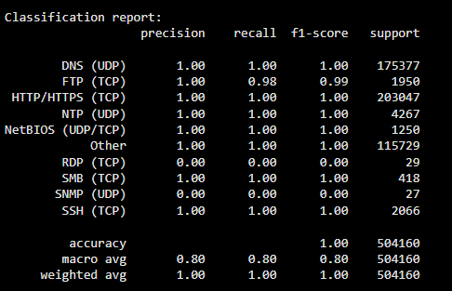
model 1 Result

Slide 15
model 2 explanation
Model 2 – Suspicious vs. Benign Detection
Goal : Binary classification to detect whether network traffic is benign or suspicious.
Why it matters :
Prioritizes security monitoring on potentially malicious traffic.
Reduces false alarms by filtering benign flows.
Modeling Approach : Binary classification problem
Algorithms : XGBoost
Evaluation Metrics :
Accuracy
Precision, Recall, F1-Score
Confusion matrix to visualize classification performance

Slide 16

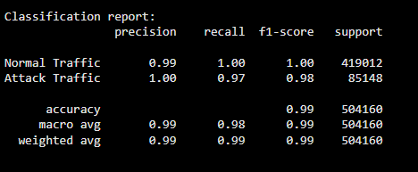
model 2 Result
.

Slide 17
model 3 explanation
Model 3 – Attack Type Classification
Goal : Classify suspicious traffic into specific attack categories (e.g., DoS, DDoS, Brute Force, Heartbleed).
Why it matters :
Provides granular identification of attack types for targeted responses.
Enhances threat intelligence and mitigation strategies.
Modeling Approach : Multi-class classification problem
Algorithms : XGBoost
Evaluation Metrics :
Accuracy
Precision, Recall, F1-Score per attack type
Confusion matrix to understand misclassification trends

Slide 18

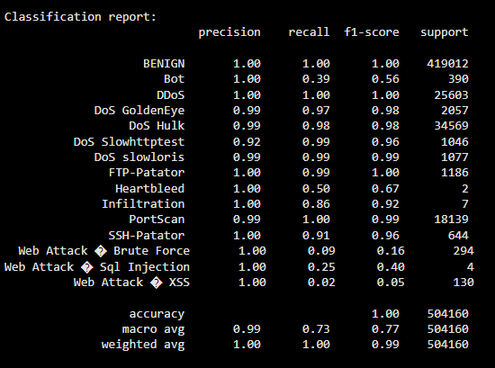
model 3 result
.

Slide 19
Summary & Key Takeaways
Designed a detailed, multi-stage intrusion detection pipeline.
Used strong classical and boosting ML models tuned for cybersecurity data.
Tackled major challenges: data imbalance, noise, interpretability.
Set foundation for continuous improvement with future work directions.

Slide 20
Future Work
Incorporate anomaly detection techniques to identify zero-day or unknown attacks.
Experiment with deep learning models on time-series traffic data.
Expand dataset with new threats and simulate emerging attack vectors.
Develop real-time streaming analytics for continuous network monitoring.
Enhance user interface and alerting mechanisms for operational environments.

Slide 21

.
.

