Slide 1



Scorecard_Axis_Bank
View in Power BI
Last data refresh:
8/17/2025 2:29:58 PM UTC
Downloaded at:
8/29/2025 6:49:13 AM UTC

Slide 2
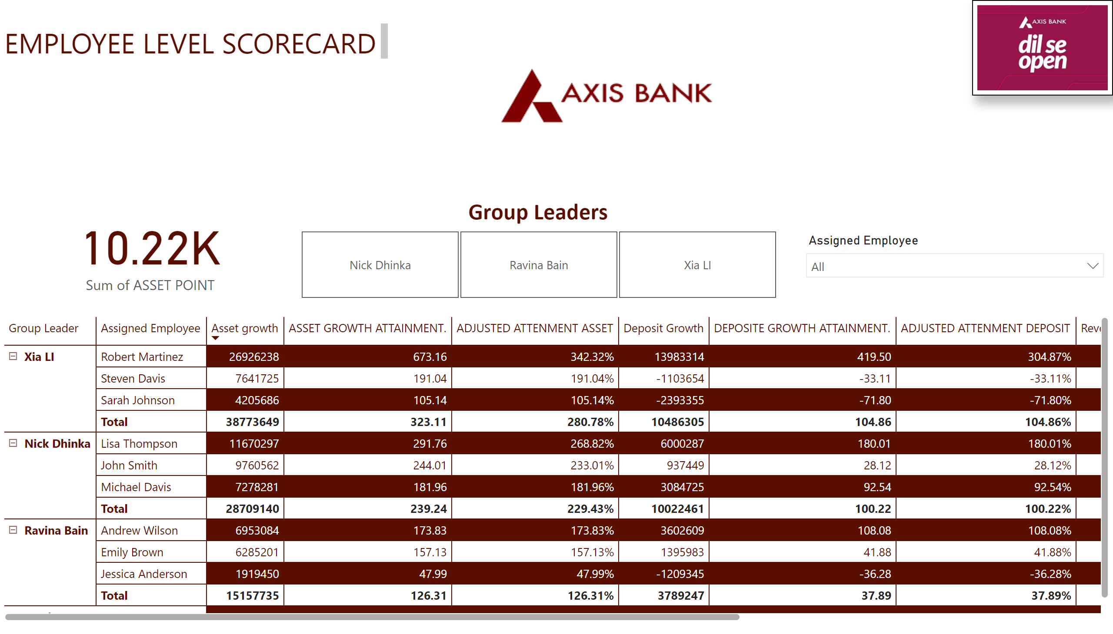
EMPLOYEE LEVEL
Notes:
image
No alt text provided
card
No alt text provided
textbox
No alt text provided
image
No alt text provided
slicer
No alt text provided
Group Leaders
No alt text provided
pivotTable
No alt text provided

Slide 3
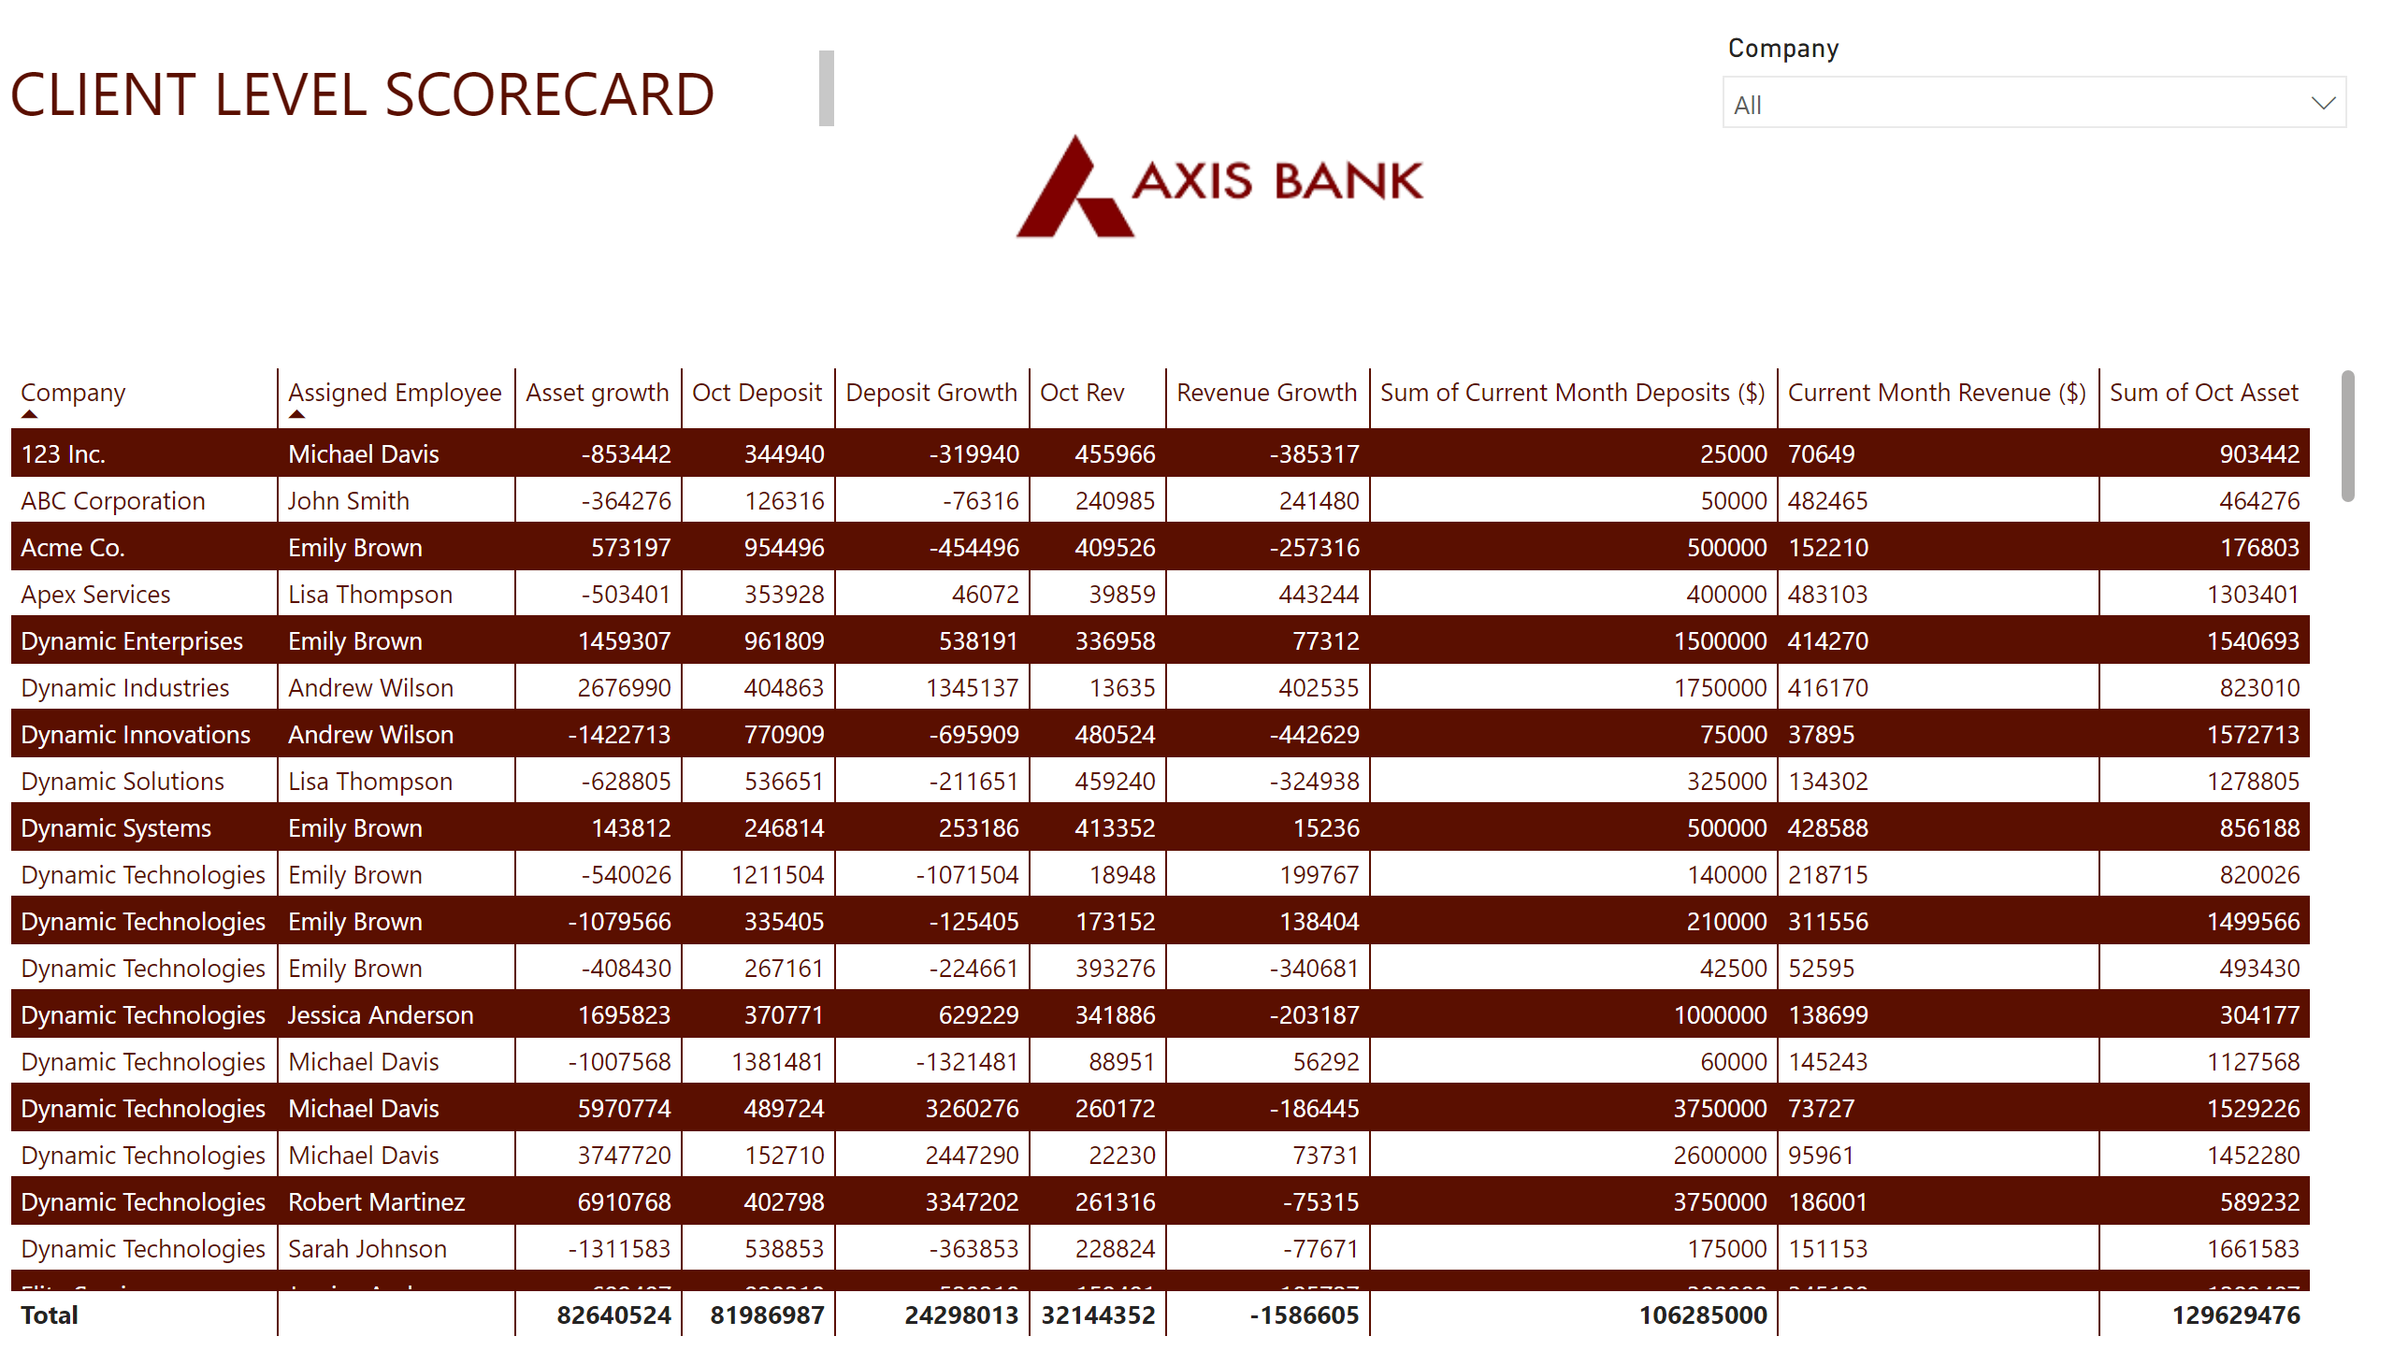
CLIENT LEVEL
Notes:
tableEx
No alt text provided
slicer
No alt text provided
image
No alt text provided
textbox
No alt text provided

Slide 4
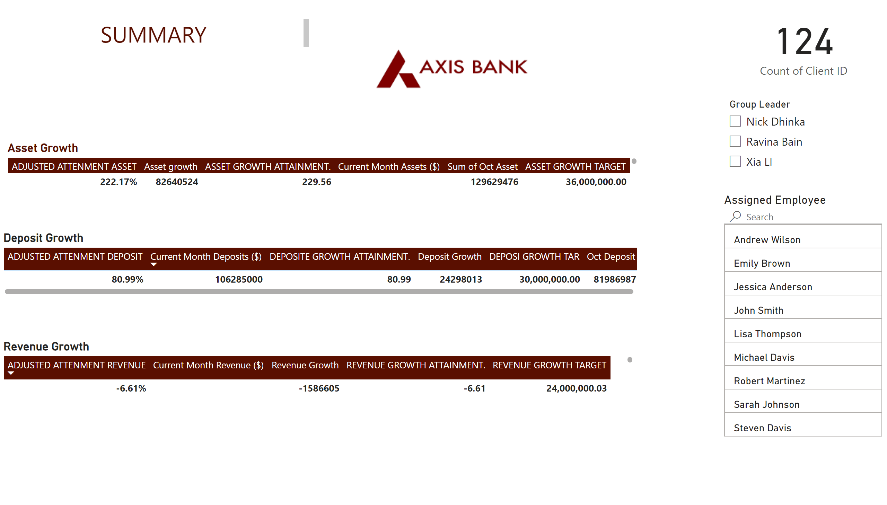
SUMMARY
Notes:
Asset Growth
No alt text provided
Revenue Growth
No alt text provided
slicer
No alt text provided
advancedSlicerVisual
No alt text provided
Deposit Growth
No alt text provided
image
No alt text provided
card
No alt text provided
textbox
No alt text provided

