Slide 1

Seasonal Agriculture Performance Analysis
Ayush Kumar
Indian Institute of Technology Patna
AICTE STU ID : STU6a644077872ca1784954999

Slide 2

PROBLEM STATEMENT
Agricultural activities are influenced by seasonal variations in environmental conditions, farming practices, resource availability and market conditions. As a result, agricultural performance may differ from one season to another. However, raw agricultural data does not clearly explain how agricultural performance changes across seasons or what patterns can be observed in different seasonal conditions. The problem is to analyze the given agricultural dataset and investigate seasonal differences in agricultural performance by identifying meaningful patterns, trends, relationships and variations within the available data.

Slide 3
Project Description
This project analyzes agricultural data across different seasons, regions, crops and farming conditions. The analysis includes data cleaning, exploratory data analysis, seasonal comparisons, crop and irrigation analysis, profitability analysis, water efficiency and correlation analysis.
The main aim is to identify useful patterns and insights that can support better understanding of seasonal agricultural performance.

Slide 4

WHO ARE THE END USERS?
Farmers
Agricultural planners
Government agricultural departments
Agricultural researchers
Data analysts
The analysis can help users compare seasonal performance and identify areas that may require further investigation.

Slide 5

Technology Used
Programming Language
Python
Libraries
Pandas
NumPy
Matplotlib
Seaborn
Environment
Jupyter Notebook

Slide 6
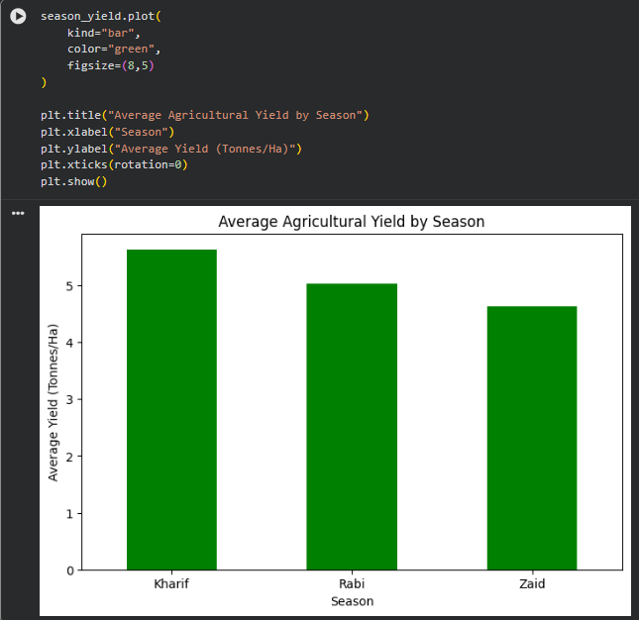
RESULTS
Seasonal Yield Analysis
Season | Average Yield (Tonnes/Ha)
Kharif | 5.63
Rabi | 5.04
Zaid | 4.64
Kharif recorded the highest average yield at 5.63 tonnes/ha, followed by Rabi at 5.04 and Zaid at 4.64 tonnes/ha.

Slide 7
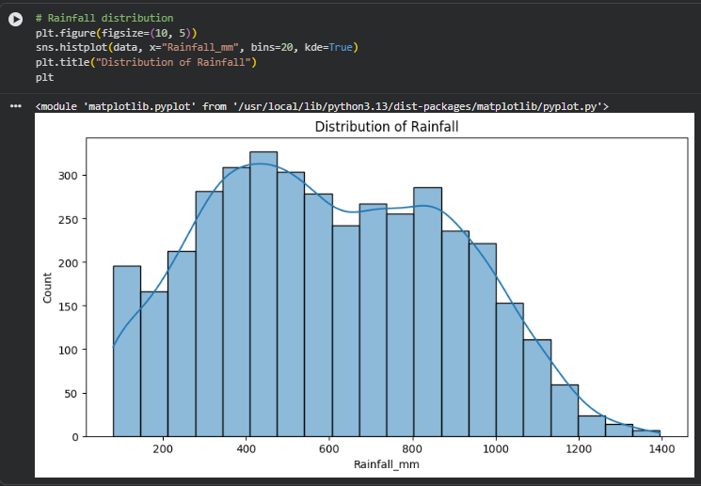
RESULTS
Rainfall Distribution
Rainfall values show a broad distribution, with most observations concentrated approximately between 300 mm and 900 mm. Higher rainfall observations become less frequent toward the upper end of the distribution.

Slide 8
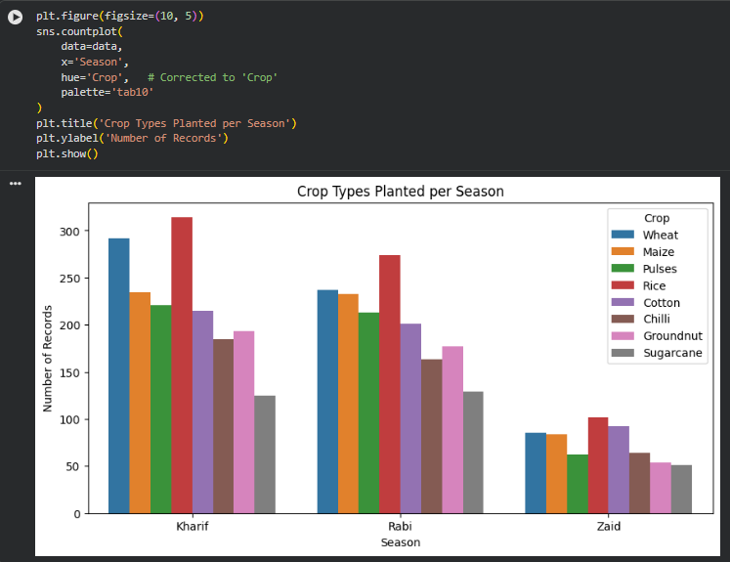
RESULTS
Crop Distribution Across Seasons
Crop distribution varies across seasons. Rice has the highest number of records in all three seasons, while Sugarcane has comparatively fewer records. The number of crop records is also substantially lower in Zaid than in Kharif and Rabi.

Slide 9
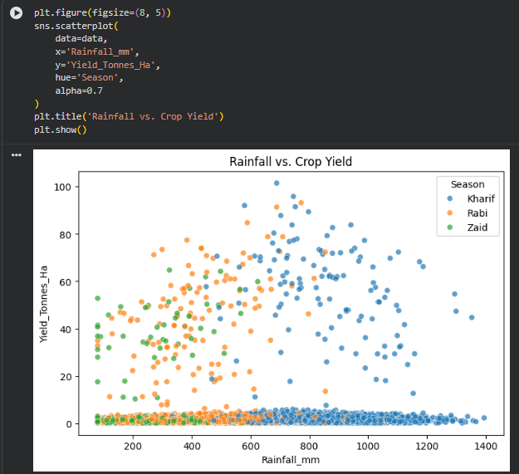
RESULTS
Rainfall vs Croop Yield
The scatter plot shows considerable variation in crop yield across rainfall levels and seasons. The relationship between rainfall and yield appears weak overall, which is consistent with the very low correlation between rainfall and yield (r ≈ 0.03).

Slide 10
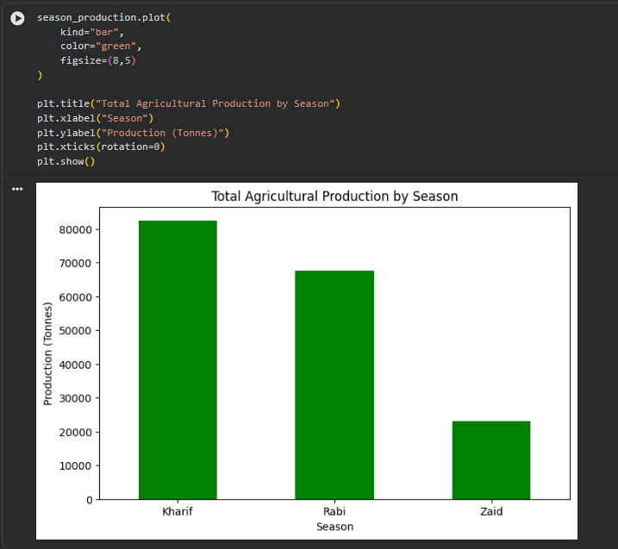
RESULTS
Seasonal Production and Environmental Conditions
Season | Total Production (Tonnes)
Kharif | 82,387.61
Rabi | 67,498.88
Zaid | 23,098.35
Season | Avg Rainfall | Avg Temperature
Kharif | 852.11 mm | 28.45°C
Rabi | 435.94 mm | 23.49°C
Zaid | 299.12 mm | 31.04°C
Kharif showed the highest total production and also had the highest average rainfall among the three seasons.

Slide 11
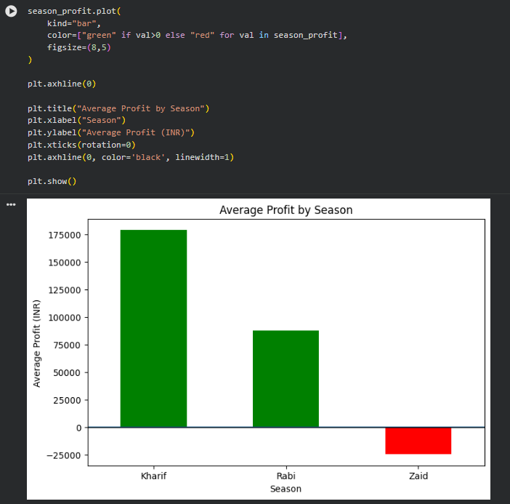
RESULTS
Crop Performance and Profitability
Crop performance varies considerably across seasons. Sugarcane stands out for its high average yield, while Sugarcane and Chilli show comparatively strong profitability.

Slide 12
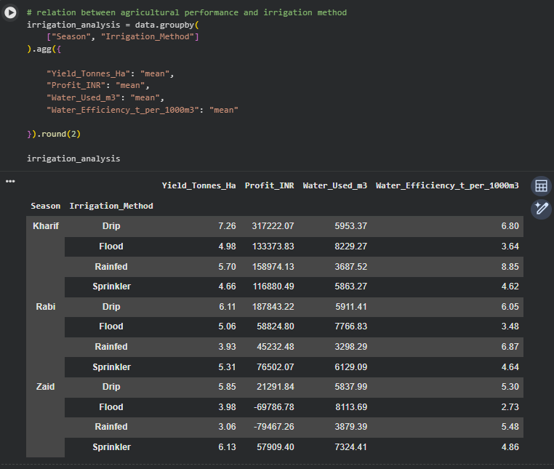
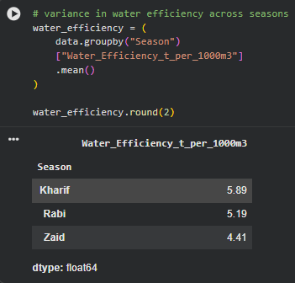
RESULTS
Irrigation Performance
Water efficiency
Irrigation performance varies across seasons. Kharif Drip irrigation showed comparatively high average yield and profit, while Kharif also recorded the highest average water efficiency.

Slide 13
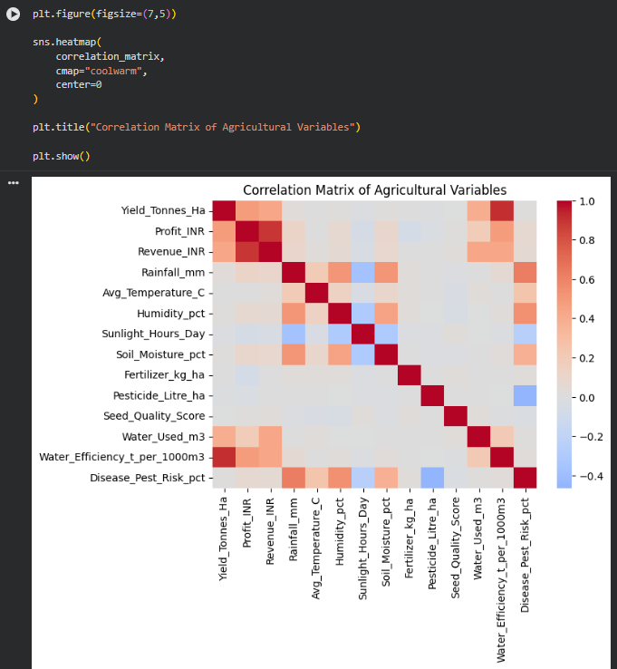
RESULTS
[Add screen shots of your code ]
Relationships and Regional Variation
Agricultural performance also varied across regions, indicating that seasonal results should be considered together with location and crop type.

Slide 14
Future scope
Add more years of agricultural data.
Include market price and weather forecasts.
Build an interactive dashboard using Power BI or another visualization tool.
Develop predictive models for yield and profitability.
Analyze individual crops and regions in greater detail.

Slide 15
GitHub Link
GitHub Repository
https://github.com/Ayush-0021/seasonal-agriculture-performance-analysis.git

Slide 16

VOIS Course completion certificate - Course name- Data Visualization

Slide 17
Thank you
Seasonal Agriculture Performance Analysis
.
.

