Slide 1
PULSECART
PulseCart
Quick-commerce operator intelligence
Track 02 · Customers, Channels & Demand
Built on Exasol · Powered by Groq LLMs · MIT License · 2026
Demo: 97 seconds · 4 dark stores · Bengaluru

Slide 2
THE LEAK
Quick-commerce loses 8–12% of revenue to four silent killers.
Operators run fragmented order, loyalty, support, returns, and guest systems; no system connects the same customer across them.
01
02
03
04
Identity fragmentation
Silent stockouts
Unused churn signals
Unattributed returns
Customers discover the failure after the order fails.
Burner aliases exploit promo gaps.
70–80% of churn intent sits in unread free-text tickets.
Logistics events hide profit-eroding customer behavior.
The root cause is not four problems. It is one: the absence of a unified customer record.
02

Slide 3
THE OPERATOR VIEW
One dashboard. Four modules. Zero leakage.
PulseCart unifies identity, inventory, churn, and returns intelligence into one operator view, built on Exasol.
01
02
03
04
Identity & Fraud Guard
Predictive Inventory Radar
Autonomous Customer Success
Margin Protection
Returns are attributed to customer LTV and toxic SKUs are flagged.
Fuzzy-matched golden IDs block promo abuse at 0.85 similarity.
Six-hour stockout predictions per dark store with one-click reorder.
Groq classifies every ticket and returns a retention offer in two seconds.
5 source systems
Exasol
13 tables · 5 views · 1 mat. view
FastAPI
19 endpoints
Next.js
6 operator views
Sub-second queries at billion-row scale · LLM enrichment in-database · Zero cold pipelines
03

Slide 4
IDENTITY & FRAUD GUARD
Promo abuse blocked in real time.
A burner email alias triggers an instant block, logs a fraud event to Exasol, and surfaces in the live alert feed within 15 seconds.
LIVE ALERT
INPUT | aarav.sharma+spam@gmail.com
PROMO | $15OFF (₹500)
MATCH | address_similarity → 100.0%
ACTION | BLOCKED · fraud_event inserted
FR-001
Reason: email alias matches existing customer GID-1001.
04

Slide 5
AUTONOMOUS CUSTOMER SUCCESS
LLM classifies every ticket in 2 seconds.
Groq’s gpt-oss-20b returns strict JSON validated against Pydantic, then writes sentiment, urgency, churn risk, category, and a retention offer back to Exasol.
01
02
03
04
Ticket
Strict JSON
Risk read
Offer
Damaged packaging · eggs arrived crushed · refund request ₹60
Validated against Pydantic.
NEGATIVE · HIGH urgency · 70% churn risk · product_quality
₹1,200 store credit + apology
Customer
Telemetry
Sneha Desai · GID-1008
57 tickets analyzed
LTV ₹19,350
88% average churn risk in top decile · ₹680 retained today
05

Slide 6
PREDICTIVE INVENTORY RADAR
Five SKUs predicted to stock out in six hours.
Live across four Bengaluru dark stores; refreshed every 60 seconds.
One click → reorder approved.
No spreadsheet. No Slack thread.
SKU | STORE | STOCK | 6H DEMAND | STATUS | REORDER
Amul Taaza Milk 1L | Koramangala | 4 | 6 | CRITICAL | +158
Hass Avocado | Indiranagar | 2 | 8 | CRITICAL | +118
Whole Wheat Bread | HSR Layout | 6 | 12 | CRITICAL | +174
Free-Range Eggs (6) | Whitefield | 5 | 10 | CRITICAL | +205
Bananas (1kg) | Koramangala | 8 | 14 | CRITICAL | +136
06

Slide 7
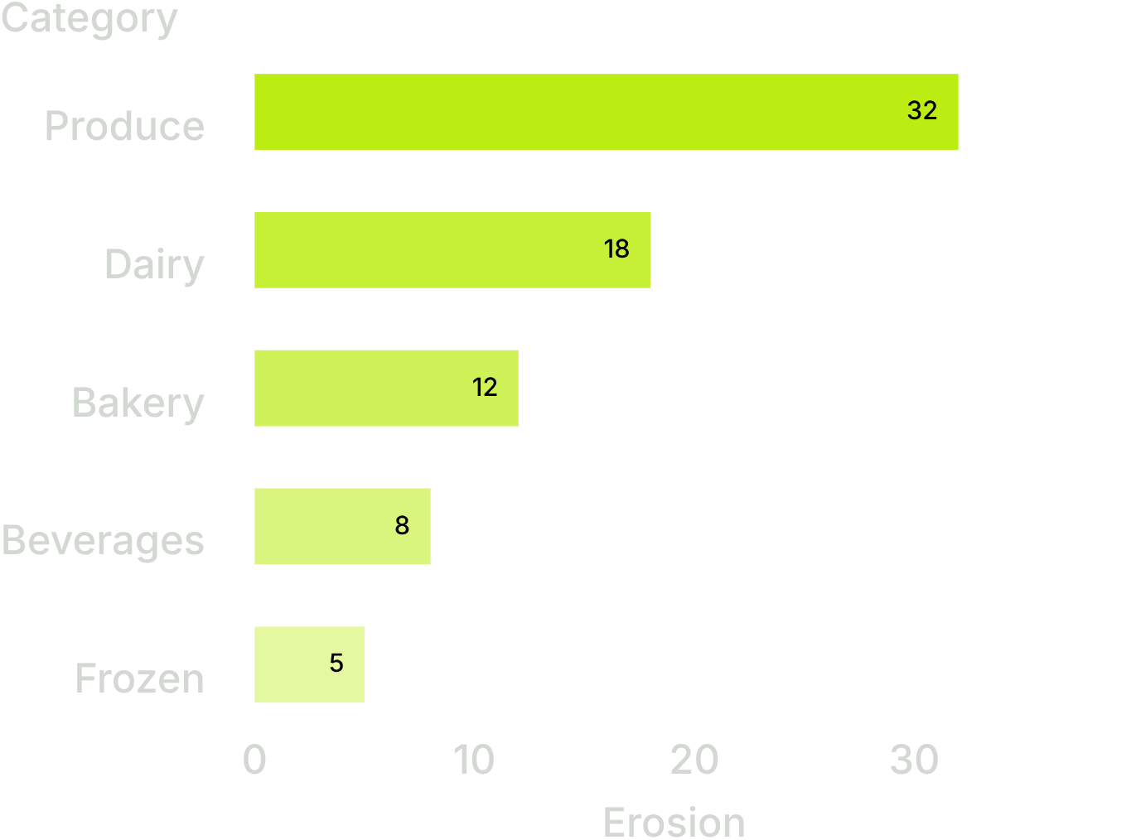
MARGIN PROTECTION
Returns abusers. Toxic SKUs. Real margin impact.
PulseCart ties every return back to customer LTV and SKU profitability.
RETURNS ABUSER #1
TOXIC SKU
Rohit Gupta
Hass Avocado
Margin erosion by category
GID-1005 · 6 returns · ₹2,700+ margin impact · 28% return rate.
AV-006 · 4 returns ·
₹−48.50 net margin · flagged TOXIC.
Total margin lost: ₹1,845.20 · Erosion: 14.8%
07

Slide 8
LIVE ROI TELEMETRY · POLLED EVERY 30 SECONDS FROM EXASOL
₹1,842.50
revenue saved today.
FRAUD BLOCKED
CHURN RETAINED
STOCKOUTS AVOIDED
₹740
₹680
₹422.50
+18.4% versus the 7-day average · 7-day cumulative: ₹12,980.00 (+9.2%)
08

Slide 9
UNDER THE OPERATOR VIEW
The stack is deep where operators feel it.
Sub-second execution: Exasol’s in-memory columnar engine scans only the columns each query needs; materialized views refresh in seconds.
Views powering every module: VW_CUSTOMER_GOLDEN, VW_STOCKOUT_WARNINGS, VW_CHURN_RISK, VW_RETURNS_ABUSERS, MV_CUSTOMER_360.
LLM fallback chain: openai/gpt-oss-20b on Groq → qwen/qwen3.8-27b → heuristic keyword classifier.
Open source by design: MIT License, no proprietary dependencies, Exasol Personal Edition compatible, deterministic synthetic seeder.
13 tables · 5 views · 1 materialized view
09

Slide 10
THE CLOSE
Catch what quick-commerce loses to silence.
PulseCart recovers the 8–12% of revenue that quietly leaks every quarter across fraud, stockouts, churn, and returns.
One unified customer record. One operator dashboard. Built on Exasol.
Live demo →
GitHub repository →
3-min video walkthrough →
Track 02 · Customers, Channels & Demand · Hackathon submission · 2026 · MIT License · Open source · Built in Bengaluru

