Slide 1
STRESS ANALYZER
PREDICTOR
“ Your personal check-engine light for well-being.“
- By Ananya Jain (S24CSEU1571) , Ayush Kumar (S24CSEU1572)

Slide 2

PROBLEM STATEMENT
Chronic stress is a major modern health issue , leading to burnout, anxiety, and physical health complications.
Most people only recognize stress when it's already severe. We lack simple, accessible , and objective tools for early detection.
A proactive system is needed to help individuals monitor their stress levels before they become overwhelming , allowing for timely intervention.

Slide 3
PROBLEM SOLUTION
We have developed the "Stress Analyzer Predictor," a working model that analyzes key personal inputs.
The system takes user-provided data on lifestyle factors and classifies their current stress level into one of three categories : Low , Medium , High.
To provide an easy-to-use, data-driven "check engine light" for mental well-being, empowering users to make informed decisions about their health.

Slide 4
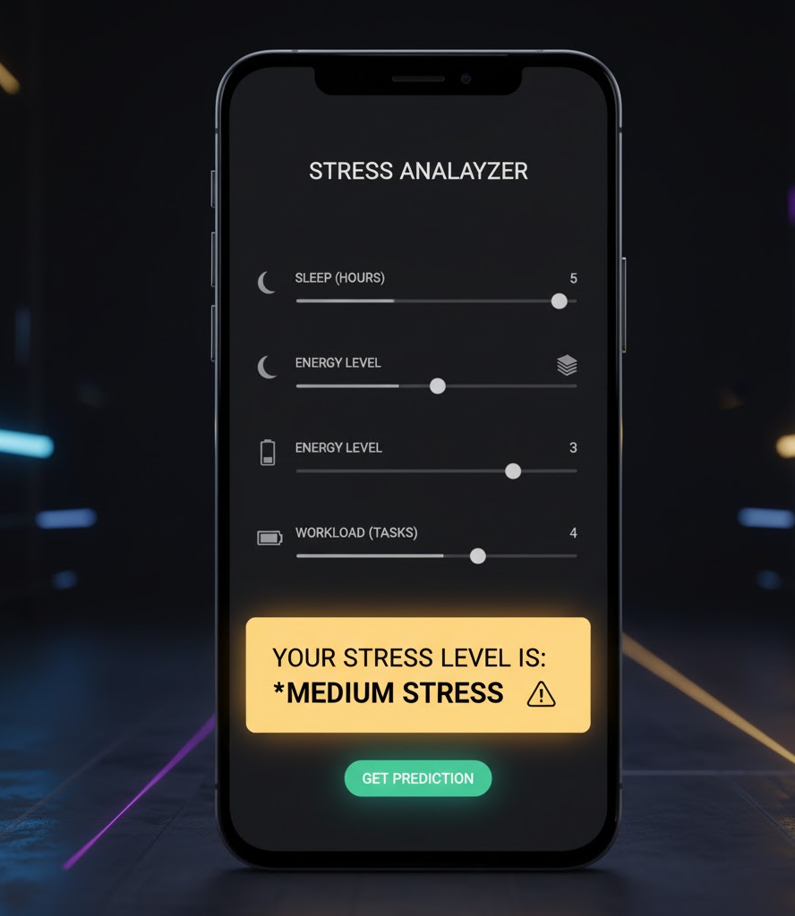
KEY FEATURES :
Multi-Factor Analysis: The model uses a holistic approach, analyzing a combination of features (e.g., sleep, workload, activity) for a more accurate prediction.
Instant Classification: Delivers a real-time prediction, providing immediate feedback to the user.
Simple Interface: Designed for accessibility. Users can easily input their data and understand the clear,-categorical output.
Data-Driven: The prediction is not a guess; it's based on a machine learning model trained on a dataset to recognize patterns associated with stress.

Slide 5
TECHNOLOGIES USED:
Application Framework
Streamlit: For rapidly building and deploying interactive web applications for the stress predictor.
Development Environment
Jupyter Notebook: Employed for iterative prototyping, data exploration, and model development workflows.
Core Libraries
Scikit-learn: Essential for building, training, and evaluating the machine learning prediction model.
Python: The foundational language for data science, machine learning, and application development.
Pandas: Used for efficient data loading, manipulation, and preprocessing of datasets.
Matplotlib & Seaborn: Powerful libraries for creating insightful data visualizations and exploratory data analysis.

Slide 6
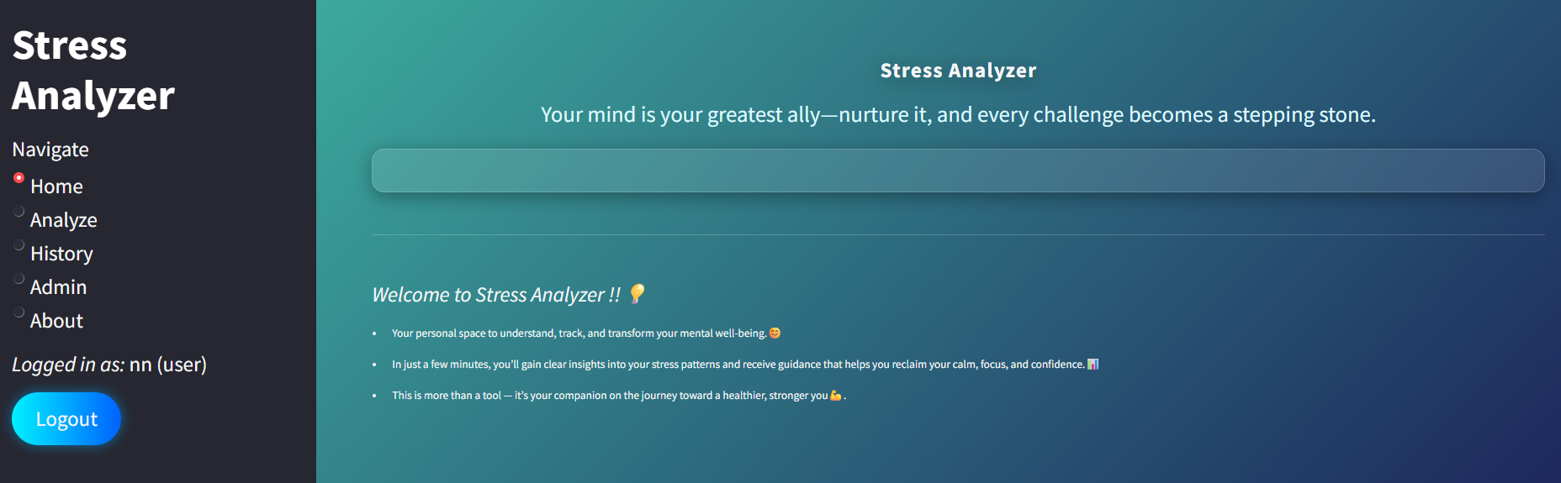
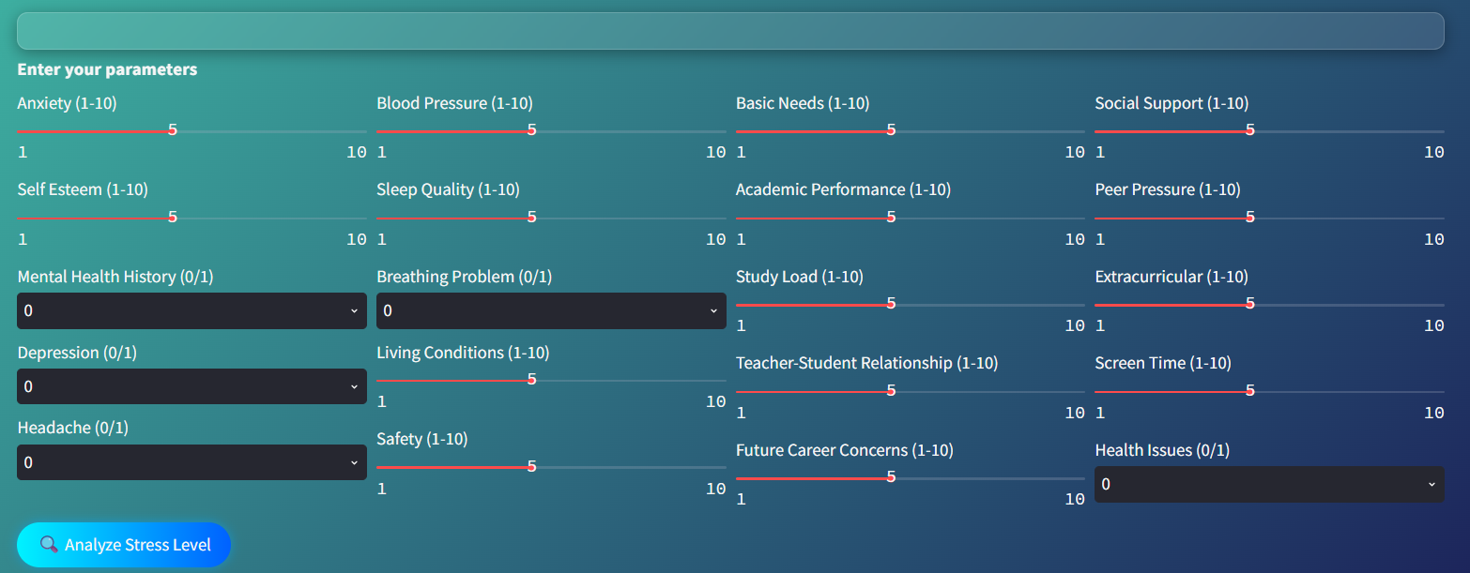
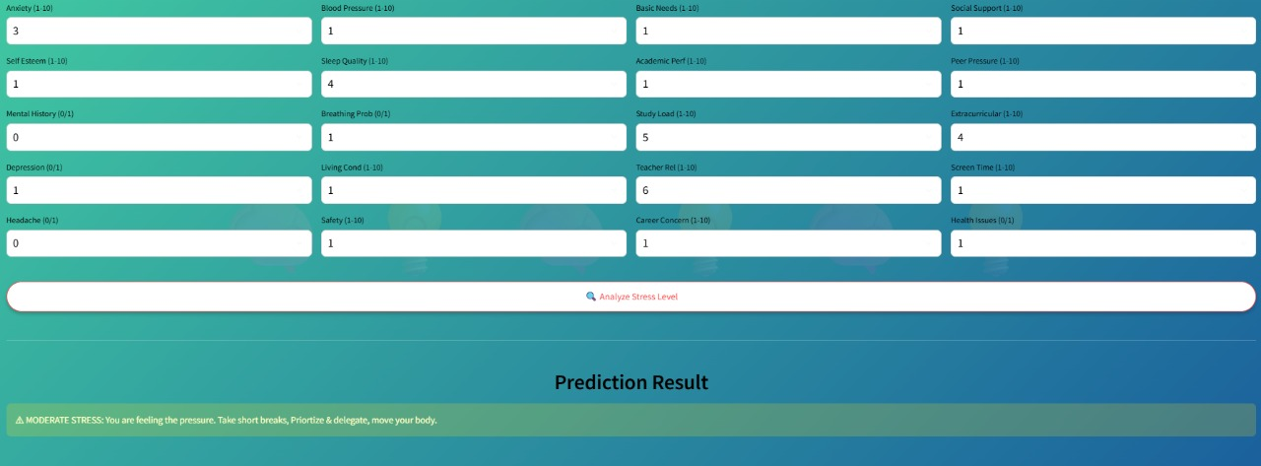
FINAL WORKING PROJECT

Slide 7
CONCLUSION :
We successfully built a working model that can effectively predict stress levels based on user-provided data.
The "Stress Analyzer Predictor" serves as a crucial first step in creating accessible tools for mental health awareness.
This project has strong potential to evolve from a predictive model into a comprehensive personal wellness assistant.

Slide 8
THANK YOU !

