Slide 1
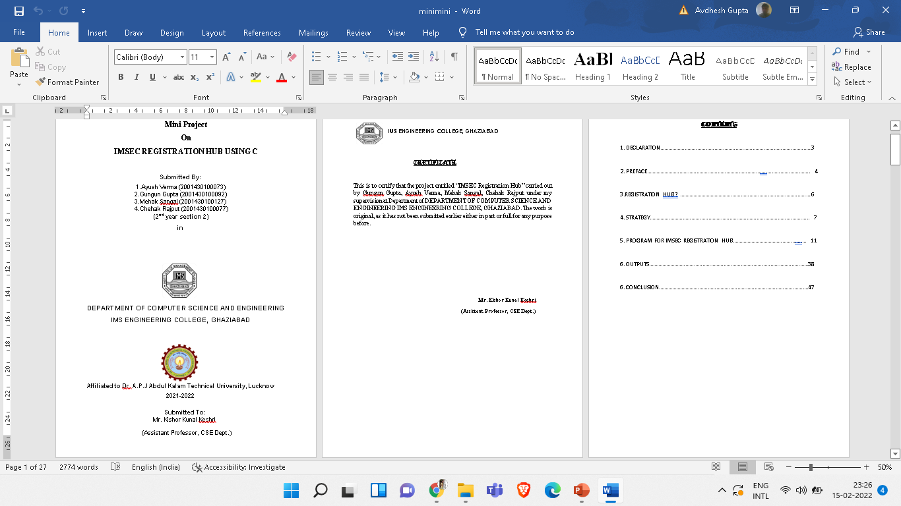

Slide 2
IMSEC REGISTRATION HUB
PROJECT TITLE:

Slide 3

IMSEC REGISTRATION HUB

Slide 4

We have created functions to perform each and every specific task. Functions like, reg(), show(), reg_no(),etc. these functions help us to perform each and every task differently and efficiently. Structures are made to store the names of all students, roll numbers of the participant, branch, year, and the event they participate in and count the number of participants that are registered in this event. In the main block, we will print the instructions whether to make a registration, see the details of the students or exit out of the program. We run a switch case in this block to make choices and execute the following block which is asked for. We then enter a case 4 in which we thank the user for using our program.

Slide 5
Then we pass on to the function reg(), in this function we make the user enter the first name, last name, roll number, branch and the event in which the user wants to participate. Then at last we increase the value of i by 1. This is the way the users ends making a registration in the program. After the function reg() we pass the year() function. The year() function checks the participant’s year and compares it with 1,2,3 and 4. Therefore, then makes a file year wise and stores the name and the entry corresponding to it in the same file. This function uses file handling. The function trait(), checks the participant’s branch and compares it with cse, cs, it, mech, ec, biotech and mba . If any other branch is added it will be added in a separate file. Therefore, then makes a file branch wise and stores the name and the entry corresponding to it in the same file. This function uses file handling. Now using the above two functions we can sort year and branch wise.

Slide 6
The function event(), checks the participant’s event in which he/she may have participated and compares it with the give choice of the events mainly singing, dancing, poetry and anchoring .Therefore, then makes a file event wise and stores the name and the entry corresponding to it in the same file. This function uses file handling. Now using the above two functions we can sort year, event wise and branch wise. The next function count(), counts the total number of registration and stores in a variable then we increment the value of that variable by 1. Then it enters the value of the total count to a file. This function basically tells the total number of registrations done through the entire program. The function reg_no() stores the number of registrations. It uses file handling. It opens the file in which it stores the number of registration and prints it. If no data is found it will print the message respectively. This function is just an addition to the previous function count.

Slide 7
LASTLY,We made the next function named show(), first of all we check by year, this function shows the students detail sorted by year, branch and event respectively. This takes the user input according to its needs and then access the corresponding block. It prints the name and the entry corresponding to it in the same file. If there is no such entry by users choice it will print no data found or a message related to the error.

Slide 8
THANKYOU!

