Slide 1
KUMBHATHON INNOVATION S.P.R.I.N.T. 2026
Kumbh Setu
An AI field companion for the people who serve the Kumbh —
and a live bridge from the ground to the control room.
Problem · Solution · Outcomes · The Ask
Kumbh Setu · 01
SIMULATION MODE · SYNTHETIC DATA

Slide 2
PROBLEM STATEMENT
At a mass gathering, the people on the ground
and the people in the control room can't see each other.
A field volunteer meets thousands of unpredictable situations an hour — medical, lost people, crowd pressure, water, sanitation — across a dozen languages.
One person can't know every answer, speak every language, or recall every procedure under stress — and can't stop to fill a form for each thing they see. So most of it goes unreported.
The control room learns of it late, as radio anecdotes — no location, no time, no way to tell one report from ten — and acts only after crowding has already escalated.
Pilgrims who don't read the local signage can't get simple guidance without reaching a police post.
Kumbh Setu · 02
SIMULATION MODE · SYNTHETIC DATA

Slide 3
PROBLEM — WHY IT MATTERS
The gap is where crowd incidents,
slow reunifications and blind spots live.
12+ languages
minutes
anecdotes
spoken at one ghat on a principal bathing day — most field staff share two
decide the outcome when a child is missing or someone collapses in a dense crowd
not data — is how ground truth reaches the control room today; it can't be verified or ranked
Traditional crowd management is reactive physical security — radios, paper logs, manual cordoning. The information exists on the ground; it just never becomes operational.
Kumbh Setu · 03
SIMULATION MODE · SYNTHETIC DATA

Slide 4
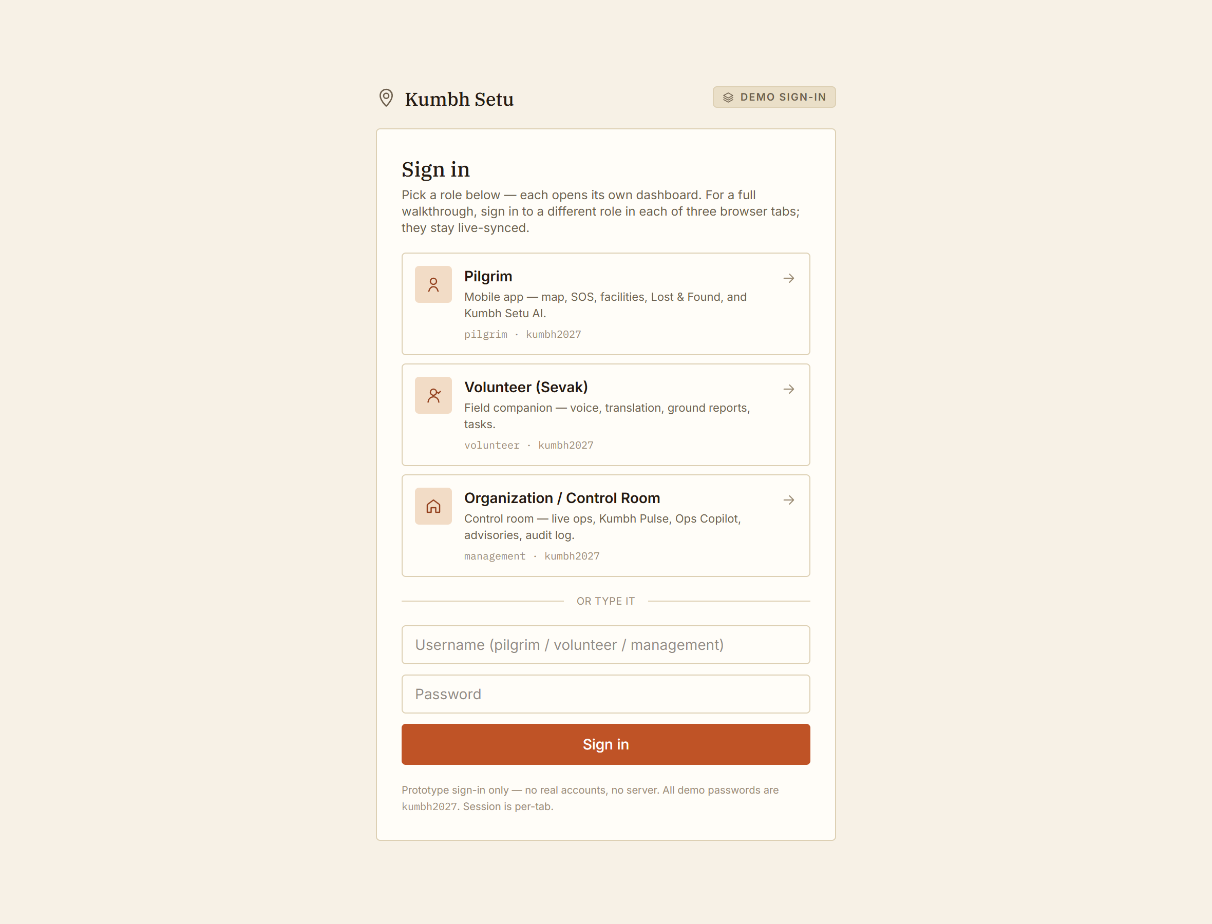
SOLUTION
One connected platform: three role apps,
one live backbone, Kumbh Setu AI across all of it.
Pilgrim app — map, one-tap SOS, facilities, Lost & Found, Plan-my-Kumbh, and Setu to ask anything in your language.
Volunteer field companion — voice-first: ask, get the procedure as a checklist, translate live for a pilgrim, report what you see, manage your tasks.
Control room — one screen: live map + real Nashik infrastructure, Kumbh Pulse risk, emerging signals, an Ops Copilot, advisories, a full audit log, a CCTV/security layer.
An action anywhere reaches the others in real time. The AI proposes; a human always confirms.
Kumbh Setu · 04
SIMULATION MODE · SYNTHETIC DATA

Slide 5
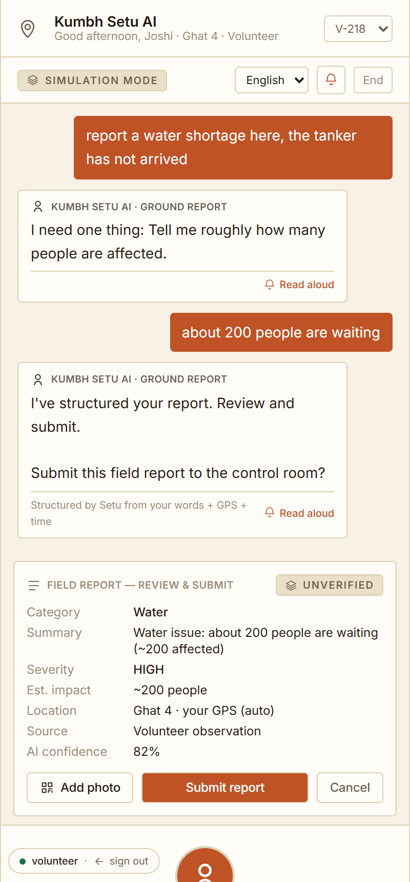
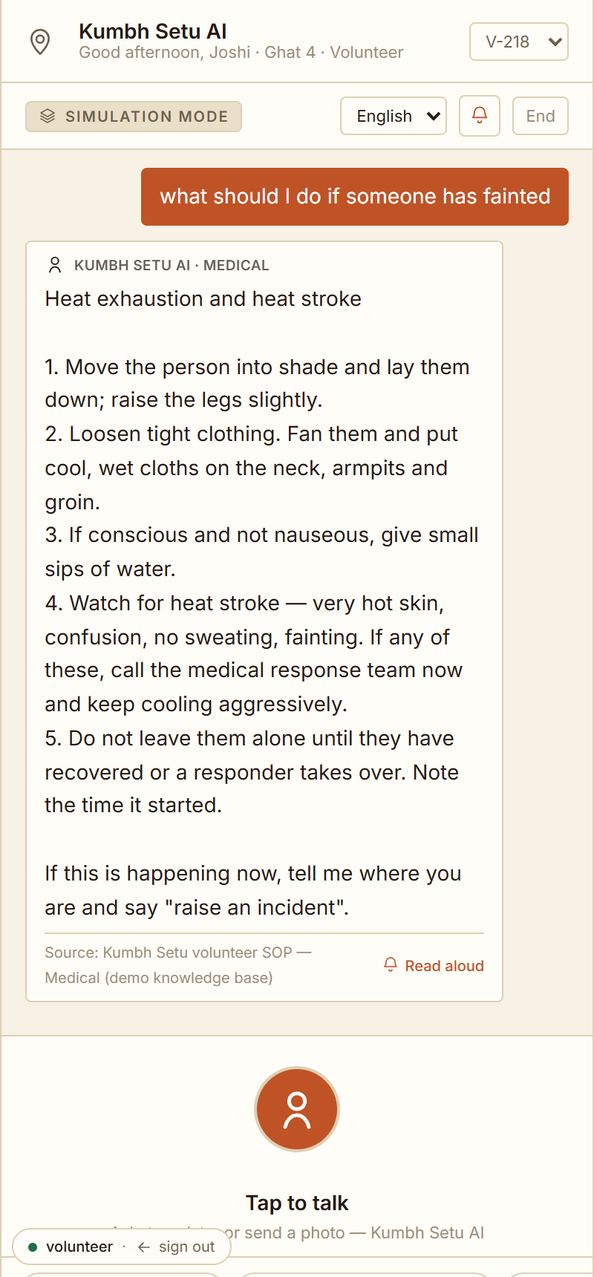
SOLUTION — THE FIELD COMPANION
Speak naturally. Setu understands,
answers, translates, and structures the report.
“What do I do if someone faints?” → the SOP as a numbered checklist, with its source.
“Help me talk to a Tamil pilgrim” → a live two-way translator, each turn playable aloud (EN / हिन्दी / मराठी / தமிழ், built for all Maharashtra-region languages).
“Report a water shortage here” + a photo → Setu structures category, severity, headcount, GPS, confidence — marked UNVERIFIED — and one tap files it.
“Where is the holy dip today?” → the date- and ghat-specific answer (Vaishnava → Ramkund, Shaiva → Kushavarta).
Kumbh Setu · 05
SIMULATION MODE · SYNTHETIC DATA

Slide 6
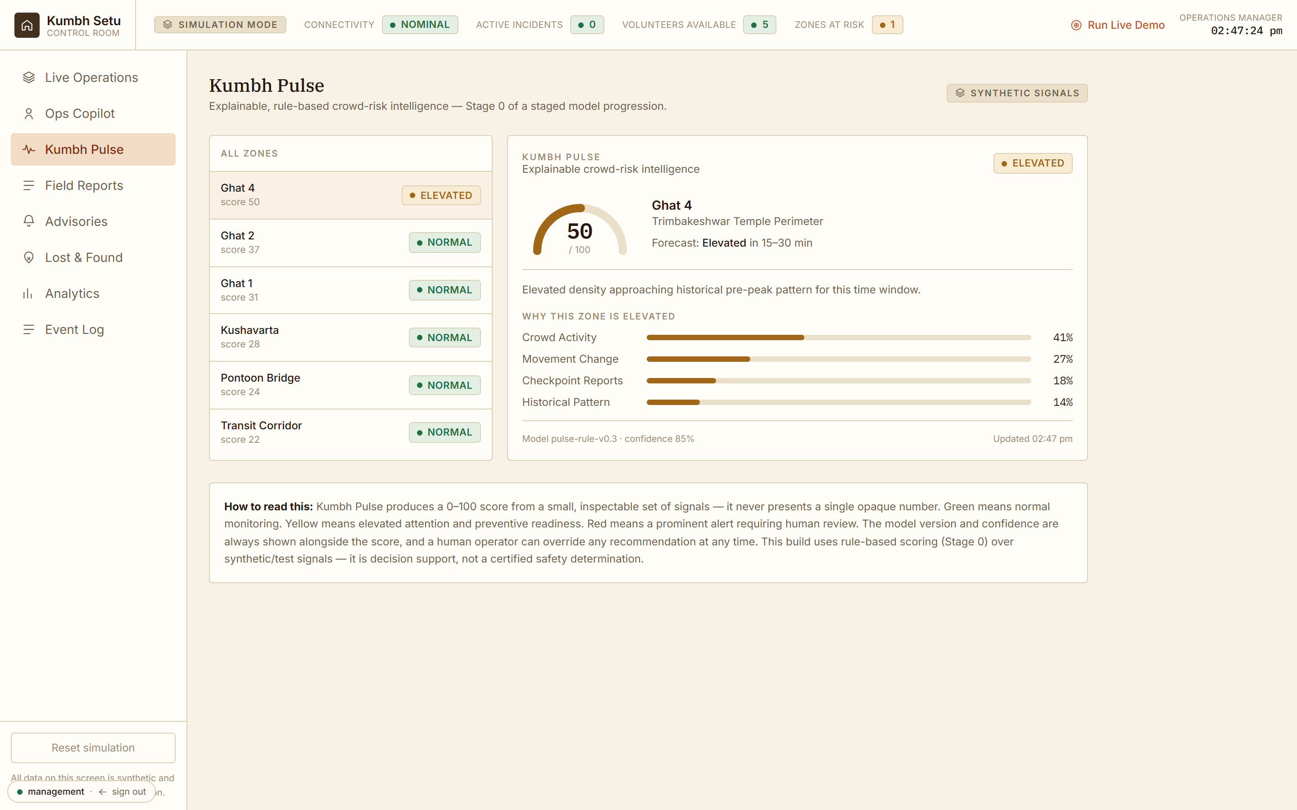
SOLUTION — THE CONTROL ROOM
Weak field signals become one thing
worth a human's attention.
Kumbh Pulse: an explainable 0–100 crowd-risk score per zone — contributor bars, model version, confidence. Never one opaque number.
Ground reports aggregate into an EMERGING SIGNAL; its confidence rises with independent corroboration. An operator verifies, then promotes it to a dispatchable incident.
Skill- and language-aware dispatch (with a crowd-density travel-time model), advisories to every pilgrim phone in scope, and a tamper-evident audit trail.
2,900+ real Nashik places (Nashik Monitor open data) as a live reference layer.
Ops Copilot — “give me the operational overview”
Kumbh Setu · 06
SIMULATION MODE · SYNTHETIC DATA

Slide 7
SOLUTION — THE LOOP THAT CLOSES
Observe → Corroborate → Signal → Decide → Resolve → Audit
1
Observe
2
Corroborate
3
Signal
Volunteer speaks a report + photo. Structured, GPS-tagged, audit-logged.
More volunteers report the same. Verification status climbs the ladder.
Kumbh Pulse raises an emerging signal; confidence tracks corroboration.
4
Decide
5
Resolve
6
Audit
Operator verifies, promotes to an incident, dispatches the right volunteer.
Accept → arrive → resolve, each step on the control-room timeline.
The whole chain — who knew what, when — in one exportable ledger.
The AI never acts on its own — every arrow is real state, and a human authorises every dispatch.
Kumbh Setu · 07
SIMULATION MODE · SYNTHETIC DATA

Slide 8
OUTCOMES
What changes when the loop closes.
Response time
Right volunteer, not just the nearest one — matched on skill, language and crowd-adjusted travel time; dispatch in one confirmed click, not a radio round-robin.
Ground truth
Every observation becomes a located, timed, ranked signal. Corroboration separates a real problem from a one-off before assets move.
Early warning
The control room sees a build-up while it's still an inconvenience — with a confidence figure it can defend to the incident commander.
Reunification
A structured missing-person case, matched against found-person reports, with a QR handshake at handover — not a search on foot.
Accountability
A tamper-evident ledger of every AI suggestion, volunteer action and operator decision — ready for a post-event inquiry.
Reach
A pilgrim who reads no local language gets guidance in their own — without approaching a police post.
Prototype today; these are the outcomes a zone-level pilot would measure — MTTR, corroboration lead time, reunification time, advisory reach.
Kumbh Setu · 08
SIMULATION MODE · SYNTHETIC DATA

Slide 9
THE ASK — FROM AUTHORITIES, GOVERNMENT & PARTNERS
Give us one sanctioned zone, the data, and
a seat in the control room.
Event & district authority
State government
NTKMA · Nashik & Trimbakeshwar municipal · SP office
Maharashtra DoIT · State Disaster Management
A sanctioned pilot in one zone during a Simhastha parva or a large temple-town festival, with the control-room team in the loop — and access to the zone / facility / route data behind the digital twin.
Recognition as crowd-safety decision support; a line in the Simhastha 2027 digital-infrastructure plan; a path to integrate with the state 112 / emergency stack.
Bhashini / MeitY
Akhara Parishad & temple trusts
National Language Translation Mission
Trimbakeshwar Devasthan · Akhara Parishad
Speech and translation API access for the 22 scheduled languages at event scale, behind our provider interface.
An authoritative feed of the snan / procession schedule, and an endorsement so pilgrims trust the advisories.
Volunteer bodies
Telecom / TRAI
NYKS · NSS · local seva sangathans
—
A credentialing partnership so the verified-hours certificate carries weight — the reason a working professional keeps picking up tasks.
A priority SMS lane for the degraded-network fallback when towers are saturated on a peak day.
Kumbh Setu · 09
SIMULATION MODE · SYNTHETIC DATA

Slide 10
IN ONE LINE
The field-to-control-room nervous system
a mass gathering needs and doesn't have.
Most assistants answer questions. Kumbh Setu helps the people serving the Kumbh understand, communicate, act and report — and turns what they see into operational intelligence.
Live demo: npm run dev → /login — pilgrim / volunteer / management, password kumbh2027
github.com/Ayush-170906/KumbhSetu
Kumbh Setu · 10
SIMULATION MODE · SYNTHETIC DATA

