Slide 1
KUMBHATHON INNOVATION S.P.R.I.N.T. 2026
Kumbh Setu
An AI field companion for the people who serve the Kumbh —
and a live bridge from what they see on the ground to the control room.
Pilgrim · Volunteer · Control Room one live platform, four languages
SIMULATION MODE · SYNTHETIC DATA

Slide 2
1
THE PROBLEM
A field worker at a mass gathering can't
carry it all in their head.
Thousands of unpredictable human situations, every hour — medical, lost people, crowd pressure, water, sanitation.
One person can't know every answer, speak every language, or remember every procedure under stress.
And they can't stop to fill a form for each thing they see — so most of it goes unreported.
The control room hears it late, as radio anecdotes — no location, no time, no way to tell one report from ten.
12+ languages
at a single ghat on a Shahi Snan day
minutes
matter when a child is missing or someone collapses
Kumbh Setu · 02

Slide 3
2
THE INSIGHT
Setu is a copilot for the volunteer —
not a chatbot for the pilgrim.
It makes one field worker significantly more capable, and turns every field interaction into structured operational intelligence.
SPEAK
UNDERSTAND
ACT
in your own language — voice or text
→
intent, urgency, the Kumbh context
→
answer, translate, report, escalate — with a human in the loop
Not: open menu → find feature → fill form → submit.
Kumbh Setu · 03

Slide 4
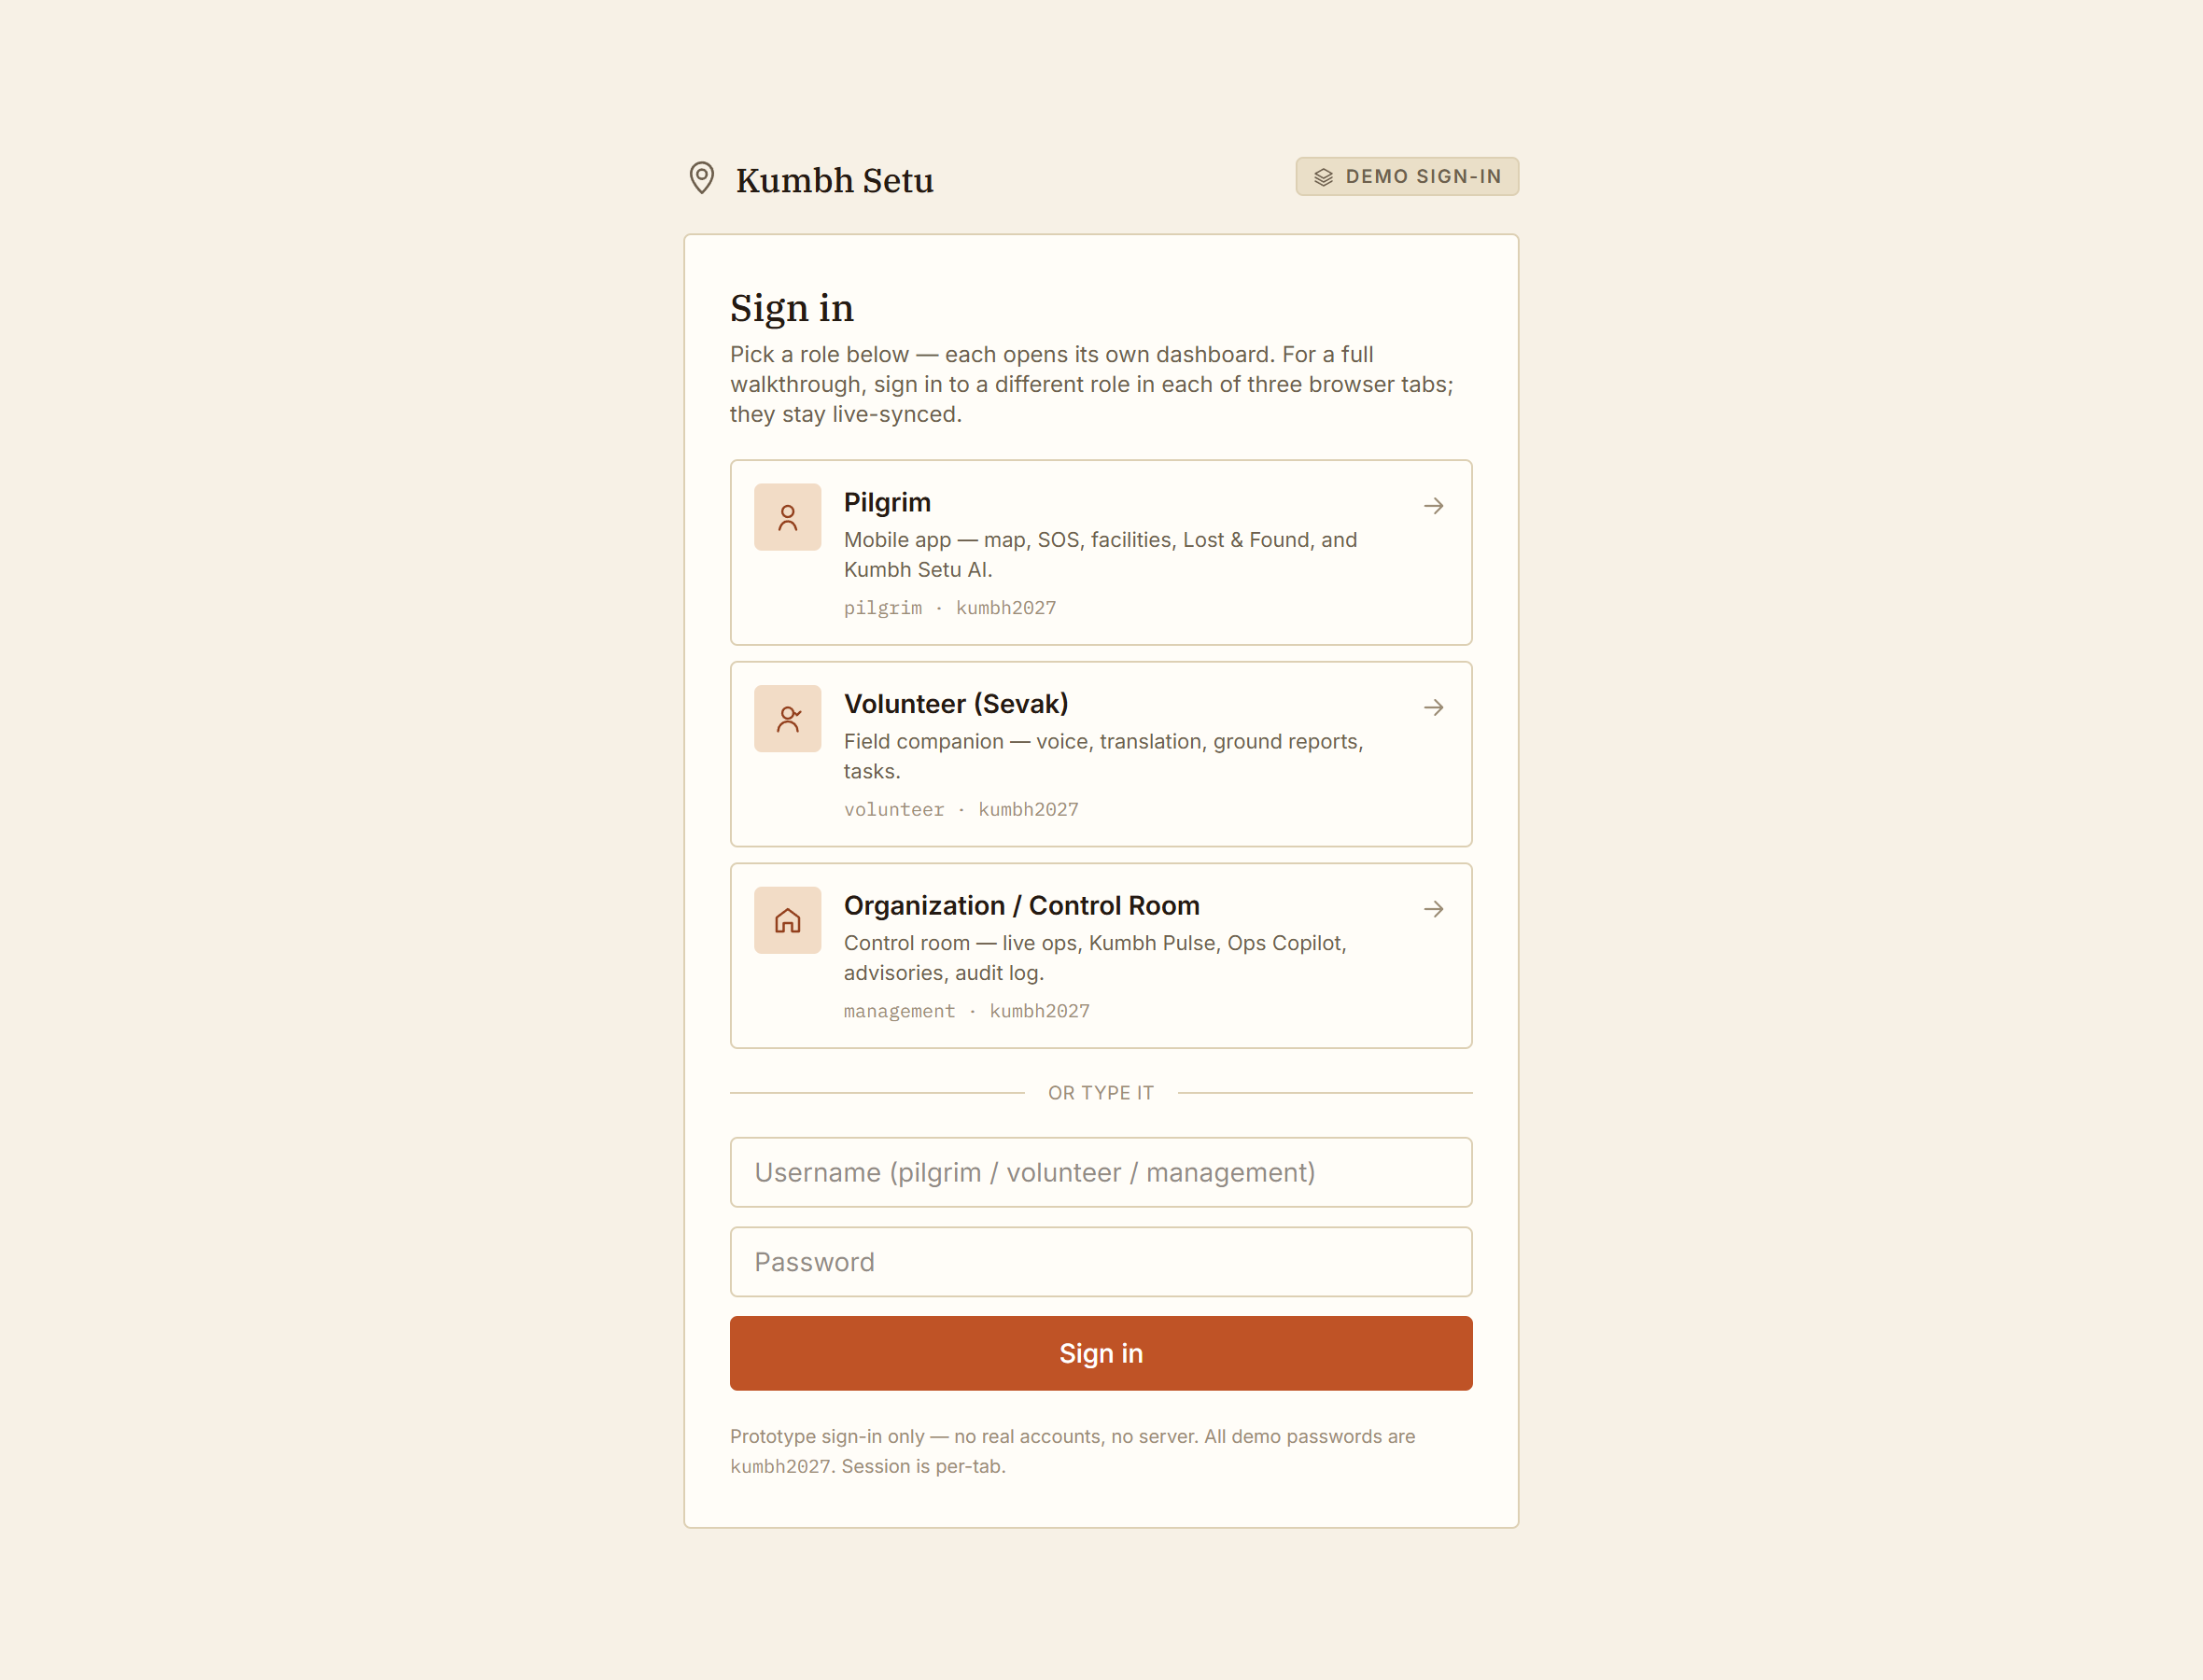
3
WHAT WE BUILT
Three connected apps on one live backbone,
with Kumbh Setu AI across all of them.
Pilgrim — a mobile app: map, one-tap SOS, facilities, Lost & Found, and Setu to ask anything in your language.
Volunteer — a voice-first field companion: ask, get the procedure as steps, translate for a pilgrim, report what you see, manage your tasks.
Control Room — one screen for the whole ground: live map, Kumbh Pulse risk, emerging signals, an Ops Copilot, advisories, full audit log.
An action anywhere propagates to the others in real time. Sign in per role — three tabs, three roles, one synced picture.
Kumbh Setu · 04
SIMULATION MODE · SYNTHETIC DATA

Slide 5
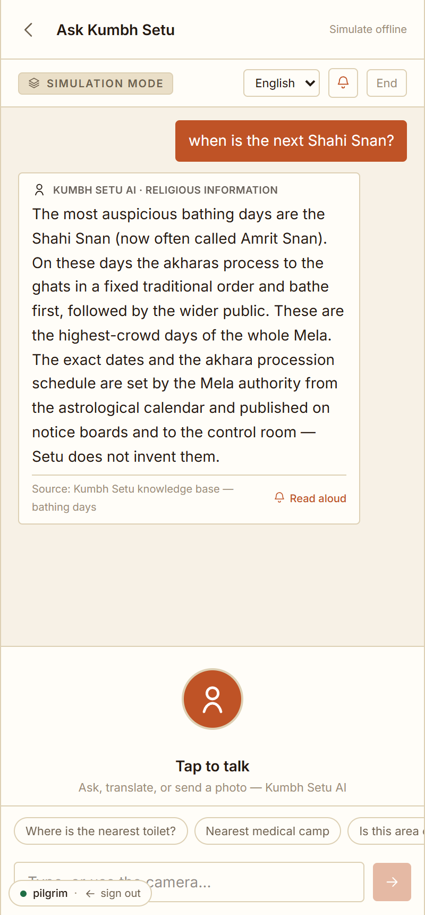
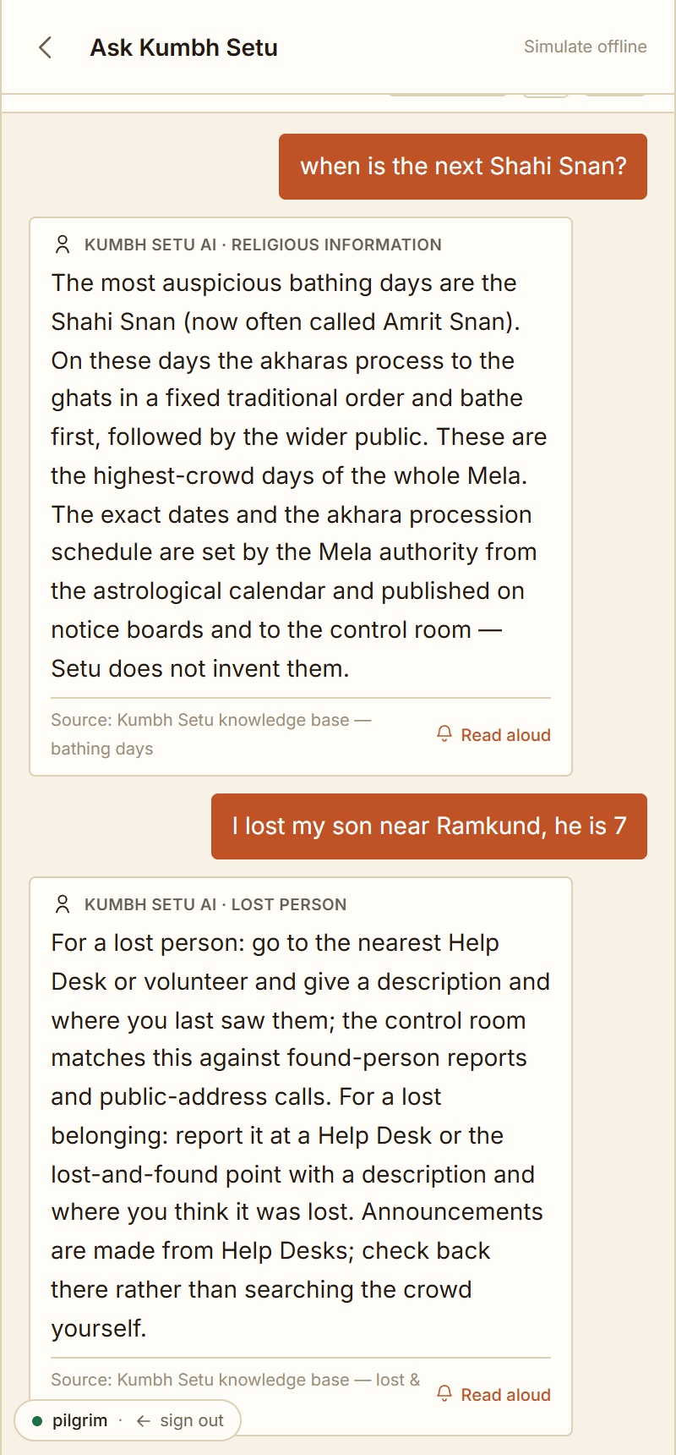
4
PILGRIM EXPERIENCE
Ask in your language. Get a straight answer,
or a hand-off to the right screen.
Facilities, routes, darshan, bathing days, safety — grounded in a verified Kumbh knowledge base, with the source shown.
Says “I don’t have verified information for that” instead of inventing dates or numbers.
“I need help” / “I lost my son” → Setu opens SOS or Lost & Found for you — one confirmed tap.
Works on a mid-range phone; degrades gracefully when the signal is weak.
Kumbh Setu · 05
SIMULATION MODE · SYNTHETIC DATA

Slide 6
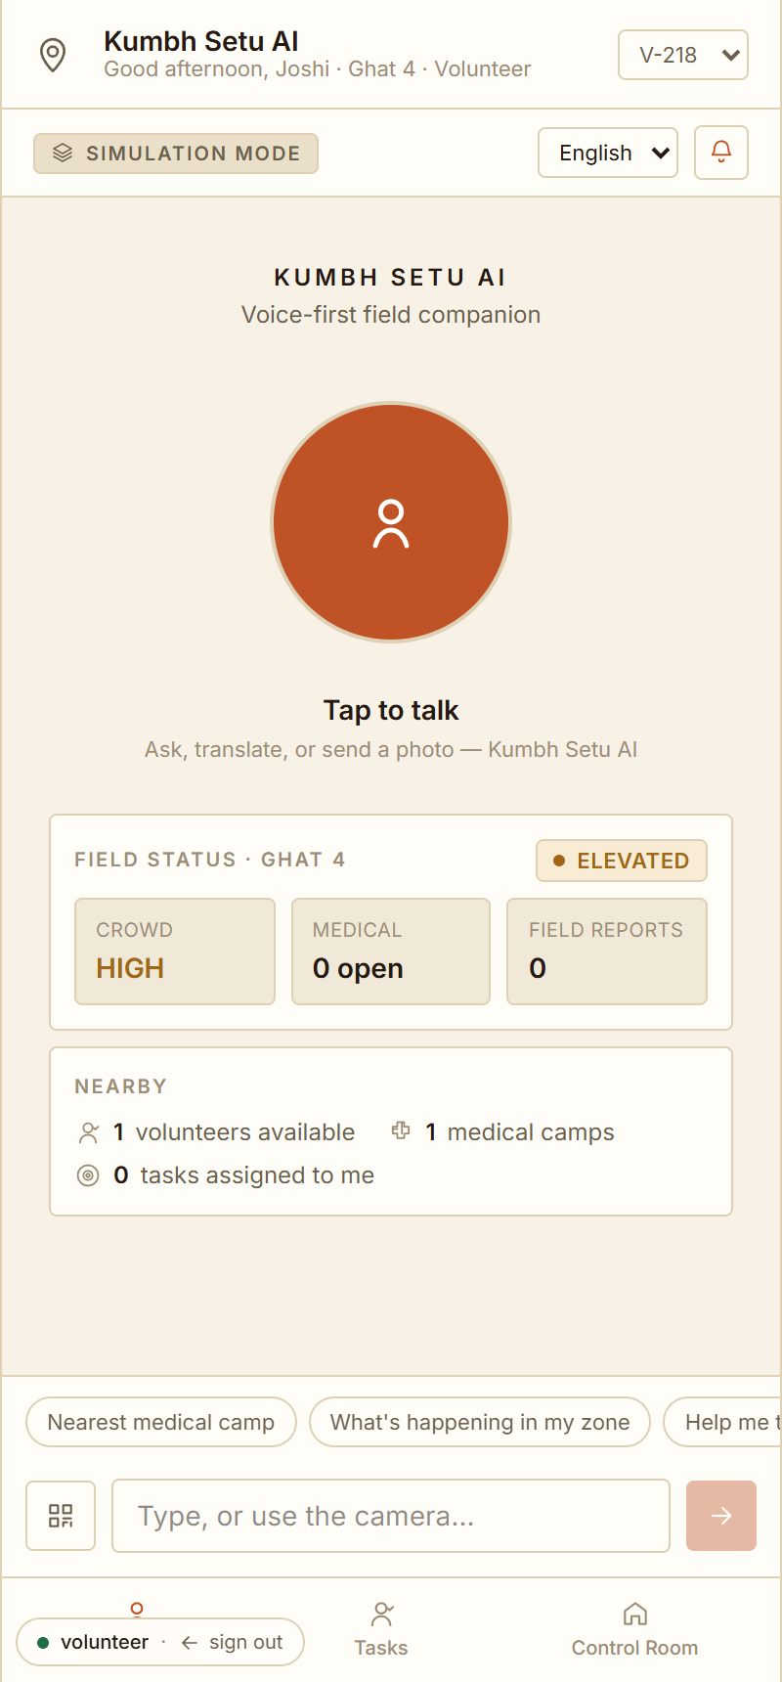
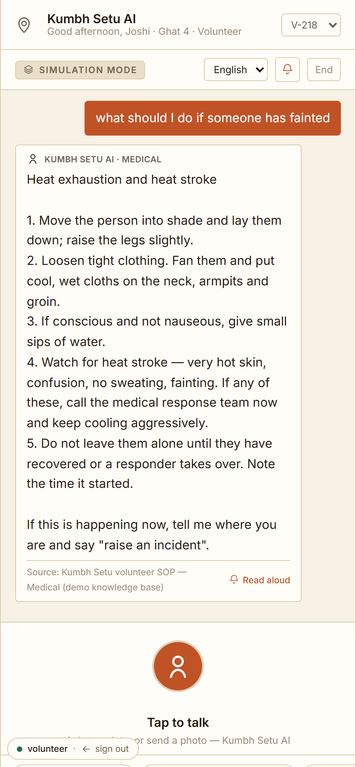
5
VOLUNTEER FIELD COMPANION
“What do I do if someone faints?”
→ the SOP, as a checklist, sourced.
Voice-first: tap-to-talk, live transcript, spoken replies, replay — with a text + camera fallback for noise.
Grounded answers from live facility / zone data and the Kumbh SOP library — not the model’s memory.
Procedure questions return a numbered checklist and end with “if this is happening now, say raise an incident”.
High-risk actions (create incident, escalate, resolve) always need one confirmation.
Kumbh Setu · 06
SIMULATION MODE · SYNTHETIC DATA

Slide 7
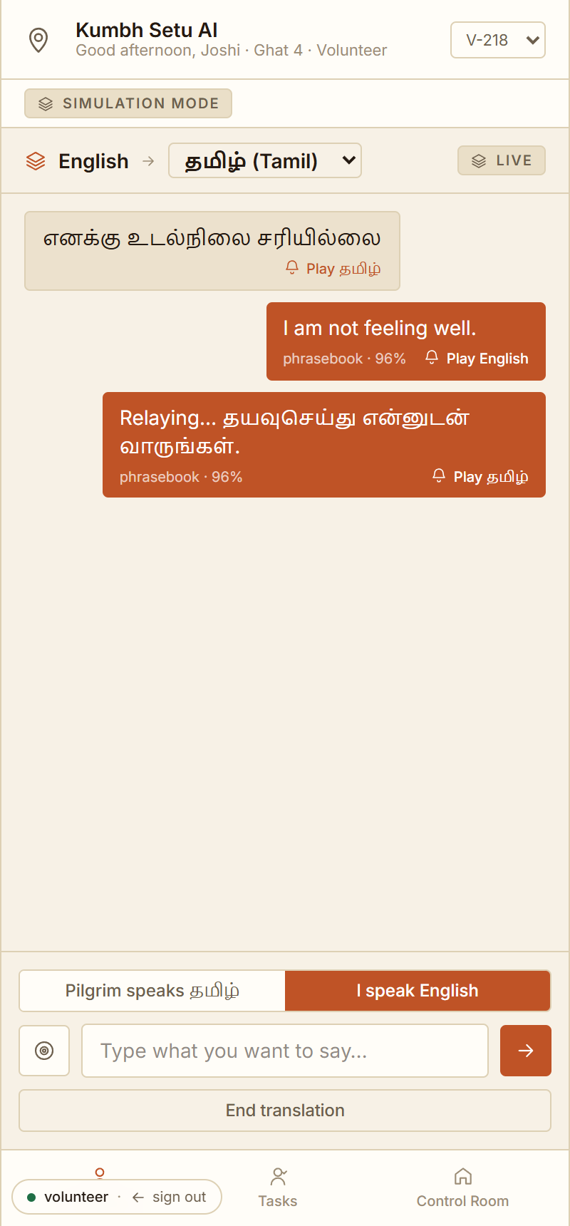
6
THE LANGUAGE BRIDGE
A volunteer and a pilgrim who don’t share
a language, having a conversation.
English · हिन्दी · मराठी · தமிழ் today — a LanguageService built to add every Maharashtra-region language.
One-shot (“translate this into Tamil”) and a live two-way relay mode — each turn translated and playable aloud.
Confidence and source shown on every line; the phrasebook layer is honest about what it can’t translate.
A real STT / TTS / MT provider (e.g. Sarvam) drops in behind the same interface — no UI change.
Kumbh Setu · 07
SIMULATION MODE · SYNTHETIC DATA

Slide 8
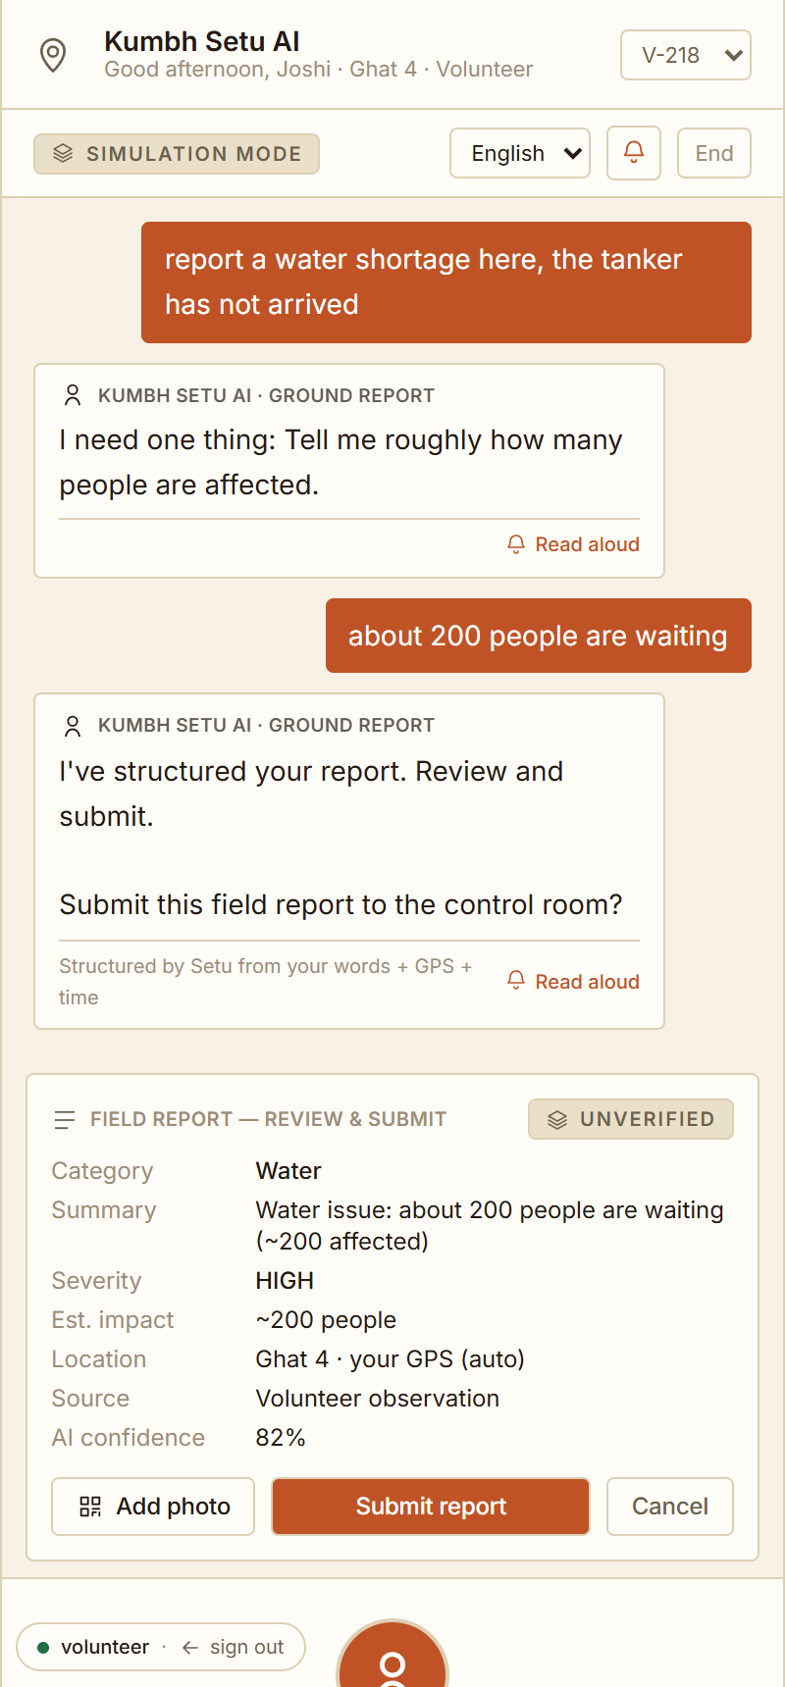
7
GROUND REPORTING
Speak it once. Setu structures it,
attaches GPS and time, and files it.
“Report a water shortage here” → Setu asks only what’s missing (a headcount) — nothing else.
Output: category, severity, people affected, location, source, an AI-confidence score — marked UNVERIFIED.
Add a photo; the vision layer proposes a category. Ground truth is never confused with verified fact.
One tap sends it to the control room. Offline, it queues and syncs when the signal returns.
Kumbh Setu · 08
SIMULATION MODE · SYNTHETIC DATA

Slide 9
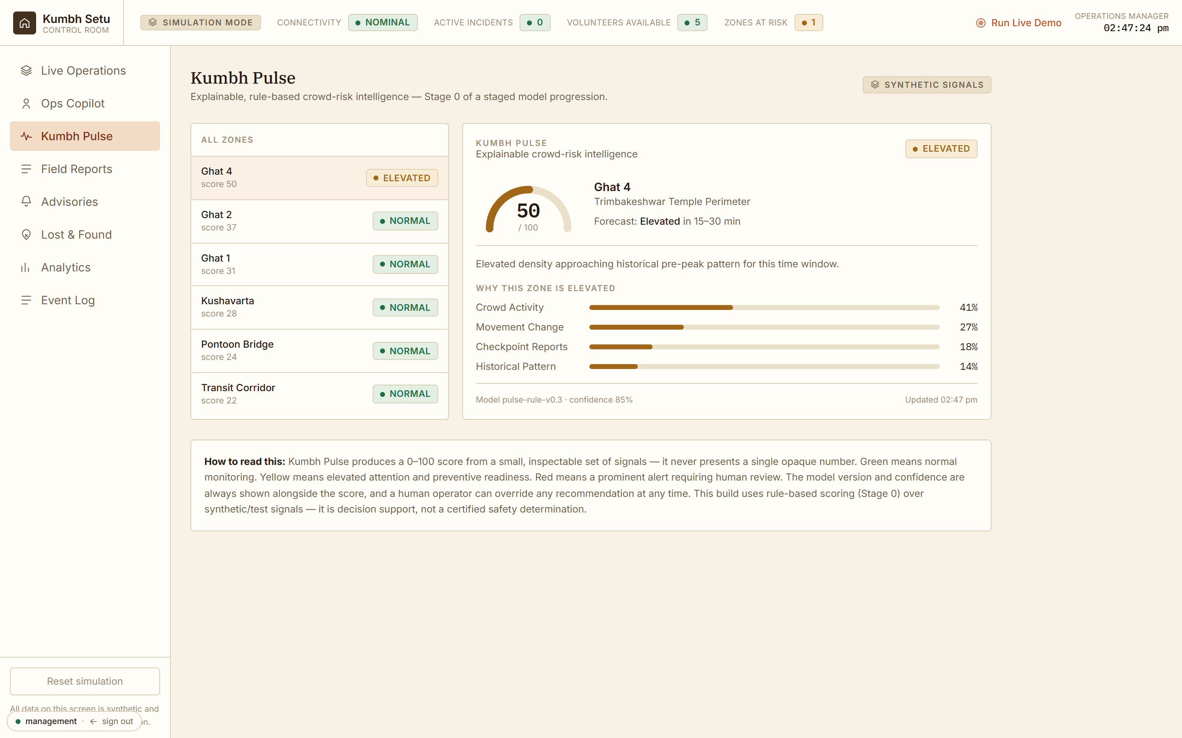
8
KUMBH PULSE
Several weak field signals become
one thing worth a human’s attention.
An explainable 0–100 crowd-risk score per zone — contributor bars, model version, confidence. Never one opaque number.
Ground reports aggregate into an EMERGING SIGNAL; its confidence rises with independent corroboration.
Decision support, not automation — an operator verifies, then promotes a signal to a dispatchable incident.
Clearly Stage 0: rule-based over synthetic signals, not a certified safety model.
Kumbh Setu · 09
SIMULATION MODE · SYNTHETIC DATA

Slide 10
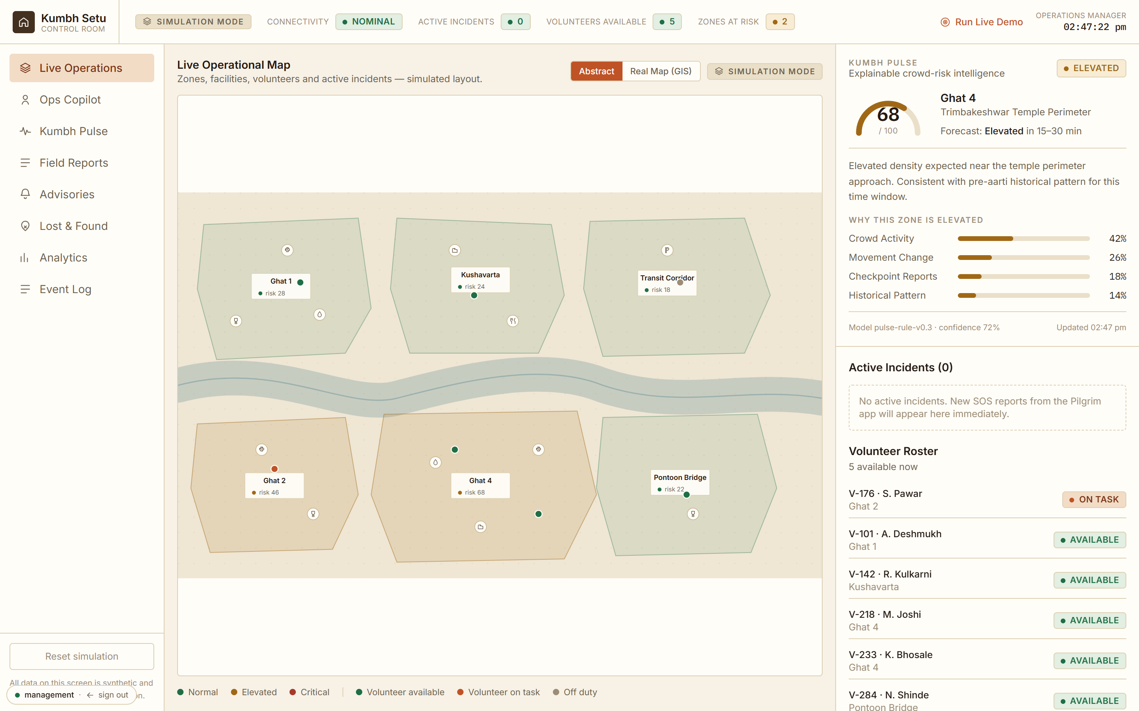
9
CONTROL ROOM + OPS COPILOT
One screen for the whole ground —
and you can just ask it.
Live map (abstract or real GIS), active incidents, volunteer roster, per-zone Pulse, field reports, advisories, audit log.
Ops Copilot: “give me the overview”, “which zones are at risk”, “show the signals” — the whole ground in one line.
Draft and publish an advisory to every pilgrim phone in scope (with confirmation) — worded as an instruction, not a warning.
Promote a corroborated signal straight to a dispatchable incident; every action lands in the audit log with actor and time.
Ops Copilot — “give me the operational overview”
Kumbh Setu · 10
SIMULATION MODE · SYNTHETIC DATA

Slide 11
10
THE LOOP THAT WINS
Observe → Corroborate → Signal → Decide → Resolve → Audit
1
Observe
2
Corroborate
3
Signal
Volunteer speaks a report + photo. GR created, audit event written.
More volunteers report the same thing. Verification status climbs.
Kumbh Pulse raises an emerging signal; confidence tracks corroboration.
4
Decide
5
Resolve
6
Audit
Operator verifies, promotes it to an incident, dispatches the right volunteer.
Accept → arrive → resolve. Each step on the control-room timeline.
The whole chain — who knew what, when — in one exportable log.
Every arrow is real state, synced live — and the AI never acts on its own.
Kumbh Setu · 11

Slide 12
11
UNDER THE HOOD
Built to be trusted, and to plug in real models.
Provider interface
AIProvider / SpeechProvider / TranslationProvider / VisionProvider. Mock now (no keys, fully offline); Sarvam or another service drops in with no UI change.
Tool-calling, gated
The model proposes; a typed tool layer validates, checks role authorisation, and requires confirmation for anything high-risk. It never touches state directly.
RAG over a Kumbh KB
~35 verified passages — what the Kumbh is, Shahi Snan, akharas, ghats, SOPs, control-room guides — retrieved and weighted by who’s asking.
Human-in-the-loop + audit
Fact vs retrieved vs AI-inference vs user-report are kept distinct. Every AI action is logged with actor and time. Offline reports queue.
37/37 automated reasoning checks pass · tsc + lint clean · production build green.
Kumbh Setu · 12

Slide 13
12
WHY THIS ISN’T A GENERIC ASSISTANT
It knows the Kumbh.
Simhastha, Shahi / Amrit Snan, the akhara procession order, Trimbakeshwar Jyotirlinga, Kushavarta, Ramkund and the ghats.
Priority lanes for elderly and divyang pilgrims; cloakrooms before the ghat; hydration and shade in the 11–16h heat.
Crowd-safety phrasing that gives an instruction (“move left toward the blue gate”), never “don’t panic”.
Routes pilgrims off a red ghat to a calmer one — without stampeding everyone to a single alternative.
We are not building a super-app. We are building the one thing a mass gathering needs and doesn’t have: a field-to-control-room nervous system.
Kumbh Setu · 13

Slide 14
13
BUSINESS MODEL
The pilgrim app is free, forever.
We sell the operations layer.
Per-event deployment
Year-round SaaS
Usage add-ons
Mela authority / state / NTKMA. Setup + an operations fee for the event window. Crowd safety is already a budgeted line item at a Simhastha.
Municipal corporations and large temple trusts — Trimbakeshwar, Shirdi, Pandharpur, Tirupati, Vaishno Devi — annual subscription for recurring crowd events.
Language/AI minutes (STT/TTS/MT passthrough), SMS/push, extra zones and volunteer seats.
Wedge: a Kumbhathon pilot → one Simhastha zone → the full event → cross-sell to other pilgrimage sites off the same platform.
ROI story: response time, lost-person reunification, and a defensible audit trail — measured against the cost of one incident.
Volunteer retention: verified-hours certificate, recognition, and priority for future events — the reason a sevak keeps picking up tasks.
Kumbh Setu · 14

Slide 15
14
HONEST SCOPE
What’s real today vs simulated.
Genuinely functional
Simulated / next
Full incident lifecycle + skill/language-aware dispatch
Real cross-tab sync, local persistence, real audit trail
Setu intent routing, tool policy, confirm gates, ground-report structuring, offline queue — all real logic
Real Leaflet/OSM GIS + real registered hospital/police reference points
Zones, facilities, volunteers, incidents, risk numbers — synthetic
Kumbh Pulse = rule-based Stage 0, not a validated model
Setu LLM / speech / translation / vision = local mock providers (no keys); translation is a phrasebook
No cross-device sync yet; no SSO/RBAC — sign-in is a demo gate
Every screen is labelled SIMULATION MODE. Nothing here claims to be live Nashik–Trimbakeshwar data.
Kumbh Setu · 15

Slide 16
THE ASK
Shortlist us to pilot
the field-to-control-room loop.
Next: regional languages across Maharashtra, a real MT/STT provider, a Help Desk queue, and a volunteer rewards layer.
Then: a real backend (Postgres + websockets), SSO + RBAC, and a hardened Kumbh Pulse with reviewed thresholds.
Pilot target: one zone at a Simhastha or a large temple-town festival, with the operations team in the loop.
Live demo: npm run dev → /login — pilgrim / volunteer / management, password kumbh2027
SIMULATION MODE · SYNTHETIC DATA

