Slide 1

PAYTM BUILD FOR INDIA AI HACKATHON · MUMBAI EDITION
VYAPARI MITRA
India's Vernacular AI Copilot for Every Paytm Merchant
Track: Merchant Growth AI
Powered by Sarvam AI
+ Fraud Shield
Team: The Vision | Ayush Korde · Harshita Girase
Oct 3, 2026

Slide 2
Problem Statement
India's Paytm merchants get payments infrastructure — but not a growth partner
H
Language barrier
?
No business insight
Most kirana/local merchants think and decide in Hindi or a regional language — not English dashboards or app menus.
Sales, top products, and complaints sit in raw transaction data merchants never actually see or understand.
the real gap
T
No time to analyze
!
Fake-payment fraud
A shopkeeper running the counter all day has no time to read analytics — they need a 3-second spoken answer.
RBI FY25: 13,516 digital-payment fraud cases worth ₹520 crore; NPCI projects UPI fraud incidents to cross 1.1M — QR-swap and fake-screenshot scams hit small merchants daily.

Slide 3
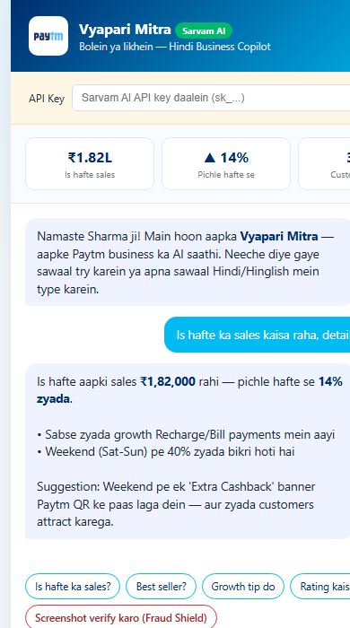
Proposed Solution
An AI business partner that talks to merchants
in their own language
1
Merchant asks
"Is hafte ka sales kaisa raha?" — in Hindi/Hinglish, by voice or text
2
Sarvam AI understands
Native Indian-language LLM reads intent + merchant's own sales/product/rating data
3
Vyapari Mitra replies
Plain-language insight + ONE concrete action — never just a chart or number
4
Merchant acts
One-tap suggestions: launch cashback, bundle a product, fix a complaint driver

Slide 4
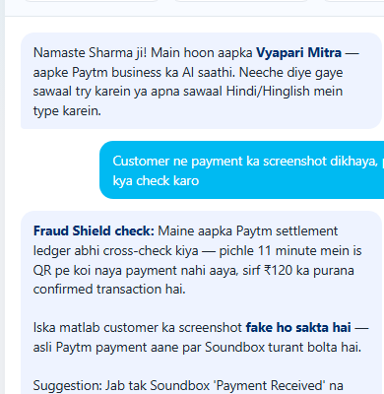
Our Moat: Real-Time Fraud Shield
A feature every other 'merchant insights' bot skips — because it protects money, not just gives advice
nobody else builds this
The scenario Paytm already fights every day
How Vyapari Mitra closes it
!
Fraudsters paste a fake QR sticker over a merchant's real QR — every scan pays the attacker, not the shop.
Voice-verify any screenshot
✓
Cross-checks the real Paytm settlement ledger in real time, in Hindi.
!
Or a customer shows a fake “payment successful” screenshot from a modified app and walks off with the goods.
✓
Catch silent QR-swaps
Actual output from the working prototype
Flags it when Soundbox stays quiet while the merchant says sales are happening.
!
RBI FY25: 13,516 digital-payment fraud cases worth ₹520 crore. NPCI projects UPI fraud incidents to cross 1.1M.
✓
Zero new hardware
!
Sep 2026, Basti (UP): two arrested for exactly this — fake UPI screenshots, cash taken, no real payment made.
Runs on the Soundbox + settlement data Paytm already has.

Slide 5
Live Demo — Vyapari Mitra in Action
Working prototype · web app · Sarvam-105B model
1
Merchant ka sawaal
“Is hafte ka sales kaisa raha, detail mein batao” — typed in Hinglish, exactly like a shopkeeper would ask a friend.
2
Merchant ka apna context
Sarvam AI ko un's sales (₹1.82L, +14%), top products, aur ratings pehle se pata hain — koi generic jawab nahi.
3
Action-first jawab
Sirf number nahi — ek specific suggestion: 'Weekend pe Extra Cashback banner Paytm QR ke paas laga dein.'
4
Ek-tap follow-up
Quick-suggestion chips se merchant turant agla sawaal pooch sakta hai — koi typing friction nahi.

Slide 6
Technology / Tech Stack
Lean, API-first stack — built to demo in hours, scale to millions of merchants
sponsor tech
H
W
₹
Sarvam-105B
Web App (HTML/JS)
Paytm Merchant APIs
Indian-language LLM — understands Hindi/Hinglish merchant queries natively, no translation layer
Lightweight, installs nowhere — works on any merchant's phone browser, low-bandwidth friendly
Sales, settlement, and QR transaction data feed the copilot's real-time business context
N
M
D
n8n Workflows
Cognee Memory
PostgreSQL
Automates the suggested action itself — e.g. auto-triggers a cashback campaign, not just advice
Persistent merchant memory layer — copilot remembers past patterns across sessions
Stores merchant profiles, transaction history, and conversation logs

Slide 7
System Architecture
One request, five hops — from a merchant's voice to a verified action
Merchant
Vyapari Mitra App
Sarvam-105B
Decision Layer
Response
Voice or text,
Hindi/Hinglish
Web app, no
install needed
Hindi/Hinglish
intent + NLU
Insight engine +
Fraud Shield
Spoken + written
reply to merchant
action, not just advice
DATA & SPONSOR-TECH LAYER
Cognee Memory
Paytm Settlement API
Soundbox Signal
n8n Workflows

Slide 8
Why Vyapari Mitra Wins
A straight, feature-by-feature comparison against every category of alternative on the market
the full picture
Capability | Generic Chatbots | Analytics Dashboards | Fraud-Detection Apps | Vyapari Mitra
Understands Hindi/Hinglish natively | ✗ | ✗ | ✗ | ✓
Grounded in THIS merchant's own data | ✗ | ✓ | ✗ | ✓
Gives ONE concrete action, not raw numbers | ✗ | ✗ | ✗ | ✓
Real-time fraud & QR-swap protection | ✗ | ✗ | ✓ | ✓
Can trigger the action itself (n8n) | ✗ | ✗ | ✗ | ✓
Zero new hardware or app install | ✓ | ✓ | ✗ | ✓

Slide 9
Impact & Benefits
4M+
10+
0
Paytm merchants who could get a growth copilot instantly, at near-zero marginal cost
Indian languages Sarvam AI can extend Vyapari Mitra to beyond this Mumbai demo
New apps to install — works inside the merchant's existing Paytm touchpoints
✓
For Merchants:
Higher sales through personalised nudges, plus real money saved from fraud caught before it happens
✓
For Paytm:
Fewer fraud disputes and chargeback complaints to resolve — and a daily reason to open the app beyond payments
✓
For India's Economy:
Millions of small businesses get enterprise-grade growth intelligence and fraud protection in their own language

Slide 10
Why This Wins
Three capabilities nobody else combines, on top of the data merchants already generate
Vernacular AI (Sarvam)
Payment Channel Mix
Vyapari
Mitra
68% of transactions already run through Paytm QR — exactly the ledger Fraud Shield cross-checks against.
Fraud Shield
Autonomous Action (n8n)

Slide 11
Business Model
Built to plug into Paytm's existing merchant monetisation — not a separate product to sell
₹
Freemium Copilot
+
Merchant Subscription Add-on
Free basic insights for every merchant; premium tier for automated campaign execution & deeper analytics
Bundled inside existing Paytm for Business plans as a value-add tier — low CAC, existing distribution
$
Sponsored Growth Actions
%
Aggregated Insights (B2B)
Brands pay to surface relevant offers (e.g. supplier discounts) through the copilot's suggestions
Anonymised, aggregated local-commerce trend data licensed to FMCG/brand partners
✓
Built compliance-first: no fund movement by the copilot itself — every payment/cashback action stays inside Paytm's existing NPCI-compliant rails; Vyapari Mitra only recommends and triggers, it never touches money directly.

Slide 12
Build with AI. Solve for India.
Vyapari Mitra — giving every Paytm merchant an AI business partner who speaks their language.
Team: The Vision · Ayush Korde & Harshita Girase · Powered by Sarvam AI

