Slide 1

Player Centuries Scored Analysis
Female in Professional Cricket
A PPT Automation Demo
By: Ayush - Automation
dhanrajaayush123@gmail.com

Slide 2
Female - Player Centuries Scored Analysis
Name | Country | Total Centuries
Meg Lanning | Australia | 17
Charlotte Edwards | England | 13
Mithali Raj | India | 8
Laura Wolvaardt | South Africa | 9
Suzie Bates | New Zealand | 12
Hayley Matthews | West Indies | 10
Fargana Hoque | Bangladesh | 2
Chamari Athapaththu | Sri Lanka | 12
Javeria Khan | Pakistan | 2
Gaby Lewis | Ireland | 2

Slide 3
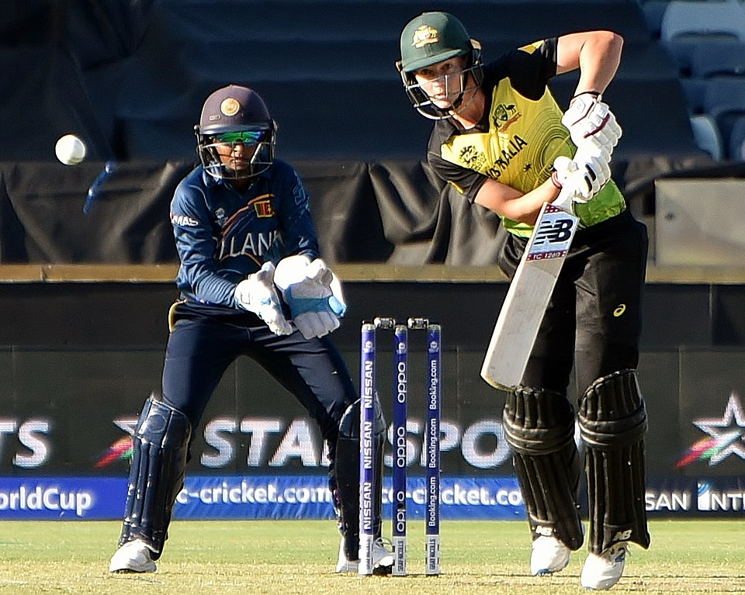

Meg Lanning
Australia
DOB
25 Mar 1992
Birth Place
Singapore
Mother
Sue Lanning
Father
Wayne Lanning
Height
5'7"
Marital Status
Unmarried
Retired
Yes
Total Centuries
17

Slide 4
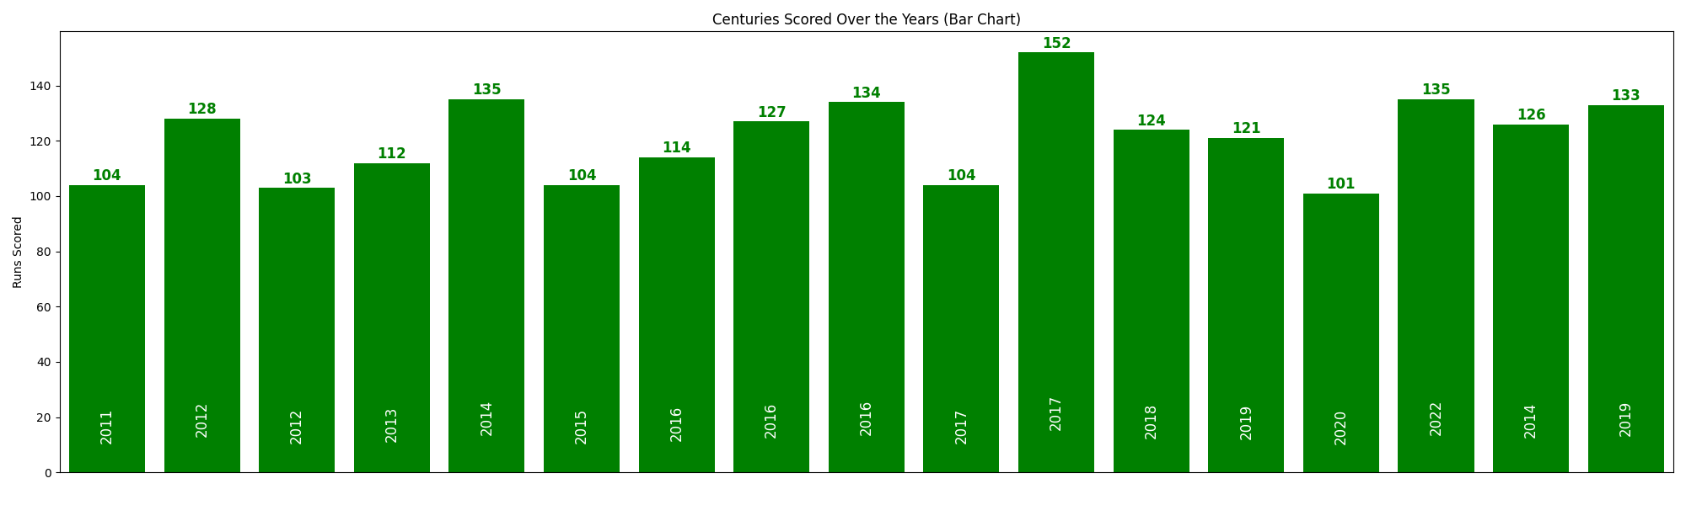
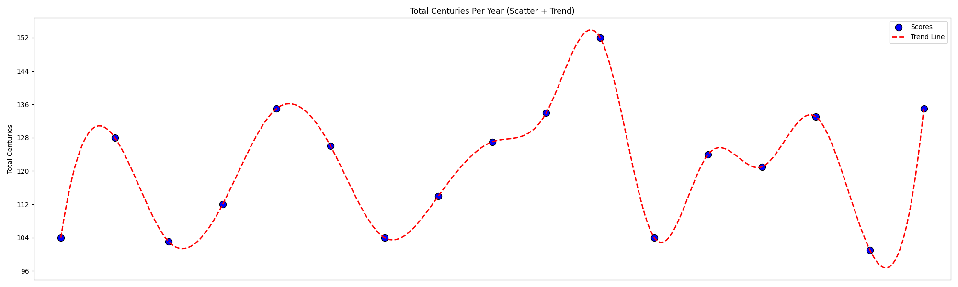
Meg Lanning
Australia
Year | Centuries
2011 | 1
2012 | 2
2013 | 1
2014 | 2
2015 | 1
2016 | 3
2017 | 2
2018 | 1
2019 | 2
2020 | 1
2022 | 1
Top Year | Top Run
2017 | 152

Slide 5
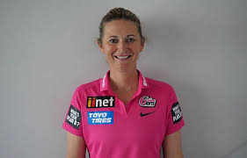
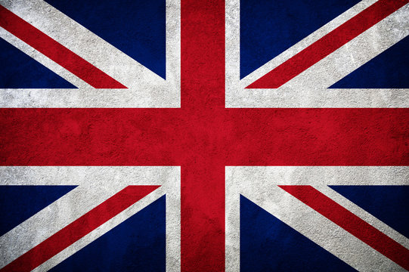
Charlotte Edwards
England
DOB
17 Dec 1979
Birth Place
Huntingdon, England
Mother
nan
Father
Clive Edwards
Height
5'7"
Marital Status
Married
Retired
Yes
Total Centuries
13

Slide 6
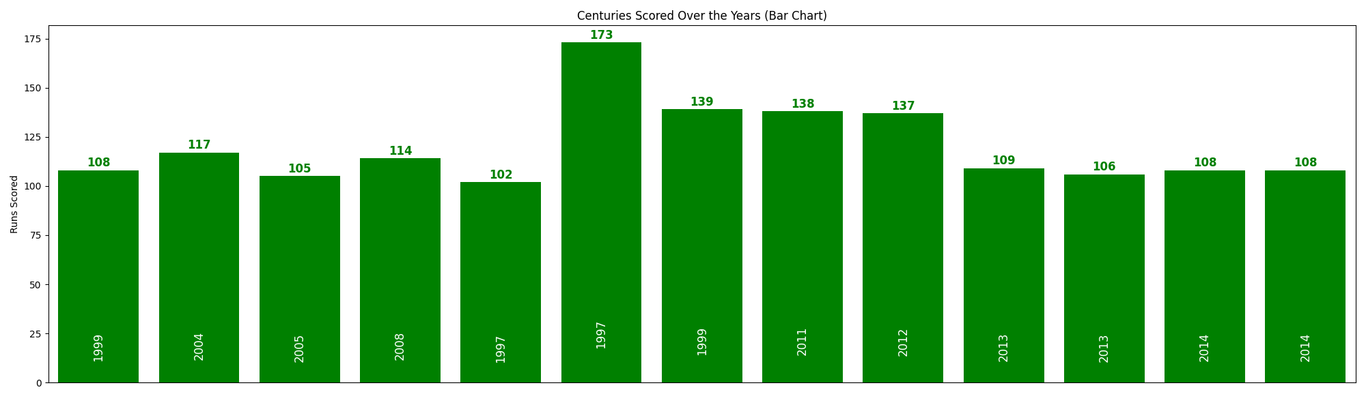
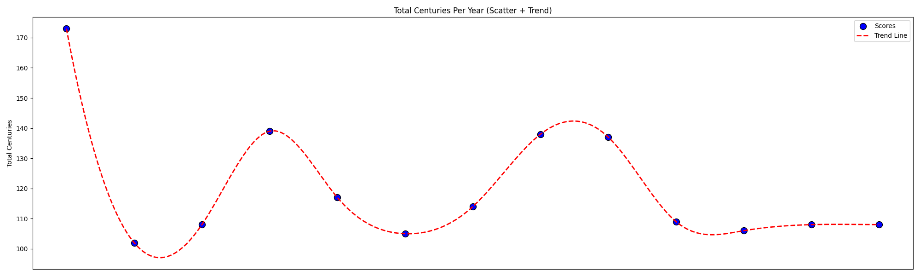
Charlotte Edwards
England
Year | Centuries
1997 | 2
1999 | 2
2004 | 1
2005 | 1
2008 | 1
2011 | 1
2012 | 1
2013 | 2
2014 | 2
Top Year | Top Run
1997 | 173

Slide 7
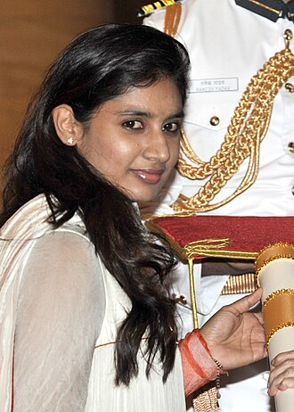
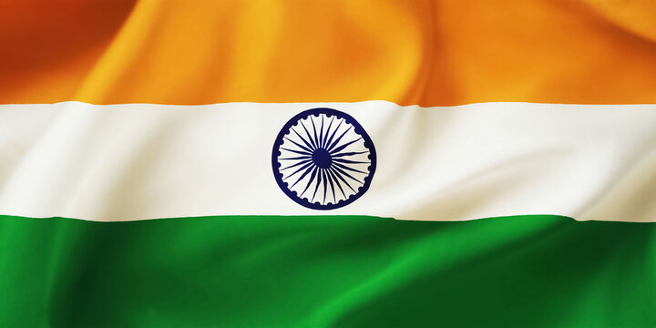
Mithali Raj
India
DOB
3 Dec 1982
Birth Place
Jodhpur, India
Mother
Leela Raj
Father
Dorai Raj
Height
5'4"
Marital Status
Unmarried
Retired
Yes
Total Centuries
8

Slide 8
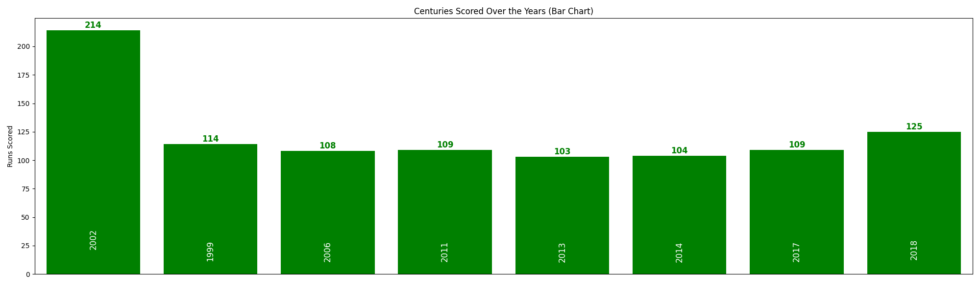
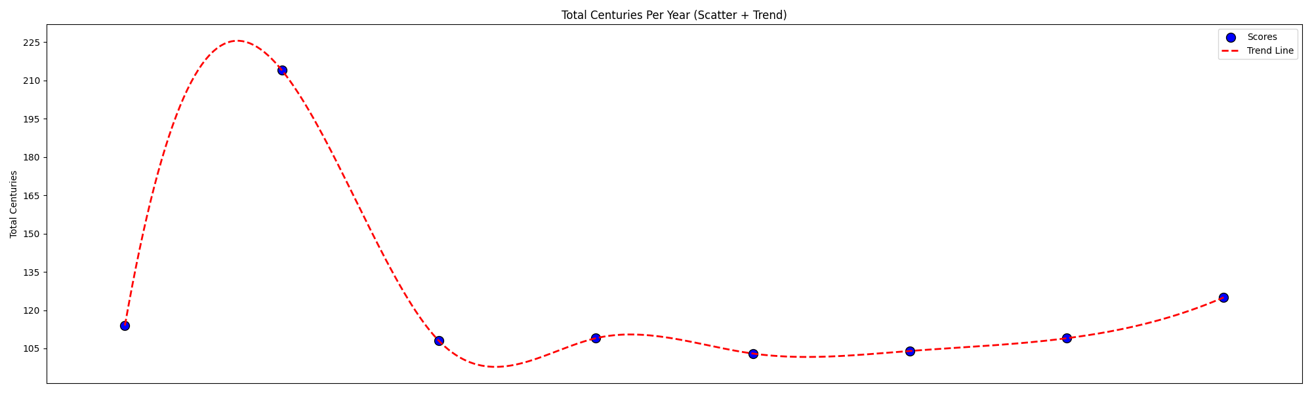
Mithali Raj
India
Year | Centuries
1999 | 1
2002 | 1
2006 | 1
2011 | 1
2013 | 1
2014 | 1
2017 | 1
2018 | 1
Top Year | Top Run
2002 | 214

Slide 9
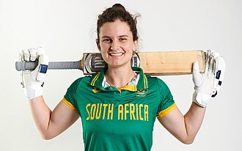
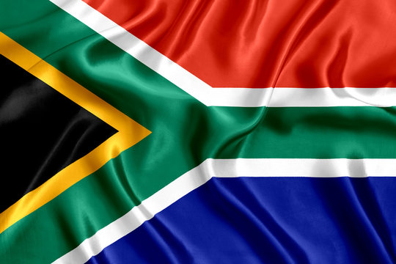
Laura Wolvaardt
South Africa
DOB
26 Apr 1999
Birth Place
Cape Town, South Africa
Mother
nan
Father
nan
Height
5'7"
Marital Status
Unmarried
Retired
No
Total Centuries
9

Slide 10
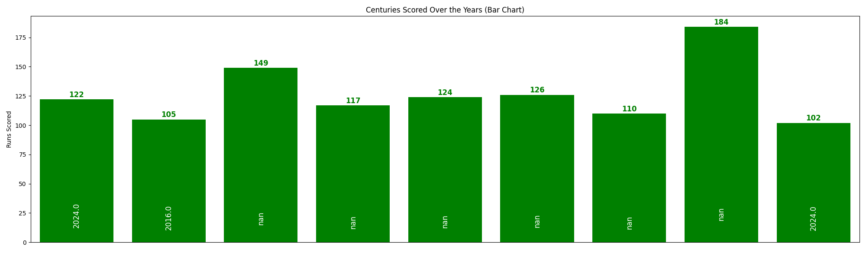
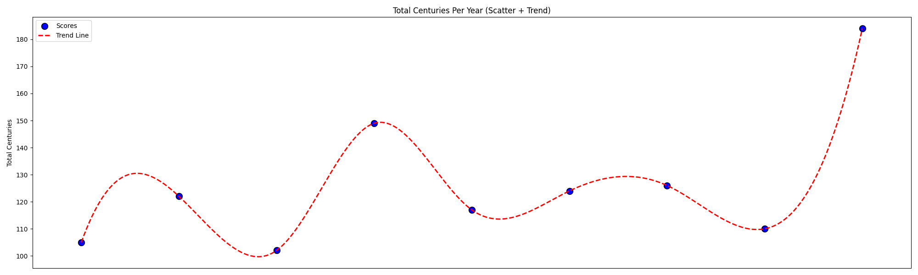
Laura Wolvaardt
South Africa
Year | Centuries
2016.0 | 1.0
2024.0 | 2.0
Top Year | Top Run
nan | 184.0

Slide 11
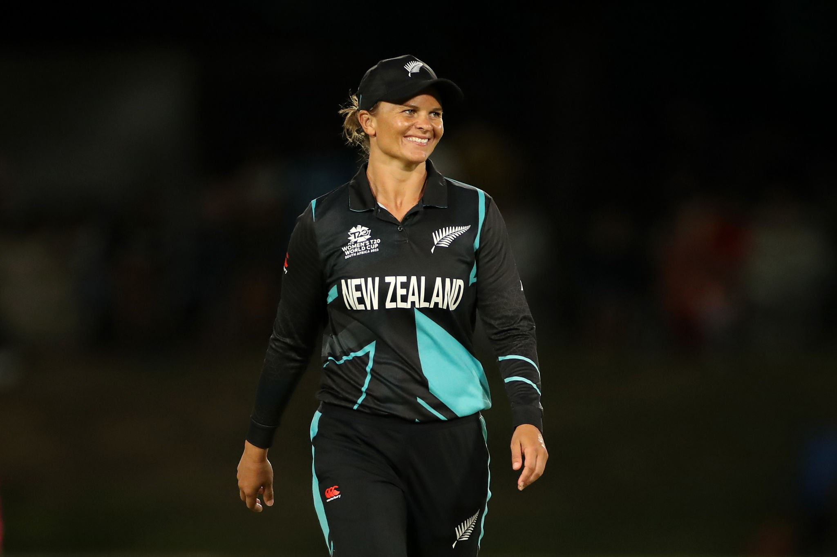
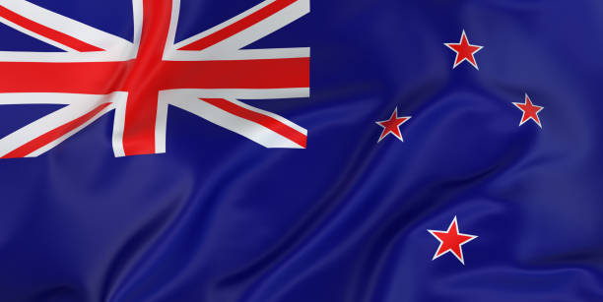
Suzie Bates
New Zealand
DOB
16 Sep 1987
Birth Place
Dunedin, New Zealand
Mother
nan
Father
nan
Height
5'8"
Marital Status
Unmarried
Retired
No
Total Centuries
12

Slide 12
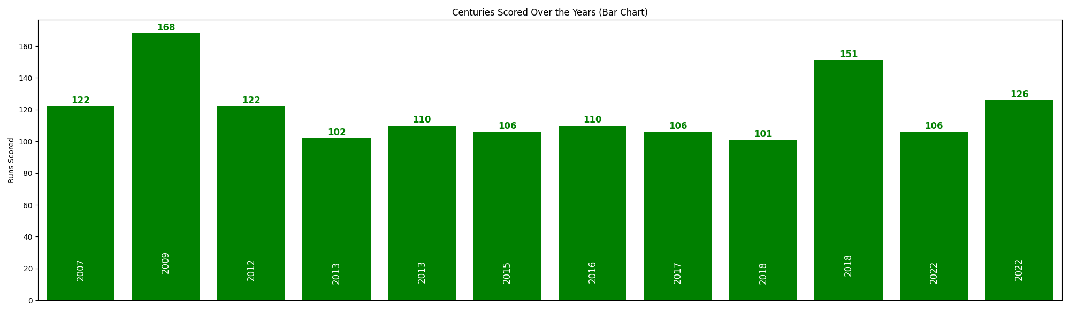
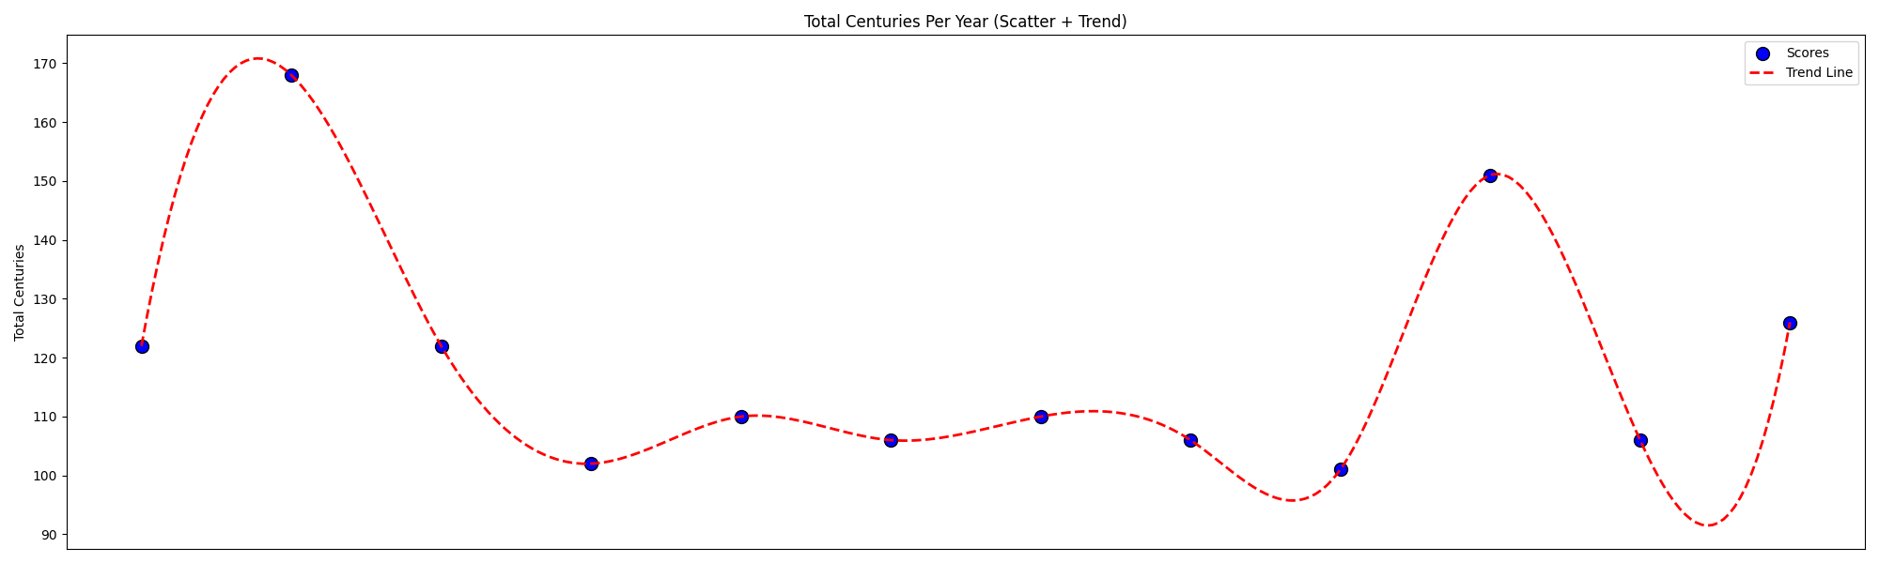
Suzie Bates
New Zealand
Year | Centuries
2007 | 1
2009 | 1
2012 | 1
2013 | 2
2015 | 1
2016 | 1
2017 | 1
2018 | 2
2022 | 2
Top Year | Top Run
2009 | 168

Slide 13
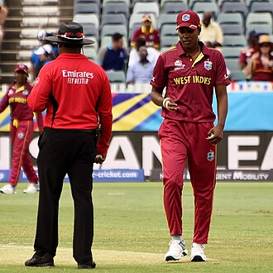
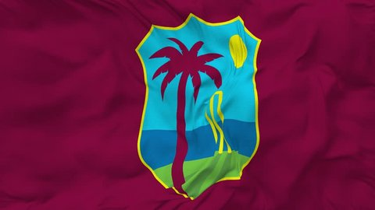
Hayley Matthews
West Indies
DOB
19 Mar 1998
Birth Place
Bridgetown, Barbados
Mother
Lisa Matthews
Father
Mike Matthews
Height
5'7"
Marital Status
Unmarried
Retired
No
Total Centuries
10

Slide 14
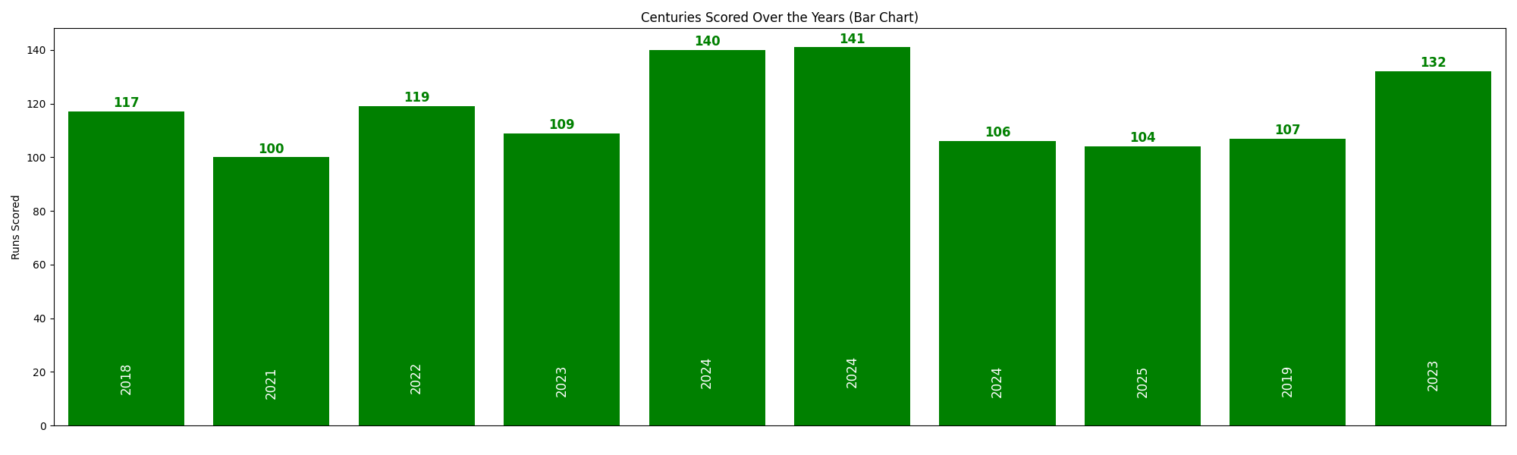
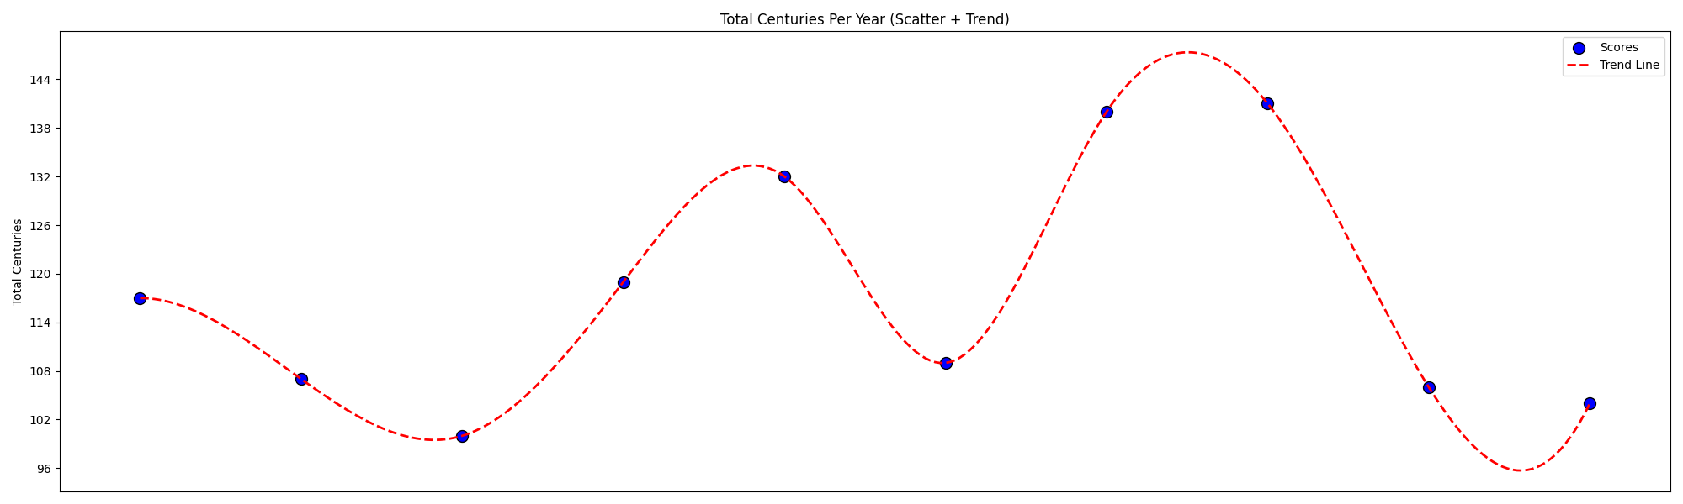
Hayley Matthews
West Indies
Year | Centuries
2018 | 1
2019 | 1
2021 | 1
2022 | 1
2023 | 2
2024 | 3
2025 | 1
Top Year | Top Run
2024 | 141

Slide 15
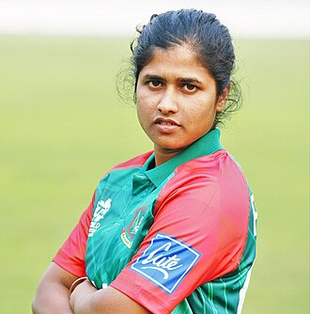
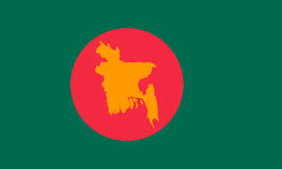
Fargana Hoque
Bangladesh
DOB
19 Mar 1993
Birth Place
Gaibandha, Bangladesh
Mother
nan
Father
nan
Height
5'3"
Marital Status
Unmarried
Retired
No
Total Centuries
2

Slide 16
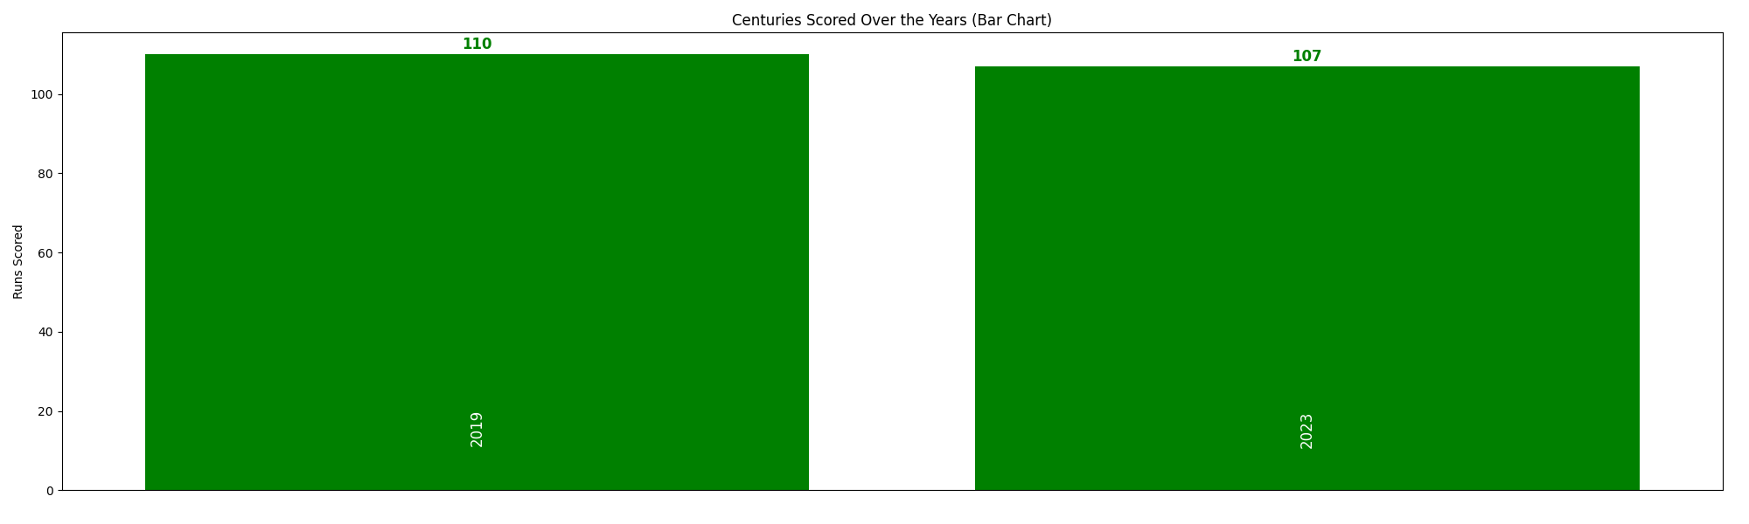
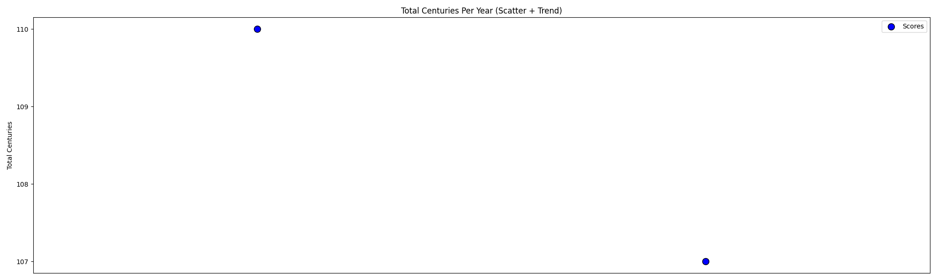
Fargana Hoque
Bangladesh
Year | Centuries
2019 | 1
2023 | 1
Top Year | Top Run
2019 | 110

Slide 17
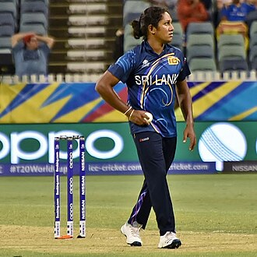
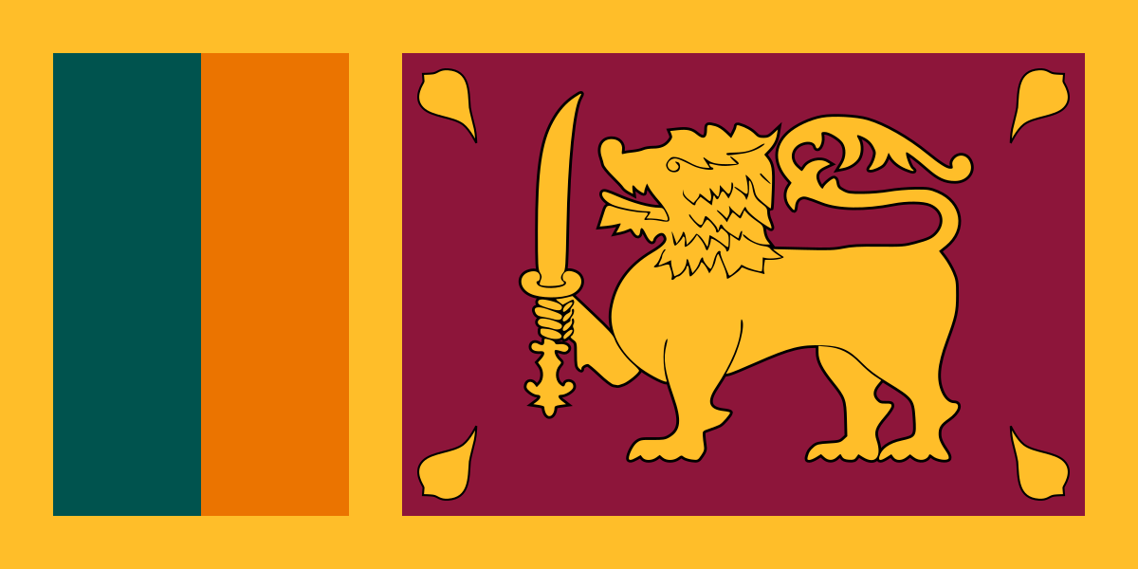
Chamari Athapaththu
Sri Lanka
DOB
9 Feb 1990
Birth Place
Kurunegala, Sri Lanka
Mother
nan
Father
nan
Height
5'5"
Marital Status
Unmarried
Retired
No
Total Centuries
12

Slide 18
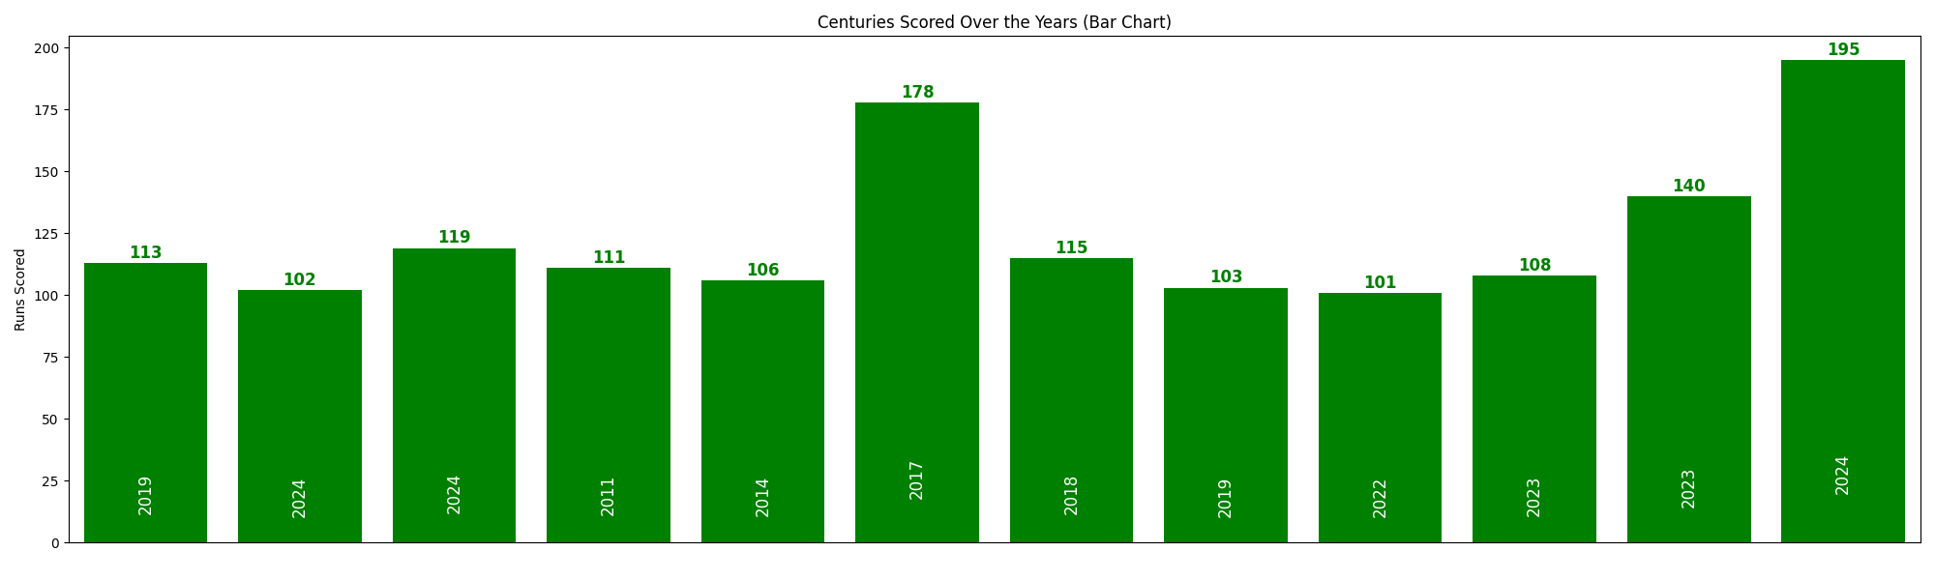
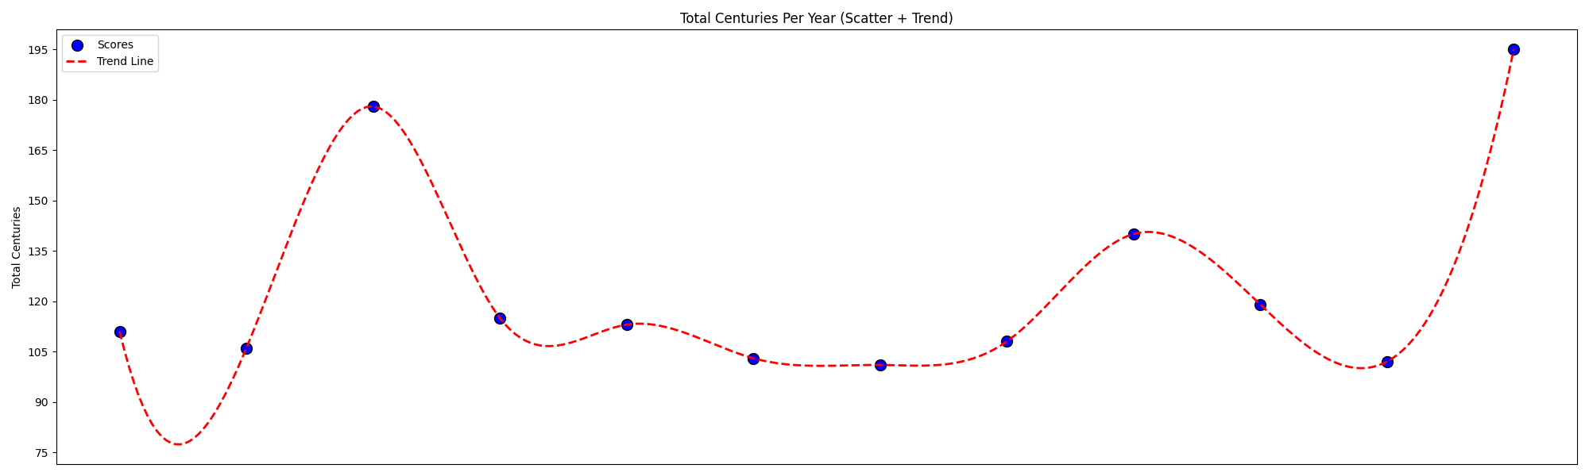
Chamari Athapaththu
Sri Lanka
Year | Centuries
2011 | 1
2014 | 1
2017 | 1
2018 | 1
2019 | 2
2022 | 1
2023 | 2
2024 | 3
Top Year | Top Run
2024 | 195

Slide 19
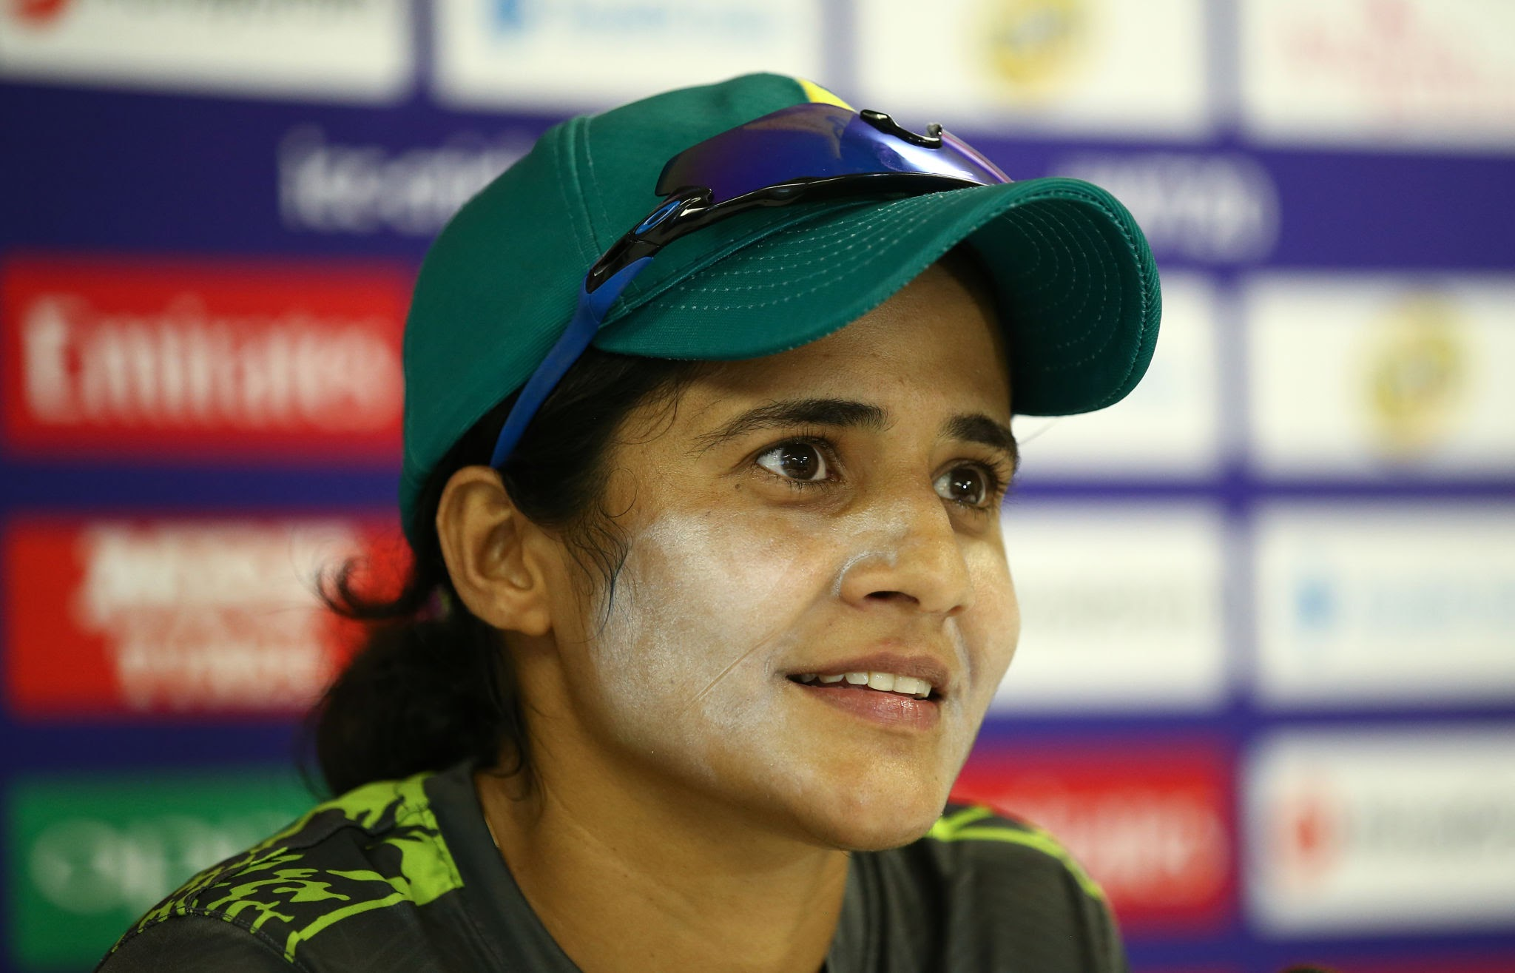
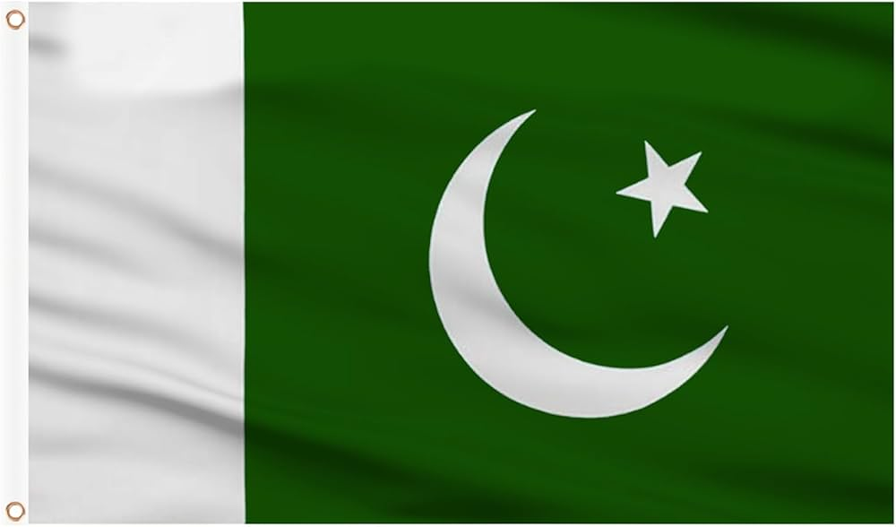
Javeria Khan
Pakistan
DOB
14 May 1988
Birth Place
Karachi, Pakistan
Mother
nan
Father
nan
Height
5'3"
Marital Status
Married
Retired
No
Total Centuries
2

Slide 20
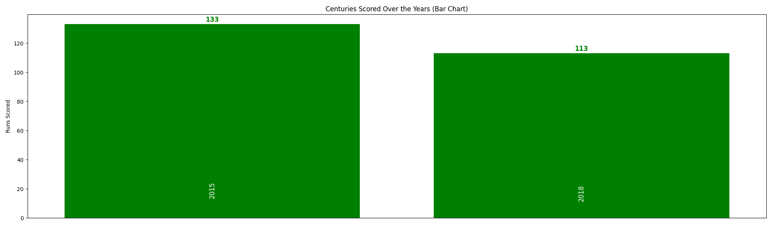
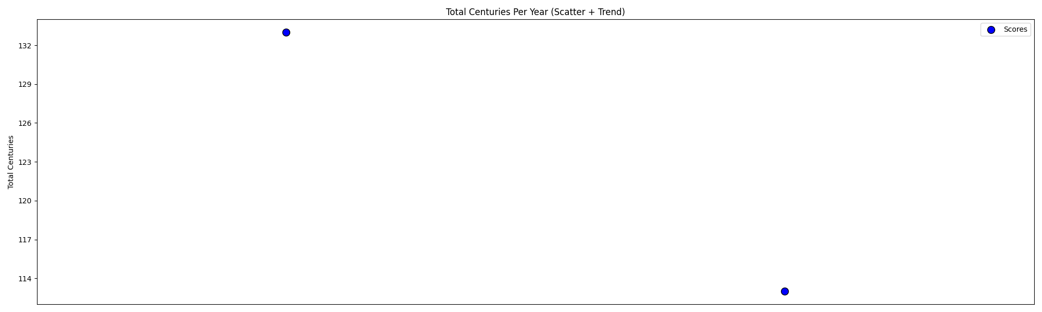
Javeria Khan
Pakistan
Year | Centuries
2015 | 1
2018 | 1
Top Year | Top Run
2015 | 133

Slide 21
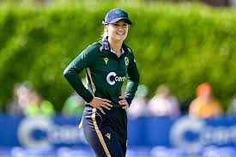

Gaby Lewis
Ireland
DOB
27 Mar 2001
Birth Place
Dublin, Ireland
Mother
nan
Father
Alan Lewis
Height
5'5"
Marital Status
Unmarried
Retired
No
Total Centuries
2

Slide 22
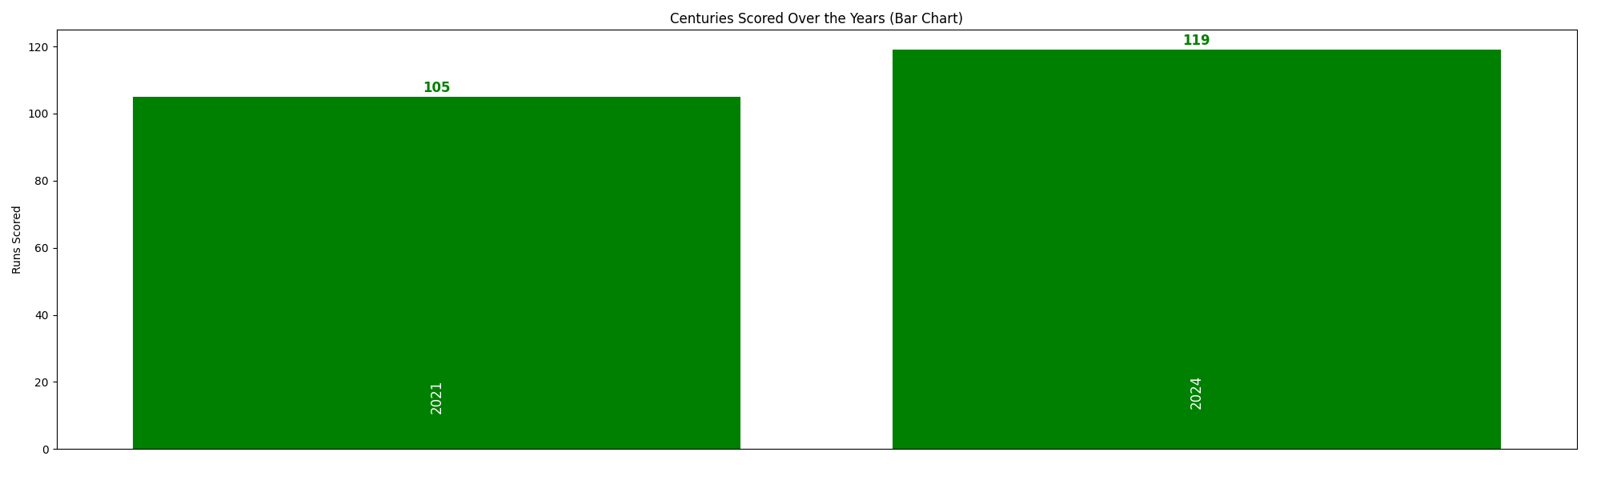
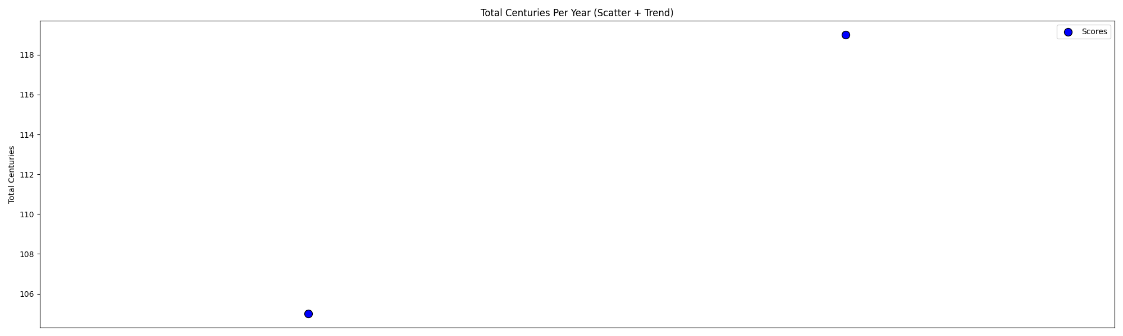
Gaby Lewis
Ireland
Year | Centuries
2021 | 1
2024 | 1
Top Year | Top Run
2024 | 119

