Slide 1

Player Centuries Scored Analysis
Male in Professional Cricket
A PPT Automation Demo
By: Ayush - Automation
dhanrajaayush123@gmail.com

Slide 2
Male - Player Centuries Scored Analysis
Name | Country | Total Centuries
Don Bradman | Australia | 29
Joe Root | England | 53
Sachin Tendulkar | India | 100
Jacques Kallis | South Africa | 62
Kane Williamson | New Zealand | 48
Brian Lara | West Indies | 53
Mushfiqur Rahim | Bangladesh | 20
Kumar Sangakkara | Sri Lanka | 63
Inzamam-ul-Haq | Pakistan | 35
Paul Stirling | Ireland | 9

Slide 3
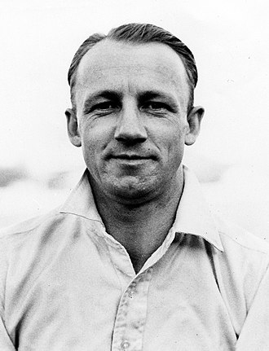

Don Bradman
Australia
DOB
27 Aug 1908
Birth Place
Cootamundra, Australia
Mother
nan
Father
nan
Height
5'8"
Marital Status
Married
Retired
Yes
Total Centuries
29

Slide 4
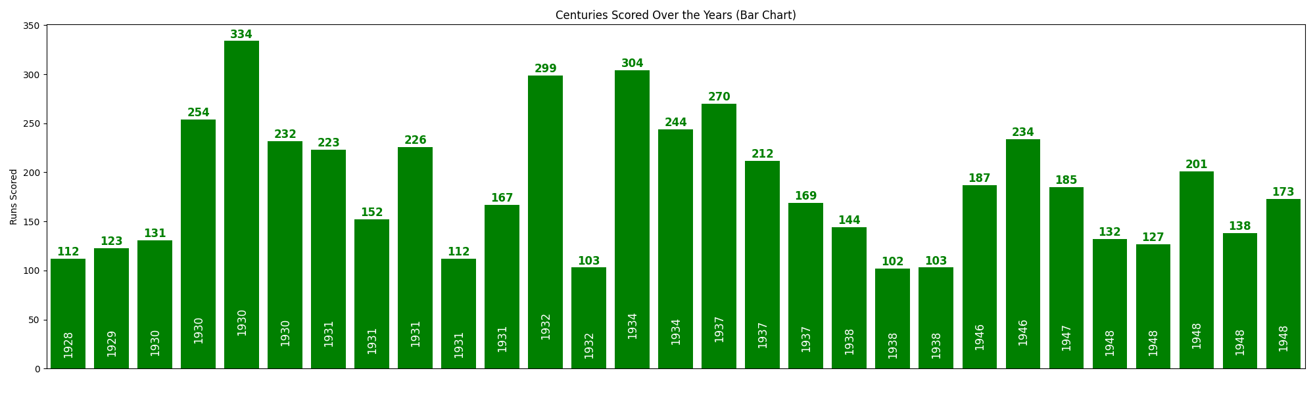
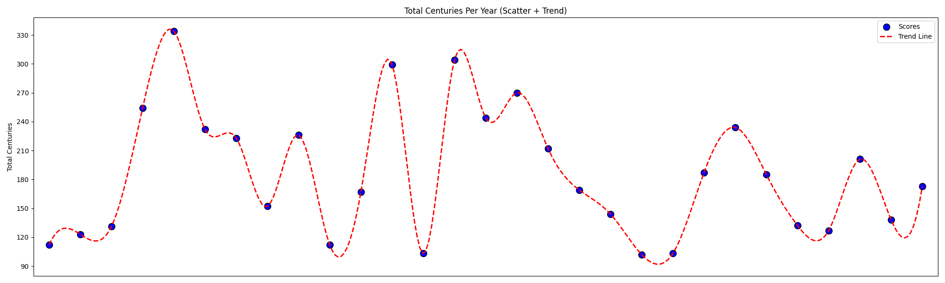
Don Bradman
Australia
Year | Centuries
1928 | 1
1929 | 1
1930 | 4
1931 | 5
1932 | 2
1934 | 2
1937 | 3
1938 | 3
1946 | 2
1947 | 1
1948 | 5
Top Year | Top Run
1930 | 334

Slide 5
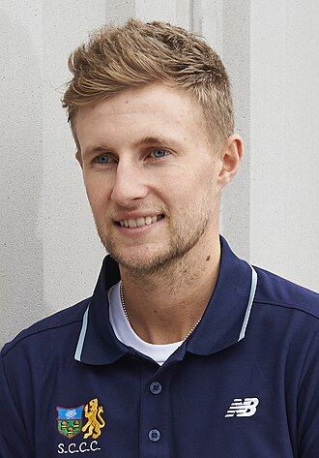
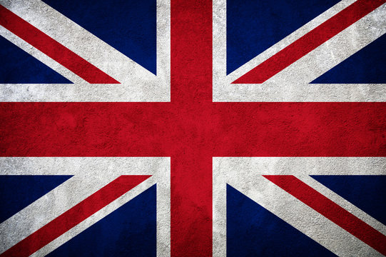
Joe Root
England
DOB
30 Dec 1990
Birth Place
Sheffield, England
Mother
Helen Root
Father
Matt Root
Height
6'0"
Marital Status
Married
Retired
No
Total Centuries
53

Slide 6
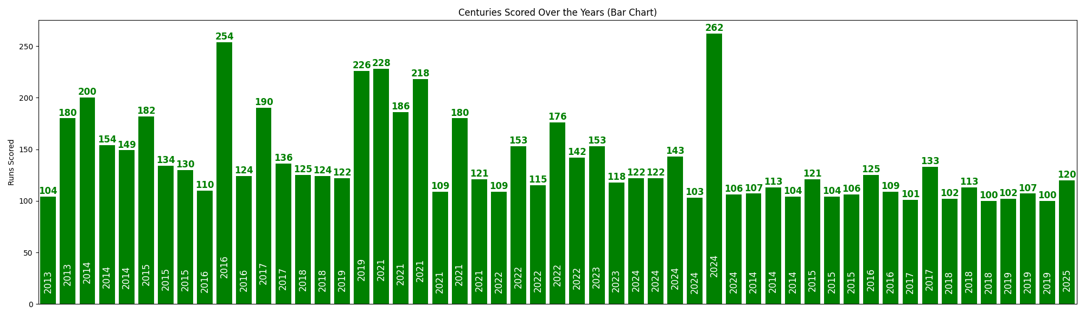
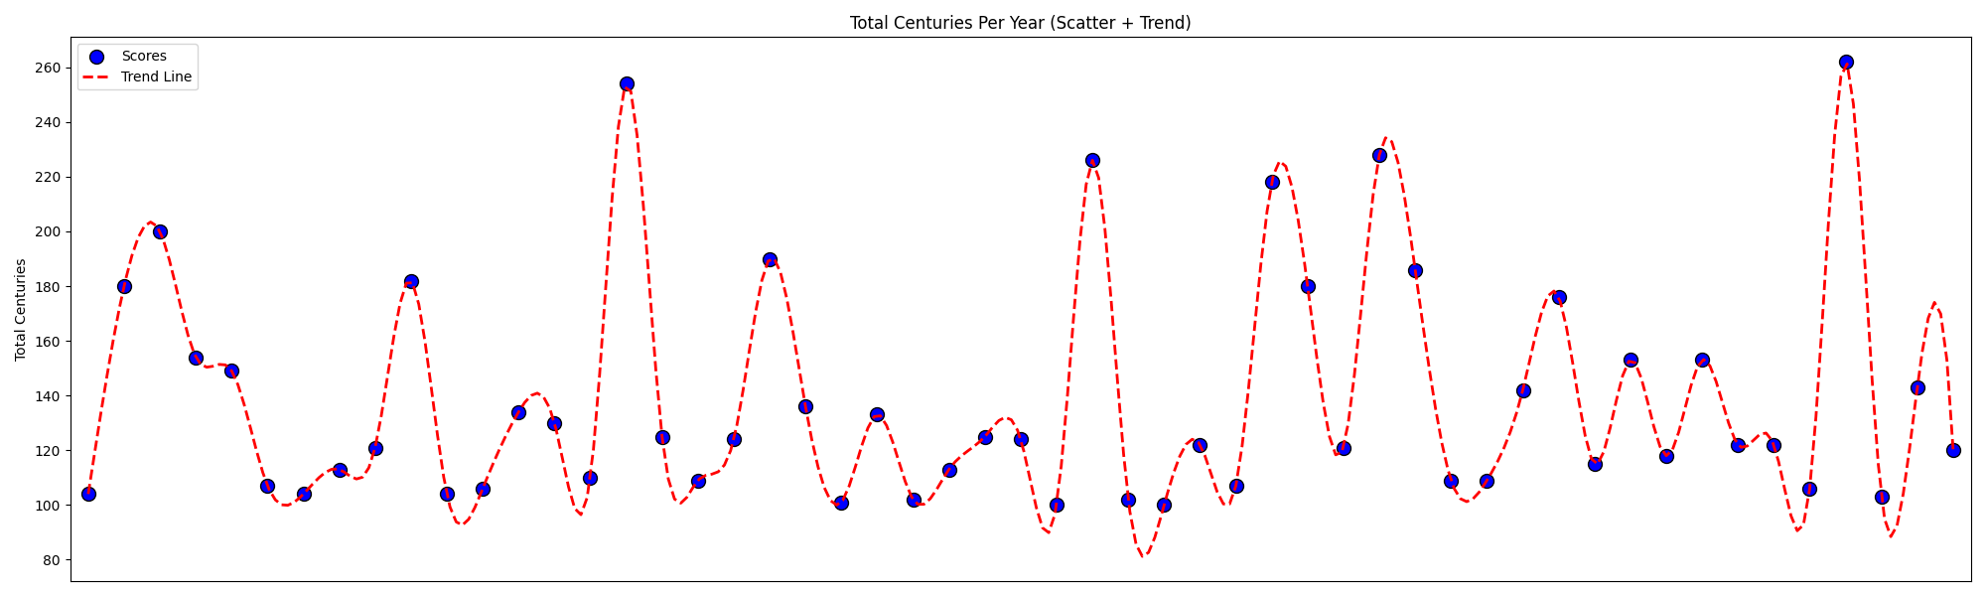
Joe Root
England
Year | Centuries
2013 | 2
2014 | 6
2015 | 6
2016 | 5
2017 | 4
2018 | 5
2019 | 5
2021 | 6
2022 | 5
2023 | 2
2024 | 6
2025 | 1
Top Year | Top Run
2024 | 262

Slide 7
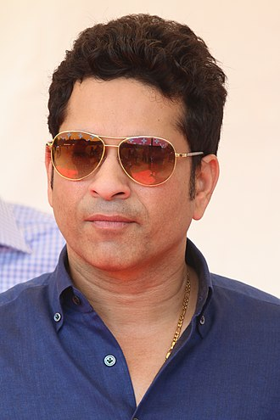
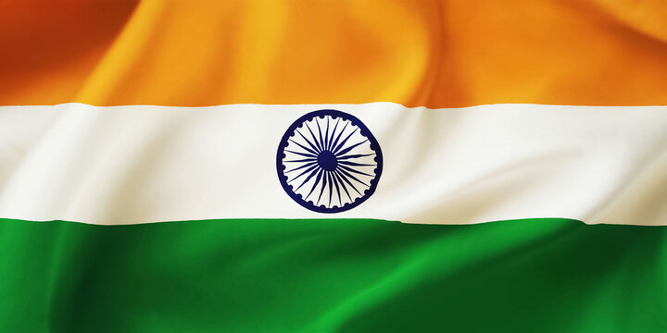
Sachin Tendulkar
India
DOB
24 Apr 1973
Birth Place
Mumbai, India
Mother
Rajni
Father
Ramesh
Height
5'5"
Marital Status
Married
Retired
Yes
Total Centuries
100

Slide 8
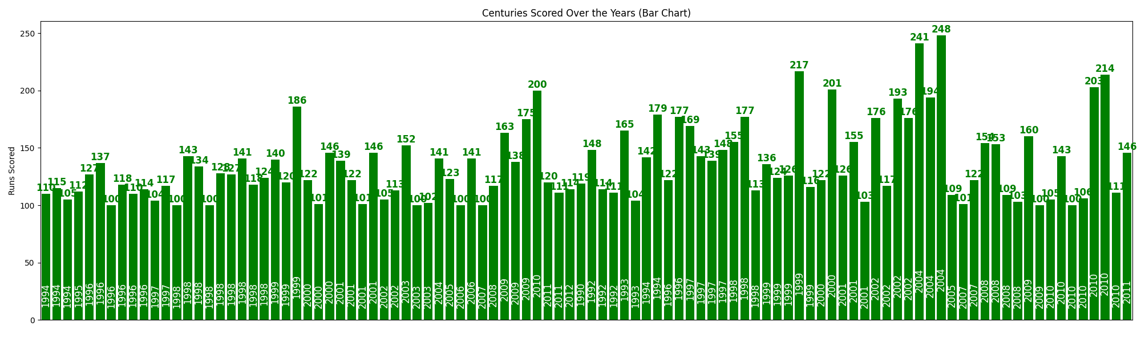
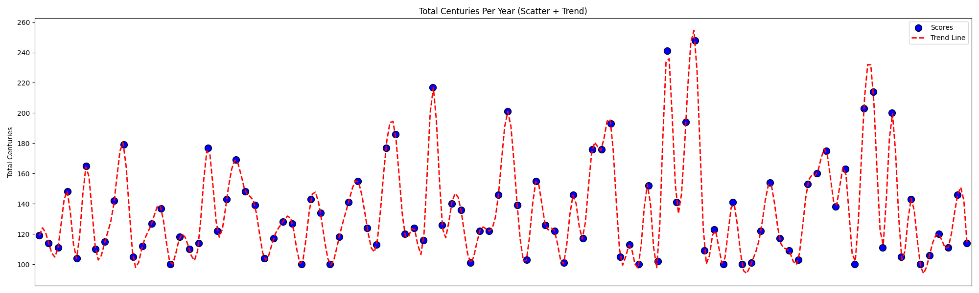
Sachin Tendulkar
India
Year | Centuries
1990 | 1
1992 | 3
1993 | 2
1994 | 5
1995 | 1
1996 | 8
1997 | 6
1998 | 12
1999 | 8
2000 | 5
2001 | 7
2002 | 6
2003 | 3
2004 | 4
2005 | 2
2006 | 2
2007 | 3
2008 | 5
2009 | 5
2010 | 8
2011 | 3
2012 | 1
Top Year | Top Run
2004 | 248

Slide 9
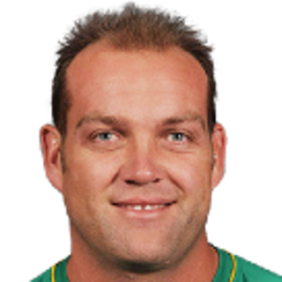
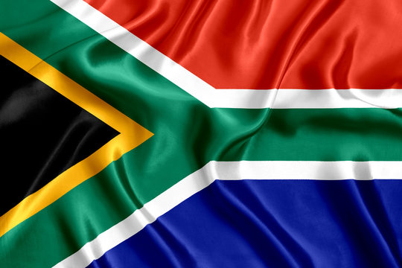
Jacques Kallis
South Africa
DOB
16 Oct 1975
Birth Place
Cape Town, South Africa
Mother
Mercia Kallis
Father
Henry Kallis
Height
6'1"
Marital Status
Married
Retired
Yes
Total Centuries
62

Slide 10
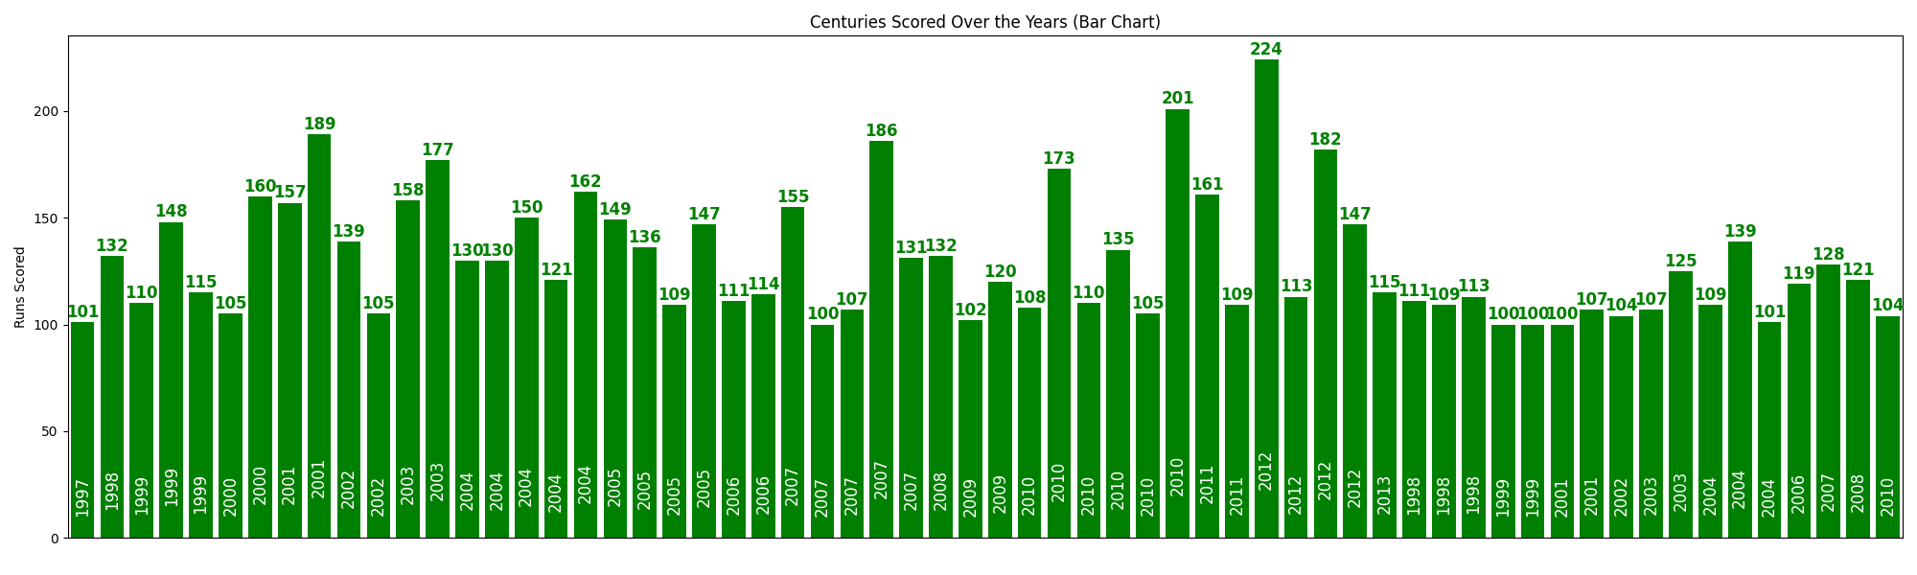
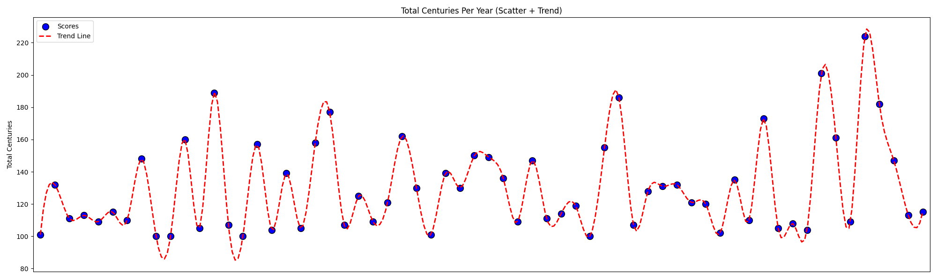
Jacques Kallis
South Africa
Year | Centuries
1997 | 1
1998 | 4
1999 | 5
2000 | 2
2001 | 4
2002 | 3
2003 | 4
2004 | 8
2005 | 4
2006 | 3
2007 | 6
2008 | 2
2009 | 2
2010 | 7
2011 | 2
2012 | 4
2013 | 1
Top Year | Top Run
2012 | 224

Slide 11
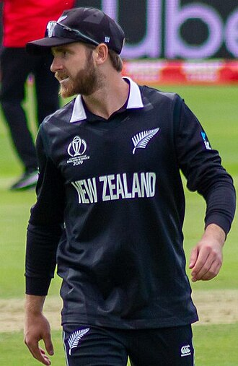

Kane Williamson
New Zealand
DOB
8 Aug 1990
Birth Place
Tauranga, New Zealand
Mother
Sandra
Father
Brett
Height
5'8"
Marital Status
Unmarried
Retired
No
Total Centuries
48

Slide 12
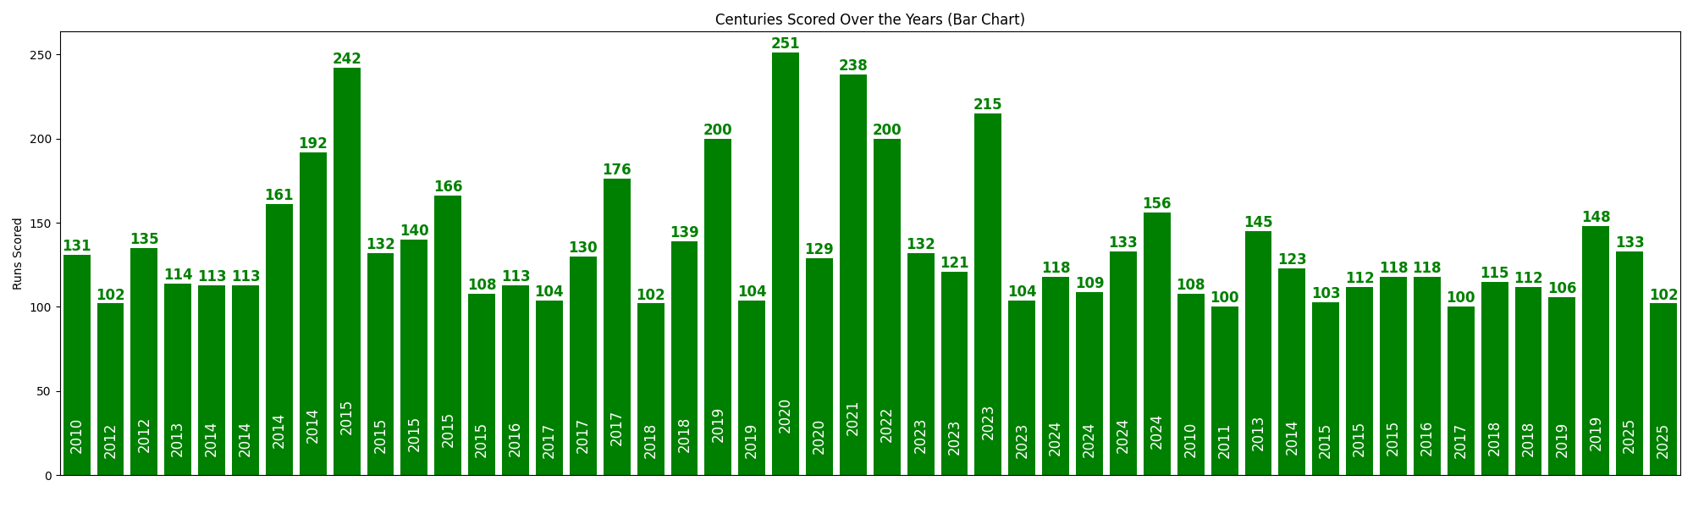
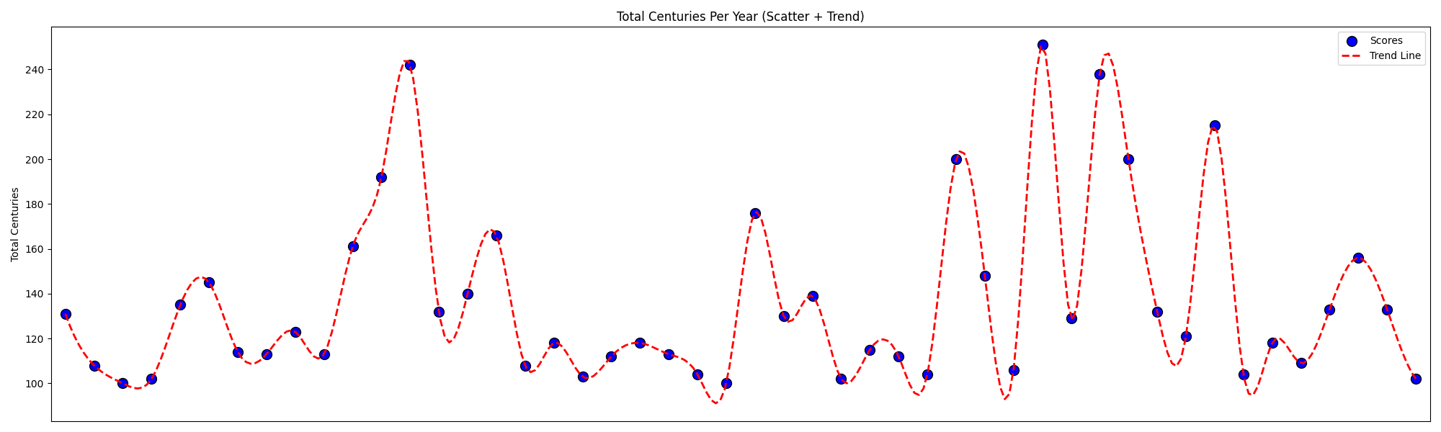
Kane Williamson
New Zealand
Year | Centuries
2010 | 2
2011 | 1
2012 | 2
2013 | 2
2014 | 5
2015 | 8
2016 | 2
2017 | 4
2018 | 4
2019 | 4
2020 | 2
2021 | 1
2022 | 1
2023 | 4
2024 | 4
2025 | 2
Top Year | Top Run
2020 | 251

Slide 13
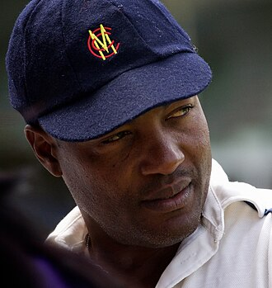
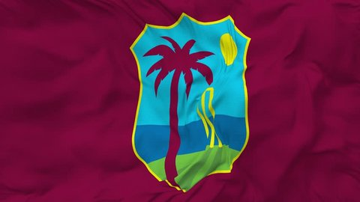
Brian Lara
West Indies
DOB
2 May 1969
Birth Place
Santa Cruz, Trinidad
Mother
Pearl
Father
Bunty
Height
5'8"
Marital Status
Married
Retired
Yes
Total Centuries
53

Slide 14
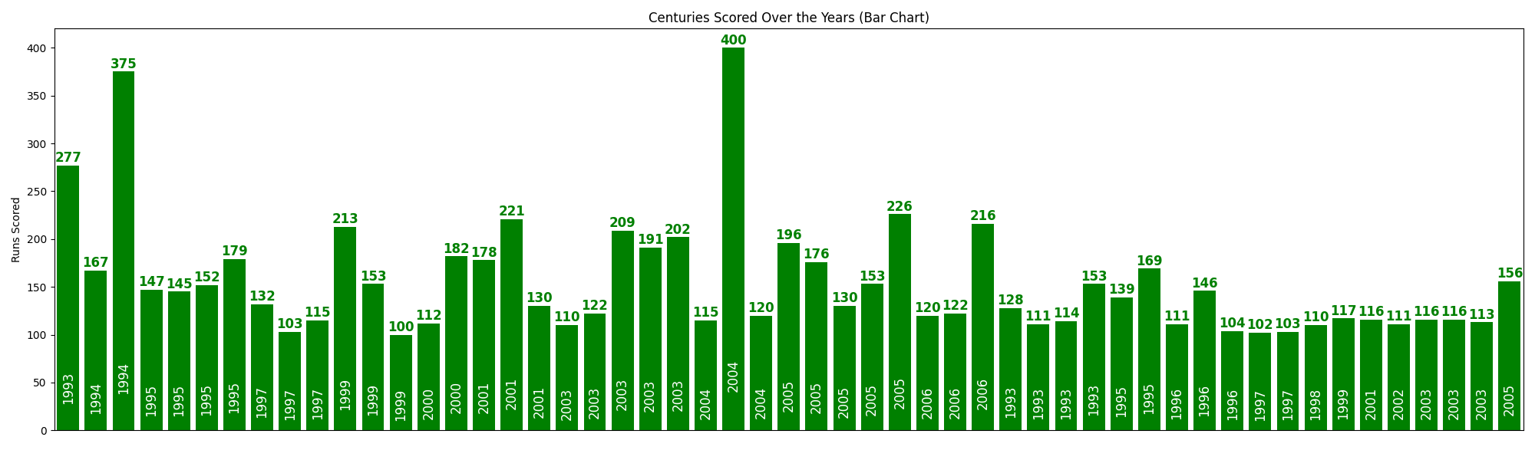
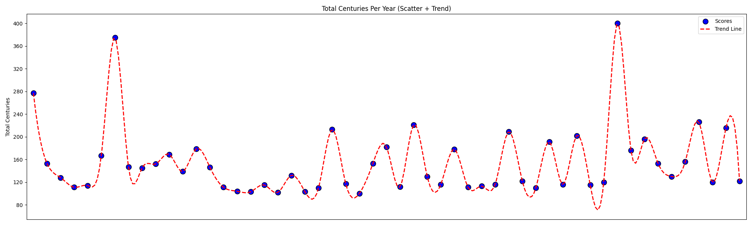
Brian Lara
West Indies
Year | Centuries
1993 | 5
1994 | 2
1995 | 6
1996 | 3
1997 | 5
1998 | 1
1999 | 4
2000 | 2
2001 | 4
2002 | 1
2003 | 8
2004 | 3
2005 | 6
2006 | 3
Top Year | Top Run
2004 | 400

Slide 15
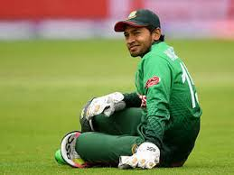
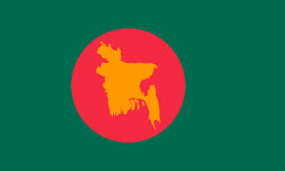
Mushfiqur Rahim
Bangladesh
DOB
9 May 1987
Birth Place
Bogra, Bangladesh
Mother
Rahima Khatun
Father
Mahbub Habib
Height
5'3"
Marital Status
Married
Retired
No
Total Centuries
20

Slide 16
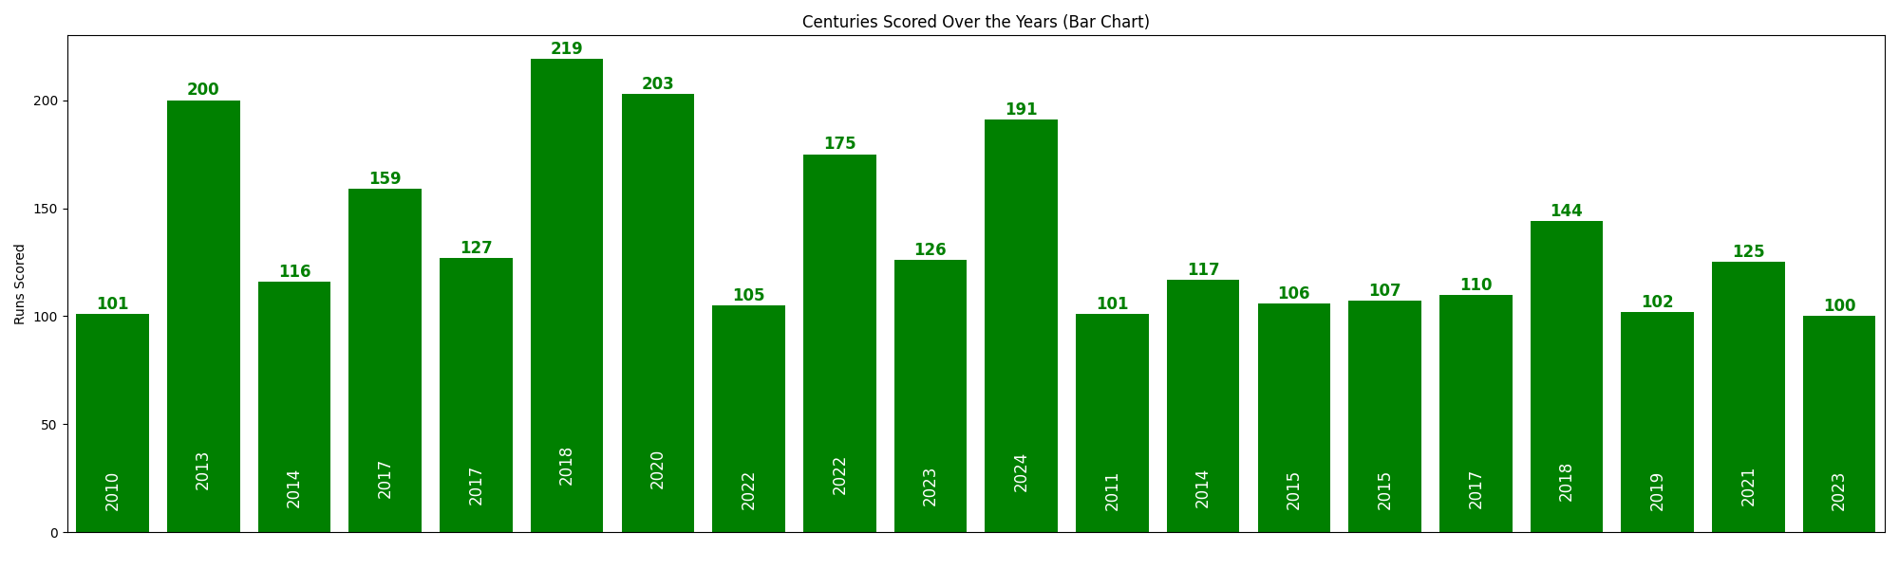
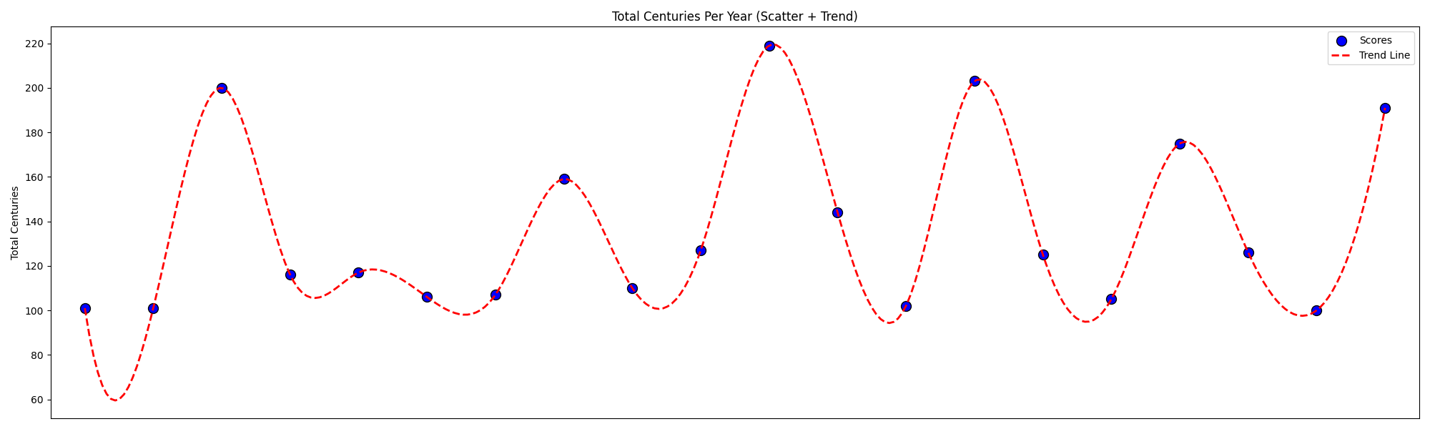
Mushfiqur Rahim
Bangladesh
Year | Centuries
2010 | 1
2011 | 1
2013 | 1
2014 | 2
2015 | 2
2017 | 3
2018 | 2
2019 | 1
2020 | 1
2021 | 1
2022 | 2
2023 | 2
2024 | 1
Top Year | Top Run
2018 | 219

Slide 17
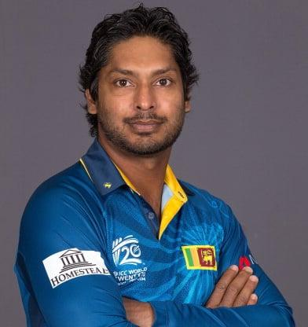
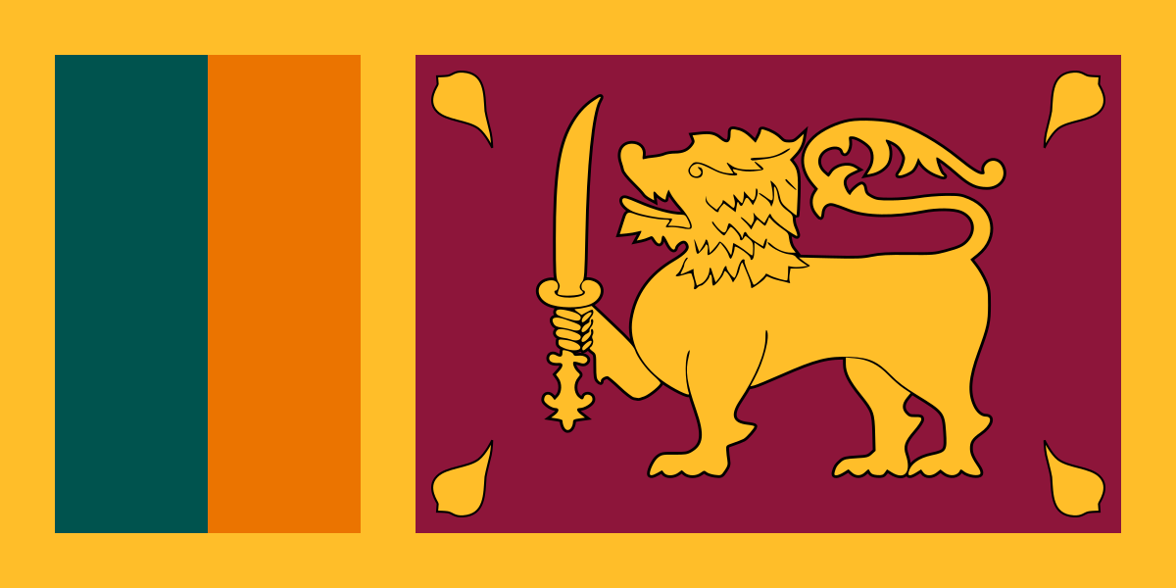
Kumar Sangakkara
Sri Lanka
DOB
27 Oct 1977
Birth Place
Matale, Sri Lanka
Mother
Kumari
Father
Kshema
Height
5'10"
Marital Status
Married
Retired
Yes
Total Centuries
63

Slide 18
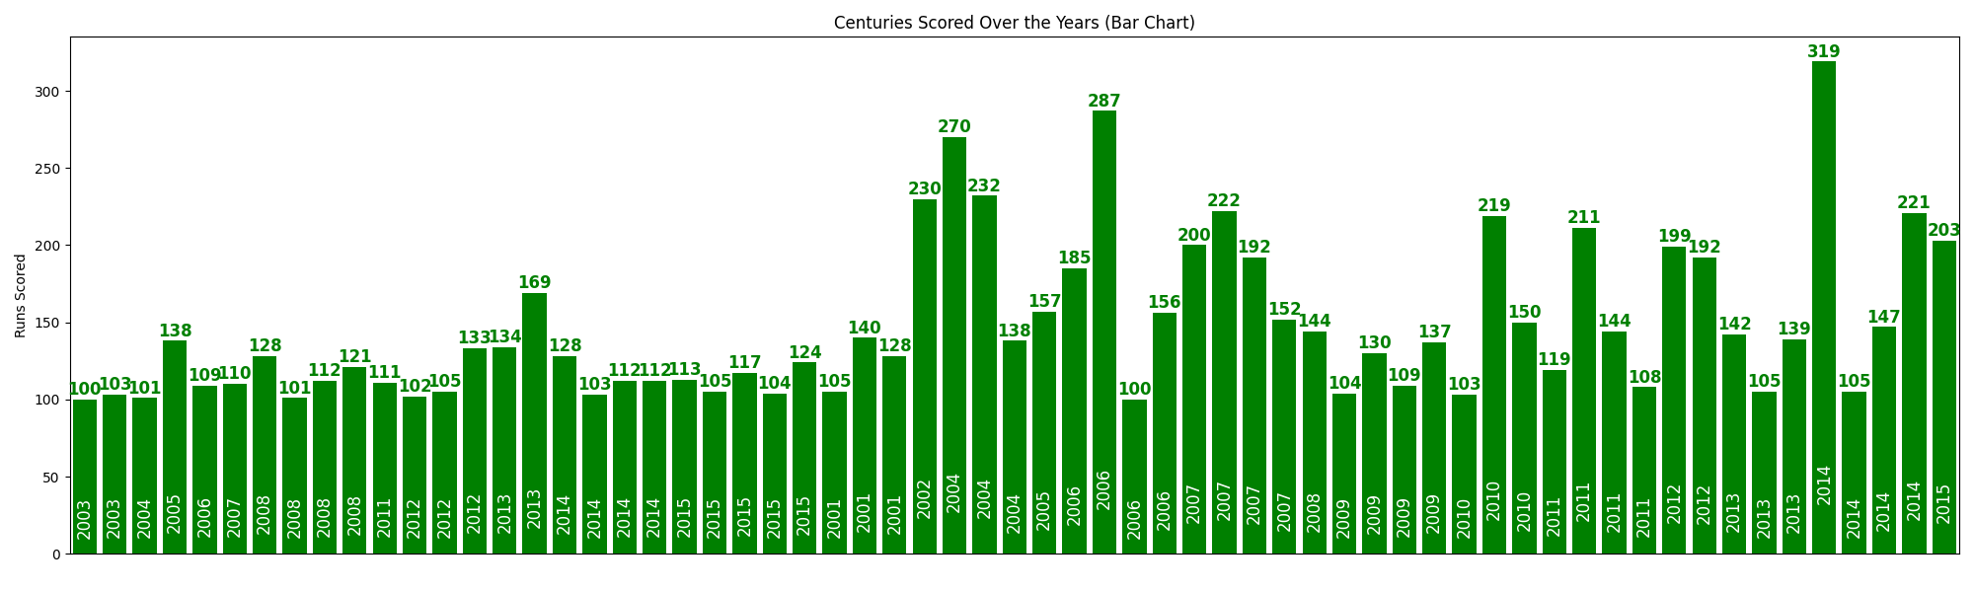
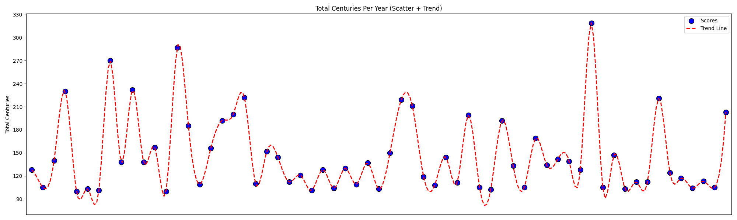
Kumar Sangakkara
Sri Lanka
Year | Centuries
2001 | 3
2002 | 1
2003 | 2
2004 | 4
2005 | 2
2006 | 5
2007 | 5
2008 | 5
2009 | 4
2010 | 3
2011 | 5
2012 | 5
2013 | 5
2014 | 8
2015 | 6
Top Year | Top Run
2014 | 319

Slide 19
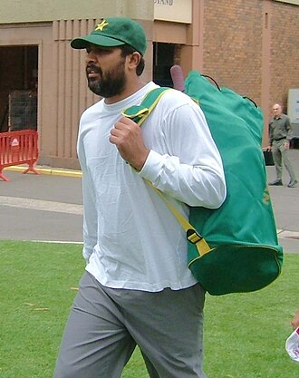

Inzamam-ul-Haq
Pakistan
DOB
3 Mar 1970
Birth Place
Multan, Pakistan
Mother
nan
Father
Peerzada
Height
6'3"
Marital Status
Married
Retired
Yes
Total Centuries
35

Slide 20
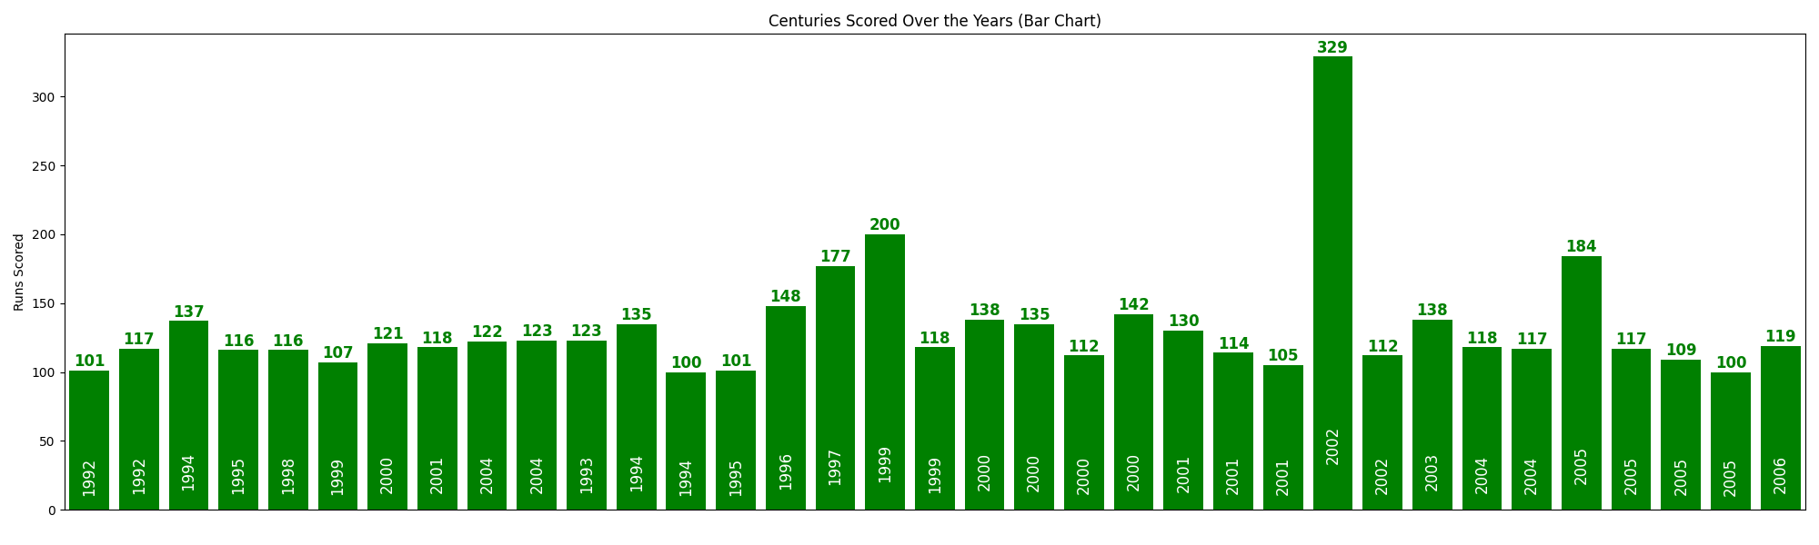
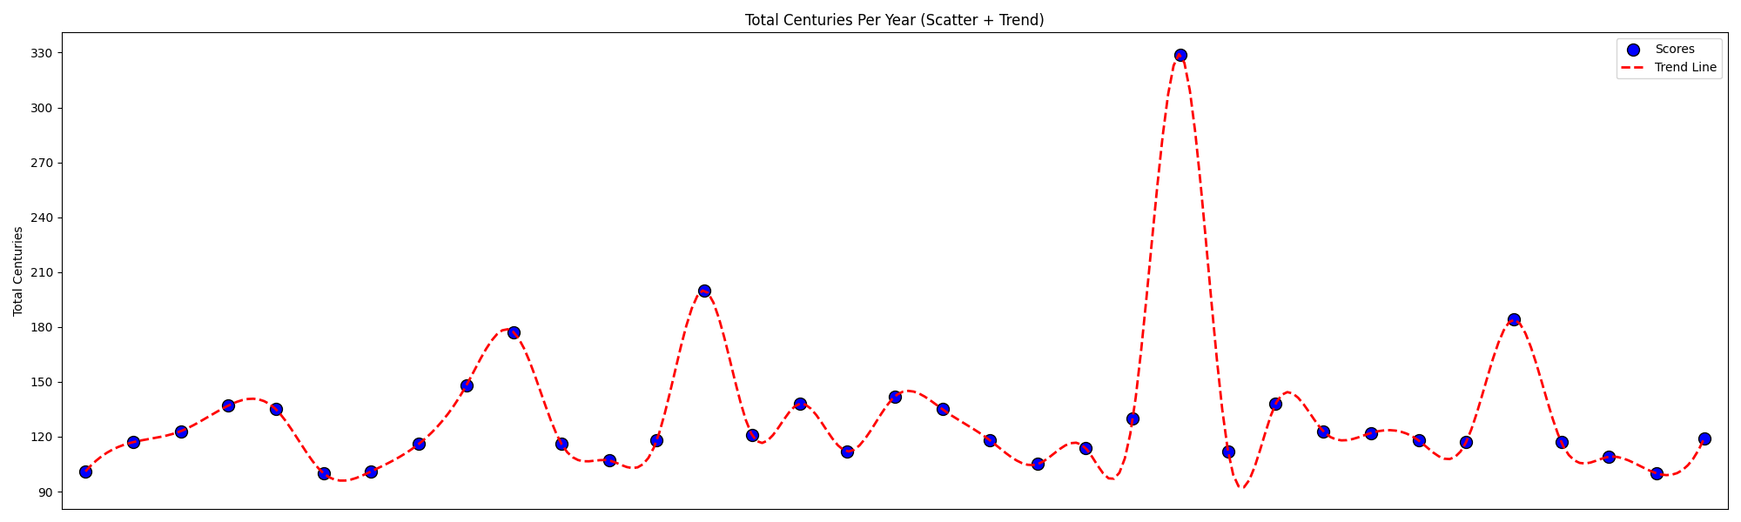
Inzamam-ul-Haq
Pakistan
Year | Centuries
1992 | 2
1993 | 1
1994 | 3
1995 | 2
1996 | 1
1997 | 1
1998 | 1
1999 | 3
2000 | 5
2001 | 4
2002 | 2
2003 | 1
2004 | 4
2005 | 4
2006 | 1
Top Year | Top Run
2002 | 329

Slide 21
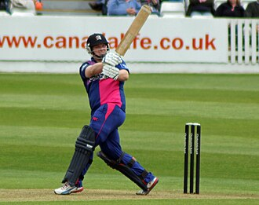

Paul Stirling
Ireland
DOB
3 Sep 1990
Birth Place
Belfast, Northern Ireland
Mother
nan
Father
nan
Height
5'9"
Marital Status
Unmarried
Retired
No
Total Centuries
9

Slide 22
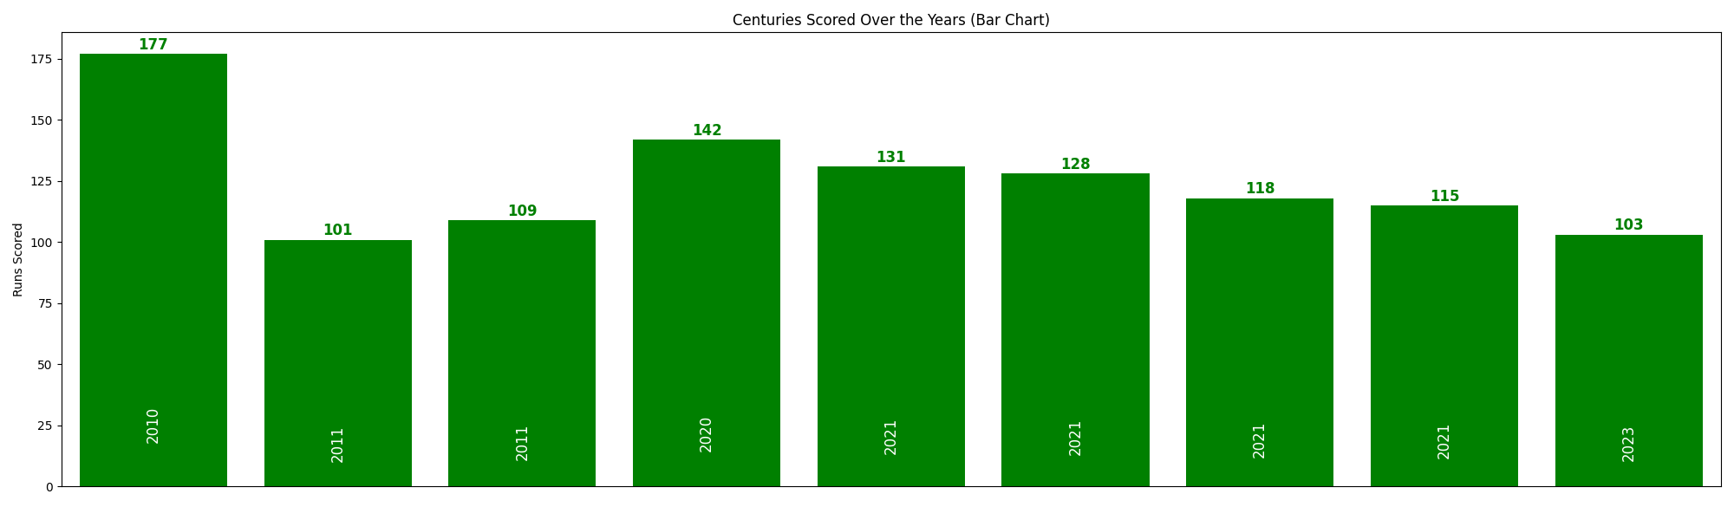
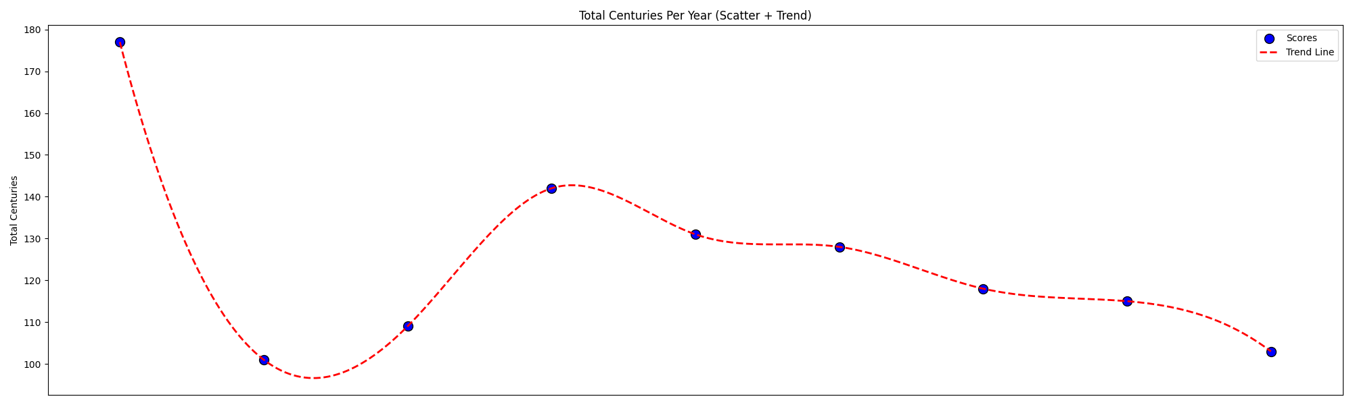
Paul Stirling
Ireland
Year | Centuries
2010 | 1
2011 | 2
2020 | 1
2021 | 4
2023 | 1
Top Year | Top Run
2010 | 177

