Slide 1

Seasonal Agriculture Performance Analysis
Ayush Ranjan
Maharaja Agrasen institute of technology
Student ID: STU6a2aafcb805e11781182411

Slide 2

PROBLEM STATEMENT
(Agricultural activities are influenced by seasonal variations in environmental conditions, farming practices, resource availability and market conditions. As a result, agricultural performance may differ from one season to another. However, raw agricultural data does not clearly explain how agricultural performance changes across seasons or what patterns can be observed in different seasonal conditions. The problem is to analyze the given agricultural dataset and investigate seasonal differences in agricultural performance by identifying meaningful patterns, trends, relationships and variations within the available data.

Slide 3
Project Description
For this project I used a seasonal agriculture dataset with 4000 farm records and 28 columns, covering crops grown across the Kharif, Rabi and Zaid seasons in India.
I cleaned the missing values, then analyzed how rainfall, temperature, yield, profit, water usage and disease/pest risk change from one season to another, and which crops perform best in which season.
And finds the meaningfull insights.

Slide 4

WHO ARE THE END USERS?
Farmers – to know which season and crop combination is likely to give better yield and profit
Agricultural planners & government bodies – to plan irrigation, subsidies and support based on seasonal risk
Agri-tech and insurance companies – to assess risk and design better products for farmers
Researchers/students – as a reference for studying seasonal farming trends

Slide 5

Technology Used
  Python – the main language I used for this project
  Pandas & NumPy – for cleaning, grouping and analyzing the data
  Matplotlib & Seaborn – to plot all the charts and the correlation heatmap
  Jupyter Notebook – where I wrote and ran all the code

Slide 6
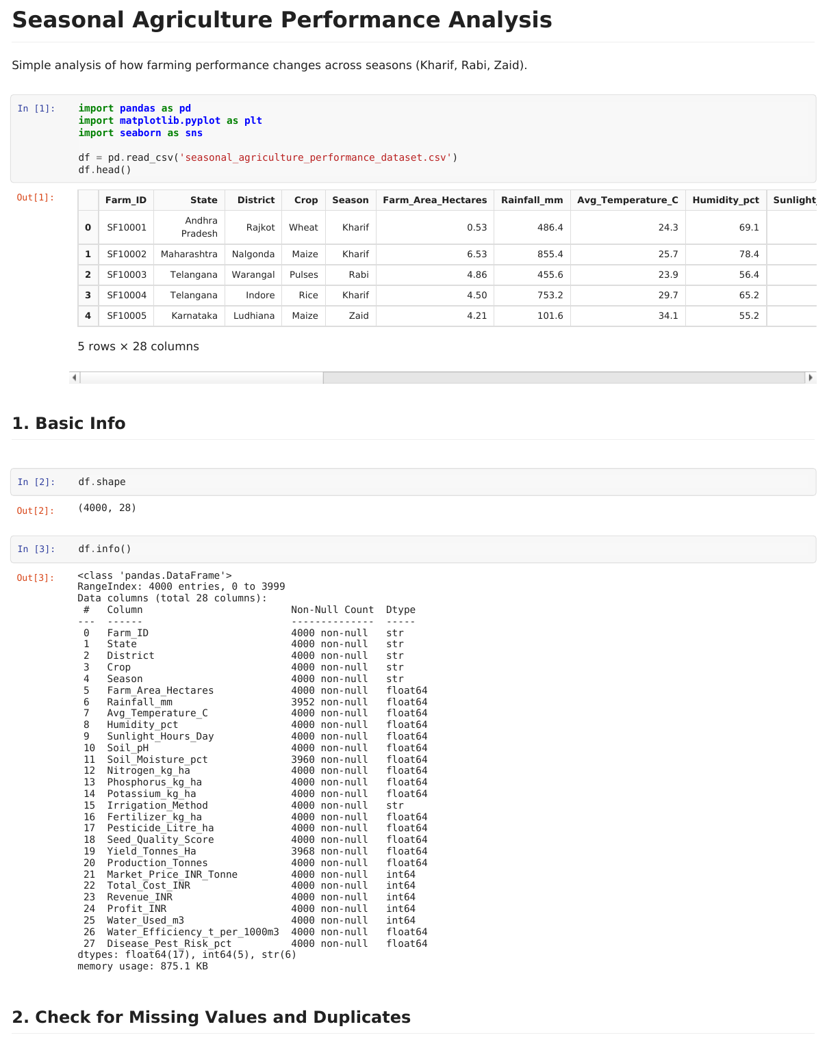
RESULTS
Data Overview & Basic Info

Slide 7
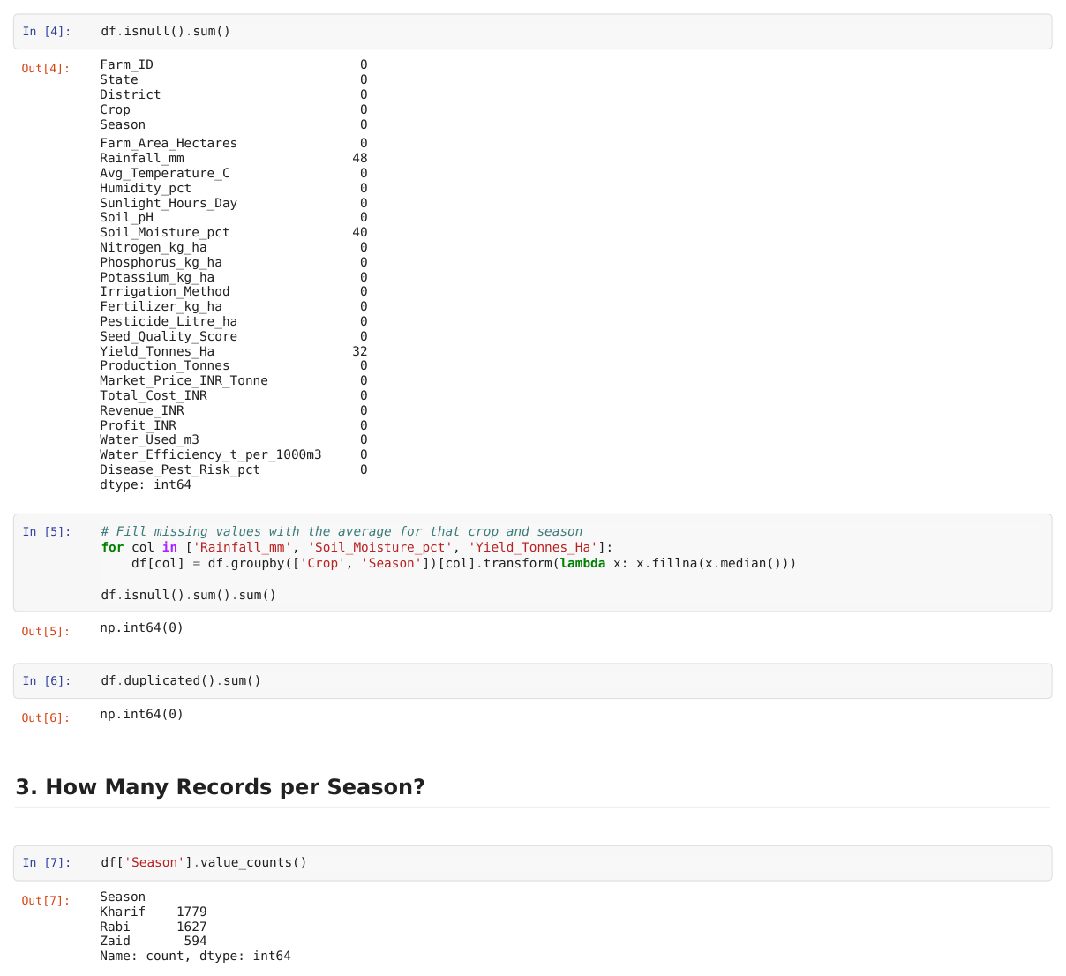
RESULTS
Missing Values, Duplicates & Season Counts

Slide 8
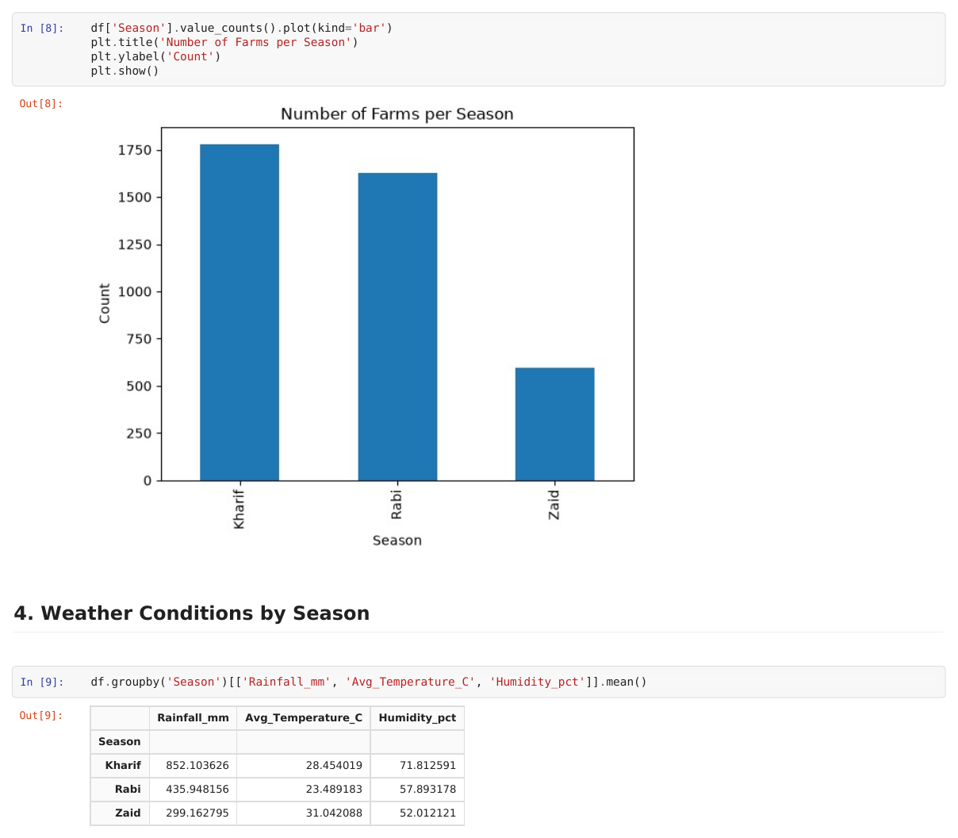
RESULTS
Farms per Season & Weather Conditions

Slide 9
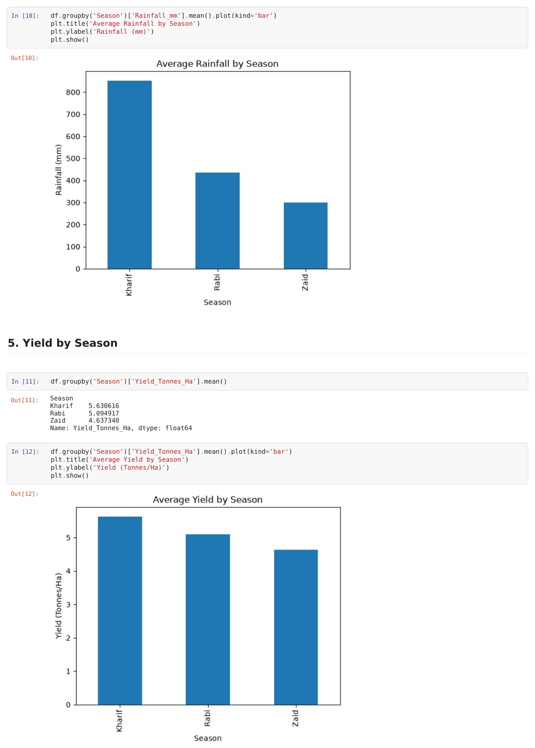
RESULTS
Average Rainfall & Yield by Season

Slide 10
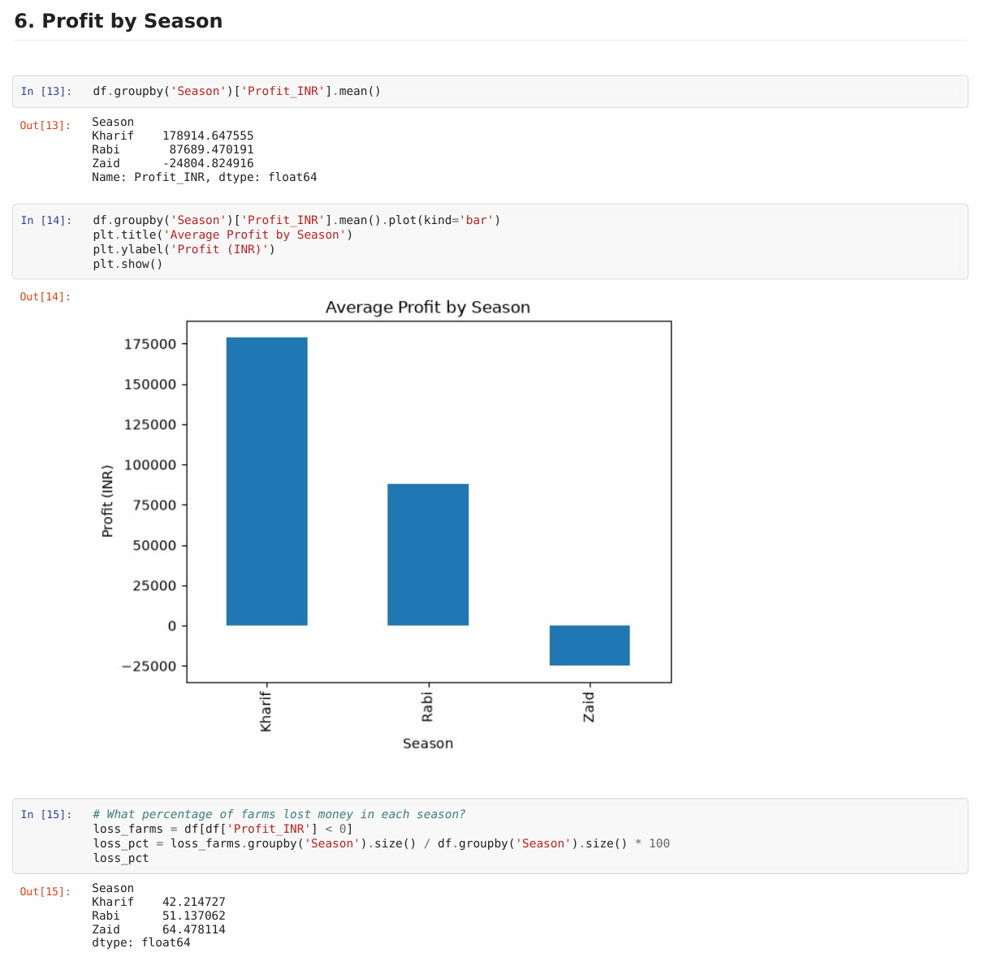
RESULTS
Profit by Season & Loss Analysis

Slide 11
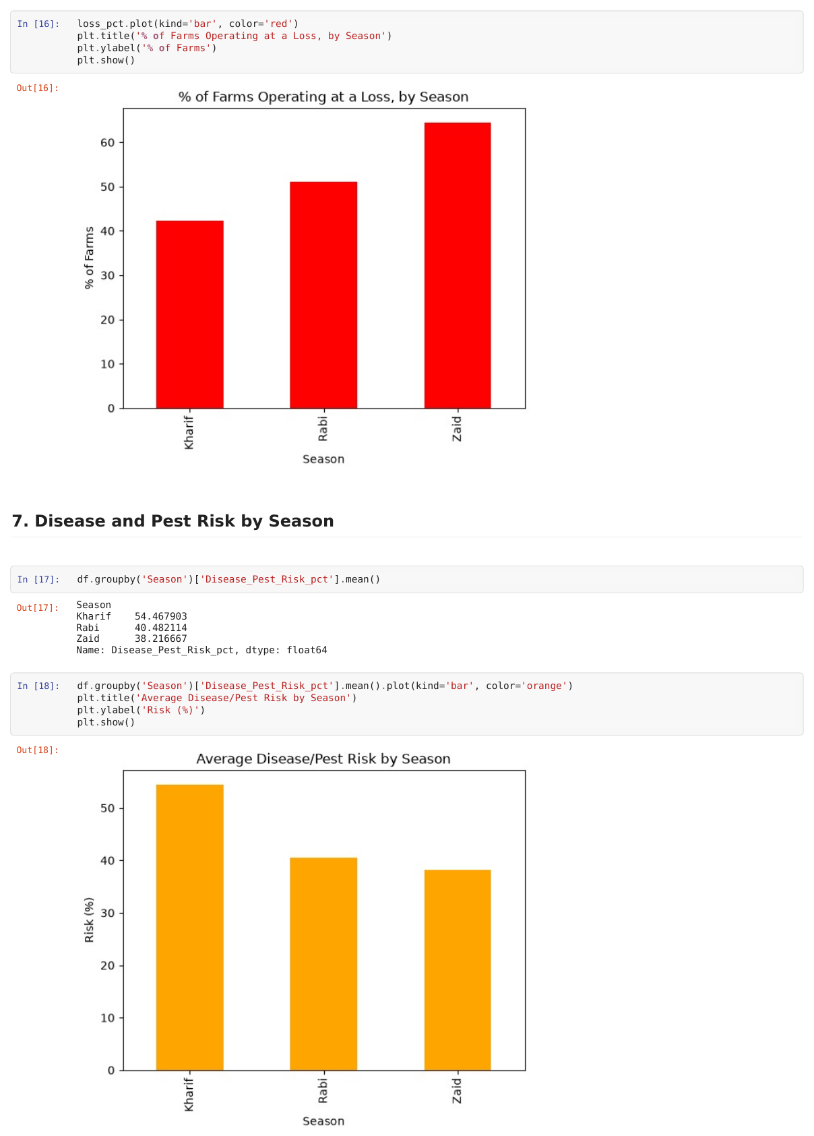
RESULTS
Loss % and Disease/Pest Risk by Season

Slide 12
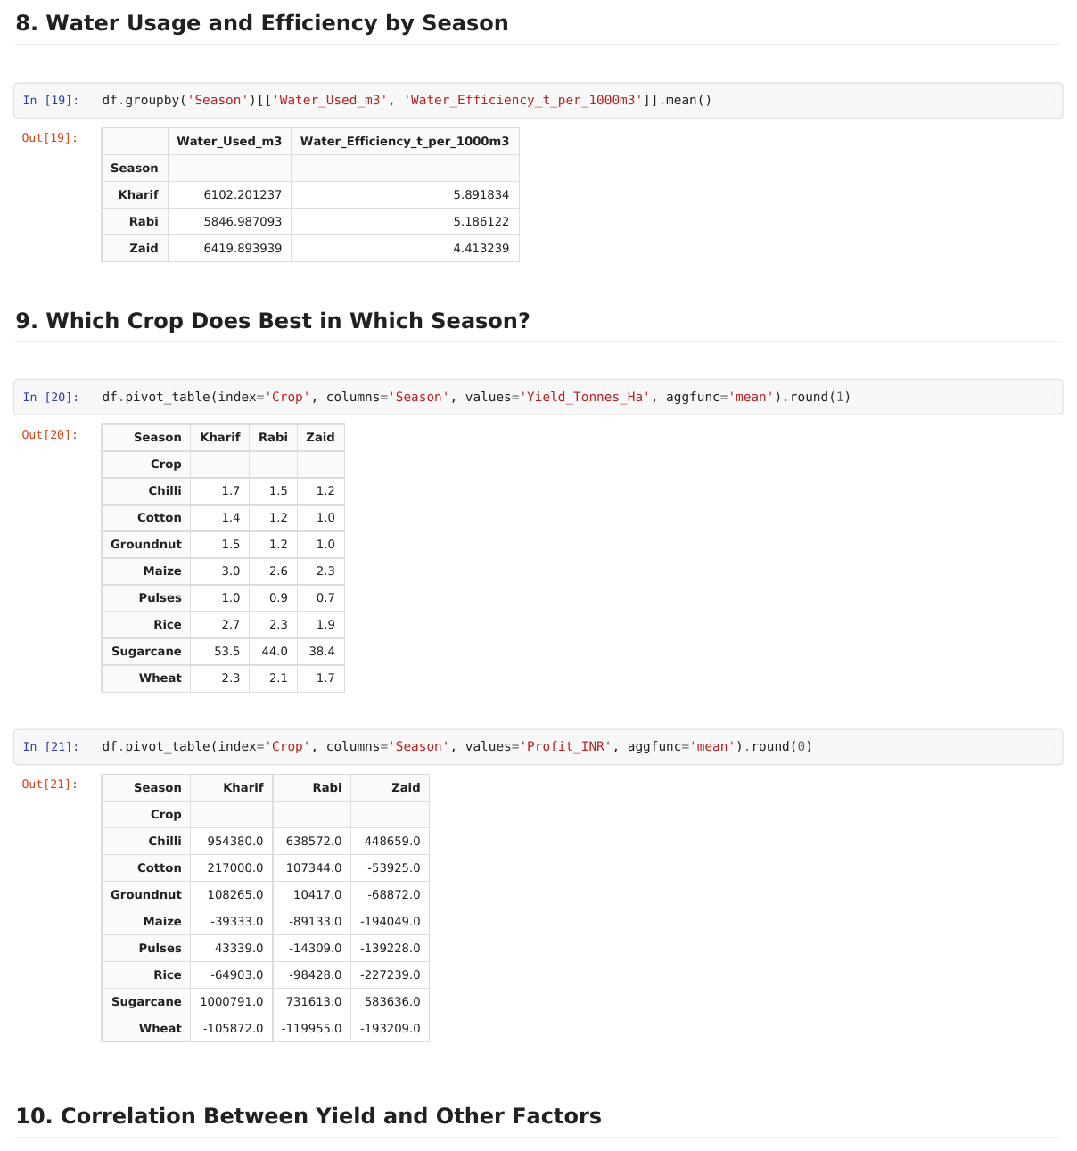
RESULTS
Water Usage & Crop Performance by Season

Slide 13
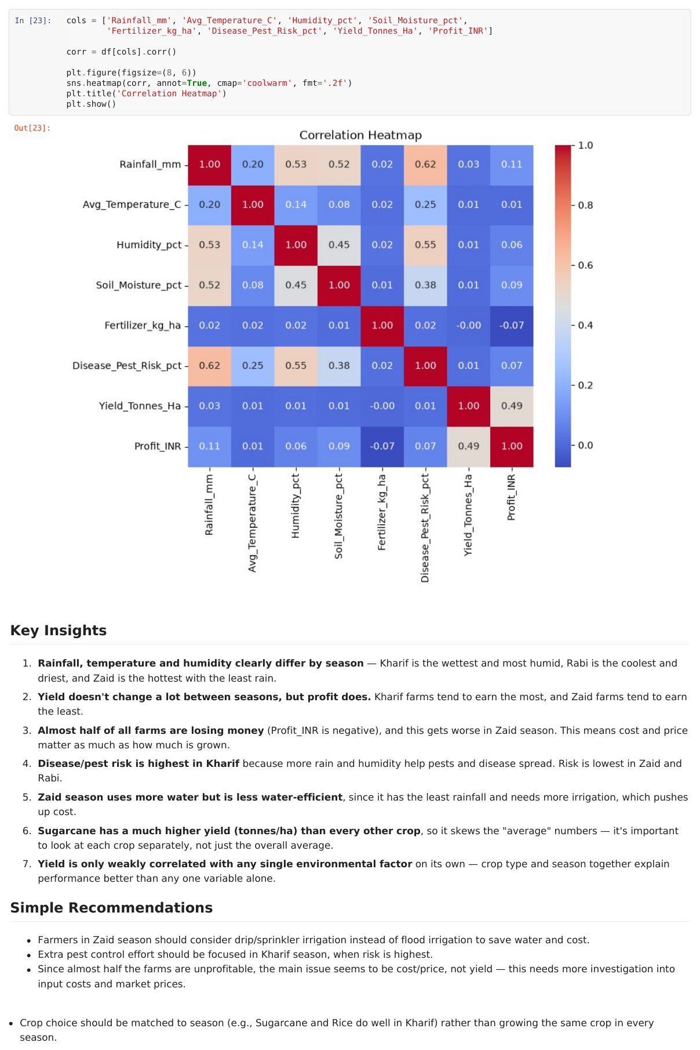
RESULTS
Correlation Heatmap & Key Insights

Slide 14
Future scope
Build a machine learning model to predict yield and profit for a given crop, season and set of conditions
Add real-time weather and market price data to make the analysis more useful for current decisions
Turn this into a simple dashboard/app where a farmer can enter their crop and season and get quick insights
Dig deeper into cost and pricing data to understand exactly why almost half the farms are running at a loss

Slide 15
GitHub Link
https://github.com/Ayush-25-27/Seasonal_Agriculture_analysis_EDA.git

Slide 16
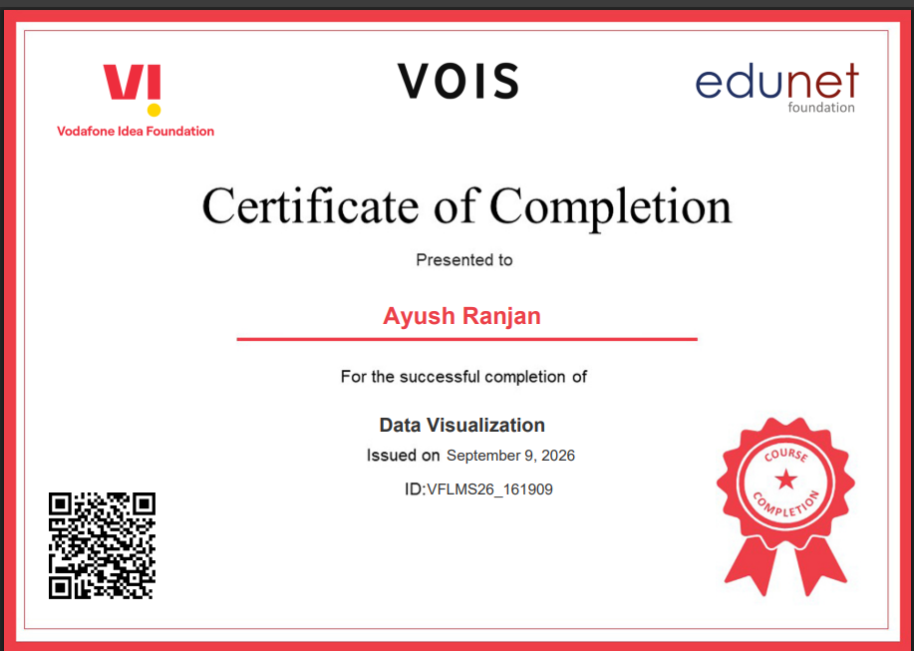
VOIS Course completion certificate -
Course name- Data Visualization

Slide 17
Thank you
.
.

