Slide 1
Radar Signal Detection in Spectrograms : Ablation-Driven Analysis , Hybrid Detection Framework, and Embedded Deployment
Harshit Anand (24095134)
Ayush Verma (24095136)
Bibek Barman (24095147)
Department of Electronics Engineering, IIT (BHU) Varanasi
Guide: Prof. P. R. Muduli, Department of Electronics Engineering, IIT (BHU) Varanasi
Project Convener – Dr. Jaya Jha, Department of Electronics Engineering, IIT (BHU) Varanasi

Slide 2
Introduction & Objectives
Project Overview
Dataset
Image Size
Radar signal detection in spectrogram representations presents significant challenges due to low signal-to-noise ratios, variability in signal structure, and the presence of small, localized patterns. This work adopts a dual-perspective approach combining interpretability and performance to address these challenges systematically.
Raddet-NIST CBRS (NISTSpecMaxHold512)
512×512 spectrogram
Research Objectives
1)PON#1
2)PON#2
3)Q3N#1
4)Q3N#2
5)Q3N#3
Classes :
Ensemble mAP50
Conduct comprehensive ablation study to investigate feature hierarchy, spatial resolution, feature fusion, and model capacity using YOLOv8 architecture
Propose and validate a hybrid ensemble detection framework for improved performance
Demonstrate real-time feasibility via embedded deployment on PYNQ-Z2 platform
94.36

Slide 3
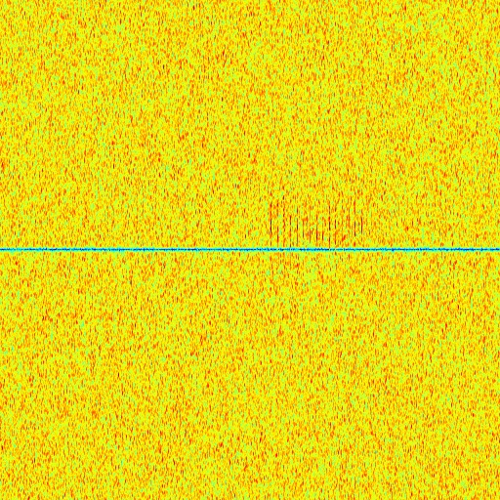
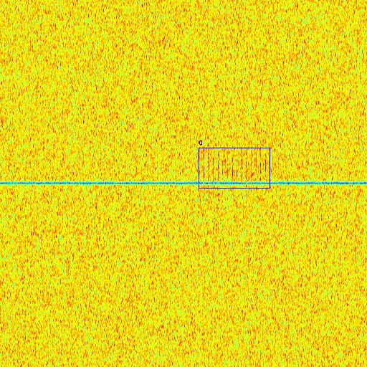
RADDET-NIST CBRS Dataset
The NIST CBRS dataset utilizes the MaxHold spectrogram representation (NISTSpecMaxHold512). Spectrograms are derived from radar signals in the CBRS band using a max-hold operation, which emphasizes persistent signal components over time, making transient radar signals visible as localized patterns.
Each sample is a 512×512 image where radar signals appear as localized patterns in the time–frequency domain. The dataset includes multiple radar classes — P0N and Q3N variants — with precise bounding box annotations. It is divided into training, validation, and test sets using a standard supervised learning protocol.
Fig: Input and Output

Slide 4
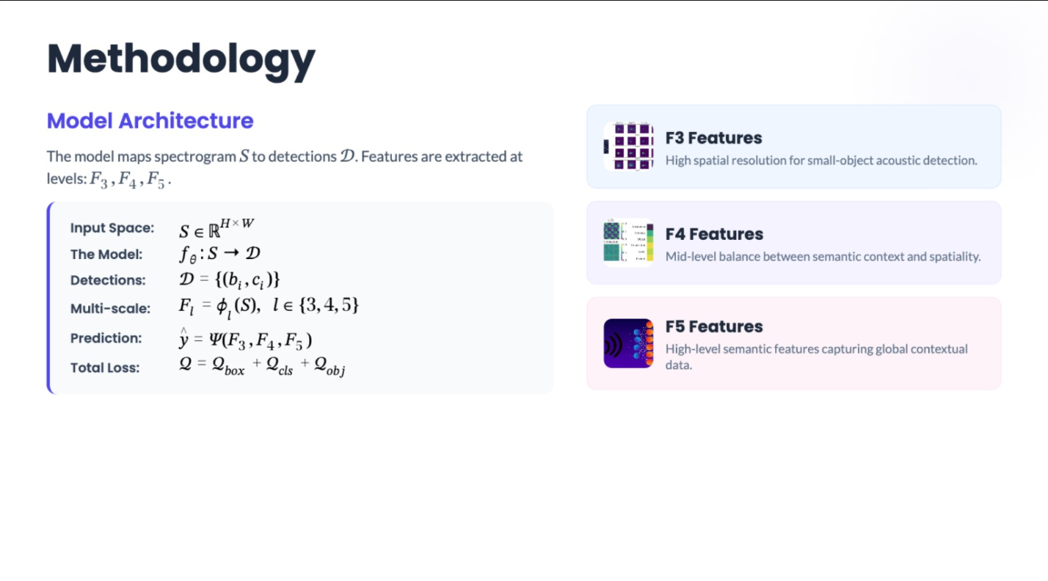
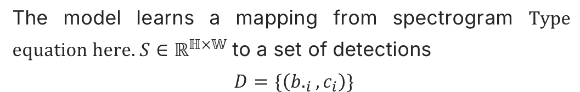
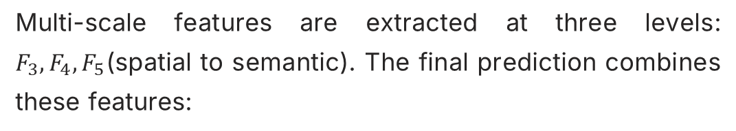
Methodology
Model Architecture
The model learns a mapping from spectrogram $S∈ℝ^{ℍ×𝕎}$ to a set of detections
$$D=\{\left(b._{i},c_{i}\right)\}$$
F3 Features
F4 Features
Multi-scale features are extracted at three levels: $F_{3},F_{4},F_{5}$(spatial to semantic). The final prediction combines these features:
High spatial resolution for small-object detection
Mid-level features with balanced representation
Loss function: $L=L_{box}+L_{cls}+L_{obj}$
F5 Features
High-level semantic features, low spatial resolution

Slide 5
Baseline Performance
YOLOv8 Baseline on NISTSpecMaxHold512
The baseline YOLOv8 model was trained on the NIST spectrogram dataset and serves as the reference for all ablation comparisons. The model demonstrates strong precision but lower recall, motivating further investigation into missed detections in low-SNR conditions.
Metric
Value
mAP50
0.9305
Precision
0.9527
Recall
0.8917
Strong precision indicates high confidence in detections, while lower recall suggests missed detections in challenging low-SNR conditions remain a challenge.

Slide 6
Ablation Study
Comprehensive Ablation Experiments
A systematic ablation study was conducted to understand the contribution of different architectural components. Each experiment modifies a specific aspect of the baseline model while keeping other parameters constant.
Ablation
mAP50
Precision
Recall
ΔmAP
Baseline
0.9305
0.9527
0.8917
0
No P3
0.8610
0.9102
0.8025
−0.0695
No P5
0.9289
0.9511
0.8890
−0.0016
Frozen Backbone
0.9030
0.9215
0.8450
−0.0275
No PAN
0.9152
0.9360
0.8653
−0.0153
Half Channels
0.9128
0.9324
0.8611
−0.0177
Blur Input
0.9021
0.9203
0.8422
−0.0284
Noise Input
0.8955
0.9158
0.8350
−0.0350

Slide 7
Ablation Findings
Key Insights from Ablation Analysis
Finding 1: P3 is Critical
Finding 2: P5 is Negligible
Finding 3: Backbone Adaptation Matters
Finding 4: Noise and Blur Sensitivity
Removing P3 (small-scale feature map) caused the largest performance drop: mAP fell by 0.0695 and recall dropped sharply by 0.0892. Radar signals behave as small objects in the spectrogram domain — high-resolution spatial features are essential for detection.
Removing P5 (high-level semantic features) had almost no impact (ΔmAP = −0.0016). Unlike natural image detection, global semantic context is not required. Detection is driven by local structural patterns rather than high-level semantics.
Freezing the backbone caused a drop of ΔmAP = −0.0275. Radar spectrograms have fundamentally different statistical properties from natural images. Domain-specific fine-tuning is critical for optimal performance.
Gaussian noise caused mAP to drop to 0.8955 (Δ = −0.0350); blur to 0.9021 (Δ = −0.0284). The model relies on sharp spatial precision and lacks inherent robustness to noise, indicating a need for augmentation or denoising techniques.
Most Critical
Moderately Important
Less Important
P3 features, backbone adaptation
PAN fusion, spatial fidelity
P5 semantics, channel count

Slide 8
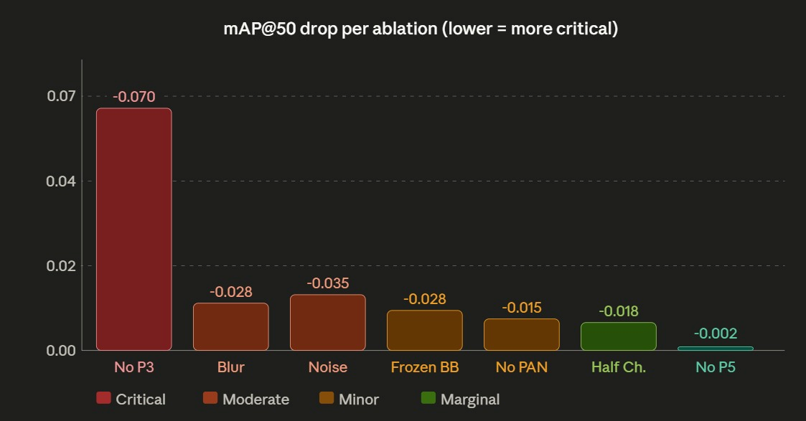
Ablation Study graph :

Slide 9
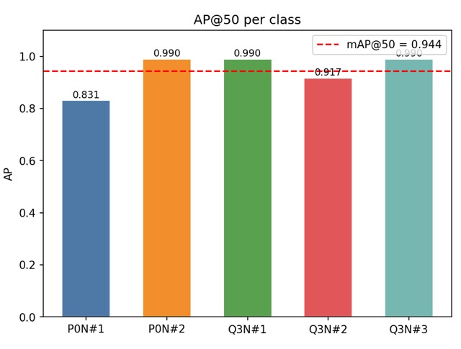
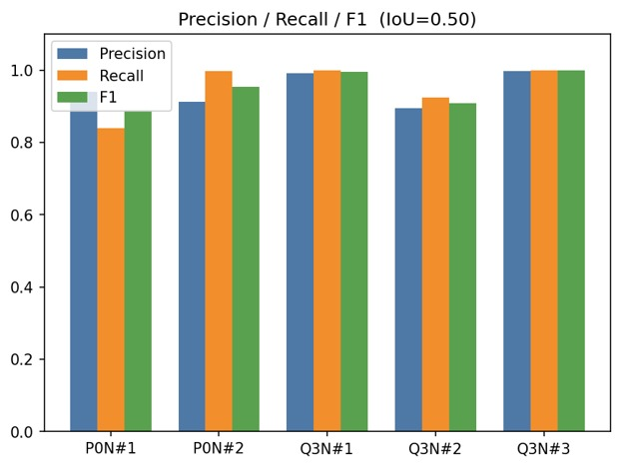
Hybrid Ensemble & Results
Ensemble Framework — WBF: YOLOv8s + RT-DETR | RADDet NIST512
A hybrid ensemble was constructed by combining predictions from multiple detectors using a fusion strategy (Weighted Box Fusion). The ensemble achieves higher mAP and significantly improves recall, indicating reduced missed detections through complementary model strengths.
Model
mAP50
Precision
Recall
YOLOv8 (Baseline)
0.9305
0.9527
0.8917
Ensemble (Hybrid)
0.9436
0.9471
0.9521
Recall improvement: +6.04% (from 0.8917 to 0.9521)

Slide 10
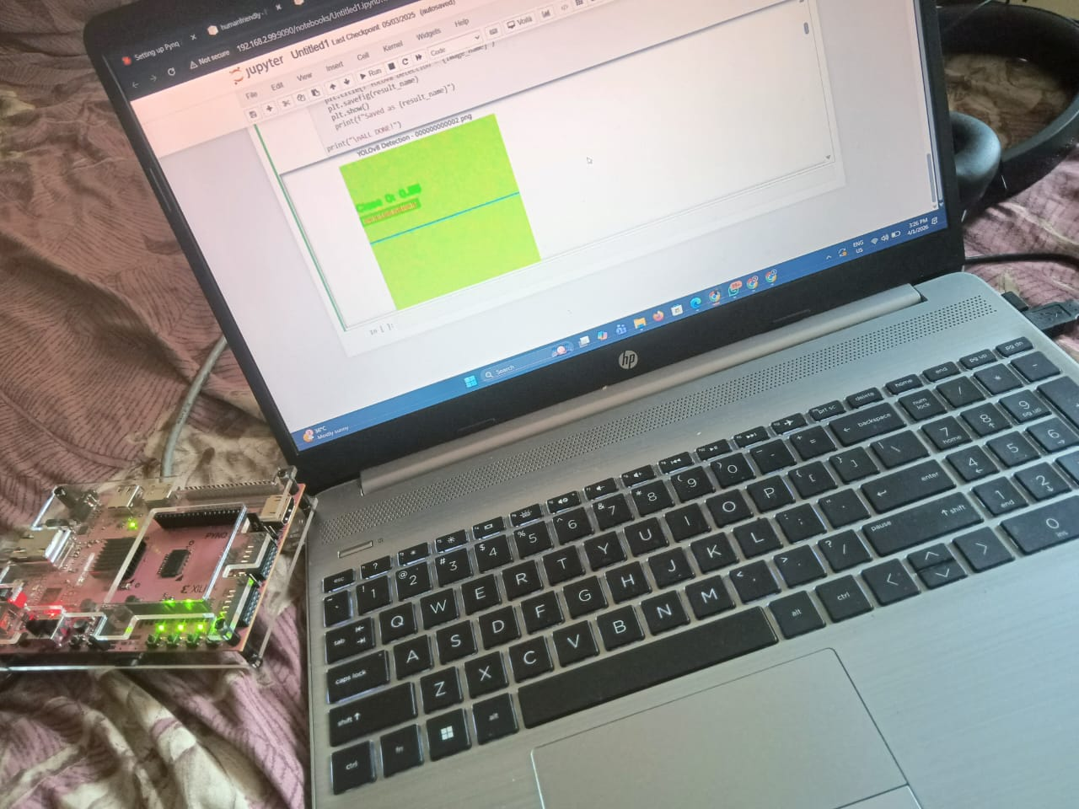
Embedded Deployment on PYNQ-Z2
Edge Deployment — Real-Time Radar Detection
Platform & Implementation
Conf. Threshold
Format
0.25
ONNX (ARM-compatible)
Platform: PYNQ-Z2 development board (Xilinx Zynq-7000), dual-core ARM + FPGA fabric. Connected to host via Ethernet; controlled via Jupyter Notebook interface.
Model: YOLOv8 Nano converted to ONNX format for ARM inference. Input spectrograms resized to 256×256 and normalized. Confidence threshold: 0.25.
Constraints acknowledged: Lower representational capacity vs. larger models; quantization introduces a performance–efficiency tradeoff, slightly reducing accuracy in exchange for faster inference.
Conclusion: Demonstrates feasibility of real-time spectrum monitoring on resource-constrained edge devices with minimal infrastructure requirements.

Slide 11
Conclusion & Future Directions
Key Achievements
Future Work
Systematic ablation study revealing that radar detection is fundamentally a small-object detection problem
P3 (high-resolution) features dominate; P5 (semantic) features contribute minimally to performance
Backbone fine-tuning critical for domain-specific adaptation to radar spectrograms
Hybrid ensemble achieves mAP50 of 94.36, recall of 95.21 — significant improvement over baseline
Real-time embedded deployment demonstrated on PYNQ-Z2 with YOLOv8 Nano + ONNX
Deployment of the model on FPGA hardware for real time processing.
Augmentation and denoising techniques for noise robustness
Adaptive or learned thresholding strategies
Non-maximum suppression improvements (Canny-style)
RGB/multi-channel spectrogram support
Self-checking testbench and quantization-aware training for edge deployment
Thank You

