Slide 1

PRESENTED BY : AYUSH SAHU
Phishing Awareness Training
Stay Safe Online – Recognize and Avoid Cyber Threats

Slide 2



Introduction to Phishing
Definition: Phishing is a cyberattack where attackers trick people into revealing sensitive information by pretending to be trustworthy sources.
Why It Matters: Students are frequent targets due to their online activity and lack of awareness.

Slide 3



Email Phishing: Fake emails from banks, schools, or services.
Types of Phishing Attacks
Spear Phishing: Targeted attacks using personal info.
Smishing: Phishing via SMS/text messages.
Vishing: Voice calls pretending to be official.
Clone Phishing: Duplicate of a real email with malicious links.

Slide 4


Suspicious sender address (e.g., support@micros0ft.com)
Recognizing Phishing Emails
Urgent or threatening language (“Your account will be suspended!”)
Unexpected attachments or links
Poor grammar and spelling

Slide 5

Spotting Fake Websites
Your paragrapCheck the URL carefully (look for misspellings or extra characters)
Look for HTTPS and a padlock icon 🔒
Poor design or outdated logos
Pop-ups asking for login info
No contact or privacy policy page

Slide 6
Social Engineering Tactics
Urgency: “Act now or lose access!”
Greed: “You’ve won a prize!”
Curiosity: “See who viewed your profile!”
Authority: “This is your school’s IT department.”

Slide 7


Lesson: Always verify before clicking or submitting
personal info.
Real-World Examples
Example 1: A student received a fake scholarship email asking for bank details.
Example 2: A fake university login page stole credentials during exam season.

Slide 8

Best Practices to Stay Safe
Don’t click suspicious links or download unknown files.
Use strong, unique passwords and enable 2FA.
Think before you click!
Keep software and antivirus updated..
Report phishing attempts to your school or email provider.

Slide 9
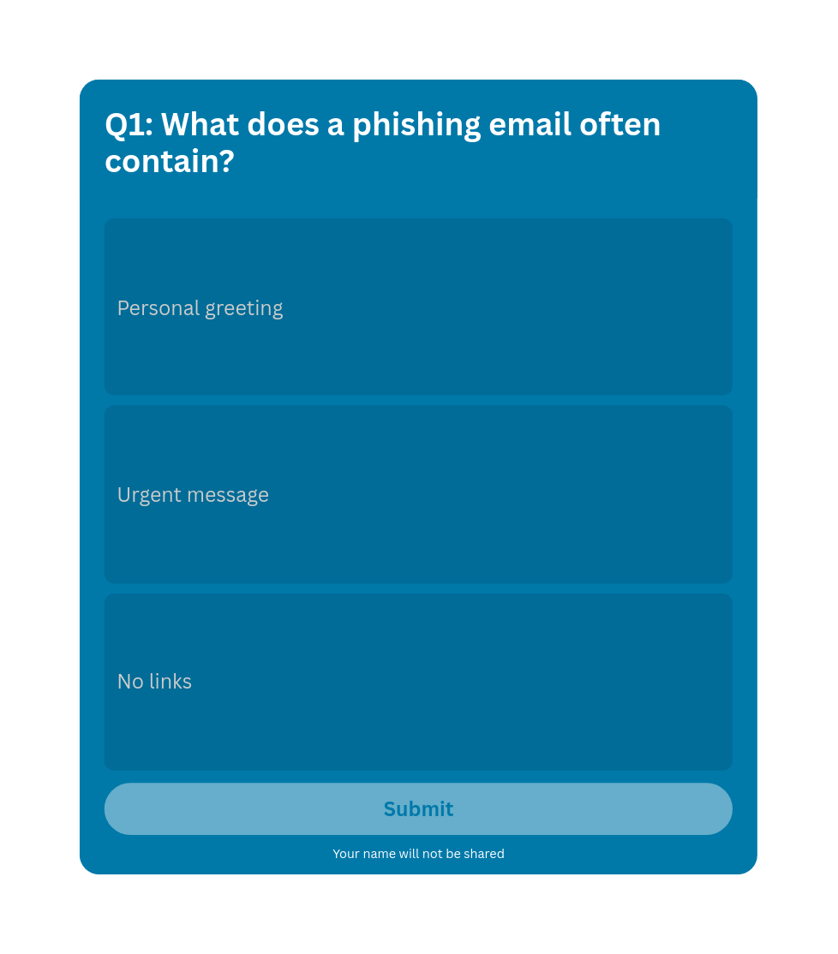
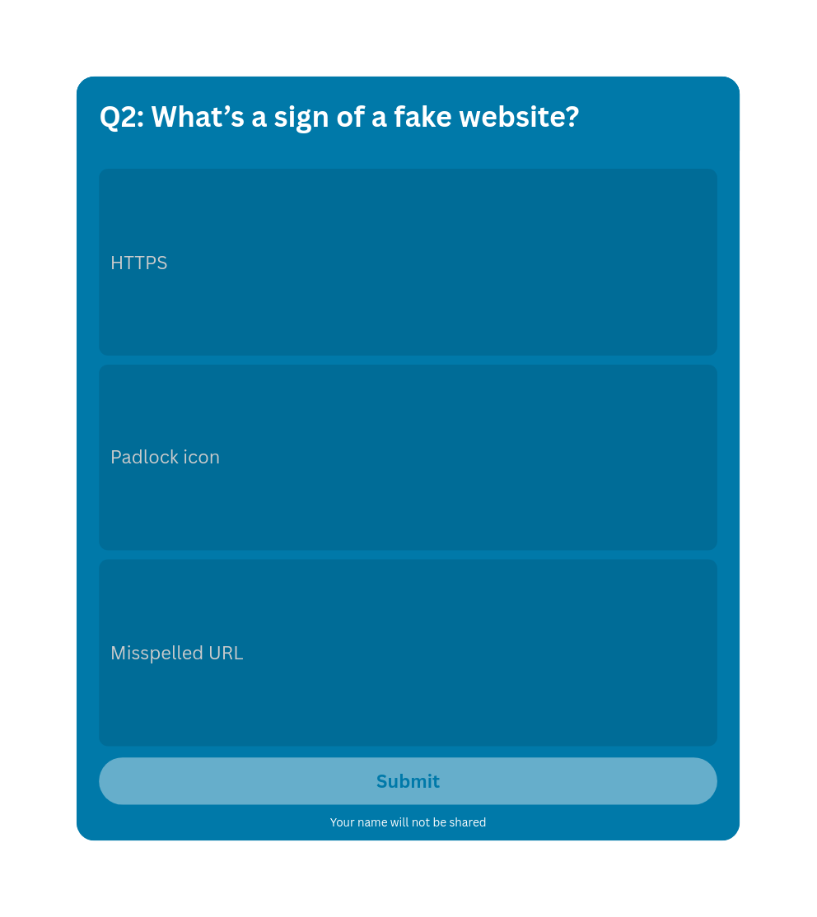

Slide 10
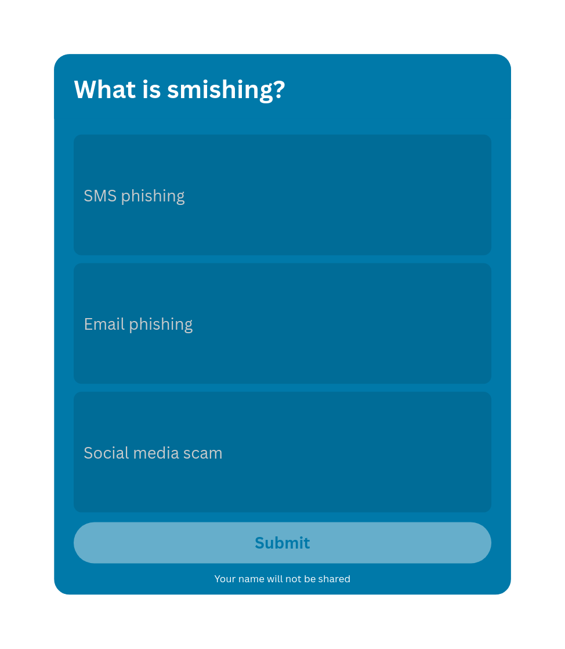
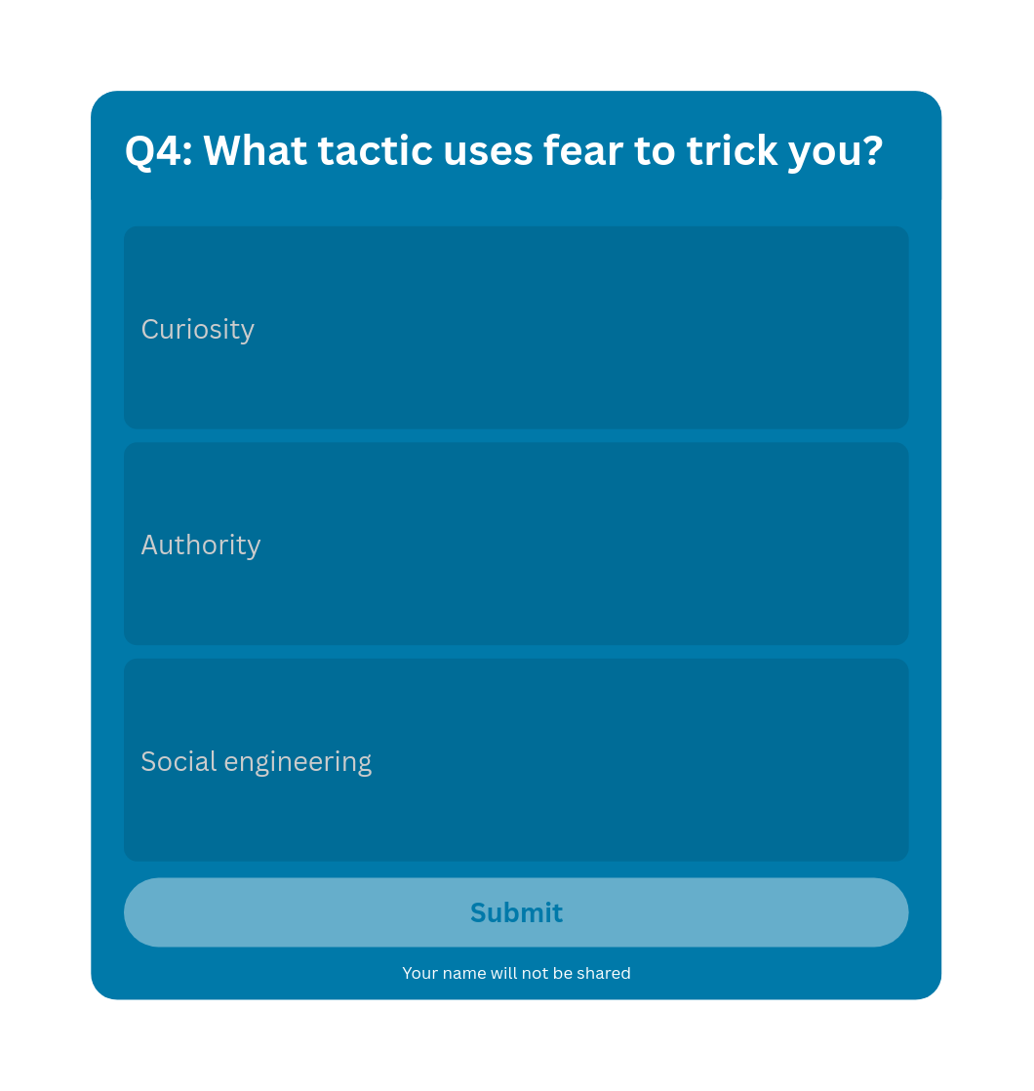

Slide 11
Conclusion & Key Takeaways
Phishing is a serious threat, even to students.
Stay alert and question unexpected messages.
Use tools and knowledge to protect yourself.
Share what you’ve learned with friends!

Slide 12
Resources & Reporting
Cybercrime Reporting Portal – India
Google Phishing Quiz
Report suspicious emails to: Your school’s IT department or email provider

