Slide 1
Apartment Management System
Submitted to -
Prof. B.Nath
Submitted by –
Ayush Bajpai (CSM23043)
Akhilesh Yadav (CSM23011)

Slide 2
INTRODUCTION
Resident & Visitor Tracking: Manages apartment details, resident information (owners or tenants), and visitor records.
Vehicle Entry & Exit Control: Tracks vehicle movements for secure entry and exit of residents and visitors.
User Roles & Permissions: Enables roles like Secretary and security staff to manage access and data.
Centralized Data Management: Streamlines data storage and access, ensuring efficient and organized record-keeping.
Enhanced Security & Convenience: Provides a secure, user-friendly platform to support daily apartment operations and access control.

Slide 3
Project Approach For Apartment Management System
Requirements: Manage tenants, family members, visitors, and vehicle entry/exit.
EER Modeling: Create an Extended Entity-Relationship diagram to define relationships among entities.
Normalization: Normalize the database to 4NF for data integrity and efficiency.
Data Management: Implement user login/logout and store tenant and family member information.
Security: Incorporate user management security features.
Technology Stack: Utilize MySQL for database management, HTML for front end.

Slide 4
Requirements
The document provides a comprehensive structure for an Apartment Management System, detailing the management of apartments, owners, tenants, vehicles, family members, visitors, and system users. It specifies functions for adding, viewing, updating, and logically deleting records across these categories. Apartment and owner information include details like occupancy status and identification, while tenant records cover rental periods and emergency contacts. Vehicle management tracks details for owners, tenants, and visitors, with logs for entries and exits, and driver information is maintained for additional security. Visitor management includes check-in/out records and purpose of visits. Lastly, user management allows for role assignment, authentication, password recovery, and deactivation, ensuring secure access control within the system.

Slide 5
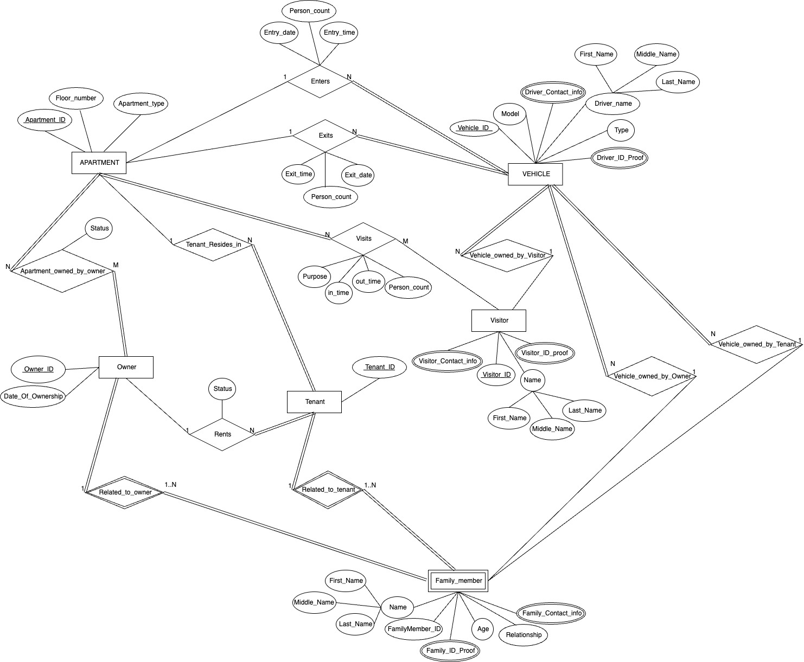
fig.1. ER-Diagram

Slide 6
ER-Diagram for Apartment Management System
The Apartment Management System ER diagram represents a structured approach to managing residential apartments, focusing on entities like Apartment, Owner, Tenant, Visitor, Vehicle, and Family Member. Each apartment can be owned by an Owner or rented by a Tenant, with details about ownership and tenancy recorded in the system. Vehicles are linked to Owners, Tenants, or Visitors, allowing tracking of vehicle entries and exits. Visitors can register their visits, specifying details like the purpose and duration. Family Members are associated with both owners and tenants, capturing personal details and relationships. The system centralizes apartment-related data, enhancing security and providing an organized, efficient way to manage apartment access, vehicle movement, and resident information.

Slide 7
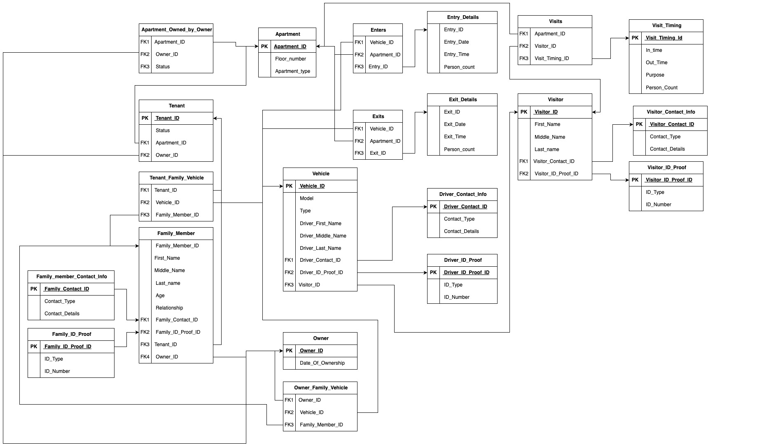
fig.2. Relational Model

Slide 8
Relational Model Structure
This Apartment Management System relational model is designed to efficiently organize and manage data related to apartments, residents, visitors, vehicles, and access control.
Apartment: Basic details for each apartment, linked to either Owner or Tenant records.
Owner and Tenant: Capture ownership and tenancy information, allowing apartments to be assigned to individuals with specific roles.
Vehicle: Manages vehicle data linked to either owners, tenants, or visitors, including driver and ID proof information.
Entry and Exit Details: Track vehicle entry and exit events with timestamps and person count, enhancing security.
Visitor and Visit Timing: Record visitor information, purpose, and visit times.
Family Member: Stores family details associated with tenants or owners.
Contact and ID Proof tables: Manage contact and identity verification information separately for enhanced data integrity.
The model uses foreign keys and linking tables to maintain relationships and avoid redundancy, achieving up to 4NF normalization, which ensures efficient data storage and retrieval while supporting complex relationships.

Slide 9
Data Dictionary
Attribute | Data Type | Field Size | Remark | Example Value
Family_Contact_ID | INT | 10 | Primary Key | 11001
Contact_Type | VARCHAR | 20 | Type of contact (e.g., Phone or Email) | "Phone"
Contact_Details | VARCHAR | 100 | If Contact is "Phone": 10-digit only If Contact is "Email": email format | ”6384484961" or ”csm23043@gmail.com"
Attribute | Data Type | Field Size | Remark | Example Value
Tenant_ID | INT | 10 | Primary Key | 1001
Status | VARCHAR | 15 | Current status of tenant | "Active"
Apartment_ID | INT | 10 | Foreign Key to Apartment | 2002
Owner_ID | INT | 10 | Foreign Key to Owner | 3003
Attribute | Data Type | Field Size | Remark | Example Value
Vehicle_ID | INT | 10 | Primary Key | 5001
Model | VARCHAR | 30 | Vehicle model name | "Toyota Corolla"
Type | VARCHAR | 15 | Type of vehicle (e.g., Sedan, SUV) | "Sedan"
Driver_First_Name | VARCHAR | 30 | Driver’s First Name, should match driver's ID proof | ”Ayush"
Driver_Contact_ID | INT | 10 | Foreign Key to Driver_Contact_Info | 6001
Visitor_ID | INT | 10 | Foreign Key to Visitor, if vehicle is associated with a visitor | NULL
Attribute | Data Type | Field Size | Remark | Example Value
Visitor_ID | INT | 10 | Primary Key | 7001
First_Name | VARCHAR | 30 | Visitor's first name | ”Aniket"
Middle_Name | VARCHAR | 10 | Optional, visitor's middle name | ”Singh."
Last_Name | VARCHAR | 30 | Visitor's last name | ”Yadav"
Visitor_Contact_ID | INT | 10 | Foreign Key to Visitor_Contact_Info | 8001
Visitor_ID_Proof_ID | INT | 10 | Foreign Key to Visitor_ID_Proof | 9001

Slide 10
Data Dictionary
Tenant Table
Tenant_ID and other ID fields use a length of 10 for accommodating unique, auto-incrementing numbers. Status is set to VARCHAR(15) to allow status descriptions like "Active" or "Inactive" without wasting space.
Vehicle Table
Model is set to VARCHAR(30) to fit typical vehicle names, while Type uses VARCHAR(15) to cover types like "SUV" or "Sedan." The ID fields again use 10 to ensure ample space for unique keys without excessive allocation.
Visitor Table
First_Name, Middle_Name, and Last_Name are limited to VARCHAR(30) to capture full names without excess, based on common name lengths. ID fields use 10, consistent with the other tables for simplicity in relational referencing.
Family_Member_Contact_Info Table
Contact_Type is set to VARCHAR(20) for values like "Phone" or "Email." Contact_Details is VARCHAR(100) to support both 10-digit phone numbers and longer email addresses, balancing flexibility with data integrity.

Slide 11

Thank You

