Slide 1

GitHub Governance
Intelligence
Turning enterprise audit logs into explainable findings
A complete audit trail records what happened.
The governance layer shows what deserves attention and why.
Ayush Baranwal
GitHub Platform Engineering, Developer Tooling All Hands
01
Notes:
Timing: about 60 seconds.
Open with the distinction between a complete audit trail and a reviewable governance signal.
Set the scope: the session covers the problem, the architecture, how priorities remain explainable, a short demo, and one future AI concept.
Do not start with BigQuery or Grafana. Start with the operational question: what deserves attention and why?
The cover visual is illustrative and does not show a production interface.

Slide 2

The signal-to-noise problem at enterprise scale
The audit stream is complete, but manual review cannot prioritize it
650+
11K+
~365K
~3M
GitHub organizations
repositories
audit events per day
events per week
The platform retains every source event while ranking the smaller set of governance findings.
GitHub Governance Intelligence
02
Notes:
Timing: about 75 seconds.
Use the scale numbers to establish why manual inspection is not sustainable: 650+ organizations, 11K+ repositories, about 365K events per day and roughly 3M per week.
The problem is prioritization. The platform keeps the full audit evidence but creates a smaller, explainable review surface.
Avoid claiming a measured reduction in review time unless you have validated it after production use.
The event-stream illustration is conceptual and contains no production data.

Slide 3

A raw event records facts, not review meaning
Illustrative example: a technical account is suspended
RAW AUDIT EVENT
user.suspended
actor
admin-user
affected identity
runner-tech-account
scope
enterprise
Context needed before review
1
Is the identity registered as business critical?
2
Was this suspension expected and approved?
Technical account suspended
3
Which services or runner environments depend on it?
Critical identity context promotes this suspension to CRITICAL
GitHub Governance Intelligence
03
Notes:
Timing: about 75 seconds.
State clearly that the values on this slide are illustrative and not a live incident.
Use the runner technical-account suspension as one concrete example, then broaden the point to security controls, branch policies, access and GitHub Apps.
The platform needs registries and rules to turn an audit fact into an operationally meaningful review item.
The service-account illustration is conceptual and not a production incident.

Slide 4
Architecture and evidence lineage
Each layer adds context while retaining the source event
GH
GitHub Enterprise
GCS
GCS landing zone
N
Normalize
C
Classify
UI
Grafana and reports
Enterprise audit events
Raw files by environment
github_audit_events_
normalized
github_governance_
events
Queues, drilldowns, exports
Rule catalogue
Exception register
Event type, base priority, review reason
Approved actor, scope, override and owner
Traceability retained: event_key, source_file, rule_id, rule_version and review_reason
GitHub Governance Intelligence
04
Notes:
Timing: about 90 seconds.
Walk left to right. GitHub audit data lands in GCS, the processing layer normalizes it, the classifier adds governance meaning in BigQuery, and Grafana exposes the review experience.
Call out the two control inputs: a versioned rule catalogue and an approved exception register.
Emphasize that event_key and source_file preserve drill-back to the original evidence.

Slide 5
The classifier makes every priority explainable
One technical action can lead to different review outcomes when context changes
RAW ACTION
RULE MAPPING
BASE PRIORITY
CONTEXT CHECK
protected_branch.
policy_override
Protected branch
policy override
HIGH
Does an active approved
automation exception match?
Policy bypass requires review
No matching exception
Approved automation matches
Final priority: HIGH
Visible in the review queue
Final priority: LOW
Still visible with exception reason
Every finding retains the event, rule version, final priority and review reason
GitHub Governance Intelligence
05
Notes:
Timing: about 90 seconds.
Use one branch-policy override to explain the classifier. The raw action maps to a governance event type and base priority before the exception register applies.
The same action stays HIGH for a normal actor but can become LOW for an approved automation identity. The event remains visible and the reason is attached.
Mention that the event catalogue and final priority choices should continue through stakeholder review. The mechanism is stable; the policy decisions remain governable.

Slide 6

Three user journeys organize the governance experience
Six dashboards support awareness, investigation and evidence without overwhelming users
1
AWARENESS
2
INVESTIGATION
3
EVIDENCE
What needs attention?
What happened and who acted?
Why was it classified?
Overview + Advanced Security
Repository + User Activity
Reports + Classifier Operations
GitHub Governance Intelligence
06
Notes:
Timing: about 75 seconds.
Explain the dashboards by user journey rather than reading six product names as a list.
Overview and Advanced Security answer what needs attention. Repository and User Activity support investigation. Reports and Classifier Operations provide evidence and operational transparency.
Mention that specialist dashboards remain outside the main path unless regular use justifies them.
The engineering-workspace image is illustrative; it does not depict an actual bank environment.

Slide 7

Use cases that matter to platform teams
The same curated model supports security, identity, policy and evidence questions
SECURITY CONTROLS
ACCESS AND IDENTITY
CODE AND WORKFLOW POLICY
APPROVED AUTOMATION
Was a mandatory control disabled?
Did a critical account lose access?
Who bypassed a protected policy?
Was the change expected and approved?
GitHub Governance Intelligence
07
Notes:
Timing: about 75 seconds.
Pick two examples that match the room. For developer tooling, security-control changes and branch or workflow policy changes usually resonate.
Use the technical-account suspension as the runners example, but keep the platform broader than runner-specific monitoring.
Approved automation remains a core governance use case because expected changes must stay visible without dominating the review queue.
The four scenarios are illustrative representations rather than screenshots of production events.

Slide 8

Live demo: answer one question end to end
Was a security control disabled, who changed it, and was it expected?
1
2
3
4
OVERVIEW
REPOSITORY
ACTOR + EXCEPTION
EVIDENCE
Find the signal
Inspect the change
Check context
Prove the answer
GitHub Governance Intelligence
08
Notes:
Timing: 4 to 6 minutes for the live demo.
Bookmark one useful non-sensitive security event in advance. Follow the same event through the four screens instead of opening every dashboard.
Show the Overview queue, repository context, actor or exception context, then evidence export and source lineage.
Keep a prepared BigQuery query as a fallback if Grafana is slow, but do not type complex SQL live.
The screen sequence is an illustrative guide to the demo path, not a literal capture of the dashboards.

Slide 9

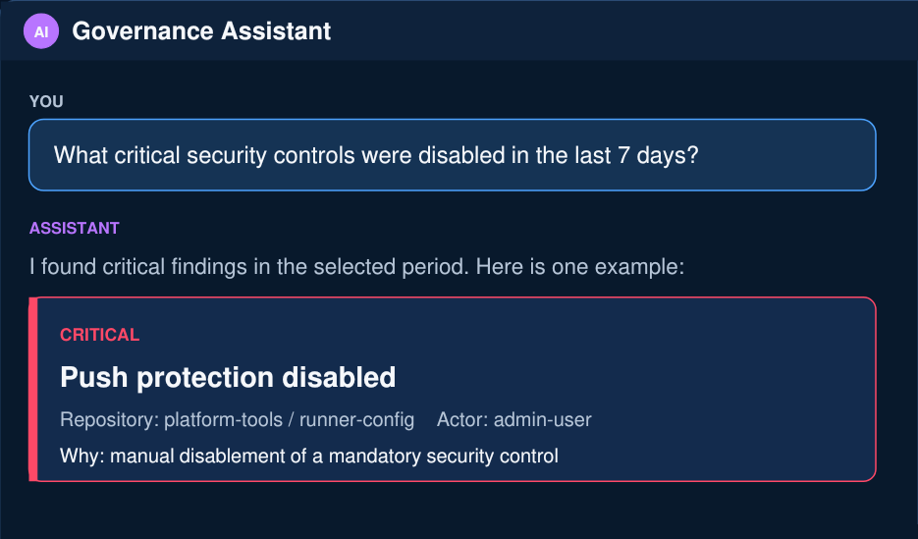
AI could make the same evidence conversational
Illustrative future concept: read-only answers over curated governance data
FUTURE CONCEPT
Ask one governance question
“Which critical controls were disabled this week?”
READ ONLY
The first version cannot change configuration.
EVIDENCE SHOWN
Every answer links to the source event and rule.
NO UNSOURCED ANSWERS
The assistant responds only when evidence exists.
GitHub Governance Intelligence
09
Notes:
Timing: about 90 seconds.
Label this clearly as an illustrative future concept. The UI and example finding are not a live implementation or real incident.
The first version should remain read-only and query curated governance tables, not raw audit JSON.
Every answer should show the source event, rule id, rule version and review reason. The user should be able to open the event, repository and evidence directly.
Guardrails: no write actions, no hidden evidence, and no answer without a traceable source.
The workstation is an illustrative mockup. The embedded interface represents the proposed experience rather than a released product.

Slide 10

Next decisions
Validate event priorities, then add targeted alerts and review ownership
AVAILABLE TODAY
Curated High and Critical queues
Explainable rule and exception decisions
Validate the event priority catalogue
Agree what each priority means with platform, security and governance stakeholders.
Alert only on agreed critical signals
Start with technical account suspension, mandatory control disablement and processing failure.
Add review ownership, then pilot AI
Create the evidence workflow before introducing a read-only assistant.
Which governance question does your team still answer manually?
GitHub Governance Intelligence
10
Notes:
Timing: about 75 seconds, then discussion.
Summarize the current value without inventing adoption or time-saving metrics.
The immediate next decision is the stakeholder-reviewed event-priority catalogue. Alerts should follow the agreed semantics, not precede them.
Close by asking teams for a governance question they still answer manually. This gives you concrete use cases for the next iteration.
The collaboration image is illustrative and does not show a real bank meeting or production dashboard.

