Slide 1
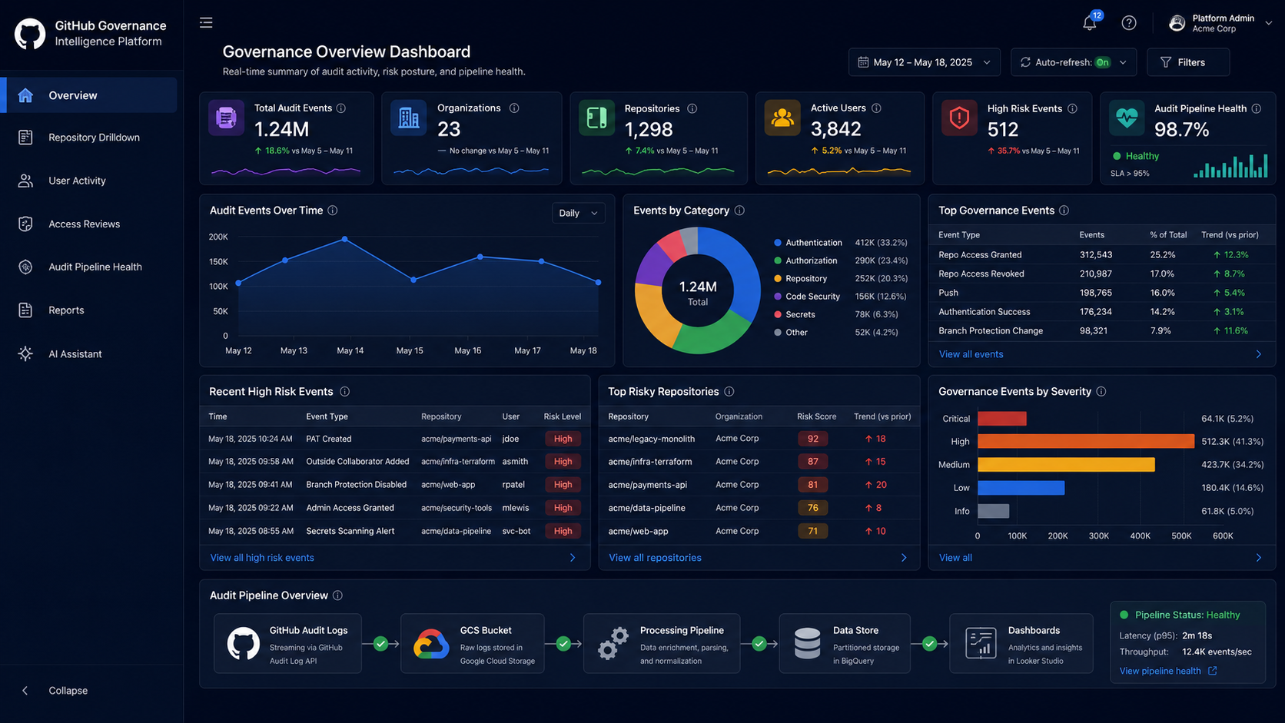
GitHub Governance
Intelligence Platform
Turning GitHub Enterprise audit logs into governance visibility, audit readiness, and self-service investigation.
Manager / Product Owner Discussion
GitHub Governance Intelligence Platform
01

Slide 2
OPPORTUNITY
Audit logs are stored — now make them actionable
Move from passive retention to a product capability for platform, compliance, and product stakeholders.
Current state
Target state
Business value
• GitHub audit logs already land in GCS
• Chronicle path handles security detections
• Product/platform teams still need self-service visibility
• Manual investigation and reporting remain time-consuming
• Independent read-only governance processor
• Clean normalized audit-event data
• Dashboards for governance and pipeline health
• Repeatable compliance evidence reports
• Faster “who changed what?” answers
• Better audit readiness
• Reduced ad-hoc queries to platform/security
• Clear product value from existing data
GitHub Governance Intelligence Platform
02

Slide 3
SCOPE DEFINITION
How the scope is defined
A narrow, useful MVP that avoids overlap with existing Chronicle/SecOps ownership.
1. Ownership boundary
2. Data boundary
3. MVP value boundary
Chronicle remains the owner for broker-bypass detection, SIEM correlation, security alerts, incident response, and SOC workflows.
This platform owns governance visibility, data quality, reports, and review context.
The first version uses audit logs already stored in the existing GCS bucket. No new source system and no change to the Chronicle forwarding path.
Start with high-value governance questions: access changes, external collaborators, repo visibility, branch protection, and pipeline health.
Non-goals for MVP: security alert replacement, broad anomaly detection, free-form AI over raw logs, write/remediation actions.
GitHub Governance Intelligence Platform
03

Slide 4
STAKEHOLDER VALUE
Who benefits, and what they get
A shared governance product rather than a one-off analytics dashboard.
Product Owner
Manager / Platform Lead
Compliance / Audit
Roadmapable product capability: governance dashboards, reports, and future AI assistant.
Visible platform maturity: data quality, self-service investigation, reduced manual queries.
Repeatable evidence reports for access, visibility, branch protection, and stream health.
Security / Chronicle
Org / Repo Owners
Engineering Teams
Clear context and links without duplicating security detections or SOC workflows.
Repo drilldowns and timelines showing what changed, who changed it, and why review is needed.
Less back-and-forth; faster answers from approved self-service views.
GitHub Governance Intelligence Platform
04

Slide 5
DATA FOUNDATION
The event data already has the signals we need
The MVP can start from fields already available in GitHub audit-log events.
Identity & actor
Location & request
Org & repo context
Access signals
@timestamp, _document_id, actor, actor_id, user, user_id, external_id, external_identity_username
actor_ip, action_location, country_code, request_id, user_agent, transport_protocol_name
business, business_id, org, org_id, repo, repository, repository_id, repository_public
programmatic_access_type, hashed_token, token_id, request_access_security_header
What we derive
What we classify
What we report
Normalized timeline, dedupe key, event category, actor/repo/org drilldowns, pipeline health.
Privileged access, external collaborators, repo visibility, branch protection, audit-stream health.
Governance posture, evidence packs, review-needed items, top risky repos/users.
GitHub Governance Intelligence Platform
05

Slide 6
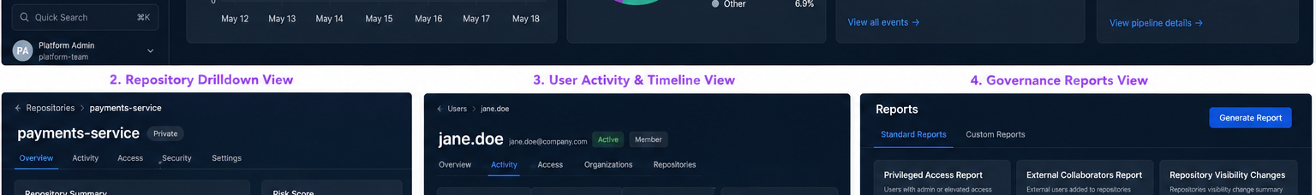
CAPABILITY ROADMAP
Four phases: from trusted data to AI-assisted investigation
Build value incrementally; AI comes after the data foundation and dashboards are trusted.
Phase 1 — Audit log pipeline
Phase 2 — Governance classification
Phase 3 — Dashboards & reports
Phase 4 — AI assistant
Read GCS files, parse, dedupe, normalize, store in BigQuery, track pipeline health.
Rules for access changes, repo visibility, branch protection, collaborators, stream health.
Grafana dashboards for overview, pipeline health, repo drilldown, and evidence reports.
Read-only investigation summaries with event IDs and approved tools only.
GitHub Governance Intelligence Platform
06

Slide 7
DASHBOARD CONCEPT
What managers and product owners will see
Start with two high-value dashboards; expand into repo/user drilldowns and reports later.
Dashboard 1: Pipeline Health
Last ingested file, ingestion lag, parse failures, duplicate rate, missing windows.
Dashboard 2: Governance Overview
High-risk governance events, top risky repos, access changes, event trends.
Next: Repo / User Drilldowns
Timelines, actors, changed settings, review-needed reasons, evidence exports.
Mockup shown for concept only; MVP can be implemented in Grafana first.
GitHub Governance Intelligence Platform
07

Slide 8
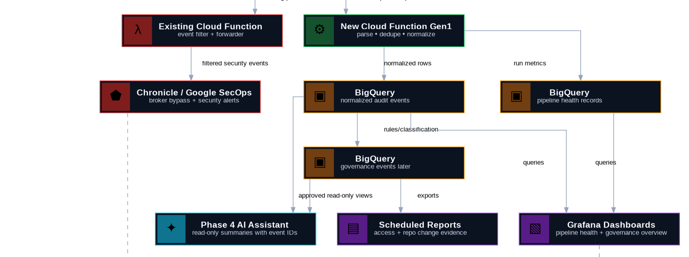
ARCHITECTURE
Independent governance path, existing Chronicle path unchanged
The new processor is read-only against the existing GCS bucket and writes only to the governance dataset.
Key point: this does not replace Chronicle. It creates a product/governance layer for visibility and reporting.
GitHub Governance Intelligence Platform
08

Slide 9
MVP PLAN
4–6 week MVP: prove usefulness with low implementation risk
Keep the first release narrow, read-only, and manager-demo friendly.
Week 1–2
Data foundation
Week 3
Governance rules
Week 4
Dashboards
Week 5–6
Reports + pilot
• Cloud Function Gen1 reads GCS files
• Parse .json.gz audit logs
• Normalize fields into BigQuery
• Write pipeline health records
• Classify 5 MVP event categories
• Start simple rule-based severity
• Generate review-needed events
• Pipeline Health dashboard
• Governance Overview dashboard
• Basic filters: org, repo, actor, action
• Weekly evidence report
• Pilot with platform/PO/security contact
• Gather feedback
GitHub Governance Intelligence Platform
09

Slide 10
SUCCESS MEASURES & ASK
What success looks like
A measurable product capability that builds on existing audit-log work.
Success metrics
Immediate decisions needed
Proposed ask
• % files processed successfully
• Ingestion freshness / lag
• Manual audit query time reduced
• # self-service investigations
• # automated evidence reports
• Stakeholder adoption/feedback
• Confirm MVP event categories
• Confirm first dashboard consumers
• Confirm BigQuery/Grafana access path
• Confirm Chronicle boundary
• Confirm pilot org/repo scope
Approve Milestone 1 implementation: independent Cloud Function Gen1 processor + BigQuery pipeline health + normalized audit-event table. No AI or alerting in the first release.
Recommended first demo: Pipeline Health + Governance Overview using a small real-data window.
GitHub Governance Intelligence Platform
10

