Slide 1
AMITY
UNIVERSITY
PATNA
quickCart
A Hyperlocal Quick-Commerce Mobile Application
Presented By
Under the Supervision of
Ayush (A45304825002) - BCA
Dr. Sushant Kumar Dubey
Amity Institute Of Information Technology, Patna
10 August, 2026

Slide 2

Internship Offer Letter
Ayush | quickCart E-Commerce App | Internship Project

Slide 3
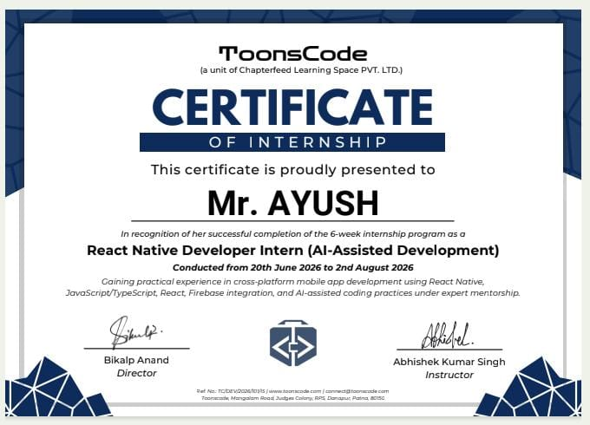
Internship Completion Certificate
Ayush | quickCart E-Commerce App | Internship Project

Slide 4
AMITY
UNIVERSITY
PATNA
Outline
Introduction
Problem Statement
Objectives
Conceptual Framework
Tools and Technologies
System Architecture
Modules and Implementation
Testing and Results
Future Scope
References

Slide 5
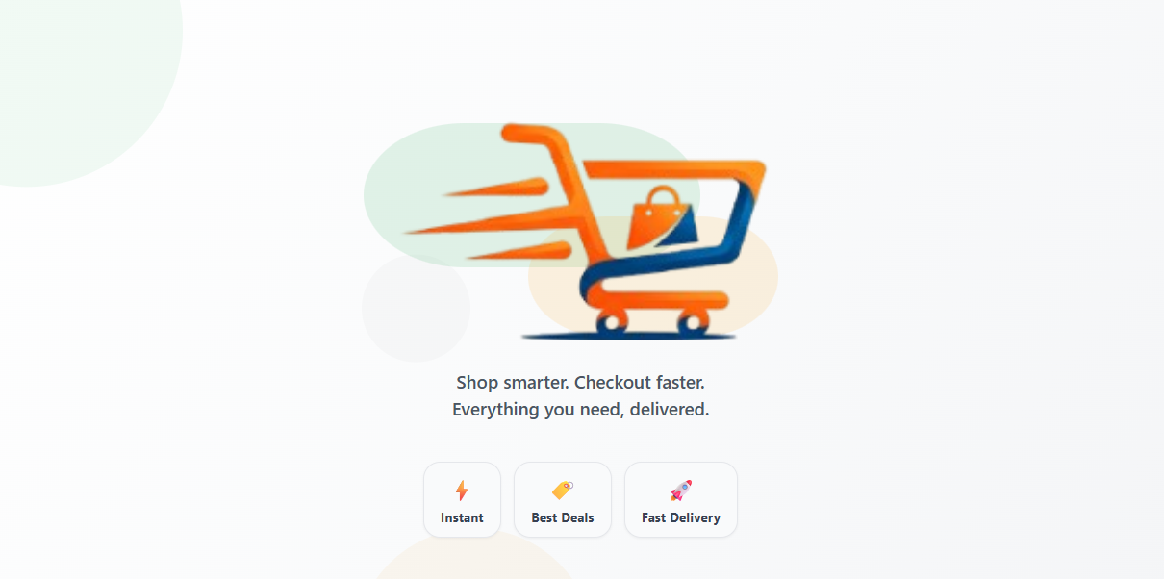
AMITY
UNIVERSITY
PATNA
Introduction
quickCart is a hyperlocal quick-commerce mobile application for groceries and daily essentials.
Users can select their state or city, browse products, add items to cart, and place Cash on Delivery orders.
The application uses Expo SDK 54, React Native, TypeScript, Firebase, and a role-based admin panel.

Slide 6
AMITY
UNIVERSITY
PATNA
Problem Statement
Local grocery ordering often lacks real-time inventory visibility and simple mobile ordering.
Small vendors need an easy way to manage products, categories, delivery cities, users, and orders.
Customers need a fast, location-aware platform for finding essentials and tracking delivery status.

Slide 7
AMITY
UNIVERSITY
PATNA
Objectives
Develop a cross-platform mobile app for grocery and essentials ordering.
Implement secure authentication with email, OTP verification, and password recovery.
Provide cart, checkout, address management, order history, and live order tracking.
Build an admin panel for product, category, city, user, and order management.

Slide 8
AMITY
UNIVERSITY
PATNA
Conceptual Framework
Customer side: onboarding, authentication, location selection, product discovery, cart, checkout, and order tracking.
Admin side: dashboard, CRUD operations, user role management, and order status updates.
Backend side: Firebase Auth, Firestore collections, Storage assets, security rules, and OTP email service.

Slide 9
AMITY
UNIVERSITY
PATNA
Tools and Technologies
Frontend: Expo SDK 54, React Native 0.81.5, Expo Router 6, TypeScript 5.9.
Backend: Firebase Authentication, Cloud Firestore, Firebase Storage, Firebase Functions.
Utilities: AsyncStorage, expo-image, expo-notifications, expo-location, nodemailer OTP server.
Build and testing: EAS Build, ESLint, TypeScript, Node test runner.

Slide 10
AMITY
UNIVERSITY
PATNA
System Architecture
Mobile App
Expo + React Native
Services Layer
Orders, Address,
Notifications
Firebase
Auth, Firestore,
Storage
Admin Panel
Inventory, Users,
Orders

Slide 11
AMITY
UNIVERSITY
PATNA
Application Flow
Splash
Login / Signup
OTP Verification
Location Picker
Home / Search
Cart
Checkout
Order Tracking

Slide 12
AMITY
UNIVERSITY
PATNA
Database / Collections
users: customer profiles, admin roles, push tokens.
products: product title, price, image, category, state, city, rating, availability.
categories: category names, icons, colors, order, visibility flags.
orders: items, totals, payment method, delivery address, status, timestamps.
states: delivery states, cities, nested banners/categories/products.

Slide 13
AMITY
UNIVERSITY
PATNA
Main Modules
Authentication Module: login, signup, OTP verification, forgot password.
Shopping Module: home feed, search, product detail, cart, checkout.
Order Module: order placement, status workflow, order history and tracking.
Admin Module: dashboard, products, categories, cities, users, and orders.
Notification Module: local/user notifications and admin order alerts.

Slide 14
AMITY
UNIVERSITY
PATNA
Testing and Validation
Unit tests validate the order status state machine.
Firestore smoke-test scripts verify database connectivity and expected collections.
Form validators are separated in utility modules for reuse across auth and address flows.
Firestore security rules and role checks restrict admin functionality.

Slide 15
AMITY
UNIVERSITY
PATNA
Expected Outcomes
A functional quick-commerce app with real shopping and checkout workflows.
Location-aware product browsing for Indian states and cities.
Real-time inventory and order administration for operators.
Improved customer convenience through quick ordering and order-status visibility.

Slide 16
AMITY
UNIVERSITY
PATNA
Future Scope
Online payment gateway integration such as UPI, cards, and wallets.
Delivery partner app with assignment, route tracking, and proof of delivery.
Recommendation engine based on purchase history and location trends.
Coupons, subscriptions, inventory alerts, analytics dashboard, and multi-vendor support.

Slide 17
AMITY
UNIVERSITY
PATNA
References
Expo SDK 54 Documentation: https://docs.expo.dev/versions/v54.0.0/
React Native Documentation: https://reactnative.dev/
Firebase Documentation: https://firebase.google.com/docs
Expo Router Documentation: https://docs.expo.dev/router/introduction/
Project source code and README: quickCart repository

Slide 18

AMITY
UNIVERSITY
PATNA
Thank You
Ayush (A45304825002) - BCA

