Slide 1
GSE FORECLOSURE
Disposition Analysis
Predicting Third-Party Sale vs REO Reversion at Auction
April 2026 | Technical Briefing

Slide 2
KEY FINDINGS
Executive Summary
0.80
10.2×
$63–128M
Test ROC-AUC (random split)
Top-decile / bottom-decile sale-rate spread
Projected annual value
1
Loan fundamentals and market context dominate
Top 5 drivers (state, equity, BPO discount, LTV, property type) account for ~60% of feature importance. The model identifies high-confidence sales before any auction marketing begins.
2
Auction venue is not a meaningful lever
Judicial vs non-judicial: 0.4pp gap. Online vs offline (indirect test): 3.4pp raw, but collapses to 0.18pp after controlling for market context — a market-selection effect, not a venue effect.
3
Decile-based triage is the operational lever
Bottom-2 deciles carry 84% REO rate. Targeted intervention there (early loss mitigation, mod-to-market) at 5–15% effectiveness yields $33–98M, plus $30M from top-decile efficiency.
GSE Foreclosure Analysis | April 2026
2 / 17

Slide 3
PROBLEM STATEMENT
The problem we set out to solve
When a foreclosed property goes to auction, two outcomes are possible:
OUTCOME A
OUTCOME B
3rd-party sale at auction
Reverts to REO
External bidder (typically an investor) buys the property at auction. Bank recovers value quickly, minimal carrying cost. Clean exit.
No qualifying bid received. Property reverts to lender ownership — bank now holds and manages real estate it never wanted. Estimated all-in cost: $50K–80K per property.
THE QUESTION
Given a foreclosure case at intake, can we predict which outcome will occur — and use that prediction to triage operations and intervene before auction?
GSE Foreclosure Analysis | April 2026
3 / 17

Slide 4
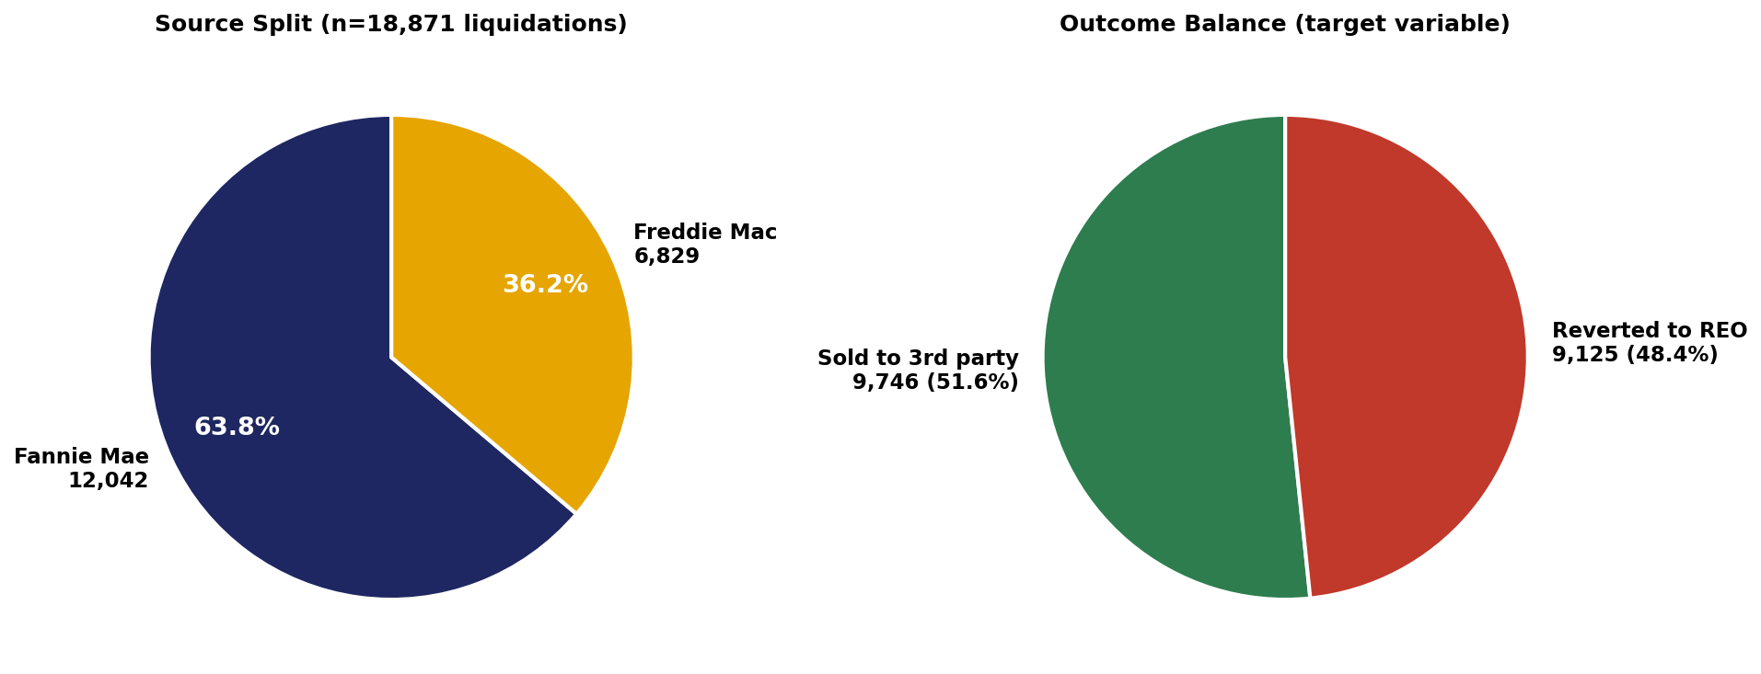
DATA & APPROACH
Data foundation
18,871
GSE foreclosure liquidations
2016–2024 dispositions
49
Quarterly source files
Fannie + Freddie loan-performance
30+
External data sources
FRED, FHFA, Census, Zillow, BLS, IRS
57
Engineered features
52 numeric + 5 categorical
Source split (left) and target balance (right)
GSE Foreclosure Analysis | April 2026
4 / 17

Slide 5
DATA & APPROACH
Why 30+ external sources?
Loan-only models reach AUC ~0.71. The remaining performance comes from external context — what investors see when deciding to bid. Sources are organized into 8 categories aligned with the investor decision framework.
A
Investor economics
B
Market supply & demand
C
Buyer psychology
D
Local economic conditions
Zillow ZORI, ZHVF, rent-to-price
Realtor.com inventory, FRED supply
UMich sentiment, inflation expectations
FHFA MSA HPI, BLS QCEW, IRS migration
E
Credit & capital markets
F
Distress & vacancy
G
Location risk
H
Neighborhood indicators
High-yield spread, lending standards
Vacancy rates, SF delinquency
FEMA NRI (county hazard scores)
Census ACS — investor density, leverage
GSE Foreclosure Analysis | April 2026
5 / 17

Slide 6
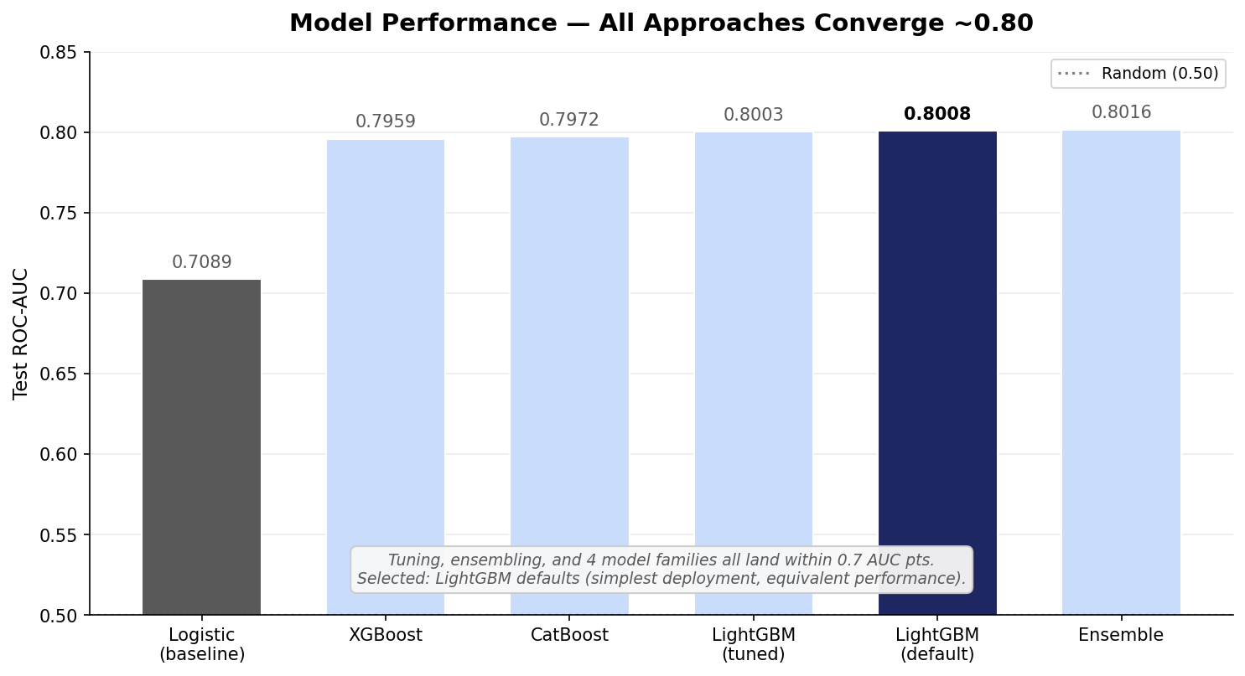
KEY FINDINGS
Model performance — 0.80 AUC, validated across approaches
What this means
All four GBT libraries land within 0.7 AUC pts of each other.
40-trial Optuna tuning produced no improvement — defaults were already optimal.
Ensembling: +0.0008 AUC. Not worth 3× deployment overhead.
Selected: LightGBM with default hyperparameters. Simplest, equivalent.
Time-aware split (train 2016-22, test 2023-24): AUC drops to 0.7365 — sensitivity to macro regime shift. Argues for quarterly retraining.
GSE Foreclosure Analysis | April 2026
6 / 17

Slide 7
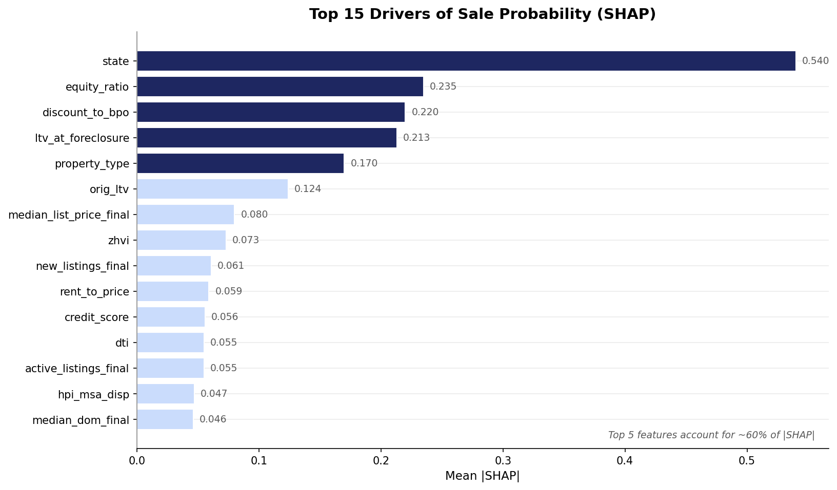
KEY FINDINGS
What drives whether a property sells?
Top 5 drivers explain ~60%
1
State
AZ/UT/NV: 75-81% sell. Late-cycle Midwest: <40%.
2
Equity ratio
More equity → investor will bid.
3
Discount to BPO
Auction starting price relative to market value.
4
LTV at foreclosure
Debt overhang — high LTV → REO.
5
Property type
SFR sells more than condo or manufactured.
GSE Foreclosure Analysis | April 2026
7 / 17

Slide 8
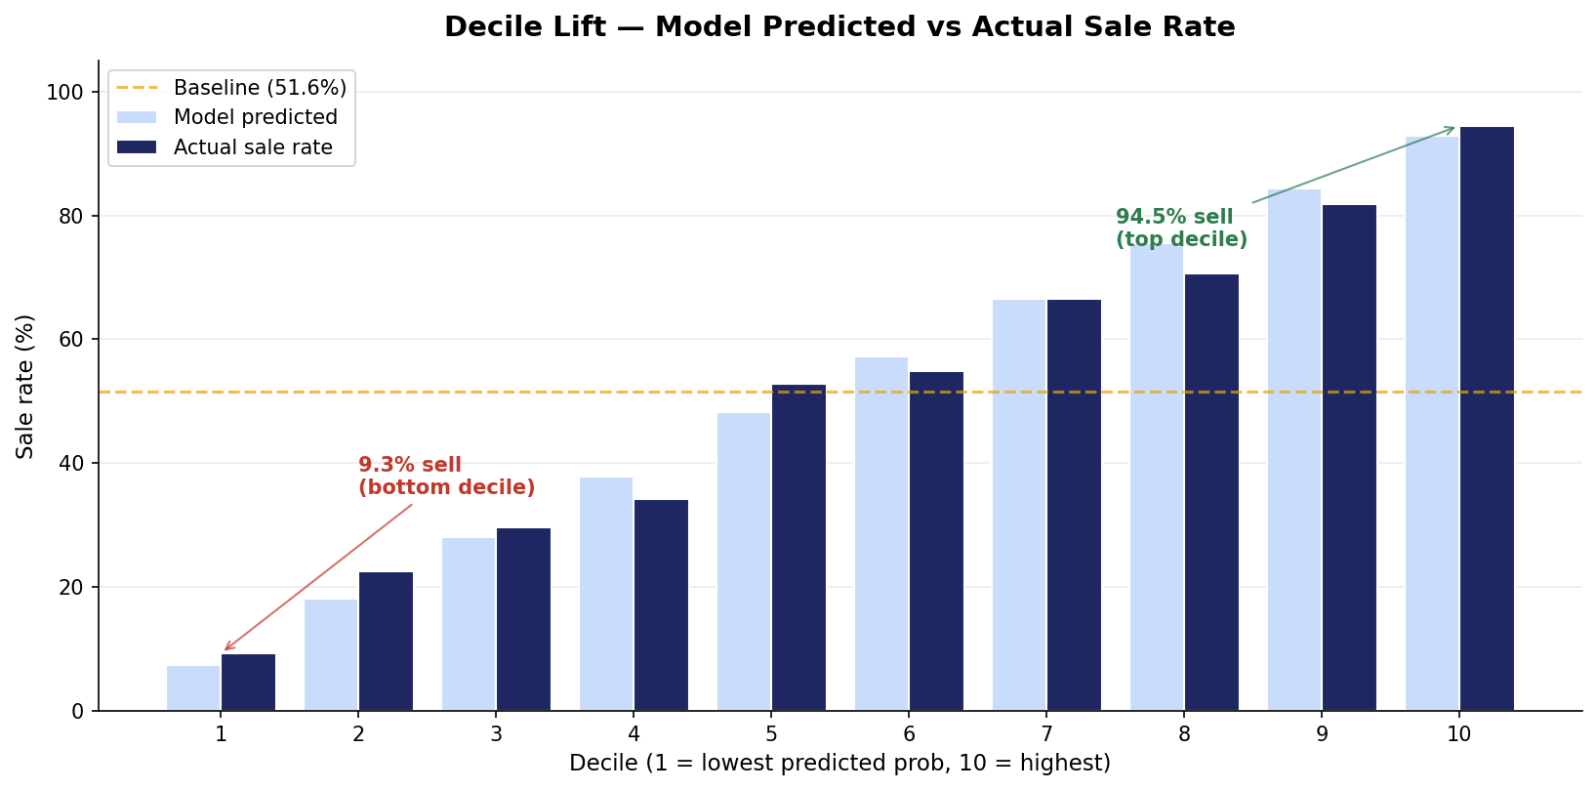
KEY FINDINGS
The operational lever — decile-based triage
How to use this
TOP 2 DECILES
88–95% sell rate. Auto-process. Minimal marketing.
MIDDLE 6 DECILES
Standard protocol. Most uncertainty, where effort moves the needle.
BOTTOM 2 DECILES
9–23% sell rate. Active intervention. Begin REO ops prep.
10.2× spread between top decile (94.5%) and bottom decile (9.3%) sale rates.
GSE Foreclosure Analysis | April 2026
8 / 17

Slide 9
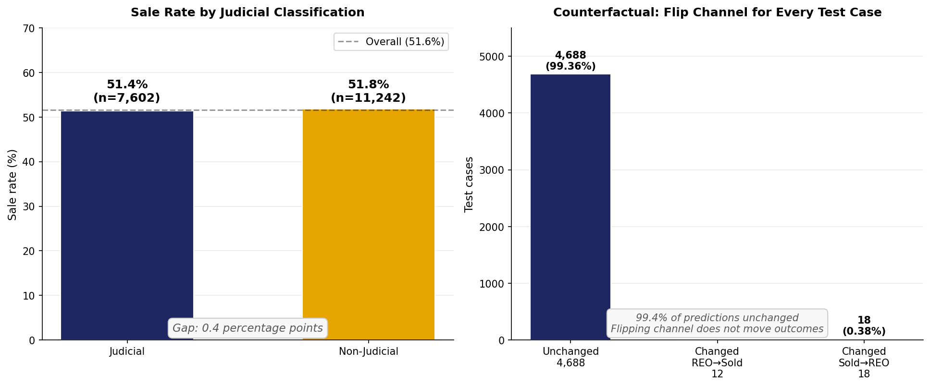
KEY FINDINGS
Does the auction venue matter? — Test 1
Test 1: Judicial vs Non-Judicial state classification
Does the state's legal foreclosure framework drive disposition outcome?
Finding: 0.4pp gap between judicial and non-judicial. Counterfactual flip changes only 12 of 4,718 predictions (0.25%).
GSE Foreclosure Analysis | April 2026
9 / 17

Slide 10
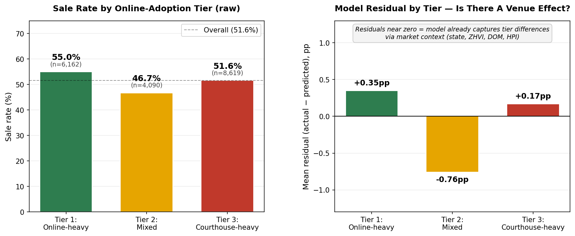
KEY FINDINGS
Does the auction venue matter? — Test 2
Test 2: Online vs offline (indirect, via state platform-adoption tier)
GSE data does not record actual venue. We grouped states by online-platform adoption and compared raw rates AND model residuals.
Finding: Raw 3.4pp gap collapses to 0.18pp once market context is controlled for. The apparent venue effect is market-selection.
GSE Foreclosure Analysis | April 2026
10 / 17

Slide 11
KEY FINDINGS
Venue is not the lever
0.4 pp
0.25%
3.4 → 0.18 pp
Judicial vs Non-Judicial sale rate gap
Of cases would change outcome if channel was flipped
Online-vs-offline raw → residual gap
A statistical wash; selection effect across states.
12 of 4,718 test predictions move; 99.4% unchanged.
After market context, the gap is 95% explained away.
WHAT WE CANNOT DEFINITIVELY ANSWER
GSE data does not record actual auction venue. Our online-vs-offline test uses state-level platform-adoption tiers as a proxy. To test venue rigorously requires -internal auction-venue records joined to disposition outcomes — a 4-6 week analytical project.
GSE Foreclosure Analysis | April 2026
11 / 17

Slide 12
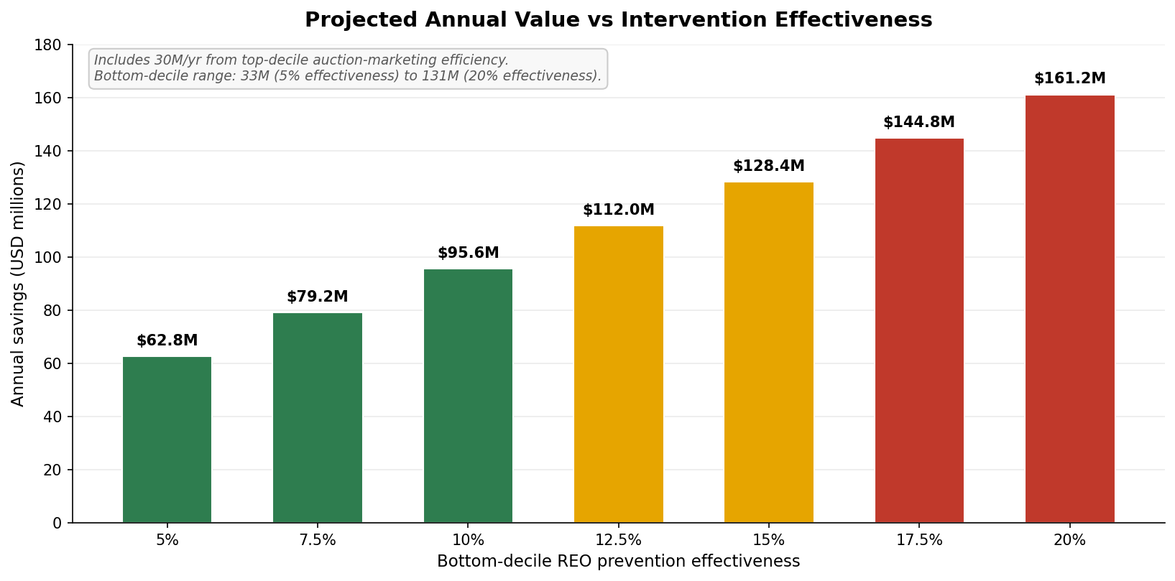
BUSINESS IMPACT
Sizing the opportunity
Combined annual upside
Low (5% effectiveness)
$62.8M
Mid (10%)
$95.6M
High (15%)
$128.4M
Includes $30M/yr from top-decile auction-marketing efficiency. Bottom-decile component scales linearly with intervention success rate.
Assumes: $65K/REO holding cost · 200K US GSE foreclosures/yr · 30% share · 84% bottom-decile REO rate. Replace with internal numbers before commitment.
GSE Foreclosure Analysis | April 2026
12 / 17

Slide 13
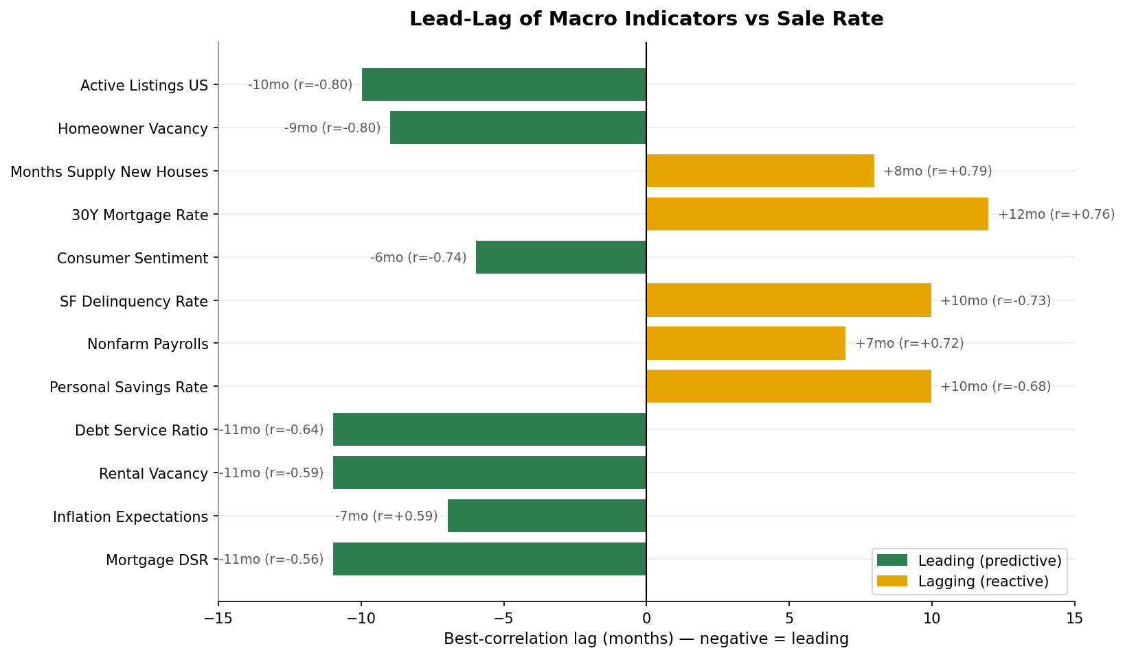
KEY FINDINGS
Macro indicators that lead the sale rate
Forward indicators
Six macro signals move 6–11 months BEFORE the disposition outcome:
Active US listings
Homeowner vacancy
Consumer sentiment
Debt service ratio
Rental vacancy
Inflation expectations
Operationally
Use as forward signals to scale bottom-decile triage staffing 6–11 months ahead of REO-rate spikes.
GSE Foreclosure Analysis | April 2026
13 / 17

Slide 14
CASE STUDIES
Two real test-set examples
CASE A — HIGH-CONFIDENCE SALE
CASE B — HIGH-CONFIDENCE REO
Predicted: 0.986
Predicted: 0.011
Actual: SOLD ✓
Actual: REVERTED TO REO ✓
Profile
Profile
Florida, owner-occupied
$84K loan, originated 2016, 80% LTV
Disposed April 2022
Minnesota, owner-occupied
$167K loan, originated 2018, 84% LTV
Credit 799, DTI 48 (high stress at origination)
Why the model said SELL
Why the model said REVERT
LTV at foreclosure: 0.43 (heavy de-leverage via appreciation)
BPO discount: 54.9% (deep auction starting price)
Hot Florida ZIP, ZHVI $546K, 26-day metro DOM
Minnesota historically low sale rate (29%)
Persistent debt stress (high origination DTI)
Disposition-period market unfavorable
GSE Foreclosure Analysis | April 2026
14 / 17

Slide 15
OPERATIONALIZING
From research to production — how this becomes a 2026 capability
The model can score any 2026 case at intake today. Two layers of work turn it into a production capability.
LAYER 1
LAYER 2
Scoring pipeline
Quarterly retraining
6–11 weeks of engineering
3–5 days per quarter
Intake adapter — pulls new cases from foreclosure system
Feature joiner — pulls fresh macro + market context
Scoring service — REST API or batch job for ops systems
Monitoring — score drift detection, feature coverage alerts
UI integration — surfaces score and decile to case manager
Pull new GSE disposition data (Fannie + Freddie quarterly)
Refresh external sources (FRED, Zillow, ACS, Realtor.com)
Rebuild feature matrix (automated pipeline)
Retrain LightGBM with same hyperparameters
Validate on holdout before promoting to production
Result: every 2026 case gets a probability of sale and decile assignment at intake.
Without retraining: AUC drifts from 0.80 → 0.74 in one year. With it: stays at 0.80.
Team needed: 1 data scientist · 0.5–1 ML engineer · 0.5 data engineer · 1 product/ops owner. If not in-house: contract, consulting partner, or managed ML platform.
GSE Foreclosure Analysis | April 2026
15 / 17

Slide 16
NEXT STEPS
Recommendations
SHORT-TERM
Validate cost assumptions internally — replace $65K/REO and 30% market share with actuals
Pilot decile triage on 6–8 weeks of incoming cases without operational change
Identify the BPO data integration owner — highest-leverage data improvement
next 30–90 days
MEDIUM-TERM
Productionize the model with quarterly retraining
Stand up a triage workflow tied to the score
Replace BPO proxy with real BPO data (+0.02–0.04 AUC improvement)
3–6 months
LONG-TERM
Test online-vs-offline rigorously with internal venue records
Extend to non-GSE portfolios (FHA, VA, private-label)
Add full property-characteristic data (ATTOM, CoreLogic, MLS)
6–12 months
GSE Foreclosure Analysis | April 2026
16 / 17

Slide 17
THREE THINGS TO REMEMBER
Foreclosure outcomes are predictable —
and the lever is loan + market, not auction venue.
01
02
03
AUC 0.80
Venue isn't the lever
$63–128M annual upside
on a model that achieves 10× lift between top and bottom deciles.
0.4pp judicial gap; 0.18pp residual online-vs-offline.
from decile-based triage on existing caseload.
Discussion · Q&A

