Slide 1
DAA ASSIGNMENT 5 Group No 19
AYUSH KHANDELWAL (IIT2019240)
AYUSH BHAGTA (IIT2019501)
TAUHID ALAM (BIM2015003)

Slide 2
Contents -
Problem Statement
Introduction
Proposed Algorithm
Illustration
Time and space complexity analysis
Conclusion
References

Slide 3
Problem Statement
In this report we designed a Dynamic Programming algorithm to find the number of subsets of given array of n elements arr[] having XOR of elements as a given number K.

Slide 4
Introduction
Given an array arr[] of size n ,we will use dynamic programming approach to find the number to elements having XOR value as K.Here in dp[i][j] we keep a count of number of sets from 0 to i-1 having XOR value as j. At the end the program we will give dp[n][k] as output.
Dynamic Programming is mainly an optimization over plainrecursion. Wherever we see a recursive solution that hasrepeated calls for same inputs, we can optimize it using Dynamic Programming. The idea is to simply store the results of sub-problems, so that we do not have to re-compute them when needed later. This simple optimization reduces time complexities from exponential to polynomial.

Slide 5
ALGORITHMIC DESIGN
Following is Dynamic Programming algorithm
• We initialize all values of dp[i][j] as 0.
• Set value of dp[0][0] = 1 since XOR of an empty set is 0.
• Iterate over all the values of arr[i] from left to right and
for each arr[i],iterate over all the possible values of XOR
i.e. from 0 to m (both inclusive).
Here m is maximum possible value for XOR of any of possible subsets. To
calculate m, we take maximum element from array and
m = (1 << (int)(log2(max) + 1)) − 1;

Slide 6
• Fill the dp array as following:
for i = 1 to n:
for j = 0 to m:
dp[i][j] = dp[i − 1][j] + dp[i − 1][j⊕arr[i − 1]]
• This can be explained as, if there is a subset arr[0. . . i-2] with XOR value j, then there also exists a subset arr[0. . . i-1] with XOR value j also if there exists a subset arr[0. . . .i-2] with XOR value j ⊕ arr[i] then clearly there exist a subset arr[0. . . i-1] with XOR value j, as:
j ⊕ arr[i − 1] ⊕ arr[i − 1] = j.
• Counting the number of subsets with XOR value k: Since dp[i][j] is the number of subsets having j as XOR value from the subsets of arr[0..i-1], then the number of subsets from set arr[0..n] having XOR value as K will be dp[n][K]

Slide 7
Illustration
Let’s take a array arr = [1, 2, 3, 4] and K=6
Firstly we initialize dp array as 0.
dp[i][j] = 0(for all i<n && j<n)
here in dp[i][j] we keep a count of number of subsets from 0 to i-1 having XOR value as j
n = sizeof(arr)
dp[0][0] = 1(Empty set)
Now take max element from array and use it to calculate maximum possible XOR value(m).
max=4
m = (1<<(int)(log(4)+1))-1
m = 7
Now we Iterate over all values of arr[i] from i=1 to i=n-1.Then
for each iteration ,we also iterate over all values of XOR.

Slide 8
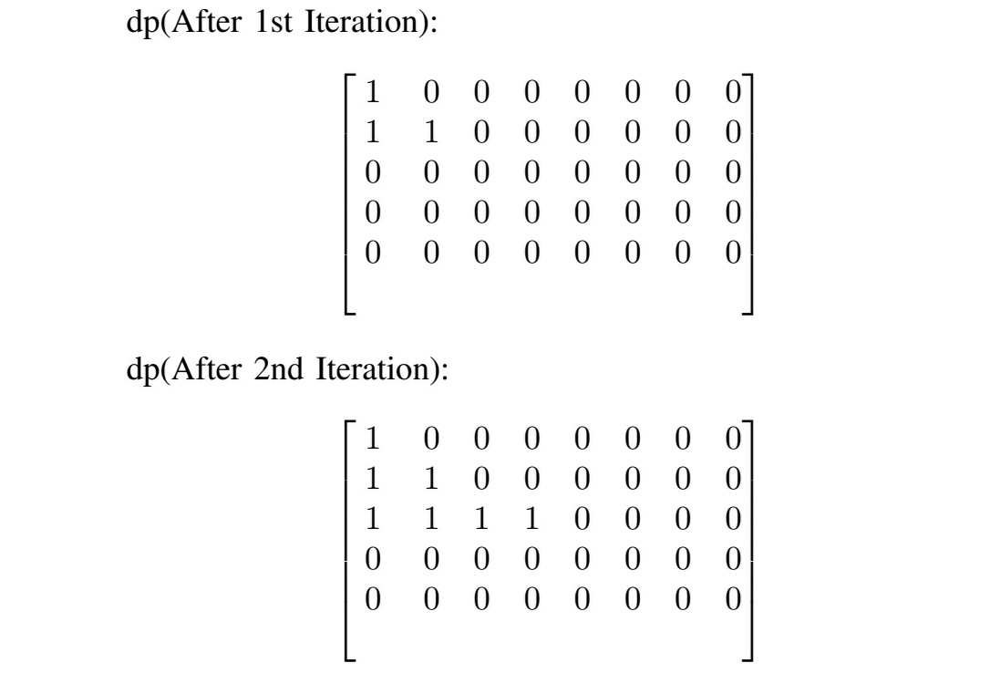

Slide 9
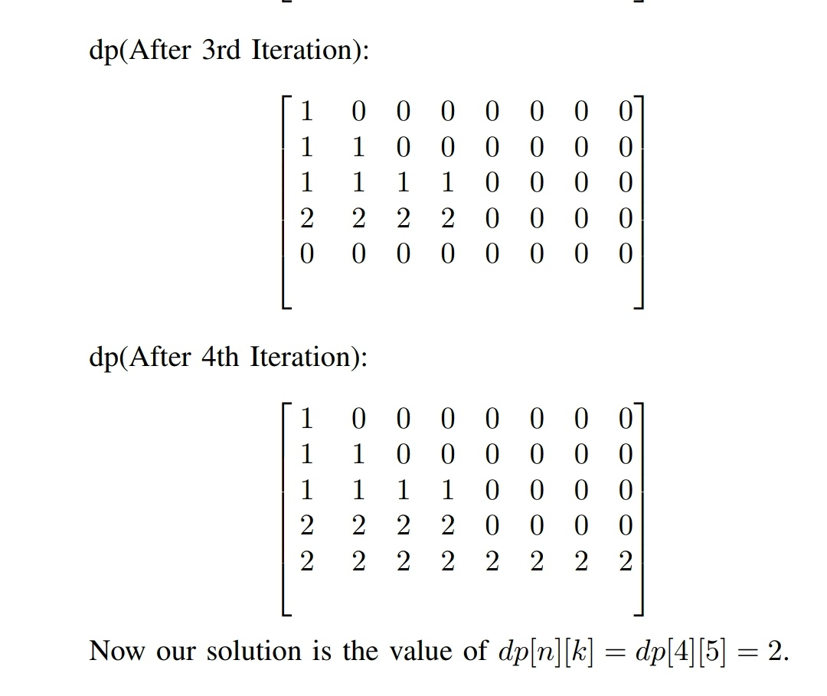

Slide 10
Time complexity
In this approach we iterate over whole array one by one
finding and storing the possible subsets that generate a value
p we say and store it in the dp[i][k] which will need time
to iterate over the array and for each element a loop of time
complexity m ,where m is the maximum possible value of
XOR and could be found from the max value of element in
array.
m = 2[log2(max−element)]+1 − 1
This will result in the time complexity of O(n ∗ m).

Slide 11
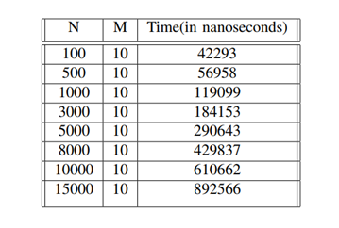
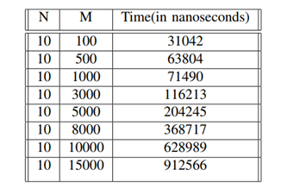

Slide 12
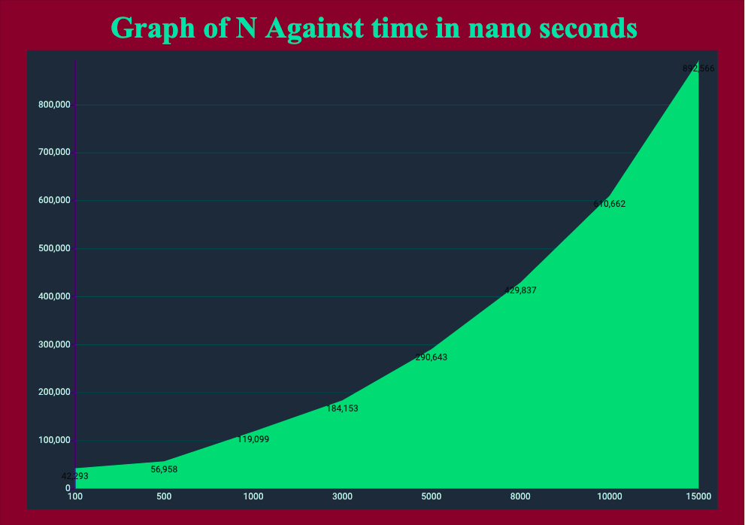
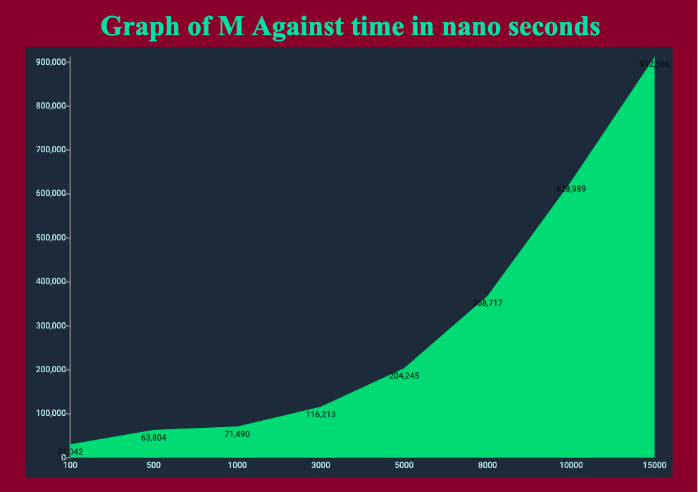
X-axis: N Y-axis: Time in ns
X-axis: M Y-axis: Time in ns

Slide 13
Space complexity
Brute-Force :
In Brute force we will be directly doing XOR operation on the variable or will be resetting the variable, no extra space other than input would be required . This will result in the space complexity of O(1).
Dynamic-Programming :
In this approach we will have to store the values for all possible cases that are generated, as the dp[i][j] requires dp[i − 1][j] and hence a 2D array of size n ∗ m is required where m is same as mentioned above, that is:
m = 2[log2(max−element)]+1 − 1
This will result in the space complexity of O(n ∗ m).

Slide 14
Conclusion
We can observe that In Dynamic Programming Approach it
may consume more space but will have better time
complexity than Brute force approach.

Slide 15
References
1. https://www.geeksforgeeks.org/calculate-xor-1-n/
2. https://www.geeksforgeeks.org/dynamic-programming/
3. Cormen, Leiserson, Rivest, and Stein (2009). Introduction to Algorithms, 3rd edition.

