Slide 1
DAA ASSIGNMENT 6 Group No 19
AYUSH KHANDELWAL (IIT2019240)
AYUSH BHAGTA (IIT2019501)
TAUHID ALAM (BIM2015003)

Slide 2
Contents -
● Problem Statement
● Introduction
● Proposed Algorithm
●Illustration
● Time and space complexity analysis
● Conclusion
● References

Slide 3
Problem Statement
You are given a m liter jug and a n liter jug. Both the jugs are initially empty. The jugs don’t have markings to allow measuring smaller quantities. You have to use the jugs to measure d liters of water where d is less than n. (X, Y) corresponds to a state where X refers to amount of water in Jug1 and Y refers to amount of water in Jug2
Determine the path from initial state (xi, yi) to final state (xf, yf), where (xi, yi) is (0, 0) which indicates both Jugs are initially empty and (xf, yf) indicates a state which could be
(0, d) or (d, 0).
The operations you can perform are:
1. Empty a Jug, (X, Y)->(0, Y) Empty Jug 1
2. Fill a Jug, (0, 0)->(X, 0) Fill Jug 1
3. Pour water from one jug to the other until one of the jugs is either empty or full, (X, Y) -> (X-d, Y+d)

Slide 4
Introduction
Given a m liter jug and a n liter jug which are initially empty. The jugs don’t have markings to allow measuring
smaller quantities. We have to use the jugs to measure d liters of water where d < n and d < m.
(X, Y) corresponds to a state where X refers to amount
of water in Jug1 and Y refers to amount of water in Jug2
Determine the path from initial state (xi, yi) to final state
(xf, yf), where (xi, yi) is (0, 0) which indicates both Jugs
are initially empty and (xf, yf) indicates a state which could
be (0, d) or (d, 0).
The operations you can perform are:

Slide 5
• Empty a Jug, (X, Y)− >(0, Y) Empty Jug 1 • Fill a Jug, (0, 0)->(X, 0) Fill Jug 1 • Pour water from one jug to the other until one of the jugs is either empty or full, (X, Y) -¿ (X-d, Y+d) Breadth-first search is an algorithm for traversing or searching tree or graph data structures. It starts at the tree root, and explores all of the neighbor nodes at the present depth prior to moving on to the nodes at the next depth level. We run breadth first search on the states and these states will be created after
applying allowed operations and we also use visited map of
pair to keep track of states that should be visited only once
in the search. This solution can also be achieved using depth
first search.

Slide 6
ALGORITHMIC DESIGN
Brute Force :
The associated Diophantine equation of the problem is given
by mx + ny = d, whose solution is described by the theorem
below. Theorem. The Diophantine equation mx + ny = d is solvable if and
only if gcd(m, n) divides d. For convenience, let us assume
mx+ny = d is solvable in the discussions below. Depending
on which jug is chosen to be filled first, there are two possible
solutions for solving the two water jugs problems. They are
labelled by M1 and M2 in the following algorithms:
Algorithm. Input: The integers m, n and d, where 0<m<n and d<n.
Output: An integer sequence corresponding to a feasible
solution (called M1) of the two water jugs problem, by filling

Slide 7
the m-litre jug first.
Procedure: Step 1. Initialize a dummy variable k = 0.
Step 2. If k < d, then repeat adding m to k and assign the
result to k until k = d or k > n.
Step 3. If k > n, then subtract n from k and assign the result
to k.
Step 4. If k = d, then stop. Otherwise, repeat the steps
from Step 2 to Step 4. The number of additions (say x1)
and subtractions (say y1) involved provides a solution to the
Diophantine equation mx+ny=d, namely x = x1, y = -y1. The
actual pouring sequence can be determined by referring to the
integer sequence obtained.
Algorithm 2.2.
Input: The integers m, n and d, where 0¡m¡n and d¡n.
Output: An integer sequence corresponding to a feasible

Slide 8
solution (called M2) of the two water jugs problem, by filling
the n-litre jug first.
Procedure:
Step 1. Initialize a dummy variable k = 0.
Step 2. If k = d, then add n to k and assign the result to k.
Step 3. If k > d, then repeat subtracting m from k and assign
the result solution (called M2) of the two water jugs problem, by filling
the n-litre jug first.
Procedure:
Step 1. Initialize a dummy variable k = 0.
Step 2. If k = d, then add n to k and assign the result to k.
Step 3. If k > d, then repeat subtracting m from k and assign
the result to k until k = d or k < m.
Step 4. If k = d, then stop. Otherwise, repeat the steps
from Step 2 to Step 4. The number of subtractions (say x2)

Slide 9
and additions (say y2) involved provides a solution to the
Diophantine equation mx+ny=d, namely x = -x2, y = y2. The
actual pouring sequence can be determined by referring to the
integer sequence obtained.to k until k = d or k < m.
Step 4. If k = d, then stop. Otherwise, repeat the steps
from Step 2 to Step 4. The number of subtractions (say x2)
and additions (say y2) involved provides a solution to the
Diophantine equation mx+ny=d, namely x = -x2, y = y2. The
actual pouring sequence can be determined by referring to the
integer sequence obtained

Slide 10
Illustration
Brute-Force
Volume of first jug: 3
Volume of second jug: 4
Desired volume: 2
k=0
Repeat adding 3 to k until k=2 or k¿4
k=3+3=6
Now subtract 4 from k
k=6-4=2
As k= desired volume so we stop here.
The actual pouring sequence can be determined by referring
to the integer sequence obtained. [0,0][0,3][3,0][3,3][2,4]

Slide 11
Time complexity
Using Graph:
In this approach we iterate over whole map generated by the
nodes containing all the possible amount of water in both the jugs until we find the any of teh one required condition. So to iterate over a graph by BFS or by DFS time complexity
will be as below:
Best Case-If the given condition is not true or the required
amount of water is equal to capacity of one of the jug.This
will result in the time complexity of constant order.So Best

Slide 12
Case Time Complexity= Ω(1) Worst Case-If the given condition is true and the required amount of waterCase Time Complexity= Ω(1) Worst Case-If the given condition is true and the required amount of water is what we get at the farthest end.This will result in the time complexity of order O(V + E) where E
ranges from 1 to V 2, but in our case number of edges is equal to six hence number of edges will be of order 3V , so,
the time complexity will be of order 4V, which is treated as
linear in time complexity, where V is the number of nodes and E is the number of Edges. Maximum value of V in
this case could be N*M where N and M are the maximum
capacities of mug.So Worst Case Time Complexity=O(V )=
O(N ∗ M) is what we get at the farthest end.This will
result in the time complexity of order O(V + E) where E
ranges from 1 to V^2

Slide 13
, but in our case number of edges is
equal to six hence number of edges will be of order 3V , so,
the time complexity will be of order 4V, which is treated as
linear in time complexity, where V is the number of nodes
and E is the number of Edges. Maximum value of V in
this case could be N*M where N and M are the maximum
capacities of mug.
So Worst Case Time Complexity=O(V )=O(N ∗ M)

Slide 14
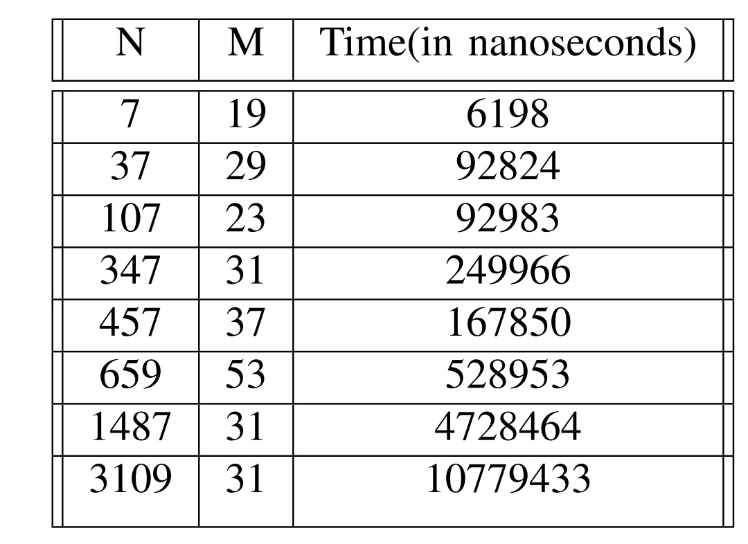
Time complexity:

Slide 15
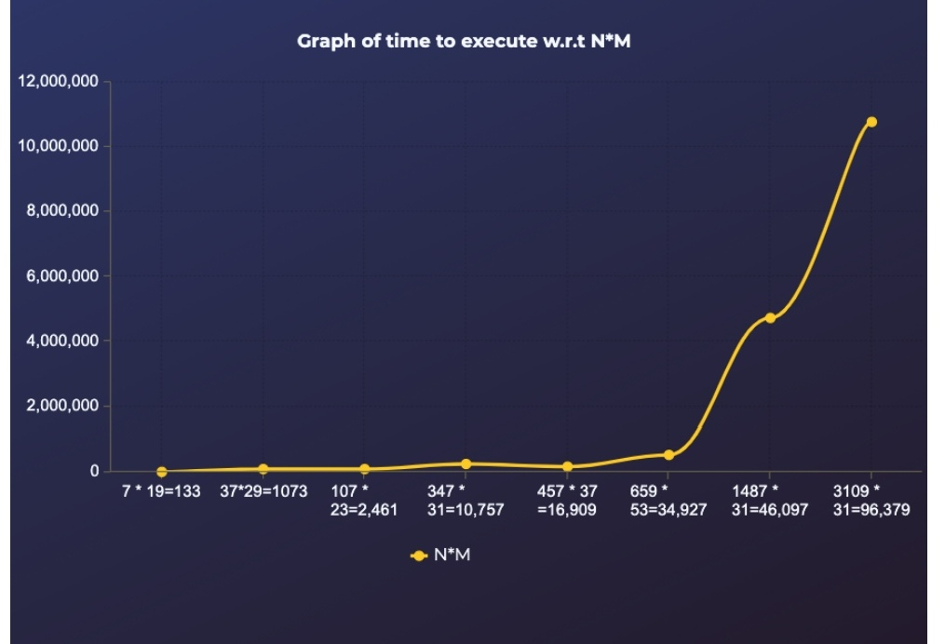

Slide 16
Space complexity
Brute-Force:
In Brute force we will be directly adding and subtracting in
an integer so no extra space is required .
This will result in the space complexity of O(1).
Using Graph:
In this approach we don’t have need to store any graph as all the path are logically decided and checked at the time, so no more Extra space is required to store the map.But we store
the path that is used to reach that point which whose length
vary from 1 to V and we need to store path for all V vertices

Slide 17
and hence the required space is of order V 2.
Maximum value of V in this case could be N*M where N and M
are the maximum capacities of mug.
So Space Complexity=O((N ∗ M)2)

Slide 18
Conclusion
We can observe that in graph the space required is more
but it is much more efficient in terms of time and will be
favourable for the values having bigger differences in the
capacity of jugs.

Slide 19
References
1) https://www.geeksforgeeks.org/breadth-first-search-or-bfs-for-a-graph/
2) https://www.geeksforgeeks.org/depth-first-search-or-dfs-for-a-graph/
3) https://www.eecis.udel.edu/∼mccoy/courses/cisc4-681.10f/lecmaterials/handouts/search-water-jug-handout.pdf
4) https://en.wikipedia.org/wiki/Breadth-first search
5) https://en.wikipedia.org/wiki/Depth-first search
6) R. S. Mary, “An alternative arithmetic approach to the
water jugs problem,” Proceedings on National Con- ference on Computational Intelligence for Engineering
Quality Software, 1, 2014, pp. 10-13.
7) S. Abu Naser, “Developing visualization tool for the
teaching AI searching algorithms,” Information Technol-
ogy Journal, 7(2), 2008, pp. 350–355.

