Slide 1
AMIGO
-Software Engineering Project
Amigo (Academic Management App)
RAHUL ROY (IIT2019194)
NISCHAY NAGAR (IIT2019198)
ESHAN VAID (IIT2019230)
AYUSH KHANDELWAL (IIT2019240)

Slide 2
FROM STUDENTS POINT OF VIEW
. Student’s find it difficult to complete the registration and admission process as on the day of admission, many students arrive at the spot at the same time which makes it difficult, slow and less efficient procedure.
. Students want a platform where they can know the admission related procedure in advance so that it does not get complicated on the day of registration.
. All institution holidays, institute calendar and course details must be provided in a simple and structured way to students.

Slide 3
AIM AND PURPOSE
“Amigo” is basically a web application that offers a user friendly interface for management of academic affairs (Admissions, Assessments, Awards and Archives).
The process of admission and academic management of our institution is less efficient and clumsy in our organisation (NU), as per one of the spokesperson from the Academic Department. Hence we aim to create a platform for smooth, easy and efficient interaction between the students, academic administration and FnA.

Slide 4
FROM ACADEMIC STAFF’S POINT OF VIEW
. The academic management gets a heavy load of work on the day of admission, due to simultaneous registration processes taking place.
. They want a platform to provide information regarding the institution calendar, events and more to all the students without worrying about any future updates, reschedulement and cancelation.
So, this project is an attempt to overcome these drawbacks in IIIT Allahabad.

Slide 5
POTENTIAL APPLICATION
“Amigo©” is aimed to increase the pace and simplicity of academic affairs of IIIT Allahabad and effective conduct of the Admission cum Registration process and to overcome the problems of current management faced by both, Students as well as the academic staff of IIIT Allahabad. One-click feature of the apps will reduce the paperwork, save a lot of time for students who have to visit the Registration Cell for small reasons at times. Overall, this application will reduce the trouble of academic management staff, of records management of students, communication with them in case of an emergency, etc.

Slide 6
DISTRIBUTION OF WORK
Nischay Nagar (IIT1019198) and Rahul Roy (IIT2019194) are involved in the frontend.They have designed the frontend on the online tools and then implemented it using React and hard coded everything.
Contribution : Template Design, Hard Coded the frontend part
Ayush Khandelwal (IIT2019240) and Eshan Viad (IIT2019230) are involved in the backend and connection of database with app directly. Also all the authentication part and routes are handled by them so no person could access the routes he/she is not allowed to.
Contribution: Connecting Database to app and handling routes.

Slide 7
NUMBER OF USE CASES IMPLEMENTED -12
USE CASES IMPLEMENTED :
HoD
Academic calendar display
Faculty list management
Creation/updation of courses (Core, Elective)
Class time-table upload and display
Exam schedule upload and display
General messages / notifications based on event
FnA
Fees chart management
Fees approve/disapprove
Defaulters list display
Re-conciliation of fees
Fees payment status at the time of admission
Fees payment status at the time of registration

Slide 8
NUMBER OF UNIMPLEMENTED USE CASES -6
HoD
Profile view (Personnel details) and request for modifications if any
Batch-wise, program-wise, semester-wise allotment of courses
Core
Elective portal management
Project portal management (Summer internship/master projects)
Batch-wise, program-wise, semester-wise course registration status
Appointment/update of course coordinator
Notice board management
FnA
Special permission granted for delayed payment of fees

Slide 9
PROJECT COMPLETION PLAN
We can say that we are at almost the finishing line. Though some use cases are pending, we are looking forward to implement them as soon as possible. There were some bugs which we have debugged successfully and are looking forward to extend our implementation levels further to increase the reachability and efficiency of our product.

Slide 10
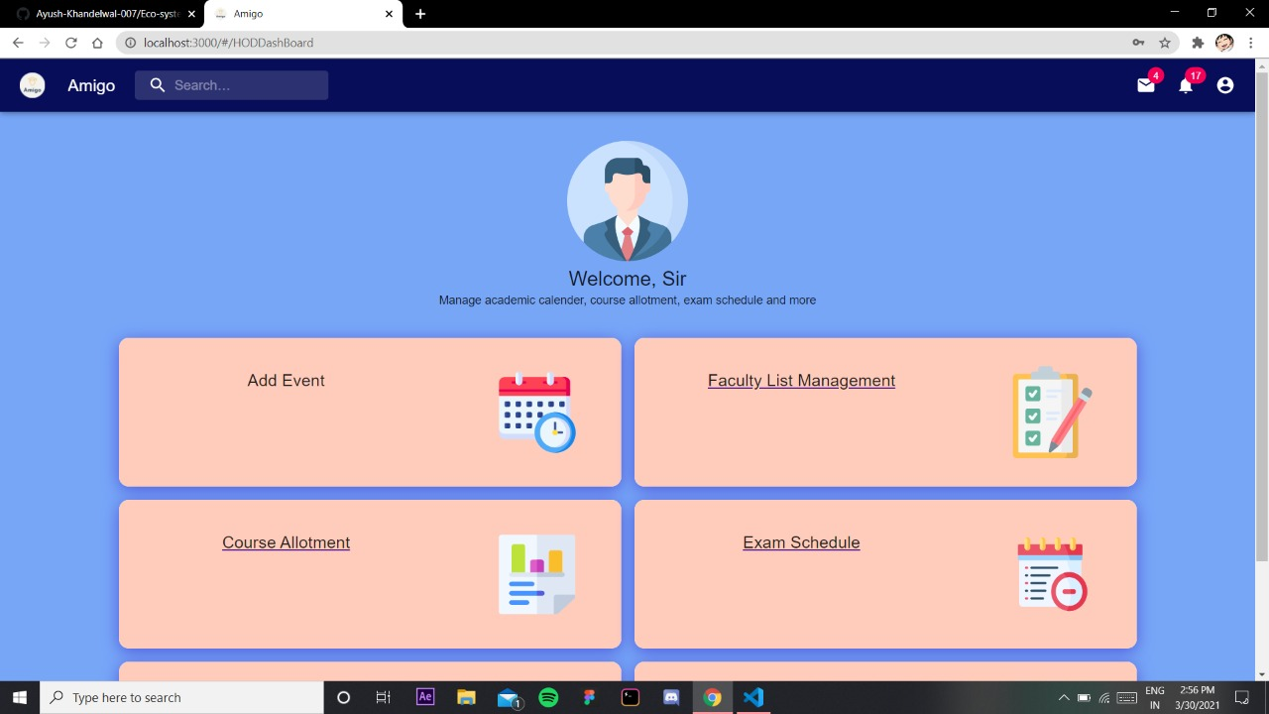
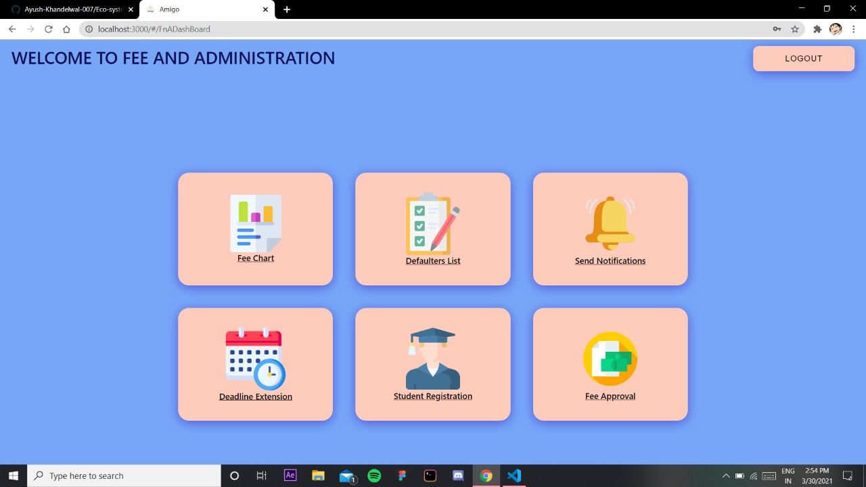
UI DESIGN

Slide 11
TEST PLAN
We have implemented The Agile Model to test out project.
In software development, Agile practices involve discovering requirements and developing solutions through the collaborative effort of self-organizing and cross-functional teams and their end users. It advocates adaptive planning, evolutionary development, early delivery, and continual improvement, and it encourages flexible responses to change.

Slide 12
THE TESTING PHASE
The testing phase includes the debugging process. All the code flaws missed during the development are detected here, documented, and passed back to the developers to fix. The testing process repeats until all the critical issues are removed and software workflow is stable

Slide 13
TESTING METHODOLOGY
The Agile Model advocates adaptive planning, evolutionary development, early delivery, and continual improvement, and it encourages flexible responses to change.
We had a detailed analysis on the design, workflow and requirements of our project and hence we had decided beforehand which model to choose.
There were some bugs which we have debugged successfully and are looking forward to extend our implementation levels further to increase the reachability and efficiency of our product.

Slide 14
TEST CASES
TC1 : We need to verify if a user will be able to login with a valid username and password.
TC2 : We need to verify the login page for HoD, FnA, and Student when “LOGIN” button is clicked.
TC3 : We need to verify whether we can insert and operate on PDF’s in the time table and fees chart section.
TC4: We need to check if the current credentials of user must be visible correctly and must be updated in real-time in database.
TC5: We need to check if the fee Pay Status must be up-to-date.

Slide 15
TEST CASES
TC6 : We need to check if the student receives notification successfully from the Hod/ FnA.
TC7 : We need to verify if a user can successfully logout with all activities saved.

Slide 16
TESTING METHODS
Unit Test: In this level we will test each individual components for example, we will check the Student, FnA and Hod.
■ Integration Test: In this level the integrated components will be tested. Incremental testing is used in agile development methods and hence, every release of the project is tested thoroughly. This ensures that any bugs in the system are fixed before the next release.
■ System Test: In this level, the entire system will be tested against different tests and checking whether any bug arises.
■ Acceptance test: In this level we will askdifferent end users, to check the app for themselves, these people will check the efficiency and practicality of the app and hence we determine the reachability of our app.

Slide 17
Modules
Module_id | Module
Mod1 | Login
Mod2 | HoD Section
Mod3 | FnA Section
Mod4 | Student Section

Slide 18
Requirements
R_ID | Requirements
R1 | Login
R2 | Calendar Display
R3 | Faculty List Management (HOD)
R4 | Course Modification (HOD)
R5 | Time Table Display
R6 | Exam Schedule Display
R7 | Notification
R8 | Manage Fees Chart (FnA)
R9 | Defaulters List Display
R10 | Fee Approval
R11 | Check Fee Status

Slide 19
Methods
M_ID | Methods
M1, M2 | input_cred(), verification()
M3, M4 | input_updated_values, update()
M5 | login_type
M6 | notification()
M7 | display()
M9 | fee_approval()
M10 | view_profile()
M11 | course_allotment()
M12 | course_modification()
M13 | manage_fee_chart()

Slide 20
TRACEABILITY MATRIX
REQUIREMENTS | USE-CASE | HIGH-LEVEL DESIGN ELEMENT | LOW LEVEL DESIGN ELEMENT
R1 | UC-1 | Mod1 | M1. M2
R2 | UC-2 | Mod4 | M7
R3 | UC-3 | Mod2 | M10, M12
R4 | UC-4 | Mod2 | M12
R5 | UC-7 | Mod4 | M7
R6 | UC-8 | Mod4 | M7
R7 | UC-11 | Mod2, Mod3, Mod4 | M6

Slide 21
TRACEABILITY MATRIX
REQUIREMENTS | USE-CASE | HIGH-LEVEL DESIGN ELEMENT | LOW LEVEL DESIGN ELEMENT
R8 | UC-13 | Mod3 | M13
R9 | UC-16 | Mod3 | M7
R10 | UC-15 | Mod3 | M9
R11 | UC-14 | Mod3, Mod4 | M7, M10

Slide 22
Test Plan
FUNCTION | INPUT | EXPECTED OUTPUT | GENERATED OUTPUT
LOGIN : USERNAME = ABC PASSWORD = 1234 CLICK ON LOGIN BUTTON | USERNAME = “ABC” PASSWORD = “123” USERNAME = “ABCD” PASSWORD = “1234” USERNAME = “ABC” PASSWORD = “1234” | “PLEASE ENTER VALID CREDENTIALS” “PLEASE ENTER VALID CREDENTIALS” “LOGIN SUCCESFULL” | “PLEASE ENTER VALID CREDENTIALS” “PLEASE ENTER VALID CREDENTIALS” “LOGIN SUCCESFULL”
PAYFEE : AMOUNT = REQ; CLICK ON PAY BUTTON | AMOUNT = REQ(BY DEFAULT) PAY | FEE PAYMENT SUCCESS | FEE PAYMENT SUCCESS

Slide 23
Test Plan
FUNCTION | INPUT | EXPECTED OUTPUT | GENERATED OUTPUT
LOGIN : USERNAME = ABC PASSWORD = 1234 CLICK ON LOGIN BUTTON | USERNAME = “ABC” PASSWORD = “123” USERNAME = “ABCD” PASSWORD = “1234” USERNAME = “ABC” PASSWORD = “1234” | “PLEASE ENTER VALID CREDENTIALS” “PLEASE ENTER VALID CREDENTIALS” “LOGIN SUCCESFULL” | “PLEASE ENTER VALID CREDENTIALS” “PLEASE ENTER VALID CREDENTIALS” “LOGIN SUCCESFULL”
PAYFEE : AMOUNT = REQ; CLICK ON PAY BUTTON | AMOUNT = REQ(BY DEFAULT) PAY | FEE PAYMENT SUCCESS | FEE PAYMENT SUCCESS

