Slide 1


OPERATING SYSTEMS
C3 Lab Assignment: File and Directory & Socket Programming

Slide 2

Udgam Shah
IIT2019186
Vikram Singh
IIT2019213
Group No.12
Navneet Bhole
IIT2019229
Eshan Vaid
IIT2019230
Ayush Khandelwal
IIT2019240
Notes:
This is group number 12

Slide 3

Q.1.: Study the file I/O related materials on page no. 05 - page no. 21 on Unix System Programming Part-II (“Prog-II.pdf”) document.
Implement the assignment given on page no. 22 of the
document.

Slide 4

Note:
Functions and Keywords used in the code-

Slide 5
1. opendir
The opendir() function shall open a directory stream corresponding to the directory named by the dirname argument.
The directory stream is positioned at the first entry.
If the type DIR is implemented using a file descriptor, applications shall only be able to open up to a total of {OPEN_MAX} files and directories.

Slide 6
2. strcmp
The strcmp() function compares two strings and returns 0 if both strings are identical.
If the first character of two strings is equal, the next character of two strings are compared

Slide 7
3. getcwd
The getcwd() function shall place an absolute pathname of the current working directory in the array pointed to by buf, and return buf
The pathname copied to the array shall contain no components that are symbolic links.

Slide 8
4. readdir
The readdir() function returns a pointer to a structure representing the directory entry at the current position in the directory stream specified by the argument dirp, and positions the directory stream at the next entry.
It returns a null pointer upon reaching the end of the directory stream.

Slide 9
5. readlink
readlink command in Linux is used to print resolved symbolic links or canonical file names.
In simple words whenever we have a symbolic link and we want to know what path it represents.
Then, in that case, the readlink command comes into play to show the actual path of the symbolic link.

Slide 10
6. localtime
The localtime() function shall convert the time in seconds since the Epoch pointed to by timer into a broken-down time, expressed as a local time.
The function corrects for the timezone and any seasonal time adjustments.

Slide 11
7. strftime
strftime() is a function in C which is used to format date and time.
It comes under the header file time.h, which also contains a structure named struct tm which is used to hold the time and date.

Slide 12
8. S_ISLINK
9. S_ISDIR
S_ISLNK checks the file mode m to see whether the file is a symbolic link. If so it returns True.
S_ISDIR checks the file mode m to see whether the file is a directory. If so it returns True.

Slide 13
10. S_IRUSR
11. S_IWUSR
S_IRUSR is a macro constant in sys/stat.h of posix. it stands for user read permission bit.
Write permission bit for the owner of the file. Usually 0200.

Slide 14
12. S_IXUSR
13. S_IRGRP
Execute (for ordinary files) or search (for directories) permission bit for the owner of the file.
Read permission bit for the group owner of the file.

Slide 15
14. S_IWGRP
15. S_IXGRP
Write permission bit for the group owner of the file.
Execute or search permission bit for the group owner of the file.

Slide 16
16. S_IROTH
17. S_IWOTH
18. S_IXOTH
Read permission bit for other users.
Write permission bit for other users.
Execute or search permission bit for other users.

Slide 17
CODE EXPLANATION:
In the start of the code we included all the header files required to execute the the different functions used and use all the structure used and returned by those functions.
Then a void function is defined which receives the mode of a file and prints all the permission the fiel have.
Then in main function we first defined all the variables and structures used in the program.

Slide 18
CODE EXPLANATION:
Then we check the no of arguments passed to the executable file.
If the number of arguments passed is 2 then check 2nd argument for flag and use the 1st argument as the directory name and open the directory .similarly if the first argument is the flag then the 2nd argument is taken as directory and the directory is opened. Otherwise error is shown for a wrong flag.

Slide 19
CODE EXPLANATION:
Now if the no of arguments is 1 we first check if it is the flag , then we take the present directory as the required directory and open it. Otherwise If it is not a flag then the argument is treated as directory name and it is opened.
And finally if no argument is passed then we take the present directory as the required directory and open it.

Slide 20
CODE EXPLANATION:
Finally we iterate over all the files in the directory except the first 2 that are the links to the present directory and the previous directory and used stat and lstat function accordingly to get the information of the file and print it.
Also while printing the symlink we used another function readlink to get the name of the file it points to and further print the link name as well as the name of the file it points.

Slide 21
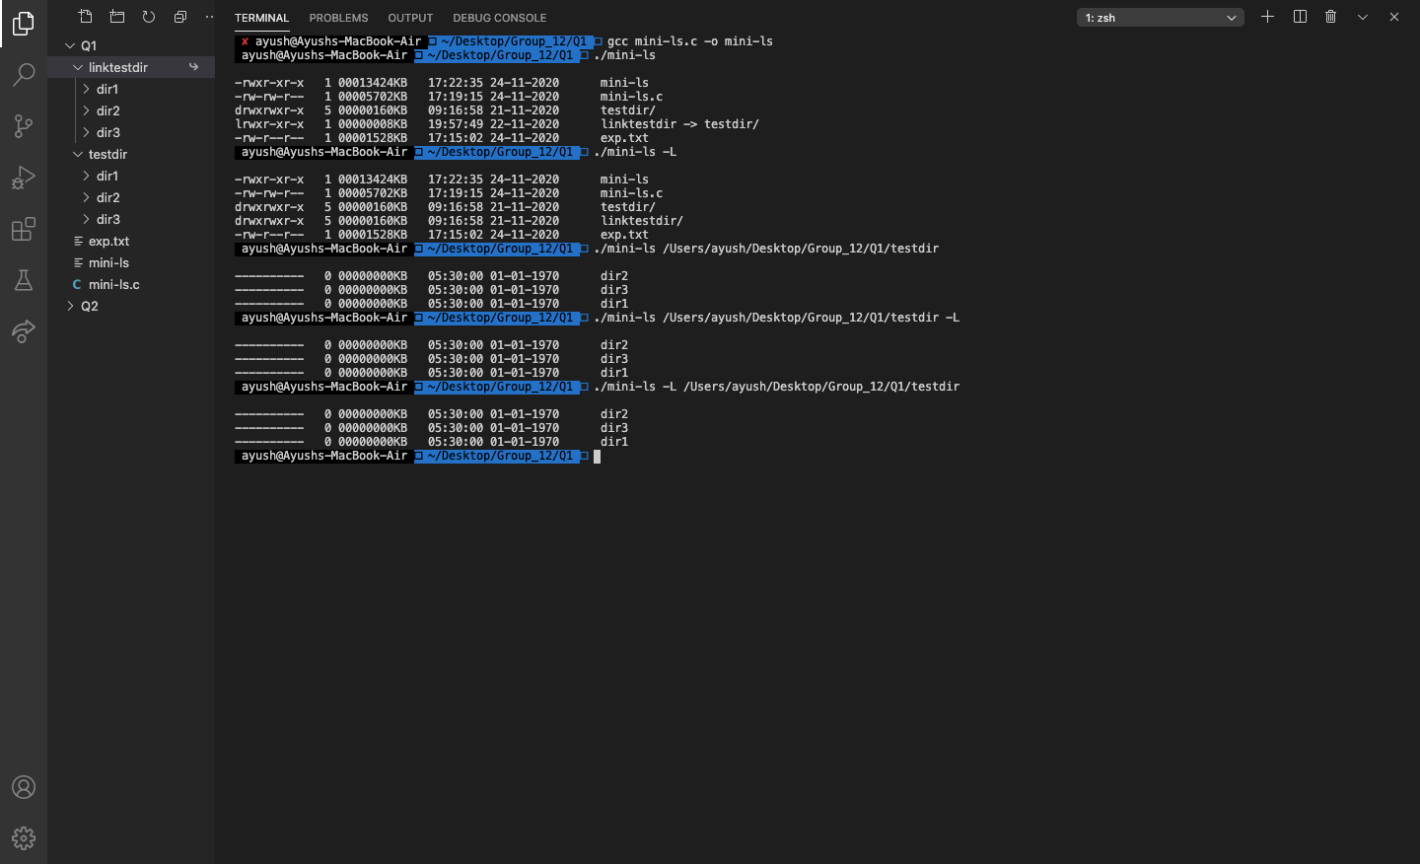
OUTPUT:

Slide 22


