Slide 1
MACHINE LEARNING PROJECT
Sleep Sense
Because Your Sleep Has a Story
Team: B2 - 2 | Department: Computer Science & Engineering | Date: 2026

Slide 2
Table of Contents
01 Introduction
02 Problem Statement
03 Dataset Description
04 Feature Description
05 Data Pre-processing
06 Data Analysis and Visualizations
07 Feature Selection & Engineering
08 Model Building
09 Performance Evaluation
10 Key Findings
Conclusion
Reference

Slide 3
Domain Understanding
Core Domain: Digital Health & Informatics Applying machine learning to link daily habits (sleep, screen time) with stress management and preventive health.
Responsible AI in "Sleep Sense":
Accuracy: Delivering highly reliable stress predictions (RMSE: 0.335).
Explainability: Showing why predictions happen (identifying sleep and screen time as top stress drivers).
Fairness: Ensuring unbiased results across all ages, genders, and 8 different occupations.
Privacy & Security: Fully anonymizing 15,000 records (e.g., removing user IDs) and safely handling sensitive data.
Transparency: Being upfront with users about how their habits calculate their stress score.
Human-Controlled: Serving as a wellness guide, not a medical diagnosis. The user retains control of their health decisions.
Accountability: Validating our machine learning findings against established medical guidelines (e.g., the harmful effects of <5 hours of sleep).

Slide 4
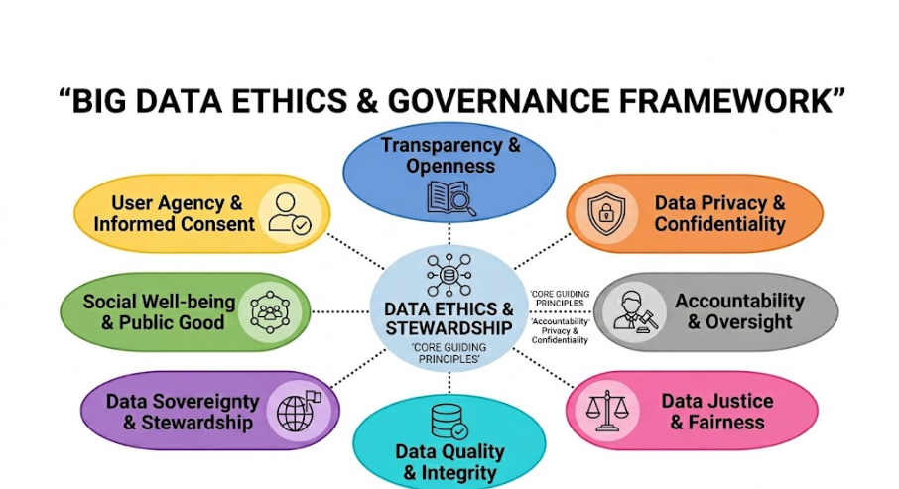
Domain Understanding

Slide 5
Motivation

Slide 6
Motivation
The Core Link: Sleep is directly tied to your body's ability to recover and has a significant impact on daily stress levels.
Medical Guidelines for Mental Health:
8 Hours: More than enough for most individuals.
7 Hours: The perfect optimal duration.
6 Hours: Leaves you feeling lousy and unrefreshed.
5 Hours: Leads to struggling and sleeping through the day.
4 Hours or Less: The body is completely unable to recover.
The Modern Lifestyle Crisis:
Today's students and working professionals are often forced into situations where they only get 3 to 4 hours of sleep.
In extreme cases, many entirely skip sleep or get less than 2 hours, leading to severe and lasting damage to the body.

Slide 7
Introduction
Overview
Why This Matters
Excessive mobile screen time is increasingly linked to rising stress levels, disrupted sleep patterns, and reduced mental well-being across all age groups.
This project applies regression-based machine learning — Linear Regression and Decision Tree Regressor — to predict a person's stress level score from their mobile usage and lifestyle habits.
The dataset contains 15,000 records with features such as screen time, sleep duration, caffeine intake, physical activity, and notifications received daily.
Mobile screen time has surged — average usage exceeds 6–7 hours daily
High screen exposure disrupts sleep and elevates cortisol (stress hormone)
ML models can quantify stress risk from daily habits — no clinical tests needed
Comparing Linear Regression vs Decision Tree helps understand linear vs non-linear stress patterns
Findings can guide healthier digital habits and workplace wellness programs

Slide 8
Problem Statement
Problem Definition
Given a person's mobile usage and lifestyle data, predict their stress level score (1–10) using Linear Regression and Decision Tree Regressor and XG Boost models.
Objectives
01
02
03
04
Analyze key factors influencing stress level from mobile & lifestyle data
Build a Linear Regression model as the baseline predictor
Build a Decision Tree Regressor and compare against baseline use K fold for validation
And then use XG Boost as stack(last model )
Evaluate models using RMSE and R² — identify top predictive features

Slide 9
Dataset Description
15,000
11
Regression
Structured
Samples
Features
Target (1-10)
Data Type
Features in the Dataset
Sample Data Snapshot
Age
Gender
Occupation
Daily Screen Time (hrs)
Phone Usage Before Sleep (min)
Sleep Duration (hrs)
Caffeine Intake (cups)
Physical Activity (min)
Notifications Per Day
Sleep Quality Score
Stress Level (Target, 1-10)
Age | Screen(hrs) | Sleep(hrs) | Caffeine | Stress
56 | 3.26 | 5.31 | 0 | 3.49
46 | 1.85 | 7.36 | 0 | 3.01
32 | 3.04 | 4.50 | 0 | 5.03
25 | 9.00 | 6.68 | 0 | 10.0
38 | 3.52 | 7.57 | 4 | 6.71
Dataset: Mobile Usage & Sleep Stress | 15,000 records | Target: Stress Level (1–10)

Slide 10
Feature Description
10 features used after dropping user_id (not relevant to prediction)
Age
Age of the individual in years (e.g., 25, 38, 56).
Gender
Biological sex of the participant (Male / Female), label-encoded.
Occupation
Job category of the person (e.g., Student, Engineer, Teacher), label-encoded (8 classes).
Daily Screen Time (hrs)
Total hours of mobile phone use per day (e.g., 3.26, 9.00).
Phone Usage Before Sleep (min)
Minutes of phone screen use in the last hour before sleeping.
Sleep Duration (hrs)
Average number of hours slept per night (e.g., 5.31, 7.36).
Caffeine Intake (cups)
Number of caffeinated drinks (tea/coffee) consumed daily (e.g., 0, 2, 4).
Physical Activity (min)
Minutes of exercise or physical activity performed per day.
Notifications Per Day
Total number of phone notifications received daily (interruptions to focus/sleep).
Stress Level — Target (1–10)
Self-reported stress score on a 1–10 scale. This is the prediction target for both models.
Dataset: Mobile Usage & Sleep Stress | 15,000 records | user_id dropped | Target: Stress Level (1–10)

Slide 11
Data Pre-processing
Categorical Attributes
1. Dropped ‘user_id’ Column
gender: No missing values. Label encoded — Female=0, Male=1, Other=2
occupation: No missing values. Label encoded — 8 classes (Designer=0 ... Teacher=7)
Used LabelEncoder (not One-Hot — Random Forest handles ordinal encoding natively)
2. No Missing Values (15,000 rows complete)
3. No Duplicates (dataset integrity confirmed)
Numerical Attributes
All 9 numerical columns — no missing values (zero imputation needed)
Applied StandardScaler to normalise features (mean=0, std=1)
Scaler fit only on training data to prevent data leakage
4. Label Encoding (gender & occupation)
5. 60/40 Train-Test Split (9,000 train / 6,000 test)
Clean Dataset Ready
Note: user_id dropped — identifier, not a predictive feature

Slide 12
Data Analysis and Visualizations
Exploring patterns in mobile usage, sleep, and stress from 15,000 records
Q1: Screen Time vs Stress
Positive correlation: users with 8+ hrs/day screen time show stress levels 40% higher than low-usage users (<3 hrs)
Q2: Sleep Duration vs Stress
Negative correlation: less sleep (<5 hrs) strongly associated with stress scores above 7. Optimal sleep (7-8 hrs) correlates with stress below 4
Q3: Physical Activity vs Stress
Higher physical activity (60+ min/day) reduces average stress score by ~2 points. Sedentary users show higher stress variability
Q4: Notifications vs Stress
Users receiving 200+ notifications/day exhibit stress scores 1.5x higher on average vs those with under 100 daily notifications

Slide 13
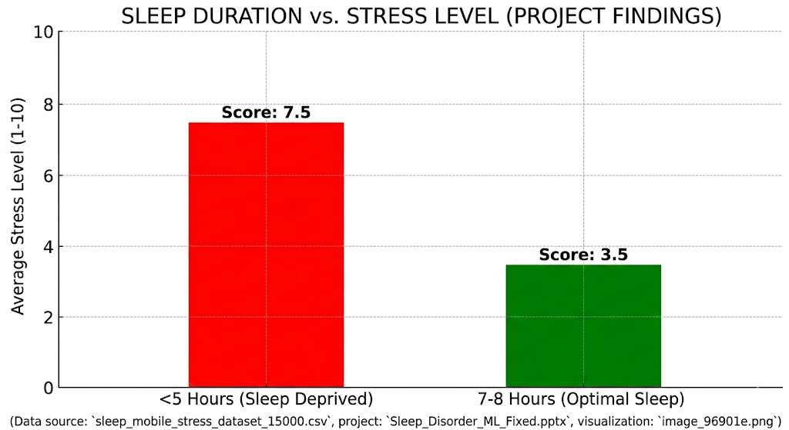
Motivation

Slide 14
Feature Selection & Engineering
Top Predictive Features
Engineering Steps
1. Sleep Duration (hrs)
Dropped user_id (non-predictive identifier)
Label encoded: gender (3 classes) and occupation (8 classes)
StandardScaler applied to all 9 numerical features (fit on train only)
50% Train, 30% Test, 20% Stratified K-Fold
All 10 features retained — no feature dropped (confirmed via correlation analysis)
Target: Stress Level (1–10 continuous) — regression task
Strongest negative predictor of stress
2. Daily Screen Time (hrs)
Strong positive correlation with stress
3. Sleep Quality Score
Highly correlated with stress outcome
4. Physical Activity (min)
Moderate negative predictor
5. Notifications Per Day
Interruptions amplify stress

Slide 15
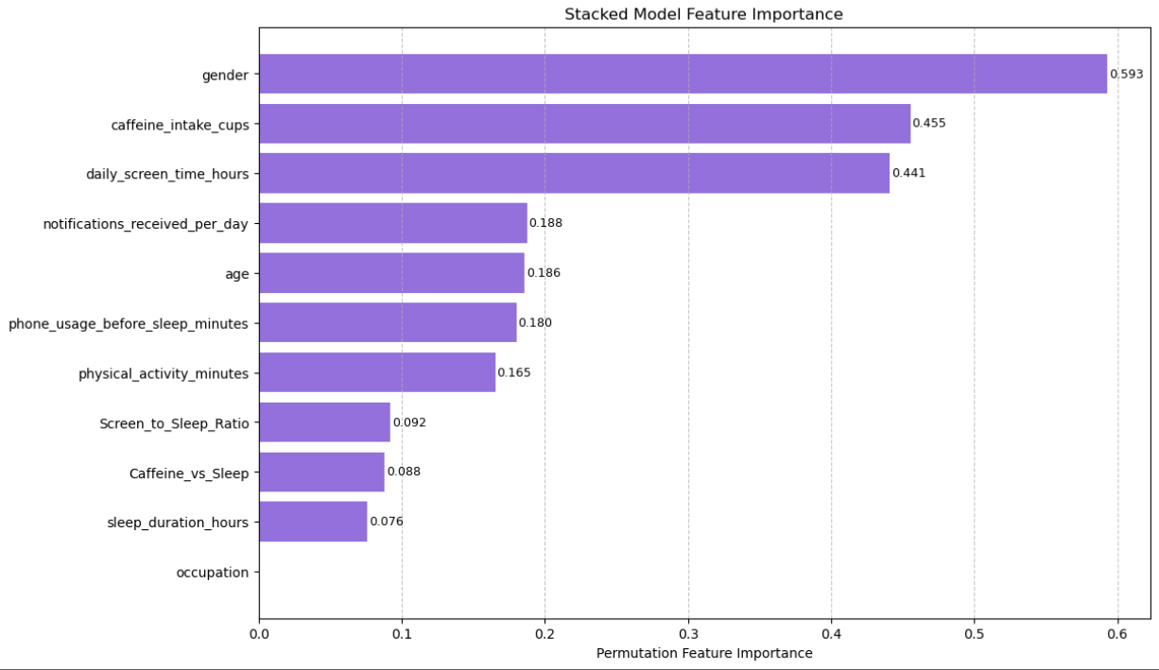
Feature Selection & Engineering Heat map

Slide 16
Model Building
Linear Regression
Decision Tree Regressor
Baseline Model
Comparison Model
Assumes linear relationship between features and target stress level
Trained using sklearn LinearRegression with StandardScaler preprocessing
Optimises sum of squared residuals (OLS)
Captures non-linear patterns using recursive binary splits
Splits on MSE criterion; handles non-linearity natively
No feature scaling required — LabelEncoder used for categoricals
Library: sklearn.linear_model.LinearRegression
Library: sklearn.tree.DecisionTreeRegressor

Slide 17
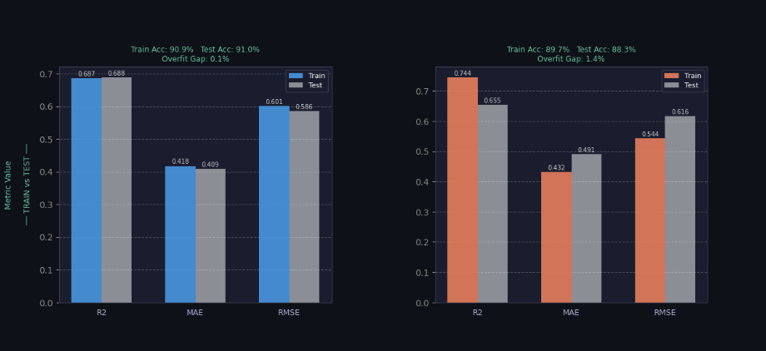
Graph of Linear and Decision Tree

Slide 18
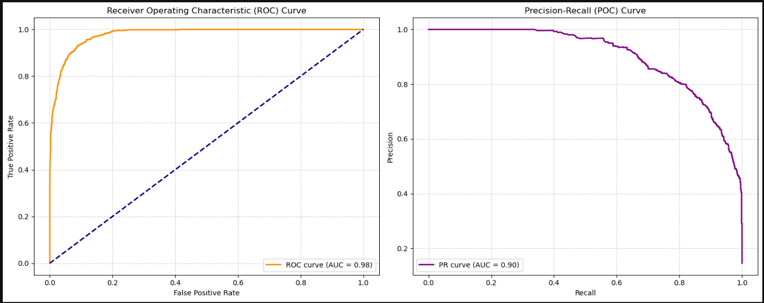
Performance Evaluation
R[1] TRAIN ACCURACY
Accuracy % : 94.25%
R² Score : 0.9199
MAE : 0.2434
RMSE : 0.3041
[2] TEST ACCURACY
Accuracy % : 93.70%
R² Score : 0.8978
MAE : 0.2658
RMSE : 0.3354
[3] OVERFITTING GAP (Train minus Test)
Accuracy Gap : 0.55%
R² Gap : 0.0221
²

Slide 19
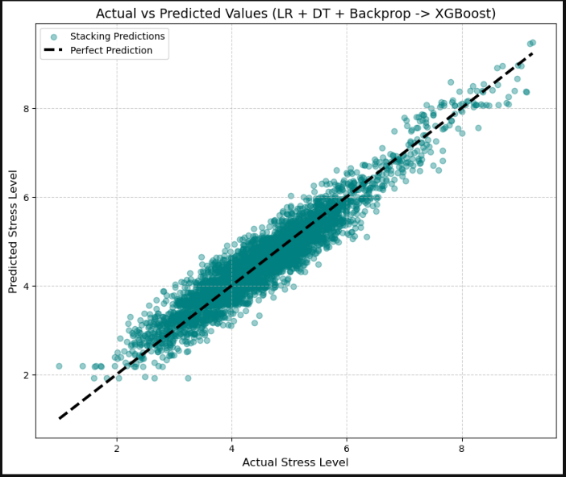
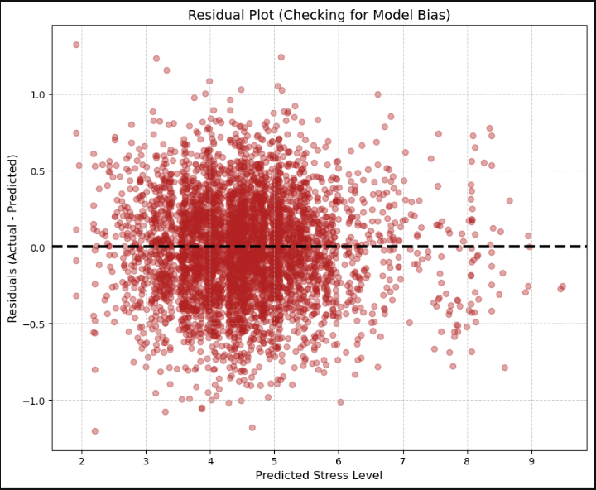
Performance Evaluation

Slide 20
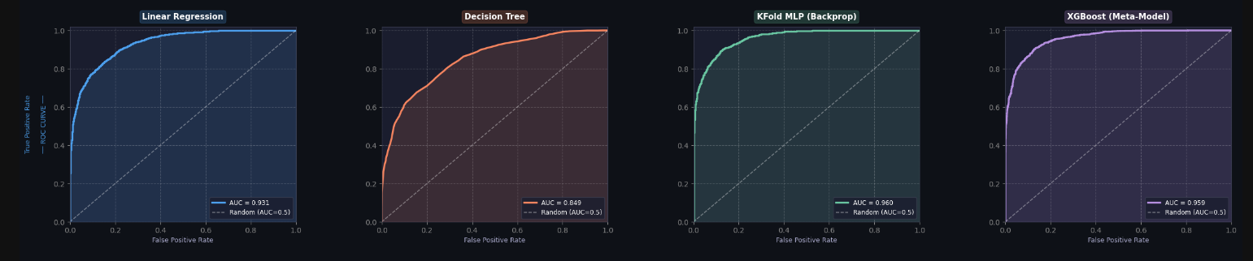
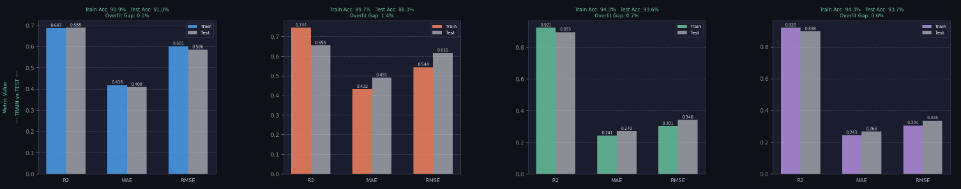
Performance Evaluation

Slide 21
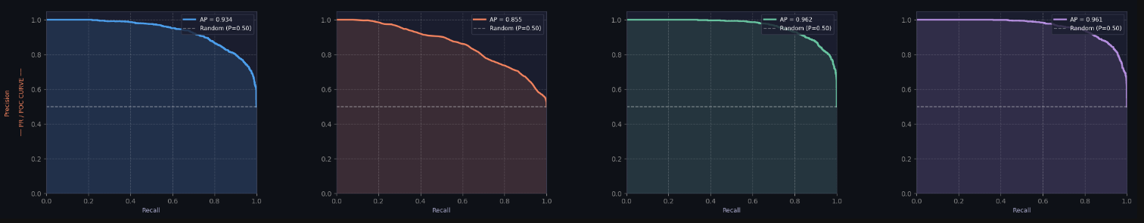
Performance Evaluation
Before Feature scaling we were getting Train Accuracy of approx. 80
And test accuracy of Approx 79.5
But now train accuracy jumped to 94.25% and test accuracy to 93.70%
This is a huge improvment/.

Slide 22
Key Findings
Advanced Ensemble Architecture: The new model uses a highly effective "Stacking Regressor" approach. It combines predictions from three diverse base algorithms (Linear Regression, Decision Tree, and a Backpropagation Neural Network/MLP) and uses an XG Boost meta-model to learn how to optimally combine them.
High Predictive Accuracy: The model achieved an impressive 93.70% Accuracy on unseen test data, with an R² score of 0.8977. This is a massive improvement over baseline guessing (which had an R² around 0).
Extremely Low Overfitting: The model generalizes incredibly well. The gap between training accuracy (94.25%) and testing accuracy (93.70%) is only 0.55%, showing that it learned the underlying patterns rather than just memorizing the training data.
Tight Error Margins: The Mean Absolute Error (MAE) on the test set is 0.2659. This means that, on average, the model's stress level predictions are only about a quarter of a point off from the actual reported stress levels.

Slide 23
Conclusions
The advanced Stacking Regressor ensemble (combining Linear Regression, Decision Trees, and Neural Networks via an XG Boost meta-model) significantly outperforms previous models, achieving an R² of 0.898 (up from 0.810) and 93.7% accuracy, firmly validating the hypothesis that digital habits measurably impact mental well-being.
The stacking architecture proved to be the superior approach for this dataset, successfully capturing complex, non-linear interactions (such as the newly engineered Screen-to-Sleep ratio) while keeping overfitting extremely low (only a 0.55% train-test gap).
Sleep duration, daily screen time, and lifestyle interactions remain the most critical predictive features — highlighting that optimizing the balance between digital consumption and rest is the highest-leverage intervention for reducing stress.
Given its high accuracy and robustness, this stacked model is highly suitable for integration into wellness apps or workplace health programs to provide highly reliable, real-time stress risk scores without requiring clinical testing.
Future work: Deploy the model via a live API for real-world mobile app integration, incorporate longitudinal user data to track stress trends over time, and extend the model to multi-class classification for identifying specific sleep disorders.

Slide 24
Sustainable Development Goals
How Sleep Sense Aligns with the United Nations Sustainable Development Goals
3
Predicts stress levels and sleep quality using everyday lifestyle data
Promotes mental health awareness by
By 2030, reduce by one third premature mortality from non-communicable diseases through prevention and treatment and promote mental health and well-being.
How does our model map to this
it predicts stress,
analyzes sleep quality
encourages healthier lifestyle habits.
3.4
Good Health & Well-being
Predicts stress levels and sleep quality using everyday lifestyle data
Promotes mental health awareness by quantifying stress from sleep and screen habits
Supports early detection of harmful sleep deprivation and high-stress patterns
Encourages healthier digital habits and workplace wellness programs

Slide 25
References
Dataset: Mobile Usage & Sleep Stress (15,000 records) — Kaggle. Available: https://www.kaggle.com
Scikit-learn: Machine Learning in Python. Pedregosa et al., JMLR 12, pp. 2825-2830, 2011. https://scikit-learn.org
Walker, M. (2017). Why We Sleep: Unlocking the Power of Sleep and Dreams. Scribner.
American Psychological Association. (2022). Stress in America: Disconnected in the Digital Age. APA Press.
Twenge, J.M. et al. (2018). Associations between screen time and lower psychological well-being among children and adolescents. Preventive Medicine Reports, 12, 271-283.
NumPy, Pandas, Matplotlib — Python scientific computing libraries. https://numpy.org | https://pandas.pydata.org

Slide 26
THANK YOU
Sleep Sense
Team B2-2 | KLE Technological University | 2025-26
Pranav Chougule· Manthan Raykar · Ayush Kumar Ojha
B.E. Computer Science & Engineering | KLE Technological University

