Slide 1
Credit Card fraud and
Anomaly Detection
Abhinav Nippani, Adwait Patil,
Ayush Patel, Shivansh Verma

Slide 2
INTRODUCTION
In the contemporary era of digital banking and e-commerce, credit card fraud has emerged as a significant threat to personal financial security and the stability of the global financial ecosystem.
This project aims to address this pressing concern by implementing and analyzing the effectiveness of four prominent clustering algorithms: DBSCAN, OPTIC, K-Means, and GMM.
The project's central question focuses on the effective implementation of these algorithms to accurately identify and mitigate fraudulent activities in credit card transactions
A key innovation in this project is the optimization of the Expectation-Maximization (EM) step within the GMM , optimizing clustering in K-Means algorithm, which is vital for refining cluster assignments and centroid updates, thus influencing the overall performance of the algorithm. Additionally, the project explores the efficacy of both Breadth-First Search (BFS) approaches in the implementation of DBSCAN, aiming to determine which method yields better performance in the context of credit card fraud detection.

Slide 3
K-Means Clustering
Gaussian Mixture Model
DBSCAN
OPTIcs
Algorithms Implemented
Simple Unsupervised method for clustering
Probabilistic approach to find Clusters
Spatial based clustering algorithm to understand Clustering and Noise
Improved DBSCAN that optimizes data in varying densities.

Slide 4
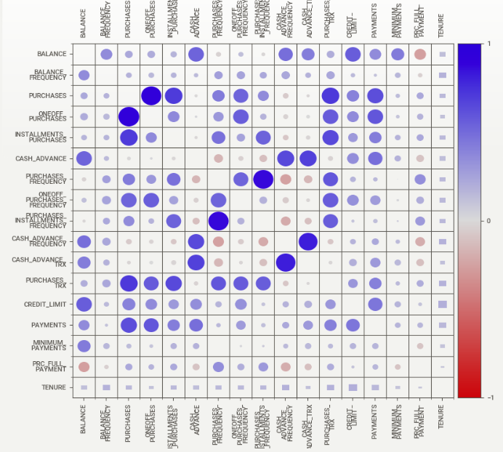
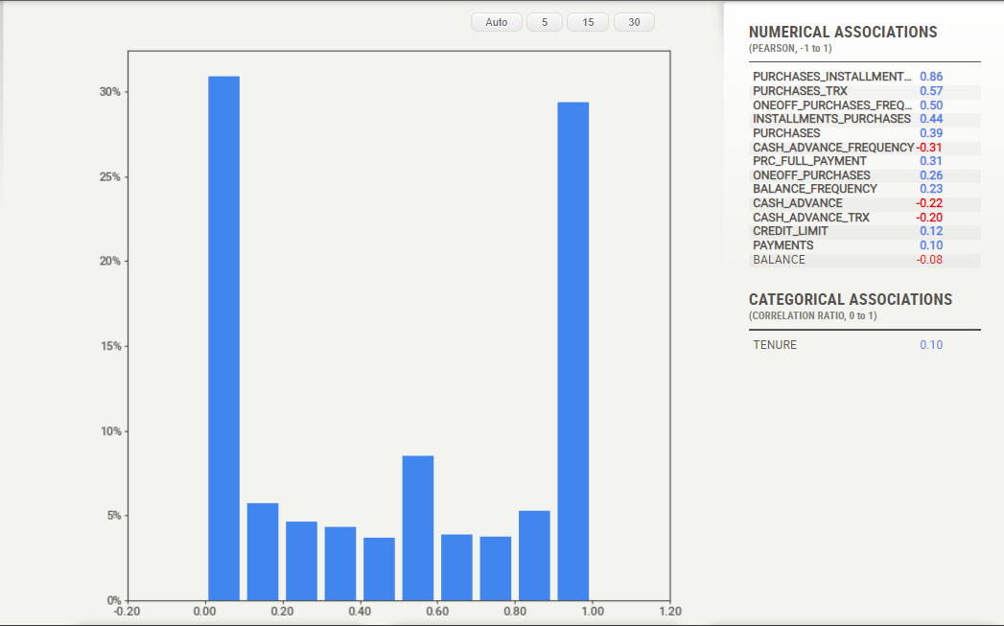
EDA
Correlation matrix
Purchase Frequency distribution

Slide 5
K-Means Clustering
Implementing K-Means clustering on the pre-processed data. In this application we try to optimize the clustering step using numpy array comprehensions to create clusters with optimum time complexity. We then compare this to scikit-learn's KMeans to verify if the clustering meets the standards
K-Means is a clustering algorithm used to divide the data into ‘k’ number of clusters. The algorithm operates by randomly initializing each cluster center, and then iteratively updating these centers to be the average of the data points in the clusters. This process continues until a defined criterion (e.g., a situation where the centers do not move) is met.
The elbow method and Silhouette score were used as supportive to the K-Means process
Elbow Method One of the toughest decisions for the K-means algorithm is determining how many clusters the data should be divided into. The elbow method is a common technique used for this decision. This method involves calculating the total within-cluster sum of squares (WCSS) for different k values. As the value of k increases, WCSS decreases. However, after a certain k value, this reduction amount becomes insignificant. This point called the "elbow" helps us to determine the optimal k value.
After implementation we found that k = 3 gave the highest silhouette hence the optimum number of clusters is 3

Slide 6
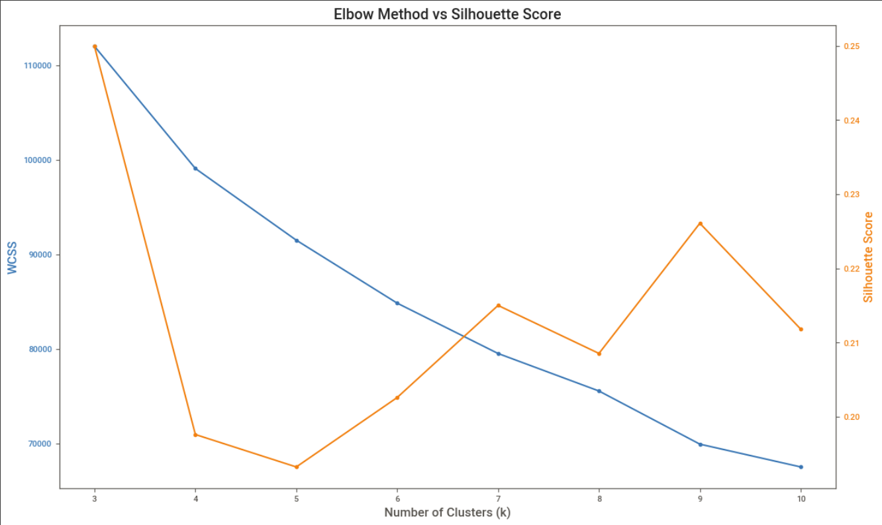
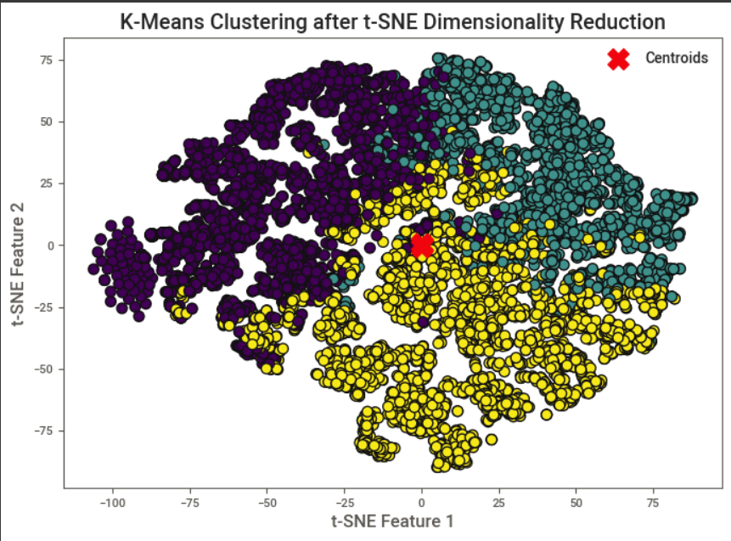
K-Means Clusters

Slide 7
Gaussian Mixture Model
Gaussian Mixture Model (GMM) is another clustering algorithm which assumes that the data is generated from a mixture of several Gaussian distributions, each representing a cluster
GMM provides a more flexible framework where data points are not strictly assigned to a single cluster but instead have probabilities of belonging to each cluster.
The Expectation-Maximization (EM) algorithm is employed in the context of GMM to iteratively update parameters. The EM algorithm consists of an E-step and an M-step
In the E-step, the algorithm calculates the probability of each data point belonging to each cluster, considering the Gaussian distributions with their means, covariances, and weights. In the M-step, the algorithm updates the parameters, including the means, covariances, and weights of the Gaussian distributions, based on the computed probabilities.
Similar to the K-Means approach, the optimal number of clusters in GMM can be determined using techniques such as the elbow method, Silhouette score, or other model selection criteria.
Time complexity is O(NKD^3), where N is the number of data points, K is the number of Gaussian components and D is the problem dimension.

Slide 8
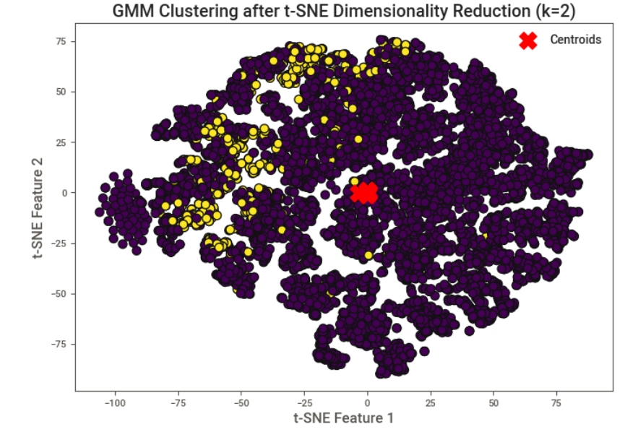
Gaussian Mixture Model

Slide 9
DBSCAN
DBSCAN stands for Density Based Spatial Clustering Algorithm with Noise.
The algorithm works by identifying core points that have “min samples” number of neighbours that are within “epsilon” distance of the given points in consideration. After core points are identified we start creating clusters of core points that are not visited by visiting them and assign them and their neighbours which are core points as a cluster. After colouring all core points we move to identify the non core points and assigning them clusters. This approach helps us to maintain the overall quality of clusters by identifying dense clusters and filtering out noise.
We have implemented Density Based Spatial Clustering of Algorithms with Noise (DBSCAN) Algorithm by using a queue and taking inspirations from Breadth First Search(BFS). We are first creating neighbourhoods by finding all the points that are within epsilon distance of each other and then we run DBSCAN by using BFS and checking their neighbours and assigning them the cluster labels while visiting them.
The overall time and space complexity of our approach is O(n²).

Slide 10
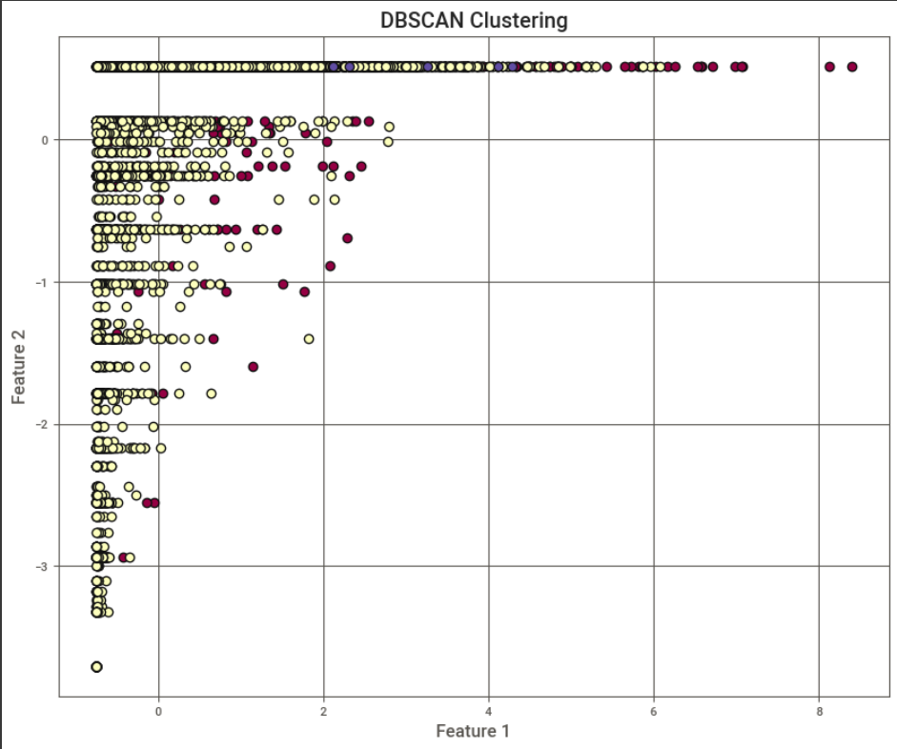
DBSCAN
Plotting DBSCAN results for two features and seeing the segregation in classes

Slide 11
Optics
OPTICS (Ordering Points To Identify the Clustering Structure) is a density-based clustering algorithm and can be considered as a generalization of DBSCAN. However, it is known for its ability to identify structures of different densities in the dataset, instead of using a single eps value. This is algorithm uses a BallTree data structure. Constructing a BallTree has a time complexity of O(n log n), where n is the number of points in the dataset.
Working Principle: - The reachability distance is calculated for each data point. This determines how close a point is to another point at a certain density. - Based on these distances, a reachability graph is created. - Valleys in the graph indicate density-based clusters.
Combining these complexities, the overall worst-case time complexity of the OPTICS implementation is O(n^2), dominated by the nested iterations in the fit method and the _expand_cluster_order method. However, it's important to note that the average time complexity might be better than the worst case, depending on the data distribution and the parameter settings for min_samples and max_eps. In practice, OPTICS can perform better than O(n^2) when the dataset has a sparse distribution or when max_eps limits the number of points to be considered in each neighbourhood query.

Slide 12
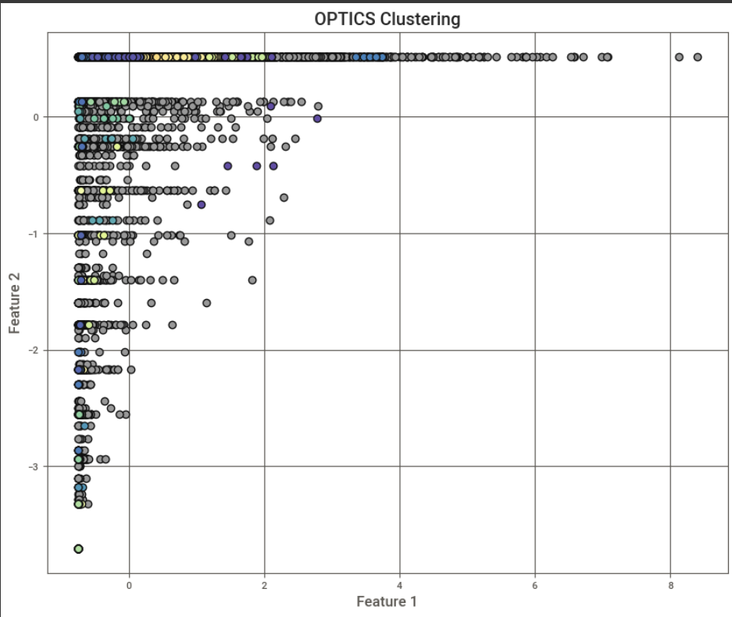
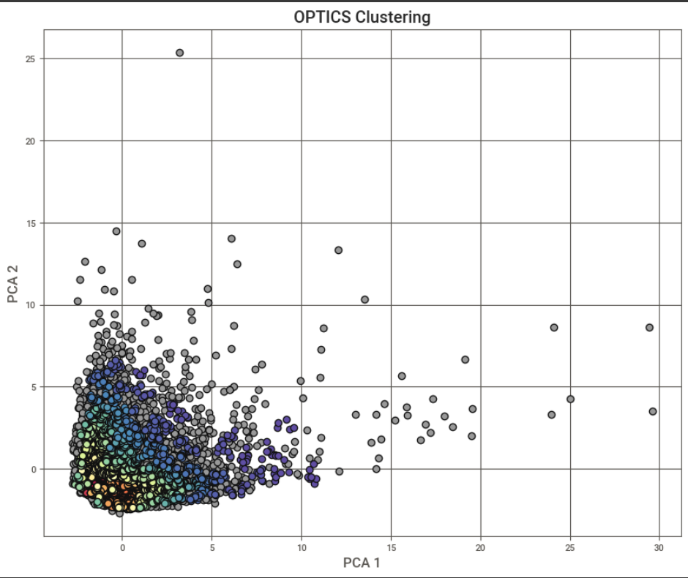
Optics
OPTIC Clusters without dimensionality reduction
Optic Clustering with PCA

Slide 13
CONCLUSIONS
a
B
C
D
K-Means after dropping redundant features gives the best results among all the algorithms. Silhouette score and Elbow method along with Gaussian initialization for centroids helps in getting these results
The performance of GMM is currently unsatisfactory, but extending the number of iterations could potentially enhance its results. It might be worthwhile to evaluate this approaches for a supervised application for fine tuning.
OPTICS The performance of OPTICS is generally lower compared to the other two methods depending on the dataset used. Particularly, the negative silhouette coefficients indicate that the clusters are quite poorly defined.
DBSCAN has a fairly high silhouette coefficient, indicating that this approach also defines clusters quite well.

Slide 14
THANK YOU

