Slide 1
Analysis & Comparison of Financial Statements
Project By:
Ayush Patel (EN19CS303019)
Deepesh Shrivastava (EN19CS303023)
Mayank Sisodiya (EN19CS303030)

Slide 2
ABSTRACT:
The main purpose of this research is to provide a comprehensive analysis of the financial performance of Nifty 50 stocks over a period of ten years. By comparing and contrasting the income statement and balance sheet of these companies, the study aims to identify trends, patterns, and differences that can shed light on the financial strengths and weaknesses of each company. The study has a broad scope as it covers all the companies listed on Nifty 50. This approach ensures that the findings are representative of the financial performance of the entire stock market in India. The income statement is used to evaluate a company’s profitability, while the balance sheet is used to assess its financial position. The study also examines other financial ratios such as liquidity ratios, debt-to-equity ratios, and return on assets to provide a more comprehensive analysis.

Slide 3
INTRODUCTION:
The Indian stock market has been one of the fastest-growing in the world over the last decade. The Nifty 50 is the main index that represent the performance of the Indian stock market. The Nifty 50 comprises the top 50 companies listed on the National Stock Exchange (NSE). These indices are widely used as benchmarks for measuring the overall performance of the Indian stock market. Financial Statement provides an overview of a business financial condition in both short and long term. In financial statement, all the relevant financial information of a business enterprise is presented in a structured manner and in the form of easy to understand. Financial statement analysis is a judgmental process which aims to estimate current and past financial positions and the results of the operation of an enterprise, with primary objective of determining the best possible estimates and predictions about the future conditions. The purpose of the financial analysis is to provide information to financial managers and analysts to make thorough decisions about their business, strengths and weaknesses.

Slide 4
The objective of this research paper is to analyze and compare the financial statements of companies listed on the Nifty 50 from 2013-2022. The study focuses on two key financial reports – the income statement and the balance sheet – to draw inferences about the current financial status of these companies. The research will provide a comprehensive analysis of the financial performance of Nifty 50 stocks over a period of ten years. The study is significant because it provides valuable insights into the financial health of companies listed on the Indian stock market. The findings can help investors, analysts, and other stakeholders to make informed decisions about investing in these companies. Furthermore, the study can be useful for companies to identify areas for improvement in their financial management and planning.

Slide 5
Data Collection Tools
To collect the necessary financial data, we have used web scraping techniques and Python libraries such as Beautiful Soup and Requests. We have developed an algorithm that scrapes the latest available data from secondary sources and stores it in Mongo Db as documents.
Beautiful Soup is a python library that is used to parse HTML and XML documents. It is particularly useful for extracting data from web pages that are not well-structured or have complex layouts.
Requests is also a python library that is used to send HTTP requests and handle responses. It provides an easy-to-use interface for making HTTP requests, and supports a wide range of HTTP methods and protocols.

Slide 6
Database Used:
Mongo DB: MongoDB was created in 2009 as an open-source, highly scalable, robust, and free NoSQL database. MongoDB has cultivated a reputation as a versatile, flexible database and is currently used today as the backend data store of many high-profile businesses and organizations such as Forbes, Facebook, Google, IBM, Twitter, and many more. MongoDB is a non-relational database system. There are two primary database types: SQL (relational) and NoSQL (non-relational). Relational databases store data in columns and rows. Organizations like Microsoft SQL Server Oracle and Sybase use the relational database management system (RDBMS).
On the other hand, NoSQL databases store schema-less, unstructured data in multiple collections and nodes. Non-relational databases don’t need fixed table sachems. NoSQL databases are scaled horizontally and support limited join queries.

Slide 7
Benefits of Mongo DB:
NoSQL databases are cheaper and easier to maintain. NoSQL databases have features like easier data distribution, simpler data models, and automatic repair.
It’s open-source and incurs fewer server costs. Open-source is free. NoSQL databases use cheaper servers.
It’s easily and highly scalable. Since NoSQL databases like MongoDB expand horizontally, you can scale by adding more machines to your resource pool.
It supports integrated caching. System memory caching boosts data output performance.
MongoDB has no schema hassles. You can place data into a NoSQL database without requiring a predefined schema.

Slide 8
Mongo DB in our project:
We have used Mongo DB as our database, because of its flexible schema and extensive capacity to store large semi-structured voluminous data.
We have created a main entity or a database called as “Fundamentals”, consisting of 3 collections – to store the data of nifty 50 stocks. Three collections are nifty_list, balance_sheets, income_statements.
1). nifty_list – It is the main backbone of the whole project ecosystem. The collection consists of all prerequisites like stock code, stock URL that are essential for scraping or collecting the data of 50 nifty stocks.
Schema Example: {
“full_name”: “Asian Paints”, “code”:”AP31”, “url_name”: ”asianpaints”
}

Slide 9
Mongo DB in our project:
2). income_statements – The collection consists of income statement data of all nifty 50 stocks. It has a stock code as it’s identifier to uniquely identify each of the stock. Whereas, it has some crucial datapoints like Total Revenue, Total Expenses, Profit/Loss Basic EPS, Equity Share Dividend etc.
Schema Example: {
“code”: “AP31”,
“data”: {
“YEARS”: [Mar 22, Mar 21, Mar 20 ……………., March 13],
“Total Revenue”: [29481, 22015, 20515, …………., 11085]
}
}

Slide 10
Mongo DB in our project:
3). Balance_sheets - The collection consists of balance sheet data of all nifty 50 stocks. It has a stock code as it’s identifier to uniquely identify each of the stock. Whereas, it has some crucial datapoints like Total Shareholders funds, Long term Borrowings, Short term Borrowings, Trade Payables etc.
Schema Example: {
“code”: “AP31”,
“data”: {
“Trade Payables”: [4164, 3378, 2136, ………………….., 1441],
“Total Shareholders funds”: [13811, 12806, 10130,………, 3384]
}
}

Slide 11
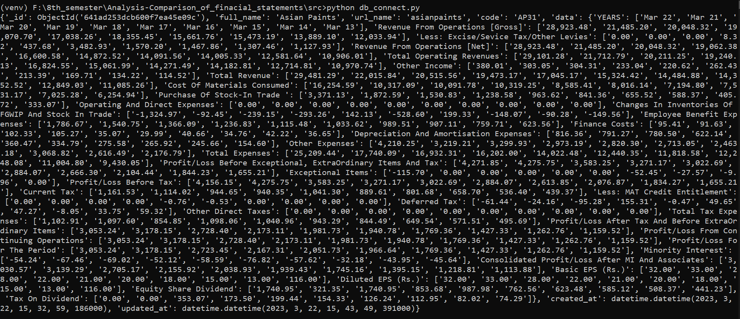
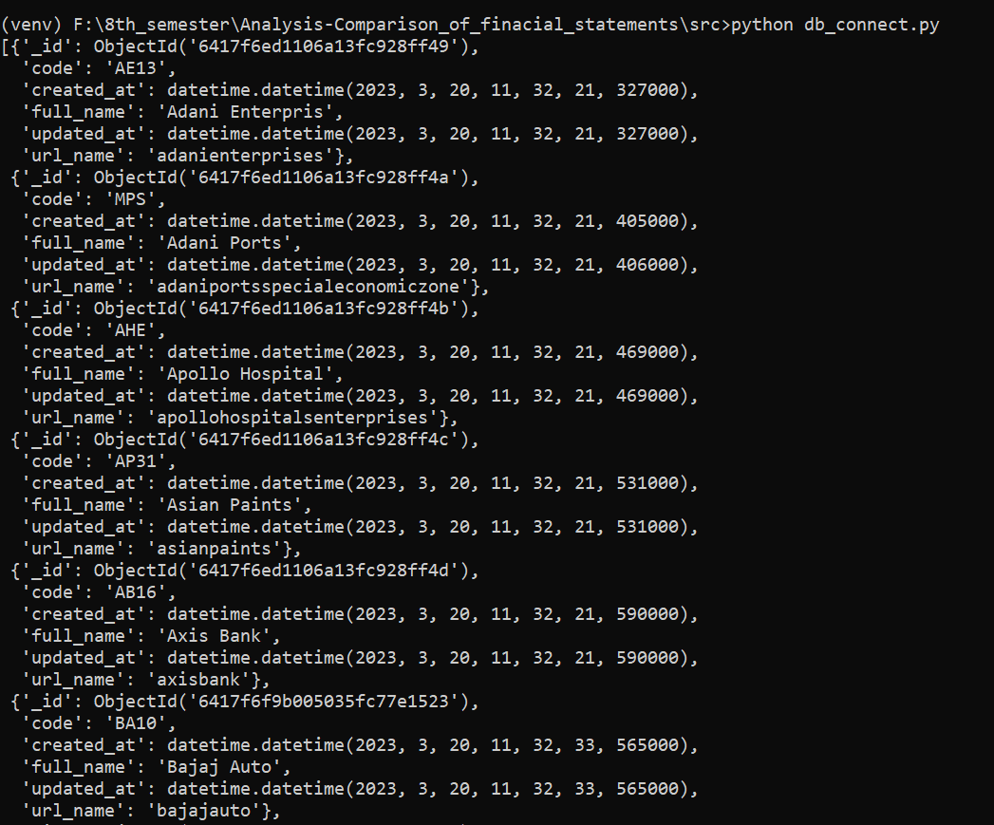
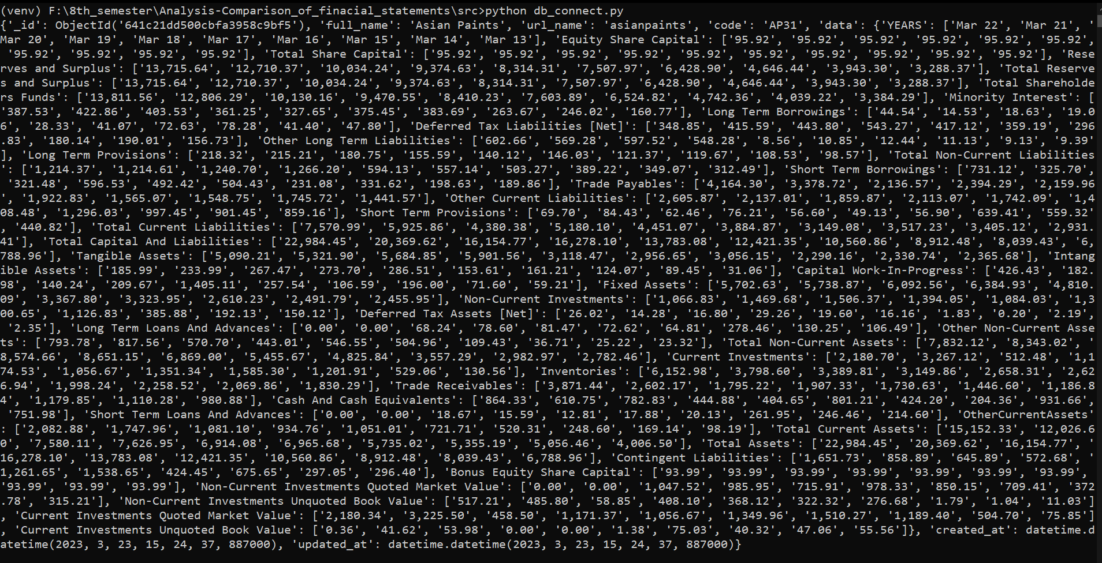
MongoDB for Project:

Slide 12
UI for Project:
Flask Web Framework: Flask is a web framework that provides libraries to build lightweight web applications in python. It is developed by Armin Ronacher who leads an international group of python enthusiasts (POCCO). It is based on WSGI toolkit and jinja2 template engine. Flask is considered as a micro framework. Flask is a web framework, it’s a Python module that lets you develop web applications easily. It’s has a small and easy-to-extend core: it’s a microframework that doesn’t include an ORM (Object Relational Manager) or such features.
We have used Flask as a web framework to display or show our project on the web. It connects the frontend, backend and database of the project. The frontend or web routes call the particular backend functions – which stores the data in the database, and return the response as the required data, in the required format. It acts as a bridge in the project.

Slide 13
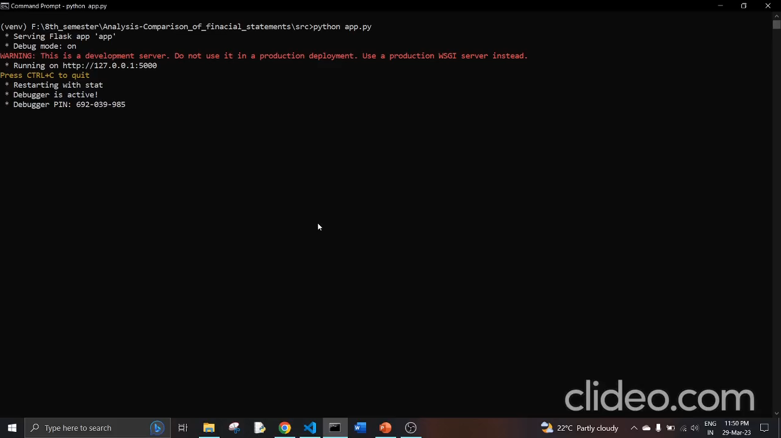
Flask for Project:

Slide 14
Conclusion:
In conclusion, our project involved scraping the income statement and balance sheet data of Nifty 50 stocks from secondary sources using Python's Beautiful Soup and Requests libraries. The data was then stored in MongoDB collections for further analysis. We calculated various financial ratios, including liquidity ratios, profitability ratios, and long-term solvency ratios, using the scraped data. To make the results accessible, we used Flask as a web framework to display the data in a structured manner on a webpage. This allowed users to easily compare and analyze the financial data of different companies. The web page also provided an easy way to view the scraped data on a daily basis.
Overall, our project demonstrated how web scraping, data analysis, and web development technologies can be used together to provide insights into the financial status of companies listed in the Nifty 50 index. By using the power of Python, Beautiful Soup, Requests, MongoDB, and Flask, we were able to create a robust and scalable workflow for collecting, analyzing, and displaying financial data.

