Slide 1

E-COMMERCE WEBSITE CARA GROUP NO:- 53
Under The Supervision of :-
Ms. Cheshtaa Bhardwaj
(Asst. Professor)
Department of CEA
GLA University , Mathura
Presented By :-
Ayush Pathak(2242000124)
Jatin Yadav(2242000253)
Aman Shakya(2242000053)
Aman Garg(2242000047)
Dev Sara(2242000158)
Aryan Jindal(2242000110)

Slide 2
Index
Introduction
Purpose
Impact
Technologies used
ER Diagram
References
Conclusion

Slide 3
Introduction
In today's fast-paced world, convenience is key. With the rise of digital technology, shopping has transcended traditional boundaries, bringing the marketplace directly to your fingertips. Introducing CARA, an innovative e-commerce platform composed to revolutionize your shopping experience.

Slide 4
Purpose
Convenience
Wide Selection
Accessibility
Personalization
User Reviews and Ratings
Convenient Payment Options
Trackable Orders and Delivery

Slide 5
Impact
Market Access:E-commerce websites break down geographical barriers, allowing businesses to reach customers beyond their local markets.
Job Creation: The growth of e-commerce often leads to job creation in various sectors such as logistics, customer service, marketing, and technology.
Consumer Convenience: They can browse and purchase products at any time, from anywhere, using various devices. This enhances the overall shopping experience and saves consumers time and effort.

Slide 6
TECHNOLOGIES USED
HTML
CSS

Slide 7

SCREENSHOTS OF WEBSITE CARA

Slide 8
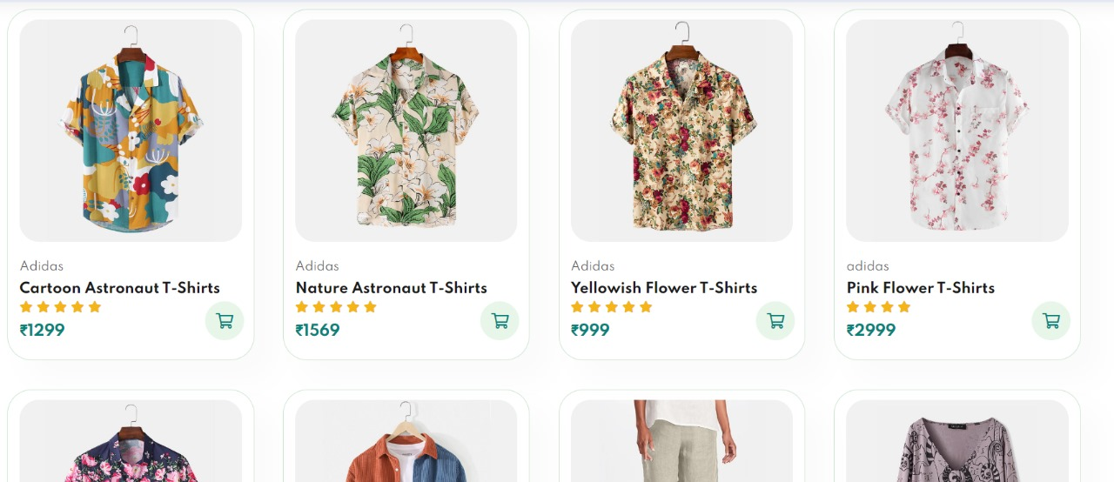
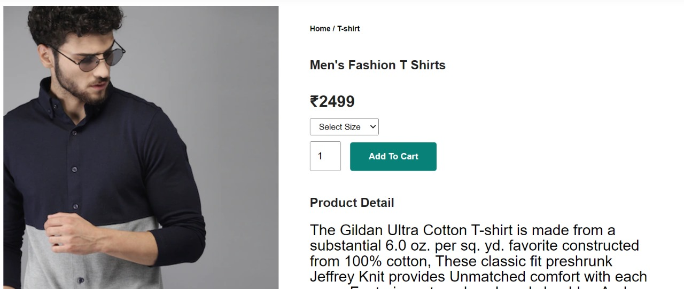

Slide 9
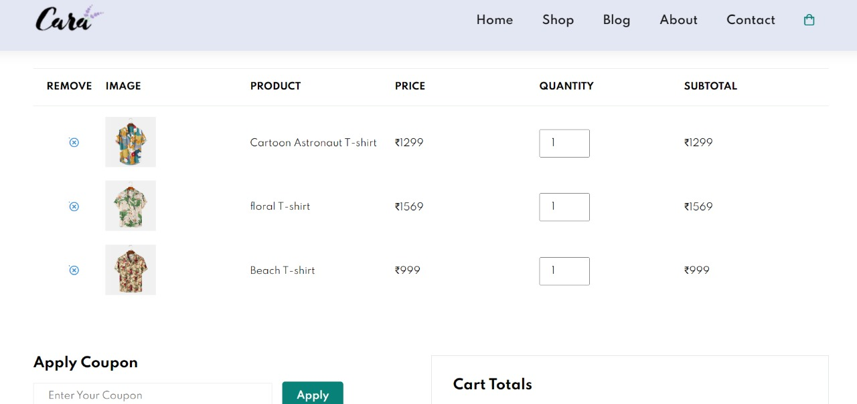

Slide 10
Conclusion
The launch of our e-commerce website represents a transformative step forward for businesses, consumers, and the economy.
Through increased growth, convenience, and innovation, this project propels us into a digital future where boundaries dissolve and opportunities flourish.
Together, we embark on a journey of evolution and adaptation, dedicated to delivering value and convenience to customers in an ever-changing landscape.

Slide 11
References
1. https://w3schools.com/html/
2. https://www.w3schools.com/css/
3.https://www.codewithharry.com/videos/web-development/

Slide 12


