Slide 1
MINOR PROJECT
WEB SCRAPING
AYUSH PRAJAPATI
01517704422

Slide 2
INTRODUCTION
The Internet is a data store of world's information - be it text, media or data in any other format. Every web page display data in one form or the other. Access to this data is crucial for the success of most businesses in the modern world. Unfortunately, most of this data is not open. Most websites do not provide the option to save the data which they display to your local storage, or to your own website. This is where a Web Scraping software can help you.
The uses of Web Scraping for business as well as personal requirements are endless. Each business or individual has their own specific need for gathering data.

Slide 3
WEB SCRAPING
Web Scraping is the process of automatically downloading data displayed by websites to your computer or database. A Web Scraping Software can crawl multiple pages within a website and automate the tedious task of manually copying and pasting the data displayed. The data is usually downloaded in a spreadsheet (tabular)

Slide 4
APPLICATIONS OF WEB SCRAPING
eCommerce
WEB SCRAPING
Real Esatate
Research
Marketing
Travel and Tourism
Sports and Analytics
Social media
Machine learning

Slide 5
BENEFITS
Scraping is about more than just acquiring data: it can also help you archive data and track changes to online.
It is closely related to the practice of web indexing, which is what search engines like Google do when mass-analysing the Web to build their indices. But contrary to web indexing, which typically parses the entire content of a web page to make it searchable, web scraping targets specific information on the pages visited.
For example, online stores will often scour the publicly available pages of their competitors, scrape item prices, and then use this information to adjust their own prices. Another common practice is “contact scraping” in which personal information like email addresses or phone numbers is collected for marketing purposes.
Web scraping is also increasingly being used by scholars to create data sets for text mining projects; these might be collections of journal articles or digitised texts. The practice of data journalism, in particular, relies on the ability of investigative journalists to harvest data that is not always presented or published in a form that allows analysis.

Slide 6
FUTURE SCOPE
FUTURE SCOPE
The future scope of this project is that we can use it for comparison of data from different sites that’s helpful for retailer or consumer it’s probably an easy and much faster method for fetching data and arranging it into a particular form so that it is easily understandable. Moreover I would like to create data more efficiently and in future I would like to make it automatic for the user to just enter the site name and the data would pop up from different entered sites into excel sheets for comparisons by using different parameters and algorithms. This project is helpful for all the future vendors or anyone who’s willing to gather information with a blink of an eye.

Slide 7
SNAPSHOTS

Slide 8
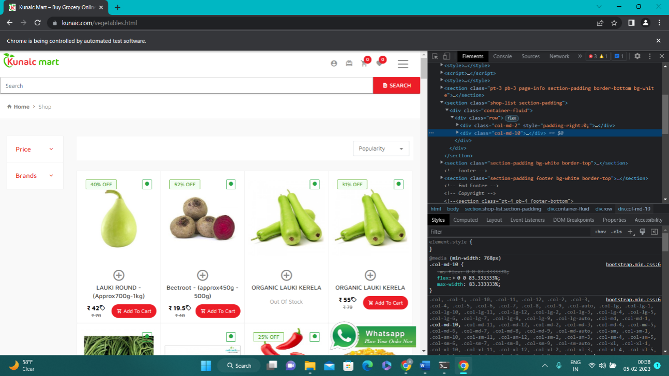

Slide 9
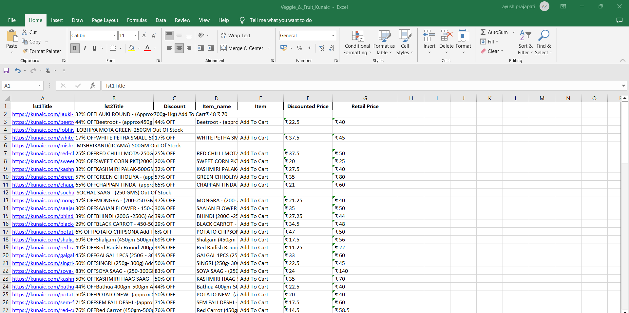

Slide 10
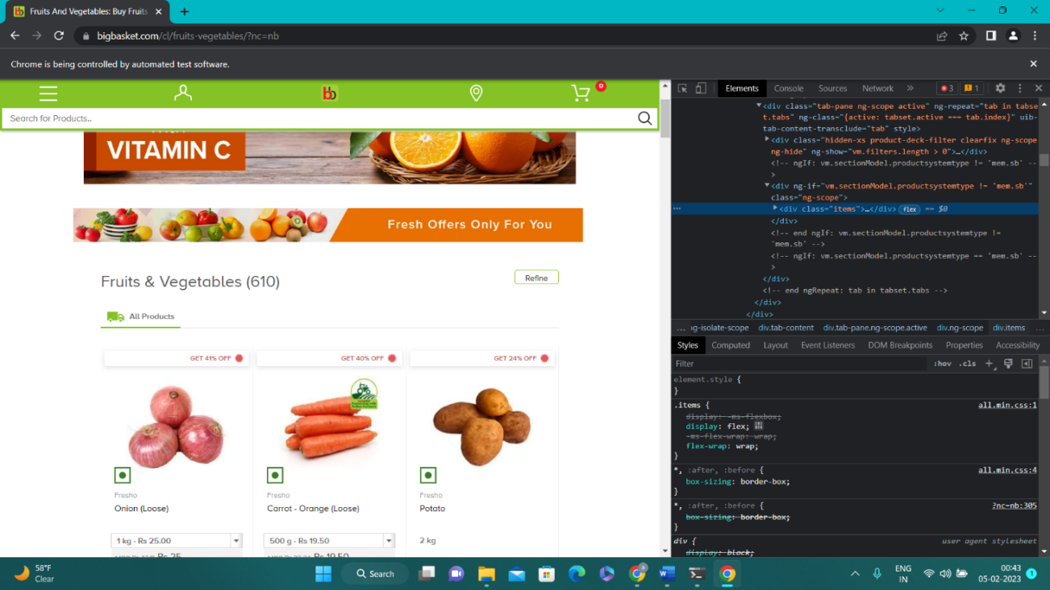
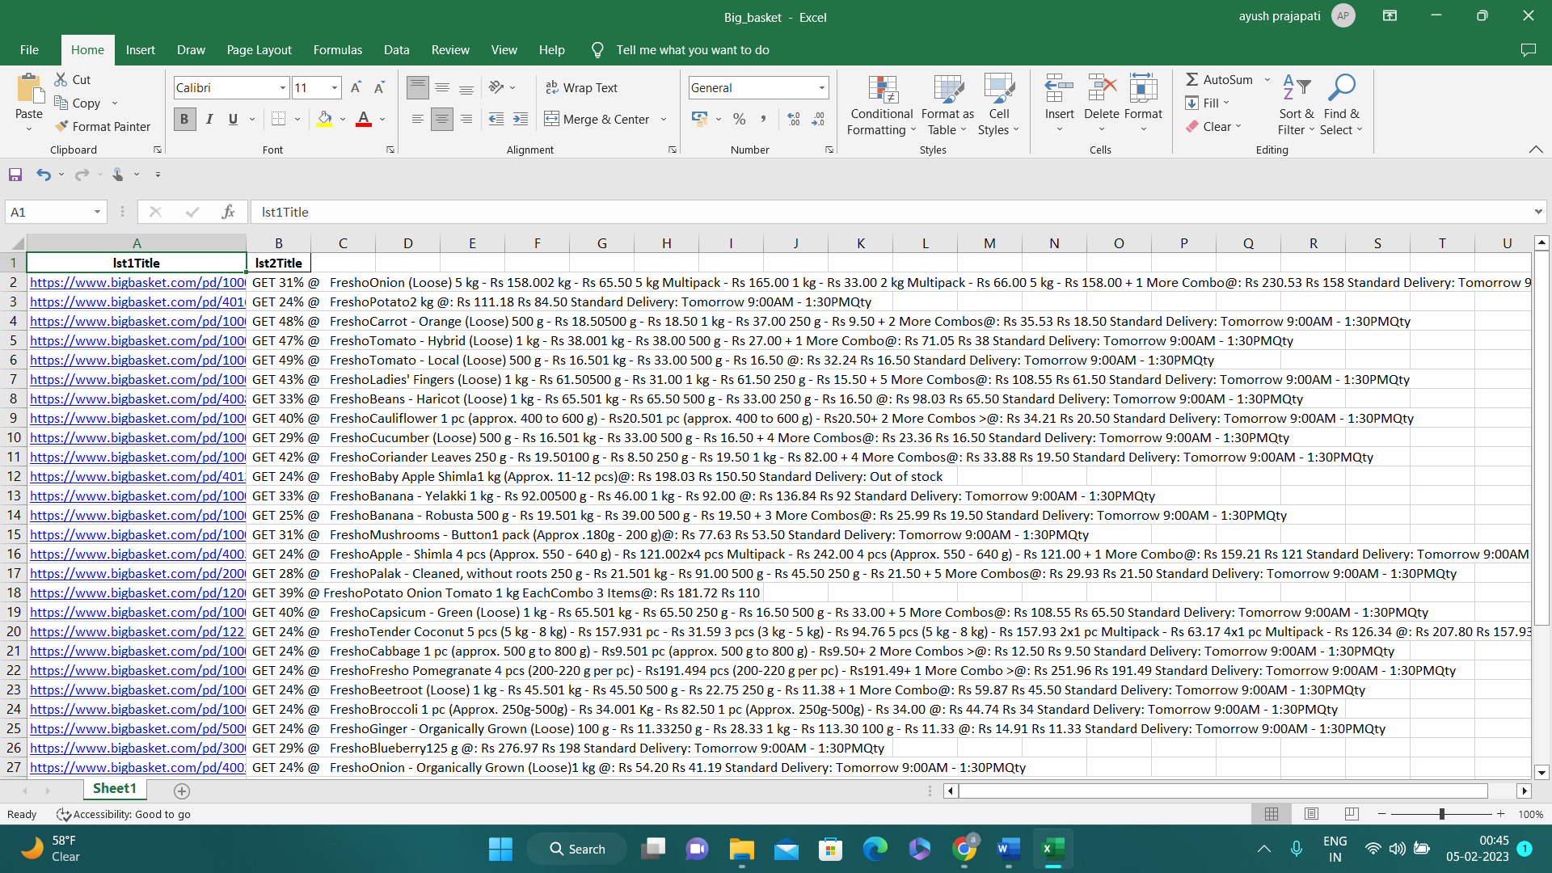

Slide 11
THANKYOUU

