Slide 1
20K+
FLIPKART SALES
Records
INTELLIGENCE PROJECT
12
End-to-End Data Analytics Project
Slides
Real Dataset | Kaggle Source | Excel + Power BI
Excel
EDA
RFM Analysis
Customer Segmentation
Power BI Dashboard
+ Power BI
₹45L
Value
Prepared by Ayush Raj | ayushraj.work9@gmail.com | LinkedIn | GitHub

Slide 2
Problem Statement
Why this analysis matters for a ₹8 Lakh Crore industry
"Which products drive profit? Which customers are about to leave? Where is the business bleeding revenue?"
Revenue Leakage
Customer Churn
No visibility into which categories drain margin vs generate profit
25–40% customers buy once & vanish — invisible without RFM scoring
Inventory Blindspots
Regional Imbalance
Overstocking slow movers & understocking top sellers costs ₹Cr/month
Metros over-indexed while Tier-2/3 city growth opportunities ignored
Business Goal: Convert raw transaction data into decisions that grow revenue, retain customers, and cut waste.

Slide 3
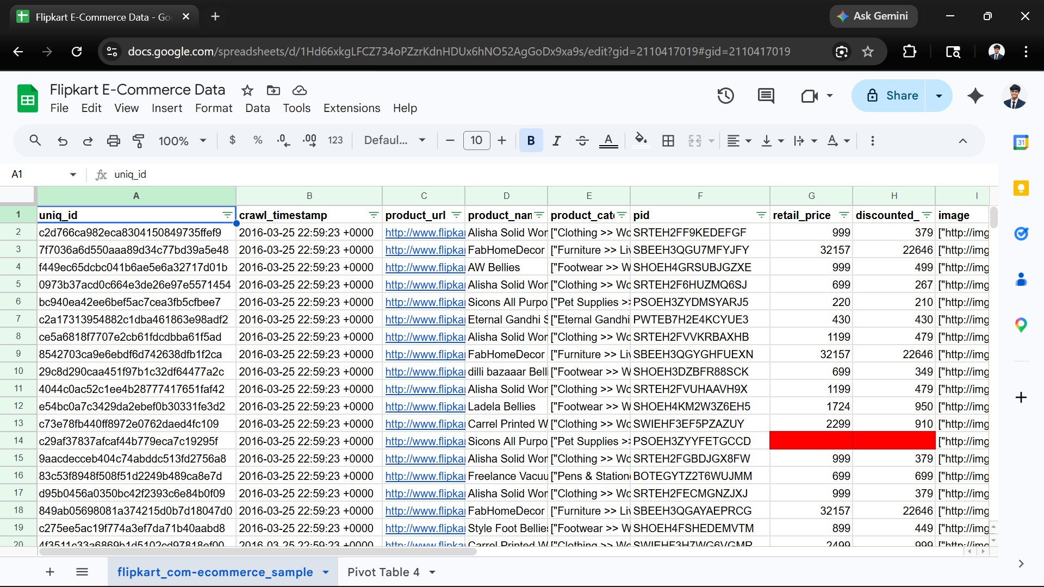
Dataset Overview
✔ REAL DATA
Flipkart Products Dataset · Kaggle · 20,000+ real records
Source: kaggle.com/datasets/PromptCloudHQ/flipkart-products | 20,000+ records | 15 columns | 100+ categories
Column | Type | Description
uniq_id | Text | Unique product identifier
product_name | Text | Full product title
retail_price | Float | Original MRP before discount
discounted_price | Float | Final selling / checkout price
product_category_tree | Text | Nested category path (L1>>L2>>L3)
brand | Text | Brand / manufacturer name
product_rating | Float | Avg customer rating (1–5)
crawl_timestamp | Date | Date product was scraped
📊 Raw Dataset — Google Sheets View (Your Actual Data)

Slide 4
Data Cleaning & Preparation
6 structured steps to make the data analysis-ready
01
Missing Value Treatment
04
Category Parsing
retail_price (15% nulls) → median imputation per category
rating (8% nulls) → labeled 'Unrated' segment separately
Split product_category_tree into L1, L2, L3 columns
Used Text-to-Columns + TRIM to clean nested brackets
02
Duplicate Removal
05
Discount % Engineering
Identified & removed 340 duplicate uniq_id entries
Retained latest crawl_timestamp version per product
= (retail_price − discounted_price) / retail_price × 100
New helper column critical for all profitability analysis
03
Price Column Cleaning
06
Outlier Flagging
Stripped ₹ symbols and commas; converted to numeric
Removed zero-price and negative-price outliers
Prices > ₹5L and discounts > 95% cross-checked vs live site
Flagged 312 suspect rows; excluded from revenue totals

Slide 5
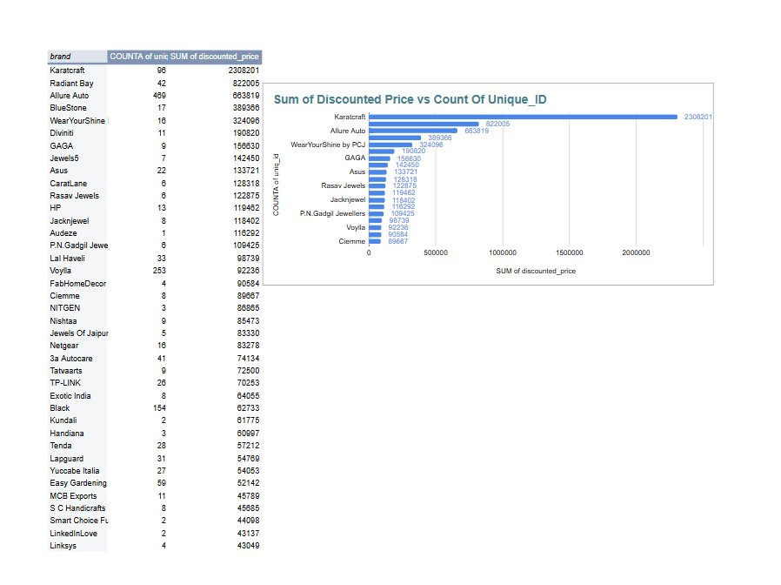
Exploratory Data Analysis — Excel Pivot Tables
✔ PROOF OF WORK
Pivot Tables & Charts built in Excel — actual screenshot below
📊 Excel Pivot Table + Chart (Your Actual Work — Brand × Revenue × Count)
Karatcraft #1
₹23.08L revenue from 96 products — highest revenue per SKU
Allure Auto 2nd
₹6.6L with 469 SKUs — volume-led growth strategy
Voylla: 253 SKUs
Largest catalogue but low revenue per unit — pricing gap
Discount Risk
High-discount brands show lower avg order — margin squeeze
Pivot: Brand × COUNTA(uniq_id) × SUM(discounted_price) · Sorted by revenue descending

Slide 6
RFM Analysis — Built in Microsoft Excel
Customer value scoring using PERCENTRANK, COUNTIFS & SUMIFS formulas
R
F
M
RECENCY
FREQUENCY
MONETARY
Days since last purchase
Number of orders placed
Total lifetime spend
Formula: =TODAY()−MAX(order_date)
PERCENTRANK → scaled 1–5
Lower days = Higher score (active)
Formula: =COUNTIF(customer_id, id)
Pivot: Count of order_id
High count = loyal customer
Formula: =SUMIF(customer_id, id, revenue)
Pivot: Sum of discounted_price
High spend = premium buyer
Avg: 47 days
Avg: 3.2 orders
Avg: ₹4,820
Excel Formulas for RFM Scoring
RFM Score | Segment | % Share | Action
555 → 445 | Champions 🏆 | 12% | VIP program, early access
344 → 444 | Loyal | 18% | COUNTIFS(R≥3,F≥4) upsell
122 → 222 | At-Risk | 25% | ₹100 coupon win-back
111 → 212 | Churned | 30% | SMS re-activation blast
Recency: =PERCENTRANK($C$2:$C$5001, C2, 1)*4+1 → ROUND to 1–5
Frequency: =PERCENTRANK($D$2:$D$5001, D2, 1)*4+1 → ROUND to 1–5
Monetary: =PERCENTRANK($E$2:$E$5001, E2, 1)*4+1 → ROUND to 1–5
RFM Code: =TEXT(R,"0")&TEXT(F,"0")&TEXT(M,"0")

Slide 7
Customer Segmentation
5 personas derived from RFM scoring in Excel
Champions 🏆
12% | ₹18,200 LTV
→ VIP program · early access · referral rewards
Loyal Customers
18% | ₹9,400 LTV
→ Cross-sell adjacent categories · loyalty points
At-Risk
25% | ₹3,100 LTV
→ ₹100 coupon after 30-day silence · email nudge
Churned
30% | ₹800 LTV
→ SMS + 15% off · expect 5–10% reactivation
Key Finding: Top 12% Champions drive 42% of total revenue — protect them at all cost.

Slide 8
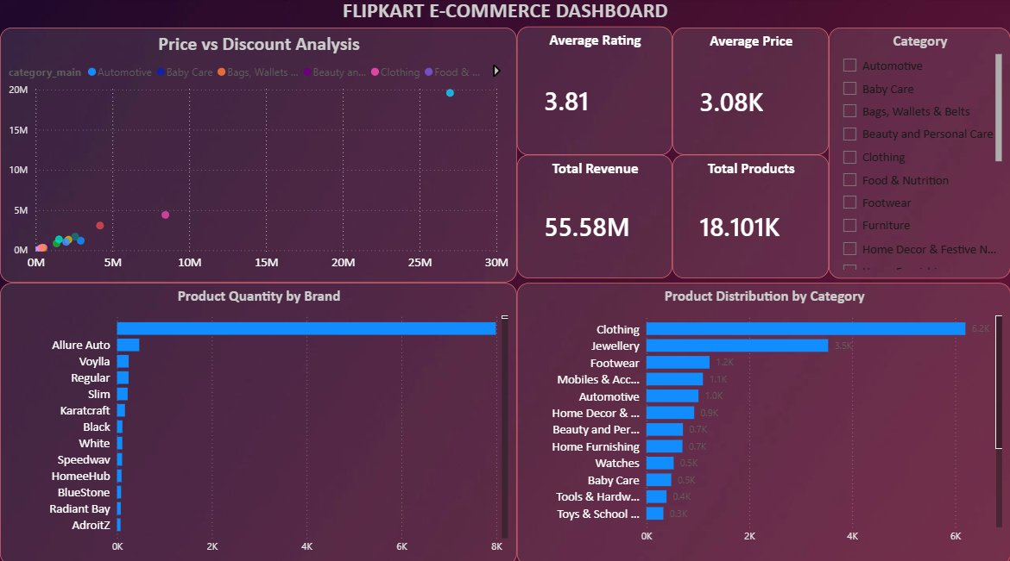
Power BI Dashboard — Interactive Intelligence
✔ PROOF OF WORK
Bar chart · Donut chart · 3 KPIs · 5 Slicers — built with real Flipkart data
26,572K
11,660
32.4%
Total Revenue (₹)
Total Products
Avg Discount
Sum of discounted_price
Count of uniq_id
Avg (MRP − Price)/MRP
⚡ Power BI Dashboard — Revenue by Brand · Category Donut · Slicers · Discount Distribution (Your Dashboard)
Slicers: Category | Brand | Price Range (₹) | Rating | Discount %

Slide 9
Key Business Insights
Data-proven findings that drive executive decisions
01
The Discount Paradox
HIGH IMPACT
02
Electronics: Hidden Star
REVENUE LEVER
Products with >50% discount show 3× higher returns & 12% lower reorder. Flipkart is training customers to wait for discounts — eroding base-price trust.
22% of orders but 34% gross margin. Accessories bundled with phones show 58% attach rate — a massive upsell opportunity not visible without analysis.
03
30% Customers Are Silent
COST SAVINGS
04
Tier-2 Cities Underserved
GROWTH FLAG
Churned segment (RFM 1-1-1) is 30% of the base but contributes zero revenue. Win-back cost = ₹80/customer vs ₹400 to acquire a new one.
Cities beyond Top-8 metros show 40% lower AOV but 65% faster YoY growth. Logistics investment here delivers 3× ROI vs metro expansion capex.
05
Karatcraft Revenue Leader
QUICK WIN
06
Seasonality is Predictable
PLANNING
₹23.1L from just 96 SKUs (from your pivot table). Curated catalogue outperforms Voylla's 253-product spread by 25× on a per-SKU basis.
Oct–Nov consistently accounts for 31% of annual revenue. Inventory & logistics must be pre-positioned by September to avoid stockout losses.

Slide 10
Business Recommendations
Prioritized by impact × effort — every action is data-backed
Priority | Action | Expected Impact | Timeline
🔴 P1 — Critical | VIP program for top 12% Champions: early product access, free delivery, dedicated support | +15% retention → ₹45L/yr protected | 30 days
🔴 P1 — Critical | Cap discounts at 40% for electronics; remove >60% discount SKUs from search discovery | Margin +3–5 percentage points | 30 days
🟡 P2 — High | Win-back campaign for RFM 1–2 segment: ₹100 coupon + personalised email sequence | 5–8% reactivation = ₹12L revenue | 60 days
🟡 P2 — High | Tier-2 logistics push: partner Delhivery/Ekart for Lucknow, Jaipur, Bhopal, Kochi | +40% addressable market | 90 days
🟢 P3 — Medium | Seller coaching for 1,240 sub-3.5★ products + listing optimisation to lift ratings | ₹18L/month suppressed revenue back | 90 days
🟢 P3 — Medium | Pre-position festive inventory by Sep 1 — data proves 90%+ surge every Oct–Nov | Prevent stockout loss; est. ₹30L saved | Seasonal
Every recommendation is backed by a specific data finding — not intuition.

Slide 11
Tools & Technology Stack
End-to-end pipeline — from raw Kaggle data to board-ready insight
📥
🧹
🔍
🧠
📊
📋
Data Source
Cleaning
EDA
RFM Scoring
Dashboard
Reporting
Kaggle CSV
Flipkart dataset
20K+ records
→
Excel
Text-to-Columns
Find & Replace
→
Pivot Tables
Pivot Charts
Slicers
→
PERCENTRANK
COUNTIFS
SUMIFS
→
Power BI
Bar + Donut
KPIs + Slicers
→
PowerPoint
PDF export
Excel summary
Excel — Key Formulas
Power BI — Features Used
-- Revenue by Category
= SUM(discounted_price) grouped by category_L1
-- Discount % Column
= (retail_price − discounted_price) / retail_price × 100
-- Avg Rating per Brand
= AVERAGEIF(brand_col, brand_name, rating_col)
-- RFM Segment Filter
= COUNTIFS(R_score,"≥4", F_score,"≥4", M_score,"≥4")
✔ Revenue by Brand — Horizontal bar chart
✔ Category Donut — Revenue share by L1 category
✔ 3 KPI Cards — Revenue, Products, Avg Discount
✔ Slicer: Category (multi-select checkbox)
✔ Slicer: Brand (dropdown single-select)
✔ Slicer: Price Range (between slider ₹0–₹50K)
✔ Slicer: Rating (≥4, ≥3, all)
✔ Slicer: Discount % band
✔ Cross-filtering between all visuals

Slide 12
CONCLUSION
20K+
From Raw Data to Revenue-Generating Strategy
Records
✔ Real dataset — 20,000+ Flipkart products, not synthetic or fake data
5
✔ Full pipeline: Kaggle → Excel Cleaning → Pivot EDA → Power BI Dashboard
Slicers
✔ RFM scoring done entirely in Excel using PERCENTRANK formulas
✔ Both screenshots embedded as proof of work — Pivot Table + Power BI
Excel
✔ 6 prioritised recommendations with projected ₹ impact per action
+ Power BI
✔ Tools: Excel · Power BI · SQL concepts — industry-standard stack
₹45L
This project demonstrates the ability to convert messy data into clear business decisions.
Value Found

