Slide 1
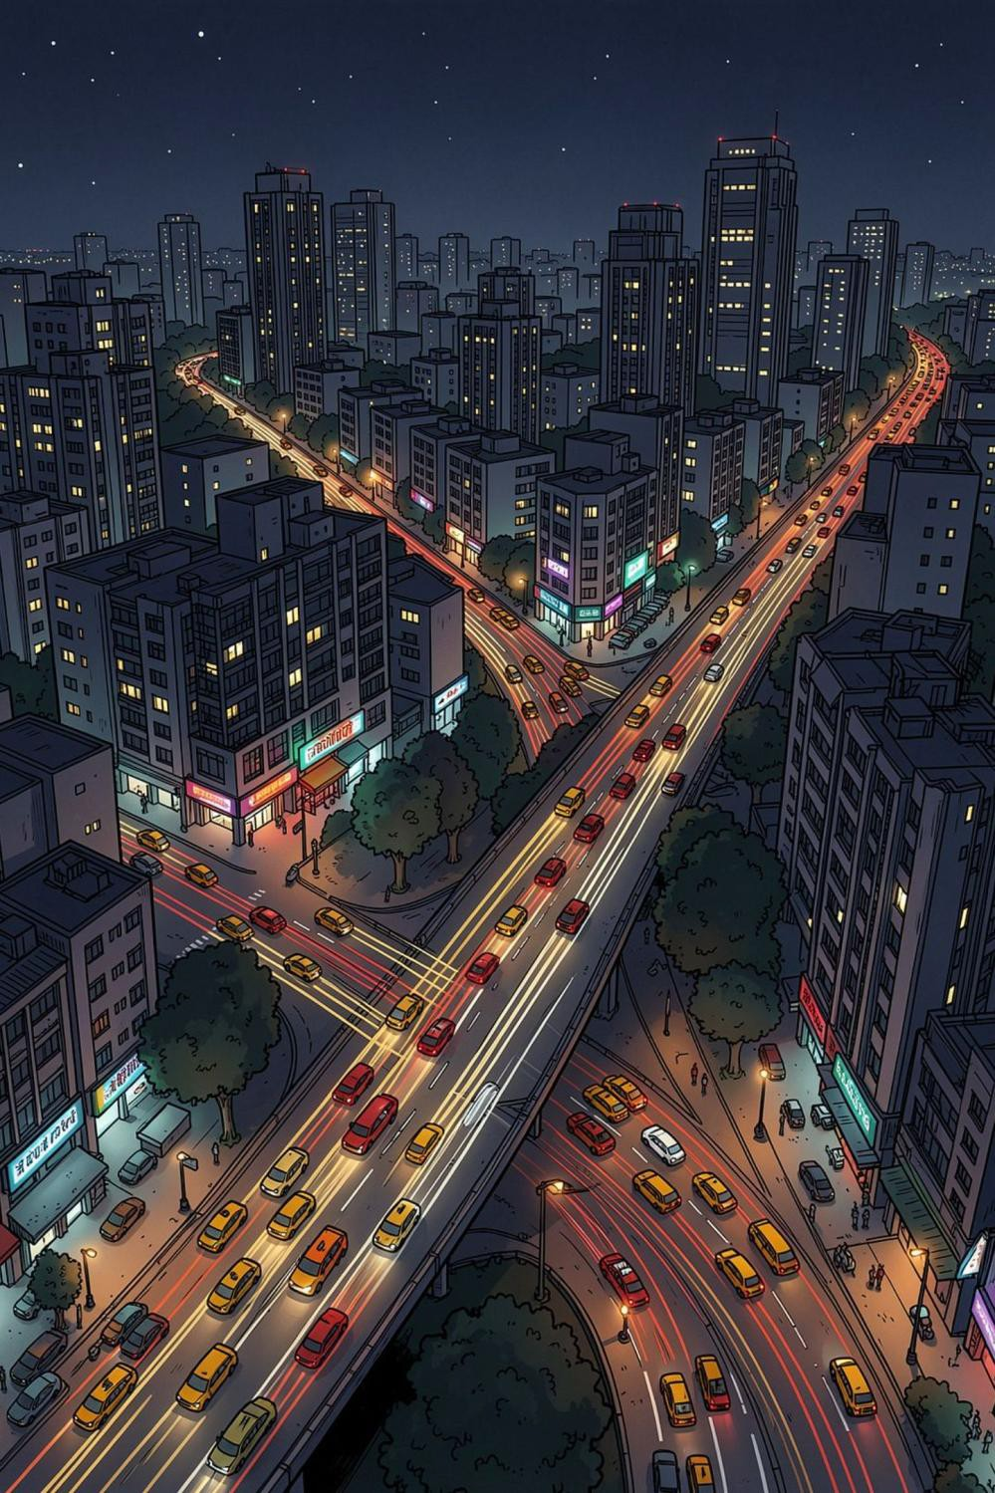

UrbanCab Dynamics: Mobility Fare Intelligence & Fleet
Analytics
EXECUTIVE ANALYTICS REPORT · 2025–2026
An End-to-End Analytics Pipeline from Raw Ride Logs to Executive Decision Systems
Arunima Mahakul and Ayush Roy
· Python · SQLite · Power BI
Analysis of 1,000 completed trips representing 108,047 ride requests,
₹370.24K total revenue, and 17,911 km traveled across 6 major
metropolitan hubs.
preencoded.png

Slide 2
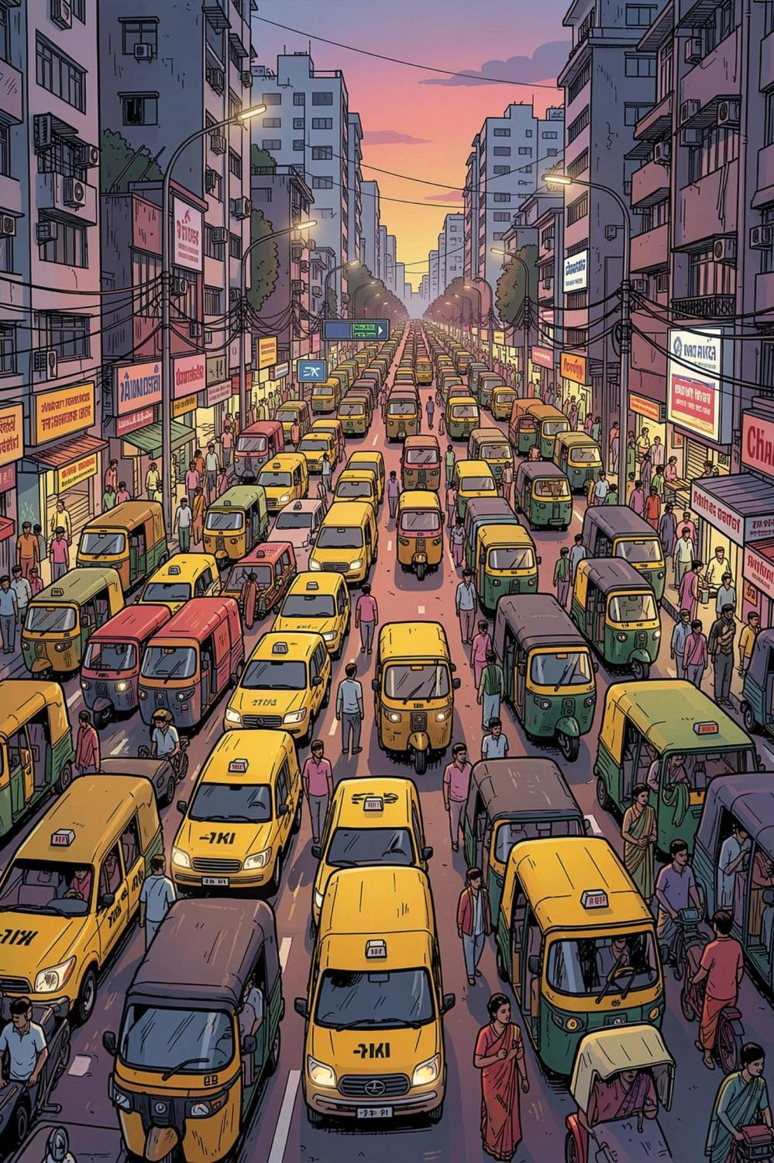
The Problem: Demand-Supply Imbalance at Scale
Dynamic ride demand and fleet supply imbalances create extreme surges, transit bottlenecks, and unmet rider demand across urban corridors.
Standardize Transaction Logs
Clean and validate messy urban transit records for reliable downstream analysis.
1
Architect a Relational Database
Build a local SQLite database to query operational KPIs and driver rankings.
2
Deliver an Executive Dashboard
Provide interactive Power BI tools for city managers and dispatch teams.
3
preencoded.png

Slide 3

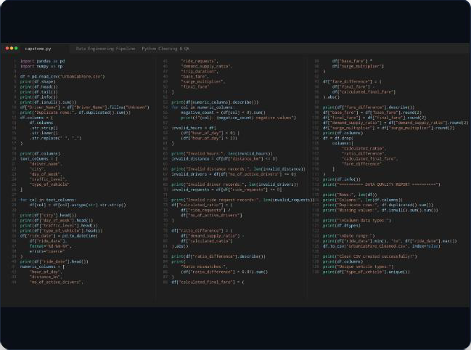




Data Engineering Pipeline: Python QA
Pre-Processing & Validation
→ Standardized Schema: Enforced snake_case headers, removed whitespace, and parsed dates to strict DD-MM-YYYY format.
→ Zero-Tolerance Auditing: Filtered negative fares, checked hour bounds (0–23), and purged zero-distance trips.
→ Mathematical Integrity: Cross-checked ratios (requests/drivers) and verified final fare logic against surge multipliers.
130
SCRIPT LINES
0
RESIDUAL NULLS
100%
AUDITED CONSISTENCY

Slide 4

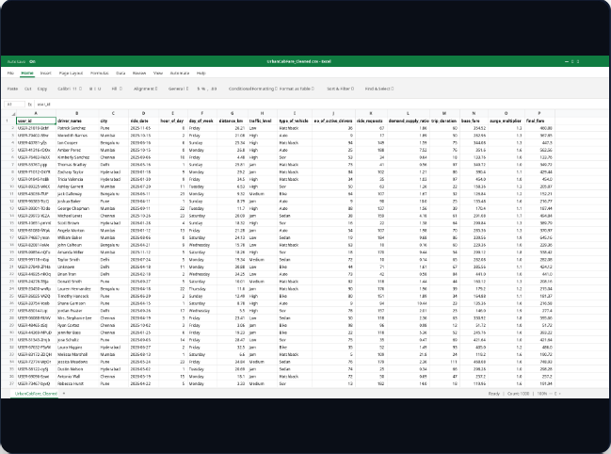



Dataset Schema & Feature Structure
1,000 Validated Records
→ Analysis-Ready Core: 1,000 completed urban trips across 16 fully normalized dimensional and metric attributes.
→ Feature Depth: Tracks temporal stamps, traffic density, vehicle class, driver supply, and dynamic surge multipliers.
→ Downstream Ready: Verified baseline enabling reproducible reporting across SQLite and Power BI dashboards.
1,000
ROW RECORDS
16
FEATURES (A-P)
6
METRO MARKETS

Slide 5
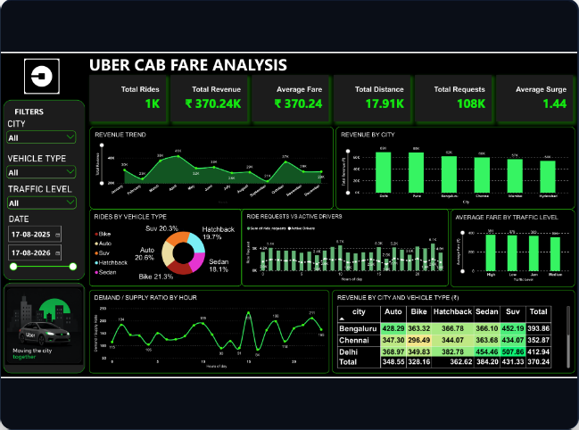



Executive Analytics Control Center
Operational KPI Dashboard
→ Revenue Trajectory: ₹370.24K gross revenue realized, with peak financial volume in April (₹41K).
→ Demand/Supply Strain: Peak hour deficit spikes reaching 2.11x demand-supply ratios at 21:00.
→ Volume Dynamics: 108K ride requests captured across 17.91K kilometers with an average surge of 1.44x.
₹370.2K
GROSS REVENUE
₹370.24
AVERAGE FARE
108K
RIDE REQUESTS

Slide 6






Executive KPI Snapshot
Six primary metrics define operational performance across the full 1,000-ride sample.
1,000
Completed Rides
Total trips in the analyzed sample
₹370K
Gross Revenue
Total revenue realized across all cities
₹370
Avg Trip Fare
Mean fare per completed ride
17.9K
Km Covered
Total distance traveled fleet-wide
108K
Market Requests
Total ride requests across all hubs
1.44x
Avg Surge
Mean surge multiplier applied
preencoded.png

Slide 7
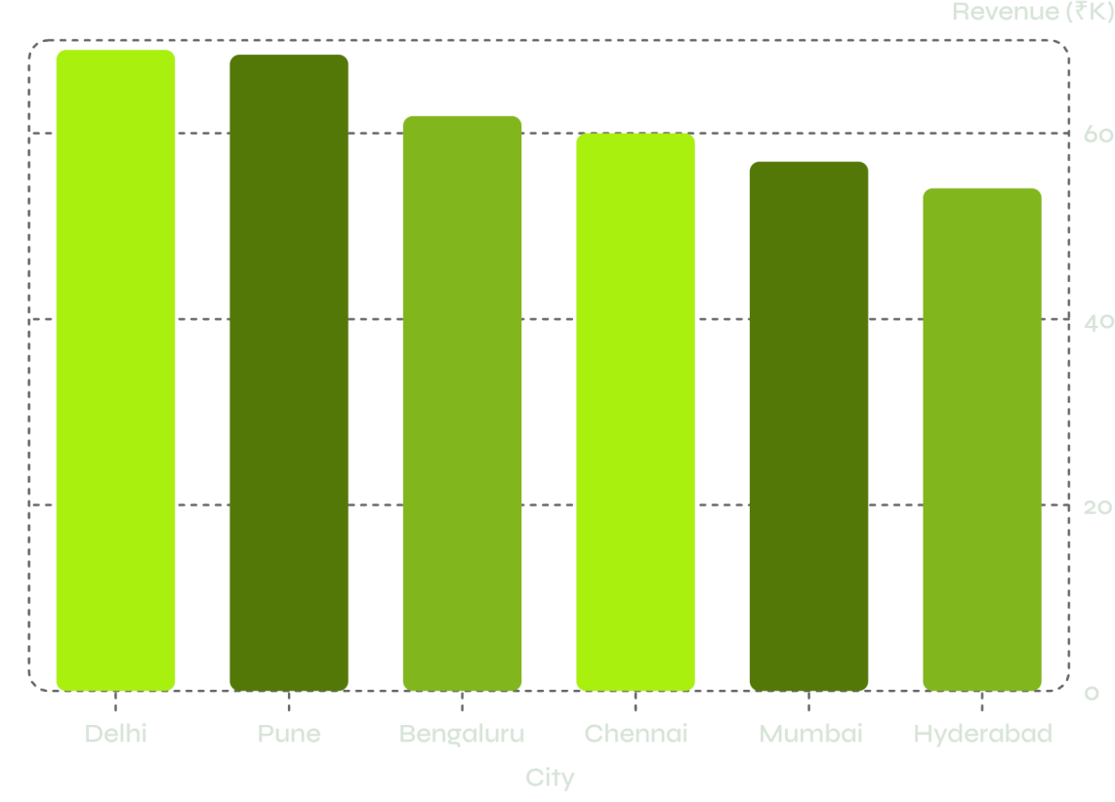


Geographic Market Breakdown: 6-City Revenue Comparison
Strategic Insights
Delhi leads revenue at ₹68.96K with the highest avg fare (₹412.94) across 167 rides
Pune follows at ₹68.45K with the highest ride frequency — 194 completed trips
Bengaluru (₹61.84K) and Chennai (₹59.99K) form a strong mid-
tier cluster
Mumbai and Hyderabad represent the lower-revenue but high- volume tier
Delhi commands the highest ticket size per trip; Pune leads in completed ride frequency.
preencoded.png

Slide 8
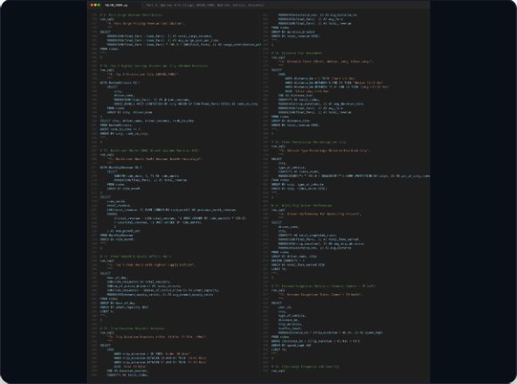


Advanced SQL Relational Analytics
Enterprise Query Engine
→ DENSE_RANK() Driver Tiering: Segments top 3 revenue- generating drivers per city to structure incentive bonuses.
→ LAG() MoM Revenue Growth: Calculates consecutive month- over-month revenue deltas across 2025–2026.
→ NTILE(4) Statistical Quartiles: Groups ride transactions into 4 fare tiers to isolate top 5% revenue outliers.
34
SQL QUERIES
₹112.7K
SURGE REVENUE
30.5%
SURGE MARGIN

Slide 9
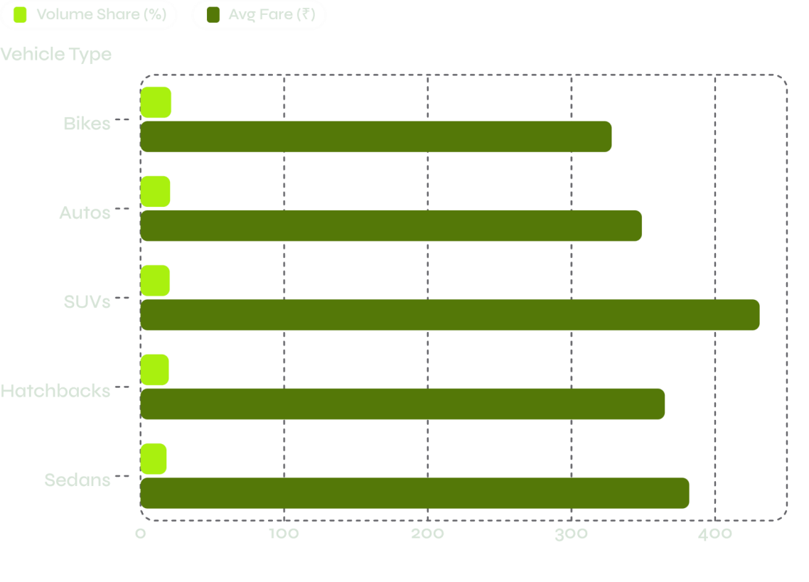

Fleet Distribution & Vehicle Economics
Volume vs. Value
SUVs generate the highest individual fares — averaging
₹431.33 across all cities
Bikes and Autos provide baseline volume and urban affordability at ₹328.16 and ₹348.55
Fleet share is remarkably balanced: all five vehicle types sit
within a 3-point band (18.1%–21.3%)
Premium Benchmark: Delhi SUVs record the highest cross-tab fare at ₹507.86 — a clear premium corridor signal.
preencoded.png

Slide 10
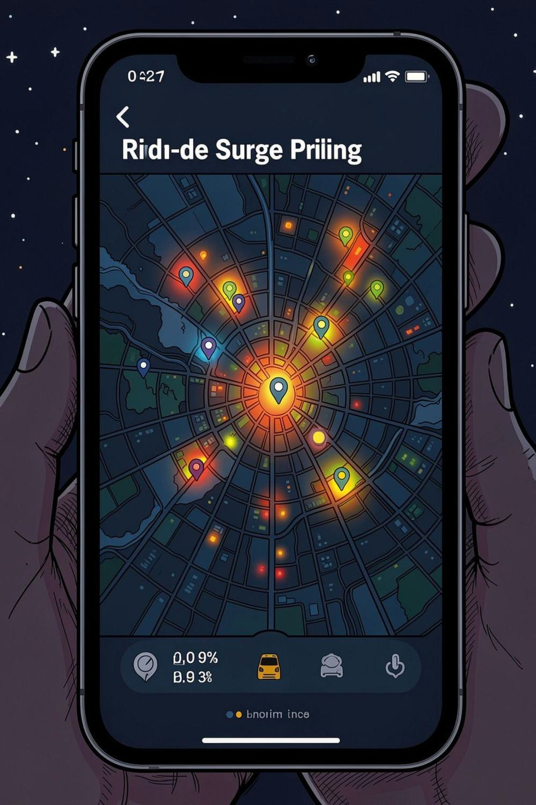
Demand vs. Supply Dynamics & Surge Analytics
Peak Deficit Windows
₹112.76K Surge Revenue
Demand-to-supply spikes between 14:00–16:00 and 21:00–23:00, reaching ratios of 1.85–2.11x
Pure surge pricing contributes
~30.46% of total realized revenue — a major margin driver
Driver Shortage Driver
Surge is driven by localized driver shortages, not baseline transit distance — a fleet repositioning opportunity
preencoded.png

Slide 11
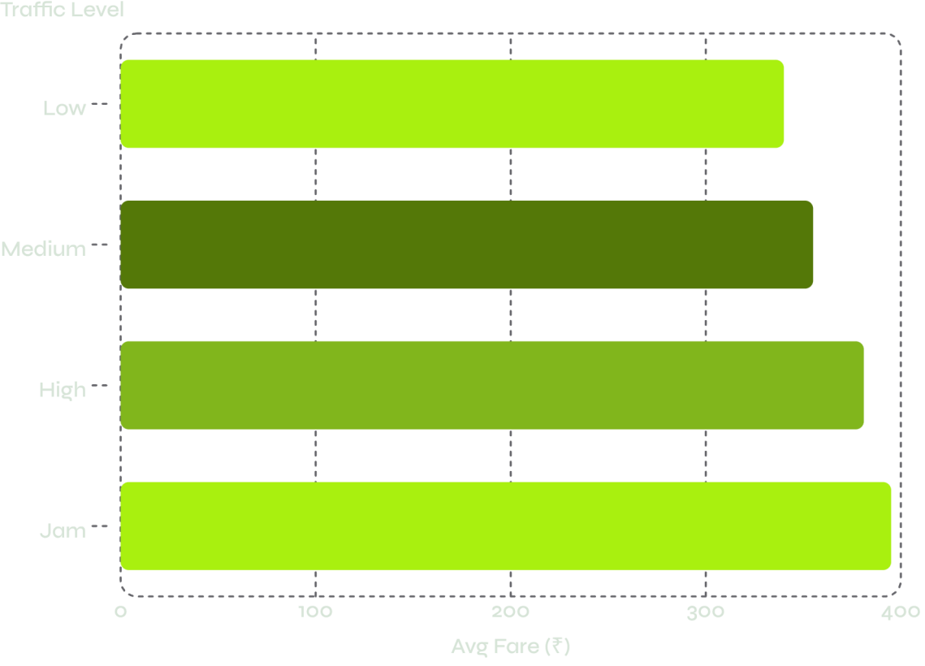

Traffic Congestion & Operational Velocity
Key Findings
Traffic levels (Jam → Low) directly influence transit time
without suppressing base demand
Jam traffic trips experience speeds <10 km/h and durations exceeding 60 minutes for sub-10 km trips
Fares average ₹381 in High traffic vs. ₹355 in Medium —
a 7.3% dynamic pricing response to road delays
Congestion pricing is partially compensating for time- loss, but Jam-tier trips remain operationally inefficient.
preencoded.png

Slide 12
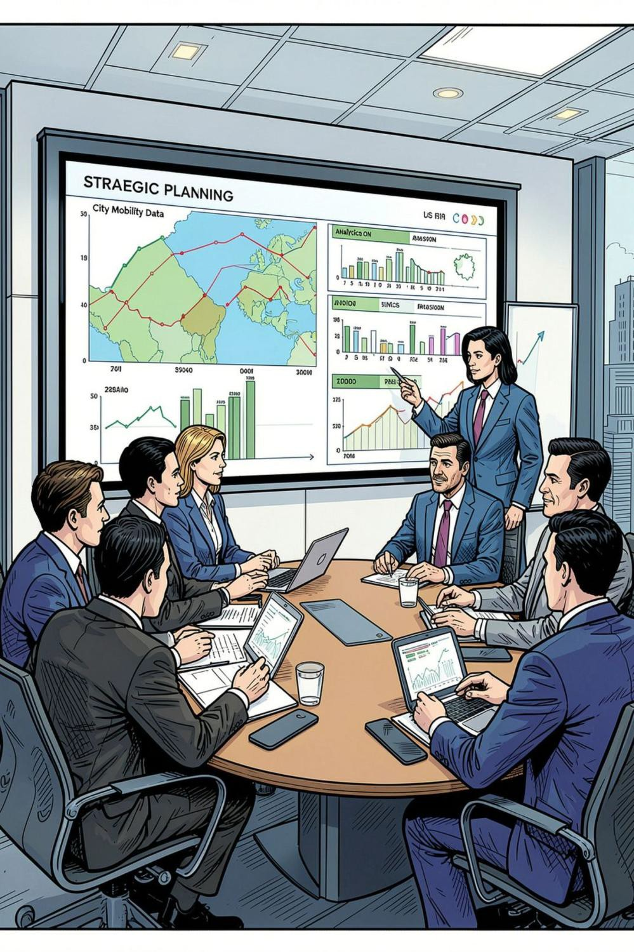


Strategic Recommendations & Action Plan
Dynamic Fleet Relocation
Tiered Vehicle Expansion
Deploy driver repositioning incentives toward peak evening hours (21:00–23:00) where unmet requests peak and supply ratios exceed 2.0x.
Expand SUV availability in high-fare corridors — particularly Delhi and Bengaluru — to capture demonstrated premium fare willingness.
Surge Capping & Reliability
Rebalance surge ceilings during peak windows to protect rider retention while preserving driver margin incentives and platform trust.
preencoded.png

